Slide 1
Snowmelt Runoff, The Fourth Paradigm, and the End of Stationarity
How can we protect ecosystems and better manage and predict water availability and quality for future generations, given changes to the water cycle caused by human activities and climate trends?
In what ways can feasible improvements in our knowledge about the mountain snowpack lead to beneficial decisions about the management of water, for both human uses and to restore ecosystem services?
Jeff Dozier, University of California, Santa Barbara

Slide 2
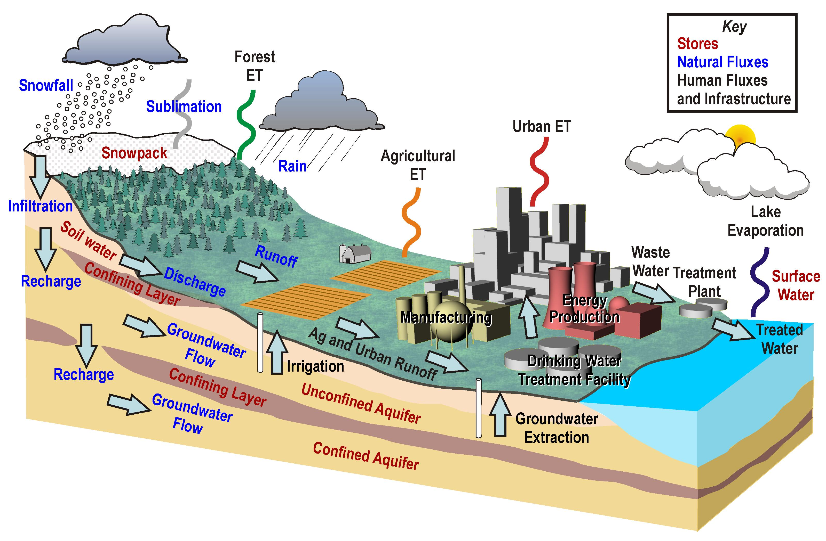

Slide 3
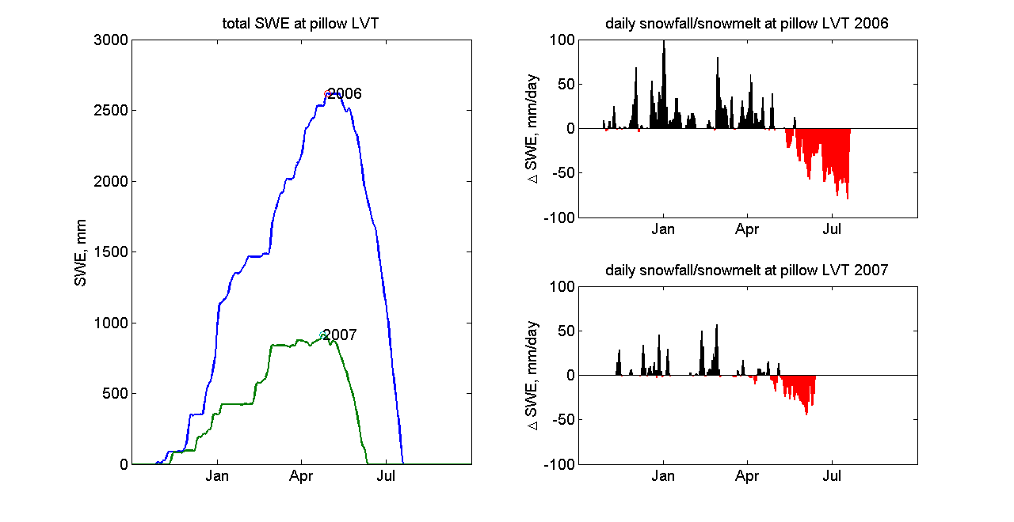
Snow-pillow data for Leavitt Lake, 2929 m, Walker R drainage, applies to Tuolumne & Stanislaus

Slide 4
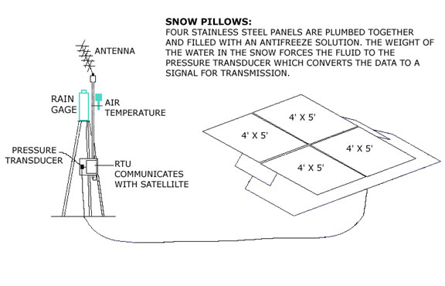
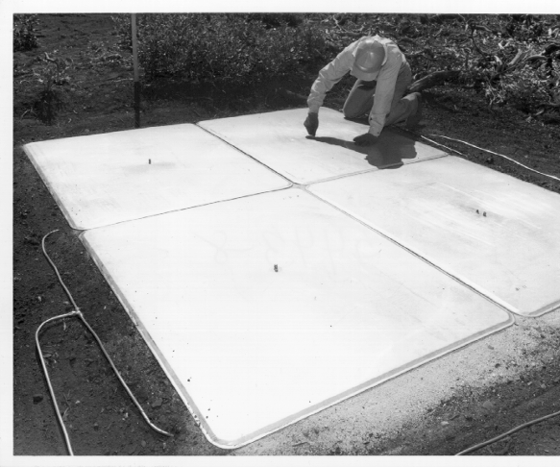
Automated measurement with snow pillow

Slide 5
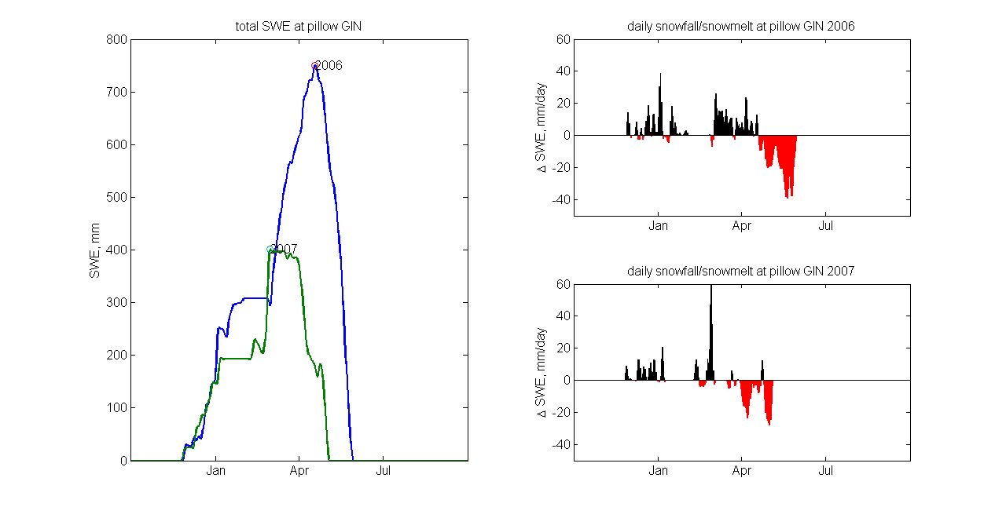
Snow-pillow data for Gin Flat, 2149 m, Tuolumne R drainage, applies to Merced R

Slide 6
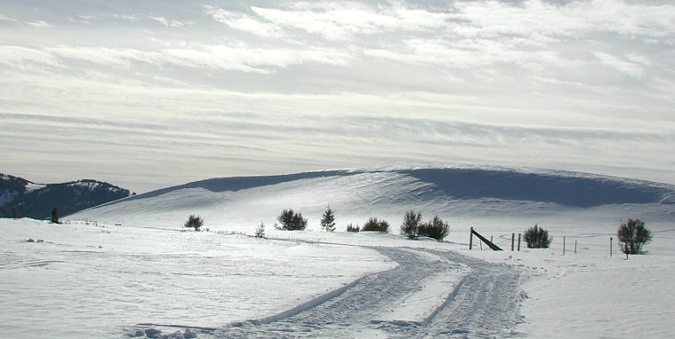

Snow redistribution and drifting

Slide 7
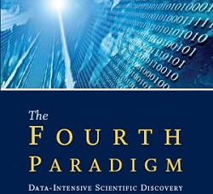
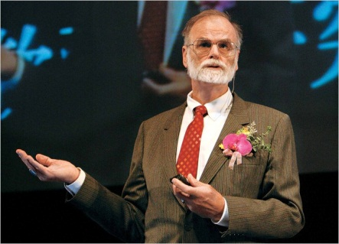
The Fourth Paradigm
An “exaflood” of observational data requires a new generation of scientific computing tools to manage, visualize and analyze them.
http://research.microsoft.com/en-us/collaboration/fourthparadigm/

Slide 8
Along with The Fourth Paradigm, an emerging science of environmental applications
Thousand years ago —experimental science
  Description of natural phenomena
Last few hundred years —theoretical science
  Newton’s Laws, Maxwell’s Equations . . .
Last few decades — computational science
  Simulation of complex phenomena
Today — data-intensive science
  (from Tony Hey)
1800s → ~1990 — discipline oriented
  geology, atmospheric science, ecology, etc.
1980s → present — Earth System Science
  interacting elements of a single complex system (Bretherton)
  large scales, data intensive
Emerging today — knowledge created to target practical decisions and actions
  e.g. climate change
  large scales, data intensive

Slide 9
The water cycle and applications science
Need driven vs curiosity driven
  How will we protect ecosystems and better manage and predict water availability and quality for future generations?
Externally constrained
  e.g., in the eastern U.S., the wastewater management systems were built about 100 yrs ago with a 100-year design life
Useful even when incomplete
  The end of stationarity means that continuing with our current procedures will lead to worsening performance (not just continuing bad performance)
Consequential and recursive
  Shifting agricultural production to corn-for-ethanol stresses water resources
Scalable
  At a plot scale, we understand the relationship between the carbon cycle and the water cycle, but at the continental scale . . .
Robust
  Difficult to express caveats to the decision maker
Data intensive
  Date volumes themselves are manageable, but the number and complexity of datasets are harder to manage

Slide 10
“We seek solutions. We don't seek—dare I say this?—just scientific papers anymore”
Steven Chu
Nobel Laureate
US Secretary of Energy

Slide 11
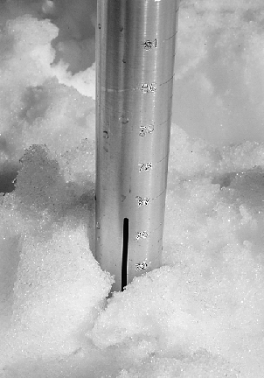
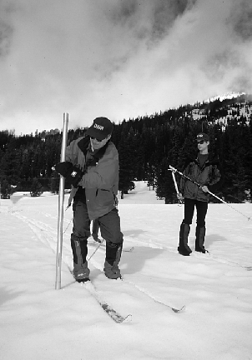
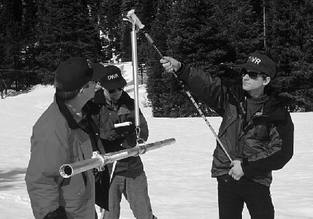
Manual measurement of SWE (snow water equivalent), started in the Sierra Nevada in 1910

Slide 12
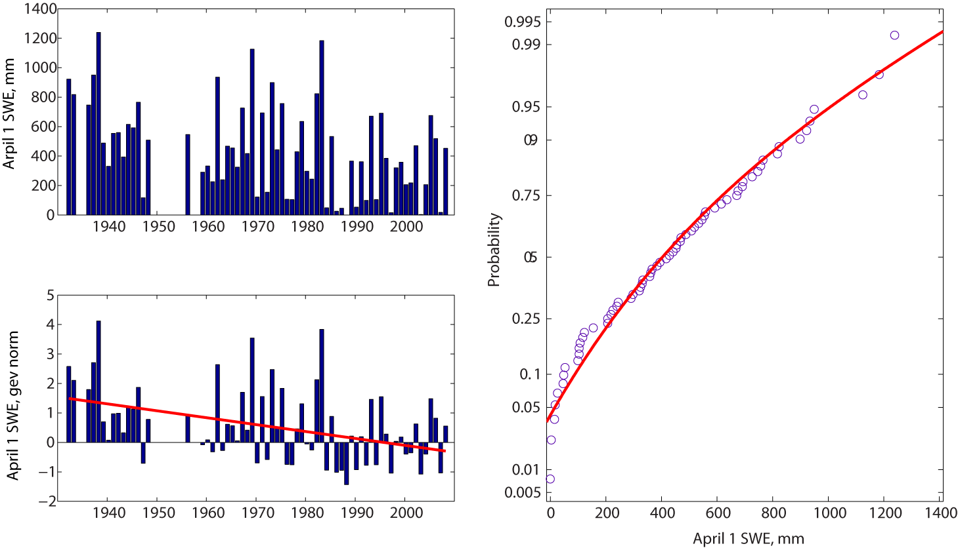
Snow course RBV, elev 1707m, 38.9°N 120.4°W (American R)

Slide 13
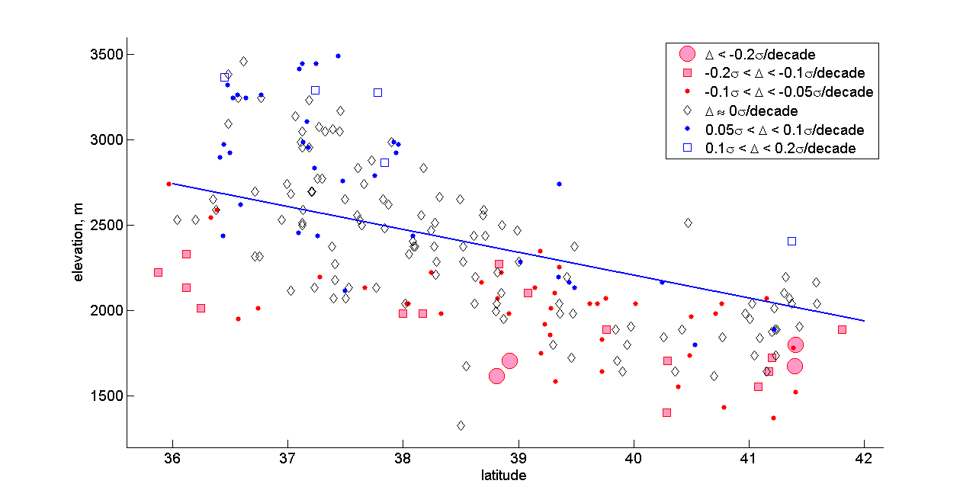
Sierra Nevada, trends in 220 long-term snow courses (> 50 years, continuing to present)

Slide 14
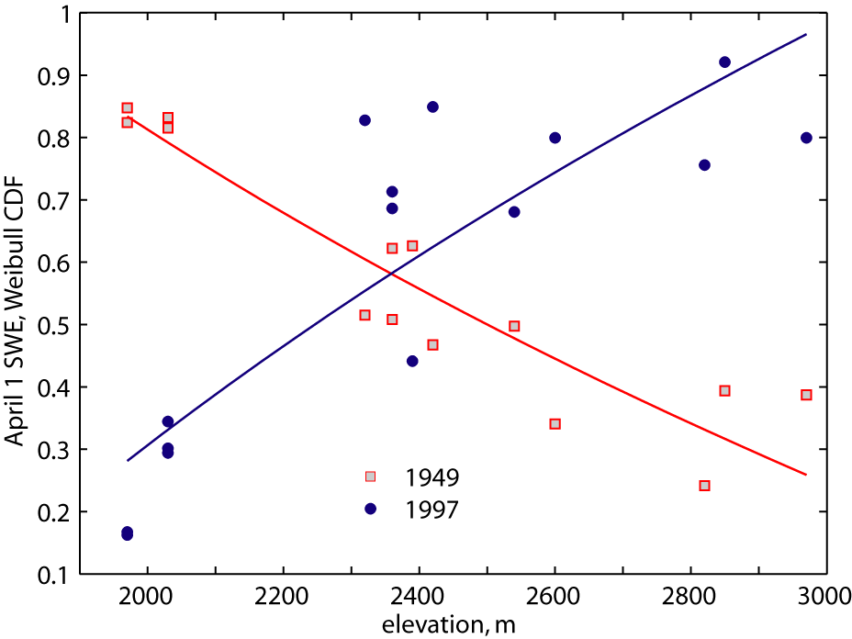
Example of variability in orographic effect, Tuolumne R

Slide 15
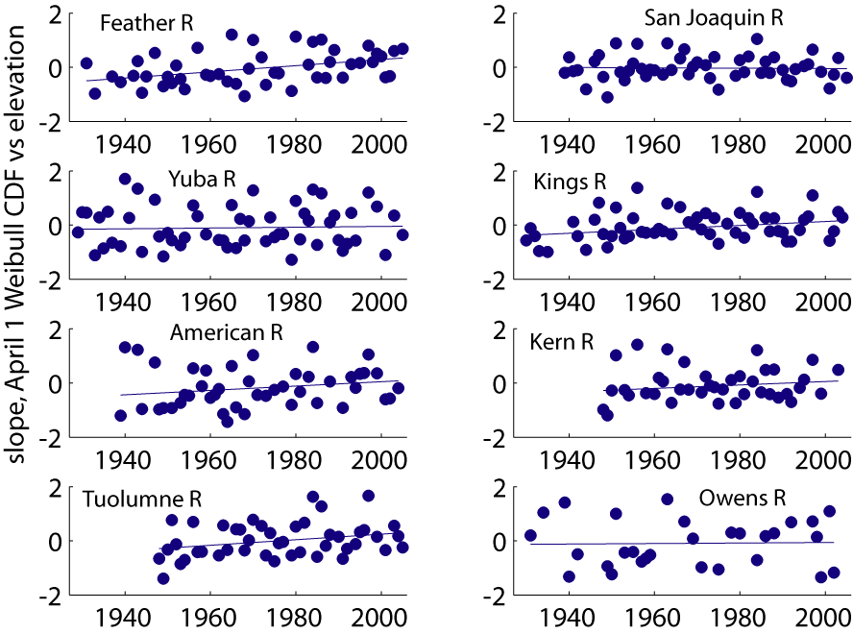
Trend of orographic effect?

Slide 16
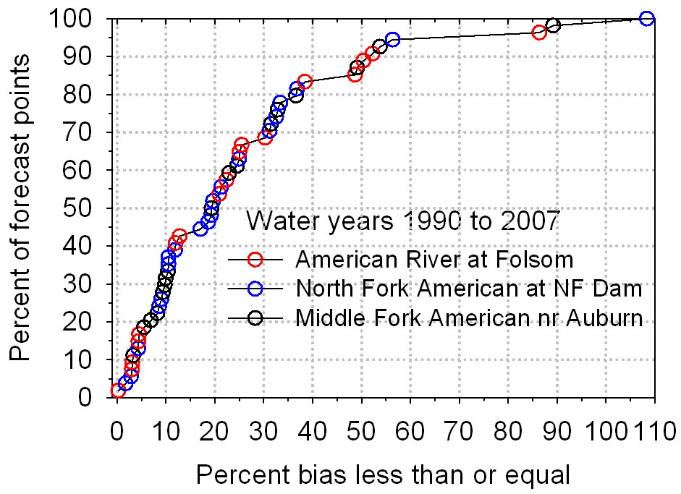

Slide 17
Example forecast, April 2010
American River below Folsom Lake, April-July unimpaired runoff (units are 1,000 acre-ft)
50-yr mean | Max | Min | This year | % of avg | 80% prob range
1,240 | 3,074 | 229 | 1,050 | 85% | 770–1,700

Slide 18
We manage water poorly . . .
We do not predict and manage water and its constituents well
  Despite large investments, we suffer from droughts, floods, stormwater, erosion, harmful algal blooms, hypoxia, and pathogens with little warning or prevention
Current empirical methods were developed over a period when human impacts were isolated and climate trends slower
  Drivers are climate change, population growth and sprawl, land use modification
  Milly et al., Science 2008: Stationarity is dead: whither water management?
We need to better understand how/when to adapt, mitigate, solve, and predict
  More physically based, less empirical, methods are needed

Slide 19
Integrating across water environments: How to make the integral greater than the sum of the parts?

Slide 20
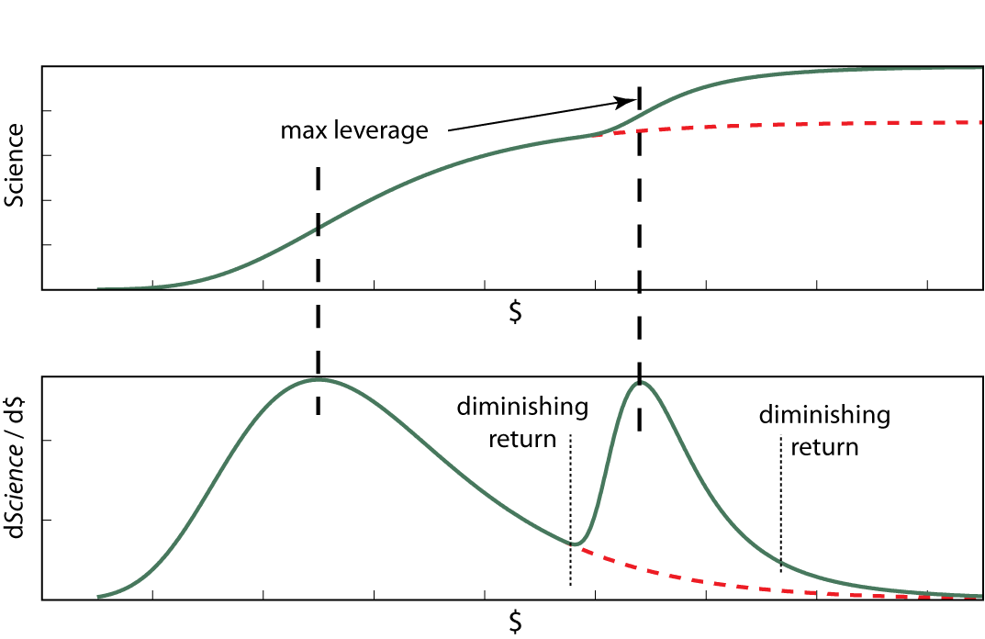
Science progress vs funding (conceptual)

Slide 21
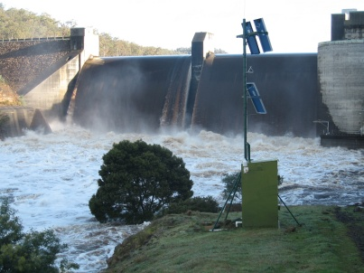
The water information value ladder
Forecasting
Reporting
Analysis
Done poorly
Integration
Data >>> Information >>> Insight
>>> Increasing value >>>
Distribution
Done poorly to moderately
Aggregation
Quality assurance
Collation
Sometimes done well, by many groups,
but could be vastly improved
Monitoring
Slide Courtesy CSIRO, BOM, WMO

Slide 22
The data cycle perspective, from creation to curation
The science information user:
  I want reliable, timely, usable science information products
    Accessibility
    Accountability
The funding agencies and the science community:
  We want data from a network of authors
    Scalability
The science information author:
  I want to help users (and build my citation index)
    Transparency
    Ability to easily customize and publish data products using research algorithms
The Data Cycle
Collect
Present
Store
Analyze
Search
Retrieve

Slide 23
Organizing the data cycle
Progressive “levels” of data
  (Earth Observing System)
  Raw: responses directly from instruments, surveys
  Processed to minimal level of geophysical, engineering, social information for users
  Organized geospatially, corrected for artifacts and noise
  Interpolated across time and space
  Synthesized from several sources into new data products
System for validation and peer review
  To have confidence in information, users want a chain of validation
  Keep track of provenance of information
  Document theoretical or empirical basis of the algorithm that produces the information
Availability
  Each dataset, each version has a persistent, citable DOI (digital object identifier)

Slide 24
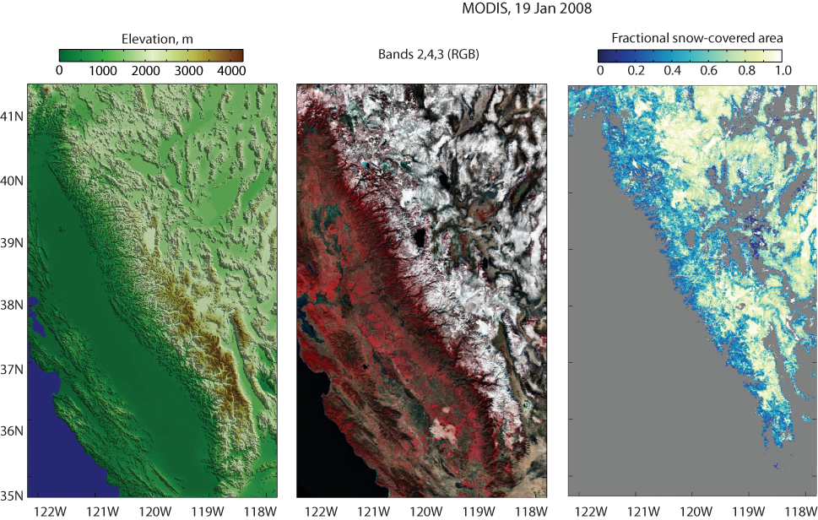
Example data product: fractional snow-covered area, Sierra Nevada

Slide 25
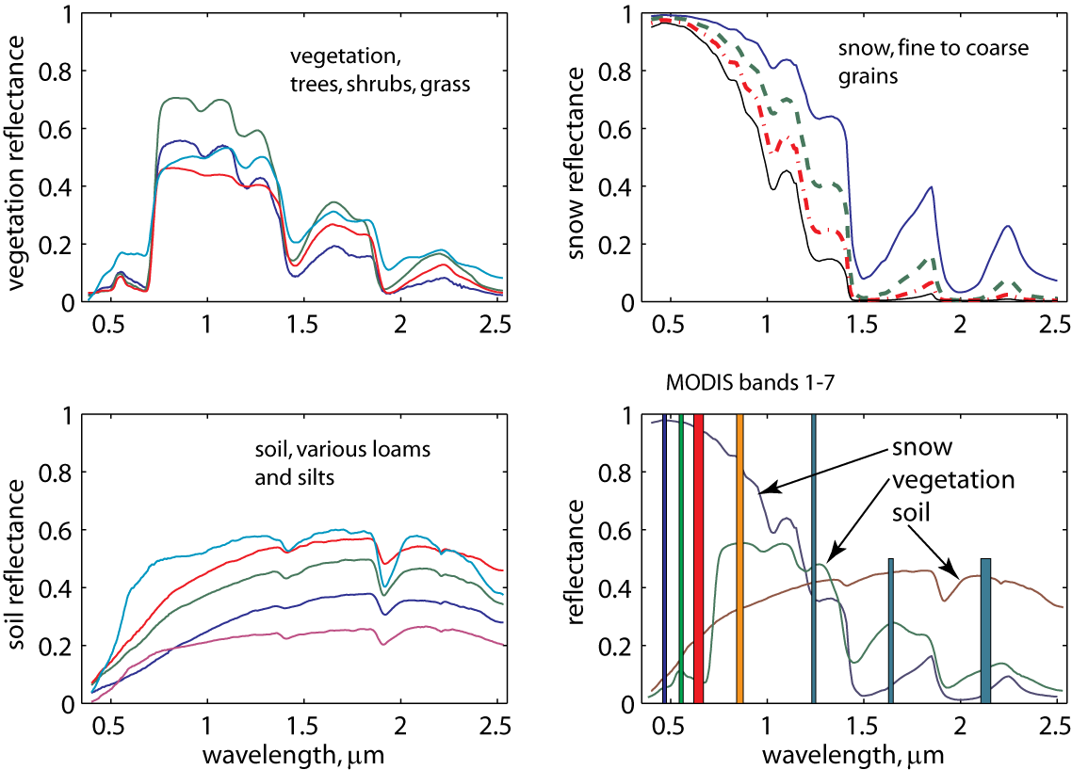
Spectra with 7 MODIS “land” bands (500m resolution, global daily coverage)

Slide 26
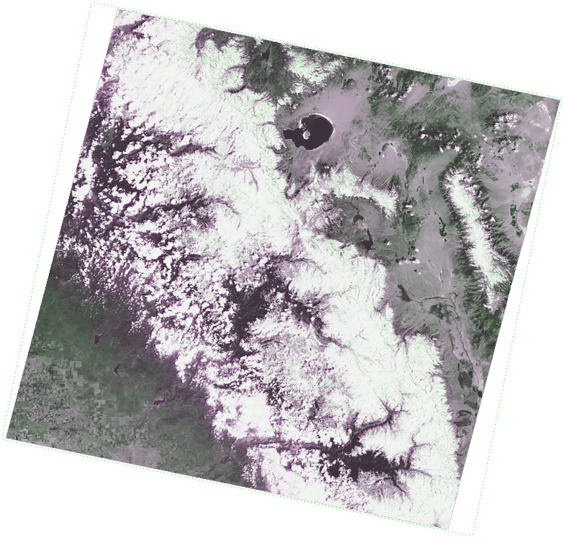
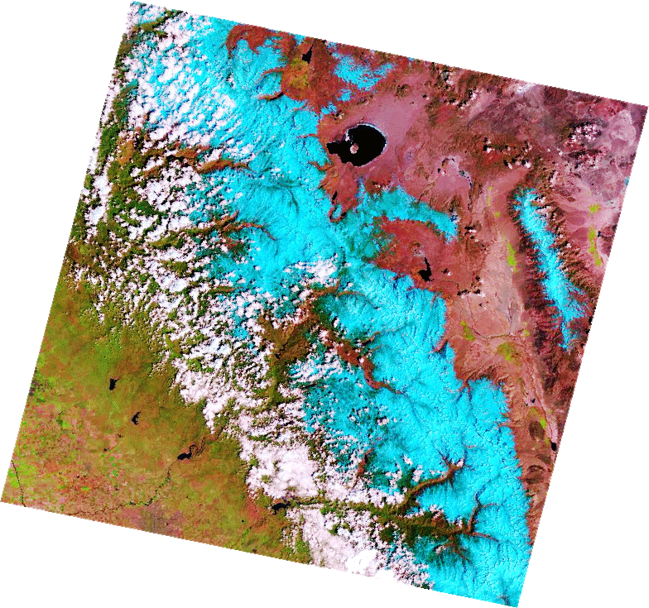
Snow/cloud discrimination with Landsat
Bands 3 2 1 (red, green, blue)
Bands 5 4 2

Slide 27
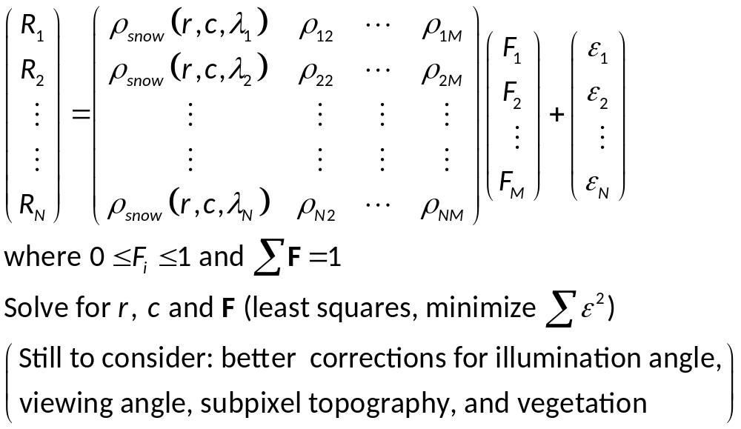
Set of equations for each pixel
Notes:
1st column of matrix is snow reflectance = f(grain size, contaminants, wavelengths). The a’s are the coefficients in a fitting equation (usually a power function).

Slide 28
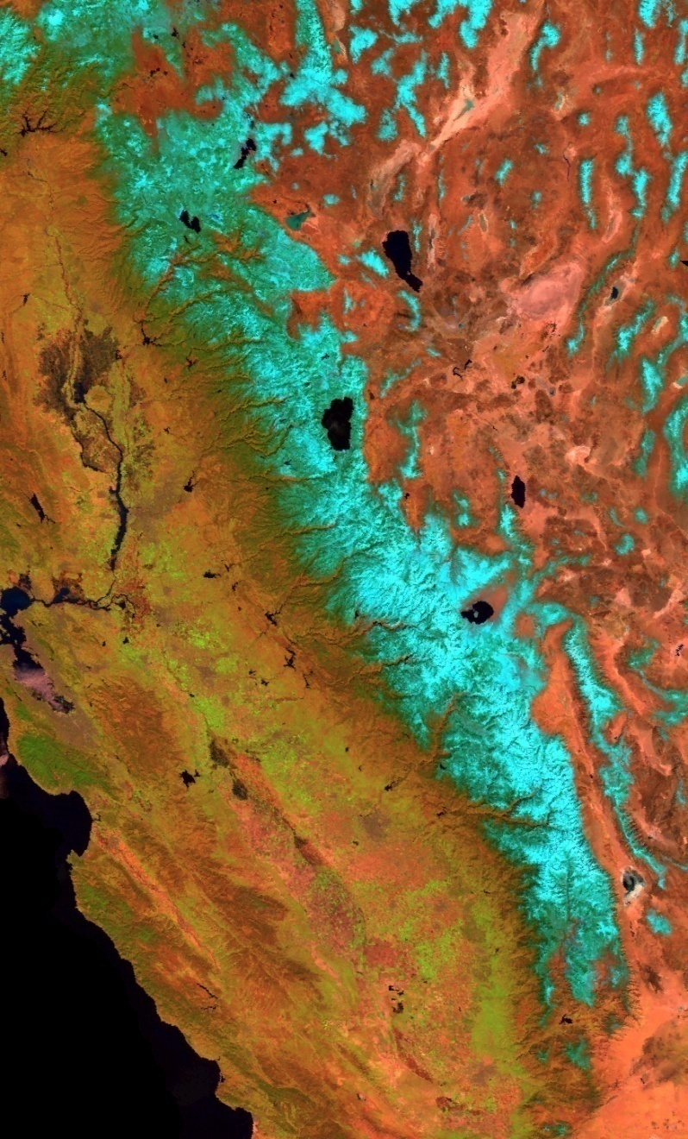
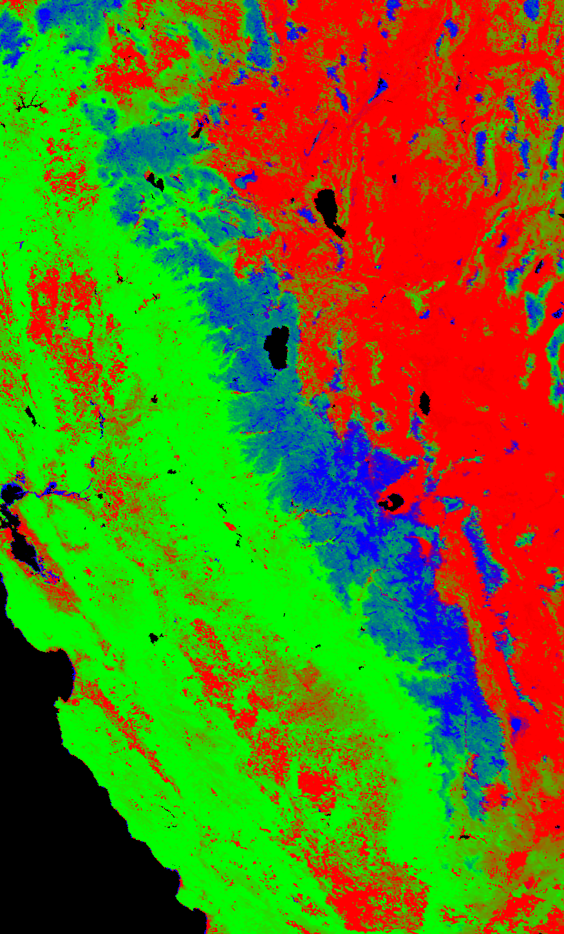
Pure endmembers,
01 Apr 2005
100% Snow
100% Vegetation
100% Rock/Soil
MODIS image

Slide 29
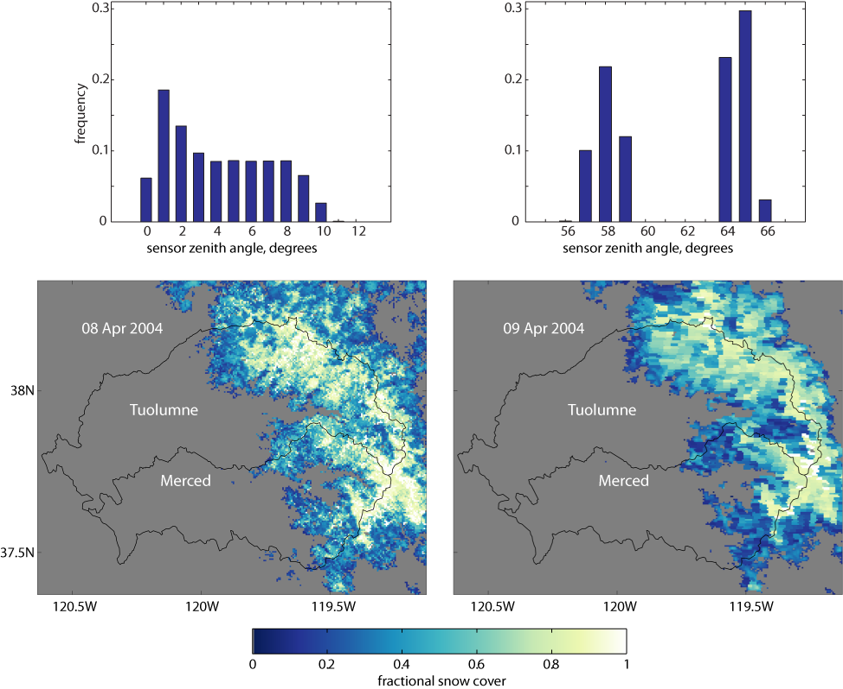
Example of satellite data management issue: blurring caused by off-nadir view

Slide 30
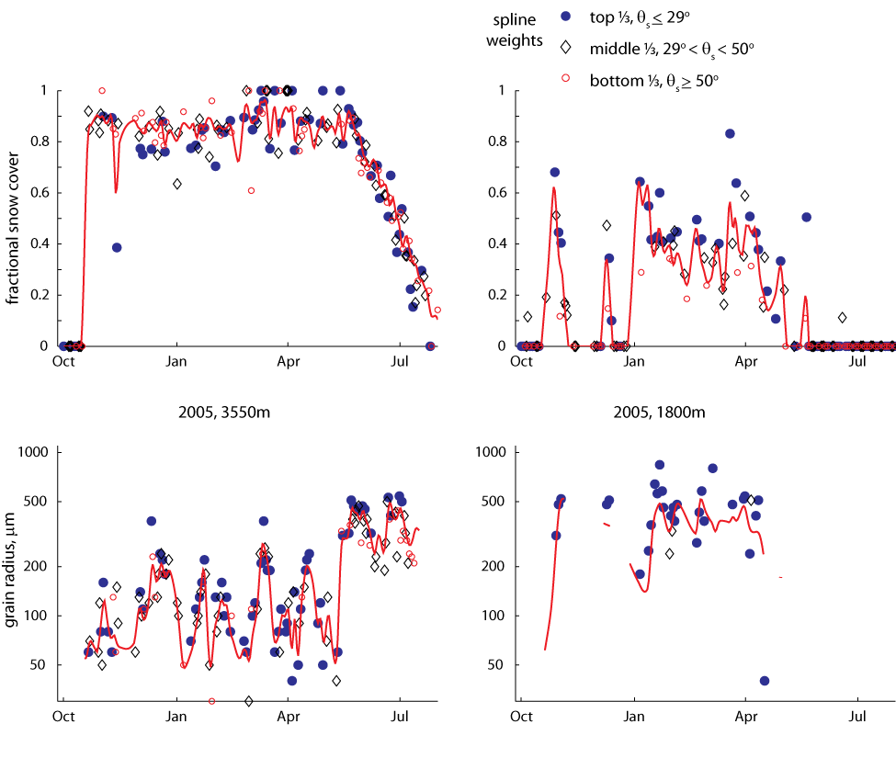
Smoothing spline in the time dimension

Slide 31
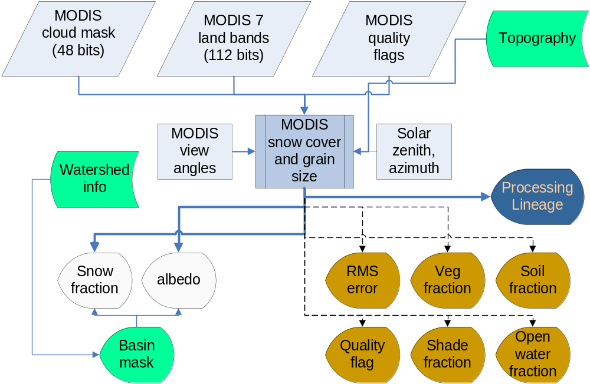
Model structure for MODIS snow-covered area and albedo
Notes:
Correct?

Slide 32
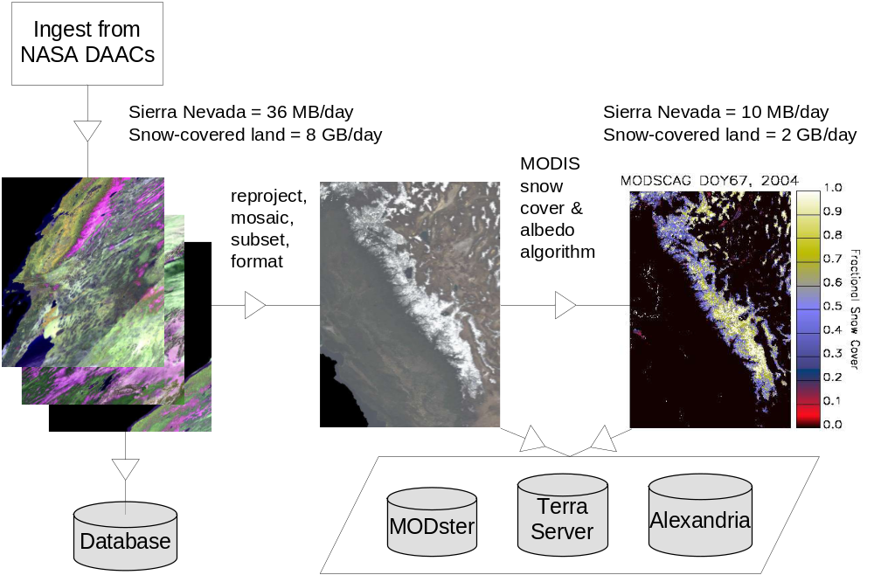
Daily MODIS acquisition, processing for Sierra Nevada snow cover and albedo
Notes:
Diagram of the processing flow. Need to revisit the volumes.

Slide 33
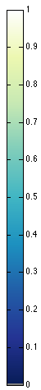
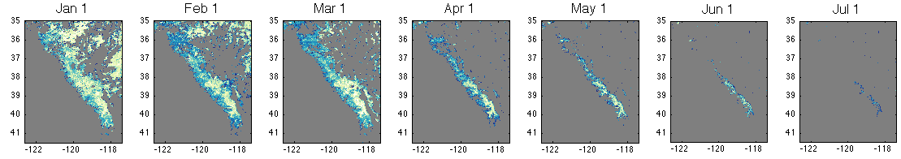
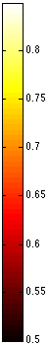
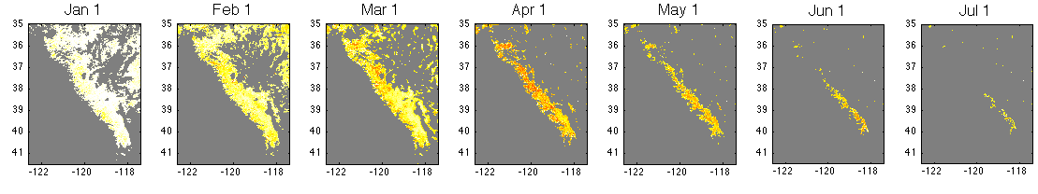
Snow-covered area and albedo, 2004
Snow Covered Area
Albedo

Slide 34
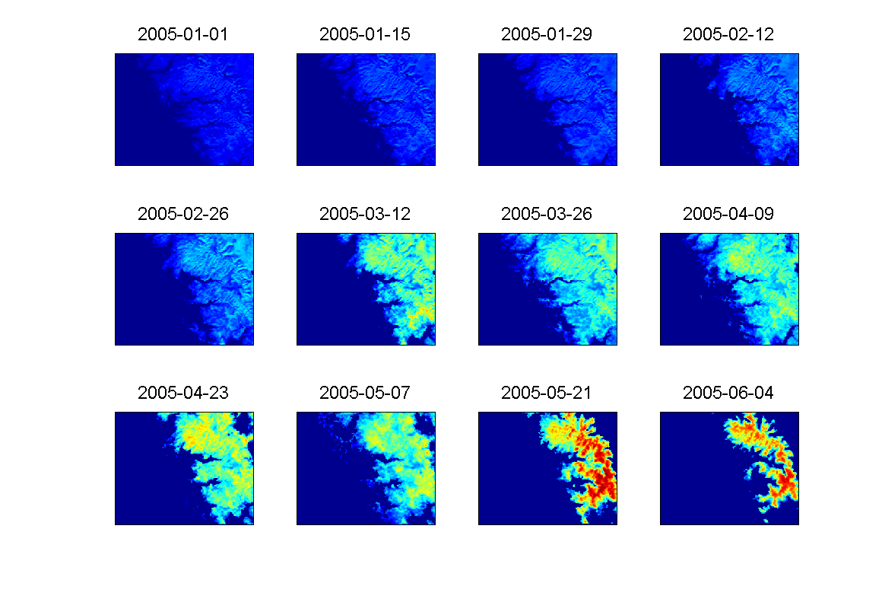


Slide 35
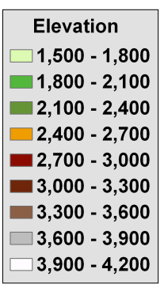
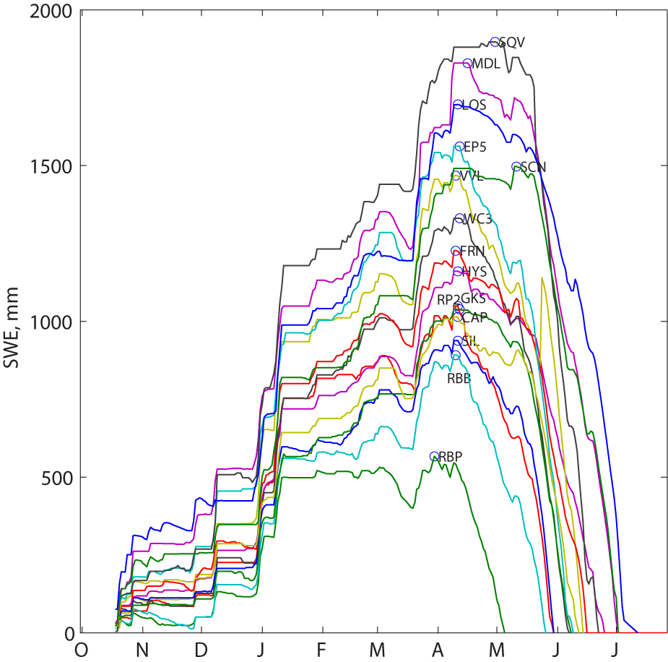
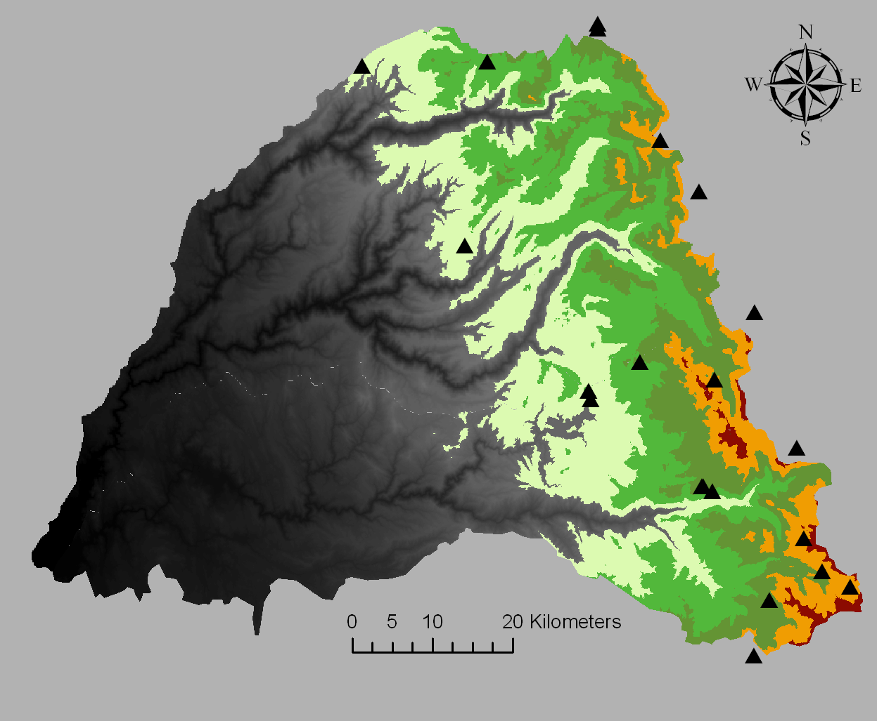
American River basin
Snow pillows, 2005

Slide 36
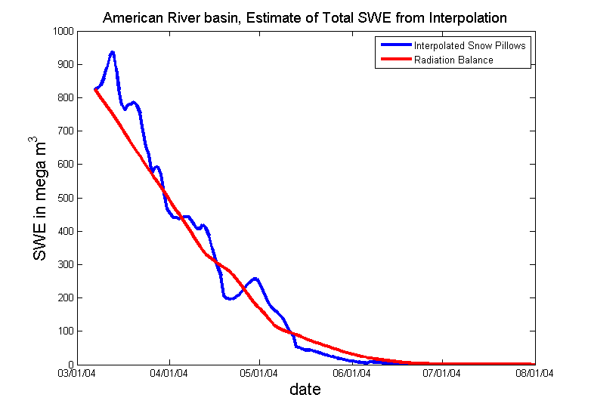
Basinwide SWE, depletion in 2004

Slide 37
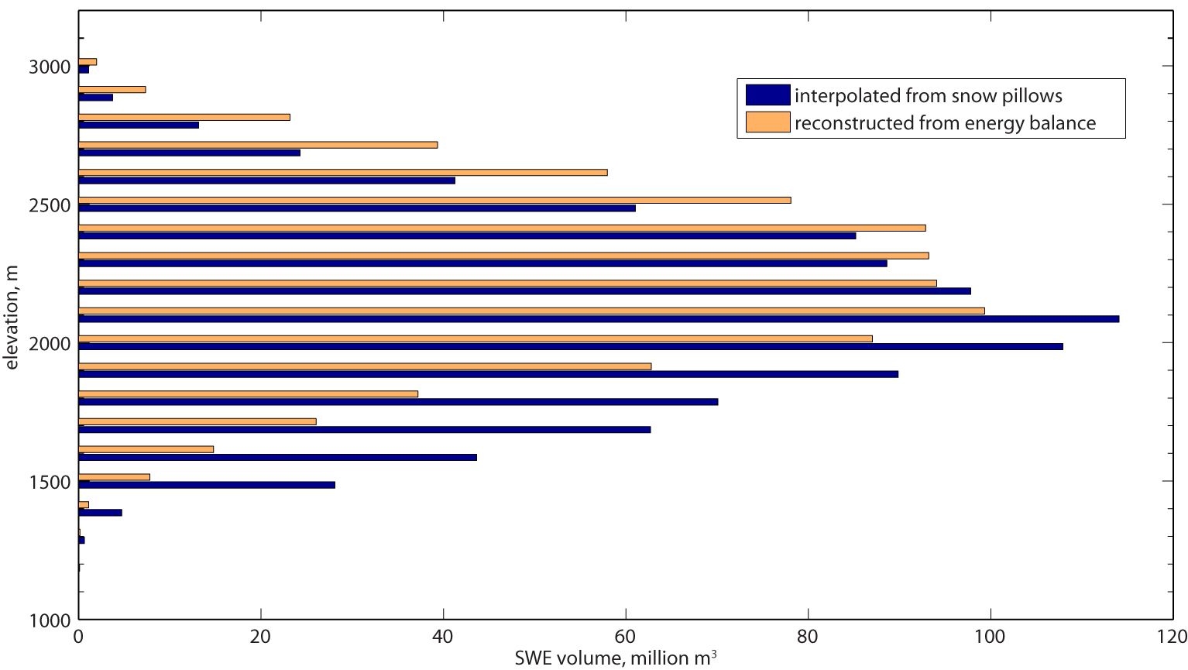
SWE distribution, American R, 07 Mar 2004

Slide 38
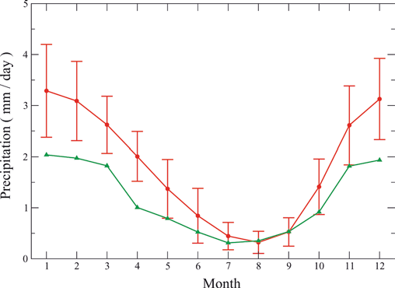
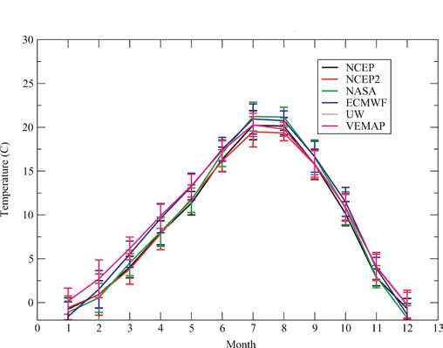
Regional models: better results for temperature than for precipitation
Precipitation: mean of 15 models (red) vs observations (green)
Temperature: mean of 15 models (red) vs observations and reanalyses
Vertical bars are ±1 standard deviation of model monthly results
Coquard et al., 2004, Climate Dynamics

Slide 39
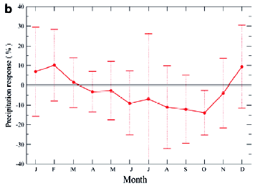
Model uncertainty in precipitation change
Change in precipitation under 2xCO₂ for western US:
Average and standard deviation of 15 different climate models
Coquard et al., 2004, Climate Dynamics

Slide 40
Real uncertainties in climate science
Regional climate prediction
  Adaptation is local
  Problems w downscaling, especially in mountains
Precipitation
  Especially winter precipitation
Aerosols
  Lack of data
  Interactions with precipitation
Paleoclimate data
  E.g., tree-ring divergence
“This climate of
suspicion we’re
working in is insane.
It’s drowning our
ability to soberly
communicate gaps in
our science.”
Gavin Schmidt
Schiermeier, 2010, Nature

Slide 41
Limits of predictability
“The right lessons for the future of climate science come from the failure to predict earthquakes”
Daniel Sarewitz
As scientists, we are attracted to the
challenge of making predictions
  And decision makers would like to pass the blame when we’re wrong
  Don’t confuse the distinct tasks of bringing a problem to public attention and figuring out how to address the societal conditions that determine the consequences
If wise decisions depended on accurate predictions, then few wise decisions would be possible
Instead of predicting the long-term future of the climate, focus instead on the many opportunities for reducing present vulnerabilities to a broad range of today's — and tomorrow's — climate impacts

Slide 42
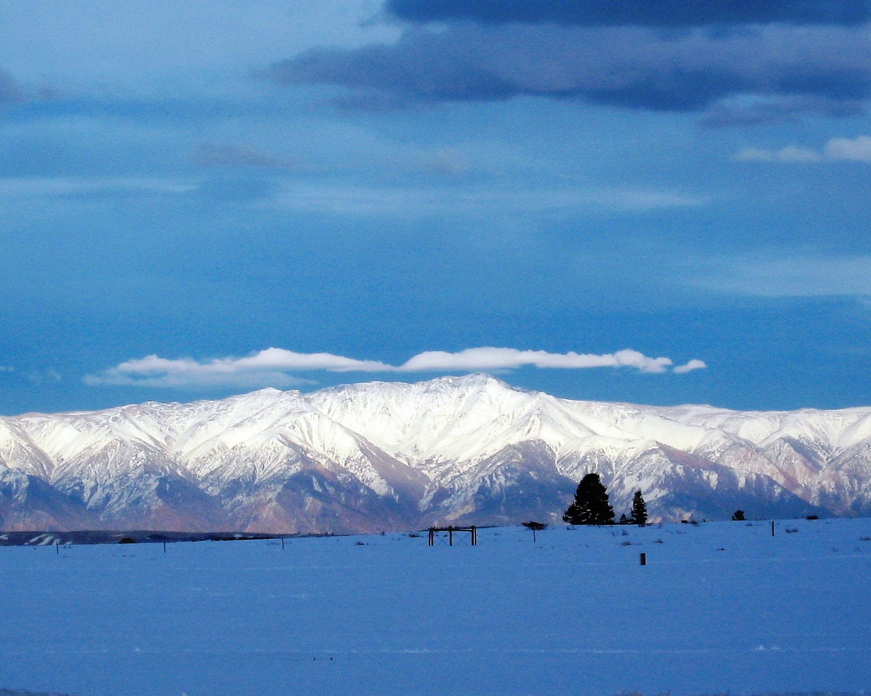
Availability of data
We have done 2000-2009 for whole Sierra Nevada, 2010 ongoing
We want users (dozier@bren.ucsb.edu)
Need information about typical formats and extents that users want

