Slide 1
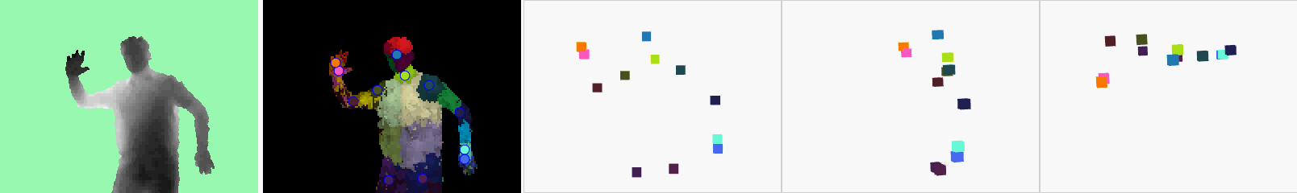
Skeletal Tracking
top view
input depth image
side view
inferred body parts &
overlaid joint hypotheses
front view
3D joint hypotheses

