Slide 1

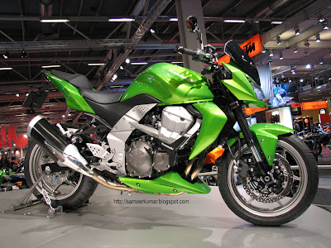
Kawasaki Disease risk-associated snps
As Identified by Lee et al., 2012
Jennifer Przybylo

Slide 2
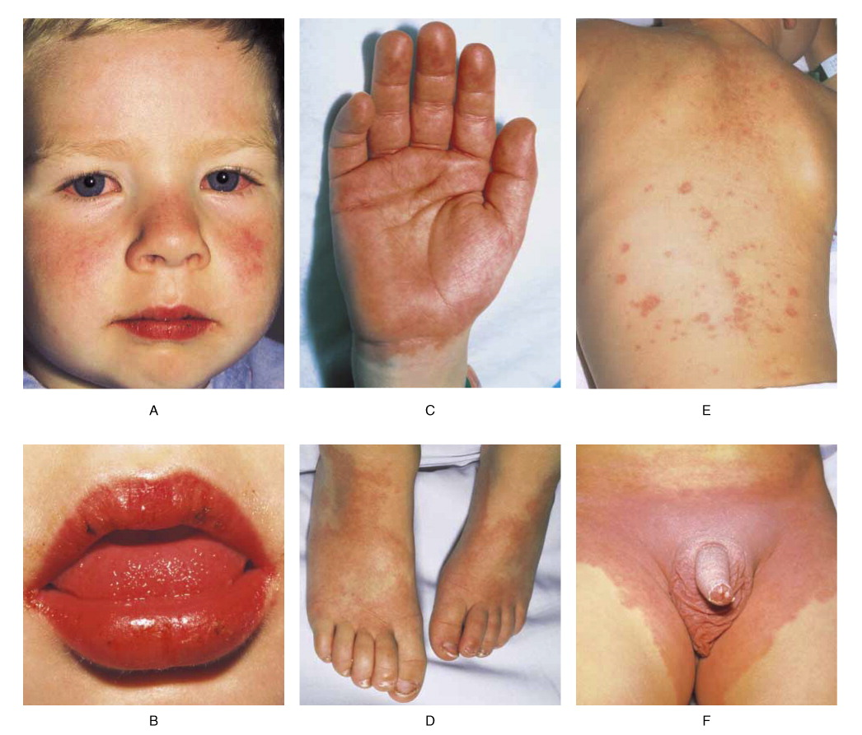
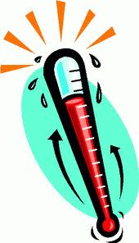

Typical presentation
Notes:
KD is an acute necrotizing vasculitis, or inflammation of the vasculature; mainly medium to large vessels
Symptoms
Etiology

Slide 3
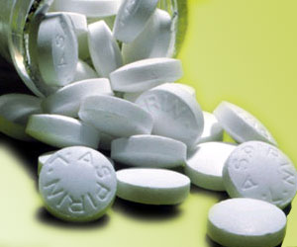
Treatment
Aspirin!
IV immunoglobulin G
BUT…

Slide 4
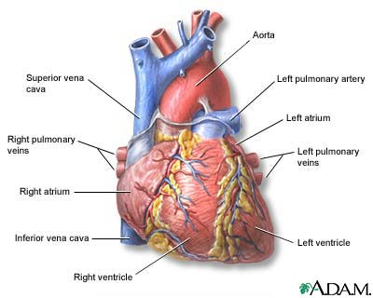


Notes:
So if the best way to prevent heart problems from happening is to catch the disease early, what could help? Well, there are no molecular diagnostics yet, but we could potentially take into account risk alleles

Slide 5
“Two new susceptibility loci for Kawasaki disease identified through genome-wide association analysis”
Lee et al., Nat Genet. 44(5):522-5, 2012
Study Design:
- Population = Han Chinese
- Case/Control GWAS using Affy 6.0 chip
Initial GWAS Cohort: 622 Cases, 1107 Controls
Replication Set: 261 Cases, 550 Controls
Notes:
Found candidate SNPs, run through replication set; in combined analysis, 3 SNPs at 2 loci proved significant

Slide 6
rs2736340 (T) / rs2618476 (G) | rs1569723 (A)
P = 9.01 x 10⁻¹⁰ / 1.96 x 10⁻⁹ | P = 5.67 x 10-9
OR = 1.54 (95% CI 1.34-1.77) / 1.52 (95% CI = 1.33-1.75) | OR = 1.42 (95% CI = 1.26-1.59)
Location: 12.2-kb LD block at 8p23.1 | Location: 17.2 kb LD block at 20q13.12
Genes: LD block contains promoter & first intron of B-lymphoid tyrosine kinase (BLK) BLK – Src-related tyrosine kinase involved in signal transduction from the B cell receptor → Involved in immune response to specific antigens | Genes: upstream of CD40; haplotype block includes CD40 exonic region CD40 – cell surface receptor found on antigen-presenting cells like B cells → B and T cell activation; promotes inflammatory response through cytokine & chemokine production

