Slide 1
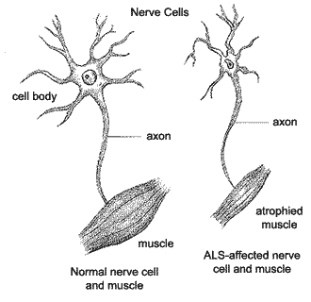
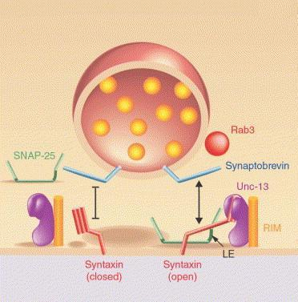
Sporadic ALS and rs12608932
Amyotrophic lateral sclerosis
Spoardic ALS estimated heritability:
0.35-0.85
Located in intron of UNC13A gene on chromosome 19
Major allele: A Minor (risk) allele: C
Unc13a Protein
Synaptic
Vesicle
Neurotransmitter
www.alsa.org
Broadie, K.S., et al. 2002.

Slide 2
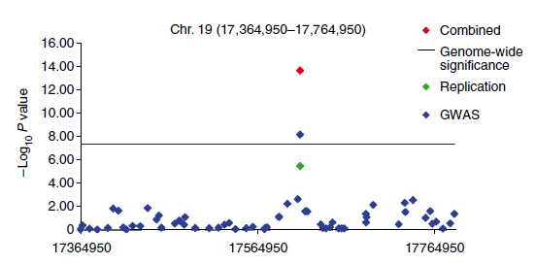
Two-stage GWAS
Phase I: Genome wide study
Phase II: Replication
European ancestry
Cases: 2,323
Controls: 9,013
Identified 58 SNPs with P<1.0x10⁻⁴
  Including rs12608932
  (P =1.30x10⁻⁹, OR=1.25)
European ancestry
Cases: 2,532
Controls: 5,940
rs12608932
P= 1.86x10⁻⁶, OR=1.20
Combined P=2.50x10⁻¹⁴
Van Es, M., et al. 2009.

Slide 3
Replication Studies
French population (2010)
285 Cases and 285 Controls
rs12608932 : P = 0.85
rs12608932
Significant association not seen in all replication studies
Sample size too small (?)
Population dependence (?)
East Asian population (2011)
Japanese
1179 Cases and 1645 Controls
P=0.67 Odds ratio = 1.02
Chinese
684 Cases and 830 Controls
P=0.73 Odds ratio = 1.02
Association with Survivability (2012)
Monitored survivability of Dutch, Swedish, Belgian ancestry
Recessive model
Patients with CC exhibited 5-10 months shorter survivability
(than those with AC or AA)
Daoud, H., et al. 2010 Iida, A., et al. 2011.

