Slide 1
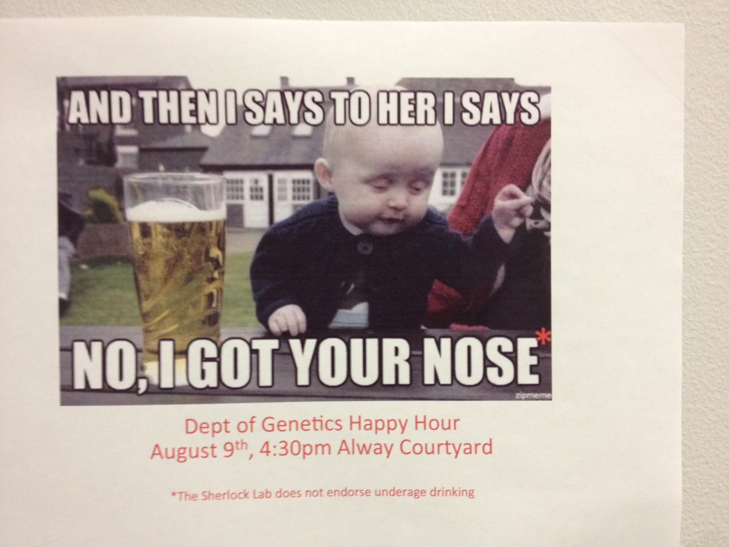
One day, at Genetics Happy Hour ….

Slide 2
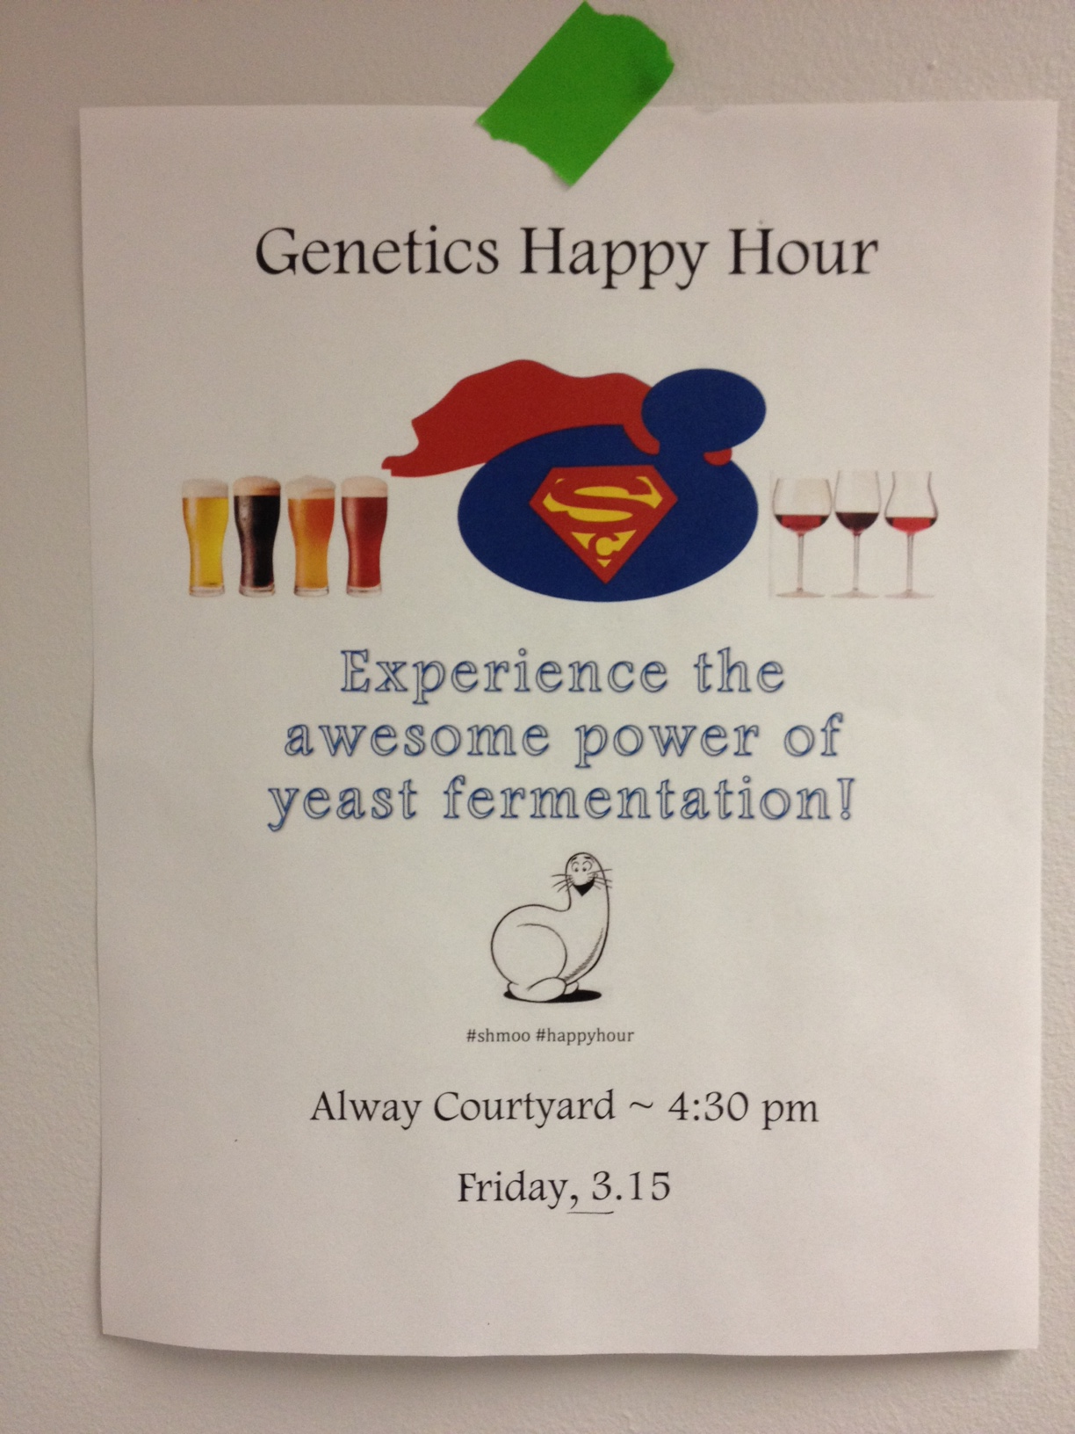
You have some beers ….

Slide 3
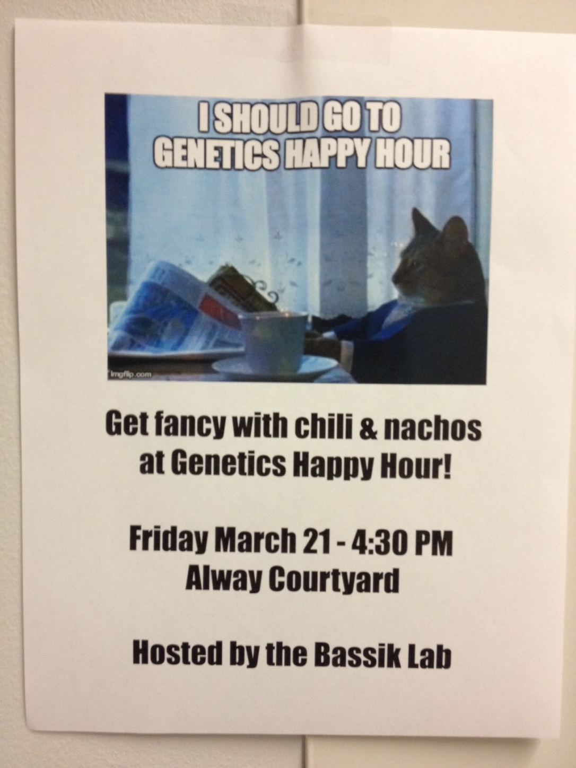
You meet some people ….

Slide 4
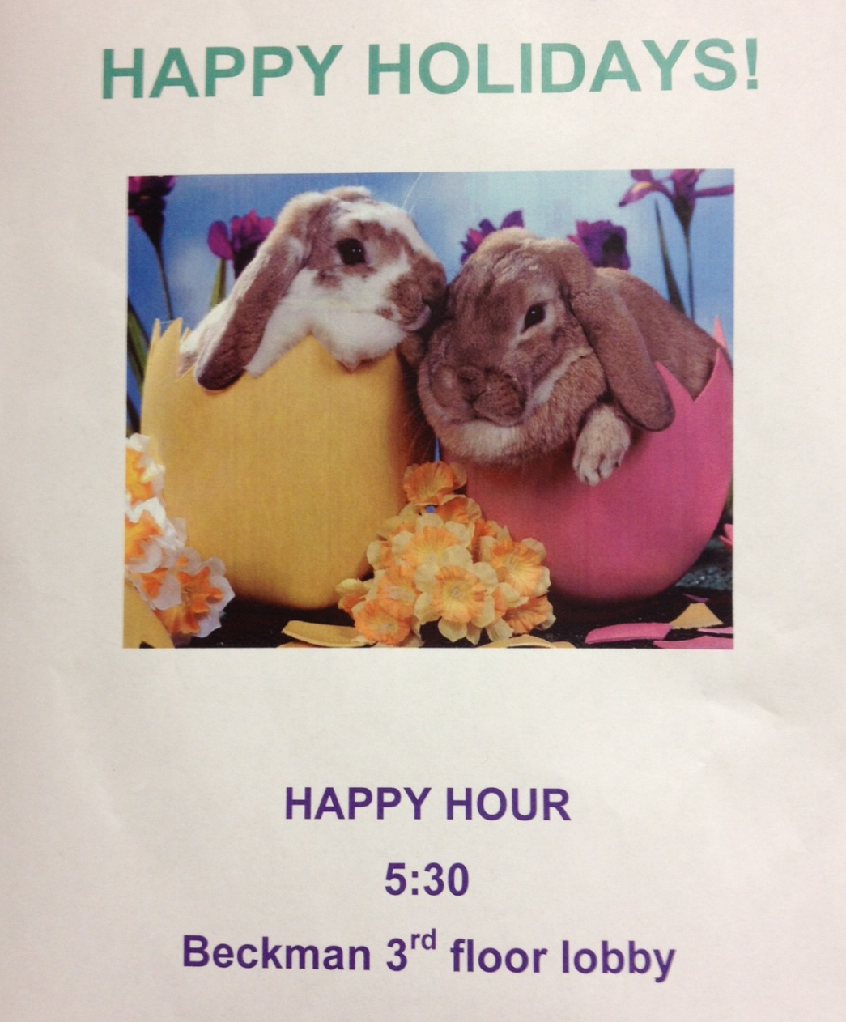
Kick around some zany ideas ….
One of your ideas seems pretty interesting….

Slide 5
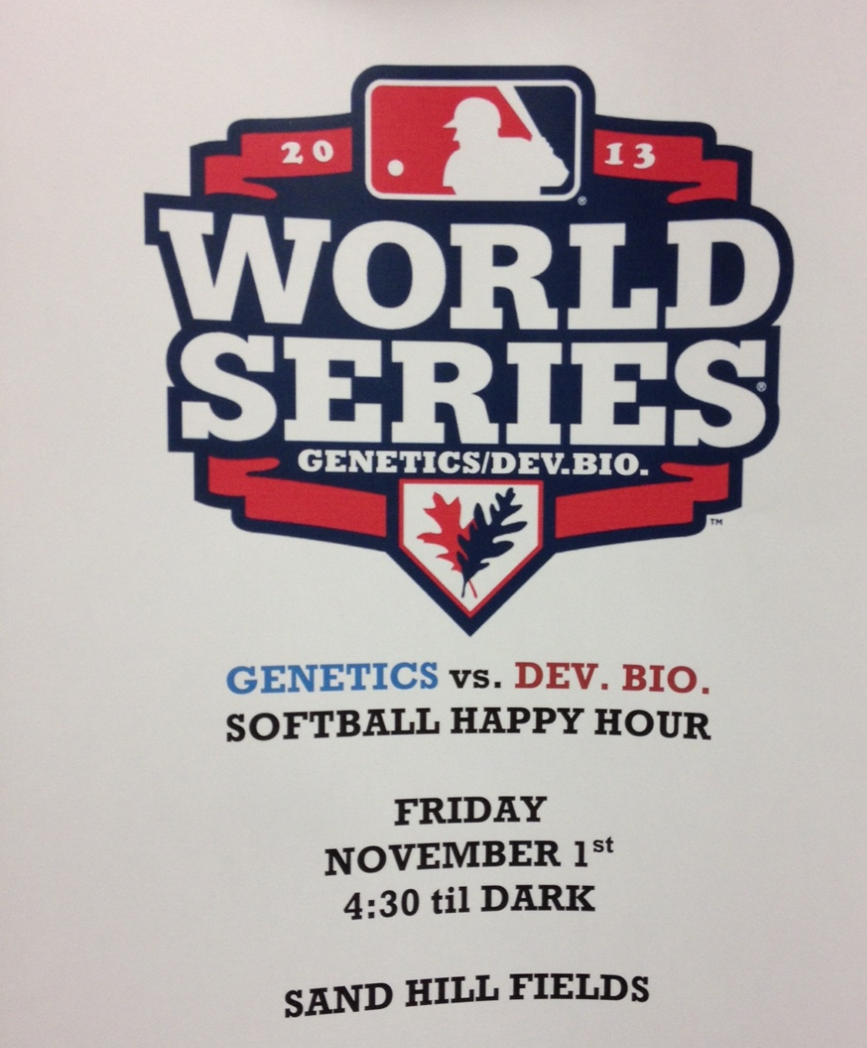
And the (VC, CEO, Dept Head) guy you’re talking to seems pretty keen on the idea ….

Slide 6
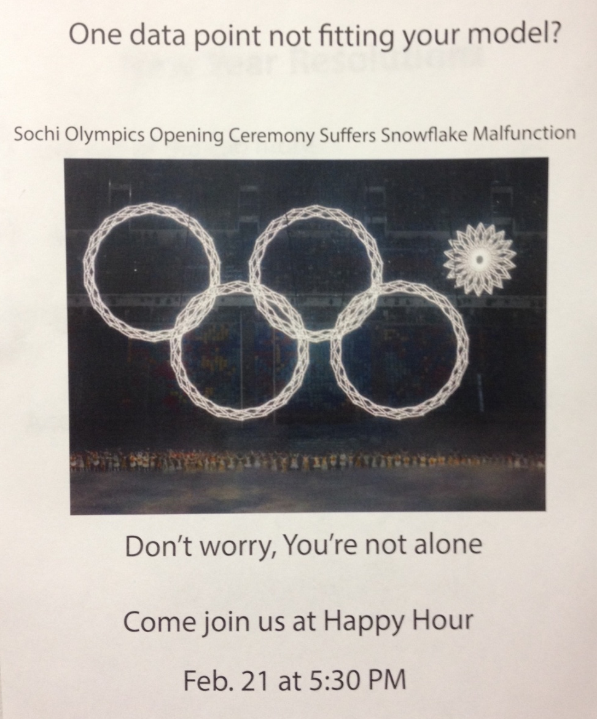
Then you go home, go to bed, zzzzz ….

Slide 7
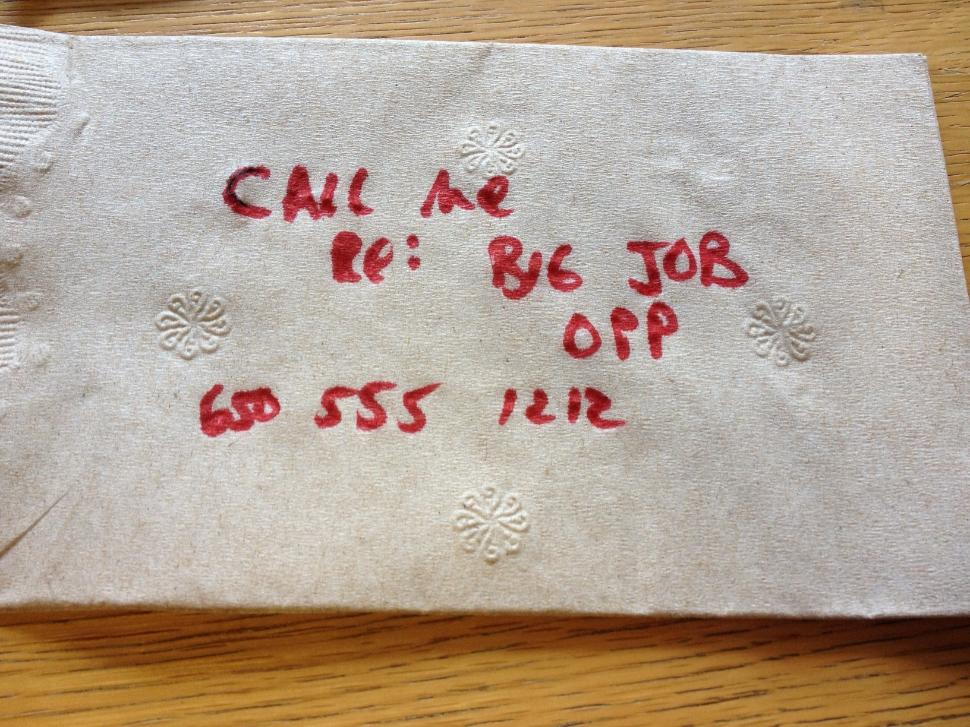
When you wake up in the morning, you find a napkin from the guy, but can’t remembe who ….

Slide 8
Spit and nachos
You find spit on the napkin, extract DNA, and genotype it ….
http://stanford.edu/class/gene210/files/data/culprit.txt

Slide 9
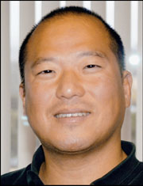
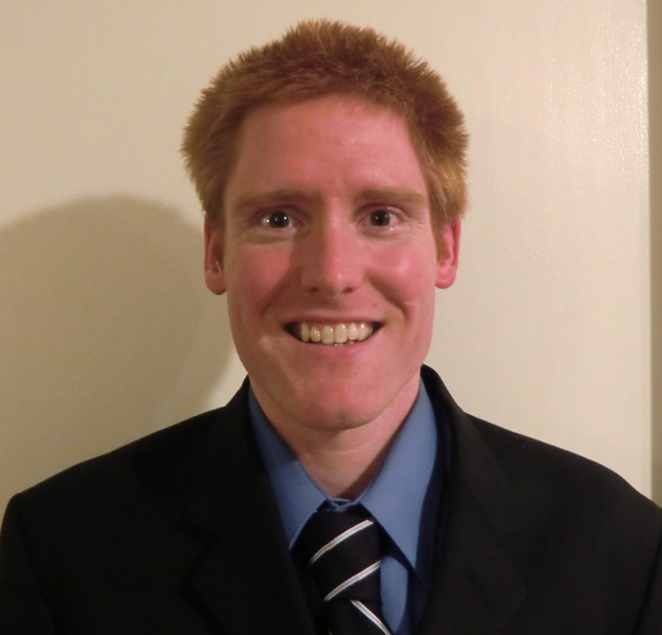
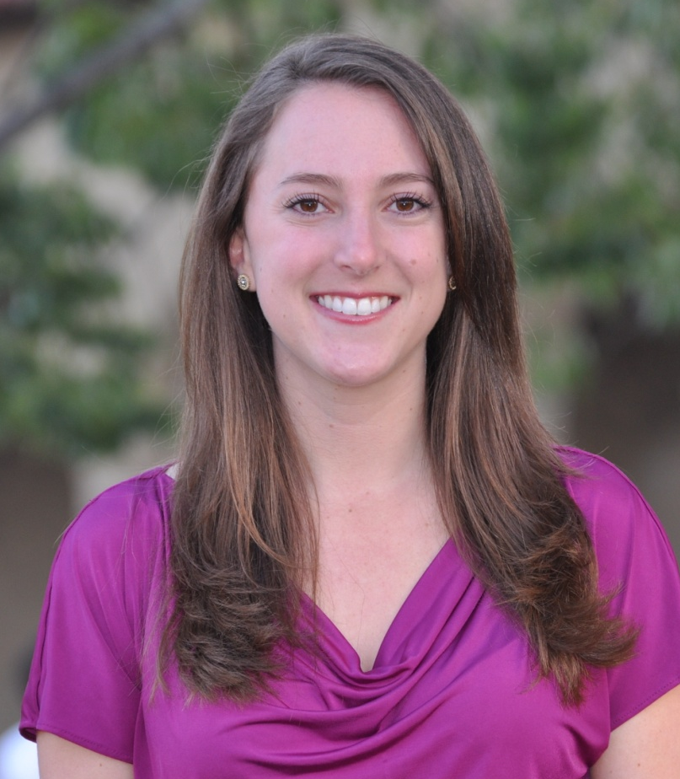
Stuart, Andrew and Rachel saw you talking to the mystery VC,
but you don’t want to let on that you forgot who,
So you ask questions trying to figure out the ID of your mystery VC ….

Slide 10
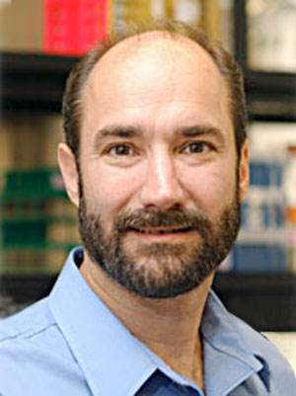
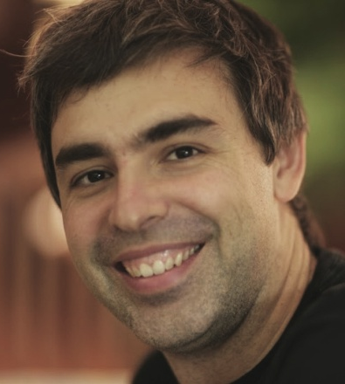
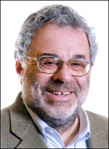
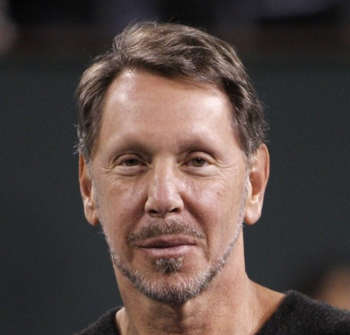
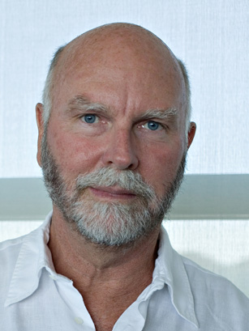
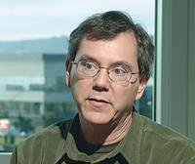
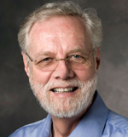
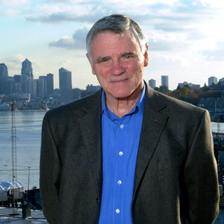
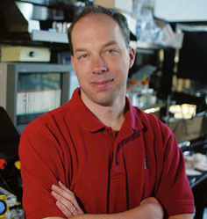
1. Mike Snyder
2. Larry Page
3. David Botstein
4. Larry Ellison
5. Craig Venter
6. Art Levinson
7. Ron Davis
8. Lee Hood
9. Steve Quake

