Slide 1
Linguistics 187/287 Week 5
Data-driven Methods in Grammar Development

Slide 2
What do we need data for?
Get data about certain grammatical phenomena/lexical items
  Query on large (automatically) PoS-tagged corpora
  Query on manually annotated/validated treebanks
Develop methods for parse pruning/ranking
  C-structure pruning
  Stochastic c-/f-structure ranking
Testing and evaluation of grammar output
  Regression tests during development
  “Gold” analyses to match against for “final” eval.

Slide 3
Testing and Evaluation
Need to know:
Does the grammar do what you think it should?
  cover the constructions
  still cover them after changes
  not get spurious parses
  not cover ungrammatical input
How good is it?
  relative to a ground truth/gold standard
  for a given application

Slide 4
Testsuites
XLE can parse and generate from testsuites
  parse-testfile
  regenerate-testfile
  run-syn-testsuite
Issues
  where to get the testsuites
  how to know if the parse the grammar got is the one that was intended

Slide 5
Basic testsuites
Set of sentences separated by blank lines
  can specify category
    NP: the children who I see
  can specify expected number of results
    They saw her duck. (2! 0 0 0)
parse-testfile produces
  xxx.new sentences plus new parse statistics
  # of parses; time; complexity
  xxx.stats new parse statistics without the sentences
  xxx.errors changes in the statistics from previous run

Slide 6
Testsuite examples
# LEXICON _'s
ROOT: He's leaving. (1+1 0.10 55)
ROOT: It's broken. (2+1 0.11 59)
ROOT: He's left. (3+1 0.12 92)
ROOT: He's a teacher. (1+1 0.13 57)
# RULE CPwh
ROOT: Which book have you read? (1+4 0.15 123)
ROOT: How does he be? (0! 0 0.08 0)
# RULE NOMINALARGS
NP: the money that they gave him (1 0.10 82)

Slide 7
.errors file
ROOT: They left, then they arrived. (2+2 0.17 110)
# MISMATCH ON: 339 (2+2 -> 1+2)
ROOT: Is important that he comes. (0! 0 0.15 316)
# ERROR AND MISMATCH ON: 784 (0! 0 -> *1+119)

Slide 8
.stats file
((1901) (1+1 0.21 72) -> (1+1 0.21 72) (5 words))
((1902) (1+1 0.10 82) -> (1+1 0.12 82) (6 words))
((1903) (1 0.04 15) -> (1 0.04 15) (1 word))
XLE release of Feb 26, 2004 11:29.
Grammar = /tilde/thking/pargram/english/standard/english.lfg.
Grammar last modified on Feb 27, 2004 13:58.
1903 sentences, 38 errors, 108 mismatches
0 sentences had 0 parses (added 0, removed 56)
38 sentences with 0!
38 sentences with 0! have solutions (added 29, removed 0)
57 starred sentences (added 57, removed 0)
timeout = 100
max_new_events_per_graph_when_skimming = 500
maximum scratch storage per sentence = 26.28 MB (#642)
maximum event count per sentence = 1276360
average event count per graph = 217.37

Slide 9
.stats file cont.
293.75 CPU secs total, 1.79 CPU secs max
new time/old time = 1.23
elapsed time = 337 seconds
biggest increase = 1.16 sec (#677 = 1.63 sec)
biggest decrease = 0.64 sec (#1386 = 0.54 sec)
range parsed failed words seconds subtrees optimal suboptimal
1-10 1844 0 4.25 0.14 80.73 1.44 2.49E+01
11-20 59 0 11.98 0.54 497.12 10.41 2.05E+04
all 1903 0 4.49 0.15 93.64 1.72 6.60E+02
0.71 of the variance in seconds is explained by the number of subtrees

Slide 10
Is it the right parse?
Use shallow markup to constrain possibilities
  bracketing of desired constituents
  POS tags
Compare resulting structure to a previously banked one (perhaps a skeletal one)
  significant amount of work if done by hand
  bank f-structures from the grammar if good enough
  reduce work by using partial structures
  (e.g., just predicate argument structure)

Slide 11
run-syn-testsuite
Initial run creates set of f-structures
Subsequent runs compares to these structures
  Errors reported as f-score and differences printed
Move over new f-structures if they are improvements (otherwise fix)
Form of testsuite is similar to parse-testfile only with numbered sentences + initial number
  # 3
  # 1
  I hop.
  # 2
  You hop.
  # 3
  She hops.

Slide 12
Where to get the testsuite?
Basic coverage
  create testsuite when writing the grammar
  publically available testsuites
  extract examples from the grammar comments
    "COM{EX NP-RULE NP: the flimsy boxes}"
  examples specific enough to test one construction at a time
Interactions
  real world text necessary
  may need to clean up the text somewhat

Slide 13
Evaluation
How good is the grammar?
Absolute scale
  need a gold standard to compare against
Relative scale
  comparing against other systems
For an application
  some applications are more error-tolerant than others

Slide 14
Gold standards
Representation of the perfect parse for the sentence
  can bootstrap with a grammar for efficiency and consistency
  hand checking and correction
Determine how close the grammar's output is to the gold standard
  may have to do systematic mappings
  may only care about certain relations

Slide 15
PARC700
700 sentences randomly chosen from section23 of the UPenn WSJ corpus
How created
  parsed with the grammar
  saved the best parse
  converted format to "triples"
  hand corrected the output
Issues
  very time consuming process
  difficult to maintain consistency even with bootstrapping and error checking tools

Slide 16
Sample triple from PARC700
sentence(
id(wsj_2356.19, parc_23.34)
date(2002.6.12)
validators(T.H. King, J.-P. Marcotte)
sentence_form(The device was replaced.)
structure(
mood(replace~0, indicative)
passive(replace~0, +)
stmt_type(replace~0, declarative)
subj(replace~0, device~1)
tense(replace~0, past)
vtype(replace~0, main)
det_form(device~1, the)
det_type(device~1, def)
num(device~1, sg)
pers(device~1, 3)))

Slide 17
Evaluation against PARC700
Parse the 700 sentences with the grammar
Compare the f-structure with the triple
Determine
  number of attribute-value pairs that are missing from the f-structure
  number of attribute-value pairs that are in the f-structure but should not be
  combine result into an f-score
    100 is perfect match; 0 is no match
    current grammar is in the low 80s

Slide 18
Using other gold standards
Need to match corpus to grammar type
  written text vs. transcribed speech
  technical manuals, novels, newspapers
May need to have mappings between systematic differences in analyses
  minimally want a match in grammatical functions
  but even this can be difficult (e.g. XCOMP subjects)

Slide 19
Testing and evaluation
Necessary to determine grammar coverage and useability
Frequent testing allows problems to be corrected early on
Changes in efficiency are also detectable in this way

Slide 20
Language has pervasive ambiguity
Tokenization
Morphology
Syntax
Semantics
Entailment
Discourse
Bill fell. John kicked him.
  because or after?
John didn’t wait to go.
now or never?
Every man loves a woman.
The same woman or each their own?
John told Tom he had to go.
Who had to go?
The duck is ready to eat. Cooked or hungry?
walk untieable knot bank?
Noun or Verb (untie)able or un(tieable)? river or financial?
I like Jan. |Jan|.| or |Jan.|.| (sentence end or abbreviation)

Slide 21
Methods for parse pruning/ranking
Goal 1: allow for selection of n best parses – n can range from 1 to whatever is suitable for a given application
Goal 2: speed up the analysis process
Philosophy: Carry ambiguity along until available information is sufficient to resolve it (or until you have to for practical reasons)

Slide 22
Methods for parse pruning/ranking
Input sentence
C-structure chart + pruning
C-structures
Unifier + parse ranking
F-structures
Semantics construction
Semantic representations

Slide 23
Methods for parse pruning/ranking
Shallow markup in deep parsing
  Use shallow modules for preprocessing?
  Use (more or less) shallow information from hand-annotated/validated corpora for construction of training and test data
C-structure pruning
  Speed up parsing without loss in accuracy
Stochastic parse ranking
  Determine probability of competing analyses

Slide 24
Shallow mark-up of input strings
Part-of-speech tags (tagger?)
I/PRP saw/VBD her/PRP duck/VB.
I/PRP saw/VBD her/PRP$ duck/NN.
Named entities (named-entity recognizer)
<person>General Mills</person> bought it.
<company>General Mills</company> bought it
Syntactic brackets (chunk parser?)
  [NP-S I] saw [NP-O the girl with the telescope].
[NP-S I] saw [NP-O the girl] with the telescope.

Slide 25
Hypothesis
Shallow mark-up
  Reduces ambiguity
  Increases speed
  Without decreasing accuracy
  (Helps development)
Issues
  Markup errors may eliminate correct analyses
  Markup process may be slow
  Markup may interfere with existing robustness mechanisms (optimality, fragments, guessers)
  Backoff may restore robustness but decrease speed in 2-pass system (STOPPOINT)

Slide 26
Implementation in XLE
Input string
Input string
Marked up string
Tokenizer (FST)
Tokenizer (FST)
(plus POS, NE converter)
Morphology (FST)
Morphology (FST)
(plus POS filter)
LFG grammar
LFG grammar
(plus bracket metarule,
NE sublexical rule)
c-str
f-str
c-str
f-str
How to integrate with minimal changes to existing system/grammar?

Slide 27
XLE String Processing
oil_filter +MWE
lexical forms
The +Tok
the +Det
+N
+V
+Tok
+N
+V
+Tok
+V
+Tok
oil
+N
+Tok
filter
’s +Tok gone
Modify
sequences
Multiwords
token morphemes
The +Tok
the +Det
+N
+Tok
+N
+V
+Tok
+V
+Tok
oil
filter
’s +Tok gone
Morph,
Guess,
+Tok
Analyze
tokens
{T|t}he TB oil TB filter TB ’s TB gone TB
Decap,
split,
commas
Tokenize
string
The oil filter’s gone

Slide 28
Part of speech tags
lexical forms
Multiwords
Morphemes to be
constrained here
token morphemes
The +Tok
the +Det
+N
+Tok
+N
+V
+Tok
+V
+Tok
oil
filter
’s +Tok gone
Analyze
  How do tags pass thru Tokenize/Analyze?
  Which tags constrain which morphemes?
  How?
tokens
Tokenize
string
The/DET_ oil/NN_ filter/NN_’s/VBZ_ gone/VBN_
Extra input
characters here

Slide 29
Named entities: Example input
parse {<person>Mr. Thejskt Thejs</person> arrived.}
tokenized string:
Mr. Thejskt Thejs TB +NEperson
Mr(TB). TB Thejskt TB Thejs
.
(.) TB (, TB)* .
TB arrived
TB

Slide 30
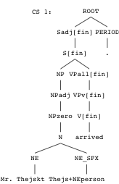
Resulting C-structure

Slide 31
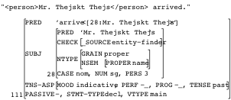
Resulting F-structure

Slide 32
Syntactic brackets
Chunker: labelled bracketing
  [NP-SBJ Mary and John] saw [NP-OBJ the girl with the telescope].
  They [V pushed and pulled] the cart.
Implementation
  Tokenizing FST identifies, tokenizes labels without interrupting other patterns
  Bracketing constraints enforced by Metarulemacro
      METARULEMACRO(_CAT _BASECAT _RHS) =
      { _RHS
      | LSB
      CAT-LB[_BASECAT]
      _CAT
      RSB}.

Slide 33
Syntactic brackets
  [NP-SBJ Mary] appeared.
  Lexicon: NP-SBJ CAT-LB[NP] * (SUBJ ^).
S
NP
VP
LSB
CAT-LB[NP]
NP
RSB
V
appeared
[
NP-SBJ
N
Mary
]

Slide 34
Experimental test
Again, F-scores on PARC 700 f-structure bank
Upper bound: Sentences with best-available markup
  POS tags from Penn Tree Bank
Some noise from incompatible coding:
Werner is president of the parent/JJ company/NN.
Adj-Noun vs. our Noun-Noun
Some noise from multi-word treatment:
Kleinword/NNP Benson/NNP &/CC Co./NNP
vs. Kleinword_Benson_&_Co./NNP
  Named entities hand-coded by us
  Labeled brackets also approximated by Penn Tree Bank
      Keep core-GF brackets: S, NP, VP-under-VP
      Others are incompatible or unreliable: discarded

Slide 35
Results
Full/All | % Full parses | Optimal sol’ns | Best F-sc | Time %
Unmarked | 76 | 482/1753 | 82/79 | 65/100
√Named ent | 78 | 263/1477 | 86/84 | 60/91
POS tag | 62 | 248/1916 | 76/72 | 40/48
Lab brk | 65 | 158/ 774 | 85/79 | 19/31

Slide 36
C-structure pruning
Idea: Make parsing faster by discarding low-probability c-structures even before f-annotations are solved.
Why? Unification is typically the most computation-intensive part of LFG parsing.
Means: Train a probabilistic context-free grammar on a corpus annotated with syntactic bracketing. Discard all c-structures that are n times less probable than the most probable c-structure.

Slide 37
What is a Probabilistic Context-Free Grammar?
Context-free rewrite rules
  one non-terminal symbol on LHS
  combination of terminal and/or non-terminal symbols on RHS
  XLE grammar rules are context-free rules augmented with f-annotations
Probabilities associated with these rules can be estimated as relative frequencies found in a parsed (and disambiguated) corpus

Slide 38
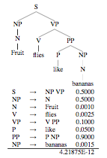
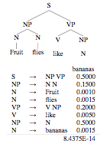
PCFG example
Fruit flies like bananas.

Slide 39
C-structure pruning example
8.4375E-14 vs. 4.21875E-12
  Reading 1 is 50 times less probable than reading 2
Depending on how the c-structure pruning cutoff is set, reading 1 may be discarded even before corresponding f-annotations are solved.
If so, sentence will only get 1 (rather than 2) solutions.
  This can be confusing during grammar development, so c-structure pruning is generally only used at application time.

Slide 40
C-structure pruning results
English:
  Trained on (WSJ) Penn Treebank data
  67% speedup
  Stable accuracy
German:
  Trained on (FR) TIGER Treebank data
  49% speedup
  Stable accuracy
Norwegian
  40% speedup, but slight loss in accuracy
  Probably needs more data

Slide 41
Finding the most probable parse
XLE produces (too) many candidates
  All valid (with respect to grammar and OT marks)
  Not all equally likely
  Some applications require a single best guess
Grammar writer can’t specify correct choices
  Many implicit properties of words and structures with unclear significance
Appeal to probability model to choose best parse
  Assume: previous experience is a good guide for future decisions
  Collect corpus of training sentences, build probability model that optimizes for previous good results
  Apply model to choose best analysis of new sentences

Slide 42
Issues
What kind of probability model?
What kind of training data?
Efficiency of training, efficiency of disambiguation?
Benefit vs. random choice of parse

Slide 43
Probability model
Conventional models: stochastic branching process
  Hidden Markov models
  Probabilistic Context-Free grammars
Sequence of decisions, each independent of previous decisions, each choice having a certain probability
  HMM: Choose from outgoing arcs at a given state
  PCFG: Choose from alternative expansions of a given category
Probability of an analysis = product of choice probabilities
Efficient algorithms
  Training: forward/backward, inside/outside
  Disambiguation: Viterbi
Abney 1997 and others: Not appropriate for LFG, HPSG…
  Choices are not independent: Information from different CFG branches interacts through f-structure
  Probability models are biased (don’t make right choices on training set)

Slide 44
Exponential models are appropriate
(aka Log-linear models)
Assign probabilities to representations, not to choices in a derivation
No independence assumption
Arithmetic combined with human insight
  Human:
    Define properties of representations that may be relevant
    Based on any computable configuration of features, trees
  Arithmetic:
    Train to figure out the weight of each property
Model is discriminative rather than generative

Slide 45
Training set
Sections 2-21 of Wall Street Journal
Parses of sentences with and without shallow WSJ mark-up
  (e.g. subset of labeled brackets)
Discriminative:
  Property weights that best discriminate parses compatible with mark-up from others

Slide 46
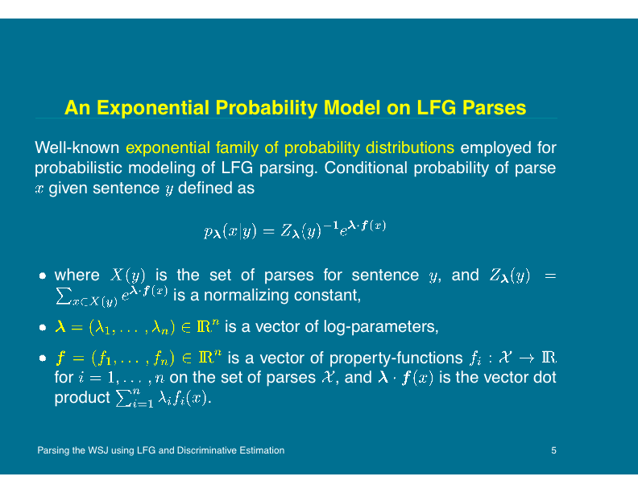

Slide 47
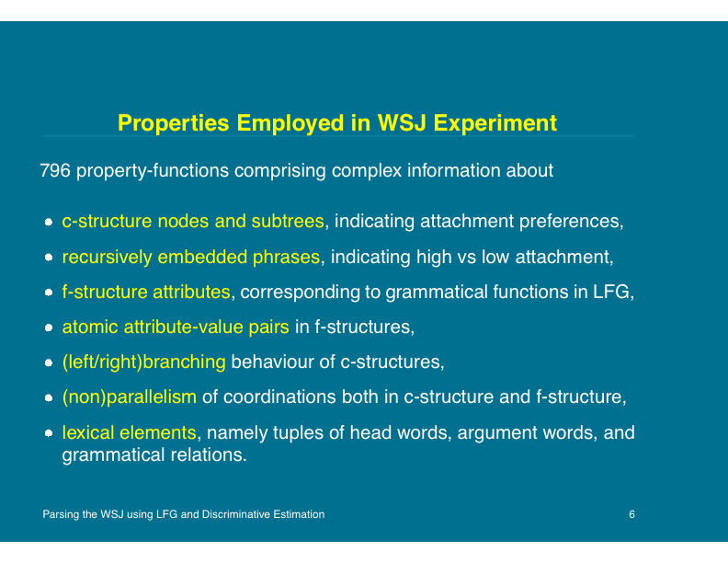

Slide 48
Some properties and weights
0.937481 cs_embedded VPv[pass] 1
-0.126697 cs_embedded VPv[perf] 3
-0.0204844 cs_embedded VPv[perf] 2
-0.0265543 cs_right_branch
-0.986274 cs_conj_nonpar 5
-0.536944 cs_conj_nonpar 4
-0.0561876 cs_conj_nonpar 3
0.373382 cs_label ADVPint
-1.20711 cs_label ADVPvp
-0.57614 cs_label AP[attr]
-0.139274 cs_adjacent_label DATEP PP
-1.25583 cs_adjacent_label MEASUREP PPnp
-0.35766 cs_adjacent_label NPadj PP
-0.00651106 fs_attrs 1 OBL-COMPAR
0.454177 fs_attrs 1 OBL-PART
-0.180969 fs_attrs 1 ADJUNCT
0.285577 fs_attr_val DET-FORM the
0.508962 fs_attr_val DET-FORM this
0.285577 fs_attr_val DET-TYPE def
0.217335 fs_attr_val DET-TYPE demon
0.278342 lex_subcat achieve OBJ,SUBJ,VTYPE SUBJ,OBL-AG,PASSIVE=+
0.00735123 lex_subcat acknowledge COMP-EX,SUBJ,VTYPE

Slide 49
Learning features available in XLE
Based on hard-wired feature templates
  cs_label, cs_adjacent_label, cs_sub_label, cs_sub_rule, cs_num_children, cs_embedded, cs_right_branching, cs_heavy, cs_conj_nonpar
  fs_attrs, fs_attr_val, fs_adj_attrs, fs_auntsubattrs, fs_sub_attr, verb_arg, lex_subcat
Problems:
  A lot of overlap between resulting features.
  A lot of potential features cannot be expressed using these templates.

Slide 50
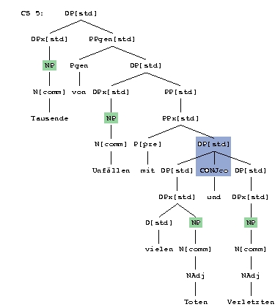
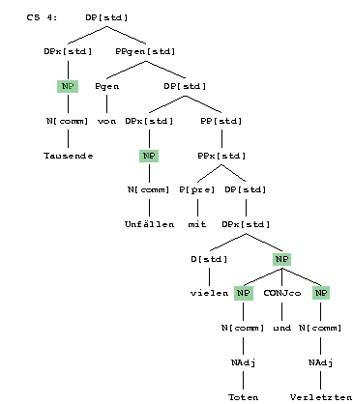
c-structures with different yields for cs_label NP and cs_adj_label DP[std] CONJco
Tausende von Unfällen mit vielen Toten und Verletzten
thousands of accidents with many dead and injured

Slide 51
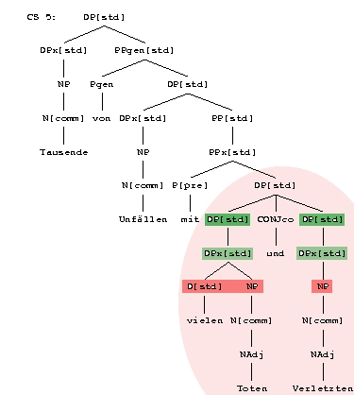
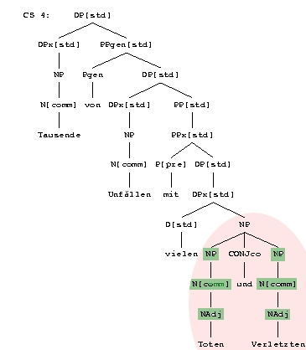
c-structures that have different yields for cs_conj_nonpar 3
Tausende von Unfällen mit vielen Toten und Verletzten
thousands of accidents with many dead and injured

Slide 52
Open issues in stochastic disamb.
What are good learning features?
  Linguistically inspired features seem to do better than linguistically “ignorant” features.
Can we design features that are useful for different grammars and different languages?
  Free-word order languages seem to require other features than more configurational languages.
How do we integrate lexicalized features without running into sparse-data problems?
  Auxiliary distributions acquired on large unannotated corpora

Slide 53
Open issues in stochastic disamb. (cont’d)
How do we reduce redundancy among features?
  Redundancy makes resulting models unnecessarily large.
  Extreme redundancy can interact negatively with feature selection techniques.
How do we avoid overfitting to the training data?
  Impose a frequency cutoff on features
  Feature selection during training

Slide 54
Efficiency of stochastic disamb.
Properties counts
  Associated with Boolean tree of XLE contexts (a1, b2)
  Shared among many parses
Training
  Inside/outside algorithm of PCFG, but applied to Boolean tree, not parse tree
  Fast algorithm for choosing best properties
  Can train on sentences with relatively low-ambiguity
  5 hours to train over WSJ (given file of parses)
Disambiguation
  Viterbi algorithm applied to Boolean tree
  5% of parse time to disambiguate
  30% gain in F-score

Slide 55
Results of stochastic parse ranking
English:
  30+% error reduction
German:
  30% error reduction with XLE features
  50% error reduction with XLE + additional features
Error reduction: percentage of distance between lower bound (random selection) and upper bound (best-possible selection)

Slide 56
Ambiguity and Robustness
Large-scale grammars are massively ambiguous
Grammars parsing real text need to be robust
  "loosening" rules to allow robustness increases ambiguity even more
Need a way to control the ambiguity
  version of Optimality Theory (OT)
  C-structure pruning
  C-/f-structure ranking

