Slide 1
Can they help us understand the human mind?
Neural Network Models of Intelligence

Slide 2
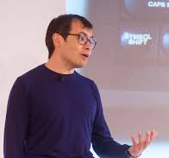
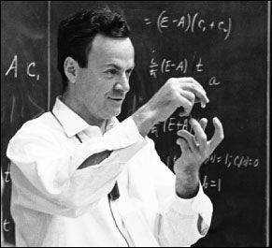
Why try to build a mind?
The ultimate test of understanding something
is being able to recreate it
-- Demis Hassabis
What I cannot build I do not truly understand
-- Richard Feinman

Slide 3
To what purpose?
To build better artificial systems to complement or support human intelligence and enhance products and services
  This is the goal at Google, Amazon, and Facebook and Stanford HAI
To provide new insights into how our own minds work
  This is the goal we focus on in this class
  We will learn about work done for other goals to help us in this effort
  We will also think about the aspects of human cognition these models can help us understand

Slide 4
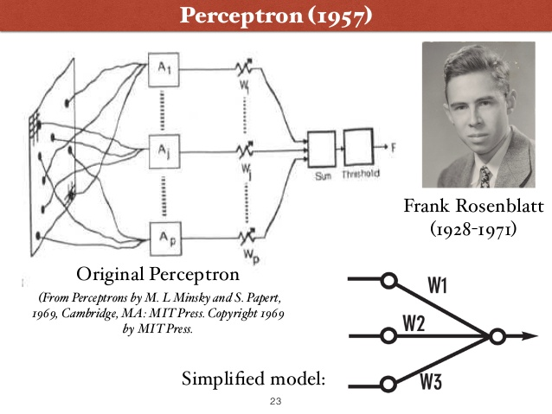
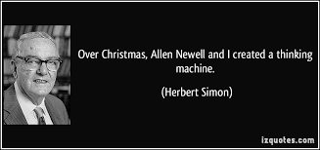
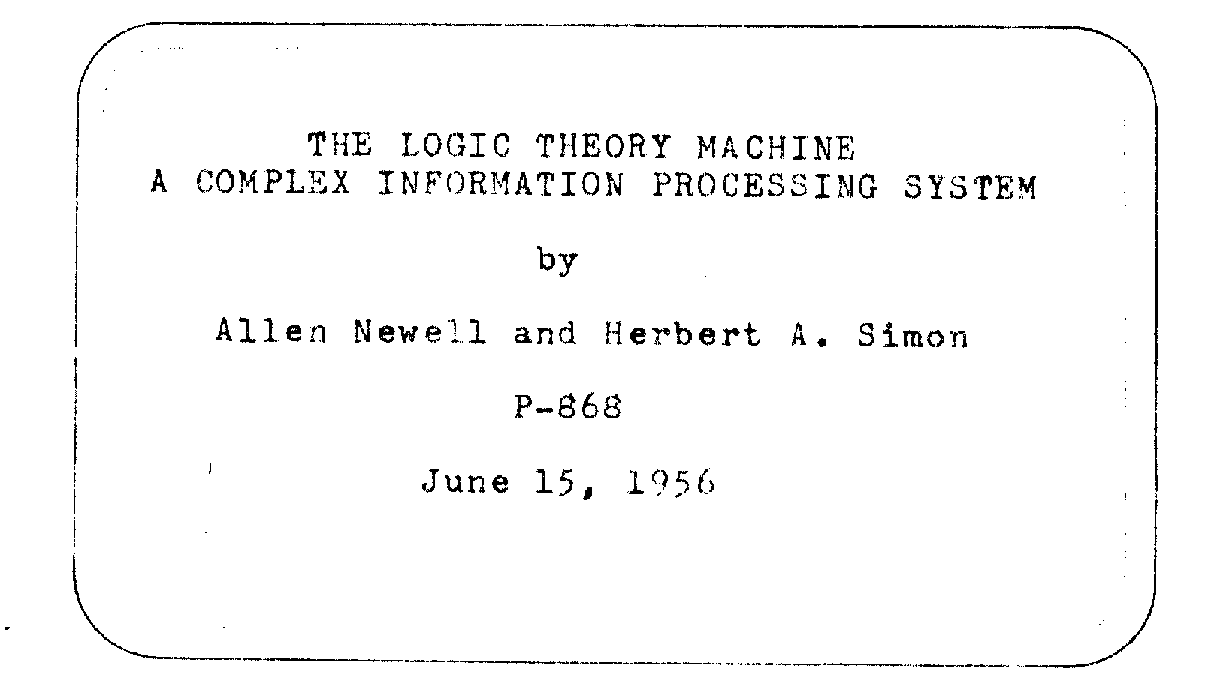
What Kind of an Artificial Mind?
Notes:
The point of this slide is to emphasize that for at least the last 65 years or so, approaches to understanding intelligence have been inspired both by the nature of the human brain and by capabilities of computers -- these tools have inspired contrasting approaches. You can hint that the approaches are beginning to merge, though you may want to save that point to bring up near the end

Slide 5
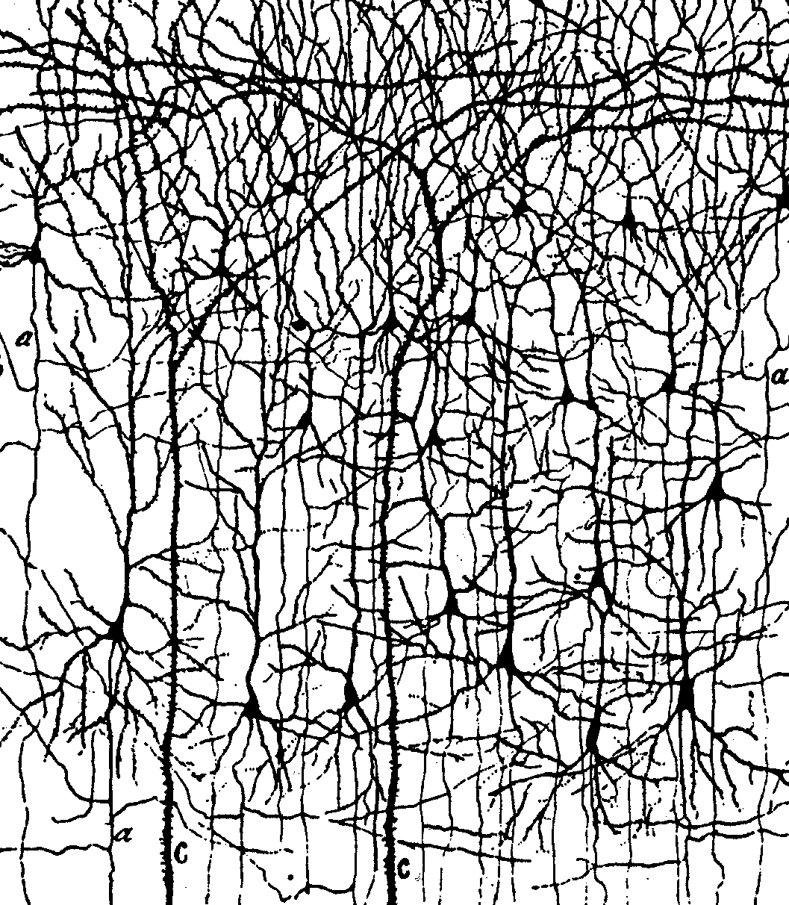
Motivations from the brain
The brain looks like a neural network
Notes:
Slide shows just a tiny subset of the neurons – and fails to show all the synapses onto them

Slide 6
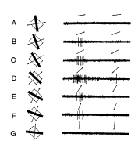
Motivations from the brain
The brain looks like a neural network
Neurons respond to interesting features in the environment in a graded and continuous way

Slide 7
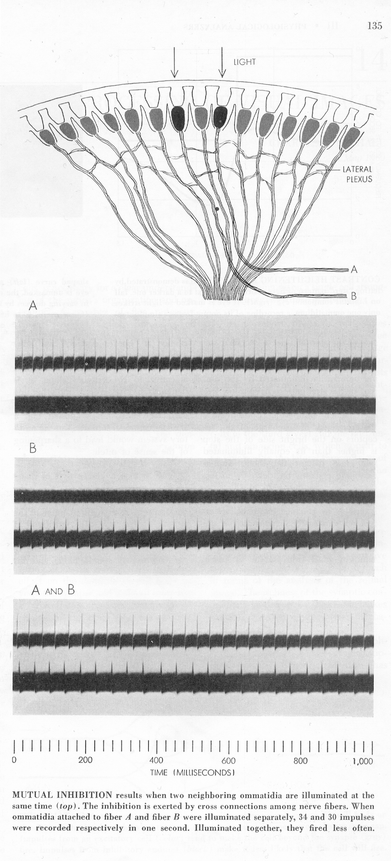
Motivations from the brain
The brain looks like a neural network
Neurons respond to interesting features in the environment in a graded and continuous way
Excitation and inhibition shape neural responses
Notes:
I like this classic figure because you can see the inhibitory connections, in the lateral nexus – Light shined on just one of the ‘omatidea’ results in strong excitation. If you shine a light on both at the same time, neither fires as strongly due to inhibition through the lateral nexus. Grey looks

Slide 8
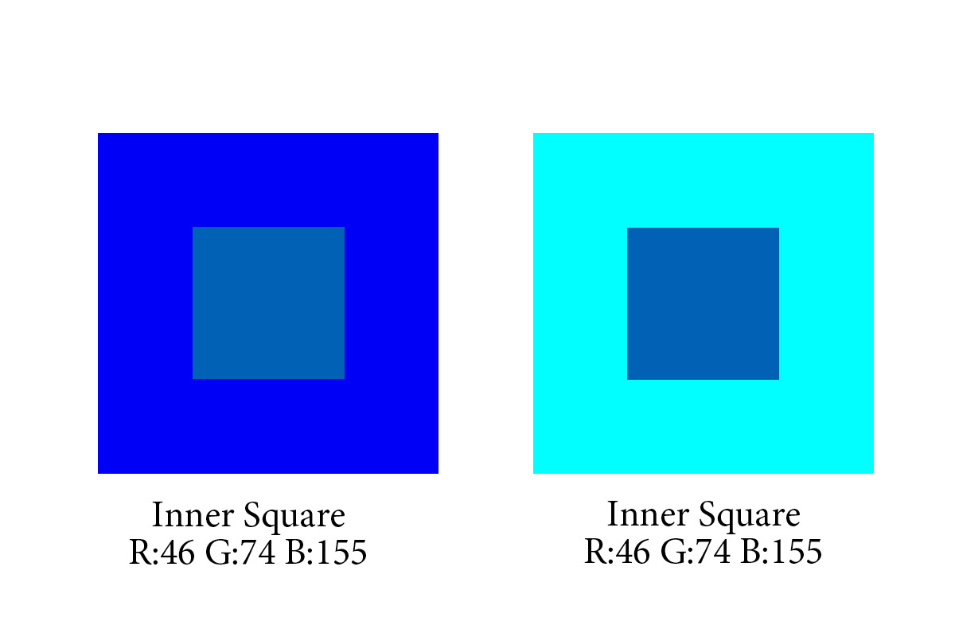
Motivations from the brain
The brain looks like a neural network
Neurons respond to interesting features in the environment in a graded and continuous way
Excitation and inhibition shape neural responses
Such influences can explain contrast effects in human perception
Notes:
I like this classic figure because you can see the inhibitory connections, in the lateral nexus – Light shined on just one of the ‘omatidea’ results in strong excitation. If you shine a light on both at the same time, neither fires as strongly due to inhibition through the lateral nexus. Grey looks

Slide 9
Motivations from the effort to understand human abilities
Contextual effects in perception
Multiple graded constraint satisfaction in many domains
Notes:
All aspects of an input influence how see and interpret all other aspects – note went and event in the sentences

Slide 10
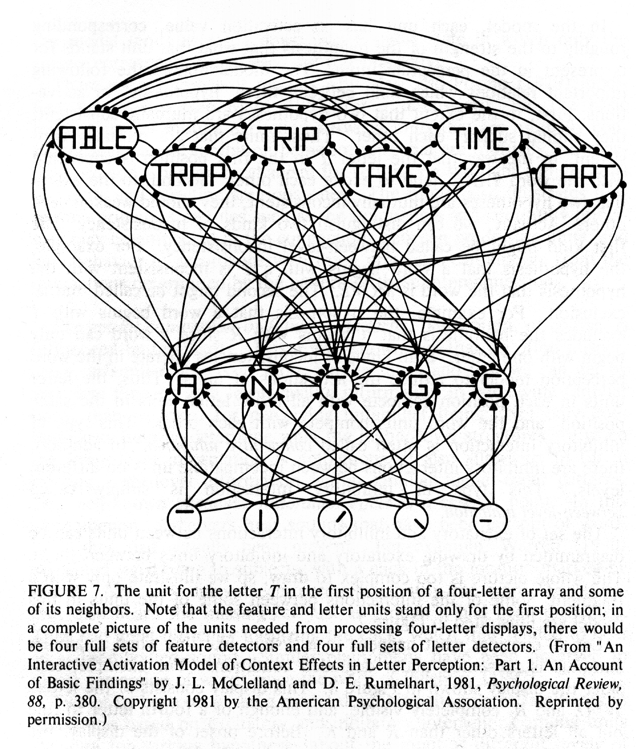
Neural network models as constraint-satisfaction systems
The interactive activation model
  Perception emerges from excitatory and interactions among simple neuron-like processing units.
  Captured context effects in perception that had been observed in human experiments.

Slide 11

Neural network models as constraint-satisfaction systems
The interactive activation model
  Perception emerges from excitatory and interactions among simple neuron-like processing units.
  Captured context effects in perception that had been observed in human experiments.

Slide 12
Neural network models as constraint-satisfaction systems
The interactive activation model
  Perception emerges from excitatory and interactions among simple neuron-like processing units.
  Captured context effects in perception that had been observed in human experiments.
The same principles captured related effects in speech and other domains

Slide 13
Can neural networks help us understand how we learn?
Most of the applications of neural networks apply to things we learn to do
Can these models help us understand the nature and time course of human learning?

Slide 14
The perceptron
Sums weights from active inputs
Sum = W1 +W3
If Sum exceeds Threshold:
output = 1
Else
output = 0
If output = 0 and target = 1
increase W’s from
active inputs
If output = 1 and target = 0
decrease W’s from
active inputs
output:
1
0
Threshold
Sum

Slide 15
Strengths and weaknesses of Perceptrons
Inspired by the brain and statistics
Designed to learn from experience
Used an error-correcting learning rule
Learning was limited to one layer of connections, limiting the functions that could be learned
An explicit teaching signal was required
Units were binary, impeding propagation of learning signals
Initial progress was slow because computers were slow and expensive
Notes:
If you want to you can note that the binary nature of the units was one limitation that had to be overcome before we could figure out now to teach multi-layer neural networks

Slide 16
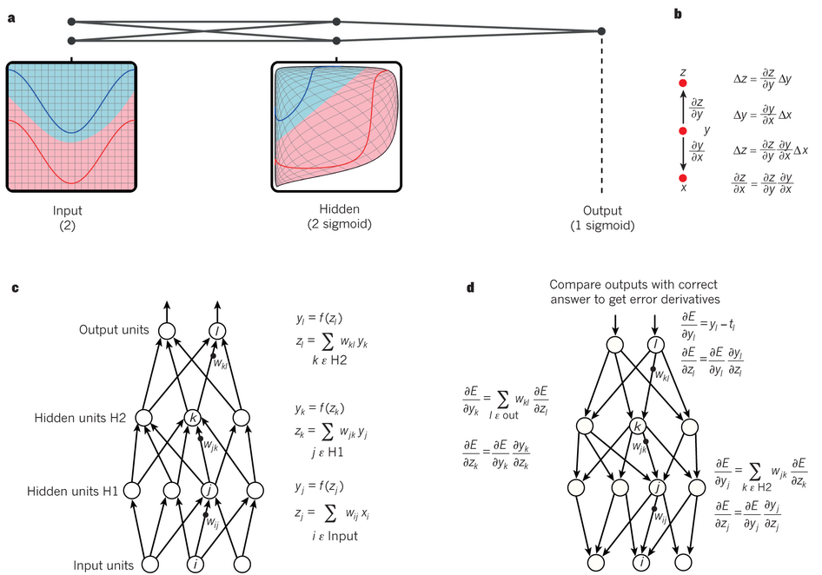

The second wave: Overcoming the limitations of the Perceptron
Continuous but non-linear units
Multiple layers to compute any computable function

Slide 17
The second wave: Overcoming the limitations of the Perceptron
Continuous but non-linear units
Multiple layers to compute any computable function
Continuity allows computing derivatives
Computers are 1,000 times faster and cheaper

Slide 18
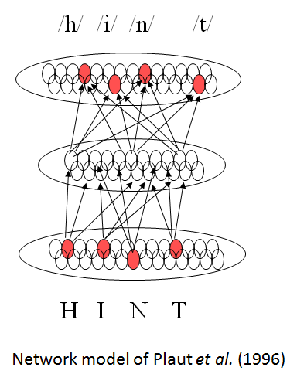
Early models of language and reading
When we learn language or when we learn to read, we gradually acquire implicit encoding and responding abilities that can be described by rules
… guided by an environment that encourages these tendencies
Fairly early models with just one hidden layer were able
to capture many of these characteristics

Slide 19
What aspects of intelligence could a neural network actually capture?
Basic skills such as
  Perception
  Skilled action
  Basic aspects of language
  and reading
  Numerical intuition
But what about
  Comprehension of sentences with complex structure and negation
  Hard games like chess and Go
Or even
  Inferring causality
  Social cognition
  Mathematical and scientific reasoning
  Explanation and justification
  …
Notes:
Point here is most people are ok with the idea that there are basic aspects of cognition that neural networks can help us understand, but we now begin to see more clearly how they may help us with other aspects

Slide 20
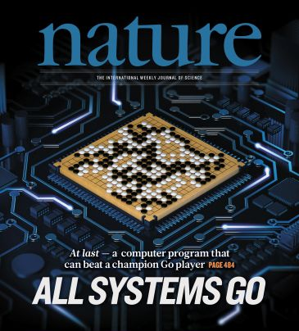
The third wave: The emergence of deep learning
Breakthroughs in machine speech perception and object classification
Exciting new applications in machine translation
Human-level action game performance and world-class performance in Go.

Slide 21
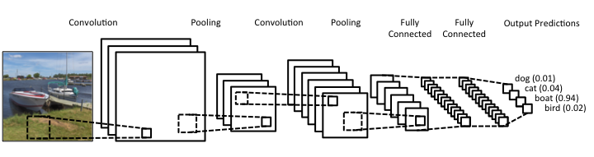
One variety of neural network: CNN
These models are not only effective for machine vision, but as we will see they provide detailed accounts of
the response properties of neurons in the visual cortex

Slide 22
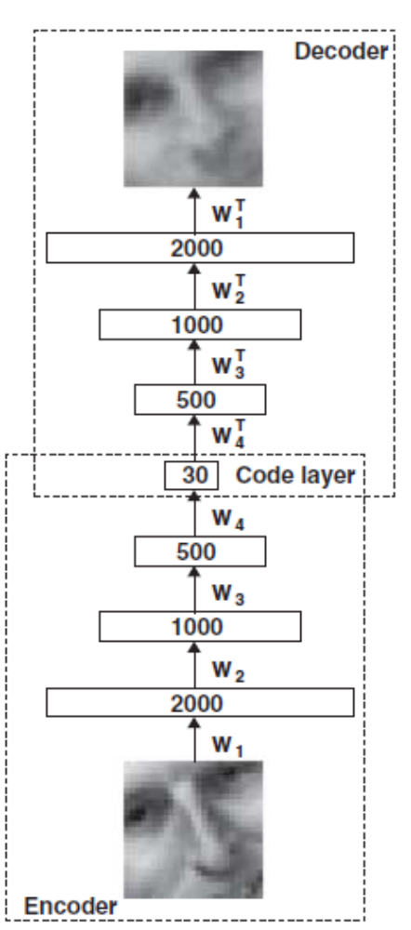
Other varieties of deep neural networks
Aut0-encoder networks
  Support unsupervised learning, providing a good start for supervised learning
Recurrent neural networks
  Allow computations to unfold overtime
Networks trained with reinforcement learning
  Can discover new ways to solve a problem
  Can reward themselves, and so be autonomous learners

Slide 23
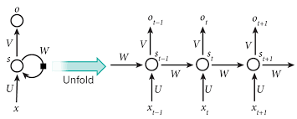
Other varieties of deep neural networks
Aut0-encoder networks
  Support unsupervised learning, providing a good start for supervised learning
Recurrent neural networks
  Allow computations to unfold overtime
Networks trained with reinforcement learning
  Can discover new ways to solve a problem
  Can reward themselves, and so be autonomous learners

Slide 24
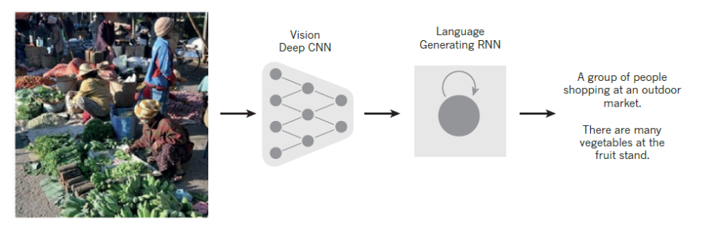
Understanding and producing complex language?
Notes:
As a follow up to the recurrent network slide, this shows how combining FF and recurrent networks can begin to address a complex scene interpretation task
You could also discuss Google Translate if you like

Slide 25
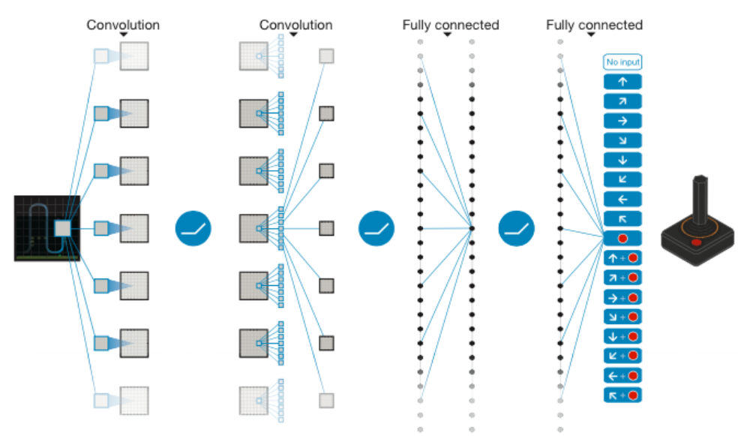
Other varieties of deep neural networks
Aut0-encoder networks
  Support unsupervised learning, providing a good start for supervised learning
Recurrent neural networks
  Allow computations to unfold over time
Networks trained with reinforcement learning
  Can discover new ways to solve a problem
  Rewards can be internal (e.g. novelty, mastery) allowing autonomous learning

Slide 26
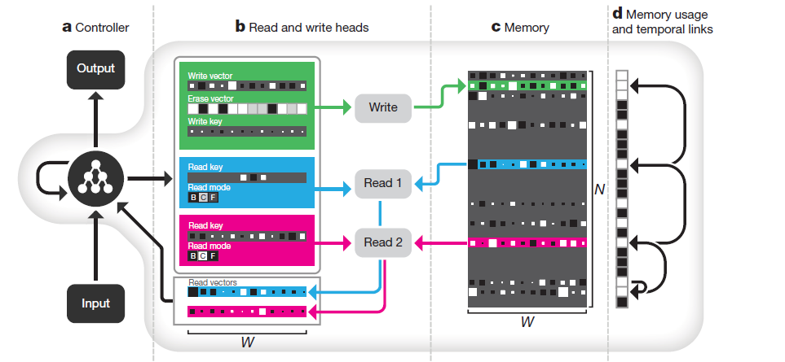
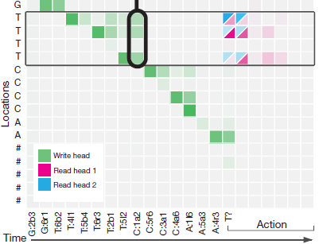
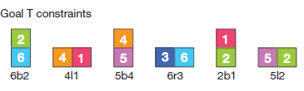
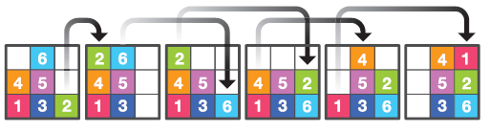
A new departure: The neural ‘Turing Machine’ and the Differentiable Neural Computer (Graves, Wayne et al, 2016)

Slide 27
Your responses to the reading
Emergent vs Explicit representation of structure
Biological vs AI motivations and their implications
Learning and development
Memory and connections
Scalability
Simplicity vs complexity; possibility of analytic understanding
Limits on what we can know about our own cognition

Slide 28
An exciting opportunity
Most of the developments in the third wave of neural network research are not intended as models of human abilities
  It could be argued that in many ways some of them exploit super-human resources, such as more computer power are larger trainings sets than humans have access to
But they provide us with a tremendous opportunity
  New tools that we can use to model human abilities
  New tasks that can finally be tackled using neural network models
These models are also still quite limited in some ways.
As students in this course, you have the opportunity to pioneer the application of these new developments to understanding human intelligence, and even to contribute to overcoming some of these existing models’ limitations

Slide 29
Psychology 209 – Goals and Approach
To familiarize students with:
  the principles that govern learning and processing in neural networks
  the implications and applications of neural networks for human cognition and its neural basis.
Provide students with an entry point for exploring neural network models, including
  software tools and programming practices
  approaches to testing and analyzing deep neural networks for cognitive and neural modeling.

Slide 30
Readings, homeworks, final projects
Up to 20 pages of reading
  Completing the reading before class is expected
  Preparation statements required before class for most sessions
Two main homeworks
  Main homeworks require demonstrating conceptual understanding, learning and manipulation of simulation tools in Python & Torch
  Download and install software by Tues, Jan 14, turn in 1st HW Tues Jan 21
  Second HW due Tues, Feb 4
Project – see course overview for more details
  Proposal due Tues, Feb 11, interim progress report due Tues Feb 25
  Brief presentations during week 10 (March 10 & 12)
  10-page paper due Wed March 18

Slide 31
For Thursday – Katherine to present
Jan 9: Learning in a one-layer network and introduction to distributed representations
Apps: Credit assignment in contingency learning and the Past Tense Model
  Reading: Chapter 4 through Sections 4.1 and 4.2 of the PDP Handbook.
  Optional reading: Seidenberg & Plaut (2014), Past Tense Debate.
Many optional readings provide starting places for projects

