Slide 1
Structure in a Experience and Learning
Psychology 209
Jan 23-28, 2020

Slide 2
Different randomly initialized neural networks trained on the same data tend to exhibit similar behavior. Why?
The structure in the data must be responsible for this outcome
Can we understand the structure in the data?
Can we understand how this structure determines the outcome of learning?
We can, for deep linear networks
While deep linear networks have limitations, understanding their learning dynamics already has some use in explaining many findings and might contribute to understanding the dynamics of learning and what is learned in non-linear networks.

Slide 3
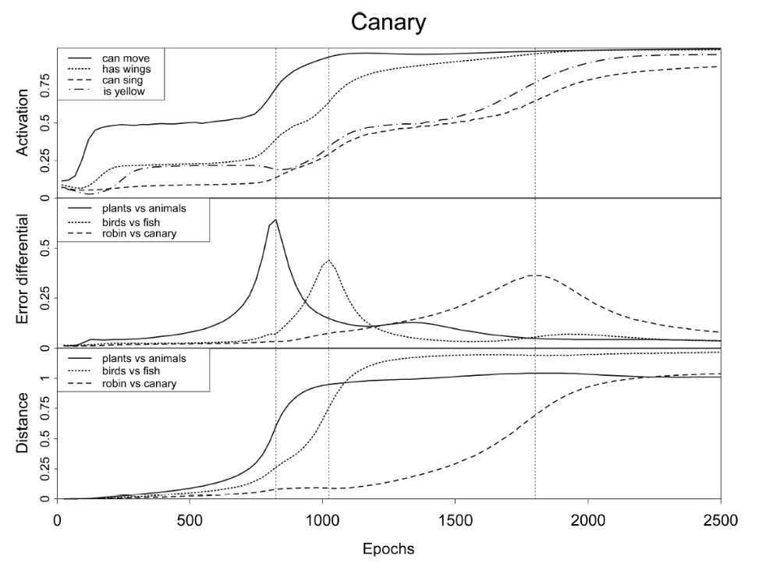
Dynamics of Learning in the Rumelhart Network

Slide 4
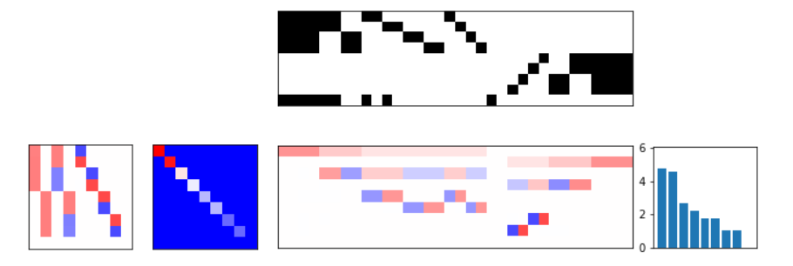
Hierarchical structure in a synthetic data set
Sparrow
Hawk
Salmon
Sunfish
Oak
Maple
Rose
Daisy
SparrowHawk
Feature class:
Examples
Animal | Bird | Fish | spw | hwk | sal | sunf | u | u | u | u | u |  | u | u | u | u | Tree | Flwr | Plant
Can Move | fly | swim | small | fierce | pink | yellow |  |  |  |  |  |  |  |  |  |  | trunk | petels | roots
Has Skin | fthrs | gills | meek | large | river | sea |  |  |  |  |  |  |  |  |  |  | bark | pretty | leaves
… |  |  |  |  |  |  |  |  |  |  |  |  |  |  |  |  |  |  | …
Note: I have swapped the orientation of this array relative to the orientation used in the Saxe et al paper and HW2.

Slide 5
Some definitional issues and questions
Outer product vs. correlation
‘Variance’ = centered vs. uncentered
Prototypes and projections onto modes

Slide 6
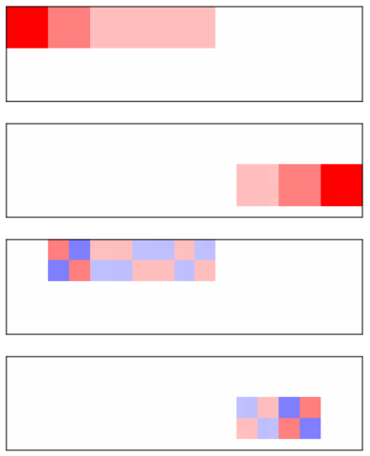
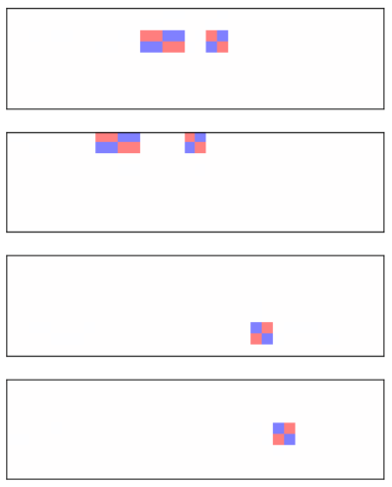

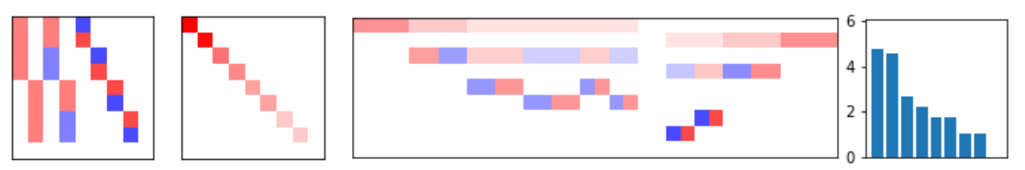
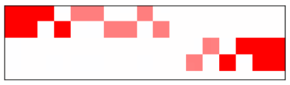
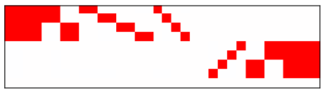










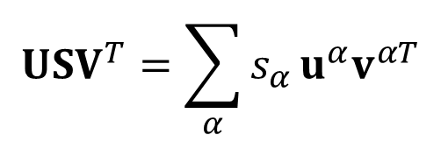
Singular Value Decomposition of the Item-Property Covariance Matrix
=
$$s_{1}u^{1}v^{1T}$$
$$s_{5}u^{5}v^{5T}$$
Feature synthesizing vectors
$$s_{2}u^{2}v^{2T}$$
$$s_{6}u^{ 6}v^{6T}$$
$$s_{3}u^{3}v^{3T}$$
$$s_{7}u^{ 7}v^{7T}$$
Item analyzing vectors
$$s_{4}u^{4}v^{2T}$$
$$s_{8}u^{ 8}v^{8T}$$
Item-property matrix =
$$USV^{T}=\sum_{α}{s_{α}}u^{α}v^{αT}$$
$${Σ_{1}^{4}s}_{α}u^{α}v^{αT}$$
$${Σ_{1}^{8}s}_{α}u^{α}v^{αT}$$

Slide 7
Sparrowhawk: what dimensions does it project onto?
Sparrow
Hawk
Salmon
Sunfish
Oak
Maple
Rose
Daisy
SparrowHawk
Feature types:
Animal | Bird | Fish | spw | hwk | sal | sunf | u | u | u | u | u |  | u | u | u | u | Tree | Flwr | Plant
Can Move | fly |  | small | fierce |  |  |  |  |  |  | x |  |  |  |  |  | trunk | petels | roots
Has Skin | fthrs |  |  |  |  |  |  |  |  |  |  |  |  |  |  |  | bark | pretty | leaves
… |  |  |  |  |  |  |  |  |  |  |  |  |  |  |  |  |  |  | …

Slide 8
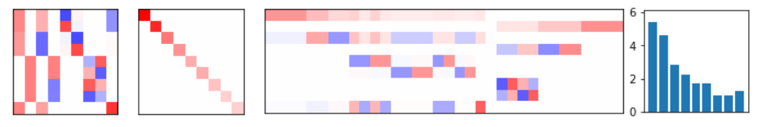
SVD of New Complete Dataset

Slide 9
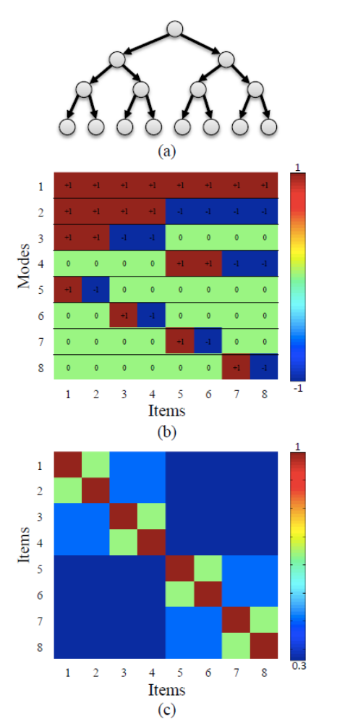
Hierarchy, Modes, and Item Similarities
For each of N = 100 features, start with +! at top.
When traversing an arrow, flip with probability .1 to -1.
At each branch point, we will create two patterns of 100
That we expect will agree in 81 + 1 values and disagree in
2*9 = 18 of their values. At the bottom, we will have 4 pairs
of patterns that have this property. Because of differences
introduced higher up, items separted higher in the tree will be
more different. This structure produces an SVD like that shown
On the next figure that has its strongest dimension corresponding
To the base rates of the features, and lower then each successive
Dimension will correspond to a specific branch point.
Item similarity matrix
Input analyzing modes

Slide 10
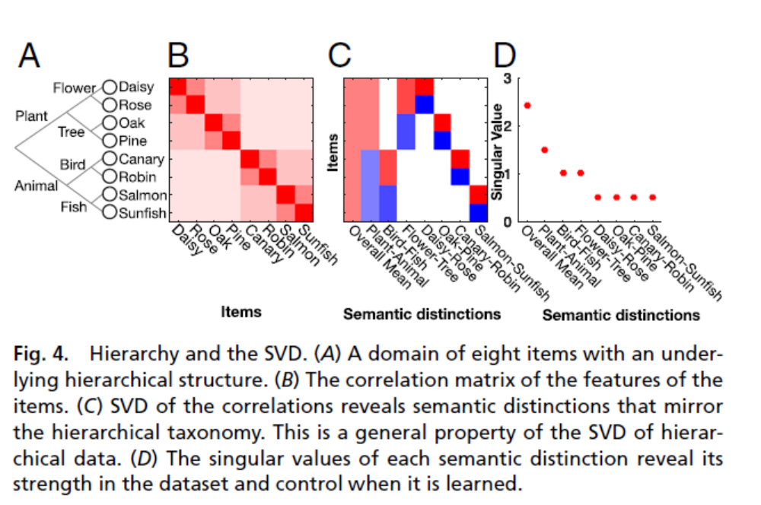
Hierarchy and SVD

Slide 11
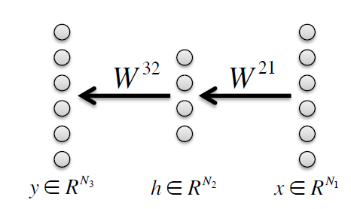
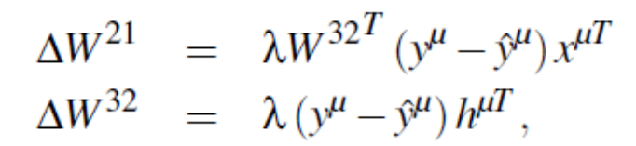
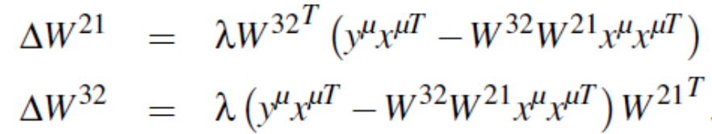
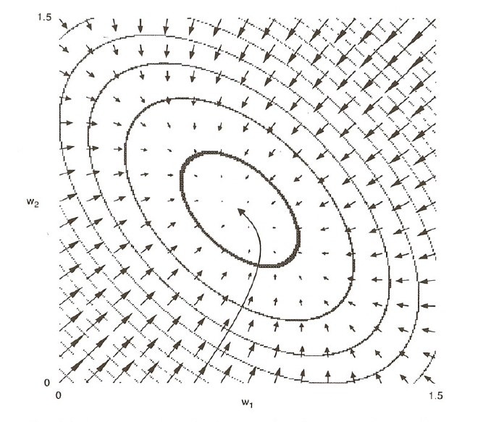
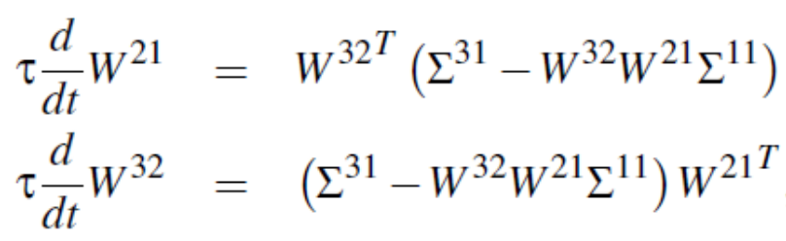

Network and learning dynamics
$$h^{μ}=W^{21}x^{μ}$$
$$Summing over all P patterns, and letting τ=P/λ$$
Note:
Not the error surface
of this network!

Slide 12
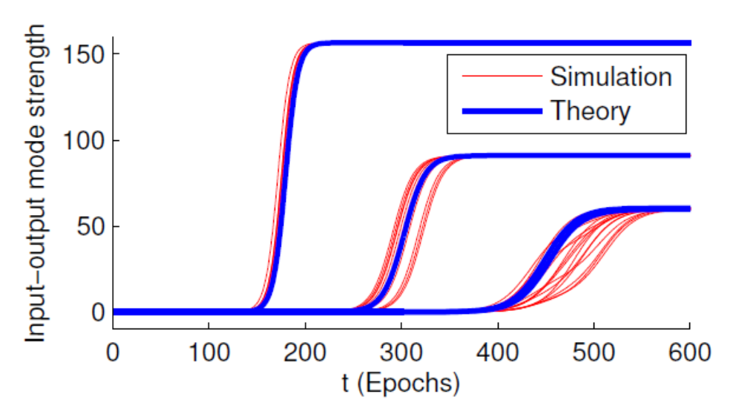
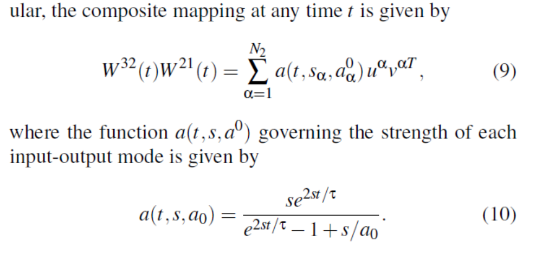
SDV analysis of learning dynamics

Slide 13
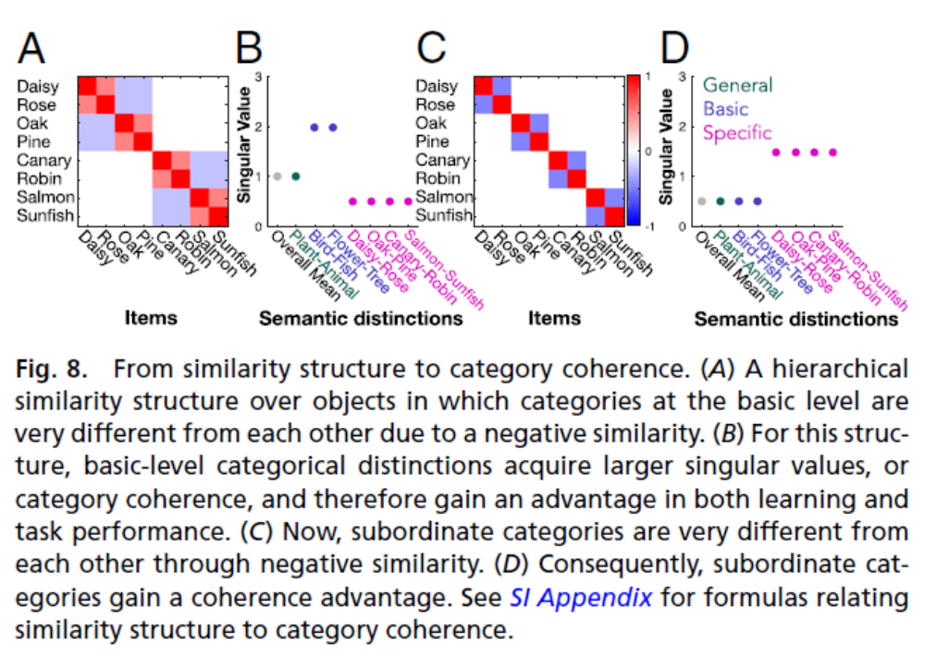
Variations on hierarchical structure

Slide 14
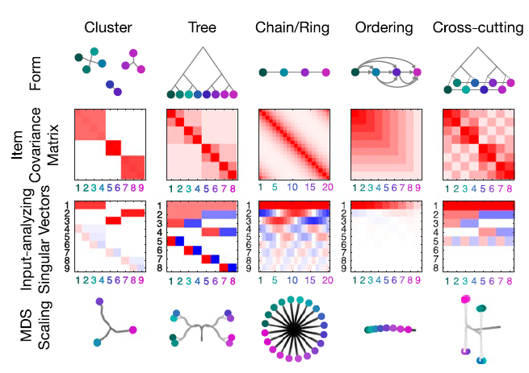
Many different types of structure
What is natural structure like?

Slide 15
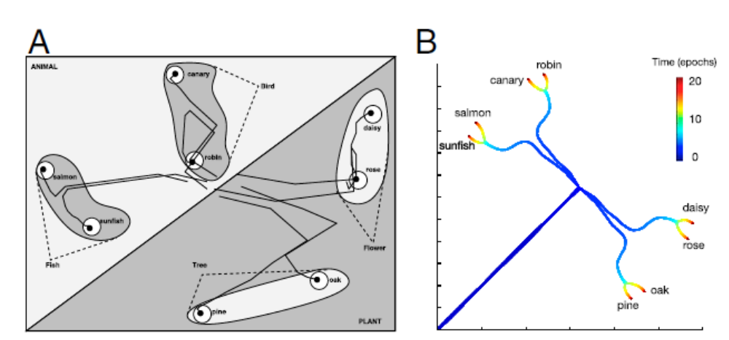
MDS projection onto 2 D = visualization that preserves distances as well as possible

Slide 16
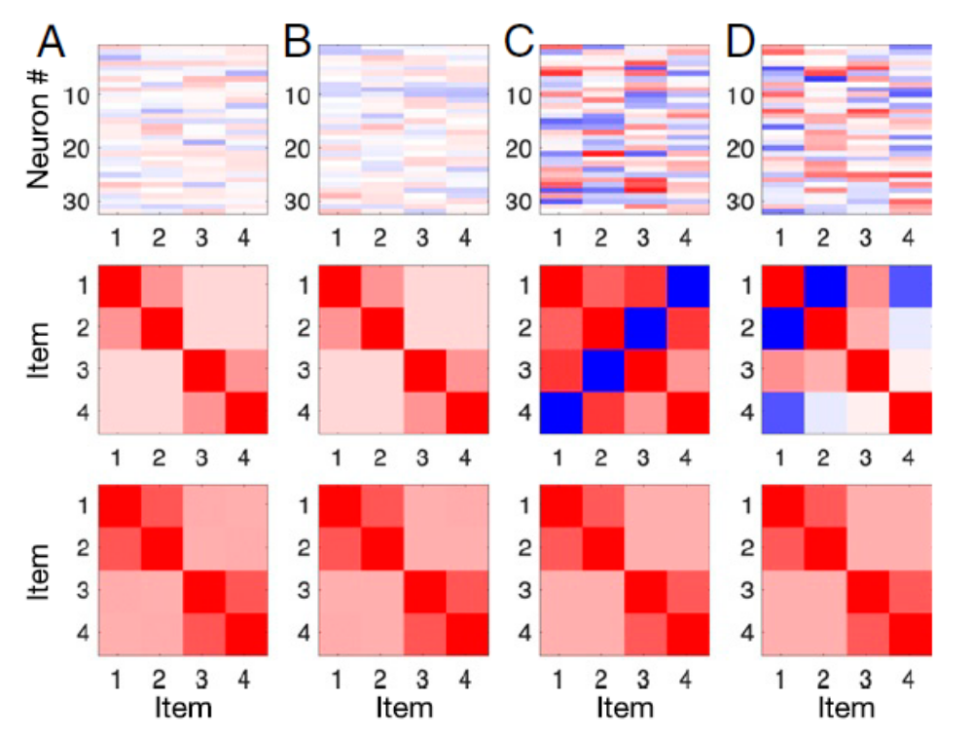
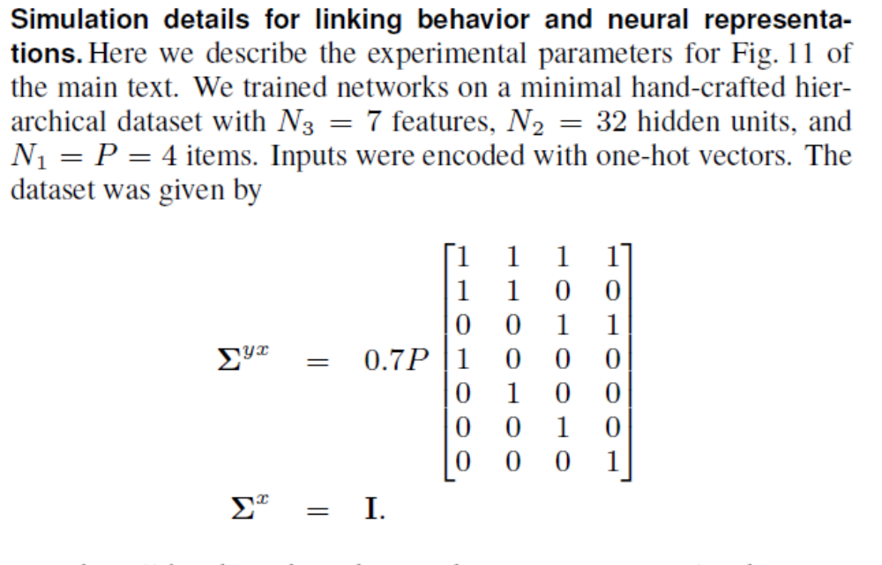
Neural Tuning vs. Representational Similarity

Slide 17
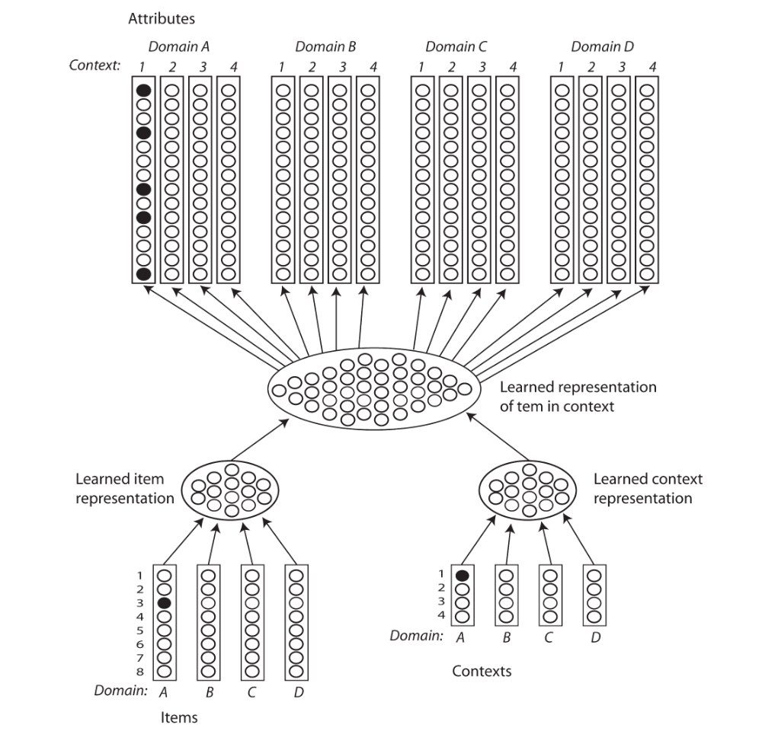
Four identical but non-overlapping domains

Slide 18
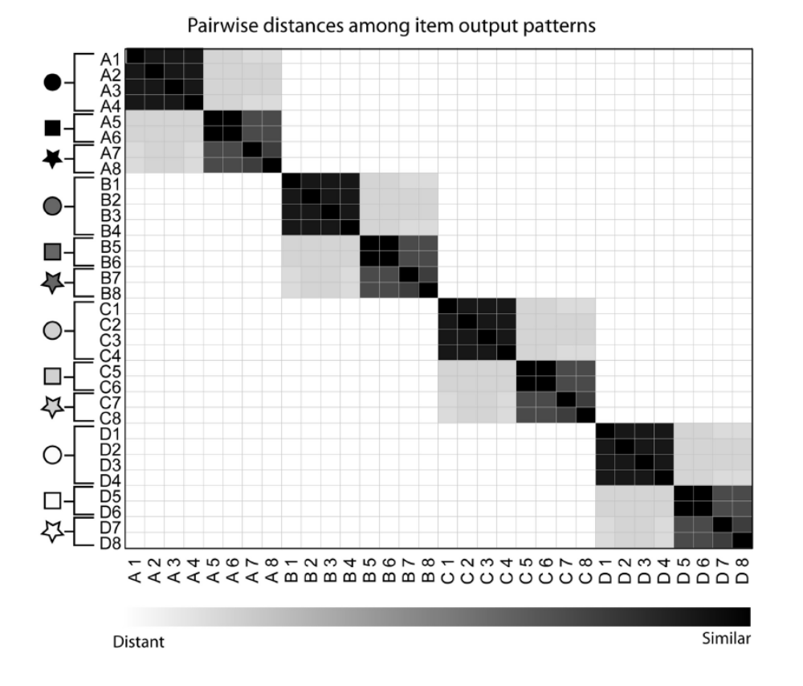
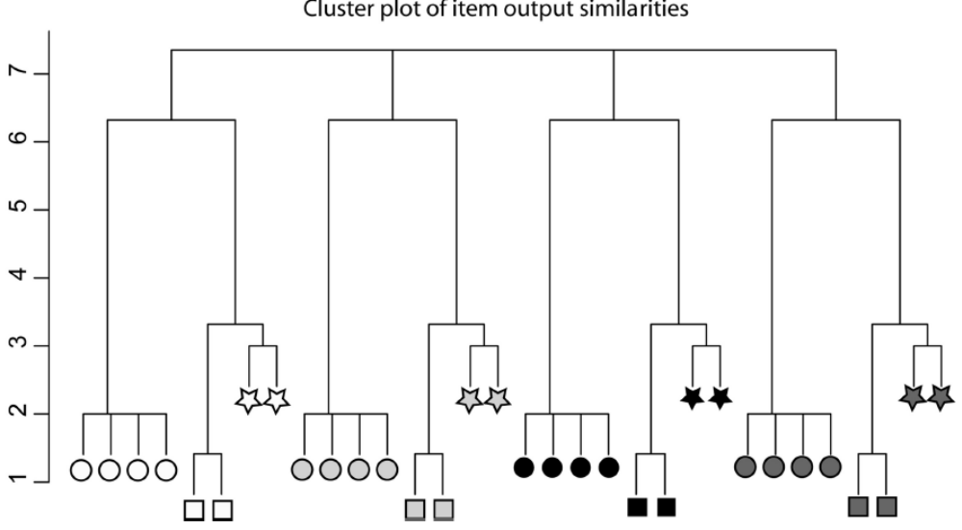
Hierarchical clustering analysis and covariance matrix using raw output patterns
(collapsing over contexts)

Slide 19
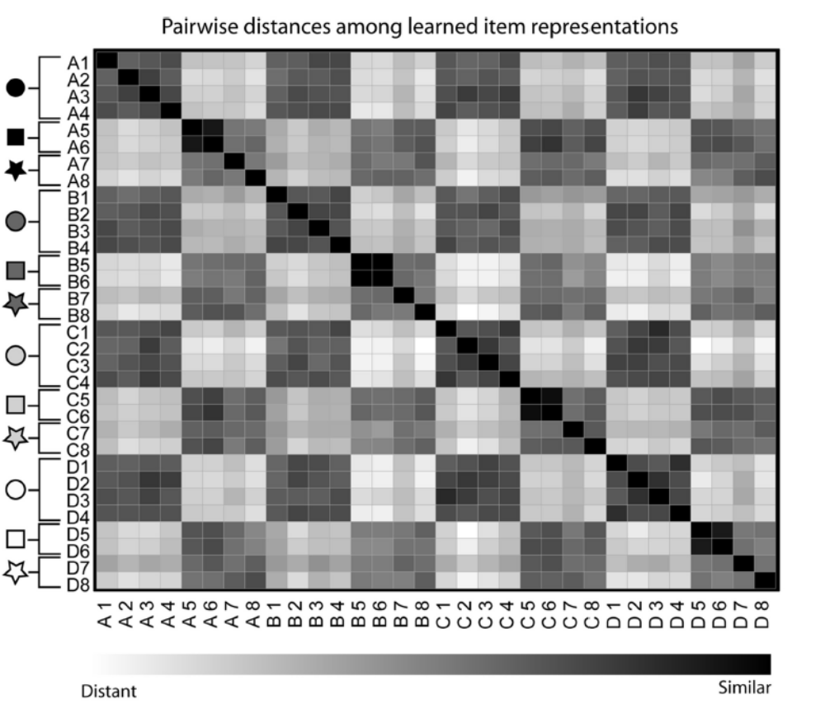
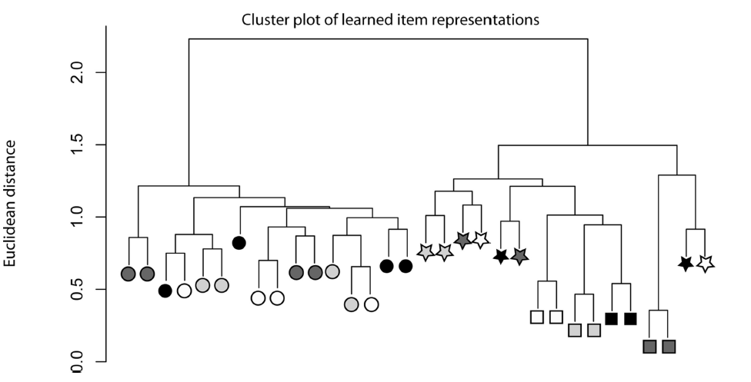
Hierarchical clustering analysis and covariance matrix at item representation layer

