Slide 1
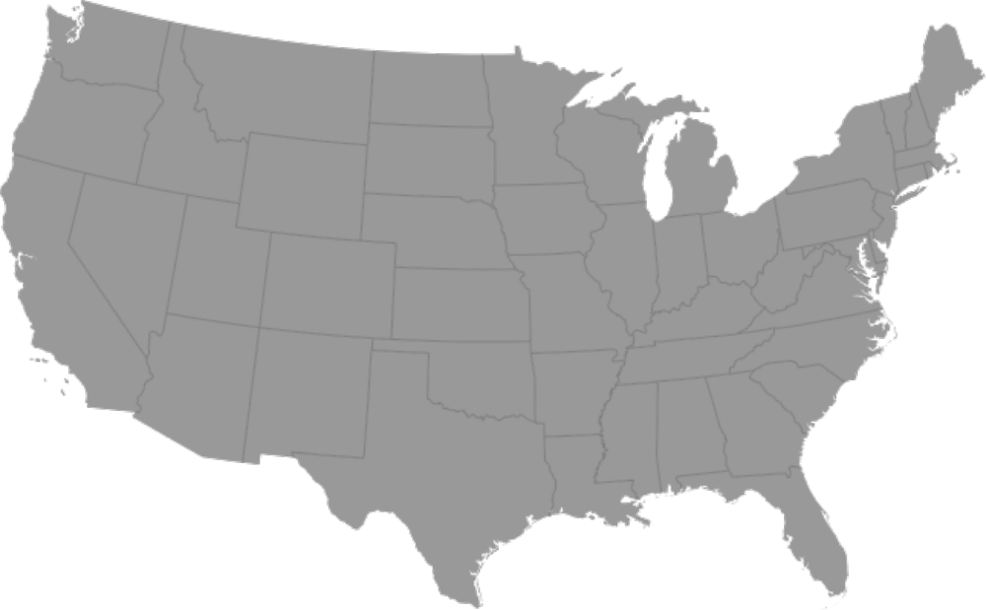
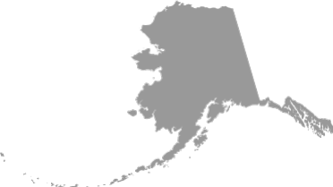

Hydroelectric (3.01%)
0.020% of U.S.
Onshore wind (30.9%)
Footprint 4.3 km²
Spacing 1.6% of US
Offshore wind (19.1%)
Footprint 2.0 km²
Spacing 0.76% of U.S.
Roof PV (7.2%)
0.052% of U.S.
Geothermal (1.25%)
0.001% of U.S.
PV+CSP plants (38.0%)
0.31% of U.S
Tidal+wave (0.51%)
Spacing 0.01% of U.S.

