Slide 1
Presentation Slides for
Air Pollution and Global Warming:
History, Science, and Solutions
Chapter 13: Energy Solutions to Air Pollution and Global Warming
By Mark Z. Jacobson
Cambridge University Press (2012)
Last update: March 8, 2012
The photographs shown here either appear in the textbook or were obtained from the internet and are provided to facilitate their display during course instruction. Permissions for publication of photographs must be requested from individual copyright holders. The source of each photograph is given below the figure and/or in the back of the textbook.

Slide 2
Electricity/Vehicle Options Compared
Electricity options compared
Wind turbines
Solar photovoltaics (PV)
Geothermal power plants
Tidal turbines
Wave devices
Concentrated solar power (CSP)
Hydroelectric power plants
Nuclear power plants
Coal with carbon capture and sequestration (CCS)
Vehicle options compared
Battery-electric vehicles (BEVs)
Hydrogen fuel cell vehicles (HFCVs)
Corn ethanol (E85)
Cellulosic ethanol (E85)

Slide 3
Effects to Consider When Comparing Energy Options
Carbon-dioxide equivalent emissions
Air pollution mortality
Water consumption
Footprint on the ground
Spacing required
Resource abundance
Normal operating reliability
Energy supply disruption / catastrophic risk
Thermal/water chemical pollution /radioactive waste
Effects on wildlife

Slide 4
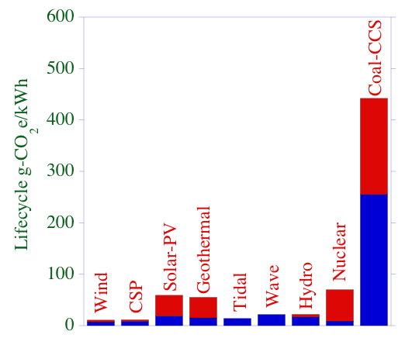
Lifecycle CO₂e of Electricity Sources

Slide 5
Time Between Planning & Operation
Nuclear: 10-19 y (lifetime 40 y before refurbishing)
Site permit (NRC): 3.5 y minimum with new regs. – 6 y
Construction permit approval and issue 2.5-4 y
Construction time 4-9 years (Low value Europe/Japan)
Hydroelectric: 8-16 y (80 y)
Coal-CCS: 6-11 y (35 y)
Geothermal: 3-6 y (35 y)
Ethanol: 2-5 y (40 y)
Wind: 2-5 y (30 y)
CSP: 2-5 y (30 y)
Solar-PV: 2-5 y (30 y)
Wave: 2-5 y (15 y)
Tidal: 2-5 y (15 y)

Slide 6
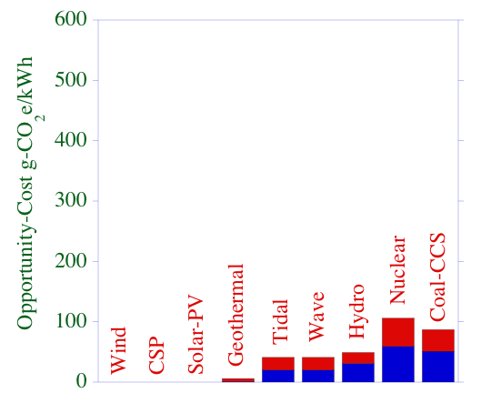
Opportunity-Cost CO₂e
Emissions from current electricity mix due to time between planning & operation of power source minus that from least-emitting power source

Slide 7
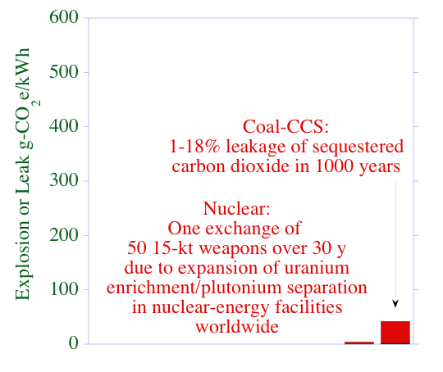
War/Leakage CO₂e of Nuclear, Coal

Slide 8
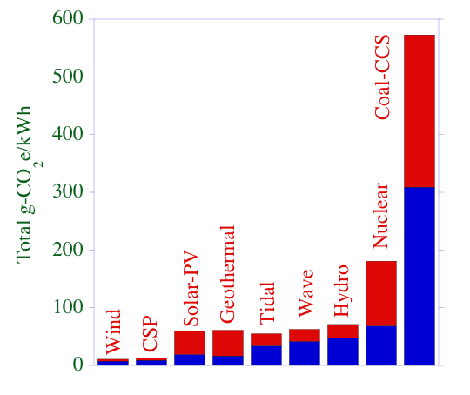
Total CO₂e of Electricity Sources
Nuclear:wind = 9-25:1
Coal-CCS:wind=41-53:1

Slide 9
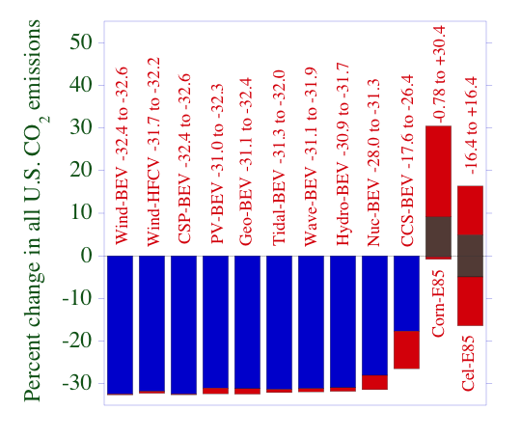
Change in U.S. CO₂(%) From Converting to BEVs, HFCVs, or E85
Fig. 13.1
Maximum possible reduction is 33%

Slide 10
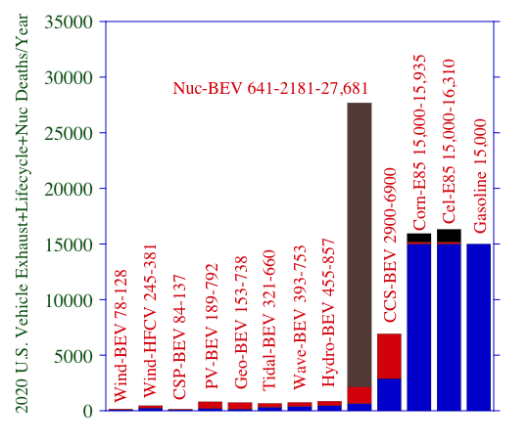
Number of Deaths in 2020 Due to Vehicle Exhaust+Lifecycle Emissions
Fig. 13.1
For nuclear, the brown is the deaths from nuclear weapons in one attack in one megacity over 30 y due to weapons production facilitated by nuclear energy facilities

Slide 11
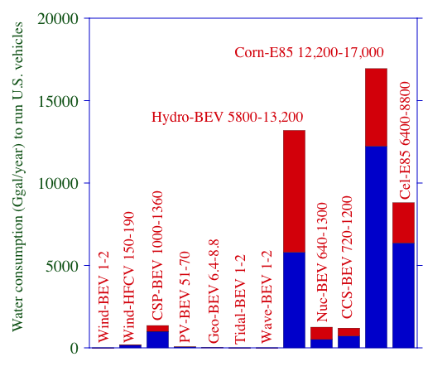
Water Required to Power 100% of U.S. Vehicles With Different Options
Fig. 13.1
U.S. Water Consumption in 2000 was 149,000 Ggal/year

Slide 12
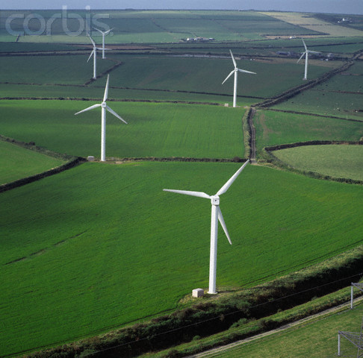
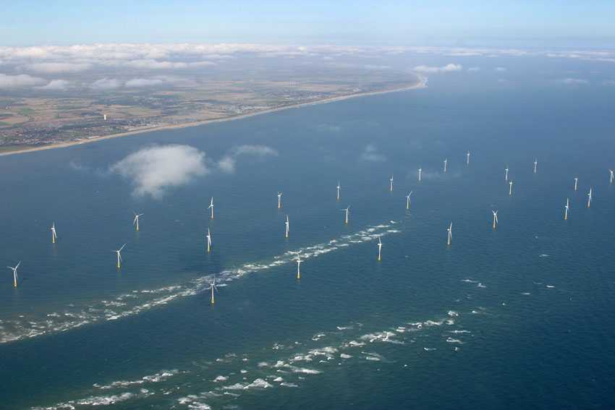
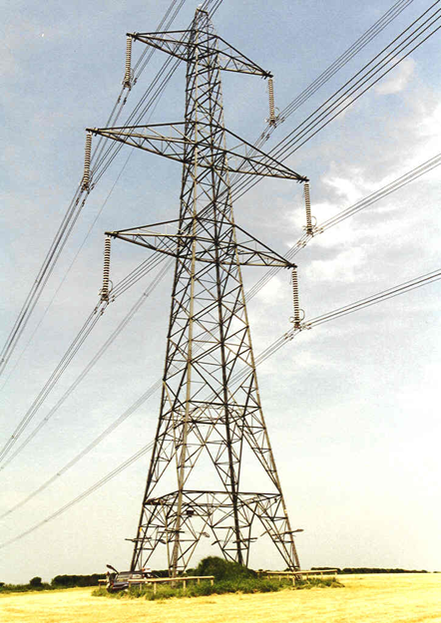

Wind Footprints
www.offshore-power.net
Pro.corbins.com
www.eng.uoo.ca
Pro.corbins.com

Slide 13
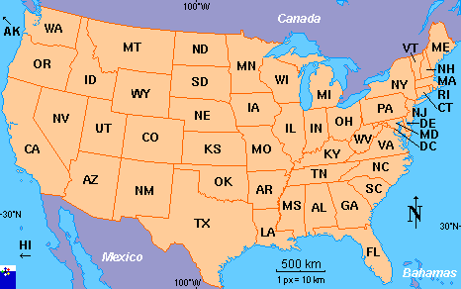
Area to Power 100% of U.S. Onroad Vehicles
Solar PV-BEV
0.077-0.18%
Wind-BEV
Footprint
1-2.8 km²
Cellulosic E85
4.7-35.4%
(low-industry est.
high-data)
Wind-BEV
turbine spacing
0.35-0.7%
Corn E85
9.8-17.6%
Map: www.fotw.net

Slide 14
Land Area For 50% of US Energy From Wind
Turbine
area
touching
ground
Spacing
between
turbines
Map: www.fotw.net

Slide 15
Alternatively, Water Area For 50% of US Energy From Wind
Spacing
between
turbines
Map: www.fotw.net

Slide 16
Cleanest Solutions to Global Warming, Air Pollution, Energy Security
Electric Power Vehicles
Recommended – Wind, Water, Sun (WWS)
1. Wind 2. CSP WWS-Battery-Electric
3. Geothermal 4. Tidal WWS-Hydrogen Fuel Cell
5. PV 6. Wave
7. Hydroelectricity
Not Recommended
Nuclear Corn, cellulosic, sugarcane ethanol
Coal-CCS Soy, algae biodiesel
Natural gas, biomass Compressed natural gas

Slide 17
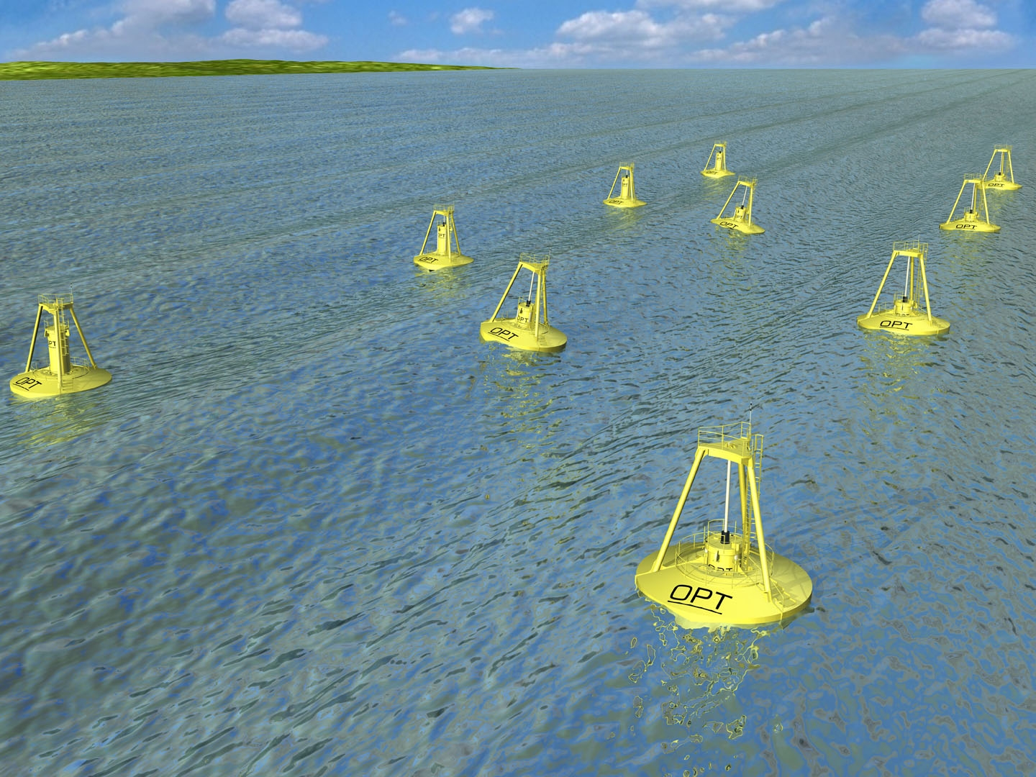
Tidal Turbines
Ocean Power Technologies.

Slide 18

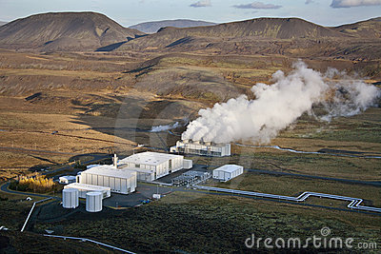
Geothermal Power Plants
Svobodapavel/Dreamstime.com.
Steve Allen/Dreamstime.com.

Slide 19
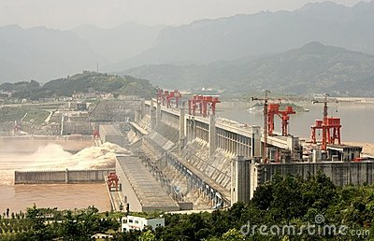
Large-Scale Hydroelectric Power
JJspring/Dreamstime.com.

Slide 20

Run-of-the-River Hydroelectric
Paura/Dreamstime.com.

Slide 21
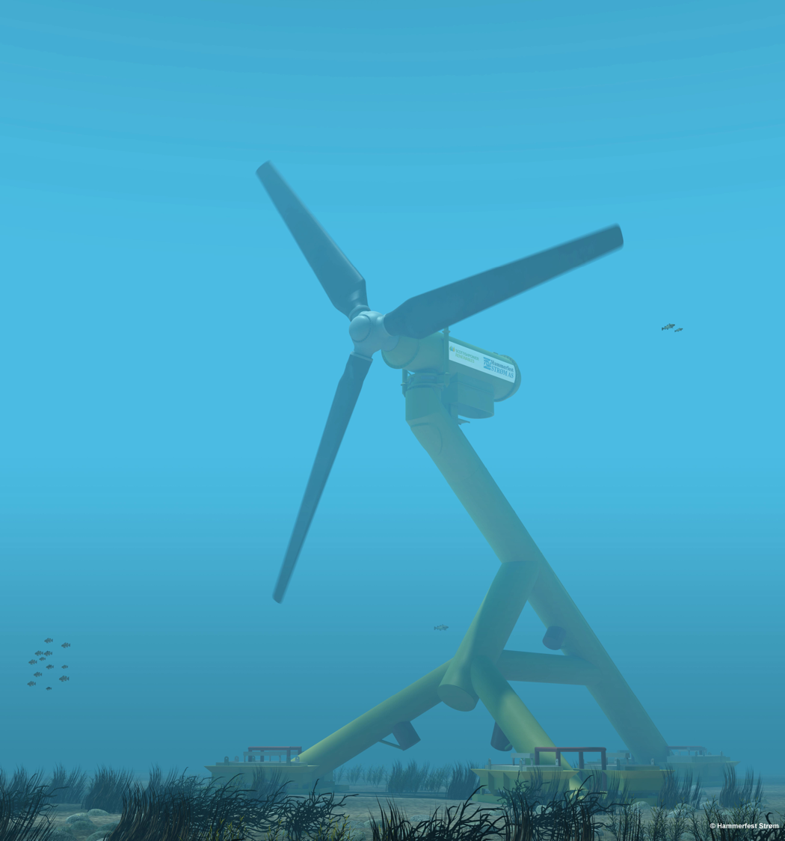
Tidal Power
Hammerfest-Strom

Slide 22
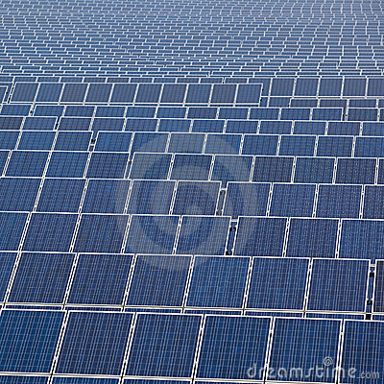
Solar Photovoltaics
View7/Dreamstime.com.

Slide 23
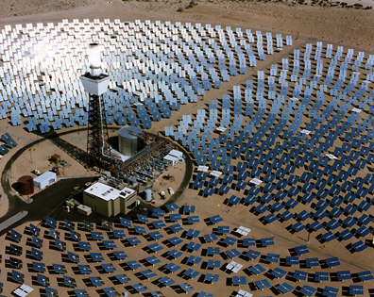
Concentrated Solar Power
Sandia National Lab Staff.

Slide 24
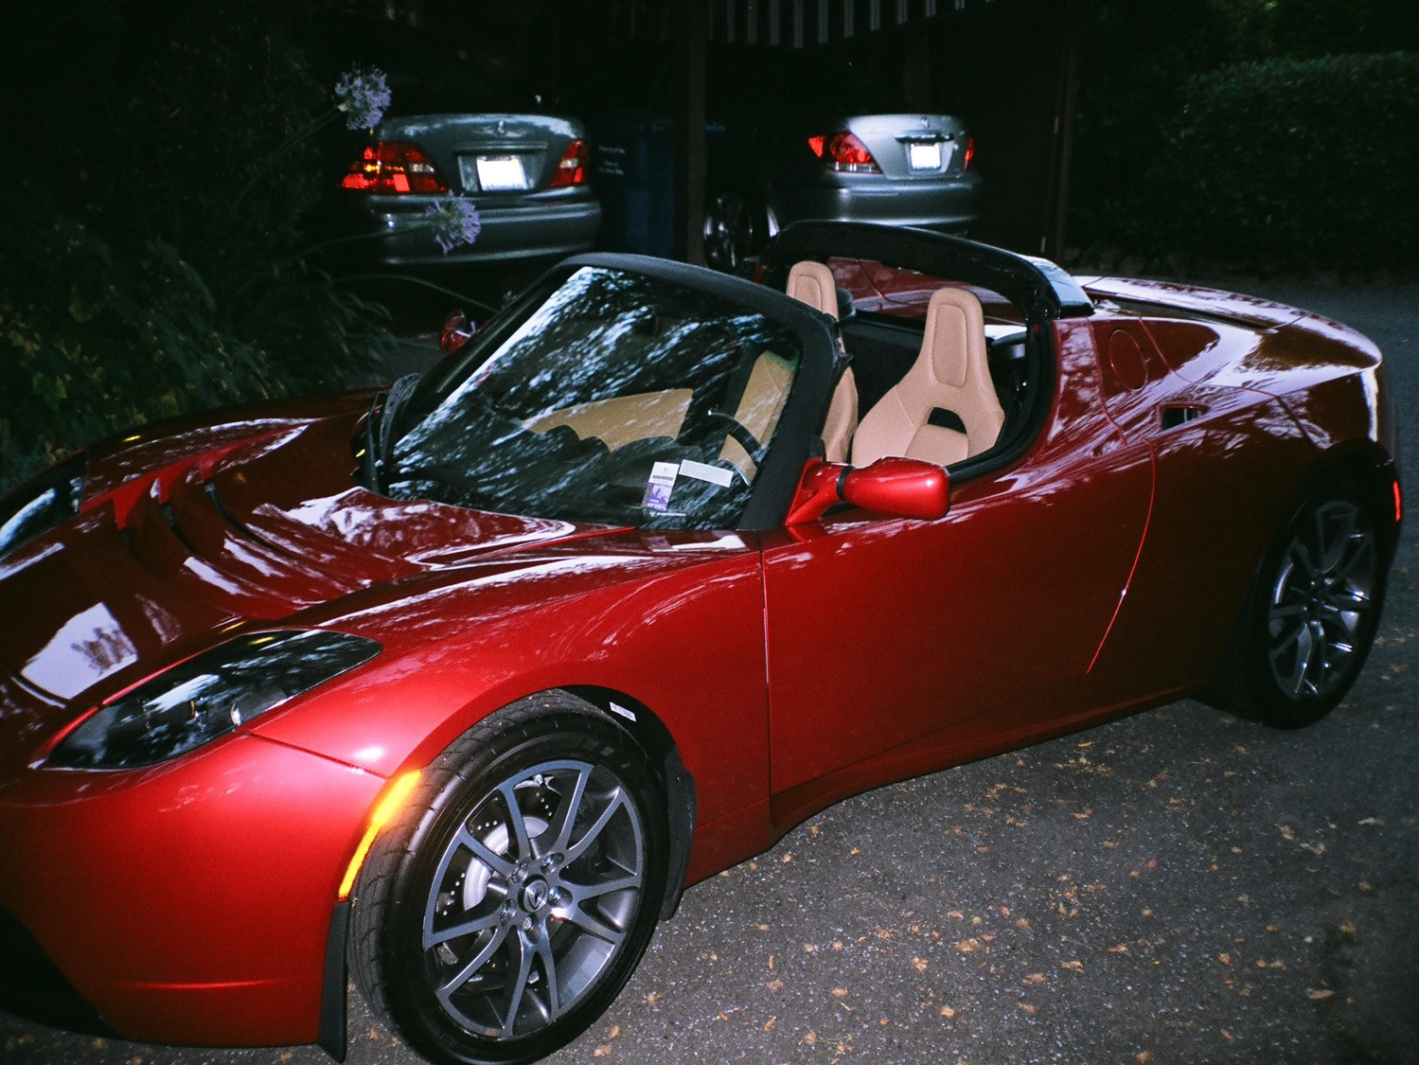
Battery-Electric Vehicles
M.Z. Jacobson

Slide 25



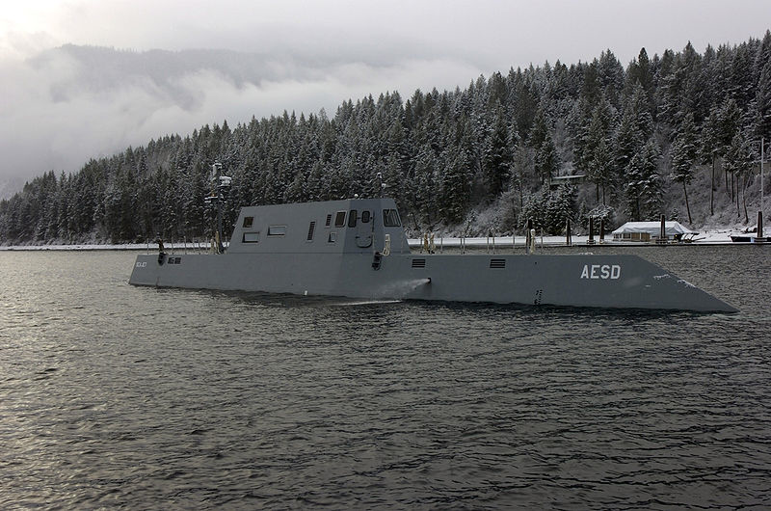
Ecofriend.org
Zmships.eu
Electric ship
upload.wikimedia.org
Ec.europa.eu

Slide 26
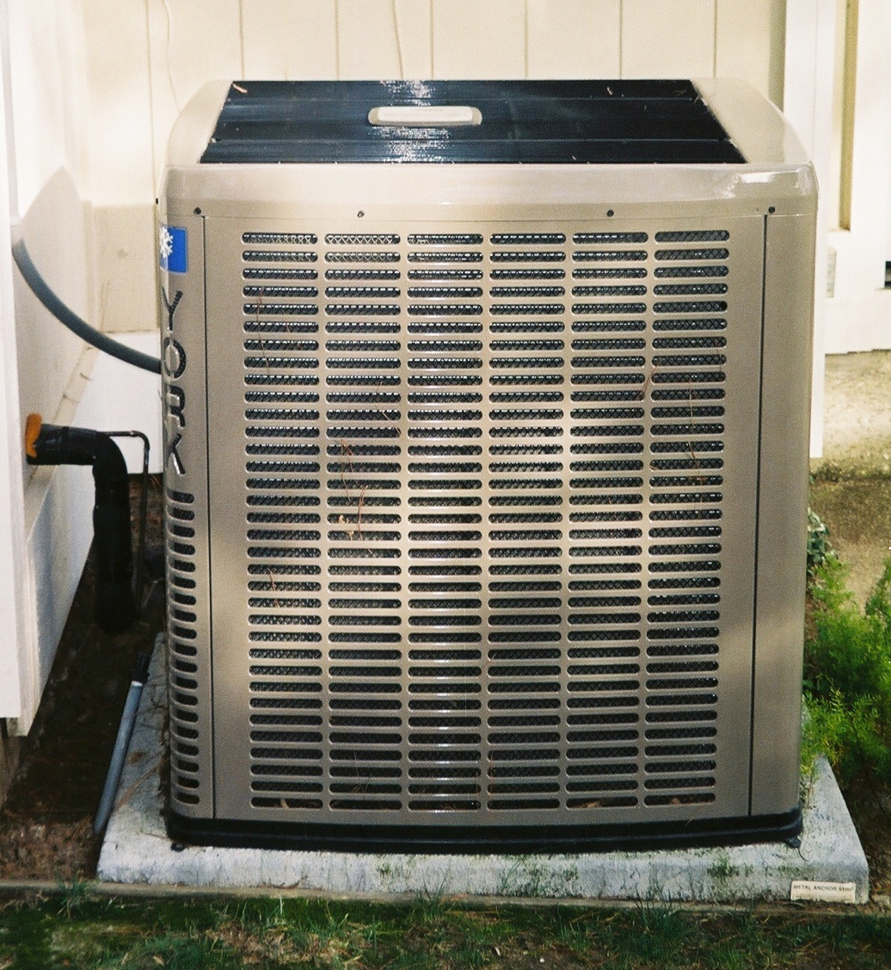
Air-Source Heat Pump

Slide 27
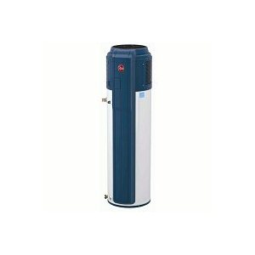
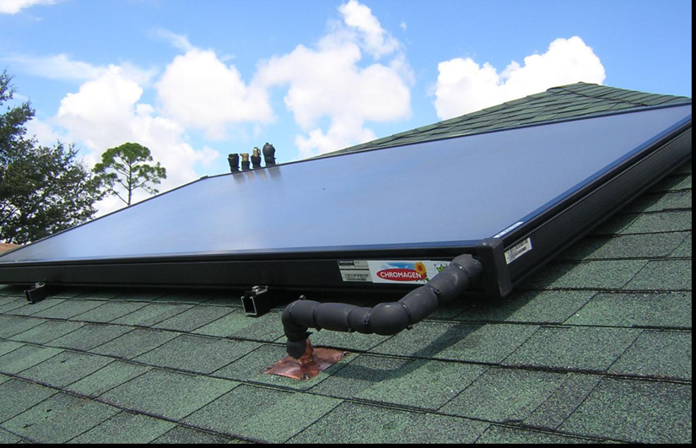
Air Source Electric Water Heater, Solar Water Pre-Heater
Conservpros.com
Adaptivebuilders.com

Slide 28
End Use Power Demand For All Purposes
World U.S.
2010 12.5 TW 2.50 TW
2030 with current fuels 16.9 TW 2.83 TW
2030 converting all energy to
wind-water-sun (WWS) and
electricty/H₂ 11.5 TW 1.78 TW
Reduction 32% 37%

Slide 29
Number of Plants or Devices to Power World
Technology Percent Supply 2030 Number
5-MW wind turbines 50% 3.8 mil (0.8% in place)
0.75-MW wave devices 1 720,000
100-MW geothermal plants 4 5350 (1.7% in place)
1300-MW hydro plants 4 900 (70% in place)
1-MW tidal turbines 1 490,000
3-kW Roof PV systems 6 1.7 billion
300-MW Solar PV plants 14 40,000
300-MW CSP plants 20 49,000
____
100%

Slide 30
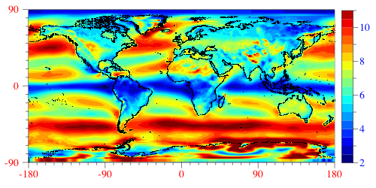
Annual World Wind Speeds at 100 m
All wind worldwide: 1700 TW;
Wind over land in high-wind areas outside Antarctica 70-170 TW
= 6-15 times world end-use WWS power demand 2030 of 11.5 TW

Slide 31
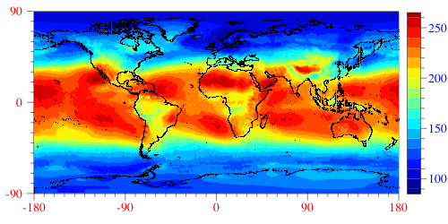
Annual Downward Surface Solar (W/m²)
All solar worldwide: ~6500 TW;
Solar over land in high-solar locations: ~340 TW
= 30 times world end-use WWS power demand 2030 of 11.5 TW

Slide 32
Resources for Nd₂O₃ (Tg) Used in Permanent Magnets for Wind Turbine Generators
Country Resources
China 16
CIS 3.8
U.S. 2.1
Australia 1.0
India 0.2
Others 4.1
World 27.3
Only 4.4 Tg needed to power 50% of world in 2030 with wind
Jacobson & Delucchi (2011)

Slide 33
Resources for Lithium (Tg) Used in Batteries
Country Resource
Bolivia 9.0
Chile 7.5
China 5.4
U.S. 4.0
Argentina 2.6
Brazil 1.0
Other 3.5
World land 33
Oceans 240
Possible number of vehicles @10kg/each with current known land resource: 3.3 billion+ (currently 800 million)
Jacobson & Delucchi (2011)

Slide 34
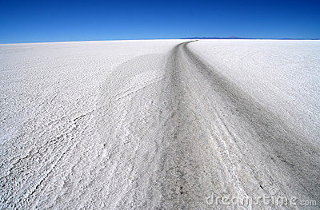
Salar de Uyuni, Bolivian Salt Flat
Covers largest known lithium source in world
Paop/Dreamstime

Slide 35
Methods of addressing variability of WWS
Interconnecting geographically-dispersed WWS resources
Bundling WWS resources as one commodity and using hydroelectricity to fill in gaps in supply
Using demand-response management
Oversizing peak generation capacity and producing hydrogen with excess for industry, transportation
Storing electric power on site or in BEVs (e.g., VTG)
Forecasting winds and cloudiness better to reduce reserves

Slide 36
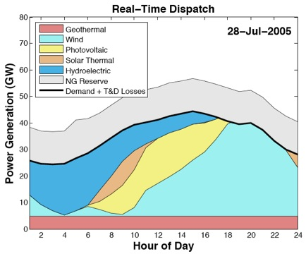
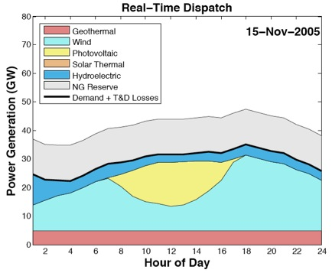
Matching Hourly California Electricity Demand With Renewable Supply
Hart and Jacobson (2011)

Slide 37
Costs of Energy With Transmission (¢/kWh)
Energy Technology 2005-2010 2020-2030
Wind onshore 4-7 ≤4
Wind offshore 10-17 8-13
Wave >>11 4-11
Geothermal 4-7 4-7
Hydroelectric 4 4
CSP 10-15 8
Solar PV 9-13 5-7
Tidal >>11 5-7
Conventional (+Externalities) 7 (+5)=12 8 (+5.5) =13.5
Delucchi & Jacobson (2010)

Slide 38
Long-Distance Transmission Costs (2007 US ¢/kWh) for Transmission 1200-2000 km
Low Med High
0.3 1.2 3.2
Delucchi & Jacobson (2010)

Slide 39
Summary
2030 electricity cost 4-10¢/kWh for most, 8-13 for some WWS vs. fossil-fuel 8 + 5.5 externality = 13.5¢/kWh
Long-distance transmission (1200-2000 km) ~1¢/kWh
Requires 0.41% more of world land for footprint; 0.59% for spacing (compared w/40% of world land for cropland and pasture)
Eliminates 2.5-3 million air pollution deaths/year
Eliminates global warming, provides energy stability

Slide 40
Summary, cont.
Converting to Wind, Water, & Sun (WWS) and electricity/H₂ will reduce global power demand by 30%
Methods of addressing WWS variability: (a) interconnecting geographically-dispersed WWS; (b) bundling WWS and using hydro to fill in gaps; (c) demand-response; (d) oversizing peak capacity and producing hydrogen with excess for industry, vehicles; (e) on-site storage; (f) forecasting
Materials are not limits although recycling may be needed.
Barriers: up-front costs, transmission needs, lobbying, politics.

Slide 41
Summary, cont.
When the WWS solution is finally implemented, the air pollution and climate problems outlined in this book will be relegated to the annals of history.

Slide 42
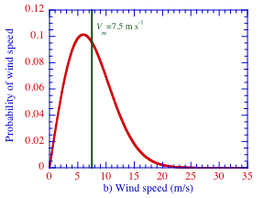
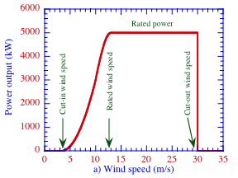
Wind Turbine Power Curve and Rayleigh Probability Distribution of Wind Speed
Power curve for RE Power 5 MW turbine (126-m diameter rotor)

