Slide 1
Presentation Slides for
Air Pollution and Global Warming:
History, Science, and Solutions
Chapter 2: The Sun, the Earth, and the Evolution of the Earth’s Atmosphere
By Mark Z. Jacobson
Cambridge University Press (2012)
Last update: August 4, 2011
The photographs shown here either appear in the textbook or were obtained from the internet and are provided to facilitate their display during course instruction. Permissions for publication of photographs must be requested from individual copyright holders. The source of each photograph is given below the figure and/or in the back of the textbook.

Slide 2
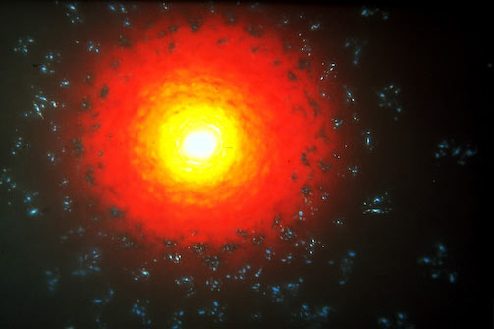
Big Bang 15 bya
www.cosmographica.com

Slide 3
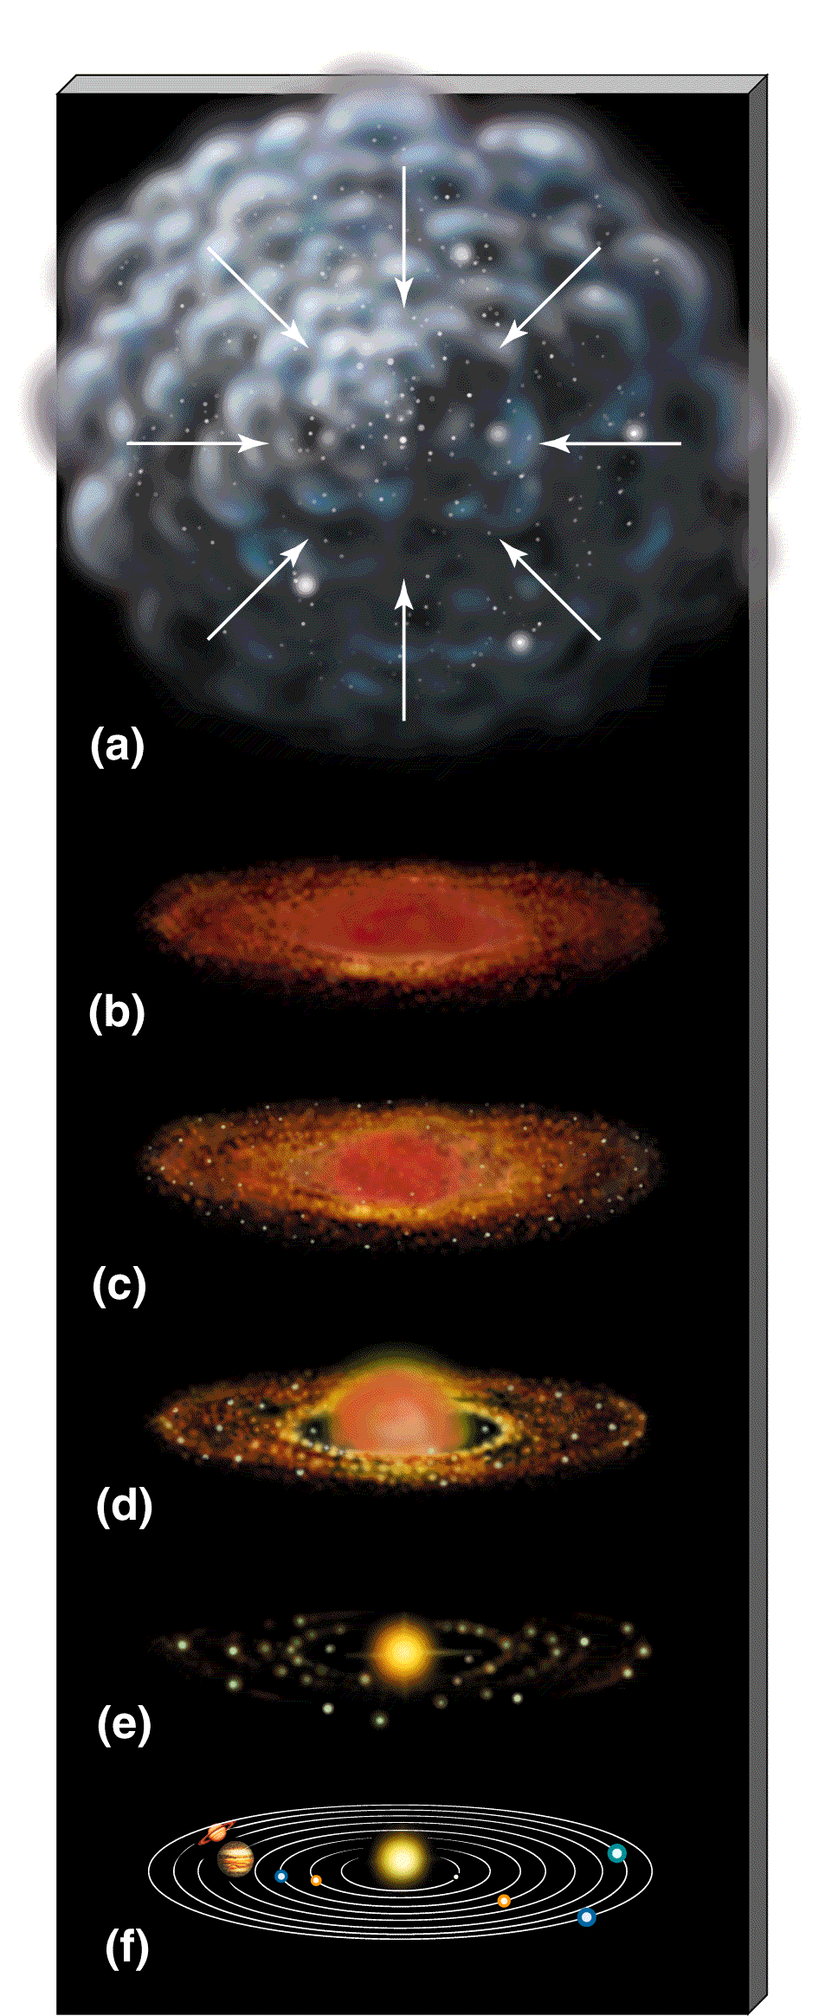
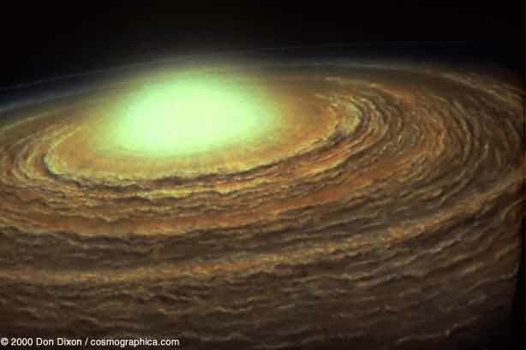
Sun and Planet Formation 4.6 bya
www.astro.psu.edu

Slide 4
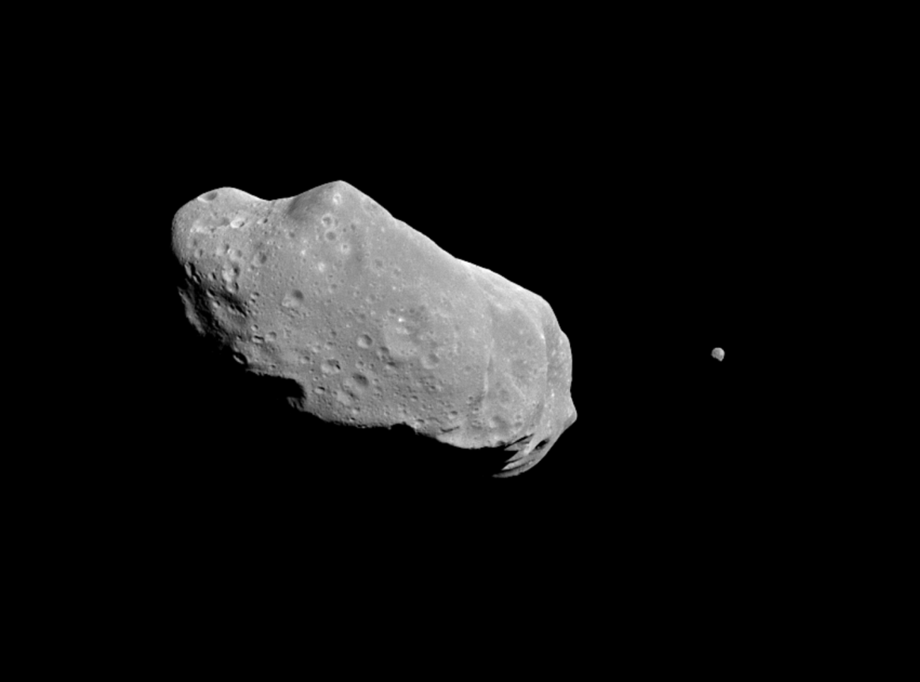
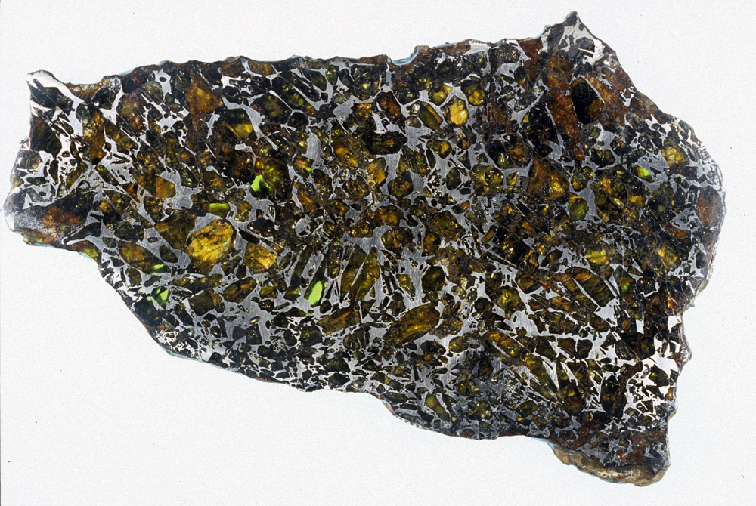
Asteroid Ida and its Moon, Dactyl
National Space Science Data Center
Stony-Iron Meteorite
(18 cm long)
meteorites.asu.edu

Slide 5
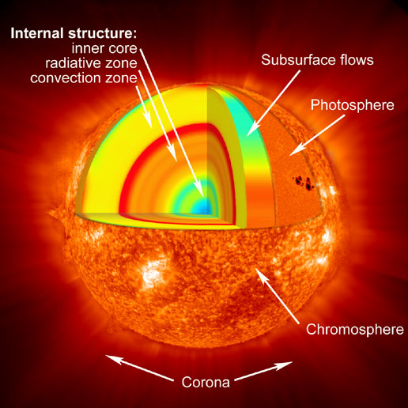
Sun
www.nasa.gov

Slide 6
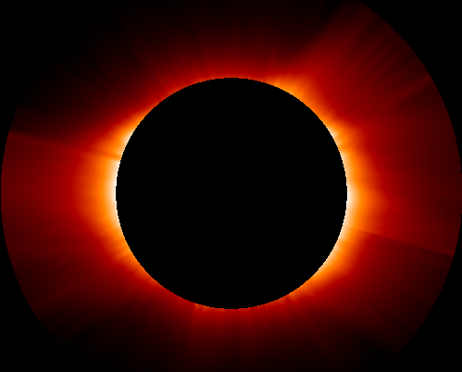
Corona
(1-2 million K, ionized gases)
www.qrg.northwestern.edu

Slide 7
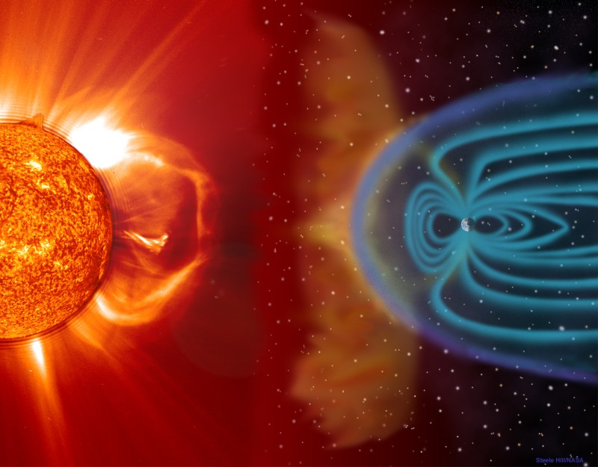
Solar Wind Interacting With Earth
300-1000 km/s, 200,000 K at Earth
www.stormblogging.com

Slide 8
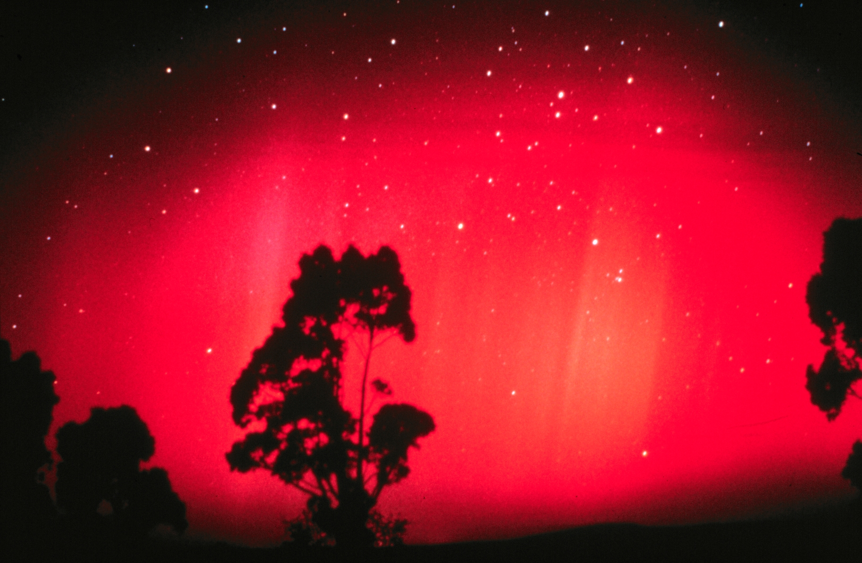
Aurora Australis
David Miller, National Geophysical Data Center, available from NOAA Central Library

Slide 9
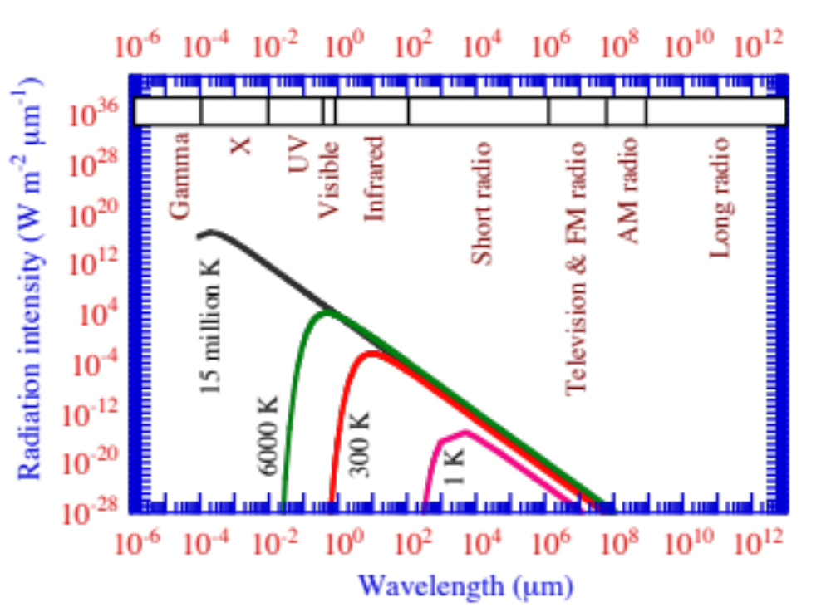
Radiation Spectra
Figure 2.3

Slide 10
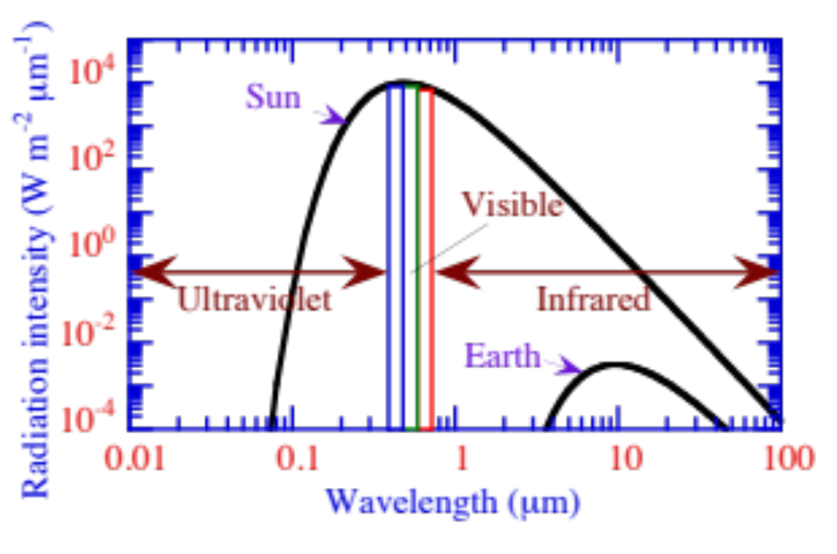
Emission Spectra of the Sun and Earth
Figure 2.4

Slide 11
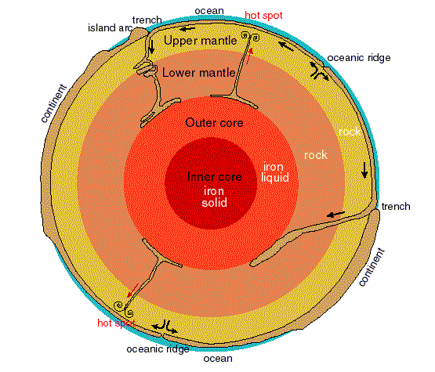
Earth
Atropos.as.arizona.edu

Slide 12
Composition of Stony Meteorites, Total Earth, and Earth’s Crust
Mass percent of element in
Stony Total Soil
Element Meteorites Earth Crust
Oxygen 33.2 29.5 46.6 (light)
Iron 27.2 34.6 5.0 (heavy)
Silicon 17.1 15.2 27.2 (light)
Magnesium 14.3 12.7 2.1 (medium)
Nickel 1.64 2.39 0.08 (heavy)
Calcium 1.27 1.13 3.6 (light)
Aluminum 1.22 1.09 8.1 (light)
Table 2.2

Slide 13
Earth’s First Atmosphere
Consisted mostly of H, He
During birth of the Sun, nuclear reactions are enhanced, increasing solar wind speeds and densities (T-Tauri stage of solar evolution).
Enhanced solar wind stripped off most H, He from the Earth.
Additional H, He lost by escape from Earth’s gravitational field.

Slide 14
Earth’s Second Atmosphere
Initially due to outgassing by volcanos, fumaroles, steam wells, geysers.
Hydroxyl molecules (OH) bound in crustal minerals, became detached and converted reduced gases to oxidized gases:
H₂(g) + OH --> … --> H₂O(g)
CH₄(g) + OH --> …. --> CO₂(g)
NH₃(g) + OH -->…--> NO(g), NO₂(g)
N₂(g) + OH -->…--> NO(g), NO₂(g)
H₂S(g) + OH -->…--> SO₂(g)
Second atmosphere dominated initially by CO₂(g), H₂(g)
Outgassed water vapor condensed to form the oceans.

Slide 15
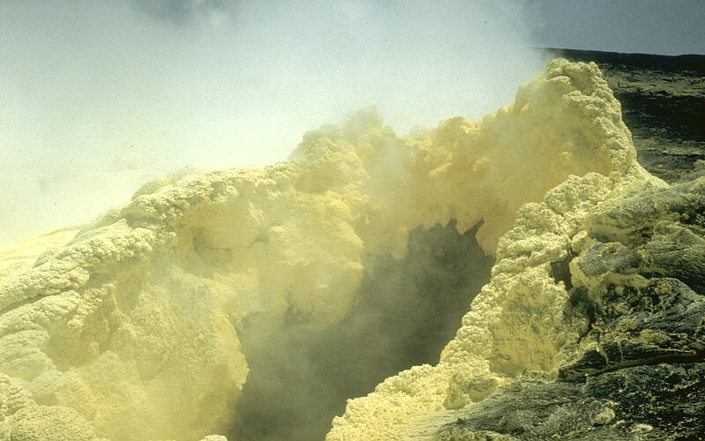
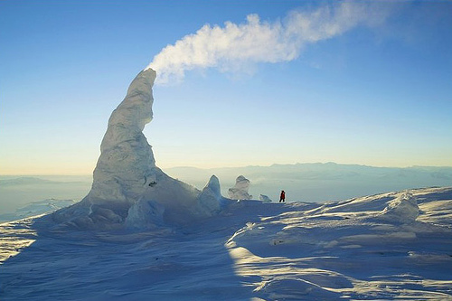
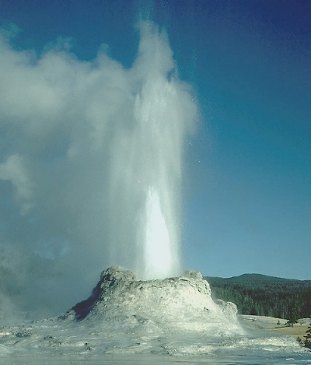
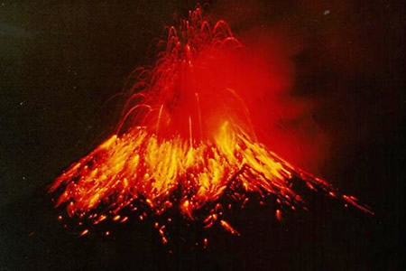
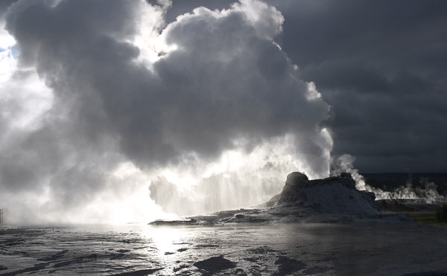
Fumaroles, Geysers, Volcanos
Volcanoes.usgs.gov
Farm1.static.flickr.com
Geology.com
z.about.com
www.naturalsciences.org

Slide 16
Timeline of Earth’s Evolution
4.6 bya Formation of the Earth
3.5 bya Abiotic synthesis,
1953 Miller and Urey
H₂(g)+H₂O(g)+CH₄(g)+NH₃(g)+H₂O(aq)+
electricity or UV --> complex organics, amino acids
--> first prokaryotes
single strand of DNA but no nucleus
conventional heterotrophs

Slide 17
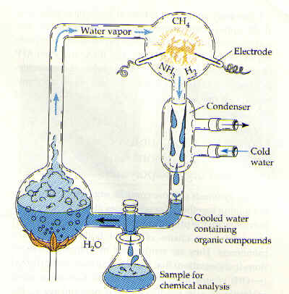
Abiotic Synthesis (3.5 bya)
Io.uwinnipeg.ca

Slide 18
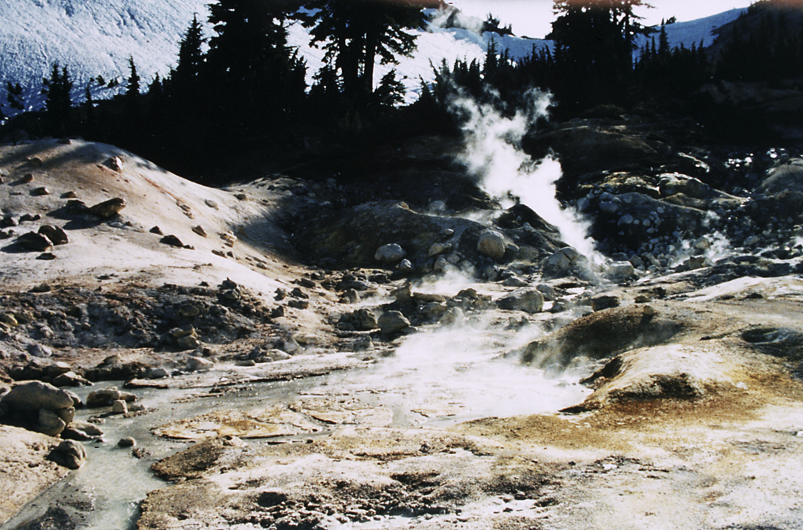
Hot Sulfur Springs in Lassen National Park
Lithotrophic autotrophic bacteria oxidize H₂S(aq) to H₂SO₄(aq), which dissolves minerals into a “mud pot.” Alfred Spormann, Stanford U.

Slide 19
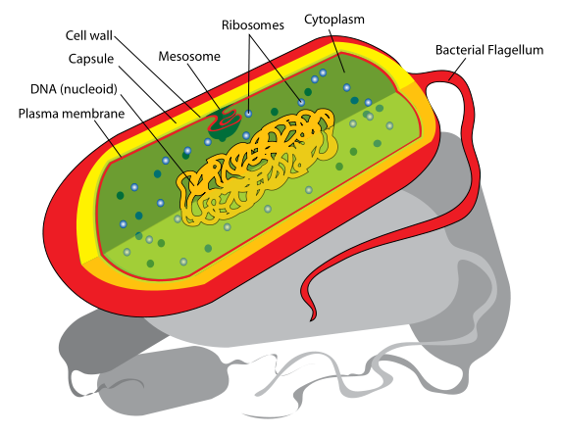
Prokaryotic Cell (3.5 bya)
Bacteria
DNA not enclosed by nucleus and is linear (has ends)
Upload.wikimedia.org

Slide 20
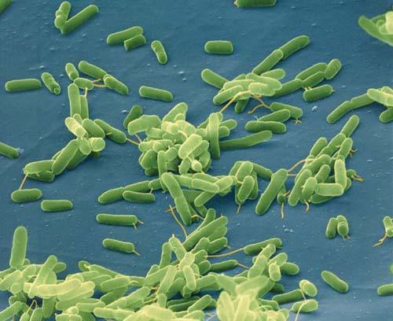
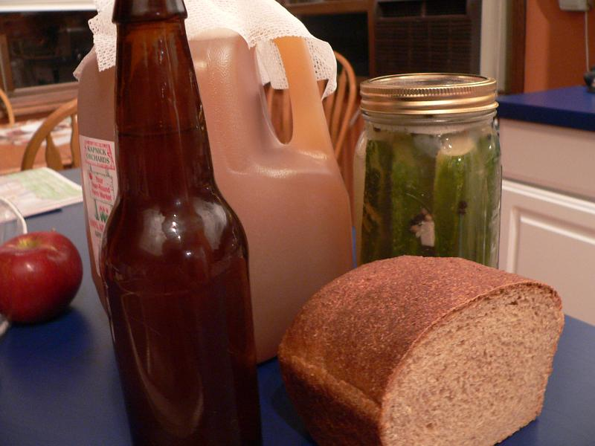
Fermenting Bacteria (3.5 bya)
Sustainabledesignupdate.com
Glasscooking.files.wordpress.com
Fermentation of fungi in yeast produces carbon dioxide, causing bread to rise, and produces alcohol

Slide 21
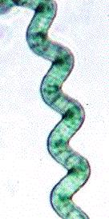
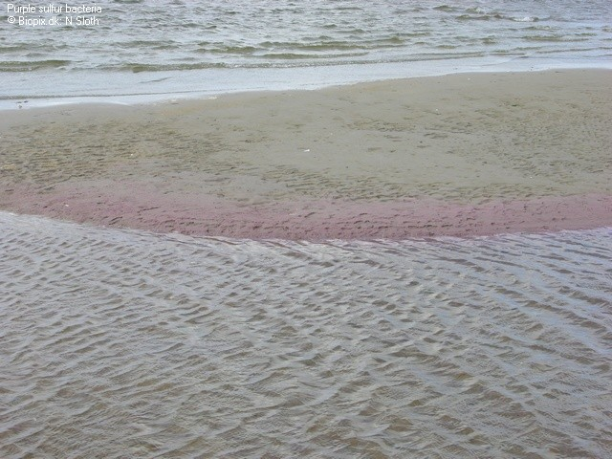
Photosynthetic Sulfur Bacteria (3.5 bya)
Filebox.vt.edu
www.biopix.dk
Sustainabledesignupdate.com

Slide 22
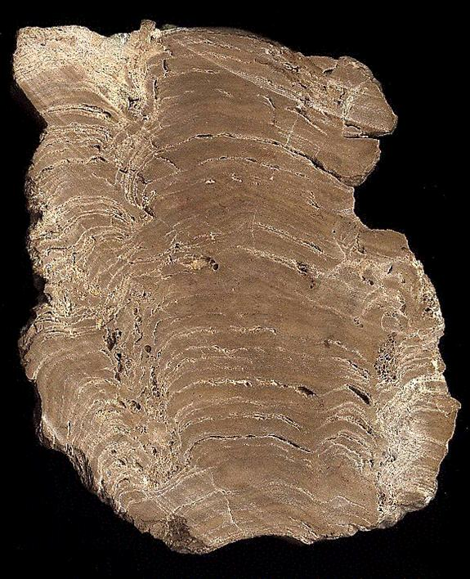
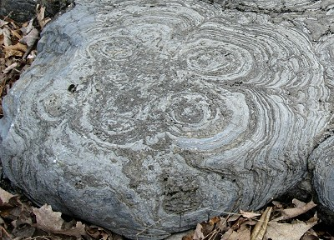
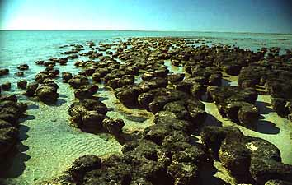
Stomatolites From Cyanobacteria (Blue-Green Algae; Blue-Green Bacteria; Sulfur bacteria)
z.about.com
www.globalchange.umich.edu
www.daviddarling.info

Slide 23
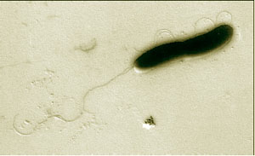
Denitrifying Bacteria (3.2 bya)
genome.jgi-psf.org

Slide 24
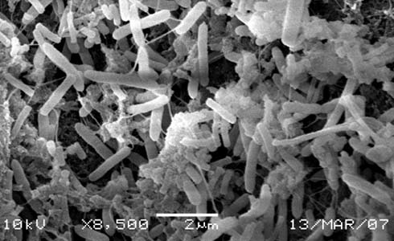
Methanogenic Bacteria (2.9 bya)
www.preciseenergy.com

Slide 25
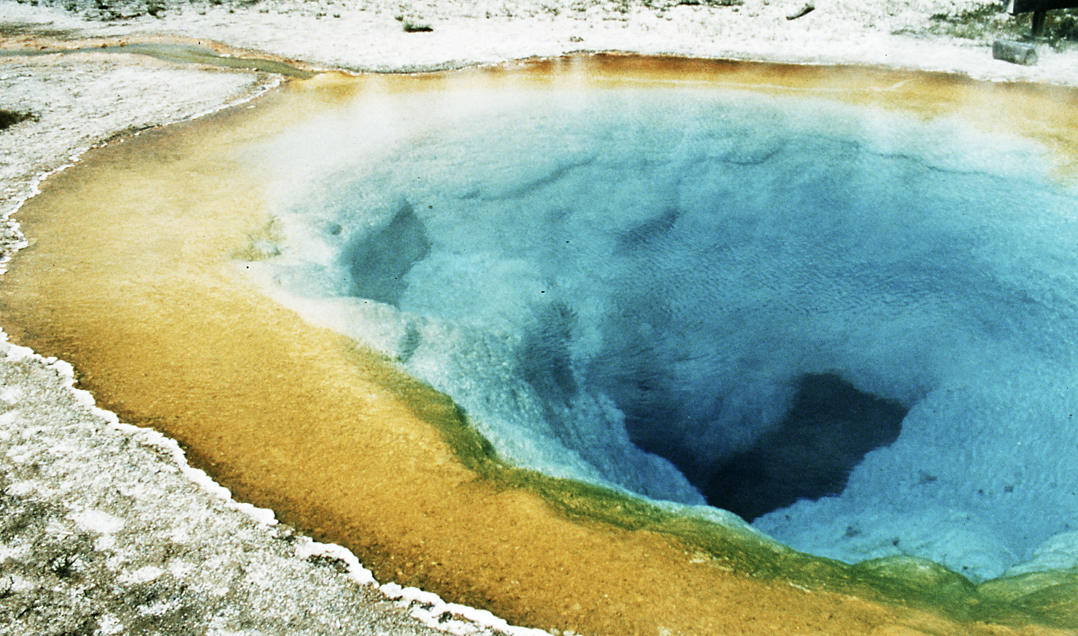
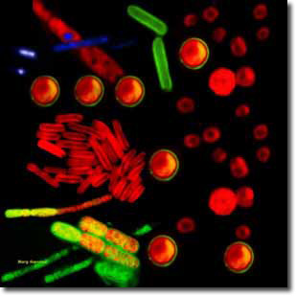
Oxygen-Forming Cyanobacteria (3.5-2.8 bya)
Publicaffairs.llnl.gov
Different colored photosynthetic cyanobacteria grow in hot spring at Yellowstone due to different temperatures. Alfred Spormann, Stanford

Slide 26
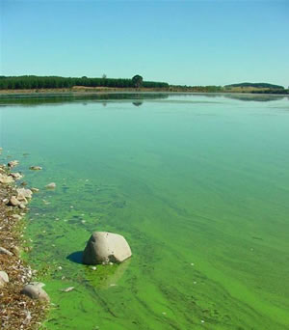
Cyanobacteria Bloom
www.mfe.govt.nz

Slide 27
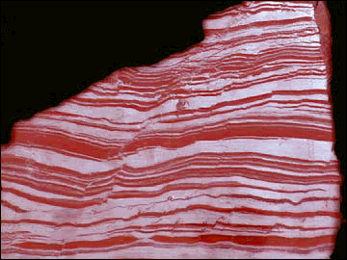
Until 1 bya, Oxygen Consumed by Rocks
Banded-Iron Formation (3.5-2 bya); Red beds 2-1 bya
Rocks from oxygen+iron (Fe₂O₃)
www.globalchange.umich.edu
Only when rocks saturated with O₂ did O₂ increase in air.
Today, 58% O₂ is in Fe₂O₃, 38% is in SO₄²⁻, and 4% is in air.

Slide 28
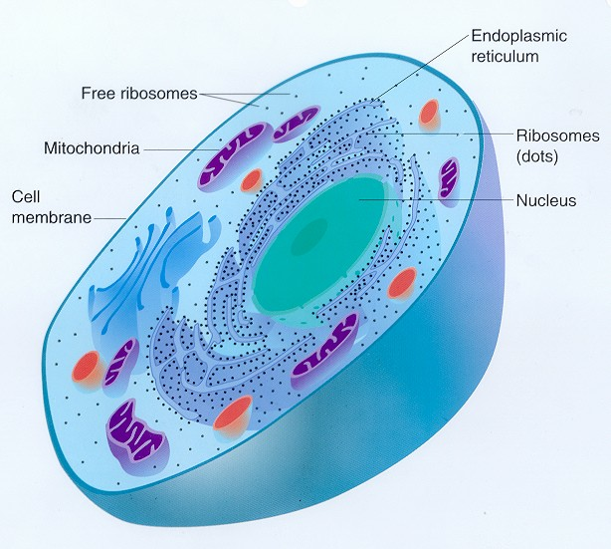
Eukaryotic Cell (2.1-1.85 bya)
Plant
Animal
Fungi
Protists
DNA enclosed by nucleus and is circular
www.williamsclass.com

Slide 29
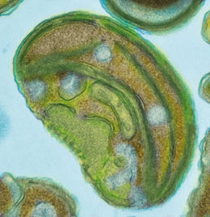
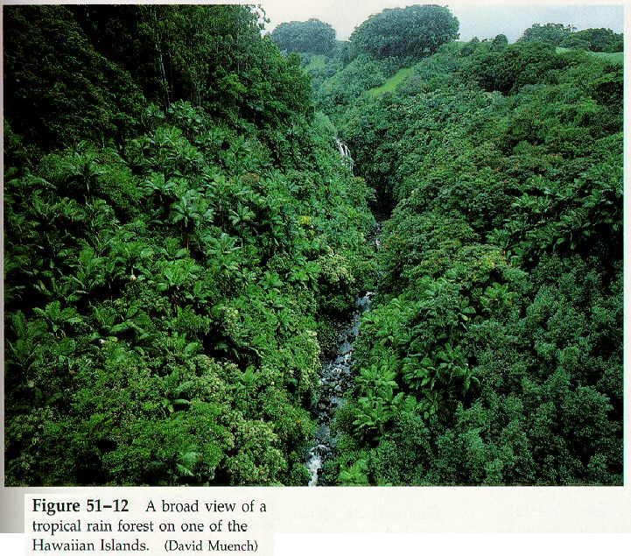
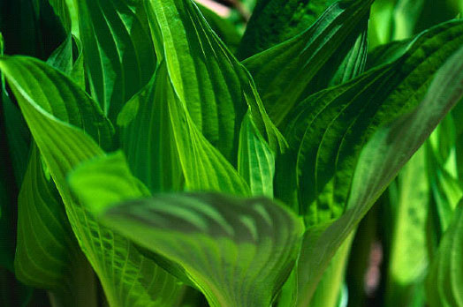
Green-Plant Photosynthesis (0.395-0.43 bya)
www.jgi.doe.gov (phytoplankton)
Mac122.icu.ac.jp
www.acohardware.com

Slide 30
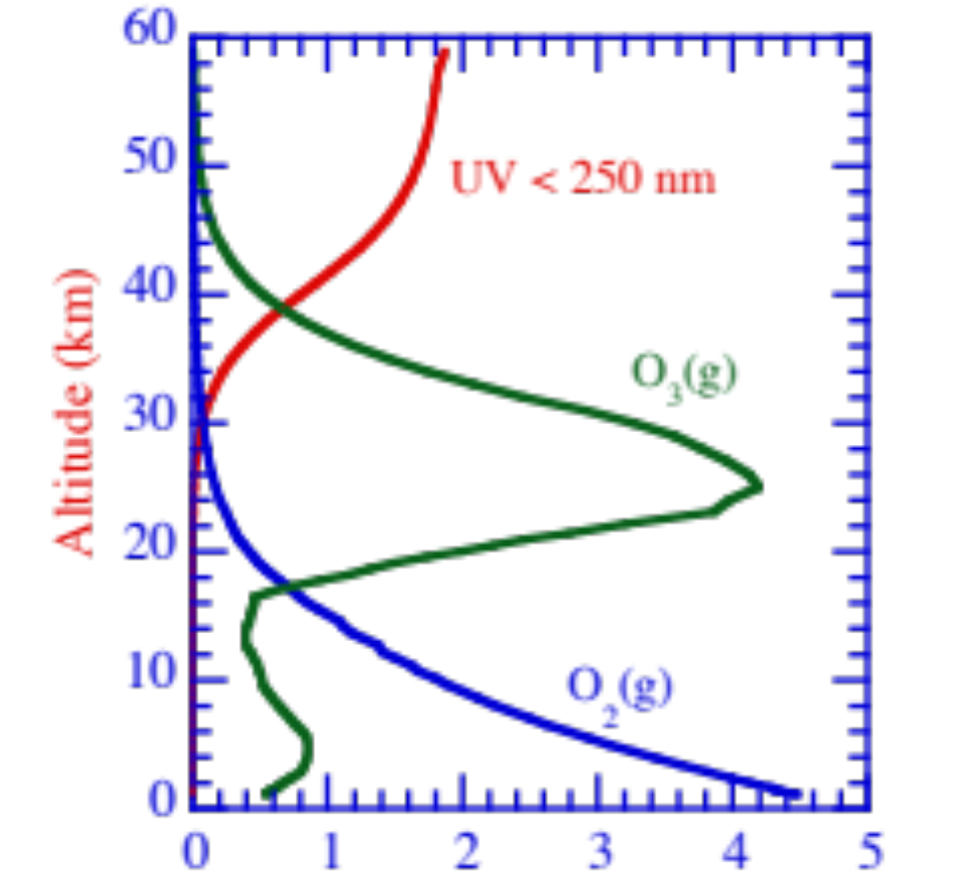
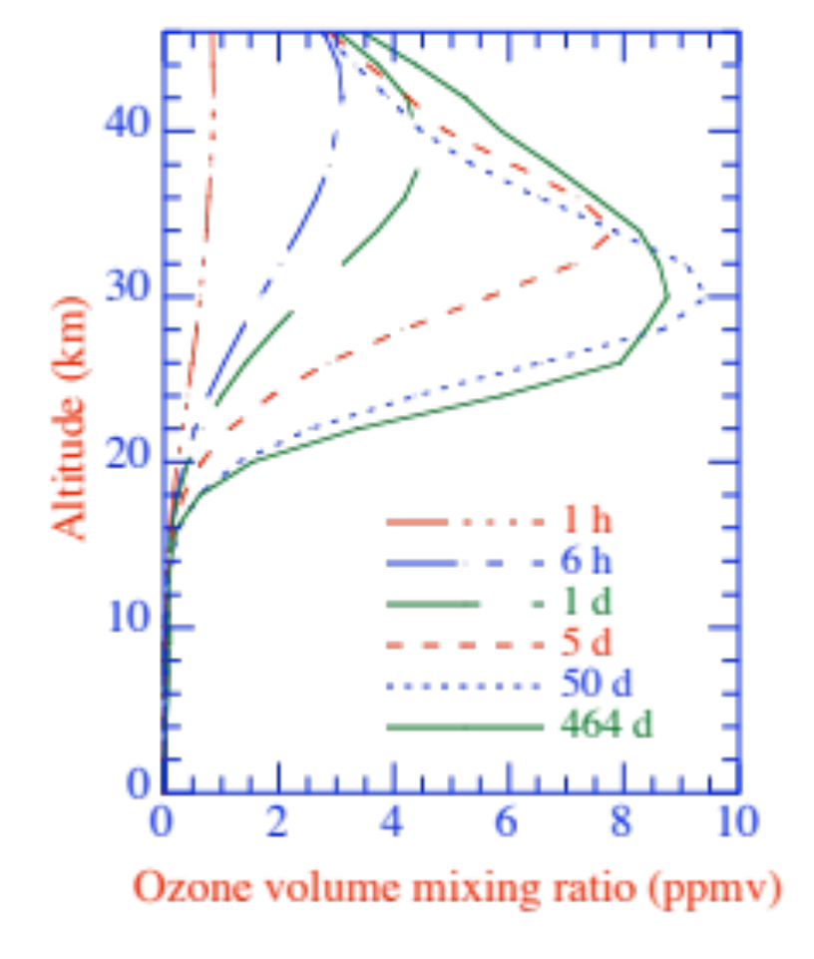
Speed of Ozone Layer Formation
Change in vertical profile of ozone, starting with no ozone but with oxygen and UV radiation
Figure 11.7

Slide 31
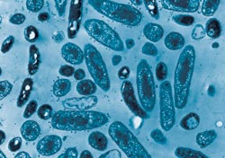
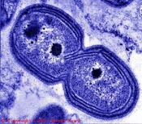
Nitrifying Bacteria (1.8 bya) (Aerobic)
www.anoxkaldnes.com
www.blm.gov

Slide 32
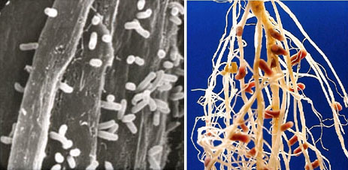
Nitrogen Fixing Bacteria (1.4 bya) (Aerobic)
Bioinfo.bact.wisc.edu
These bacteria (left) live on the roots of leguminous plants (right)

Slide 33
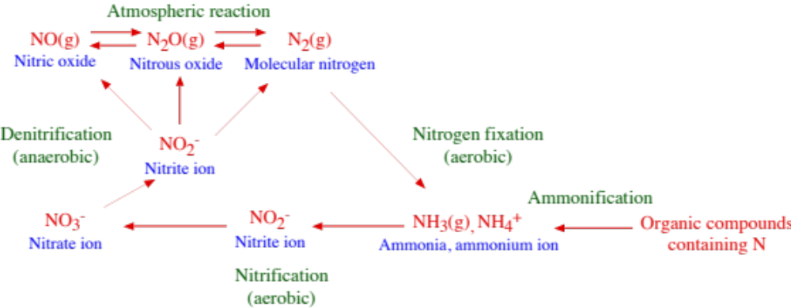
The Nitrogen Cycle
Figure 2.10

Slide 34
Timeline of Earth’s Evolution
4.6 bya Formation of the Earth
3.5 bya Abiotic synthesis, first prokaryotes
3.5 bya Fermenting bacteria produce CO₂(g)
3.5 bya Anoxygenic photosynthesis by sulfur bacteria
3.5-2.8 bya Oxygen-producing photosynthesis by cyanobacteria
3.2 bya Denitrification
2.9 bya Methanogenic bacteria
2.45 bya Great Oxygenation Event/ozone layers initiates
2.1-1.85 bya Earliest eukaryotes
1.8 bya Nitrifying bacteria
1.5 bya Nitrogen fixing bacteria
0.57 bya First shelled invertebrates
0.43-0.5 bya Primitive fish
0.395-0.43 bya First land plants -- oxygen and ozone increase
Table 2.3

Slide 35
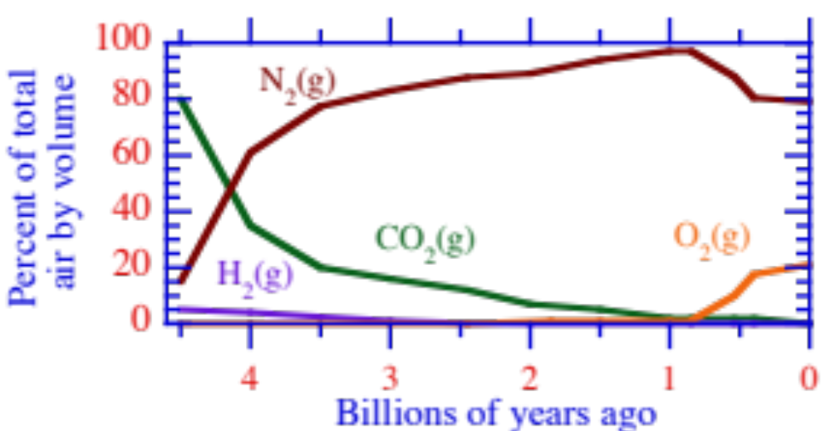
Evolution of the Earth’s Second Atmosphere
Figure 2.11

