Slide 1
Chapter 11

Slide 2
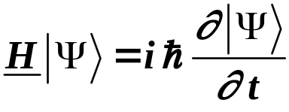

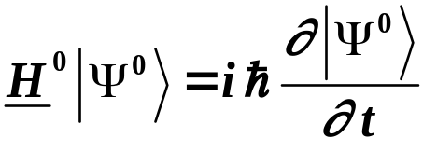



Time Dependent Perturbation Theory
Time dependent Schrödinger Equation
Take
time independent time dependent
will treat as time dependent perturbation
H⁰ time independent - solutions are
complete set of time independent orthonormal eigenfunctions of H⁰.
time dependent phase factors
Copyright – Michael D. Fayer, 2018
Notes:
2
2
2

Slide 3
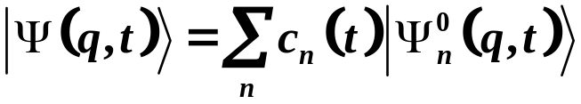
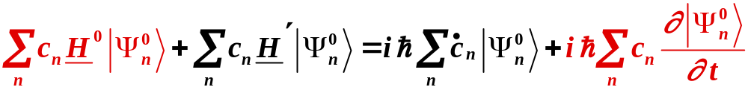
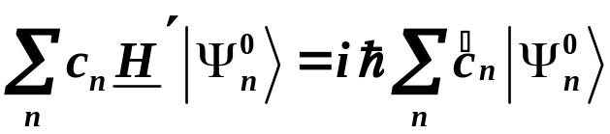
To solve
Expand
used derivative product rule
Substitute expansion
These terms equal. Unperturbed problem.
They cancel.
Canceling gives
Copyright – Michael D. Fayer, 2018
Notes:
3
3
3

Slide 4

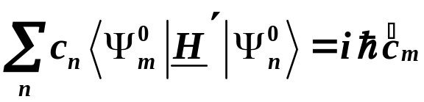
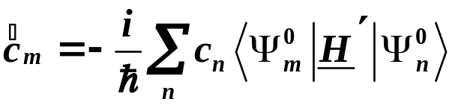
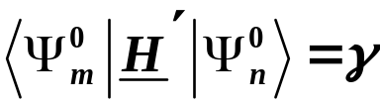
Have
Left multiply by
Eigenkets of time independent Hamiltonian
are orthonormal.
Therefore,
Exact to this point.
Set of coupled differential equations.
In Time Dependent Two State Problem (Chapter 8)
two coupled equations
Copyright – Michael D. Fayer, 2018
Notes:
4
4
4

Slide 5


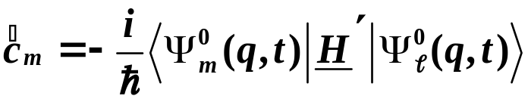
Approximations
Usually start in a particular state
Dealing with weak perturbation.
System is not greatly changed by perturbation.
Assume:
Time independent.
The probability of being in the initial state
never changes significantly.
The probability of being in any other state never gets much bigger than zero.
With these assumptions:
No longer coupled equations
Excellent approximation in many common experiments.
UV/Vis spectrometer, FT-IR spectrometer, Fluorometer
Copyright – Michael D. Fayer, 2018
Notes:
5
5
5

Slide 6
Grazing Collision of an Ion and a Dipolar Molecule - Vibrational Excitation
δ⁺
δ–
b
t
M - molecule with
dipole moment
+
M
2
a
surface
+
t
1
I⁺
x
1. Molecule, M, weakly phys. absorbed on surface.
Not translating or rotating. (Example, CO on Cu surface.)
2. Dipole moment points out of wall.
Interaction with wall very weak; can be ignored.
3. When not interacting with ion – vibrations harmonic.
4. M has δ– side to right.
Copyright – Michael D. Fayer, 2018
Notes:
6
6
6

Slide 7
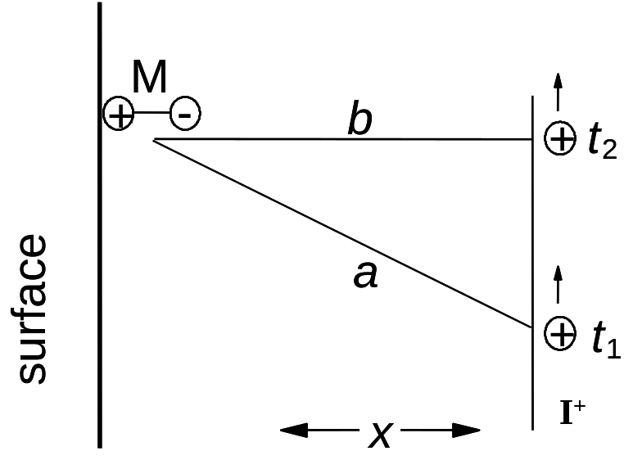



δ⁺
δ–
Positively charged ion, I⁺, flies by M.
I⁺ starts infinitely far away at
Passes by M at t = 0.
I⁺ infinitely far away at
M
At any time, t,
I⁺ to M distance = a.
b = distance of closest approach (called impact parameter).
V = Ion velocity.
Copyright – Michael D. Fayer, 2018
Notes:
7
7
7

Slide 8
Ion flies by molecule
Coulomb interaction perturbs vibrational states of M.
Model for Interaction
δ– end of M always closer to I⁺ than positive end of M.
Bond stretch energy lowered
δ– closer to I⁺.
δ⁺ further from I⁺.
δ⁺
δ–
Bond contracted opposite
Energy raised.
M
Copyright – Michael D. Fayer, 2018
Notes:
8
8
8

Slide 9
Qualitatively Correct Model
δ⁺
δ–
M
Ion causes cubic perturbation of molecule.
Correct symmetry, odd.
Strength of Interaction
Inversely proportional to square of separation.
Coulomb Interaction of charged particle and dipole.
Neglects orientational factor -
but most effect when ion close - angle small.
Strength of interaction time dependent
because distance is time dependent.
Copyright – Michael D. Fayer, 2018
Notes:
9
9
9

Slide 10

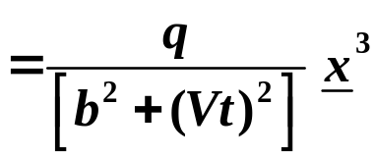


Time Dependent Perturbation
δ⁺
δ–
M
M - I⁺ separation
squared. Ion - dipole
interaction.
q = a constant (size of dipole, etc.)
x = position operator for H.O.
M starts in H.O. state .
Want probabilities of finding it in states after I⁺ flies by.
Time Dependent Perturbation Theory
Copyright – Michael D. Fayer, 2018
Notes:
10
10
10

Slide 11


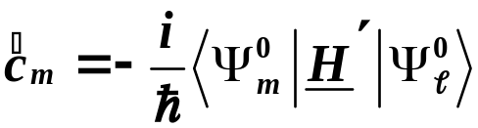


Take perturbation to be small.
Probability of system being in .
Probability of system being in .
Therefore,
Zeroth order time
dependent kets.
For this problem
ket
bra
Copyright – Michael D. Fayer, 2018
Notes:
11
11
11

Slide 12

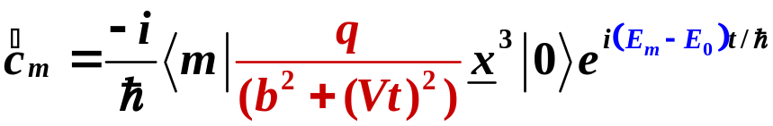
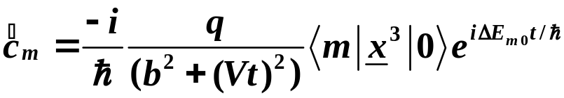
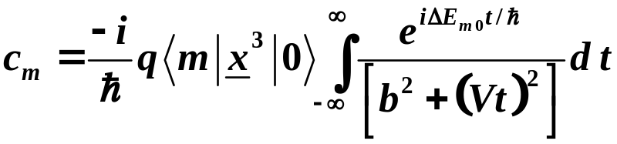
Substituting
Doesn't depend on H.O. coordinate,
take out of bracket.
Multiply through by dt and integrate.
Need to evaluate time independent and time dependent parts.
Copyright – Michael D. Fayer, 2018
Notes:
12
12
12

Slide 13

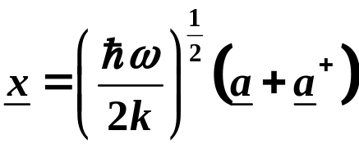
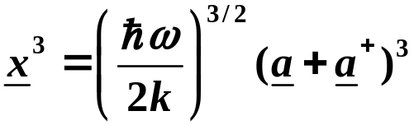



Time independent part
Because x³ operates on
must have more raising operators than lowering.
Can't lower past
Can't have lowering operator on right.
Only terms in red survive.
Copyright – Michael D. Fayer, 2018
Notes:
13
13
13

Slide 14
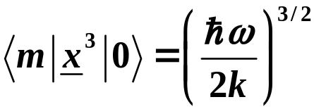
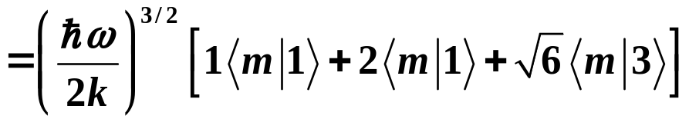
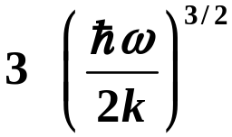

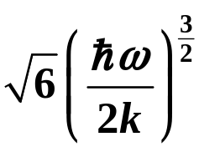

Then
Therefore,
m must be 1 or 3.
Perturbation will only cause scattering to m = 1 and m = 3 states.
Only c₃ and c₁ are non-zero. (Higher odd powers of x
included in interaction –
population in higher odd
energy levels.)
Copyright – Michael D. Fayer, 2018
Notes:
14
14
14

Slide 15
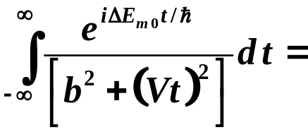
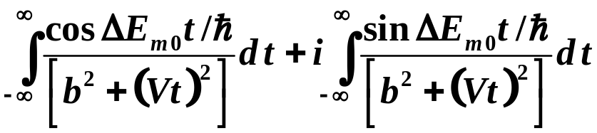
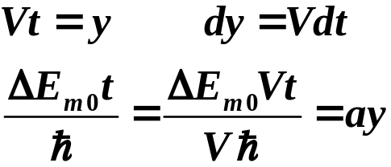
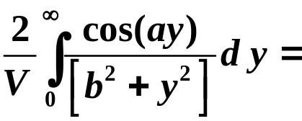
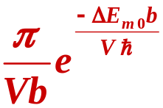
Time dependent part
Integral of odd function.
Substituting
Copyright – Michael D. Fayer, 2018
Notes:
15
15
15

Slide 16
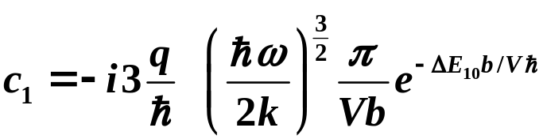
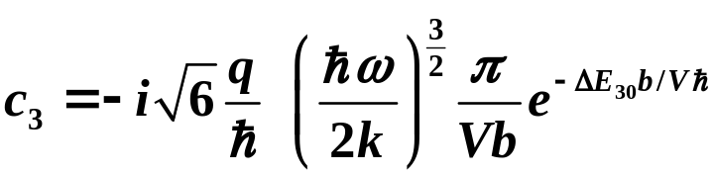
Putting the pieces together
Copyright – Michael D. Fayer, 2018
Notes:
16
16
16

Slide 17

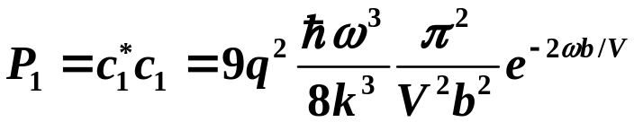

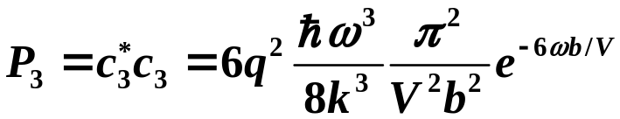

Probabilities
using
using
Probabilities are function of velocity.
P₁ and P₃ go to 0.
Must be maximum in between.
Copyright – Michael D. Fayer, 2018
Notes:
17
17
17

Slide 18

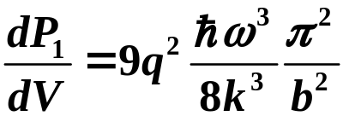
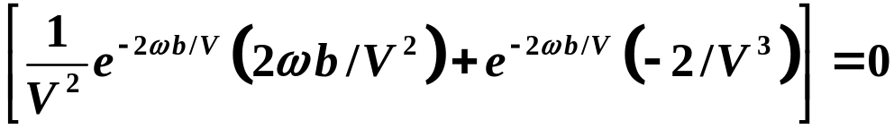
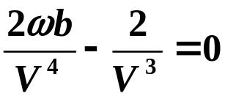
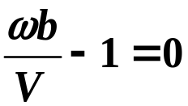

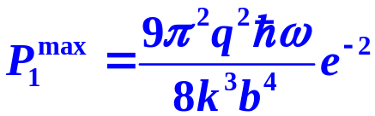

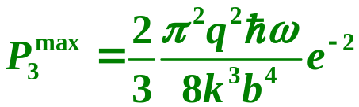

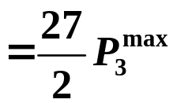

Maximum value of as function of V.
frequency of transition times
distance of closest approach (impact parameter)
Note dependence on impact parameter.
Similarly
frequency of transition times
distance of closest approach
Copyright – Michael D. Fayer, 2018
Notes:
18
18
18

Slide 19
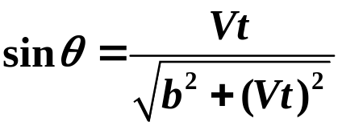
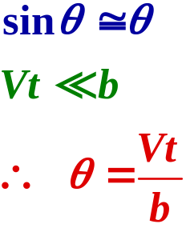
Understanding maximum probabilities as function of V.
Calculate angular frequency when ion near molecule.
b
M
θ
a
d = Vt
I
+
When ion very close to point of closest approach
Copyright – Michael D. Fayer, 2018
Notes:
19
19
19

Slide 20
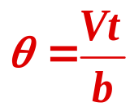
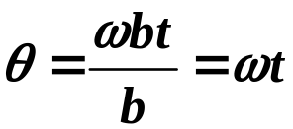
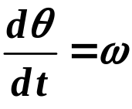
For 0 → 1 transition, velocity for max. prob. is
V = ωb.
Then
Angular velocity – change in angle per unit time.
Copyright – Michael D. Fayer, 2018
Notes:
20
20
20

Slide 21
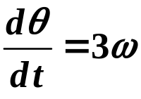
Angular velocity
Looks like charged particle moving by M with angular velocity ω.
Produces E-field changing at
frequency ω.
On resonance efficiently induces transition.
For 0 → 3 transition, velocity for max. prob. is
V = 3ωb
Again on resonance.
Copyright – Michael D. Fayer, 2018
Notes:
21
21
21

Slide 22



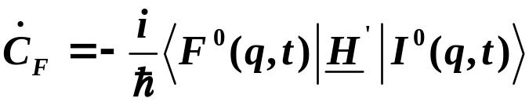
Fermi’s Golden Rule
an important result from time dependent perturbation theory
s₁
Dense manifold of vibrational states of ground state – S₀.
10¹² to 10¹⁸ states/cm⁻¹
hν
Radiationless relaxation competes with fluorescence.
Many problems in which an initially prepared state is
coupled to a dense manifold of states.
s₀
First consider a pair of coupled state.
f
i
, where f = final and i = initial.
are eigenstates of the time independent Hamiltonian, .
These are eigenstates in the absence of coupling.
From time dependent perturbation theory
H′ is the time dependent piece of the Hamiltonian that couples the eigenstates.
Copyright – Michael D. Fayer, 2018
Notes:
22
22
22

Slide 23
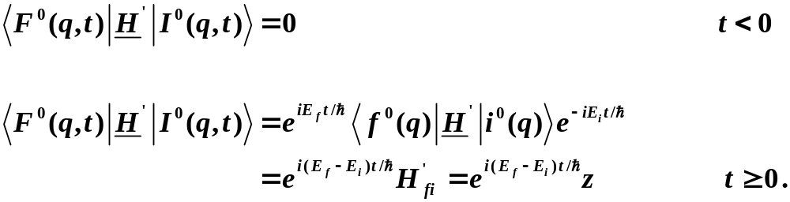
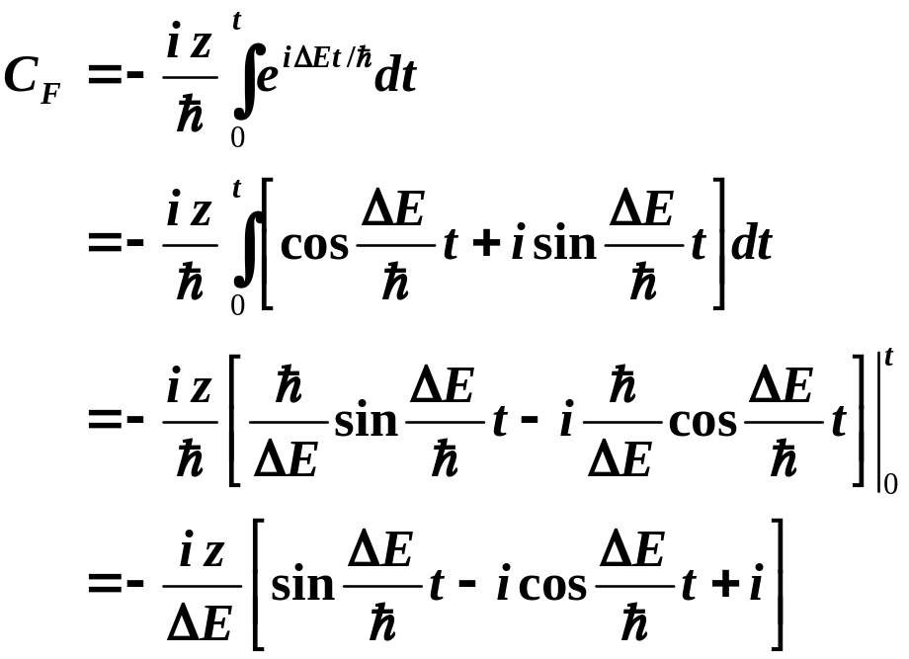

The time dependence of H′ is given by
The time dependent perturbation is 0 for t < 0, and a constant for t ≥ 0.
The probability of being in the final state is:
Copyright – Michael D. Fayer, 2018
Notes:
23
23
23

Slide 24
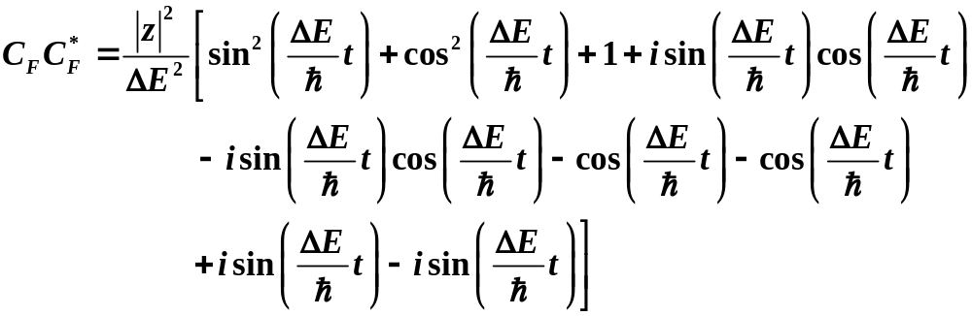
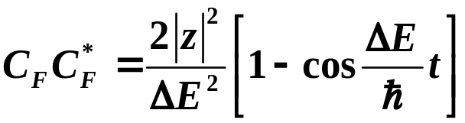

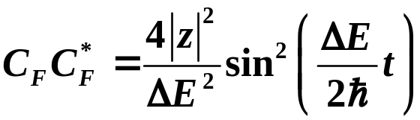

The probability of finding the system in the final state
Using
Probability of being in the final state
as a function of t and ΔE.
Only good when small.
Copyright – Michael D. Fayer, 2018
Notes:
24
24
24

Slide 25

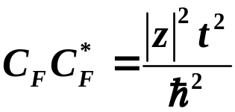



Probability of being in the final state F.
Must be small – time dependent perturbation theory
Probability must be small to use time dependent perturbation theory.
Take very short time limit.
Exact solution from time
dependent two state problem,
Chapter 8
Expand exact solution for short time.
Same at short time.
Copyright – Michael D. Fayer, 2018
Notes:
25
25
25

Slide 26


Square of zeroth order spherical Bessel function.
z = 20 cm⁻¹
t = 50 fs
ΔE (cm⁻¹)
This is a plot of the final probability at a single time
with z and t picked to keep final max probability low
as required to use time dependent perturbation theory.
Copyright – Michael D. Fayer, 2018

Slide 27


To this point, initial state coupled to a single final state.
To obtain result for initial state coupled to dense manifold of final states,
make following assumptions – very good for many physical situations.
1. Most of the transition probability is close to ΔE = 0; ΔE² in denominator.
Therefore, take the density of states, ρ, which is a function of energy,
to be constant with the value at ΔE = 0.
2. The coupling bracket
can vary with f through the manifold of final states.
Take them all to be equal to z, which is now some average value
for the final states couplings to the initial state.
Probability of being in the manifold
of final states. Area under Bessel function.
Copyright – Michael D. Fayer, 2018
Notes:
27
27
27

Slide 28





Let
Then
Using
Copyright – Michael D. Fayer, 2018
Notes:
28
28
28

Slide 29


The transition probability per unit time is
Fermi’s Golden Rule
Rate constant for gain in probability in manifold of final states
equals rate constant for loss of probability from initial state.
Initial state can decay to zero without violating time dependent perturbation
theory approximation because so many states in final manifold that none
gain much probability. Need not consider coupling among states in manifold.
Copyright – Michael D. Fayer, 2018
Notes:
29
29
29

Slide 30



Loss of probability from initial state per unit time a constant, k,
then
Probability of being in the initial state (population)
decays exponentially.
s₁
Nonradiative relaxation contribution to decay of
excited state population, k_{nr}, from Fermi’s Golden Rule.
hν
Radiative contribution, fluorescence, spontaneous emission,
k_{r} (Chapter 12, Einstein A coefficient).
heat
s₀
Fluorescence decay
τ = fluorescence lifetime
Copyright – Michael D. Fayer, 2018
Notes:
30
30
30

