Slide 1
Chapter 4

Slide 2

Q. M. Particle Superposition of Momentum Eigenstates
Partially localized Wave Packet
Photon – Electron
Photon wave packet description of light same as
wave packet description of electron.
Electron and Photon can act like waves – diffract
or act like particles – hit target.
Wave – Particle duality of both light and matter.
Copyright – Michael D. Fayer, 2018
Notes:
2
2
2

Slide 3
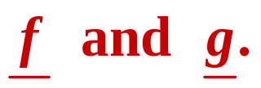
Commutators and the Correspondence Principle
Formal Connection
Q.M. Classical Mechanics
Correspondence between
Classical Poisson bracket of
And
Q.M. Commutator of
operators
Copyright – Michael D. Fayer, 2018
Notes:
3
3
3

Slide 4
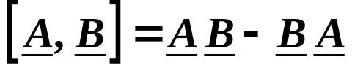

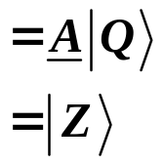

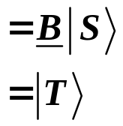
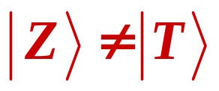
Commutator of Linear Operators
(This implies operating on an arbitrary ket.)
If A and B numbers = 0
Operators don’t necessarily commute.
In General
A and B do not commute.
Copyright – Michael D. Fayer, 2018
Notes:
4
4
4

Slide 5
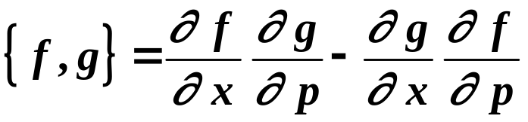
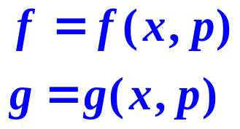
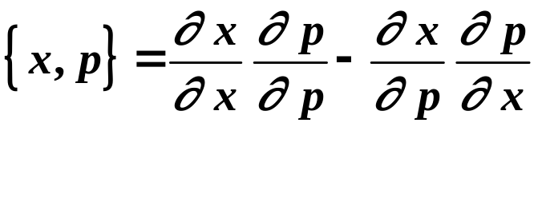

Classical Poisson Bracket
These are functions representing classical
dynamical variables not operators.
Consider position and momentum, classical.
x and p
Poisson Bracket
zero
Copyright – Michael D. Fayer, 2018
Notes:
5
5
5

Slide 6

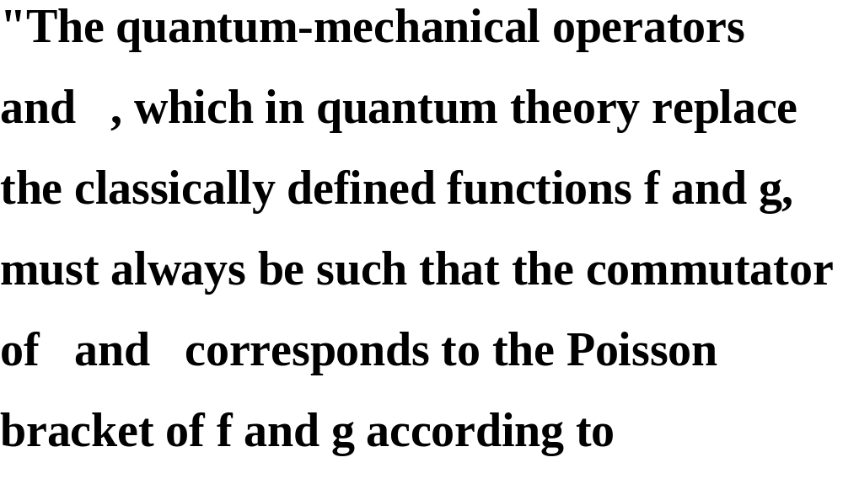

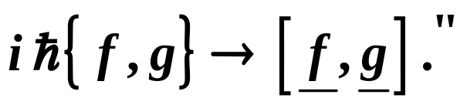
Dirac’s Quantum Condition
Dirac
Copyright – Michael D. Fayer, 2018
Notes:
6
6
6

Slide 7
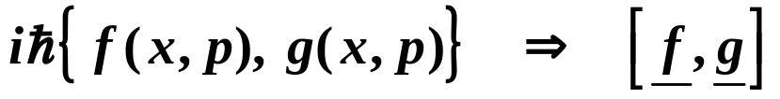
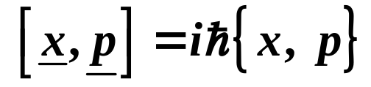
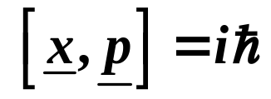
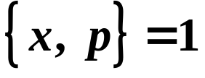
(commutator operates
on a ket)
Poisson bracket of
classical functions
Commutator of
quantum operators
Q.M. commutator of x and p.
commutator
Poisson bracket
Therefore,
Remember, the relation implies operating on
an arbitrary ket.
This means that if you select operators for x and p such that they
obey this relation, they are acceptable operators.
The particular choice a representation of Q.M.
Copyright – Michael D. Fayer, 2018
Notes:
7
7
7

Slide 8
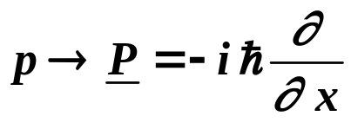
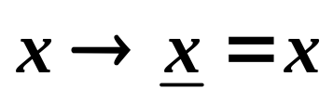


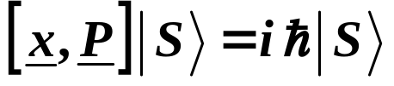

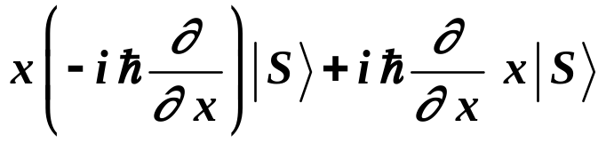
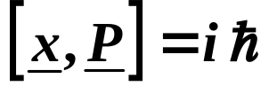
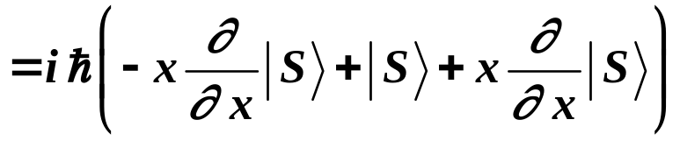
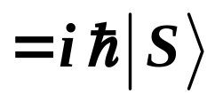
Schrödinger Representation
momentum operator, –i times derivative with
respect to x
position operator, simply x
Operate commutator on arbitrary ket .
Therefore,
and
Using the product rule
because the two sides have the
same result when operating on
an arbitrary ket.
Copyright – Michael D. Fayer, 2018
Notes:
8
8
8

Slide 9
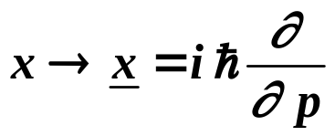
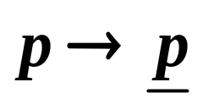

Another set of operators – Momentum Representation
position operator, i times derivative with
respect to p
momentum operator, simply p
A different set of operators, a different representation.
In Momentum Representation, solve position eigenvalue problem
for the free particle.
Get , states of definite position.
They are waves in p space. All values of momentum.
Copyright – Michael D. Fayer, 2018
Notes:
9
9
9

Slide 10


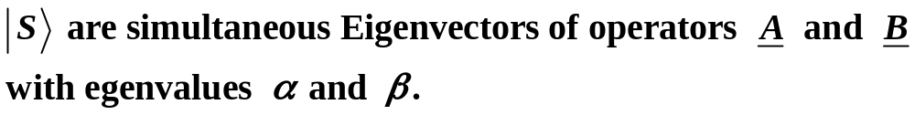

Commutators and Simultaneous Eigenvectors
Eigenvalues of linear operators observables.
A and B are different operators that represent different observables, e. g.,
energy and angular momentum.
If are simultaneous eigenvectors of two or more linear operators
representing observables, then these observables can be
simultaneously measured.
Copyright – Michael D. Fayer, 2018
Notes:
10
10
10

Slide 11


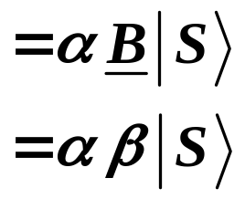
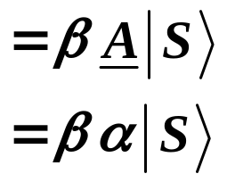

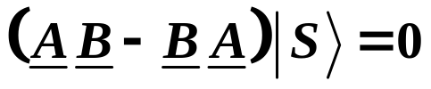


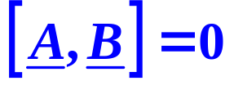

Therefore,
Rearranging
is the commutator of
The operators commute.
Operators having simultaneous eigenvectors commute.
The eigenvectors of commuting operators can always be constructed in such
a way that they are simultaneous eigenvectors.
Copyright – Michael D. Fayer, 2018
Notes:
11
11
11

Slide 12
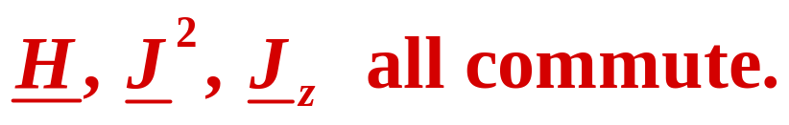
There are always enough Commuting Operators (observables) to
completely define a system.
Example: Energy operator, H, may give degenerate states.
H atom 2s and 2p states have same energy.
j ⇒ 1 for p orbital
j ⇒ 0 for s orbital
But p_{x}, p_{y}, p_{z}
Copyright – Michael D. Fayer, 2018
Notes:
12
12
12

Slide 13
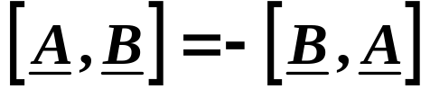
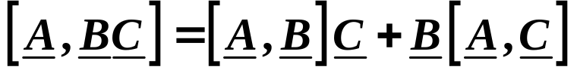
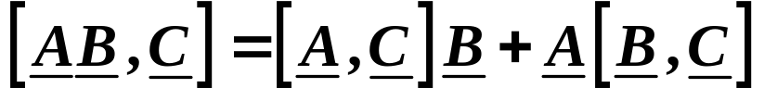
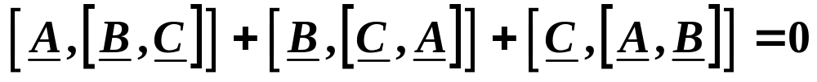

Commutator Rules
Copyright – Michael D. Fayer, 2018
Notes:
13
13
13

Slide 14
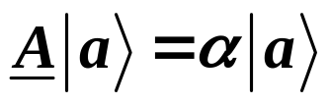

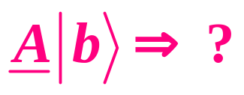


Expectation Value and Averages
normalized
eigenvector eigenvalue
If make measurement of observable A on state will observe α.
What if measure observable A on state not an eigenvector of operator A.
normalized
Expand in complete set of eigenkets Superposition principle.
Eigenkets – complete set. One for each state. Spans state space.
Copyright – Michael D. Fayer, 2018
Notes:
14
14
14

Slide 15

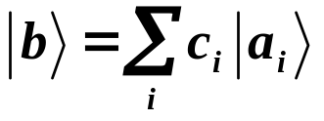
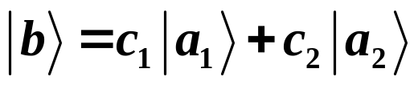
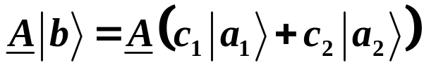
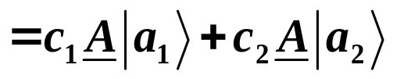
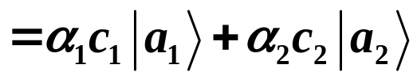


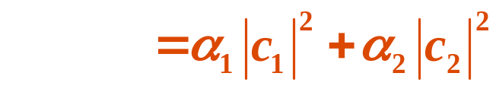
(If continuous range integral)
Consider only two states (normalized and orthogonal).
Left multiply by .
Copyright – Michael D. Fayer, 2018
Notes:
15
15
15

Slide 16

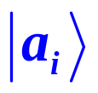
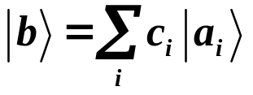
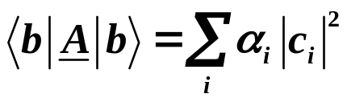
The absolute square of the coefficient c_{i}, | c_{i}|², in the expansion
of in terms of the eigenvectors of the operator (observable)
A is the probability that a measurement of A on the state
will yield the eigenvalue α_{i}.
If there are more than two states in the expansion
eigenvalue probability of eigenvalue
Copyright – Michael D. Fayer, 2018
Notes:
16
16
16

Slide 17
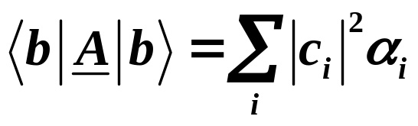
Definition:
The average is the value of a
particular outcome
times its
probability,
summed over all
possible outcomes.
Then
is the average value of the observable when many measurements are made.
Assume:
One measurement on a large number
of identically prepared non
-
interacting systems
is the same as the average of many repeated
measurements on one such system prepared
each time in an identical manner.
Copyright – Michael D. Fayer, 2018
Notes:
17
17
17

Slide 18
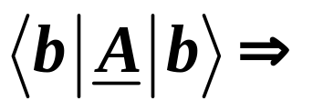
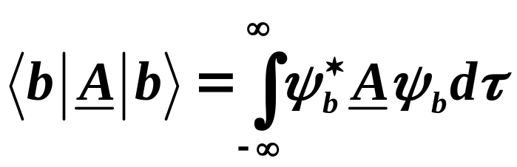
Expectation value of the operator A.
In terms of particular wavefunctions
Copyright – Michael D. Fayer, 2018
Notes:
18
18
18

Slide 19
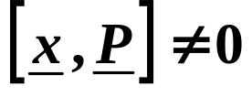


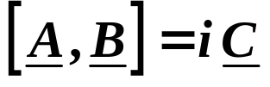

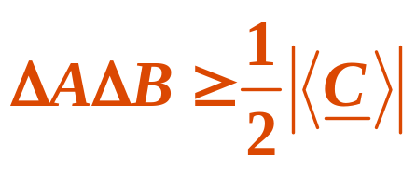


The Uncertainty Principle - derivation
Have shown -
and that
Want to prove:
Given
Hermitian with
another Hermitian operator (could be number –
special case of operator, identity operator).
Then
with
short hand for expectation value
arbitrary but normalized.
Copyright – Michael D. Fayer, 2018
Notes:
19
19
19

Slide 20










Consider operator
arbitrary real numbers
Since is the scalar product of vector
with itself.
(derive this in home work)
is the anticommutator of
.
anticommutator
Copyright – Michael D. Fayer, 2018
Notes:
20
20
20

Slide 21





for arbitrary ket .
Can rearrange to give
Holds for any value of α and β.
Pick α and β so terms in parentheses are zero.
Multiplied through by
and transposed.
Then
Positive numbers because square of real numbers.
Thus,
The sum of two positive
numbers is ≥ one of them.
Copyright – Michael D. Fayer, 2018
Notes:
21
21
21

Slide 22







Define
Second moment of distribution
- for Gaussian
standard deviation squared.
For special case
Average value of the observables are zero.
square root of the
square of a number
Copyright – Michael D. Fayer, 2018
Notes:
22
22
22

Slide 23




Have proven that for
Average value of the
observables are zero.
Example
Number, special case of an operator.
Number is implicitly multiplied by the
identity operator.
Therefore
Uncertainty comes from superposition principle.
The more general case is discussed in the book.
Copyright – Michael D. Fayer, 2018
Notes:
23
23
23

