Slide 1
Chapter 6

Slide 2
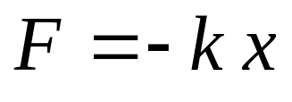
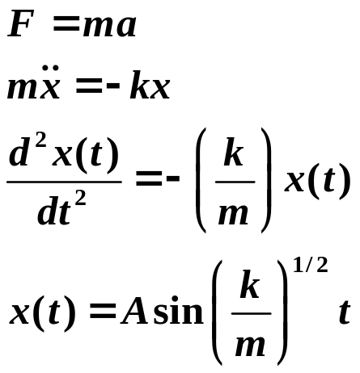
The Harmonic Oscillator
Turning Points, A, -A
m
Stretch spring, let go.
Mass, m, oscillates back and forth.
no friction
Hooke's Law
linear restoring force
force
spring constant
Harmonic oscillator - oscillates sinusoidally.
A is how far the spring is stretched initially.
At the turning points, A, -A, motion stops.
All energy is potential energy.
amplitude mass
Copyright – Michael D. Fayer, 2018
Notes:
2
2
2

Slide 3
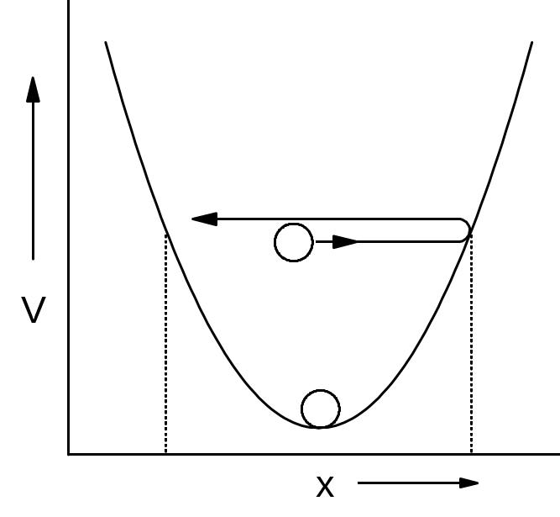
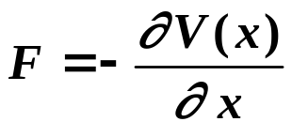
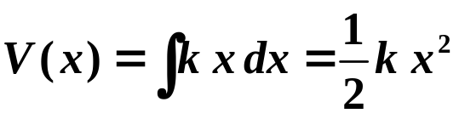


Potential is Parabolic
A
oscillator
frequency, Hz
oscillator
frequency, rad/s
Energy of oscillator is
A - classical turning point.
A can take on any value. Energy is continuous, continuous range of values.
Copyright – Michael D. Fayer, 2018
Notes:
3
3
3

Slide 4
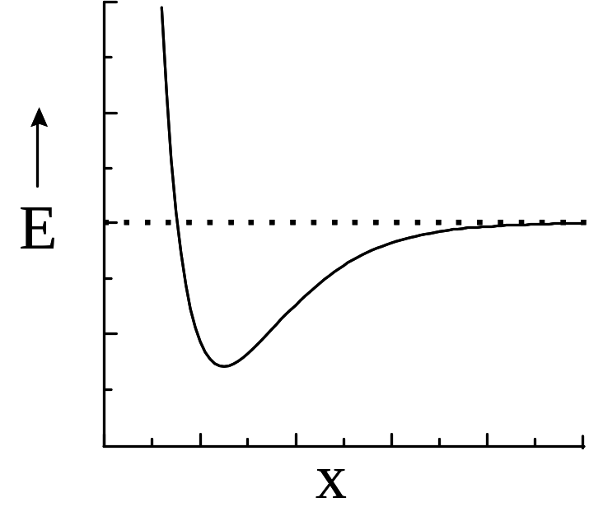
Quantum Harmonic Oscillator
Simplest model of molecular vibrations
Bond dissociation energy
Molecular potential energy
as a function of atomic separation.
Bonds between atoms act as "springs".
Near bottom of molecular potential well,
molecular potential approximately parabolic
Harmonic Oscillator.
Copyright – Michael D. Fayer, 2018
Notes:
4
4
4

Slide 5
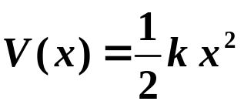


Potential
Classical particle can never
be past turning point.
V
Turning point
Kinetic energy
zero; potential
energy max.
Turning
point
x
Turning
point
Particle can be stationary at bottom of well,
know position, x = 0; know momentum, p = 0.
This can't happen for Q.M. harmonic oscillator.
Uncertainty Principle indicates that minimum Q.M. H.O. energy
Copyright – Michael D. Fayer, 2018
Notes:
5
5
5

Slide 6


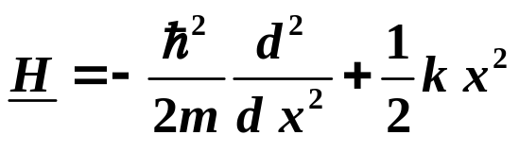
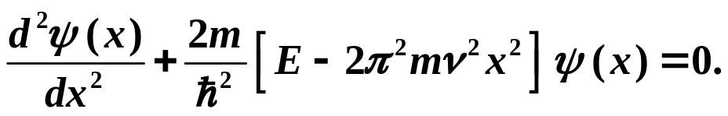

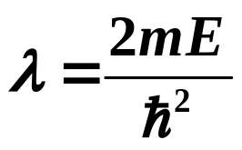
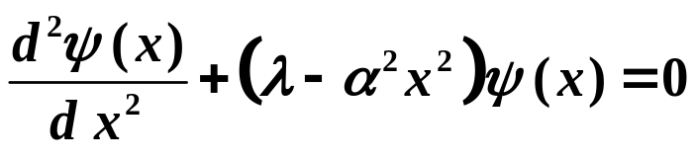
One Dimensional Quantum Harmonic Oscillator
in the Schrödinger Representation
Schrödinger Representation
kinetic energy potential energy
Substitute H and
definition of k.
Mult. by -2m/².
Define
Copyright – Michael D. Fayer, 2018
Notes:
6
6
6

Slide 7



Find
Must obey Born Conditions
1. finite everywhere
2. single valued
3. continuous
4. first derivative continuous
Use polynomial method
1. Determine for
2. Introduce power series to make the large x solution correct for all x.
Copyright – Michael D. Fayer, 2018
Notes:
7
7
7

Slide 8

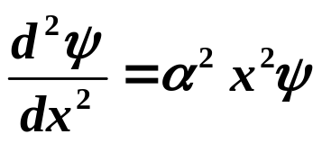
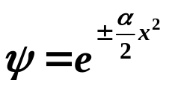
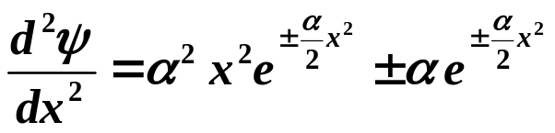
For very large x, as x goes to infinity.
Therefore, λ can be dropped.
Try
Then,
This is negligible compared to the first term
as x goes to infinity.
Copyright – Michael D. Fayer, 2018
Notes:
8
8
8

Slide 9
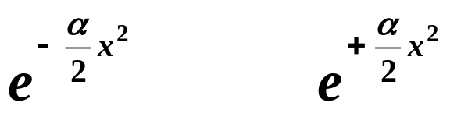

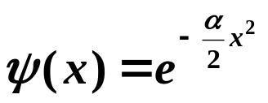
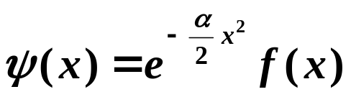
Two solutions
This is O.K. at
This blows up at
Not finite everywhere.
Therefore, large x solution is
For all x
Must find this.
Copyright – Michael D. Fayer, 2018
Notes:
9
9
9

Slide 10
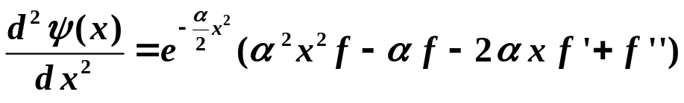
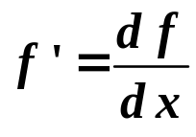
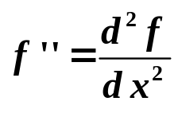
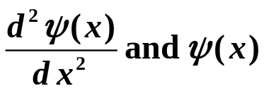
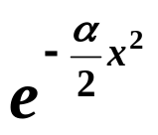
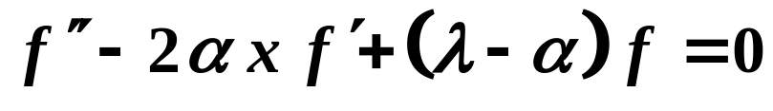

Need second derivative in Schrödinger equation
With
and
Substitute
into the original equation
and divide by
gives
Equation only in f.
Solve for f and have .
Copyright – Michael D. Fayer, 2018
Notes:
10
10
10

Slide 11
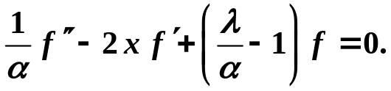


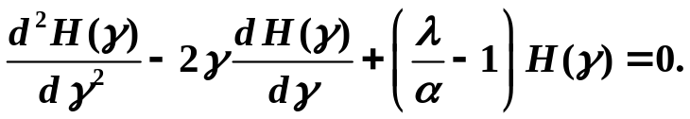
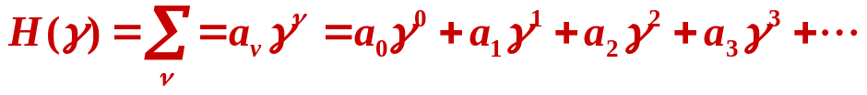
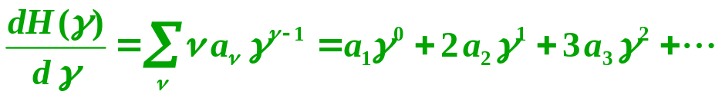
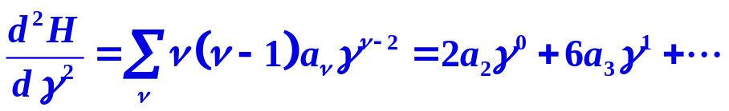
divide by α
substitute
Gives
Hermite's equation
Substitute series expansion for H(γ)
Copyright – Michael D. Fayer, 2018
Notes:
11
11
11

Slide 12

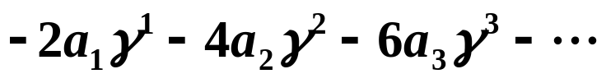
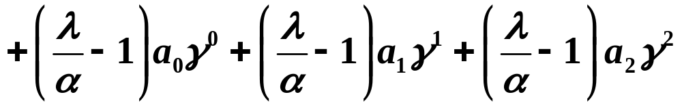
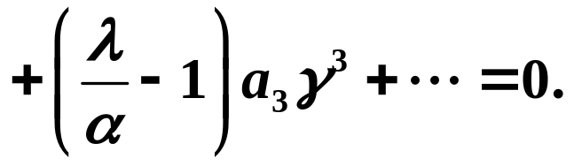
substitute in series
The sum of these infinite
number of terms in all powers
of γ equals 0.
In order for the sum of all the terms in this expression to vanish identically
for any γ,
the coefficients of the individual powers of γ must vanish separately.
To see this consider an unrelated simpler equation.
Fifth degree equation. For a given set of the a_{i}, there will be 5 values of x
for which this is true. However, if you know this is true for any value of x,
then the a_{i} all must be zero.
Copyright – Michael D. Fayer, 2018
Notes:
12
12
12

Slide 13
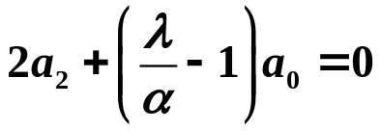
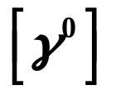
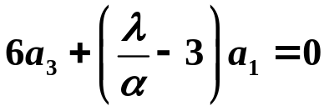
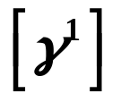
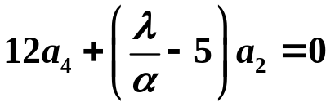
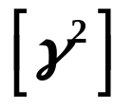
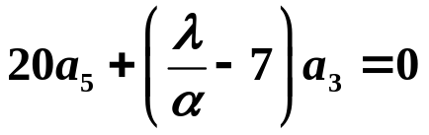

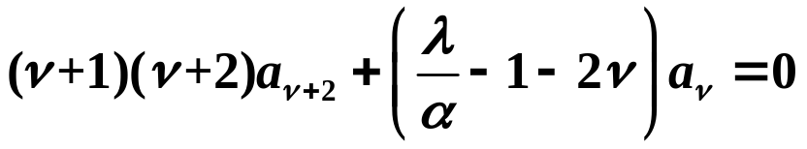
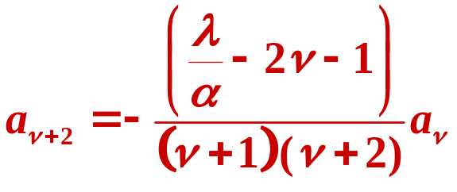
Coefficients of like powers of γ.
In general
ν is an integer. Index in the expansion.
Even and odd series.
Pick a₀ (a₁ = 0), get all even coefficients.
Pick a₁ (a₀ = 0), get all odd coefficients.
Normalization set a₀ and a₁ values.
Recursion Formula
Copyright – Michael D. Fayer, 2018
Notes:
13
13
13

Slide 14
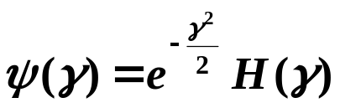


Have expression in terms of series that satisfy the diff. eq.
But not good wavefunction.
Blows up for large |x| if infinite number of terms. (See book for proof.)
For infinite number of terms and large |x|.
blows up
Unacceptable as a wavefunction.
Copyright – Michael D. Fayer, 2018
Notes:
14
14
14

Slide 15
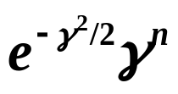
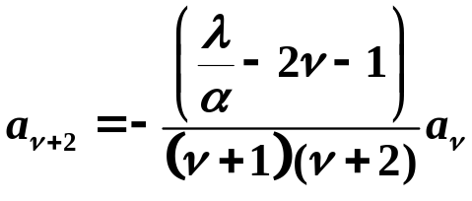
Quantization of Energy
If there are a finite number of terms in the series for H(γ),
wavefunction does not blow up. Goes to zero at infinity.
The exponential goes to zero faster than γ^{n} blows up.
To make series finite, truncate by choice of λ.
λ= α(2n + 1)
n is an integer.
Then, because
with a₀ or a₁ set equal to zero (odd or even series),
series terminates after
ν = n
a finite number of terms.
Copyright – Michael D. Fayer, 2018
Notes:
15
15
15

Slide 16
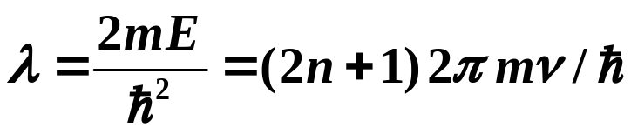
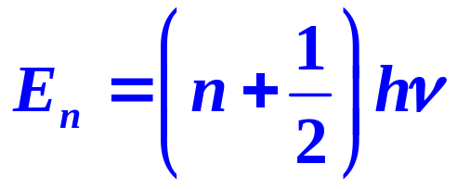

Any value of λ with
λ = (2n + 1)α
is O.K. Any other value of λ is no good.
Therefore,
definition of λ definition of α
Solving for E
n is the quantum number
Lowest energy, not zero. Called zero
point energy.
Energy levels equally spaced by hν.
Copyright – Michael D. Fayer, 2018
Notes:
16
16
16

Slide 17
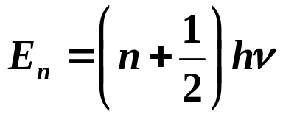


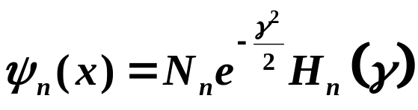





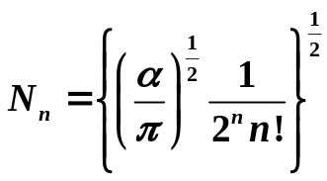


Energy Levels
Hermite Polynomials
Wavefunctions
normalization constant
Copyright – Michael D. Fayer, 2018
Notes:
17
17
17

Slide 18
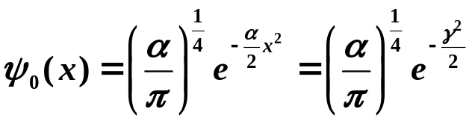
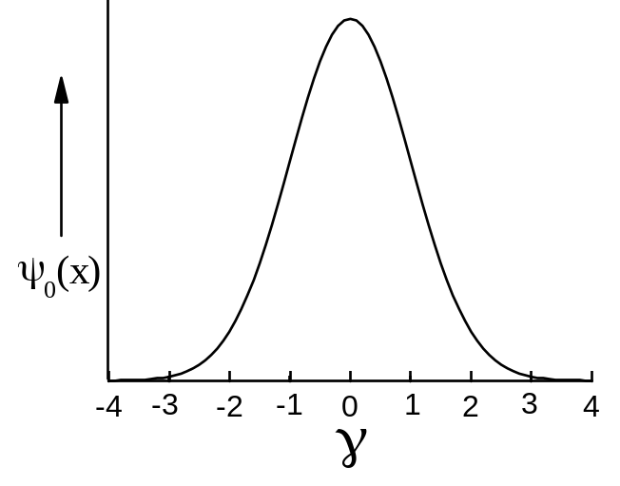





Lowest state n = 0
This is a Gaussian.
Minimum uncertainty.
Classical turning points
potential total
energy energy
classical turning points - wavefunction extends into
classically forbidden region.
Copyright – Michael D. Fayer, 2018
Notes:
18
18
18

Slide 19

More wavefunctions - larger n, more nodes
Copyright – Michael D. Fayer, 2018
Notes:
19
19
19

Slide 20

Probability for n = 10
Classical turning points
~γ = ± 4.6
Time classical oscillator
spends as a function
of position.
γ
Looks increasingly classical.
For large object, nodes so closely spaced because n very large that
can't detect nodes.
Copyright – Michael D. Fayer, 2018
Notes:
20
20
20

Slide 21






Dirac Approach to Q.M. Harmonic Oscillator
Very important in theories of
vibrations, solids, radiation
Want to solve
eigenkets, normalized
We know commutator relation
To save a lot of writing, pick units such that
In terms of these units
identity operator
Copyright – Michael D. Fayer, 2018
Notes:
21
21
21

Slide 22









Define operators
is the complex conjugate (adjoint) of a since P and x are Hermitian.
Then
Hamiltonian commutator
Copyright – Michael D. Fayer, 2018
Notes:
22
22
22

Slide 23







Similarly
Therefore
Very different looking from Schrödinger Hamiltonian.
and
Can also show
Copyright – Michael D. Fayer, 2018
Notes:
23
23
23

Slide 24









Consider ; eigenkets of H, normalized.
scalar product of vector with itself
only if
We have
Then
normalized, equals 1
Therefore,
Copyright – Michael D. Fayer, 2018
Notes:
24
24
24

Slide 25










Now consider
eigenket of H
commutator
these are same
rearrange
is some ket.
Operate H on ket, get same ket back
times number.
Then,
is eigenket with
eigenvalue, E - 1.
transpose
eigenvalue eigenket
Label ket with eigenvalue.
factor
Maybe number multiplying.
Direction defines state, not length.
Copyright – Michael D. Fayer, 2018
Notes:
25
25
25

Slide 26











a is a lowering operator.
It gives a new eigenvector of H with one unit lower energy.
Each application gives new ket with one unit
lower energy.
Could keep doing this indefinitely,
but
For eigenvector
Therefore, at some point we have a value of
E, call it E₀,
such that if we subtract 1 from it
not zero
But E₀ - 1 can't be < 1/2. Therefore
in conventional
units
Copyright – Michael D. Fayer, 2018
Notes:
26
26
26

Slide 27






Raising Operator
using the commutator
rearranging, operating, and factoring as before
These are the same.
Therefore, is an eigenket of H with eigenvalue E + 1.
number here, but direction defines state
takes state into new state, one unit higher in energy.
It is a raising operator.
Copyright – Michael D. Fayer, 2018
Notes:
27
27
27

Slide 28







is the state of lowest energy with eigenvalue (energy) 1/2.
Apply raising operator repeatedly. Each application gives state
higher in energy by one unit.
eigenvalue, one unit higher in energy
With normal units
Same result as with Schrödinger Eq.
Copyright – Michael D. Fayer, 2018
Notes:
28
28
28

Slide 29
Schrödinger vs. Dirac Approaches
Hamiltonian and method of solution,
mathematically very different, but
eigenvalues the same.
Dirac, only needed Hamiltonian and commutator,
no auxiliary Born Conditions.
No wave functions in Dirac approach. Wave functions
intermediate step in Schrödinger method.
Not necessary. Not real in sense not observables,
but can be useful in qualitative understanding.
Copyright – Michael D. Fayer, 2018

Slide 30









Eigenkets labeled with energy
Can relabel kets with quantum number
Take to be normalized.
Raising and Lowering operators
numbers multiply ket when raise
or lower
Will derive these below.
Copyright – Michael D. Fayer, 2018
Notes:
30
30
30

Slide 31





Consider operator
operating on
Therefore
is an eigenket of operator with eigenvalue n.
number operator. Eigenvalue – quantum number
Important in Quantum Theory of Radiation and Solids
and
called creation and annihilation operators.
Number operator gives number of photons in radiation field
or number of phonons (quantized vibrations of solids) in crystal.
Copyright – Michael D. Fayer, 2018
Notes:
31
31
31

Slide 32










Using the occupation number representation with normal units
Consider
Therefore, are eigenkets of H with eigenvalues .
Copyright – Michael D. Fayer, 2018
Notes:
32
32
32

Slide 33








Units in the raising and lowering operators
Many constants. This is the reason
why derivation was done in units
such that .
Need constants and units to work
problems.
Bring i inside.
Multiply top and bottom by –i,
and bring –i inside.
Add operators, P cancels.
x in terms of raising and lowering operators.
Subtract operators, get P in terms of
raising and lowering operators.
Copyright – Michael D. Fayer, 2018
Notes:
33
33
33

Slide 34



Can use the raising and lowering operator representation to calculate
any Q.M. properties of the H. O.
Example
for ground state, average value of x⁴
In Schrödinger Representation
Copyright – Michael D. Fayer, 2018
Notes:
34
34
34

Slide 35


constant - C
Many terms. Must keep order correct. Operators don’t commute.
Copyright – Michael D. Fayer, 2018
Notes:
35
35
35

Slide 36





Could write out all of the terms, but easier way.
Any term that doesn’t have same number of a’s and a⁺ = 0
Example
orthogonal = 0
Any operator that starts with a is zero.
Can't lower past lowest state.
Terms with are also zero
because
Copyright – Michael D. Fayer, 2018
Notes:
36
36
36

Slide 37




Only terms left are
No integrals. Must be able to count.
Copyright – Michael D. Fayer, 2018
Notes:
37
37
37

Slide 38

Vibrational Wave Packet
A short optical pulse will excite many
vibrational levels of the excited state
potential surface.
pulse bandwidth
excited
electronic
state
Launches
vibrational
wave packet
vibrational levels
short pulse optical excitation
ground electronic state
Copyright – Michael D. Fayer, 2018
Notes:
38
38
38

Slide 39





Model Excited State Vibrational Wave Packet with H. O. States
Time dependent H. O. ket
Superposition representing wave packet on excited surface
Calculate position expectation value - average position - center of packet.
Copyright – Michael D. Fayer, 2018
Notes:
39
39
39

Slide 40







only non-zero
if
Then
But
and
This expression shows that time dependent.
Time dependence is determined by superposition of vibrational states
produced by radiation field.
Copyright – Michael D. Fayer, 2018
Notes:
40
40
40

Slide 41


Simplify
Take n large so
n >1
Also,
α_{i} = α
Otherwise
α_{j} = 0
Each state same amplitude in superposition
for some limited set of states.
Using these
Position oscillates as cos(ωt).
Copyright – Michael D. Fayer, 2018
Notes:
41
41
41

Slide 42
Wave packet on potential surface,
modeled as a harmonic oscillator potential.
Packet moves back and forth.
I₂ example
Ground state excited to B state
λ ~ 565 nm
20 fs pulse bandwidth ~700 cm⁻¹
Level spacing at this energy ~69 cm⁻¹
Take pulse spectrum to be rectangle and all α excited same within bandwidth.
States n = 15 to n = 24 excited
(Could be rectangle)
Copyright – Michael D. Fayer, 2018
Notes:
42
42
42

Slide 43


Cos +1 to -1
distance traveled twice coefficient of Cos
10 equal amplitude states.
Distance traveled = 1.06 Å.
Comparable to bond length – 2.66 Å.
Copyright – Michael D. Fayer, 2018
Notes:
43
43
43

Slide 44

NaI Photodissociation - Zewail
Copyright – Michael D. Fayer, 2018
Notes:
44
44
44

Slide 45

Every time the wave packets hit the outer potential wall, some tunneling
occurs and a little puff of products, Na + I, comes out.
Copyright – Michael D. Fayer, 2018
Notes:
45
45
45

Slide 46





To find
Take complex conjugate
Now
Work out
from here
Copyright – Michael D. Fayer, 2018
Notes:
46
46
46

Slide 47





But
Then
and
Therefore,
True if
Copyright – Michael D. Fayer, 2018
Notes:
47
47
47

