Slide 1
English Language Learners and the Elementary and Secondary Education Act
Kenji Hakuta
Stanford University

Slide 2

English Language Learners
and the Elementary and Secondary Education Act
Kenji Hakuta
Stanford University
Source: Historical Photograph Collection of San Francisco Public Library's San Francisco History Center.

Slide 3
Lau v. Nichols (1974)
Source: Historical Photograph Collection of San Francisco Public Library's San Francisco History Center.

Slide 4




Policy and Practice:
Carrots and Sticks
Civil Rights Act, Lau v. Nichols, EEOA, Castañeda interpretation.
Elementary and Secondary Education Act Title I, Title III…
Notes:
4

Slide 5
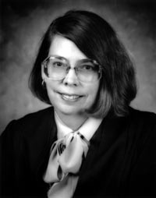
Castañeda v. Pickard (1981)
Fifth Circuit Court of Appeals
§ 1703(f) of the EEOA makes it unlawful for an educational agency to fail to take "appropriate action” to overcome language barriers that impede equal participation by its students in its instructional programs."
(1) Whether the school system is pursuing a program informed by an educational theory recognized as sound by some experts in the field, or, at least, deemed a legitimate experimental strategy.
(2) Whether the programs and practices actually used by the school system are reasonably calculated to implement effectively the educational theory adopted by the school.
(3) Whether the school's program succeeds, after a legitimate trial, to produce results indicating that the language barriers confronting students are actually being overcome.
Judge Carolyn Randall (King)
648 F.2d 989; 1981 U.S.
Notes:
5

Slide 6
Castañeda v. Pickard (1981)
Fifth Circuit Court of Appeals
§ 1703(f) of the EEOA makes it unlawful for an educational agency to fail to take "appropriate action” to overcome language barriers that impede equal participation by its students in its instructional programs."
(1) Whether the school system is pursuing a program informed by an educational theory recognized as sound by some experts in the field, or, at least, deemed a legitimate experimental strategy.
(2) Whether the programs and practices actually used by the school system are reasonably calculated to implement effectively the educational theory adopted by the school.
(3) Whether the school's program succeeds, after a legitimate trial, to produce results indicating that the language barriers confronting students are actually being overcome.
648 F.2d 989; 1981 U.S.
Notes:
6

Slide 7
Castañeda v. Pickard (1981)
Fifth Circuit Court of Appeals
§ 1703(f) of the EEOA makes it unlawful for an educational agency to fail to take "appropriate action” to overcome language barriers that impede equal participation by its students in its instructional programs."
(1) Whether the school system is pursuing a program informed by an educational theory recognized as sound by some experts in the field, or, at least, deemed a legitimate experimental strategy.
(2) Whether the programs and practices actually used by the school system are reasonably calculated to implement effectively the educational theory adopted by the school.
(3) Whether the school's program succeeds, after a legitimate trial, to produce results indicating that the language barriers confronting students are actually being overcome.
648 F.2d 989; 1981 U.S.
Notes:
7

Slide 8
Castañeda v. Pickard (1981)
Fifth Circuit Court of Appeals
§ 1703(f) of the EEOA makes it unlawful for an educational agency to fail to take "appropriate action” to overcome language barriers that impede equal participation by its students in its instructional programs."
(1) Whether the school system is pursuing a program informed by an educational theory recognized as sound by some experts in the field, or, at least, deemed a legitimate experimental strategy.
(2) Whether the programs and practices actually used by the school system are reasonably calculated to implement effectively the educational theory adopted by the school.
(3) Whether the school's program succeeds, after a legitimate trial, to produce results indicating that the language barriers confronting students are actually being overcome.
648 F.2d 989; 1981 U.S.
Notes:
8

Slide 9
Sound theory
revise
examine
Results
reform
Implementation
evaluate
Articulated in OCR policy memoranda issued on Sept. 11, 1984, reiterated successively in 1985, 1990, 1991.
Notes:
This is not rocket science, but give us a framework as we think about what is a good district or school practice.
It is important to note that this framework needs to apply to both the English language acquisition needs of the students, and to the academic content needs of the students. Both are clearly articulated in Lau, as well as most recently in NCLB.
9

Slide 10
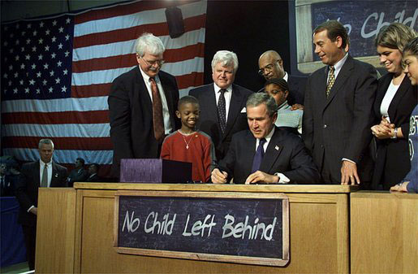
No Child Left Behind

Slide 11

No Child Left Behind:
Three important pieces for ELLs
Sec. 1111(a)(3)(ix)(III) the inclusion of limited English proficient students, who shall be assessed in a valid and reliable manner and provided reasonable accommodations on assessments administered … including, to the extent practicable, assessments in the language and form most likely to yield accurate data…
Sec. 1111(a)(3)(xiii) enable results to be disaggregated within each State, local educational agency, and school by…English proficiency status.
Sec 3113(b)(2) standards and objectives for raising the level of English proficiency that are derived from the four recognized domains of speaking, listening, reading, and writing, and that are aligned with achievement of the challenging State academic content and student academic achievement standards described in section 1111(b)(1).

Slide 12
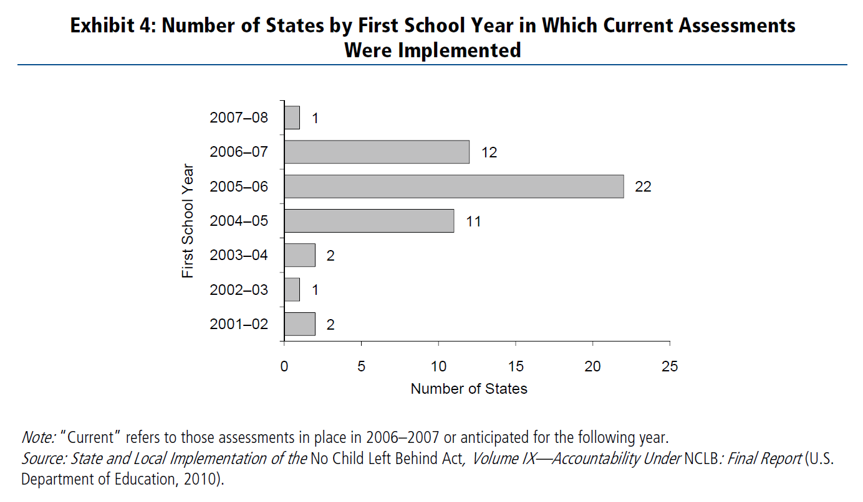
NCLB Implementation
Ramsey, A. & O’Day, J. (2010). Title III Policy: State of the States. ESEA Evaluation Brief: The English Language Acquisition Act, Language Enhancement, and Academic Achievement Act. Washington, DC: American Institutes for Research.

Slide 13
What we have learned from research and experience …
We don’t need to be scared by bilingualism, although we probably will continue to be, because it’s a cultural thing.
Language of instruction is not the question researchers should focus on, unless bilingualism is the explicit goal.
English language development takes time -- we can be more focused and direct, but it still takes time.
There is something called “academic language” that goes beyond just the vocabulary of the content glossary – and it would be a good thing to get content teachers engaged with its development.
Long-term English learners demand particular attention.
Language proficiency is not the same as mastery of academic content.
Strong relationships exist between English proficiency development and content area achievement, even using imperfect present-day measures.
Appropriate assessment of ELLs remains a challenge – we probably need something like a Castañeda standards defining appropriate assessment practices.
Standards, assessment, and accountability practices that are inclusive of ELLs have gained some ground and traction in school and district practice.
School and district organization and leadership to create coherence do seem to matter.

Slide 14
What we have learned…
Language of instruction is not the question researchers should focus on, unless bilingualism is the explicit goal.
English language development takes time -- we can be more focused and direct, but it still takes time.
There is something called “academic language” that goes beyond just the vocabulary of the content glossary – and it would be a good thing to get content teachers engaged with its development.
Long-term English learners demand particular attention.
Language proficiency is not the same as mastery of academic content.
Strong relationships exist between English proficiency development and content area achievement, even using imperfect present-day measures.
Appropriate assessment of ELLs remains a challenge – we probably need something like a Castañeda standards defining appropriate assessment practices.
Standards, assessment, and accountability practices that are inclusive of ELLs have gained some ground and traction in school and district practice.
School and district organization and leadership to create coherence do seem to matter.

Slide 15
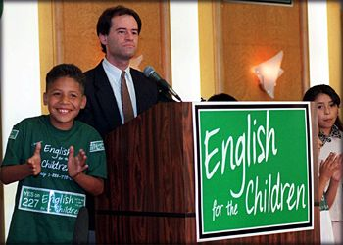
Dominance of “language of instruction” debate and time frame expectation.
1974
Getting beyond this….
1998
Notes:
Yet the policy debates in this area have focused on the learning of English and on access to academic content through English, and almost never on bilingualism. This is most evident in divisive ballot initiatives such as Proposition 227 that is a textbook example of wedge politics.
15

Slide 16
What we have learned…
English language development takes time -- we can be more focused and direct, but it still takes time.
There is something called “academic language” that goes beyond just the vocabulary of the content glossary – and it would be a good thing to get content teachers engaged with its development.
Long-term English learners demand particular attention.
Language proficiency is not the same as mastery of academic content.
Strong relationships exist between English proficiency development and content area achievement, even using imperfect present-day measures.
Appropriate assessment of ELLs remains a challenge – we probably need something like a Castañeda standards defining appropriate assessment practices.
Standards, assessment, and accountability practices that are inclusive of ELLs have gained some ground and traction in school and district practice.
School and district organization and leadership to create coherence do seem to matter.

Slide 17
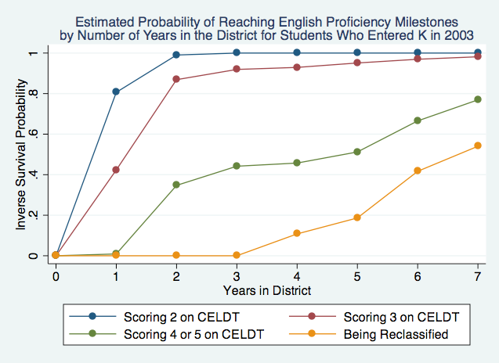

Slide 18
What we have learned…
Long-term English learners demand particular attention.
Language proficiency is not the same as mastery of academic content.
Strong relationships exist between English proficiency development and content area achievement, even using imperfect present-day measures.
Appropriate assessment of ELLs remains a challenge – we probably need something like a Castañeda standards defining appropriate assessment practices.
Standards, assessment, and accountability practices that are inclusive of ELLs have gained some ground and traction in school and district practice.
School and district organization and leadership to create coherence do seem to matter.

Slide 19
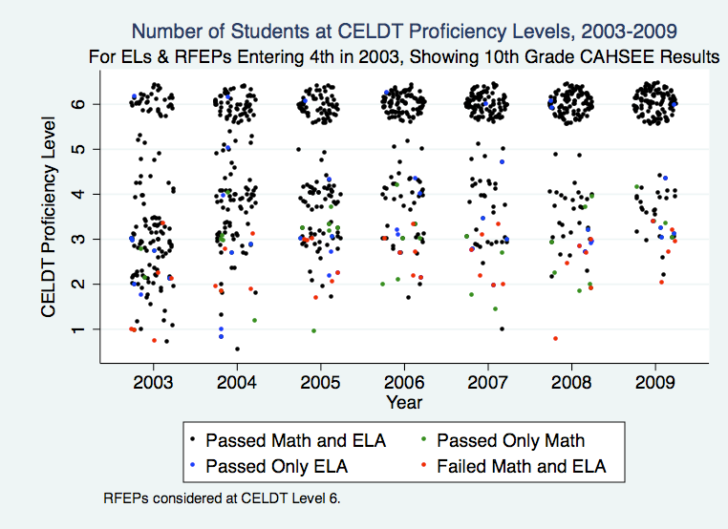
Toward High School Graduation
Notes:
Longitudinal picture of high stakes outcomes of EL and RFEP students taking CAHSEE in 10th grade in 2009, backward mapping those students’ CELDT scores to 4th grade. Color dots show those who failed CAHSEE in 10th grade. These show that getting kids in grades 4-6 out of CELDT 3 should be a high priority as far as CAHSEE pass likelihood.

Slide 20
Increasing Risk to High School Graduation…
19% 35% 38% 52% 59% 55% 70%
Notes:
Longitudinal picture of high stakes outcomes of EL and RFEP students taking CAHSEE in 10th grade in 2009, backward mapping those students’ CELDT scores to 4th grade. Color dots show those who failed CAHSEE in 10th grade. These show that getting kids in grades 4-6 out of CELDT 3 should be a high priority as far as CAHSEE pass likelihood.

Slide 21
What we have learned…
Strong relationships exist between English proficiency development and content area achievement, even using imperfect present-day measures.
Appropriate assessment of ELLs remains a challenge – we probably need something like a Castañeda standards defining appropriate assessment practices.
Standards, assessment, and accountability practices that are inclusive of ELLs have gained some ground and traction in school and district practice.
School and district organization and leadership to create coherence do seem to matter.

Slide 22
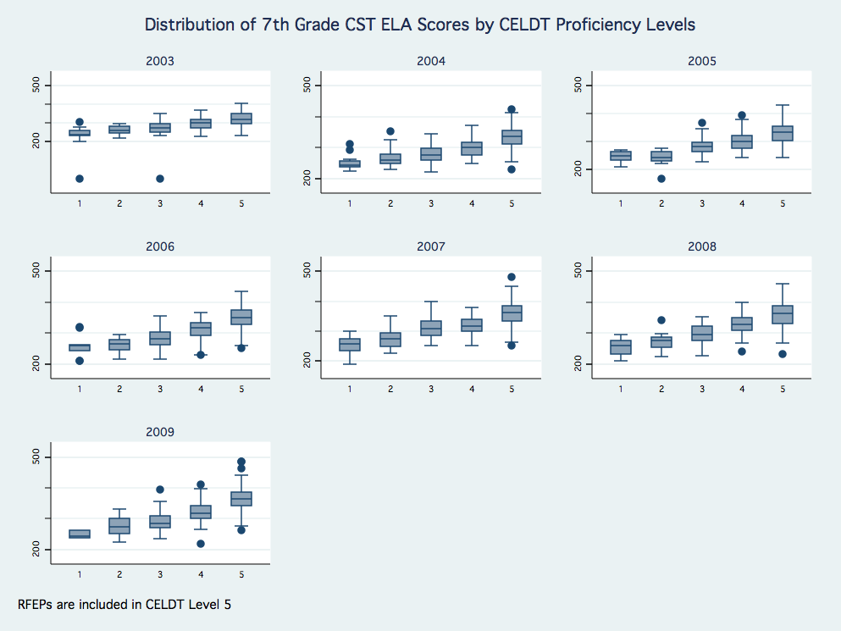

Slide 23
What we have learned…
School and district organization and leadership to create coherence do seem to matter.

Slide 24

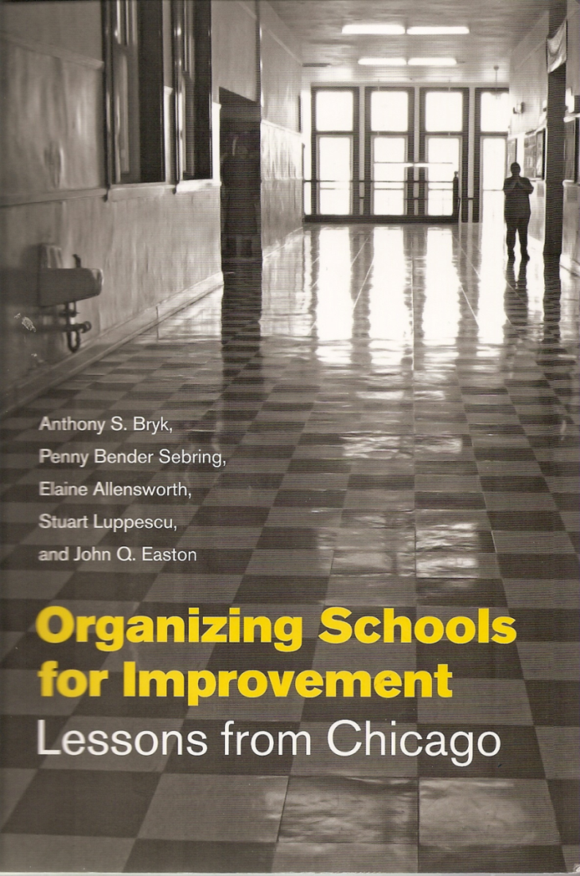

Schoolwide vision and culture
Staff capacity
Leadership continuity
http://www.edsource.org/pub_SimStu_EL9-07_lay-report.html
ELD and core curriculum
Assessment and data
http://www.cgcs.org/publications/ELL_Report09.pdf
Parents, community, trust

Slide 25
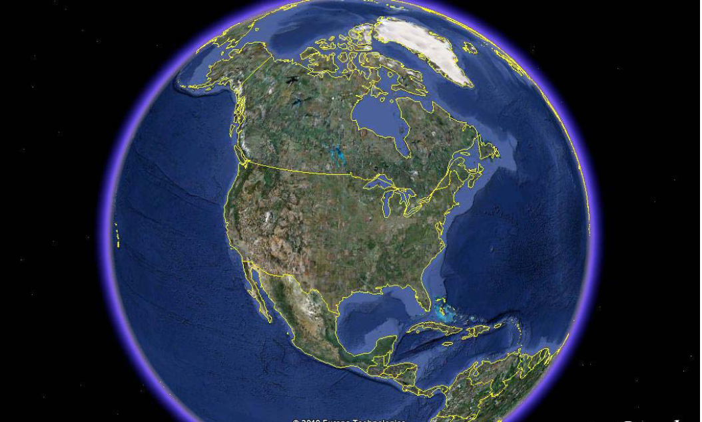

Slide 26
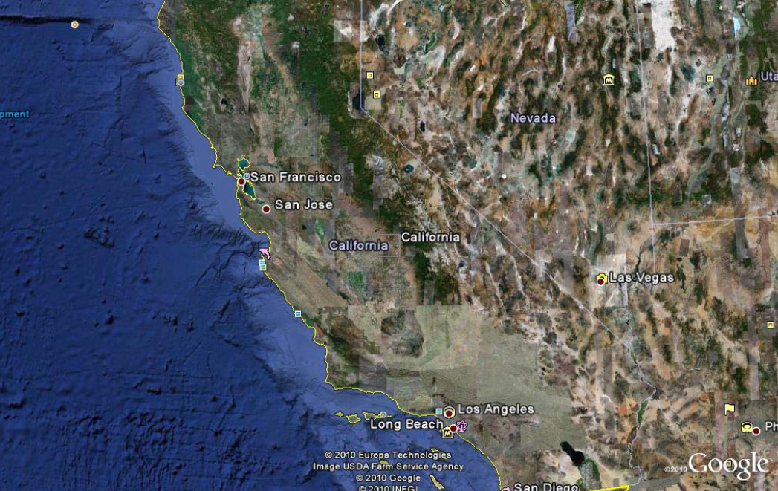

Slide 27
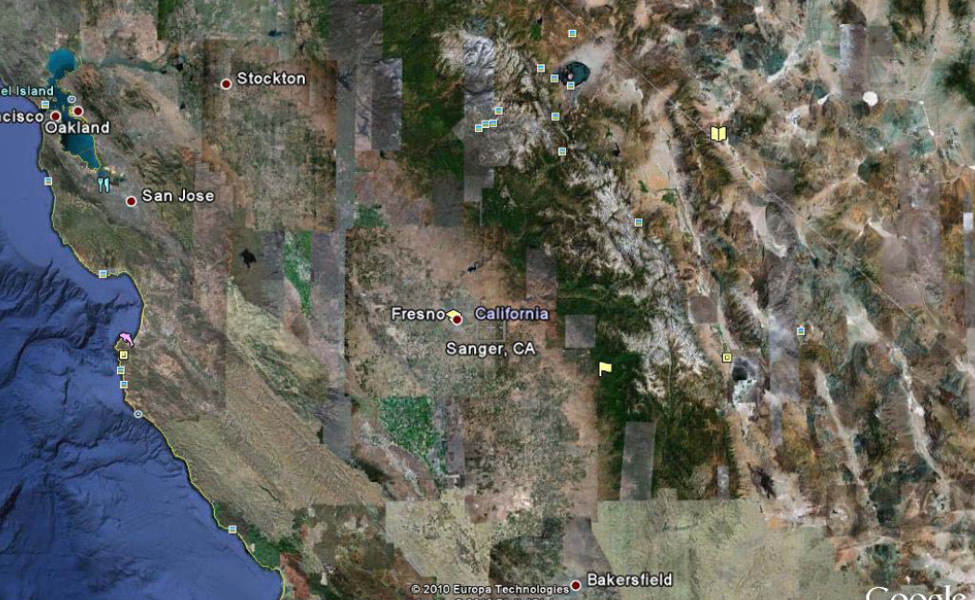

Slide 28
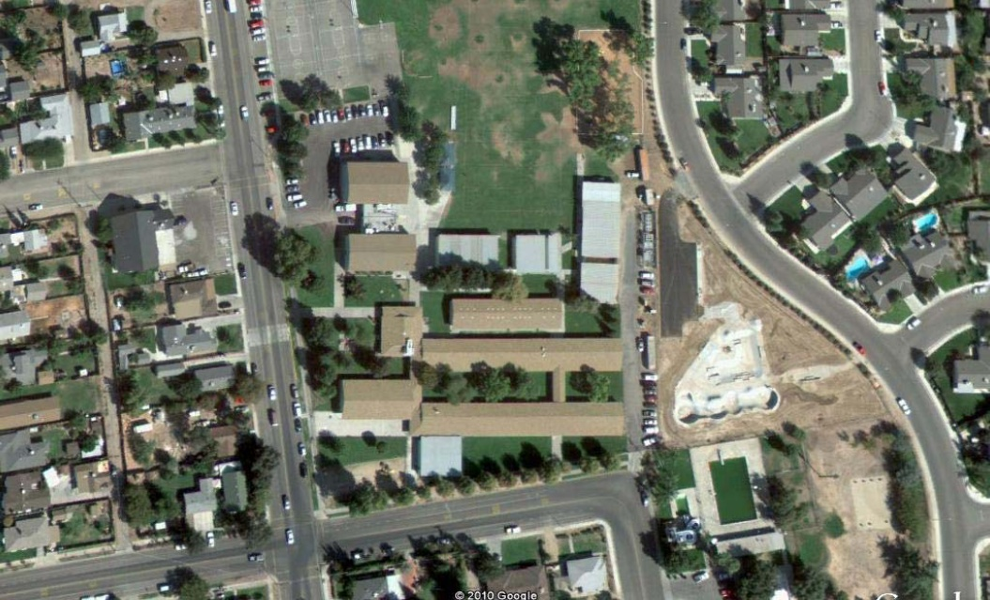

Slide 29
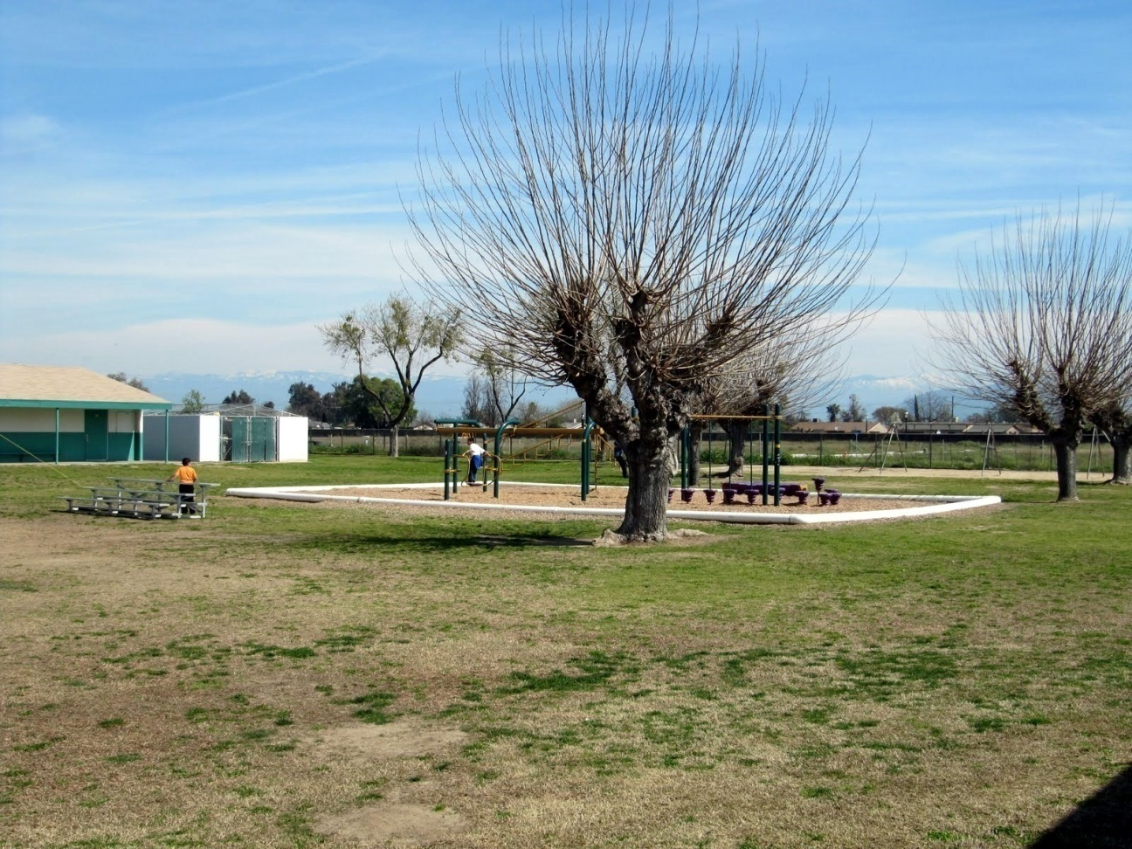
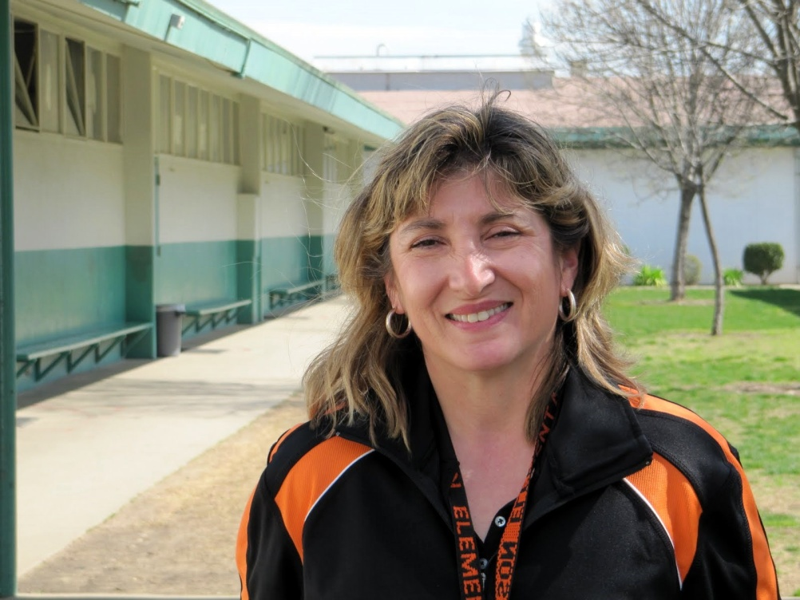

Slide 30
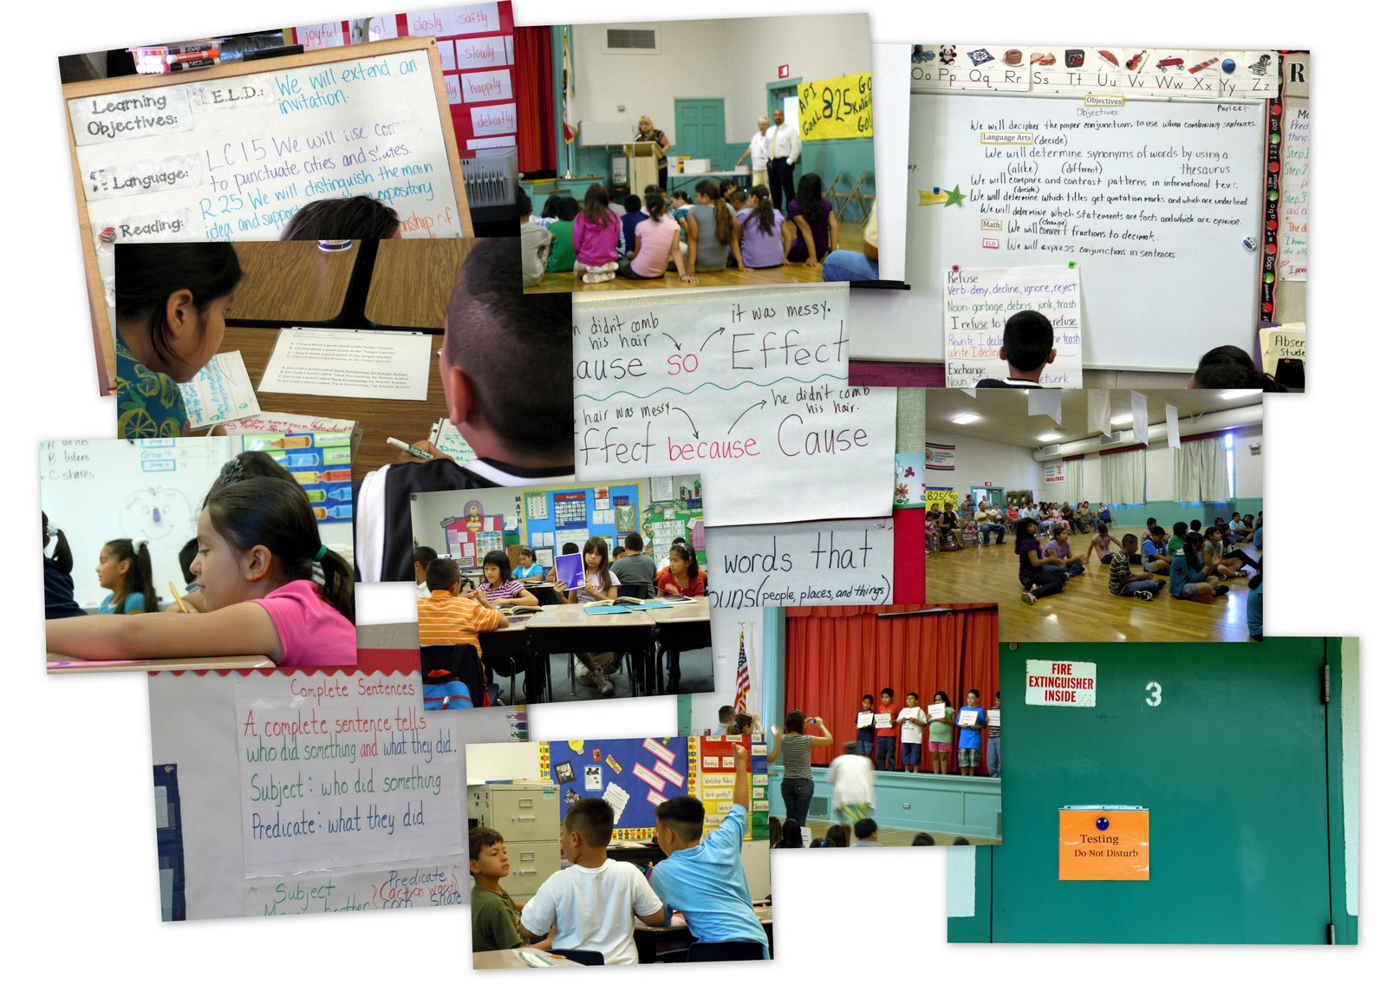

Slide 31
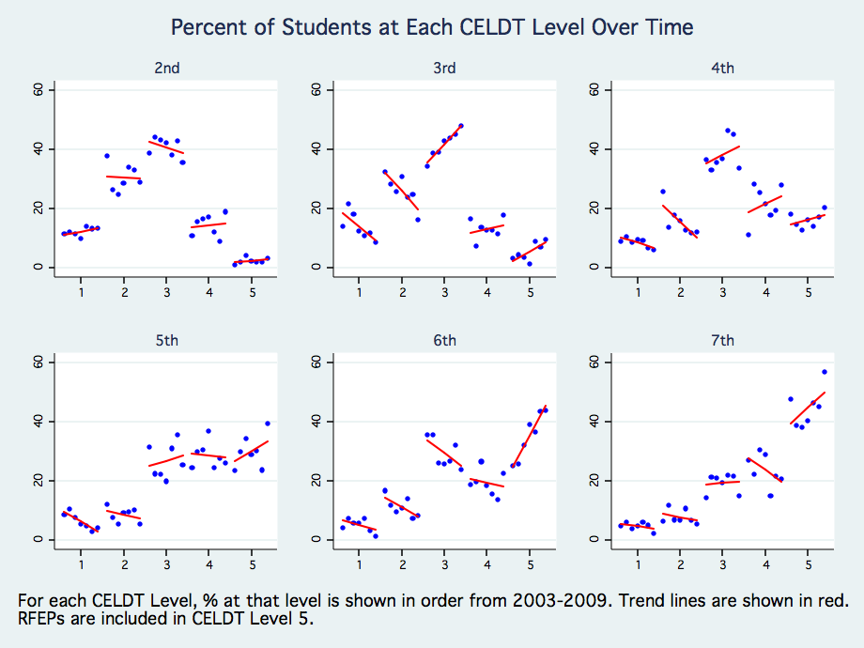
Showing Growth in English Language Proficiency Development
Notes:
Time expectations for English proficiency development is key, and policy either ignores this, or has unrealistic expectations, such as that kids should learn English in one year. This is not realistic. Data solidly show that even in the best-performing of districts, it takes five or more years for most ELLs to attain proficiency in English. Look at these data from Sanger. It is not until the 5th grade that most of the ELLs are in the higher levels of English proficiency. So, we think that 5 years is a realistic but ambitious expectation for most school districts, and that policy should drive toward this expectation.

Slide 32
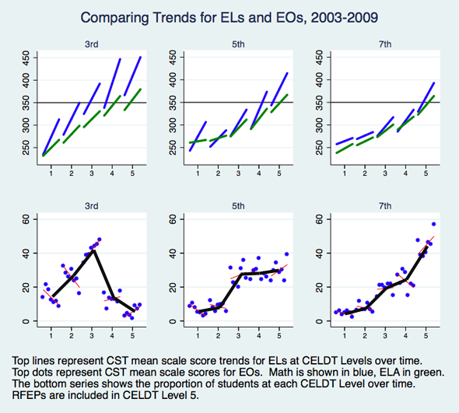
CST Relationship with CELDT

Slide 33
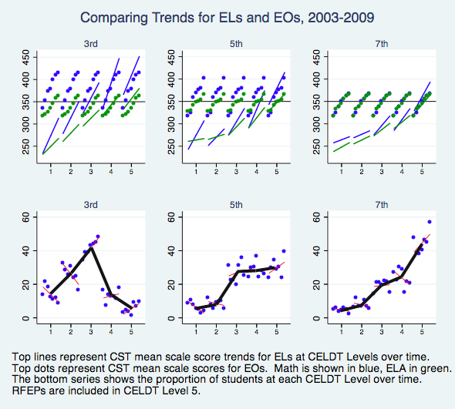
Narrowing the EL-EO Gap

Slide 34
Notes:
Example of looking at CST trends in particular grades over time, comparing district to state data, separating out schools. This can be helpful in visualizing outlier schools and schools improving (Jackson, Fairmont) and those declining (Lone Star).

Slide 35
Notes:
Disaggregated data for EL’s (including RFEPs) and EO’s over time. These data show, for example, that the district has been having special success with math but is enjoying less success with ELA.

Slide 36
What to look forward to…
ESEA reauthorization
Common Core State Standards
Re-alignment of English Language Proficiency Standards to CCSS
Increased attention to school and district organization and leadership.

Slide 37

http://ellpolicy.org

Slide 38
Working Group on ELL Policy
Diane August (Center for Applied Linguistics)
Steve Barnett (National Institute for Early Education Research)
Donna Christian (Center for Applied Linguistics)
Michael Fix (Migration Policy Institute)
Ellen Frede (National Institute for Early Education Research)
David Francis (University of Houston)
Patricia Gándara (University of California, Los Angeles)
Eugene Garcia (Arizona State University)
Claude Goldenberg (Stanford University)
Kris Gutiérrez (University of California, Los Angeles)
Kenji Hakuta (Stanford University)
Janette Klingner (University of Colorado)
Robert Linquanti (WestEd)
Jennifer O’Day (American Institutes for Research)
Charlene Rivera (George Washington University)
Notes:
The Working Group on ELL policy is made up of researchers who are working with and have expertise in ELL issues. The members continue to refine and elaborate on their original recommendations released March 2010. We very much look forward to the perspectives and recommendations of this distinguished panel and congressional staffers is gathered here today.

Slide 39

ELL Working Group
http://ellpolicy.org

Slide 40

The Revolving Door Problem

Slide 41
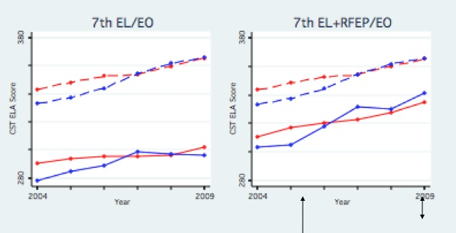
Which graph more accurately represents ELLs’ progress?
Red: California
Blue: Model District
Hakuta & Thompson, 2009
Notes:
Kenji
Now, here is what you get if you exclude the former ELLs. The gap increases, and in fact, by 7th grade, the Sanger data shows that is is doing worse than the state as a whole. This is because Sanger is successful in reclassifying its ELLs, and therefore a larger proportion of their students are no longer in the ELL category. Rather than being rewarded for this, their data make them look worse than the state overall.
So, fixing this revolving door problem, while continuing to pay attention to the needs of the low-performing ELLs, is one focus of our recommendations.
Fixing the revolving door addresses concerns not just about the low-performing ELLs but also former ELLs:
For example, current law (regs) calls for subgroup accountability for graduation rates based on tracking cohorts of high school students and accounting for the outcome of each using individual student identifiers. A four year or extended year cohort measure will see too much turnover to reliably calculate graduation rates, but that problem is solved if schools are held accountable after proficiency is attained.
Also, concerns about inappropriate reclassification of ELLs before they become English proficient, are addressed by keeping all ELLs in the group.
Finally ...less important, but maybe worth mentioning is that problematic "n" size issues will be greatly diminished...so many schools and districts that serve fewer than 100 ELLS at a time would be held accountable for the more stable ELL group.

Slide 42
What does this graph tell us about how ELLs fare educationally?

Slide 43
Recommendation
Require states to establish stable ELL subgroup membership for accountability purposes:
Designate students based on their English language proficiency status at entry into school
Distinguish among ELLs by language proficiency level and highlight long term ELLs
Count students who began as ELLs in ELL cohort for duration of their schooling in the state
Notes:
Ideas:
Say, “we’re going to reflect on this a little later”
For poll slide: do you agree with these? (all 3) Please provide comments and suggestions.
poll . Agree/ disagree?

Slide 44
Benefits
Yields more accurate progress and performance information
Supports better service delivery
Increases fairness and legitimacy of accountability system

Slide 45
Total English Learner (TEL) Group
Students Who Began as ELLs (English Proficient Learners)
Met State's English-language proficiency criteria
Should meet grade-level proficiency; Counted in subgroup to holds states accountable for equity & access
Current ELLs
1-5 yrs in State's schools
Should meet annual ELP & academic progress goals
Long-term ELLs
>5 yrs. in State's Schools
% should decrease annually

Slide 47
Accountability: Language and Academic Measurement Recommendations
Incorporate time explicitly into ESEA accountability provisions for acquiring English language proficiency
  Require states to establish expected timeframes for developing ELLs’ English language proficiency
  Take into account both students’ initial English language proficiency level and grade when first identified ELL

Slide 48
One Approach: Set Weights on
ELA Assessment by Expected ELP Level
ELP 4
Hypothetical weights for illustration only

Slide 49
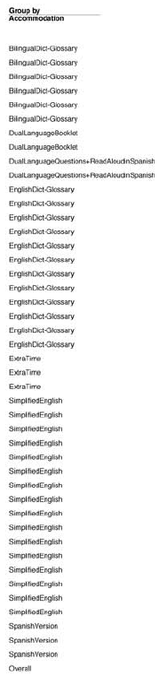
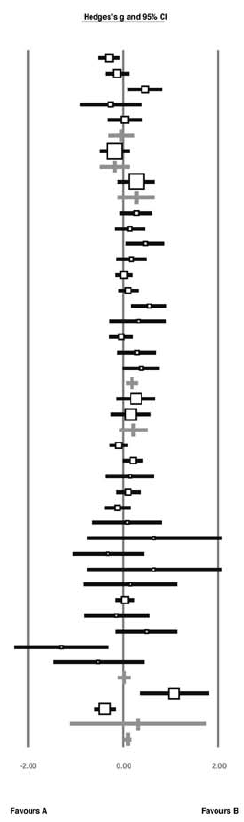
Additional Assessment Recommendations
Require states to implement assessments and assessment practices demonstrated to yield inferences comparable in validity and reliability for ELLs and non-ELLs
Strengthen Federal peer review process on assessments and assessment practices for ELLs
Francis, D., Rivera, M., Lesaux, N., Kieffer, M., & Rivera, H. (2006).

Slide 50

Recommendations related to
Human Capital and Capacity Building
Issue: States Lack Teachers Appropriately Trained to Address ELL Needs

Slide 51
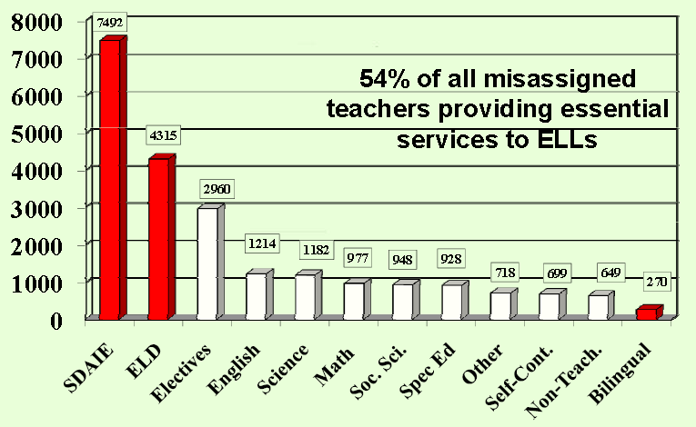
Other Key Recommendations
Require states to demonstrate—as a precondition for receiving funds under Title II and Title III—that their credential requirements and alternative routes to certification of core content teachers include components effective in preparing them to address ELLs’ content and academic language needs

Slide 52
Other Key Recommendations
Define English as a Second Language (ESL) as an additional core academic subject for ELLs within ESEA, and apply same Highly Qualified Teacher requirements to teachers of ESL/ELD as to teachers of other core academic content areas

Slide 53
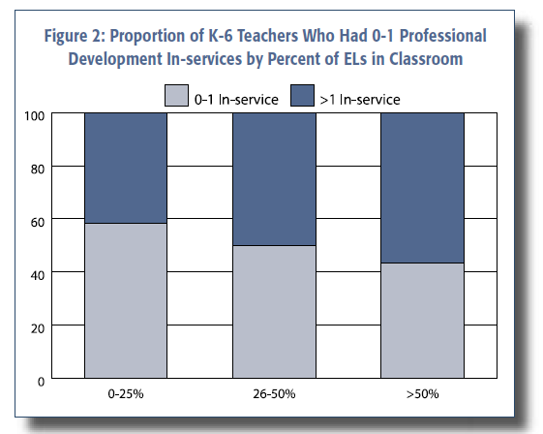
Other Key Recommendations
Focus Title III on building national, state, and local capacity to ensure ELLs acquire language competence needed for academic success
  ESEA Title III should support development of teachers from students’ language communities

Slide 54
Looking Ahead…
How will states make the Common Core State Standards accessible to ELLs?
How will Race to the Top Assessment Consortia design and implement appropriate assessment systems for ELLs?
How will the next generation ELP assessment systems (EAG-ELP) align/integrate with RTTAC?
How will ESEA reauthorization foster or constrain these efforts?
How will we improve quality and effectiveness of teachers of ELLs? How will value-added work?

Slide 55


Slide 56
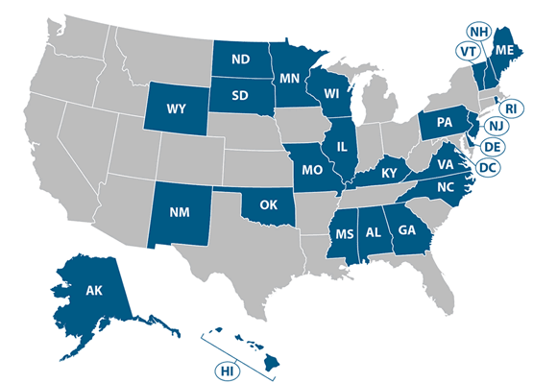
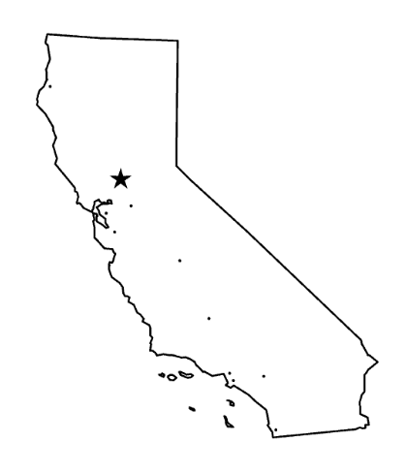
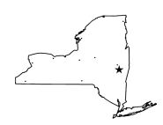
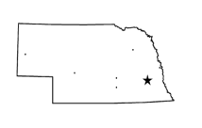
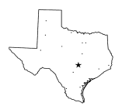
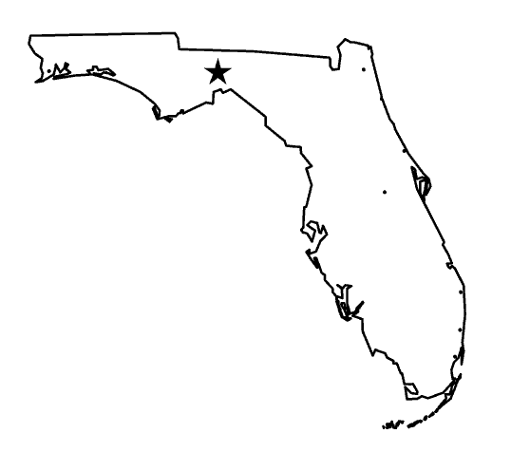
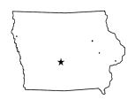
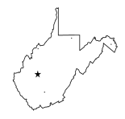
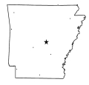
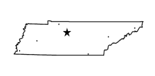
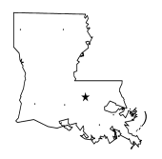
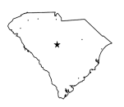
English Language and Content (ELaC)
Macro-framework
CCSS
WIDA
PARCC
SBAC
“Big Solos”
NE
EAG
IA
ELaC
ELDA
WV
AR
TN
Publishers, Professional Groups, Advocacy Groups
LA
SC

Slide 57


English Language and Content : The Cartoon
Semantics, Pragmatics
Small Groups
Classroom
Morphology, Lexicon, Syntax
Phonology, Phonetics
Language
Content
Reading
Assessment

Slide 58
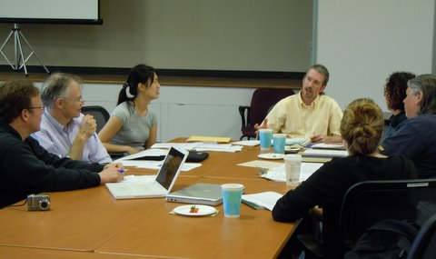



Language as Window into the Human Mind:
A field of epistemological linguistics is needed.

