Slide 1
Vector Semantics
Introduction

Slide 2
Why vector models of meaning? computing the similarity between words
“fast” is similar to “rapid”
“tall” is similar to “height”
Question answering:
Q: “How tall is Mt. Everest?”
Candidate A: “The official height of Mount Everest is 29029 feet”

Slide 3
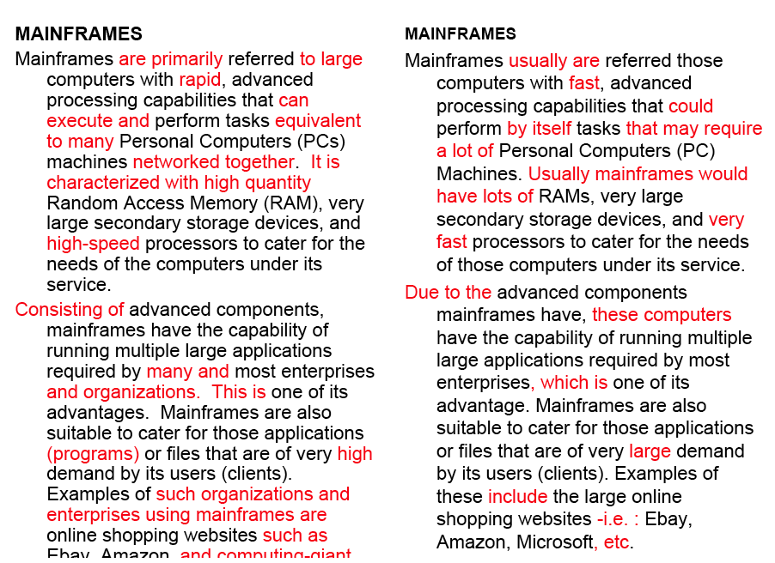
Word similarity for plagiarism detection

Slide 4
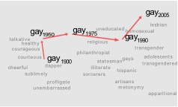
Word similarity for historical linguistics: semantic change over time
Sagi, Kaufmann Clark 2013
Kulkarni, Al-Rfou, Perozzi, Skiena 2015

Slide 5
Problems with thesaurus-based meaning
We don’t have a thesaurus for every language
We can’t have a thesaurus for every year
  For historical linguistics, we need to compare word meanings in year t to year t+1
Thesauruses have problems with recall
  Many words and phrases are missing
  Thesauri work less well for verbs, adjectives

Slide 6
Distributional models of meaning
= vector-space models of meaning
= vector semantics
Intuitions: Zellig Harris (1954):
  “oculist and eye-doctor … occur in almost the same environments”
  “If A and B have almost identical environments we say that they are synonyms.”
Firth (1957):
  “You shall know a word by the company it keeps!”

Slide 7
Intuition of distributional word similarity
Nida example: Suppose I asked you what is tesgüino?
    A bottle of tesgüino is on the table
    Everybody likes tesgüino
    Tesgüino makes you drunk
    We make tesgüino out of corn.
From context words humans can guess tesgüino means
  an alcoholic beverage like beer
Intuition for algorithm:
  Two words are similar if they have similar word contexts.

Slide 8
Four kinds of vector models
Sparse vector representations
  Mutual-information weighted word co-occurrence matrices
Dense vector representations:
  Singular value decomposition (and Latent Semantic Analysis)
  Neural-network-inspired models (skip-grams, CBOW)
  Brown clusters

Slide 9
Shared intuition
Model the meaning of a word by “embedding” in a vector space.
The meaning of a word is a vector of numbers
  Vector models are also called “embeddings”.
Contrast: word meaning is represented in many computational linguistic applications by a vocabulary index (“word number 545”)
Old philosophy joke:
  Q: What’s the meaning of life?
  A: LIFE’

Slide 10
Vector Semantics
Words and co-occurrence vectors

Slide 11
Co-occurrence Matrices
We represent how often a word occurs in a document
  Term-document matrix
Or how often a word occurs with another
  Term-term matrix
    (or word-word co-occurrence matrix
    or word-context matrix)

Slide 12
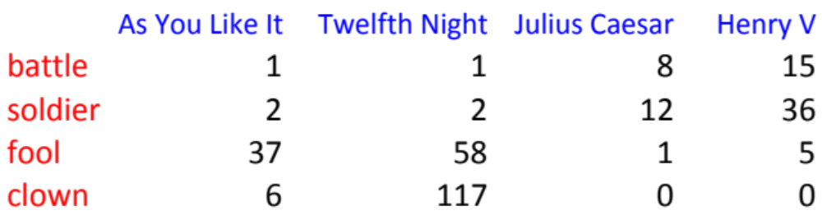
Term-document matrix
Each cell: count of word w in a document d:
  Each document is a count vector in ℕ^{v}: a column below

Slide 13
Similarity in term-document matrices
Two documents are similar if their vectors are similar

Slide 14
The words in a term-document matrix
Each word is a count vector in ℕ^{D}: a row below

Slide 15
The words in a term-document matrix
Two words are similar if their vectors are similar

Slide 16
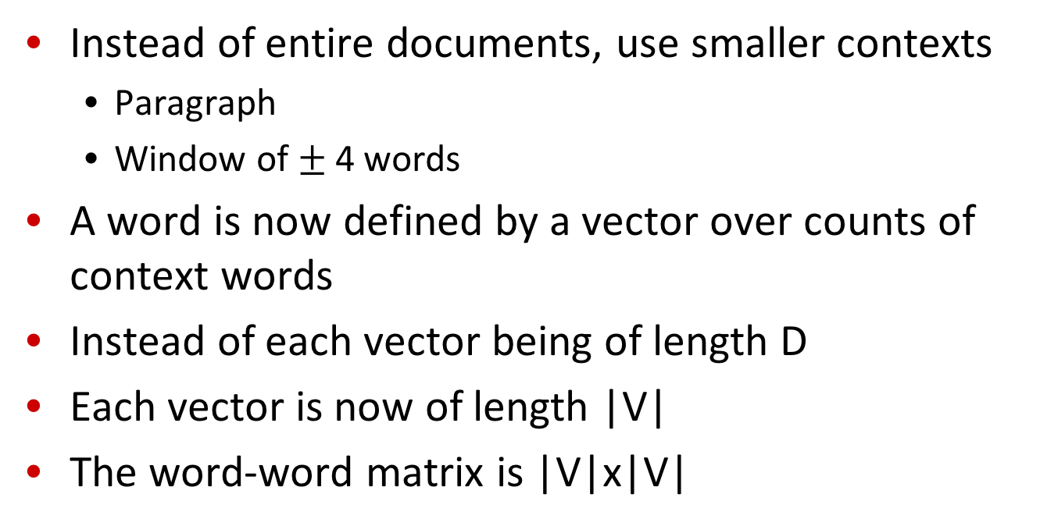
The word-word or word-context matrix
Instead of entire documents, use smaller contexts
  Paragraph
  Window of $±$ 4 words
A word is now defined by a vector over counts of context words
Instead of each vector being of length D
Each vector is now of length |V|
The word-word matrix is |V|x|V|

Slide 17
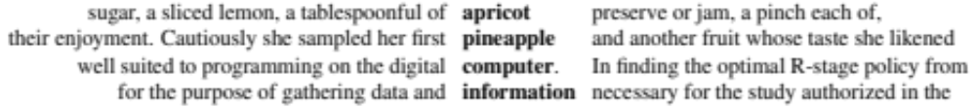
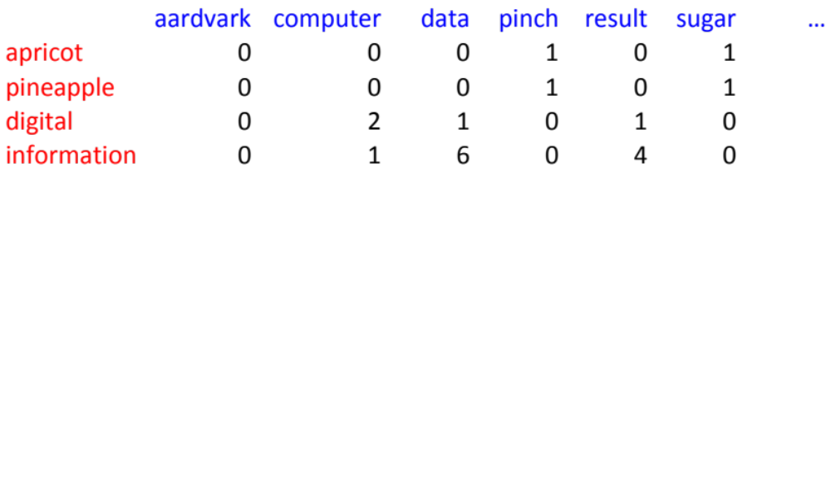
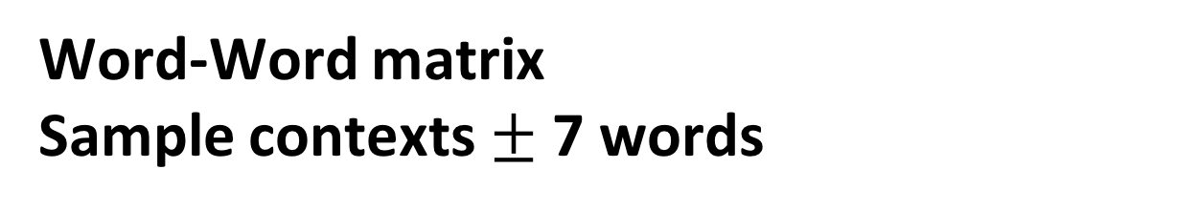
Word-Word matrix
Sample contexts $±$ 7 words
…
…

Slide 18
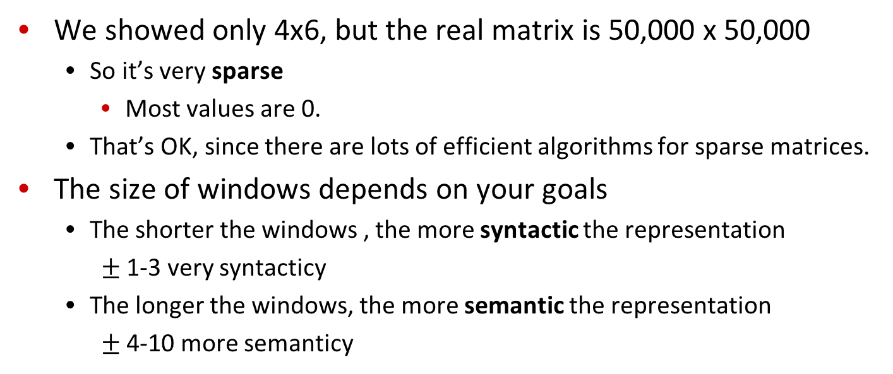
Word-word matrix
We showed only 4x6, but the real matrix is 50,000 x 50,000
  So it’s very sparse
    Most values are 0.
  That’s OK, since there are lots of efficient algorithms for sparse matrices.
The size of windows depends on your goals
  The shorter the windows , the more syntactic the representation
    $±$ 1-3 very syntacticy
  The longer the windows, the more semantic the representation
    $±$ 4-10 more semanticy

Slide 19
2 kinds of co-occurrence between 2 words
(Schütze and Pedersen, 1993)
First-order co-occurrence (syntagmatic association):
  They are typically nearby each other.
  wrote is a first-order associate of book or poem.
Second-order co-occurrence (paradigmatic association):
  They have similar neighbors.
  wrote is a second- order associate of words like said or remarked.

Slide 20
Vector Semantics
Positive Pointwise Mutual Information (PPMI)

Slide 21
Problem with raw counts
Raw word frequency is not a great measure of association between words
  It’s very skewed
    “the” and “of” are very frequent, but maybe not the most discriminative
We’d rather have a measure that asks whether a context word is particularly informative about the target word.
  Positive Pointwise Mutual Information (PPMI)

Slide 22
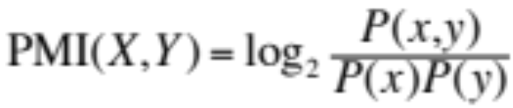
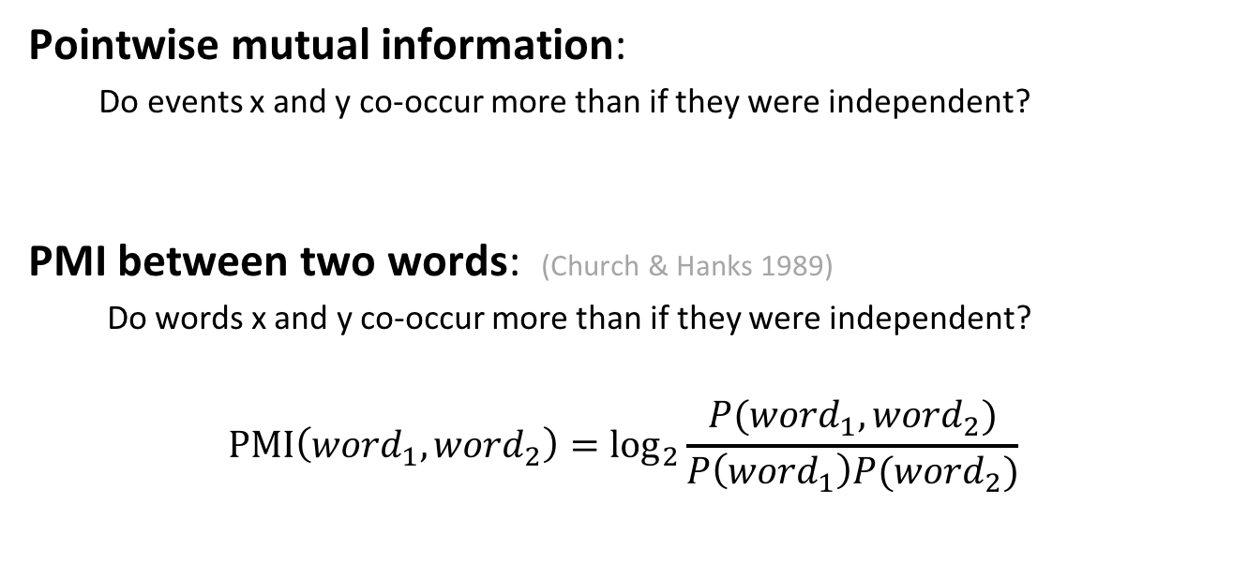
Pointwise Mutual Information
Pointwise mutual information:
  Do events x and y co-occur more than if they were independent?
  PMI between two words: (Church & Hanks 1989)
  Do words x and y co-occur more than if they were independent?
$$\text{PMI}\left({word}_{1}, {word}_{2}\right)={\text{log}}_{2}\frac{P({word}_{1}, {word}_{2})}{P\left({word}_{1}\right)P({word}_{2})}$$

Slide 23
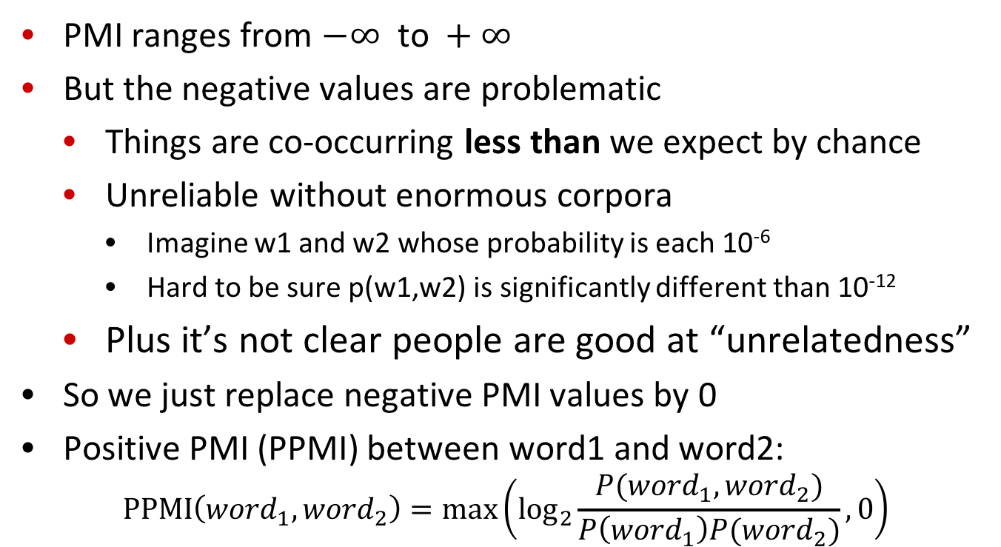
Positive Pointwise Mutual Information
  PMI ranges from $−∞ \text{to} +∞$
  But the negative values are problematic
    Things are co-occurring less than we expect by chance
    Unreliable without enormous corpora
      Imagine w1 and w2 whose probability is each 10⁻⁶
      Hard to be sure p(w1,w2) is significantly different than 10⁻¹²
    Plus it’s not clear people are good at “unrelatedness”
  So we just replace negative PMI values by 0
  Positive PMI (PPMI) between word1 and word2:
$$\text{P}\text{P}\text{MI}\left({word}_{1}, {word}_{2}\right)=\max\left({\text{log}}_{2}\frac{P({word}_{1}, {word}_{2})}{P\left({word}_{1}\right)P({word}_{2})},0\right)$$

Slide 24
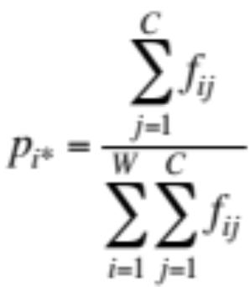
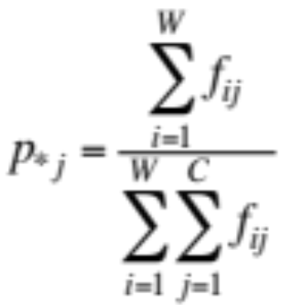
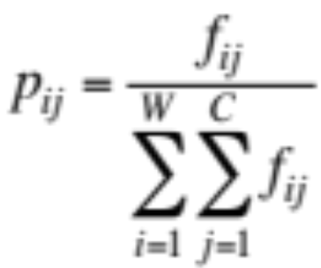
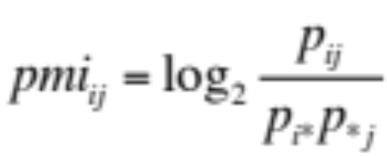
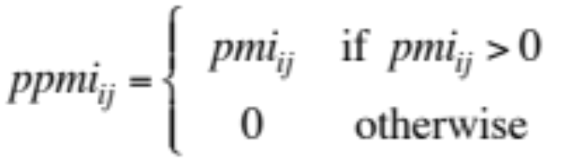
Computing PPMI on a term-context matrix
Matrix F with W rows (words) and C columns (contexts)
f_{ij} is # of times w_{i} occurs in context c_{j}

Slide 25
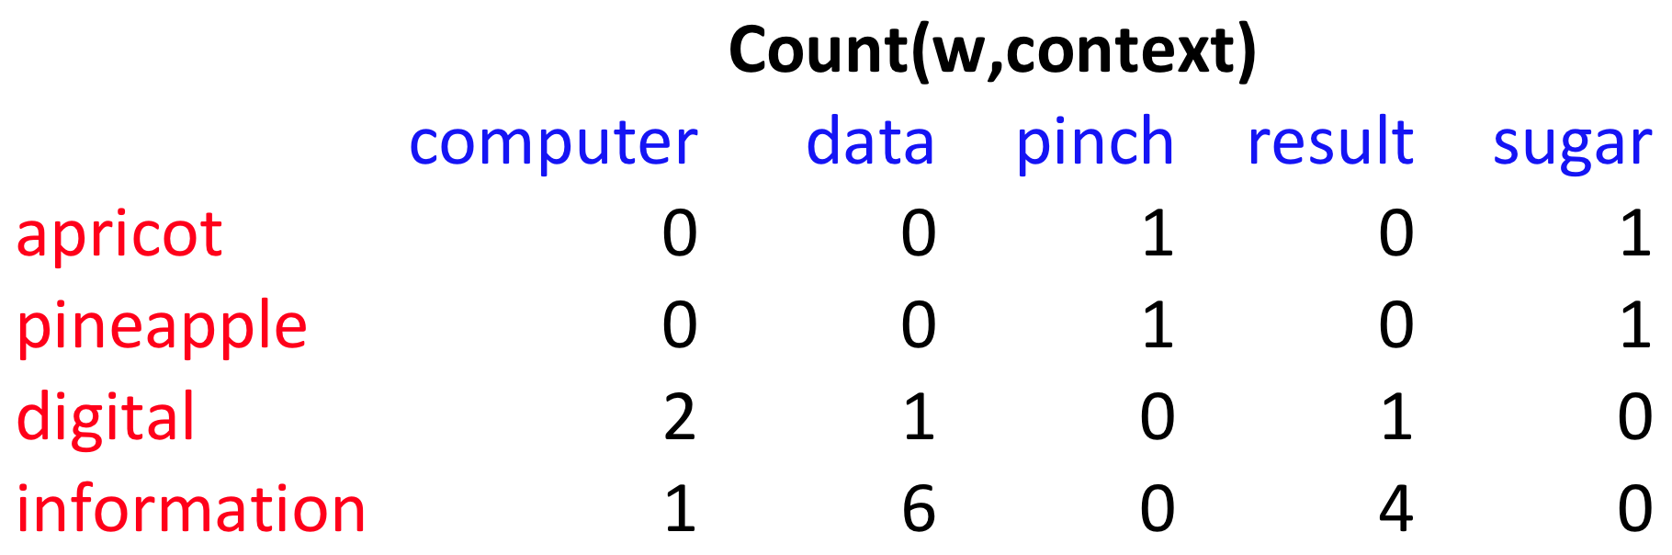
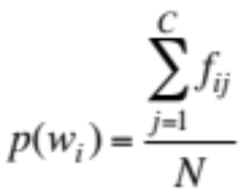
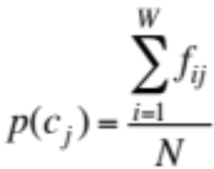
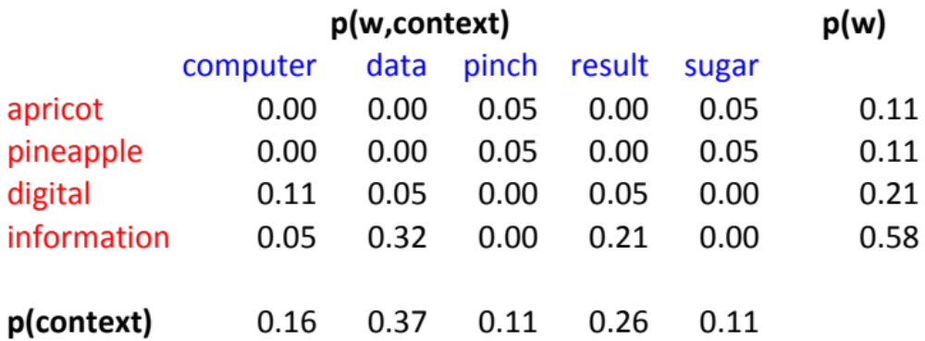
p(w=information,c=data) =
p(w=information) =
p(c=data) =
6/19
= .32
11/19
= .58
7/19
= .37

Slide 26
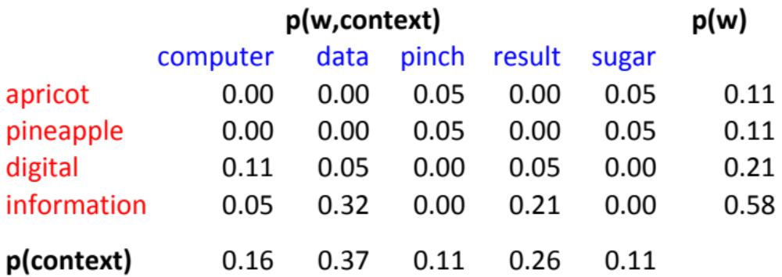
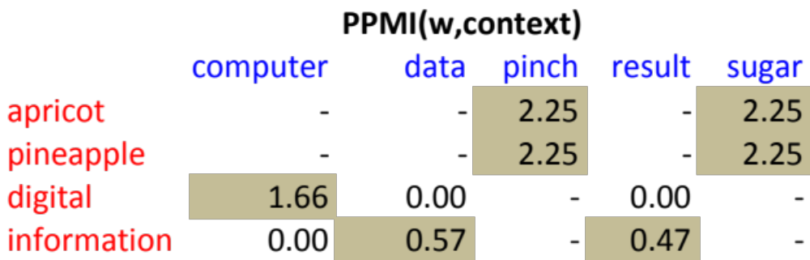
pmi(information,data) = log₂ (
.32 /
(.37*.58) )
= .58
(.57 using full precision)

Slide 27
Weighting PMI
PMI is biased toward infrequent events
  Very rare words have very high PMI values
Two solutions:
  Give rare words slightly higher probabilities
  Use add-one smoothing (which has a similar effect)

Slide 28
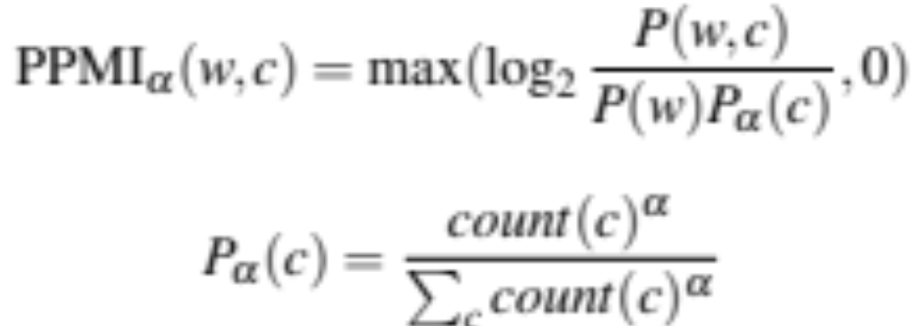
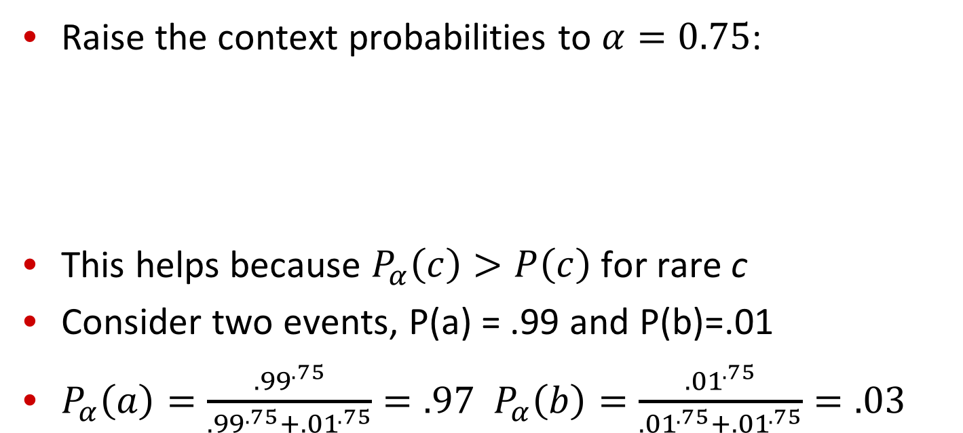
Weighting PMI: Giving rare context words slightly higher probability
Raise the context probabilities to $α=0.75$:
This helps because $P_{α}\left(c\right)>P\left(c\right)$ for rare c
Consider two events, P(a) = .99 and P(b)=.01
$P_{α}\left(a\right)=\frac{{.99}^{.75}}{{.99}^{.75}+{.01}^{.75}}=.97$ $P_{α}\left(b\right)=\frac{{.01}^{.75}}{{.01}^{.75}+{.01}^{.75}}=.03$

Slide 29
Use Laplace (add-1) smoothing

Slide 30
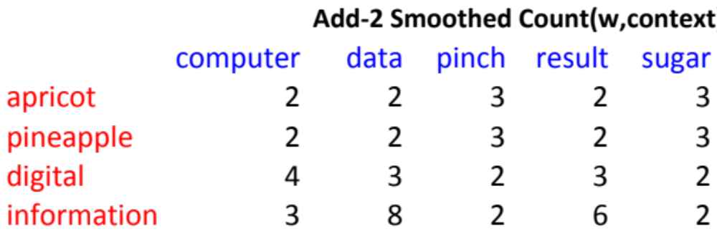
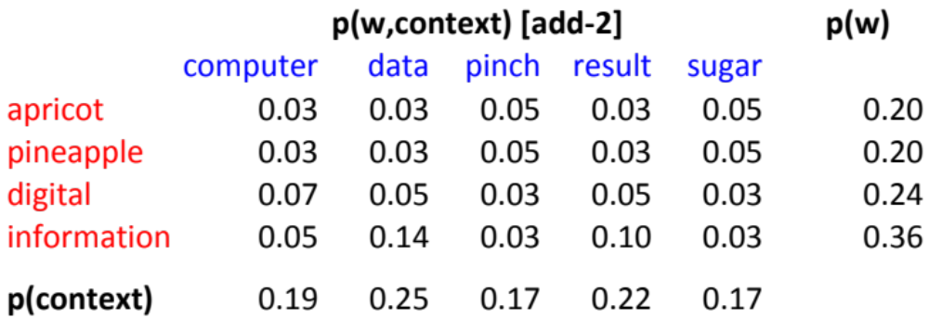

Slide 31
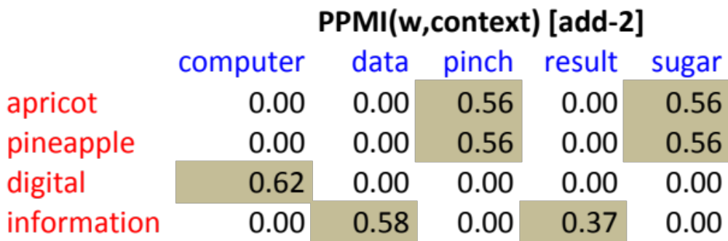
PPMI versus add-2 smoothed PPMI

Slide 32
Vector Semantics
Measuring similarity: the cosine

Slide 33
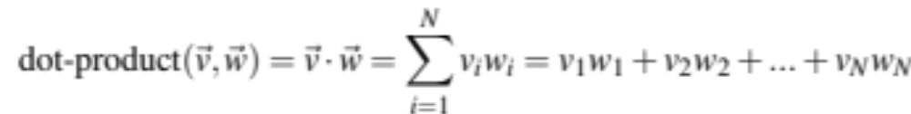
Measuring similarity
Given 2 target words v and w
We’ll need a way to measure their similarity.
Most measure of vectors similarity are based on the:
Dot product or inner product from linear algebra
  High when two vectors have large values in same dimensions.
  Low (in fact 0) for orthogonal vectors with zeros in complementary distribution

Slide 34
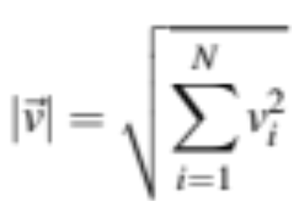
Problem with dot product
Dot product is longer if the vector is longer. Vector length:
Vectors are longer if they have higher values in each dimension
That means more frequent words will have higher dot products
That’s bad: we don’t want a similarity metric to be sensitive to word frequency

Slide 35
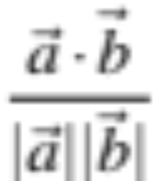
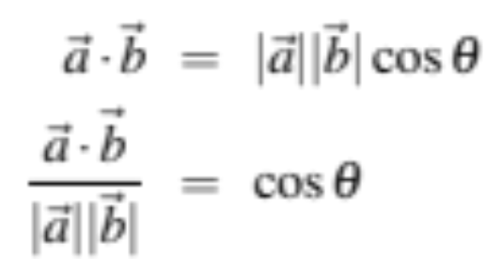
Solution: cosine
Just divide the dot product by the length of the two vectors!
This turns out to be the cosine of the angle between them!

Slide 36
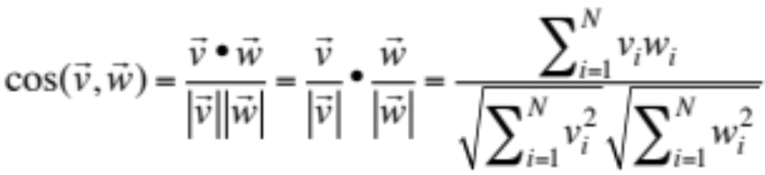
Cosine for computing similarity
Sec. 6.3
Dot product
Unit vectors
v_{i} is the PPMI value for word v in context i
w_{i} is the PPMI value for word w in context i.
Cos(v,w) is the cosine similarity of v and w

Slide 37

Cosine as a similarity metric
-1: vectors point in opposite directions
+1: vectors point in same directions
0: vectors are orthogonal
Raw frequency or PPMI are non-negative, so cosine range 0-1

Slide 38

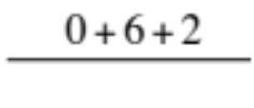
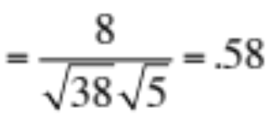

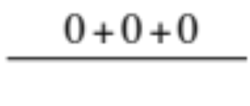





 | large | data | computer
apricot | 2 | 0 | 0
digital | 0 | 1 | 2
information | 1 | 6 | 1
Which pair of words is more similar?
cosine(apricot,information) =
cosine(digital,information) =
cosine(apricot,digital) =
$$2+0+0$$
$$= \frac{2}{\sqrt{2}\sqrt{38}}= .23$$
$$\sqrt{2+0+0 }$$

Slide 39
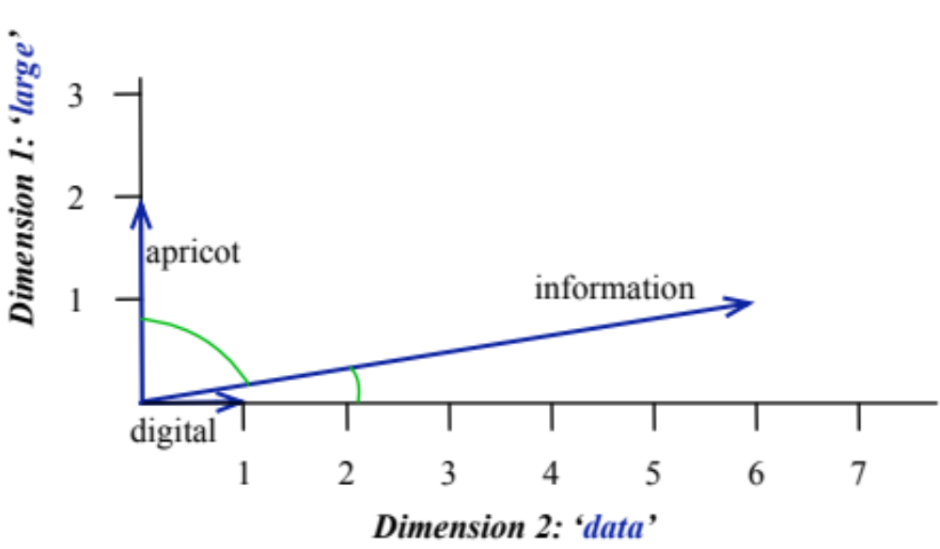
Visualizing vectors and angles
 | large | data
apricot | 2 | 0
digital | 0 | 1
information | 1 | 6

Slide 40
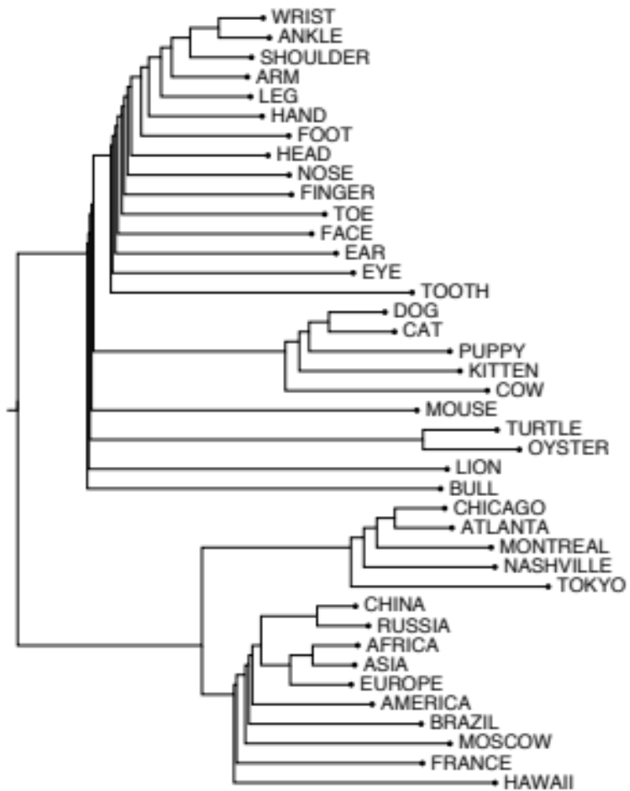
Clustering vectors to visualize similarity in co-occurrence matrices
Rohde et al. (2006)

Slide 41
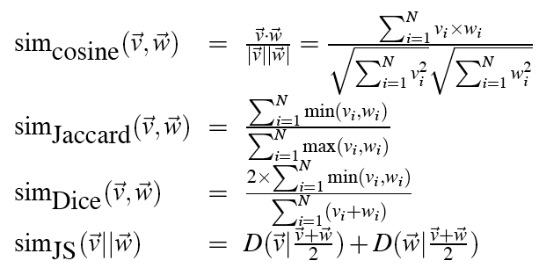
Other possible similarity measures

Slide 42
Vector Semantics
Measuring similarity: the cosine

Slide 43
Evaluating similarity
(the same as for thesaurus-based)
Intrinsic Evaluation:
  Correlation between algorithm and human word similarity ratings
Extrinsic (task-based, end-to-end) Evaluation:
  Spelling error detection, WSD, essay grading
  Taking TOEFL multiple-choice vocabulary tests
Levied is closest in meaning to which of these:
  imposed, believed, requested, correlated

Slide 44
Using syntax to define a word’s context
Zellig Harris (1968)
  “The meaning of entities, and the meaning of grammatical relations among them, is related to the restriction of combinations of these entities relative to other entities”
Two words are similar if they have similar syntactic contexts
Duty and responsibility have similar syntactic distribution:
Modified by adjectives | additional, administrative, assumed, collective, congressional, constitutional …
Objects of verbs | assert, assign, assume, attend to, avoid, become, breach..

Slide 45
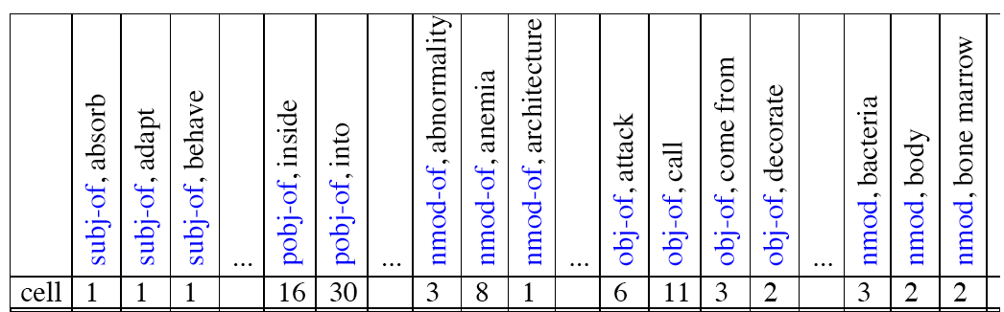
Co-occurrence vectors based on syntactic dependencies
Dekang Lin, 1998 “Automatic Retrieval and Clustering of Similar Words”
Each dimension: a context word in one of R grammatical relations
  Subject-of- “absorb”
Instead of a vector of |V| features, a vector of R|V|
Example: counts for the word cell :

Slide 46
Syntactic dependencies for dimensions
Alternative (Padó and Lapata 2007):
  Instead of having a |V| x R|V| matrix
  Have a |V| x |V| matrix
  But the co-occurrence counts aren’t just counts of words in a window
  But counts of words that occur in one of R dependencies (subject, object, etc).
  So M(“cell”,”absorb”) = count(subj(cell,absorb)) + count(obj(cell,absorb)) + count(pobj(cell,absorb)), etc.

Slide 47
PMI applied to dependency relations
Hindle, Don. 1990. Noun Classification from Predicate-Argument Structure. ACL
Object of “drink” | Count | PMI
it | 3 | 1.3
anything | 3 | 5.2
wine | 2 | 9.3
tea | 2 | 11.8
liquid | 2 | 10.5
Object of “drink” | Count | PMI
tea | 2 | 11.8
liquid | 2 | 10.5
wine | 2 | 9.3
anything | 3 | 5.2
it | 3 | 1.3
“Drink it” more common than “drink wine”
But “wine” is a better “drinkable” thing than “it”

Slide 48
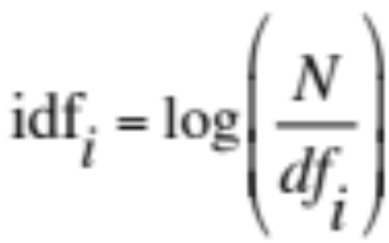
Alternative to PPMI for measuring association
tf-idf (that’s a hyphen not a minus sign)
The combination of two factors
  Term frequency (Luhn 1957): frequency of the word (can be logged)
  Inverse document frequency (IDF) (Sparck Jones 1972)
    N is the total number of documents
    df_{i} = “document frequency of word i”
    = # of documents with word I
  w_{ij} = word i in document j
  w_{ij}=tf_{ij} idf_{i}

Slide 49
tf-idf not generally used for word-word similarity
But is by far the most common weighting when we are considering the relationship of words to documents

Slide 50
Vector Semantics
Dense Vectors

Slide 51
Sparse versus dense vectors
PPMI vectors are
  long (length |V|= 20,000 to 50,000)
  sparse (most elements are zero)
Alternative: learn vectors which are
  short (length 200-1000)
  dense (most elements are non-zero)

Slide 52
Sparse versus dense vectors
Why dense vectors?
  Short vectors may be easier to use as features in machine learning (less weights to tune)
  Dense vectors may generalize better than storing explicit counts
  They may do better at capturing synonymy:
    car and automobile are synonyms; but are represented as distinct dimensions; this fails to capture similarity between a word with car as a neighbor and a word with automobile as a neighbor

Slide 53
Three methods for getting short dense vectors
Singular Value Decomposition (SVD)
  A special case of this is called LSA – Latent Semantic Analysis
“Neural Language Model”-inspired predictive models
  skip-grams and CBOW
Brown clustering

Slide 54
Vector Semantics
Dense Vectors via SVD

Slide 55
Intuition
Approximate an N-dimensional dataset using fewer dimensions
By first rotating the axes into a new space
In which the highest order dimension captures the most variance in the original dataset
And the next dimension captures the next most variance, etc.
Many such (related) methods:
  PCA – principle components analysis
  Factor Analysis
  SVD

Slide 56
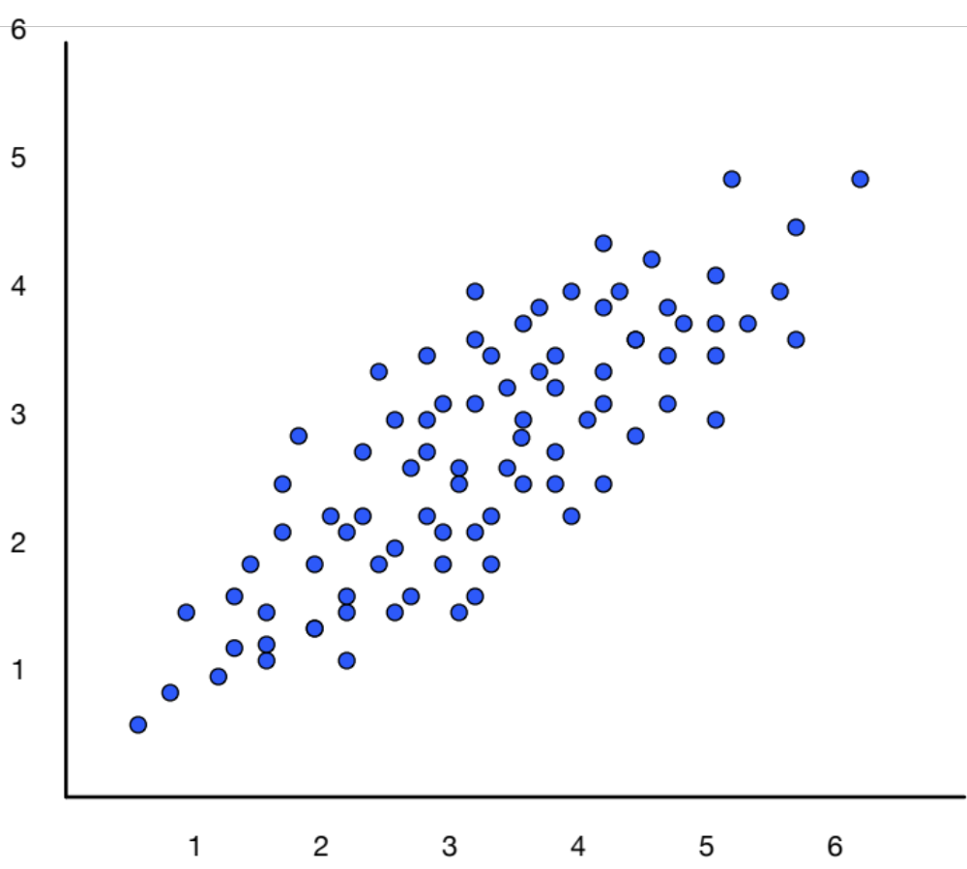
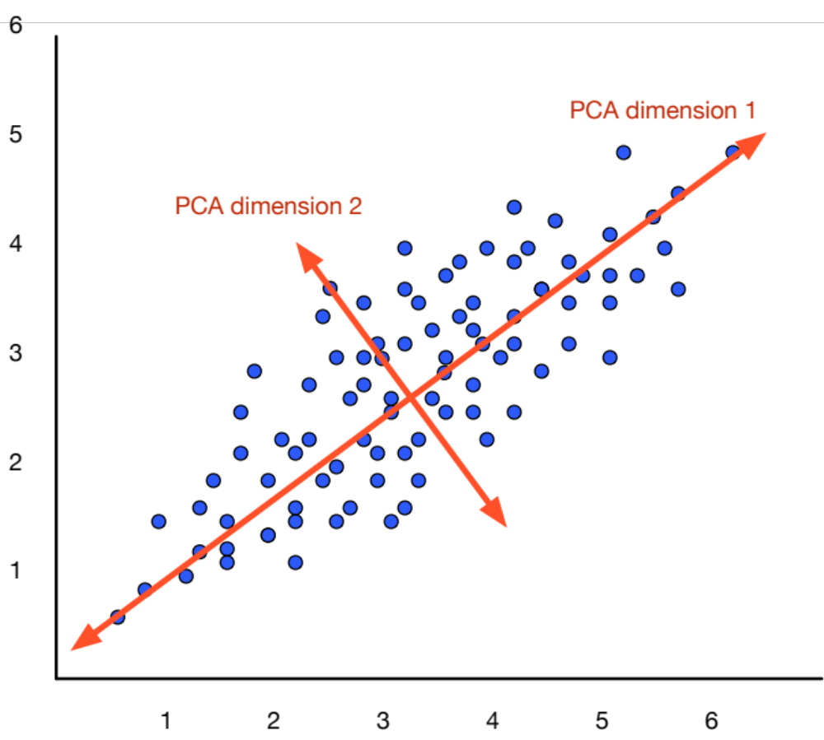
Dimensionality reduction

Slide 57
Singular Value Decomposition
Any rectangular w x c matrix X equals the product of 3 matrices:
W: rows corresponding to original but m columns represents a dimension in a new latent space, such that
  M column vectors are orthogonal to each other
  Columns are ordered by the amount of variance in the dataset each new dimension accounts for
S: diagonal m x m matrix of singular values expressing the importance of each dimension.
C: columns corresponding to original but m rows corresponding to singular values

Slide 58
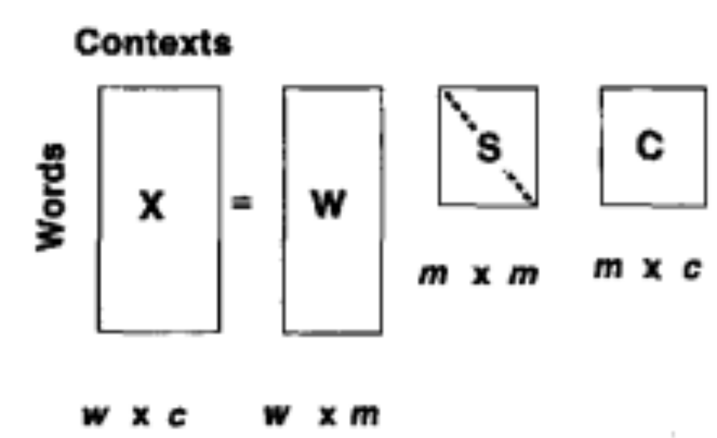
Singular Value Decomposition
Landuaer and Dumais 1997

Slide 59
SVD applied to term-document matrix:
Latent Semantic Analysis
Deerwester et al (1988)
If instead of keeping all m dimensions, we just keep the top k singular values. Let’s say 300.
The result is a least-squares approximation to the original X
But instead of multiplying, we’ll just make use of W.
Each row of W:
  A k-dimensional vector
  Representing word W
/
k
/
k
/
k
k
/

Slide 60
LSA more details
300 dimensions are commonly used
The cells are commonly weighted by a product of two weights
  Local weight: Log term frequency
  Global weight: either idf or an entropy measure

Slide 61
Let’s return to PPMI word-word matrices
Can we apply to SVD to them?

Slide 62
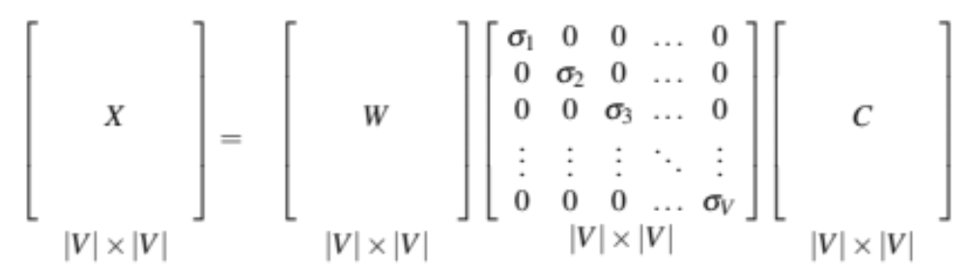
SVD applied to term-term matrix
(I’m simplifying here by assuming the matrix has rank |V|)

Slide 63
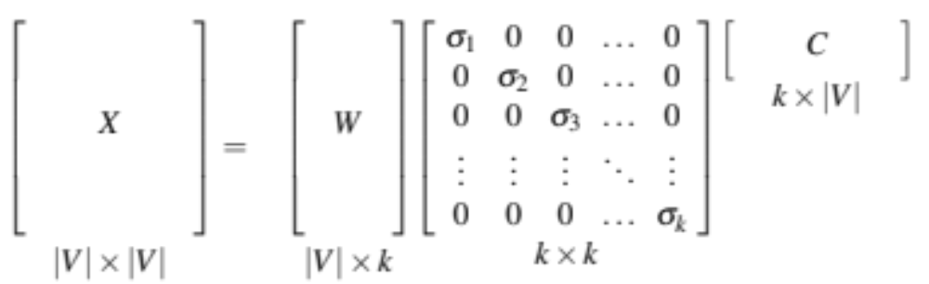
Truncated SVD on term-term matrix

Slide 64
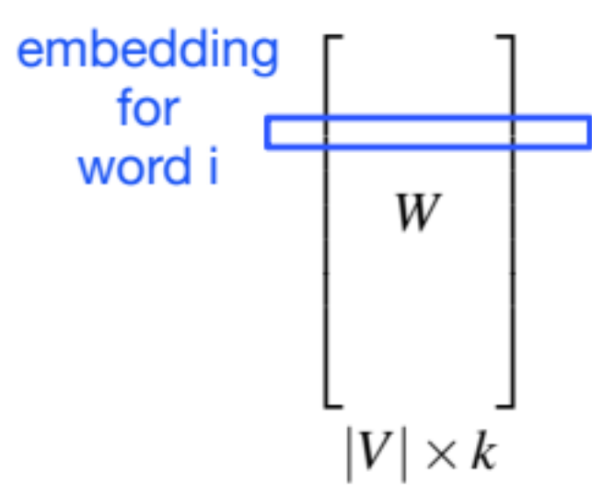
Truncated SVD produces embeddings
Each row of W matrix is a k-dimensional representation of each word w
K might range from 50 to 1000
Generally we keep the top k dimensions, but some experiments suggest that getting rid of the top 1 dimension or even the top 50 dimensions is helpful (Lapesa and Evert 2014).

Slide 65
Embeddings versus sparse vectors
Dense SVD embeddings sometimes work better than sparse PPMI matrices at tasks like word similarity
  Denoising: low-order dimensions may represent unimportant information
  Truncation may help the models generalize better to unseen data.
  Having a smaller number of dimensions may make it easier for classifiers to properly weight the dimensions for the task.
  Dense models may do better at capturing higher order co-occurrence.

Slide 66
Vector Semantics
Embeddings inspired by neural language models: skip-grams and CBOW

Slide 67
Prediction-based models:
An alternative way to get dense vectors
Skip-gram (Mikolov et al. 2013a) CBOW (Mikolov et al. 2013b)
Learn embeddings as part of the process of word prediction.
Train a neural network to predict neighboring words
    Inspired by neural net language models.
    In so doing, learn dense embeddings for the words in the training corpus.
Advantages:
  Fast, easy to train (much faster than SVD)
  Available online in the word2vec package
  Including sets of pretrained embeddings!

Slide 68
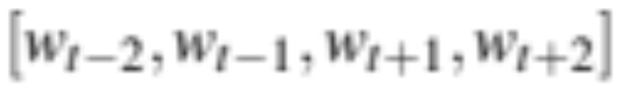
Skip-grams
Predict each neighboring word
  in a context window of 2C words
  from the current word.
So for C=2, we are given word w_{t} and predicting these 4 words:

Slide 69
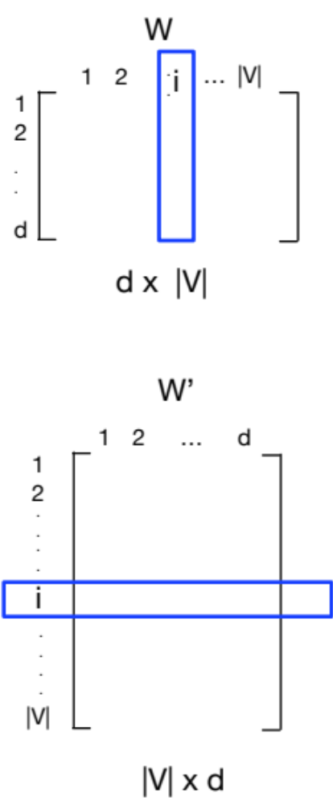
Skip-grams learn 2 embeddings for each w
input embedding v, in the input matrix W
Column i of the input matrix W is the 1×d embedding v_{i} for word i in the vocabulary.
output embedding v′, in output matrix W’
Row i of the output matrix W′ is a d × 1 vector embedding v′_{i} for word i in the vocabulary.

Slide 70
Setup
Walking through corpus pointing at word w(t), whose index in the vocabulary is j, so we’ll call it w_{j} (1 < j < |V |).
Let’s predict w(t+1) , whose index in the vocabulary is k (1 < k < |V |). Hence our task is to compute P(w_{k}|w_{j}).

Slide 71
One-hot vectors
A vector of length |V|
1 for the target word and 0 for other words
So if “popsicle” is vocabulary word 5
The one-hot vector is
[0,0,0,0,1,0,0,0,0…….0]

Slide 72
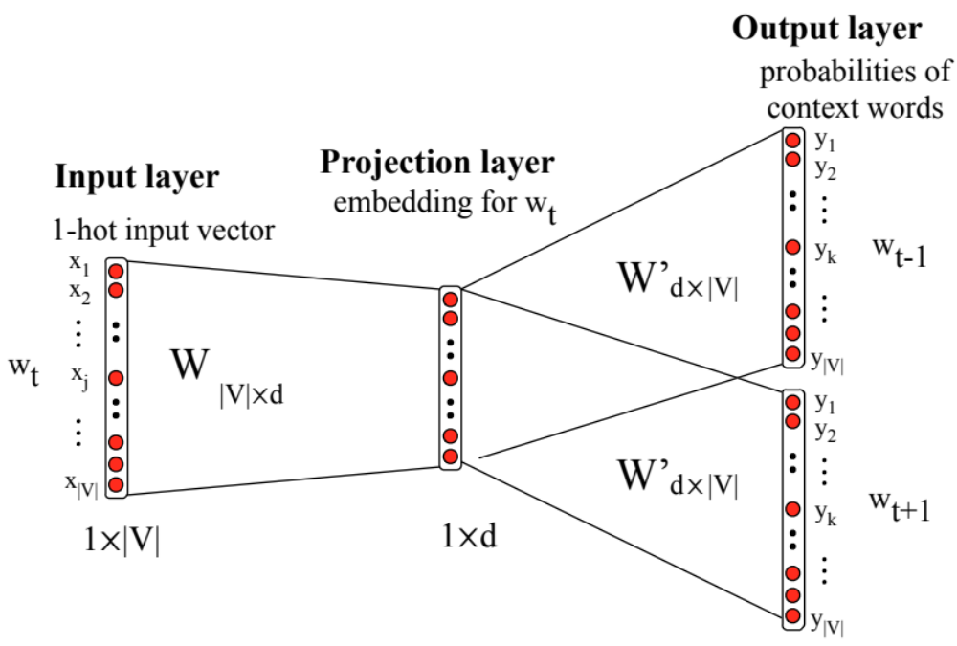
Skip-gram

Slide 73
Skip-gram
h = v_{j}
o = W’h
o = W’h

Slide 74
Skip-gram
h = v_{j}
o = W’h
o_{k} = v’_{k}h
o_{k} = v’_{k}∙v_{j}

Slide 75
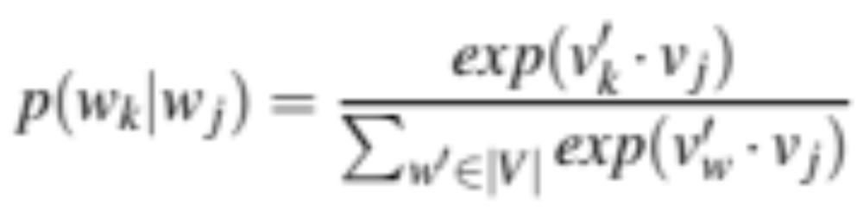
Turning outputs into probabilities
o_{k} = v’_{k}∙v_{j}
We use softmax to turn into probabilities

Slide 76
Embeddings from W and W’
Since we have two embeddings, v_{j} and v’_{j} for each word w_{j}
We can either:
  Just use v_{j}
  Sum them
  Concatenate them to make a double-length embedding

Slide 77





But wait; how do we learn the embeddings?

Slide 78
Relation between skipgrams and PMI!
If we multiply WW’^{T}
We get a |V|x|V| matrix M , each entry m_{ij} corresponding to some association between input word i and output word j
Levy and Goldberg (2014b) show that skip-gram reaches its optimum just when this matrix is a shifted version of PMI:
WW′^{T} =M^{PMI} −log k
So skip-gram is implicitly factoring a shifted version of the PMI matrix into the two embedding matrices.

Slide 79

CBOW (Continuous Bag of Words)

Slide 80

Properties of embeddings
Nearest words to some embeddings (Mikolov et al. 20131)

Slide 81


Embeddings capture relational meaning!
vector(‘king’) - vector(‘man’) + vector(‘woman’) $≈$vector(‘queen’)
vector(‘Paris’) - vector(‘France’) + vector(‘Italy’) $≈$ vector(‘Rome’)

Slide 82
Vector Semantics
Brown clustering

Slide 83
Brown clustering
An agglomerative clustering algorithm that clusters words based on which words precede or follow them
These word clusters can be turned into a kind of vector
We’ll give a very brief sketch here.

Slide 84
Brown clustering algorithm
Each word is initially assigned to its own cluster.
We now consider consider merging each pair of clusters. Highest quality merge is chosen.
  Quality = merges two words that have similar probabilities of preceding and following words
  (More technically quality = smallest decrease in the likelihood of the corpus according to a class-based language model)
Clustering proceeds until all words are in one big cluster.

Slide 85

Brown Clusters as vectors
By tracing the order in which clusters are merged, the model builds a binary tree from bottom to top.
Each word represented by binary string = path from root to leaf
Each intermediate node is a cluster
Chairman is 0010, “months” = 01, and verbs = 1

Slide 86

Brown cluster examples

Slide 87


Class-based language model
Suppose each word was in some class c_{i:}

Slide 88
Vector Semantics
Evaluating similarity

Slide 89
Evaluating similarity
Extrinsic (task-based, end-to-end) Evaluation:
  Question Answering
  Spell Checking
  Essay grading
Intrinsic Evaluation:
  Correlation between algorithm and human word similarity ratings
    Wordsim353: 353 noun pairs rated 0-10. sim(plane,car)=5.77
  Taking TOEFL multiple-choice vocabulary tests
    Levied is closest in meaning to:
    imposed, believed, requested, correlated

Slide 90
Summary
Distributional (vector) models of meaning
  Sparse (PPMI-weighted word-word co-occurrence matrices)
  Dense:
    Word-word SVD 50-2000 dimensions
    Skip-grams and CBOW
    Brown clusters 5-20 binary dimensions.

