Slide 1
Logistic Regression
Background: Generative and Discriminative Classifiers

Slide 2
Logistic Regression
Important analytic tool in natural and social sciences
Baseline supervised machine learning tool for classification
Is also the foundation of neural networks

Slide 3
Generative and Discriminative Classifiers
Naïve Bayes is a generative classifier
by contrast:
Logistic regression is a discriminative classifier

Slide 4


Generative and Discriminative Classifiers
Suppose we're distinguishing cat from dog images
imagenet
imagenet

Slide 5
Generative Classifier:
Build a model of what's in a cat image
  Knows about whiskers, ears, eyes
  Assigns a probability to any image:
    how cat-y is this image?
Also build a model for dog images
Now given a new image:
Run both models and see which one fits better

Slide 6
Discriminative Classifier
Just try to distinguish dogs from cats
Oh look, dogs have collars!
Let's ignore everything else

Slide 7
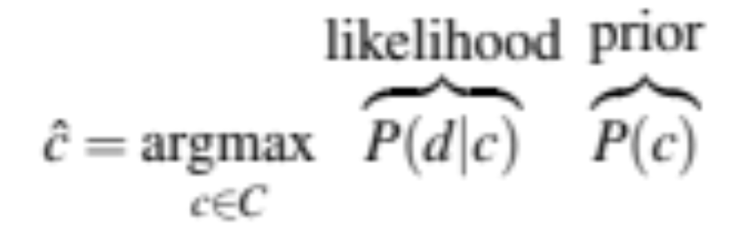
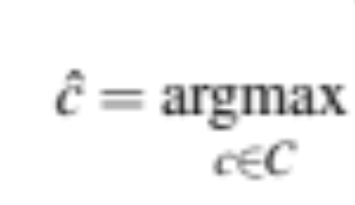
Finding the correct class c from a document d in
Generative vs Discriminative Classifiers
Naive Bayes
Logistic Regression
posterior
P(c|d)

Slide 8
Components of a probabilistic machine learning classifier
Given m input/output pairs (x^{(i),}y^{(i)}):
A feature representation of the input. For each input observation x(i), a vector of features [x₁, x₂, ... , x_{n}]. Feature i for input x^{(j)} is x_{i}, more completely x_{i}^{(j)}, or sometimes f_{i}(x).
A classification function that computes ^y, the estimated class, via p(y|x), like the sigmoid or softmax functions.
An objective function for learning, like cross-entropy loss.
An algorithm for optimizing the objective function: stochastic gradient descent.

Slide 9
The two phases of Logistic Regression
Training: we learn weights w and b using stochastic gradient descent and cross-entropy loss.
Test: Given a test example x we compute p(y|x) using learned weights w and b, and return whichever label (y = 1 or y = 0) is higher probability

Slide 10
Logistic Regression
Background: Generative and Discriminative Classifiers

Slide 11
Logistic Regression
Classification in Logistic Regression

Slide 12

Classification Reminder
Positive/negative sentiment
Spam/not spam
Authorship attribution (Hamilton or Madison?)
Alexander Hamilton

Slide 13
Text Classification: definition
Input:
  a document x
  a fixed set of classes C = {c₁, c₂,…, c_{J}}
Output: a predicted class y ∈ C

Slide 14
Binary Classification in Logistic Regression
Given a series of input/output pairs:
  (x^{(i)}, y^{(i)})
For each observation x^{(i)}
  We represent x^{(i)} by a feature vector [x₁, x₂,…, x_{n}]
  We compute an output: a predicted class y^{(i)} ∈ {0,1}
^

Slide 15
Features in logistic regression
For feature x_{i}, weight w_{i} tells is how important is x_{i}
  x_{i} ="review contains ‘awesome’": w_{i} = +10
  x_{j} ="review contains ‘abysmal’": w_{j} = -10
  x_{k} =“review contains ‘mediocre’": w_{k} = -2

Slide 16
Logistic Regression for one observation x
Input observation: vector x = [x₁, x₂,…, x_{n}]
Weights: one per feature: W = [w₁, w₂,…, w_{n}]
  Sometimes we call the weights θ = [θ₁, θ₂,…, θ_{n}]
Output: a predicted class y ∈ {0,1}
^
(multinomial logistic regression: y ∈ {0, 1, 2, 3, 4})

Slide 17
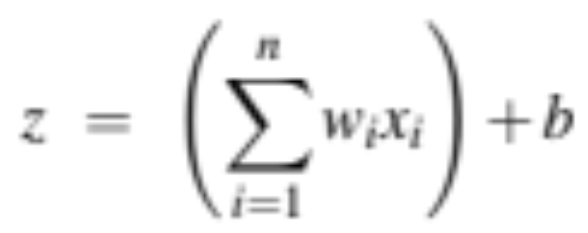
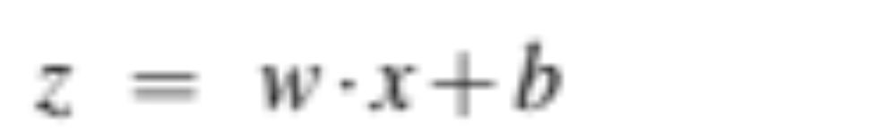
How to do classification
For each feature x_{i}, weight w_{i} tells us importance of x_{i}
  (Plus we'll have a bias b)
We'll sum up all the weighted features and the bias
If this sum is high, we say y=1; if low, then y=0

Slide 18
But we want a probabilistic classifier
We need to formalize “sum is high”.
We’d like a principled classifier that gives us a probability, just like Naive Bayes did
We want a model that can tell us:
  p(y=1|x; θ)
  p(y=0|x; θ)

Slide 19
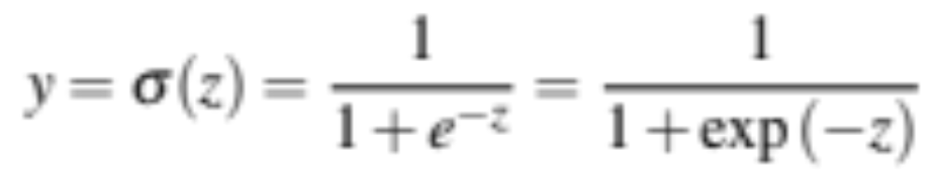
The problem: z isn't a probability, it's just a number!
Solution: use a function of z that goes from 0 to 1

Slide 20
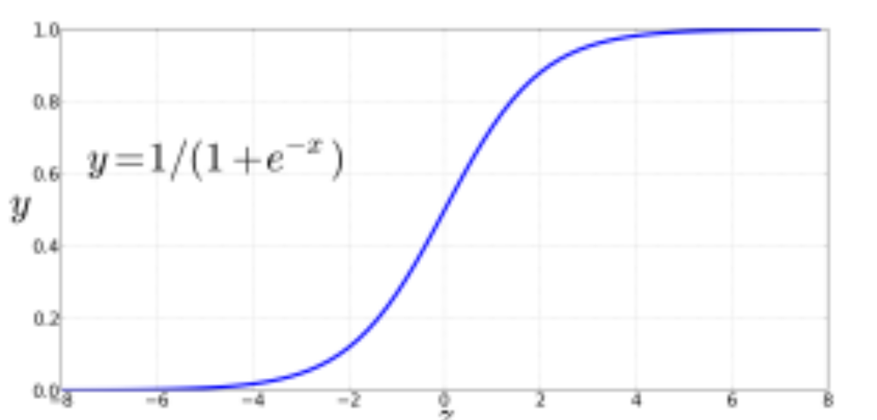
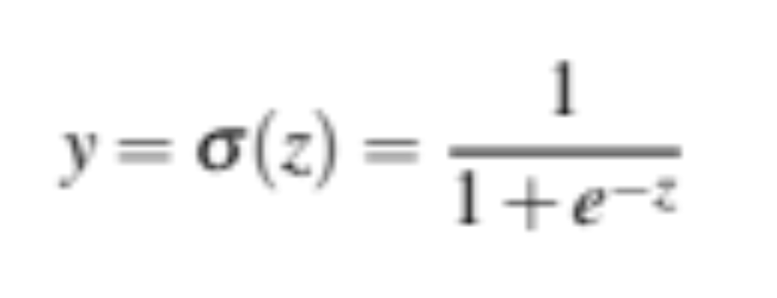
The very useful sigmoid or logistic function

Slide 21
Idea of logistic regression
We’ll compute w∙x+b
And then we’ll pass it through the sigmoid function:
σ(w∙x+b)
And we’ll just treat it as a probability

Slide 22
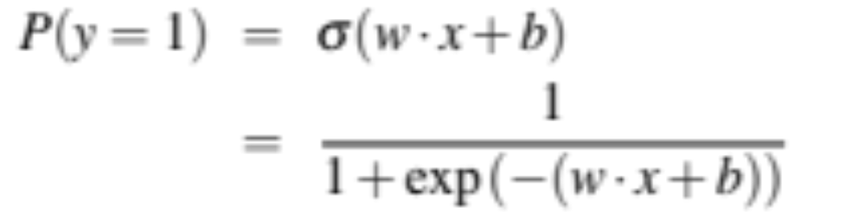
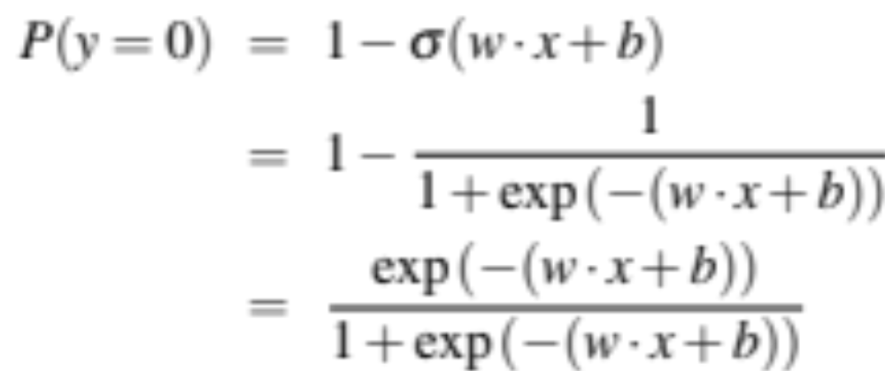
Making probabilities with sigmoids

Slide 23


By the way:
=
Because

Slide 24
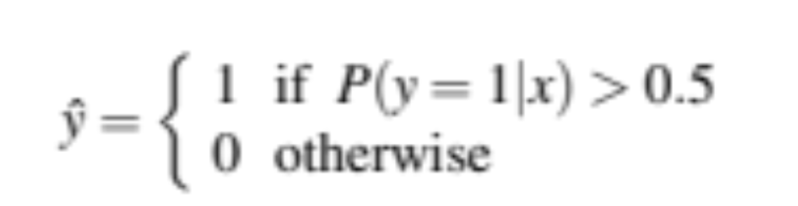
Turning a probability into a classifier
0.5 here is called the decision boundary

Slide 25
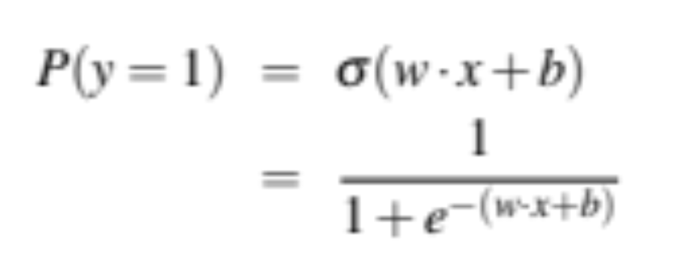
The probabilistic classifier
P(y=1)
wx + b

Slide 26
Turning a probability into a classifier
if w∙x+b > 0
if w∙x+b ≤ 0

Slide 27
Logistic Regression
Classification in Logistic Regression

Slide 28
Logistic Regression
Logistic Regression: A text (sentiment classification) example

Slide 29
Sentiment example: does y=1 or y=0?
It's hokey . There are virtually no surprises , and the writing is second-rate . So why was it so enjoyable ? For one thing , the cast is
great . Another nice touch is the music . I was overcome with the urge to get off the couch and start dancing . It sucked me in , and it'll do the same to you .

Slide 30
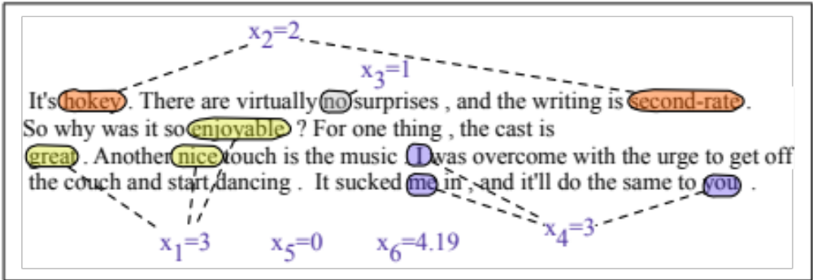
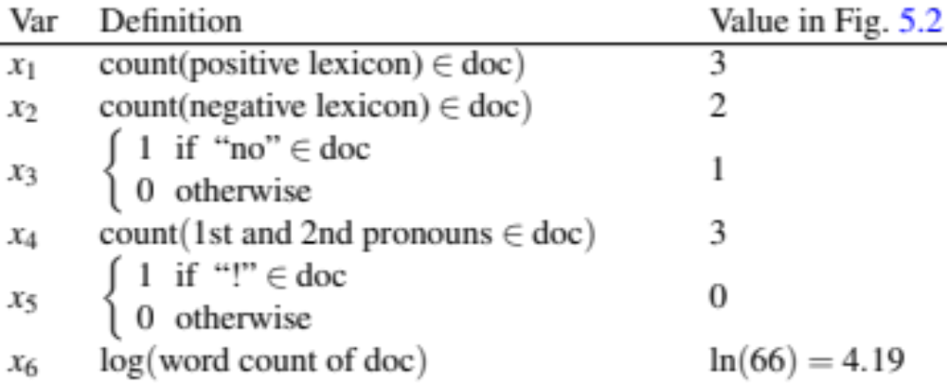

Slide 31
Classifying sentiment for input x
Suppose w =
b = 0.1

Slide 32
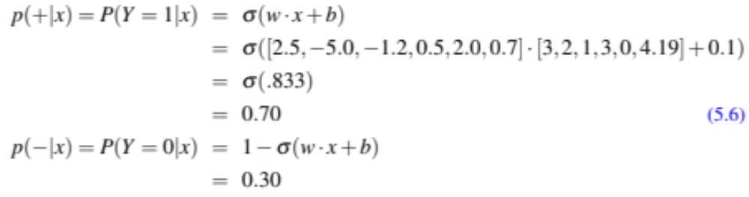
Classifying sentiment for input x

Slide 33
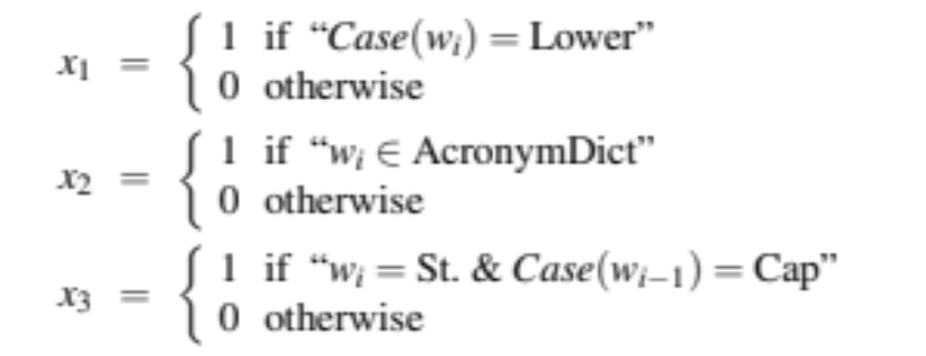
We can build features for logistic regression for any classification task: period disambiguation
End of sentence
This ends in a period.
The house at 465 Main St. is new.
Not end

Slide 34
Classification in (binary) logistic regression: summary
Given:
  a set of classes: (+ sentiment,- sentiment)
  a vector x of features [x1, x2, …, xn]
      x1= count( "awesome")
      x2 = log(number of words in review)
  A vector w of weights [w1, w2, …, wn]
    w_{i} for each feature f_{i}

Slide 35
Logistic Regression
Logistic Regression: A text example

Slide 36
Logistic Regression
Learning in Logistic Regression

Slide 37
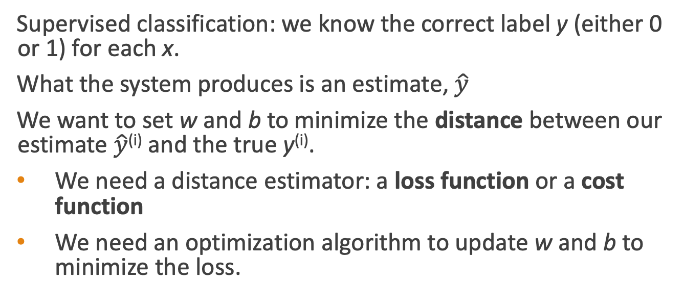
Wait, where did the W’s come from?
Supervised classification: we know the correct label y (either 0 or 1) for each x.
What the system produces is an estimate, $\hat{y}$
We want to set w and b to minimize the distance between our estimate $\hat{y}$^{(i)} and the true y^{(i)}.
We need a distance estimator: a loss function or a cost function
We need an optimization algorithm to update w and b to minimize the loss.

Slide 38
Learning components
A loss function:
    cross-entropy loss
An optimization algorithm:
    stochastic gradient descent

Slide 39
Logistic Regression
Learning in Logistic Regression

Slide 40
Logistic Regression
Cross-Entropy Loss

Slide 41
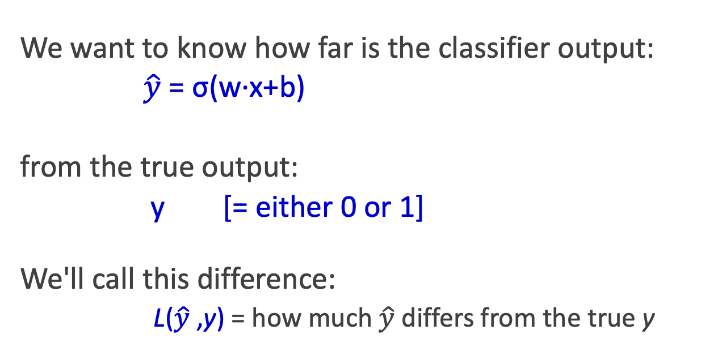

The distance between $\hat{y}$and y
We want to know how far is the classifier output:
$\hat{y}$= σ(w∙x+b)
from the true output:
y [= either 0 or 1]
We'll call this difference:
L($\hat{y}$,y) = how much $\hat{y}$ differs from the true y

Slide 42
Intuition of negative log likelihood loss
= cross-entropy loss
A case of conditional maximum likelihood estimation
We choose the parameters w,b
that maximize the log probability of the true y labels in the training data
given the observations x

Slide 43
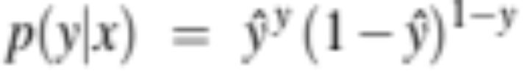
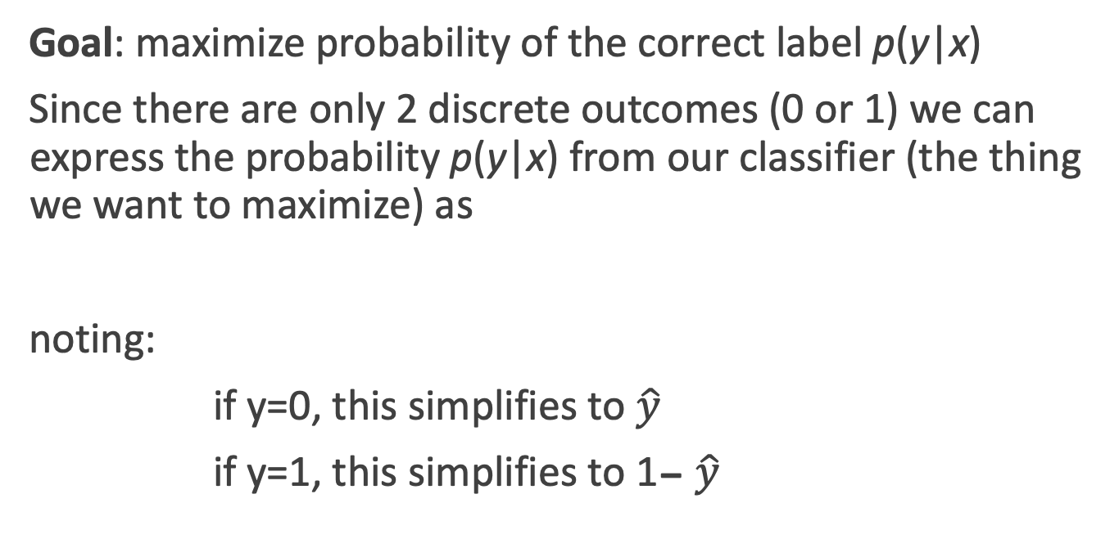
Deriving cross-entropy loss for a single observation x
Goal: maximize probability of the correct label p(y|x)
Since there are only 2 discrete outcomes (0 or 1) we can express the probability p(y|x) from our classifier (the thing we want to maximize) as
noting:
if y=0, this simplifies to $\hat{y}$
if y=1, this simplifies to 1- $\hat{y}$

Slide 44
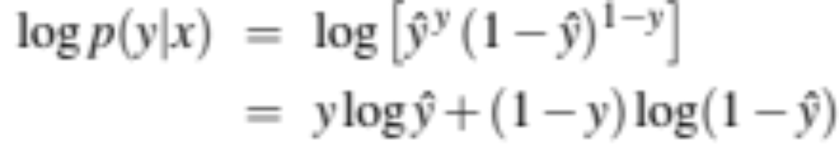
Deriving cross-entropy loss for a single observation x
Goal: maximize probability of the correct label p(y|x)
Maximize:
Now take the log of both sides (mathematically handy)
Whatever values maximize log p(y|x) will also maximize p(y|x)
Maximize:

Slide 45
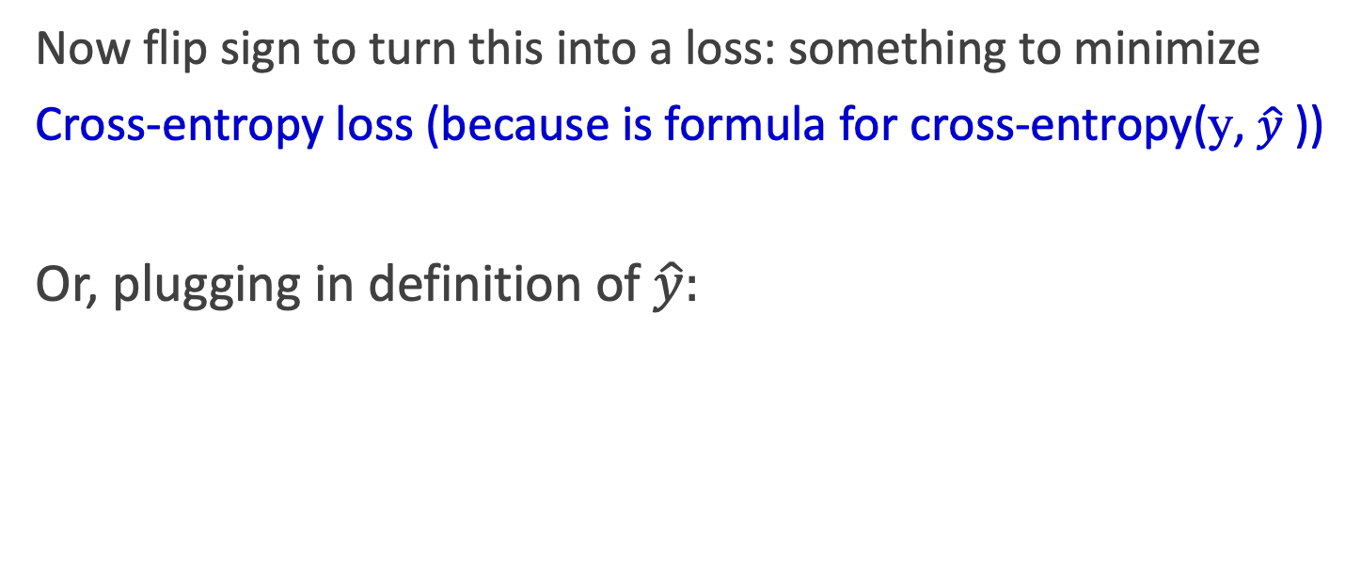
Deriving cross-entropy loss for a single observation x
Goal: maximize probability of the correct label p(y|x)
Maximize:
Now flip sign to turn this into a loss: something to minimize
Cross-entropy loss (because is formula for cross-entropy(y, $\hat{y}$))
Or, plugging in definition of $\hat{y}:$
Minimize:

Slide 46
Let's see if this works for our sentiment example
We want loss to be:
smaller if the model estimate is close to correct
bigger if model is confused
Let's first suppose the true label of this is y=1 (positive)
It's hokey . There are virtually no surprises , and the writing is second-rate . So why was it so enjoyable ? For one thing , the cast is great . Another nice touch is the music . I was overcome with the urge to get off the couch and start dancing . It sucked me in , and it'll do the same to you .

Slide 47
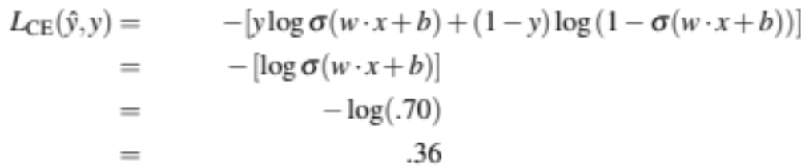
Let's see if this works for our sentiment example
True value is y=1. How well is our model doing?
Pretty well! What's the loss?

Slide 48
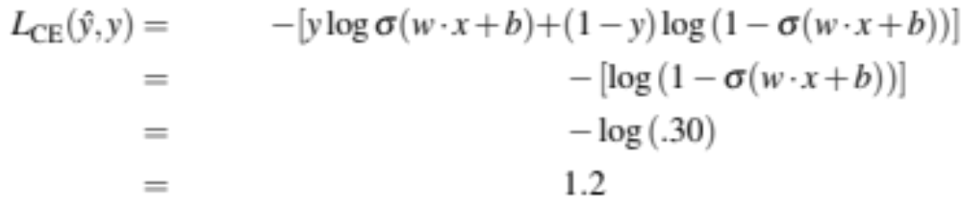
Let's see if this works for our sentiment example
Suppose true value instead was y=0.
What's the loss?

Slide 49
Let's see if this works for our sentiment example
The loss when model was right (if true y=1)
Is lower than the loss when model was wrong (if true y=0):
Sure enough, loss was bigger when model was wrong!

Slide 50
Logistic Regression
Cross-Entropy Loss

Slide 51
Logistic Regression
Stochastic Gradient Descent

Slide 52
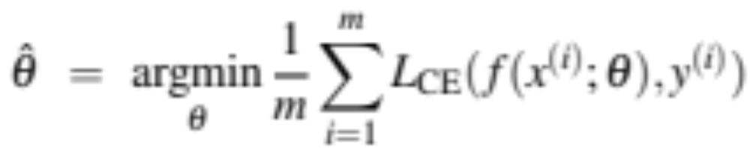
Our goal: minimize the loss
Let's make explicit that the loss function in parameterized by weights 𝛳=(w,b)
We want the weights that minimize the loss, averaged over all examples:

Slide 53

Intuition of gradient descent
How do I get to the bottom of this river canyon?
Look around me 360∘
Find the direction of steepest slope
Go that way
x

Slide 54
Our goal: minimize the loss
For logistic regression, loss function is convex
A convex function has just one minimum
Gradient descent starting from any point is guaranteed to find the minimum
  (Loss for neural networks is non-convex)

Slide 55
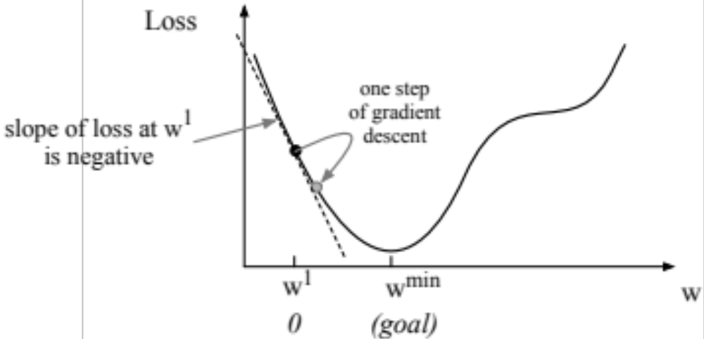
Let's first visualize for a single scalar w
Q: Given current w, should we make it bigger or smaller?
A: Move w in the reverse direction from the slope of the function
  So we'll move positive

Slide 56
Gradients
The gradient of a function of many variables is a vector pointing in the direction of the greatest increase in a function.
Gradient Descent: Find the gradient of the loss function at the current point and move in the opposite direction.

Slide 57
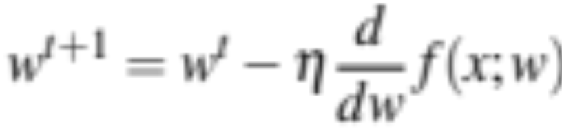
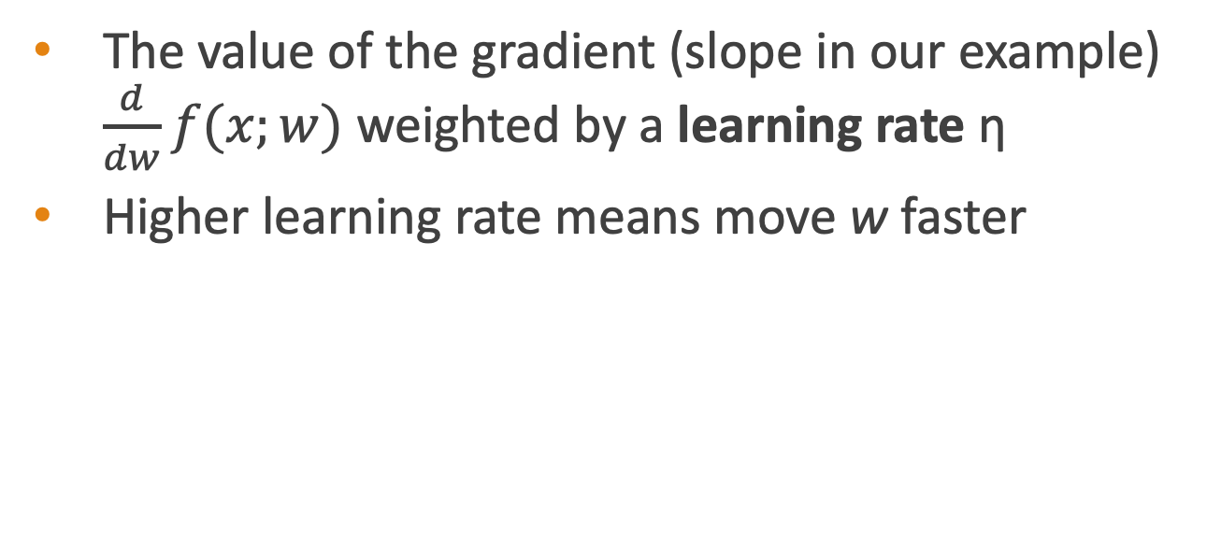
How much do we move in that direction ?
The value of the gradient (slope in our example) $\frac{d}{dw}f(x;w)$ weighted by a learning rate η
Higher learning rate means move w faster

Slide 58
Now let's consider N dimensions
We want to know where in the N-dimensional space (of the N parameters that make up θ ) we should move.
The gradient is just such a vector; it expresses the directional components of the sharpest slope along each of the N dimensions.

Slide 59
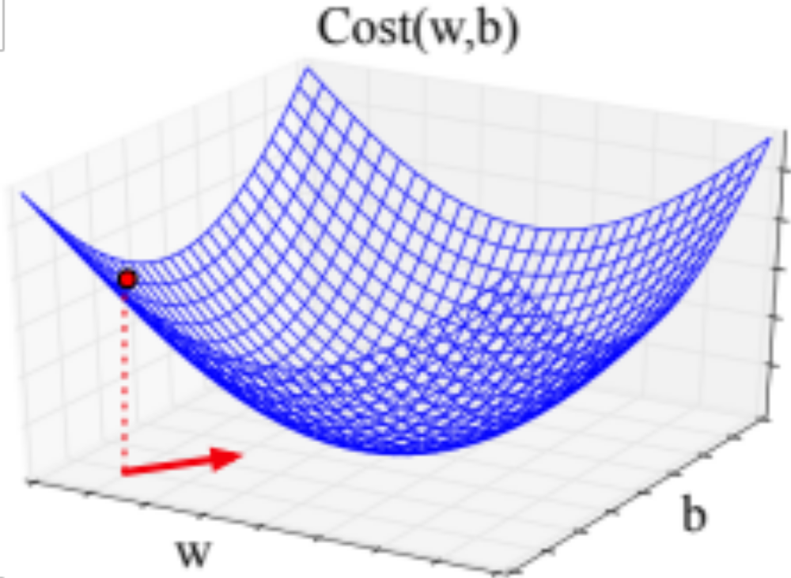
Imagine 2 dimensions, w and b
Visualizing the gradient vector at the red point
It has two dimensions shown in the x-y plane

Slide 60
Real gradients
Are much longer; lots and lots of weights
For each dimension w_{i} the gradient component i tells us the slope with respect to that variable.
  “How much would a small change in w_{i} influence the total loss function L?”
  We express the slope as a partial derivative ∂ of the loss ∂w_{i}
The gradient is then defined as a vector of these partials.

Slide 61
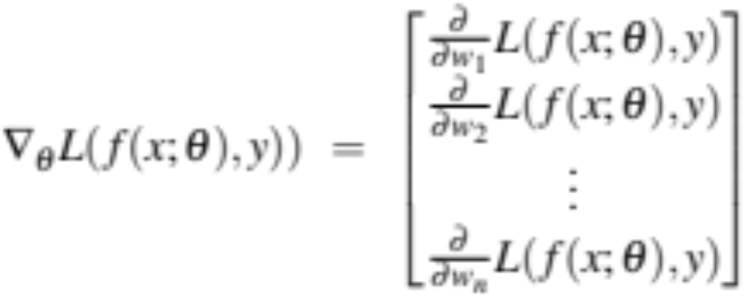
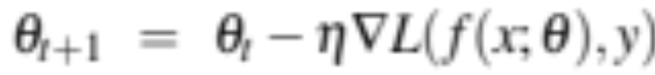

The gradient
We’ll represent $\hat{y}$as f (x; θ ) to make the dependence on θ more obvious:
The final equation for updating θ based on the gradient is thus

Slide 62
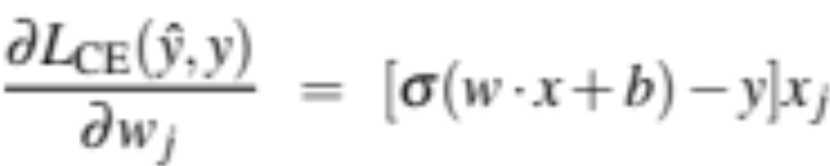
What are these partial derivatives for logistic regression?
The loss function
The elegant derivative of this function (see textbook 5.8 for derivation)

Slide 63
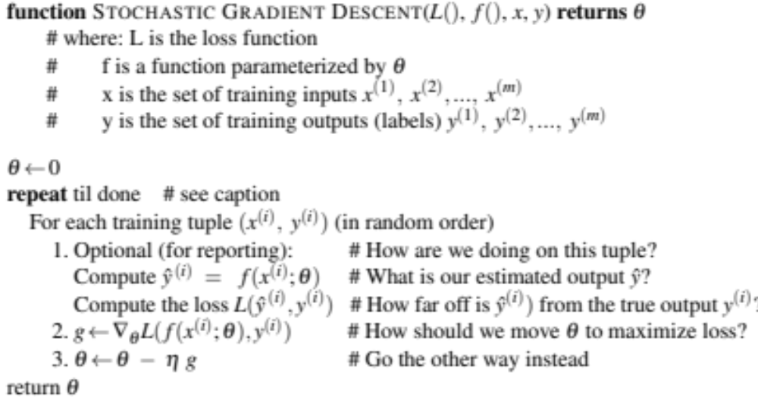

Slide 64
Hyperparameters
The learning rate η is a hyperparameter
  too high: the learner will take big steps and overshoot
  too low: the learner will take too long
More on hyperparameters in Chapter 7
Briefly, a special kind of parameter for an ML model
Instead of being learned by algorithm from supervision (like regular parameters), they are chosen by algorithm designer.

Slide 65
Logistic Regression
Stochastic Gradient Descent

Slide 66
Logistic Regression
Stochastic Gradient Descent: An example and more details

Slide 67
Working through an example
One step of gradient descent
A mini-sentiment example, where the true y=1 (positive)
Two features:
        x₁ = 3 (count of positive lexicon words)
        x₂ = 2 (count of negative lexicon words)
      Assume 3 parameters (2 weights and 1 bias) in Θ⁰ are zero:
        w₁ = w₂ = b = 0
        η = 0.1

Slide 68
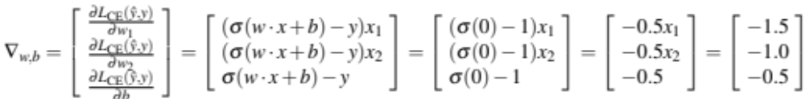
Example of gradient descent
        w₁ = w₂ = b = 0;
        x₁ = 3; x₂ = 2
Update step for update θ is:
where
Gradient vector has 3 dimensions:

Slide 69
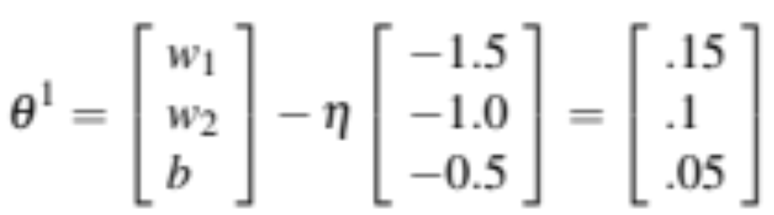
Example of gradient descent
Now that we have a gradient, we compute the new parameter vector θ¹ by moving θ⁰ in the opposite direction from the gradient:
        η = 0.1;
Note that enough negative examples would eventually make w₂ negative

Slide 70
Mini-batch training
Stochastic gradient descent chooses a single random example at a time.
That can result in choppy movements
More common to compute gradient over batches of training instances.
Batch training: entire dataset
Mini-batch training: m examples (512, or 1024)

Slide 71
Logistic Regression
Stochastic Gradient Descent: An example and more details

Slide 72
Logistic Regression
Regularization

Slide 73
Overfitting
A model that perfectly match the training data has a problem.
It will also overfit to the data, modeling noise
  A random word that perfectly predicts y (it happens to only occur in one class) will get a very high weight.
  Failing to generalize to a test set without this word.
A good model should be able to generalize

Slide 74
Overfitting
Useful or harmless features
+
X1 = "this"
X2 = "movie
X3 = "hated"
This movie drew me in, and it'll do the same to you.
X4 = "drew me in"
-
4gram features that just "memorize" training set and might cause problems
I can't tell you how much I hated this movie. It sucked.
X5 = "the same to you"
X7 = "tell you how much"

Slide 75
Overfitting
4-gram model on tiny data will just memorize the data
  100% accuracy on the training set
But it will be surprised by the novel 4-grams in the test data
  Low accuracy on test set
Models that are too powerful can overfit the data
  Fitting the details of the training data so exactly that the model doesn't generalize well to the test set
    How to avoid overfitting?
      Regularization in logistic regression
      Dropout in neural networks

Slide 76
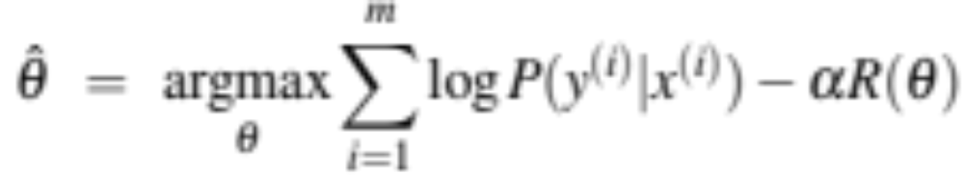
Regularization
A solution for overfitting
Add a regularization term R(θ) to the loss function (for now written as maximizing logprob rather than minimizing loss)
Idea: choose an R(θ) that penalizes large weights
  fitting the data well with lots of big weights not as good as fitting the data a little less well, with small weights

Slide 77
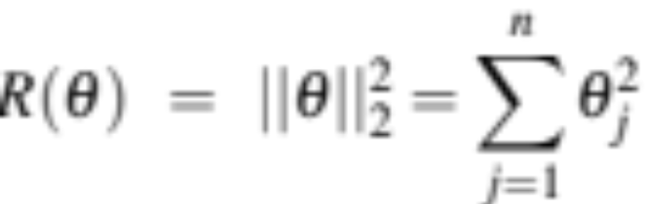
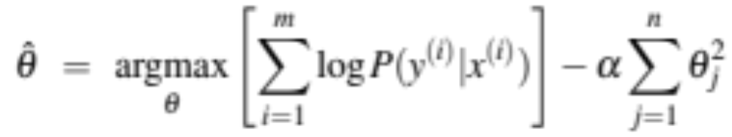
L2 Regularization (= ridge regression)
The sum of the squares of the weights
The name is because this is the (square of the) L2 norm ||θ||₂, = Euclidean distance of θ to the origin.
L2 regularized objective function:

Slide 78
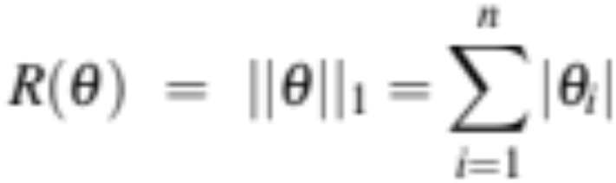
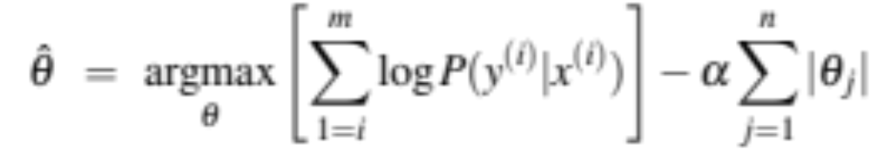
L1 Regularization (= lasso regression)
The sum of the (absolute value of the) weights
Named after the L1 norm ||W||₁, = sum of the absolute values of the weights, = Manhattan distance
L1 regularized objective function:

Slide 79
Logistic Regression
Regularization

Slide 80
Logistic Regression
Multinomial Logistic Regression

Slide 81
Multinomial Logistic Regression
Often we need more than 2 classes
  Positive/negative/neutral
  Parts of speech (noun, verb, adjective, adverb, preposition, etc.)
  Classify emergency SMSs into different actionable classes
If >2 classes we use multinomial logistic regression
    = Softmax regression
    = Multinomial logit
    = (defunct names : Maximum entropy modeling or MaxEnt
So "logistic regression" will just mean binary (2 output classes)

Slide 82
Multinomial Logistic Regression
The probability of everything must still sum to 1
  P(positive|doc) + P(negative|doc) + P(neutral|doc) = 1
Need a generalization of the sigmoid called the softmax
  Takes a vector z = [z1, z2, ..., zk] of k arbitrary values
  Outputs a probability distribution
    each value in the range [0,1]
    all the values summing to 1

Slide 83
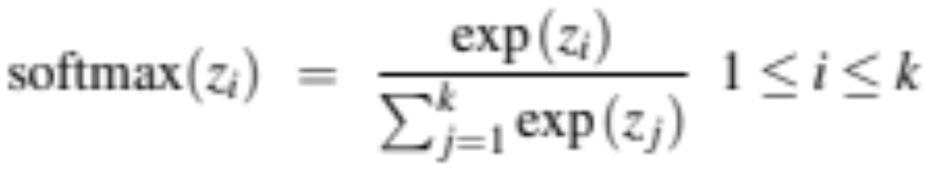
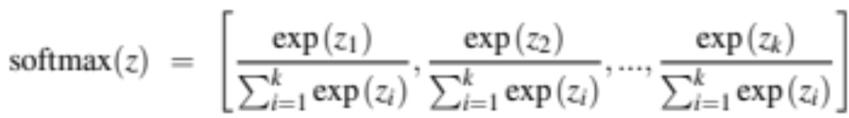
The softmax function
  Turns a vector z = [z₁, z₂, ... , z_{k}] of k arbitrary values into probabilities

Slide 84
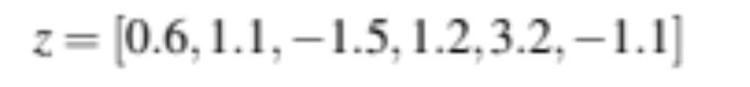
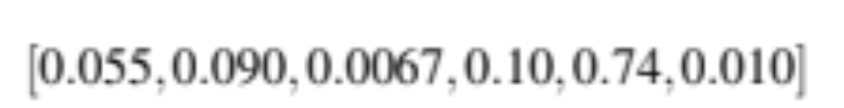
The softmax function
  Turns a vector z = [z₁,z₂,...,z_{k}] of k arbitrary values into probabilities

Slide 85
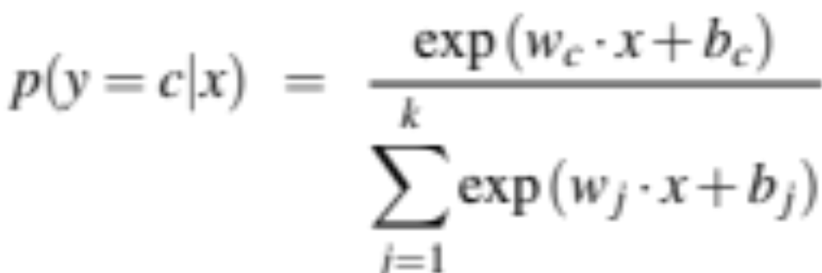
Softmax in multinomial logistic regression
Input is still the dot product between weight vector w and input vector x
But now we’ll need separate weight vectors for each of the K classes.

Slide 86
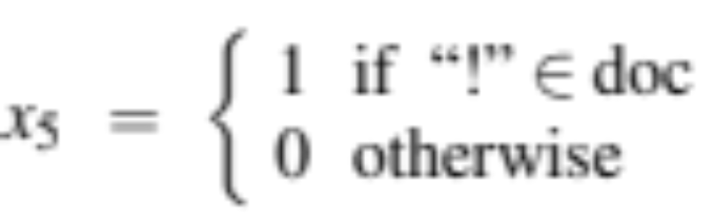
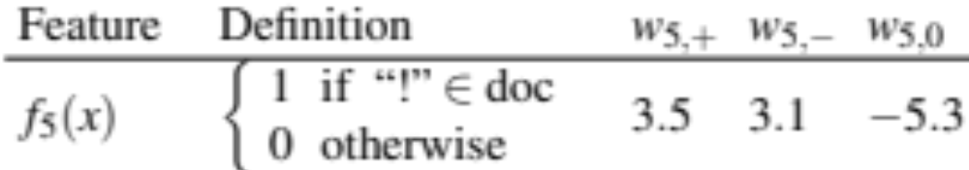
Features in binary versus multinomial logistic regression
Binary: positive weight → y=1 neg weight → y=0
Multinominal: separate weights for each class:
w₅ = 3.0

Slide 87
Logistic Regression
Multinomial Logistic Regression

