Slide 1
Vector Semantics & Embeddings
Word Meaning

Slide 2
What do words mean?
Introductory logic classes:
  The meaning of "dog" is DOG; cat is CAT
  ∀x DOG(x) ⟶ MAMMAL(x)
Old joke by Barbara Partee:
  Q: What's the meaning of life?
  A: LIFE
That seems unsatisfactory!

Slide 3
What do words mean?
Next thought: look in a dictionary
http://www.oed.com/

Slide 4
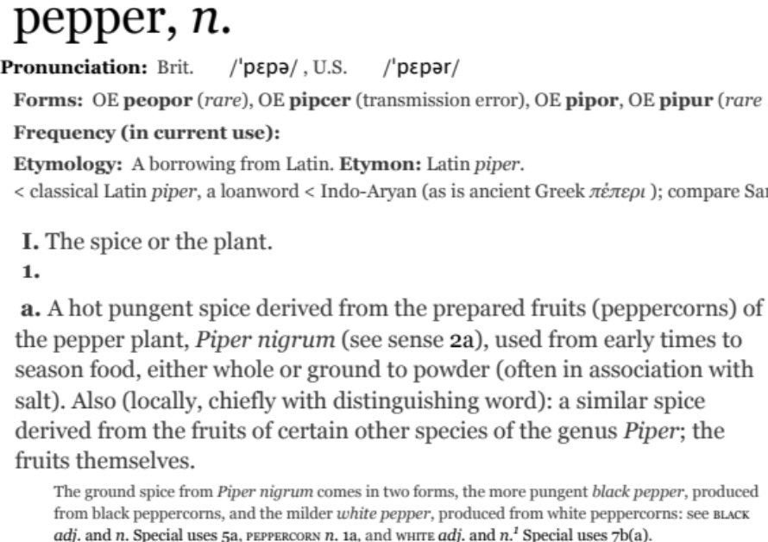
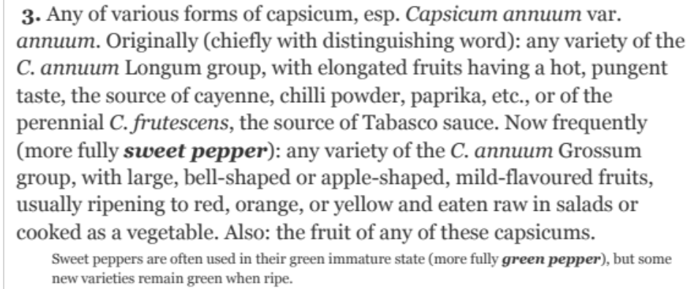
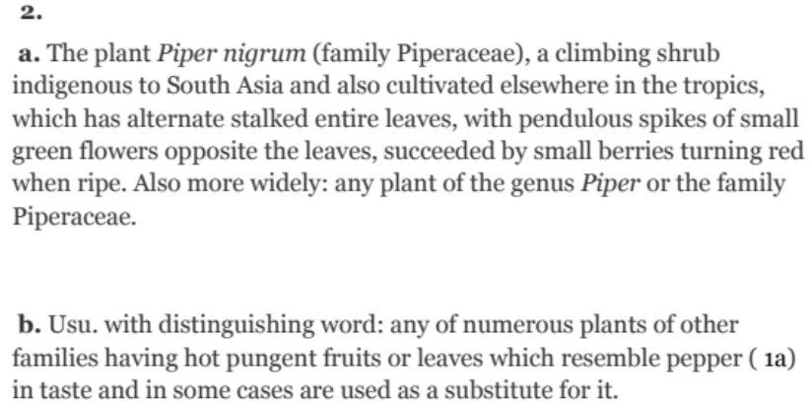
Words, Lemmas, Senses, Definitions
lemma
sense
definition

Slide 5
Lemma pepper
Sense 1: spice from pepper plant
Sense 2: the pepper plant itself
Sense 3: another similar plant (Jamaican pepper)
Sense 4: another plant with peppercorns (California pepper)
Sense 5: capsicum (i.e. chili, paprika, bell pepper, etc)
A sense or “concept” is the meaning component of a word

Slide 6
Relations between senses: Synonymy
Synonyms have the same meaning in some or all contexts.
  filbert / hazelnut
  couch / sofa
  big / large
  automobile / car
  vomit / throw up
  water / H₂0

Slide 7
Relation: Synonymy
Note that there are probably no examples of perfect synonymy.
  Even if many aspects of meaning are identical
  Still may not preserve the acceptability based on notions of politeness, slang, register, genre, etc.

Slide 8
Relation: Synonymy?
  water/H₂0
  big/large
  brave/courageous

Slide 9
The Linguistic Principle of Contrast
Difference in form → difference in meaning

Slide 10
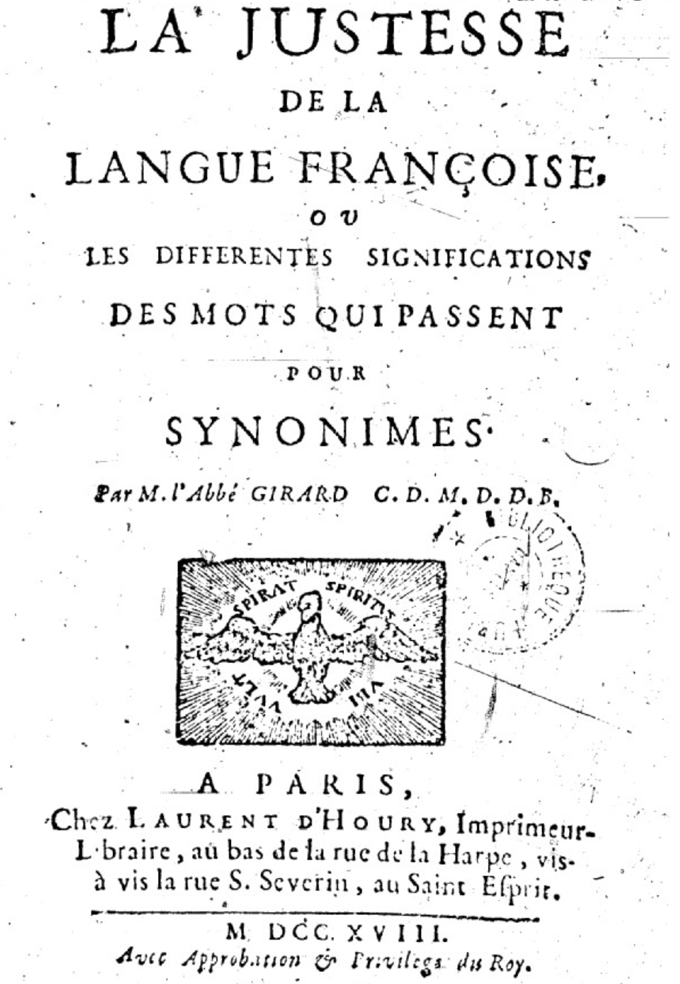
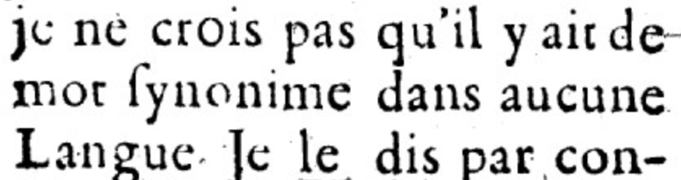
Abbé Gabriel Girard 1718
Re: "exact" synonyms
"
"
[I do not believe that there is a synonymous word in any language]

Slide 11
Relation: Similarity
    Words with similar meanings. Not synonyms, but sharing some element of meaning
    car, bicycle
    cow, horse

Slide 12
Ask humans how similar 2 words are
word1 | word2 | similarity
vanish | disappear | 9.8
behave | obey | 7.3
belief | impression | 5.95
muscle | bone | 3.65
modest | flexible | 0.98
hole | agreement | 0.3
SimLex-999 dataset (Hill et al., 2015)

Slide 13
Relation: Word relatedness
Also called "word association"
Words can be related in any way, perhaps via a semantic frame or field
    car, bicycle: similar
    car, gasoline: related, not similar

Slide 14
Semantic field
Words that
  cover a particular semantic domain
  bear structured relations with each other.
  hospitals
  surgeon, scalpel, nurse, anaesthetic, hospital
  restaurants
  waiter, menu, plate, food, menu, chef
  houses
  door, roof, kitchen, family, bed

Slide 15
Relation: Antonymy
Senses that are opposites with respect to only one feature of meaning
Otherwise, they are very similar!
  dark/light short/long fast/slow rise/fall
  hot/cold up/down in/out
More formally: antonyms can
  define a binary opposition or be at opposite ends of a scale
    long/short, fast/slow
  Be reversives:
    rise/fall, up/down

Slide 16
Relation: Superordinate/ subordinate
One sense is a subordinate of another if the first sense is more specific, denoting a subclass of the other
  car is a subordinate of vehicle
  mango is a subordinate of fruit
Conversely superordinate
  vehicle is a superordinate of car
  fruit is a subodinate of mango
Superordinate | vehicle | fruit | furniture
Subordinate | car | mango | chair

Slide 17
These levels are not symmetric
One level of category is distinguished from the others
The "basic level"

Slide 18
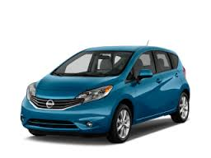
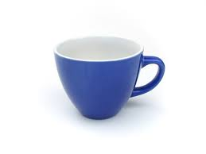
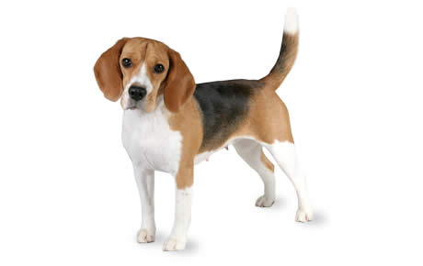

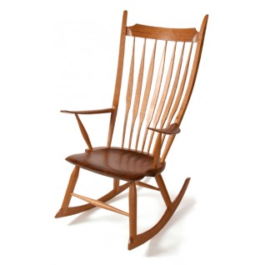
Name these items

Slide 19
Superordinate Basic Subordinate
chair office chair
piano chair rocking chair
furniture lamp torchiere
desk lamp
table end table coffee table
z

Slide 20
Cluster of Interactional Properties
Basic level things are “human-sized”
Consider chairs
  We know how to interact with a chair (sit)
  Not so clear for superordinate categories like furniture
    “Imagine a furniture without thinking of a bed/table/chair/specific basic-level category”

Slide 21
The basic level
Distinctive actions
Learned earliest in childhood
Names are shortest
Names are most frequent

Slide 22
Connotation (sentiment)
Words have affective meanings
positive connotations (happy)
negative connotations (sad)
positive evaluation (great, love)
negative evaluation (terrible, hate).

Slide 23
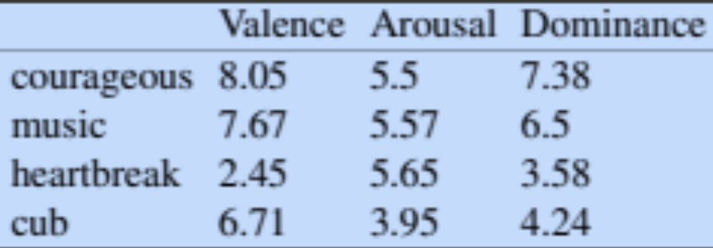
Connotation
Osgood et al. (1957)
Words seem to vary along 3 affective dimensions:
  valence: the pleasantness of the stimulus (e.g.: unhappy vs. happy)
  arousal: the intensity of emotion provoked by the stimulus (excited vs. calm)
  dominance: the degree of control exerted by the stimulus (controlling vs. awed)

Slide 24
So far
Concepts or word senses
  Have a complex many-to-many association with words (homonymy, multiple senses)
Have relations with each other
  Synonymy
  Antonymy
  Similarity
  Relatedness
  Superordinate/subordinate, basic level
  Connotation

Slide 25
Vector Semantics & Embeddings
Word Meaning

Slide 26
Vector Semantics & Embeddings
It's hard to define a concept

Slide 27
But how to define a concept?

Slide 28
Classical (“Aristotelian”) Theory of Concepts
The meaning of a word:
a concept defined by necessary and sufficient conditions
A necessary condition for being an X is a condition C that X must satisfy in order for it to be an X.
    If not C, then not X
    ”Having four sides” is necessary to be a square.
A sufficient condition for being an X is condition such that if something satisfies condition C, then it must be an X.
    If and only if C, then X
    The following necessary conditions, jointly, are sufficient to be a square
      x has (exactly) four sides
      each of x's sides is straight
      x is a closed figure
      x lies in a plane
      each of x's sides is equal in length to each of the others
      each of x's interior angles is equal to the others (right angles)
      the sides of x are joined at their ends
Example from Norman Swartz, SFU

Slide 29
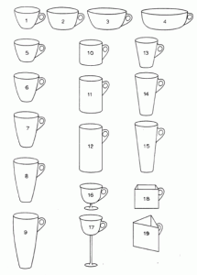
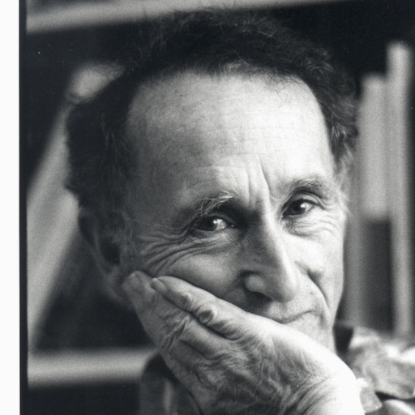
Problem 1: The features are complex & may be context-dependent
William Labov. 1975
What are these?
Cup or bowl?

Slide 30
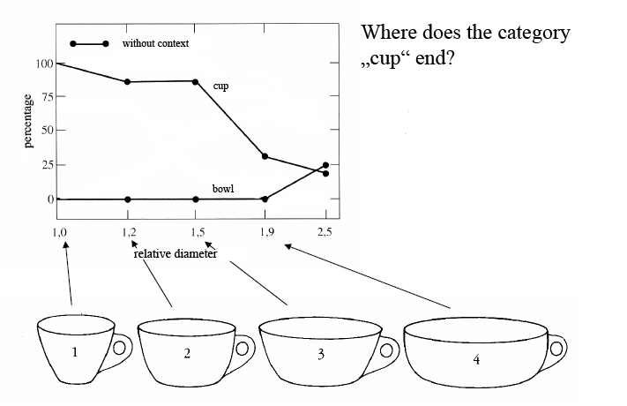
The category depends on complex features of the object (diameter, etc)

Slide 31
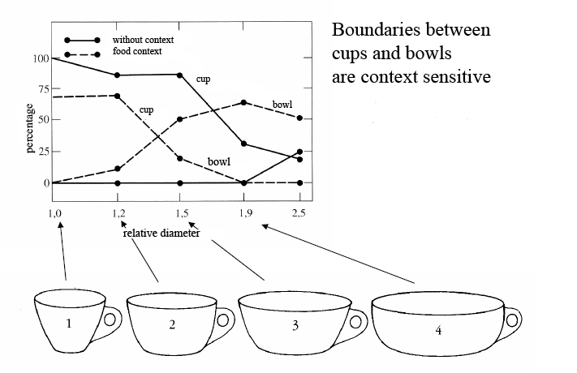
The category depends on the context!
(If there is food in it, it’s a bowl)

Slide 32
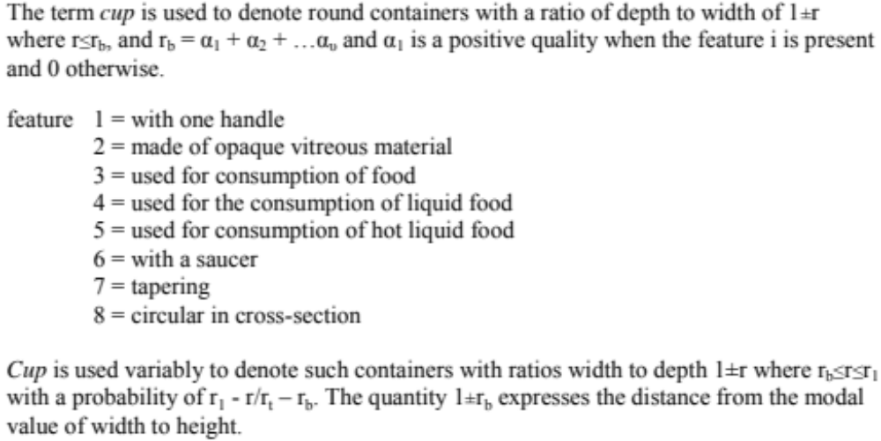
Labov’s definition of cup

Slide 33
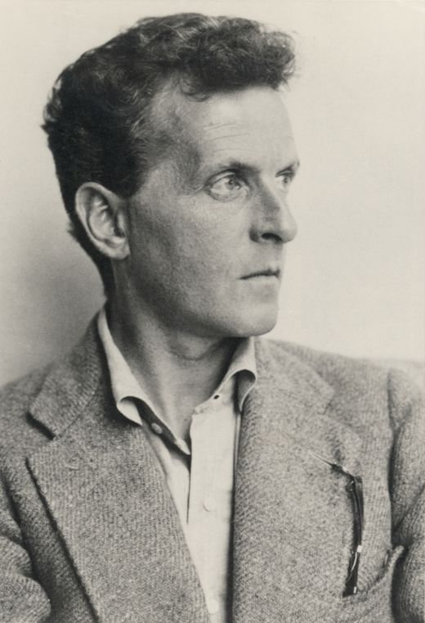
Ludwig Wittgenstein (1889-1951)
Philosopher of language
In his late years, a proponent of studying “ordinary language”

Slide 34
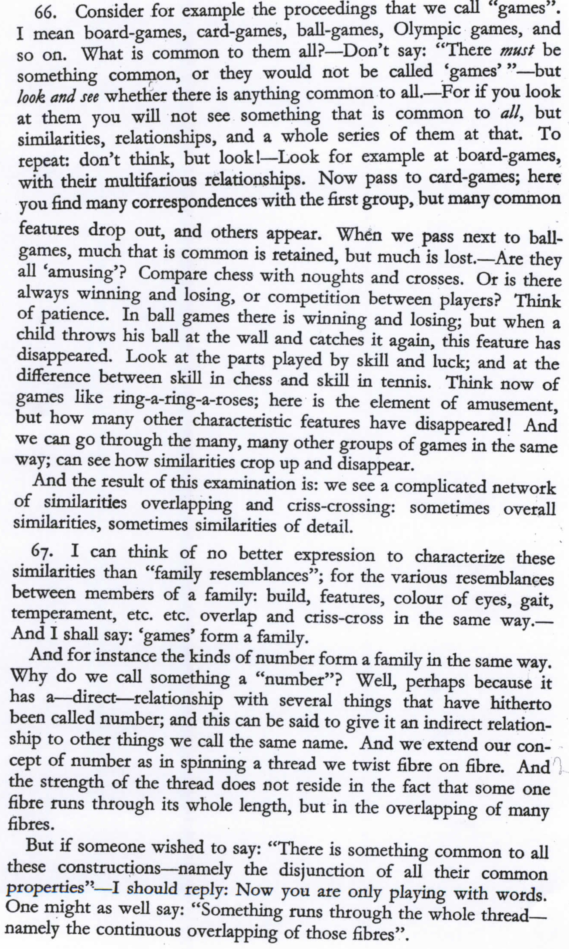
Wittgenstein (1945)
Philosophical
Investigations.
Paragraphs 66,67

Slide 35
What is a game?

Slide 36
Wittgenstein’s thought experiment "What is a game”:
PI #66:
  "Don’t say “there must be something common, or they would not be called `games’”—but look and see whether there is anything common to all"
    Is it amusing?
    Is there competition?
    Is there long-term strategy?
    Is skill required?
    Must luck play a role?
    Are there cards?
    Is there a ball?

Slide 37
Family Resemblance
Game 1 | Game 2 | Game 3 | Game 4
ABC | BCD | ACD | ABD
“each item has at least one, and probably several, elements in common with one or more items, but no, or few, elements are common to all items” Rosch and Mervis

Slide 38
Vector Semantics & Embeddings
It's hard to define a concept

Slide 39
Vector Semantics & Embeddings
Vector Semantics

Slide 40
How about a radically different approach?

Slide 41
Ludwig Wittgenstein
PI #43:
  "The meaning of a word is its use in the language"

Slide 42
Let's define words by their usages
One way to define "usage":
words are defined by their environments (the words around them)
Zellig Harris (1954):
If A and B have almost identical environments we say that they are synonyms.

Slide 43
What does recent English borrowing ongchoi mean?
Suppose you see these sentences:
  Ong choi is delicious sautéed with garlic.
  Ong choi is superb over rice
  Ong choi leaves with salty sauces
And you've also seen these:
  …spinach sautéed with garlic over rice
  Chard stems and leaves are delicious
  Collard greens and other salty leafy greens
Conclusion:
  Ongchoi is a leafy green like spinach, chard, or collard greens

Slide 44
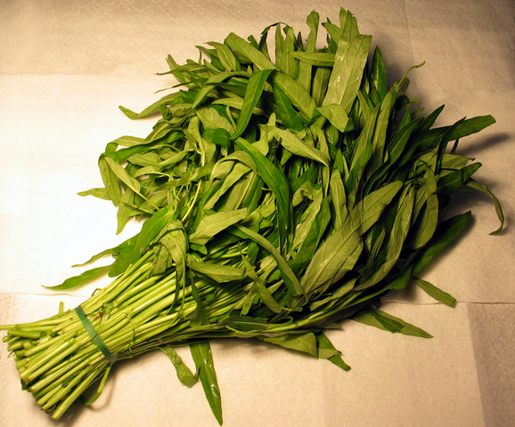
Ongchoi: Ipomoea aquatica "Water Spinach"
空心菜
kangkong
rau muống
…
Yamaguchi, Wikimedia Commons, public domain

Slide 45
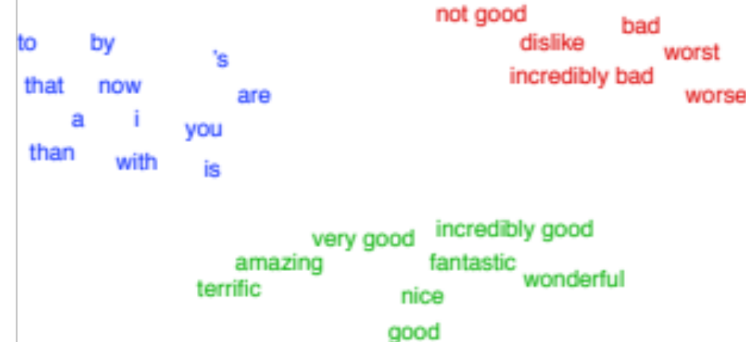
A new model of meaning focusing on distributional similarity
Each word = a vector
  Not just "word" or word45.
Similar words are "nearby in space"

Slide 46
We define a word as a vector
Called an "embedding" because it's embedded into a space
The standard way to represent meaning in NLP
Every modern NLP algorithm uses embeddings as the representation of word meaning
Fine-grained model of meaning for similarity

Slide 47
Intuition: why vectors?
Consider sentiment analysis:
  With words, a feature is a word identity
    Feature 5: 'The previous word was "terrible"'
    requires exact same word to be in training and test
  With embeddings:
    Feature is a word vector
    'The previous word was vector [35,22,17…]
    Now in the test set we might see a similar vector [34,21,14]
    We can generalize to similar but unseen words!!!

Slide 48
We'll discuss 2 kinds of embeddings
tf-idf
  Information Retrieval workhorse!
  A common baseline model
  Sparse vectors
  Words are represented by (a simple function of) the counts of nearby words
Word2vec
  Dense vectors
  Representation is created by training a classifier to predict whether a word is likely to appear nearby
  In later chapters we'll discuss extensions called contextual embeddings

Slide 49
Vector Semantics & Embeddings
Vector Semantics

Slide 50
Vector Semantics & Embeddings
Words and Vectors

Slide 51
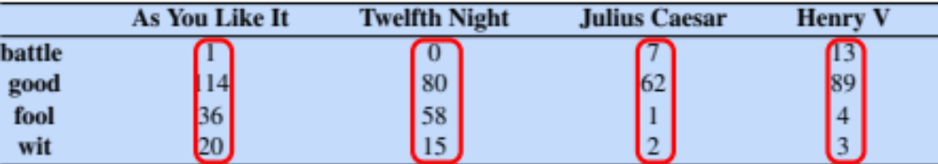
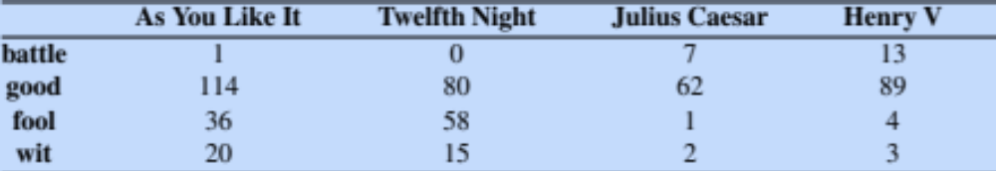
Term-document matrix
Each document is represented by a vector of words

Slide 52
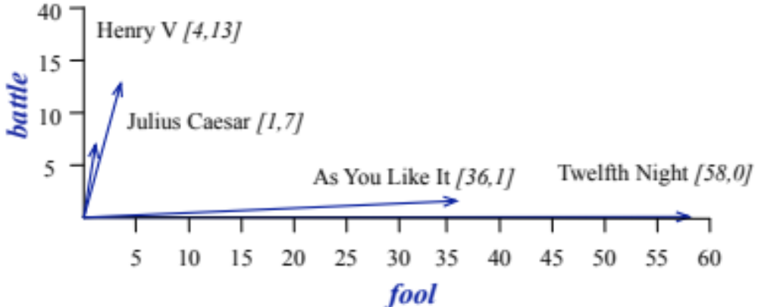
Visualizing document vectors

Slide 53
Vectors are the basis of information retrieval
Vectors are similar for the two comedies
Different than the history
Comedies have more fools and wit and fewer battles.

Slide 54
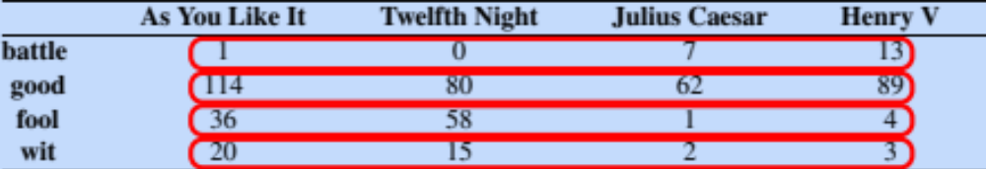
Idea for word meaning: Words can be vectors too!!!
battle is "the kind of word that occurs in Julius Caesar and Henry V"
fool is "the kind of word that occurs in comedies, especially Twelfth Night"

Slide 55
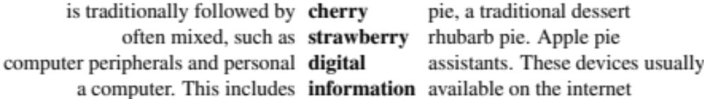
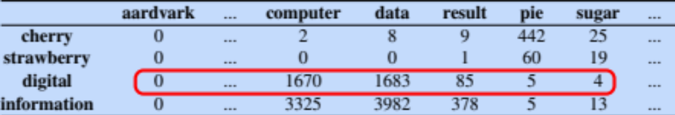
More common: word-word matrix
(or "term-context matrix")
Two words are similar in meaning if their context vectors are similar

Slide 56
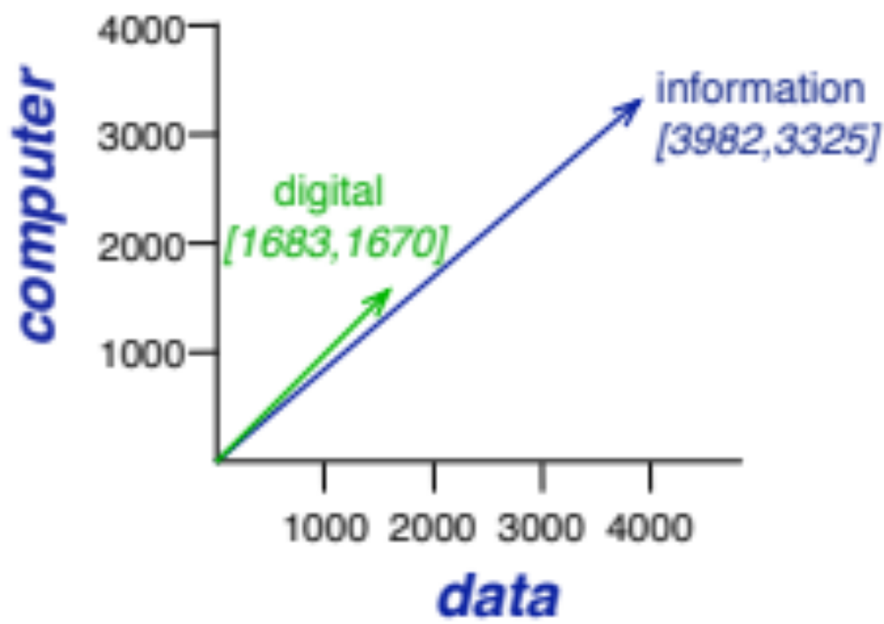

Slide 57
Vector Semantics & Embeddings
Words and Vectors

Slide 58
Vector Semantics & Embeddings
Cosine for computing word similarity

Slide 59
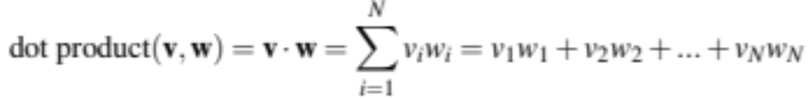
Dot product and cosine
The dot product between two vectors is a scalar:
The dot product tends to be high when the two vectors have large values in the same dimensions
Dot product can be a similarity metric between vectors

Slide 60
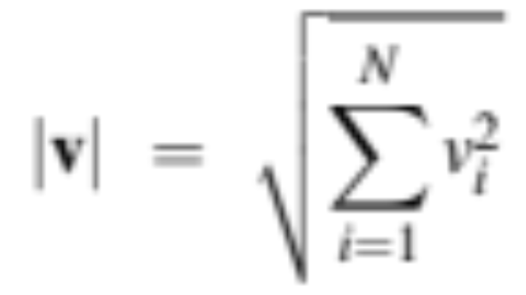
Problem with raw dot-product
Dot product favors long vectors
Dot product is higher if a vector is longer (has higher values in many dimension)
Vector length:
Frequent words (of, the, you) have long vectors (since they occur many times with other words).
So dot product overly favors frequent words

Slide 61
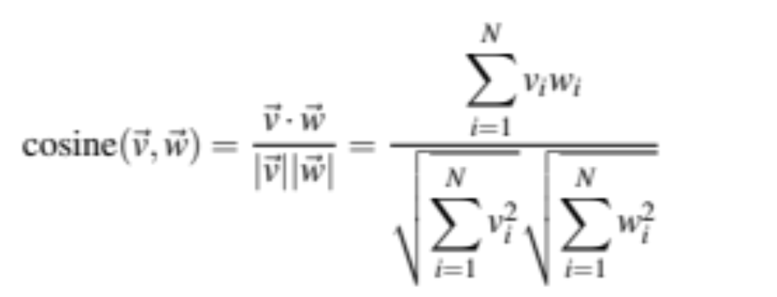
Alternative: cosine for computing word similarity
Notes:
See Law of Cosines (Cosine Rule) wikipedia page

Slide 62

Cosine as a similarity metric
-1: vectors point in opposite directions
+1: vectors point in same directions
0: vectors are orthogonal
But since raw frequency values are non-negative, the cosine for term-term matrix vectors ranges from 0–1

Slide 63
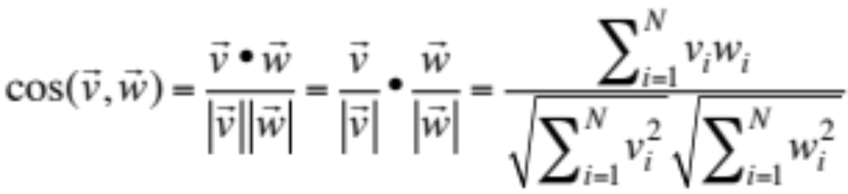
Cosine examples
 | pie | data | computer
cherry | 442 | 8 | 2
digital | 5 | 1683 | 1670
information | 5 | 3982 | 3325

Slide 64
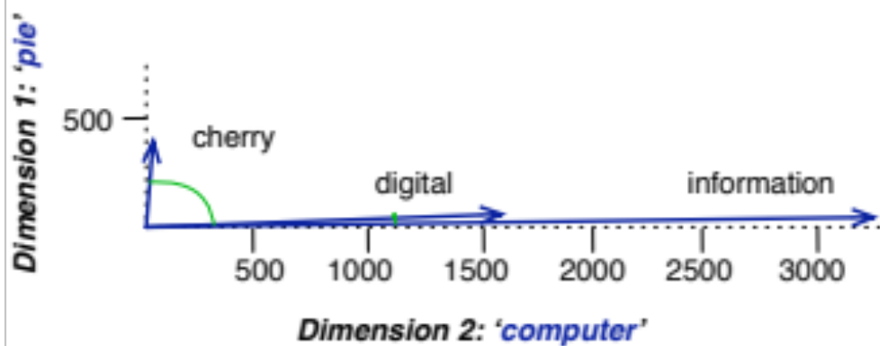
Visualizing cosines
(well, angles)

Slide 65
Vector Semantics & Embeddings
Cosine for computing word similarity

Slide 66
Vector Semantics & Embeddings
TF-IDF

Slide 67
But raw frequency is a bad representation
Frequency is clearly useful; if sugar appears a lot near apricot, that's useful information.
But overly frequent words like the, it, or they are not very informative about the context
Need a function that resolves this frequency paradox!

Slide 68
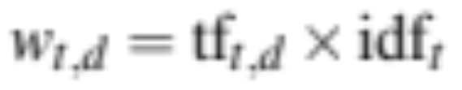
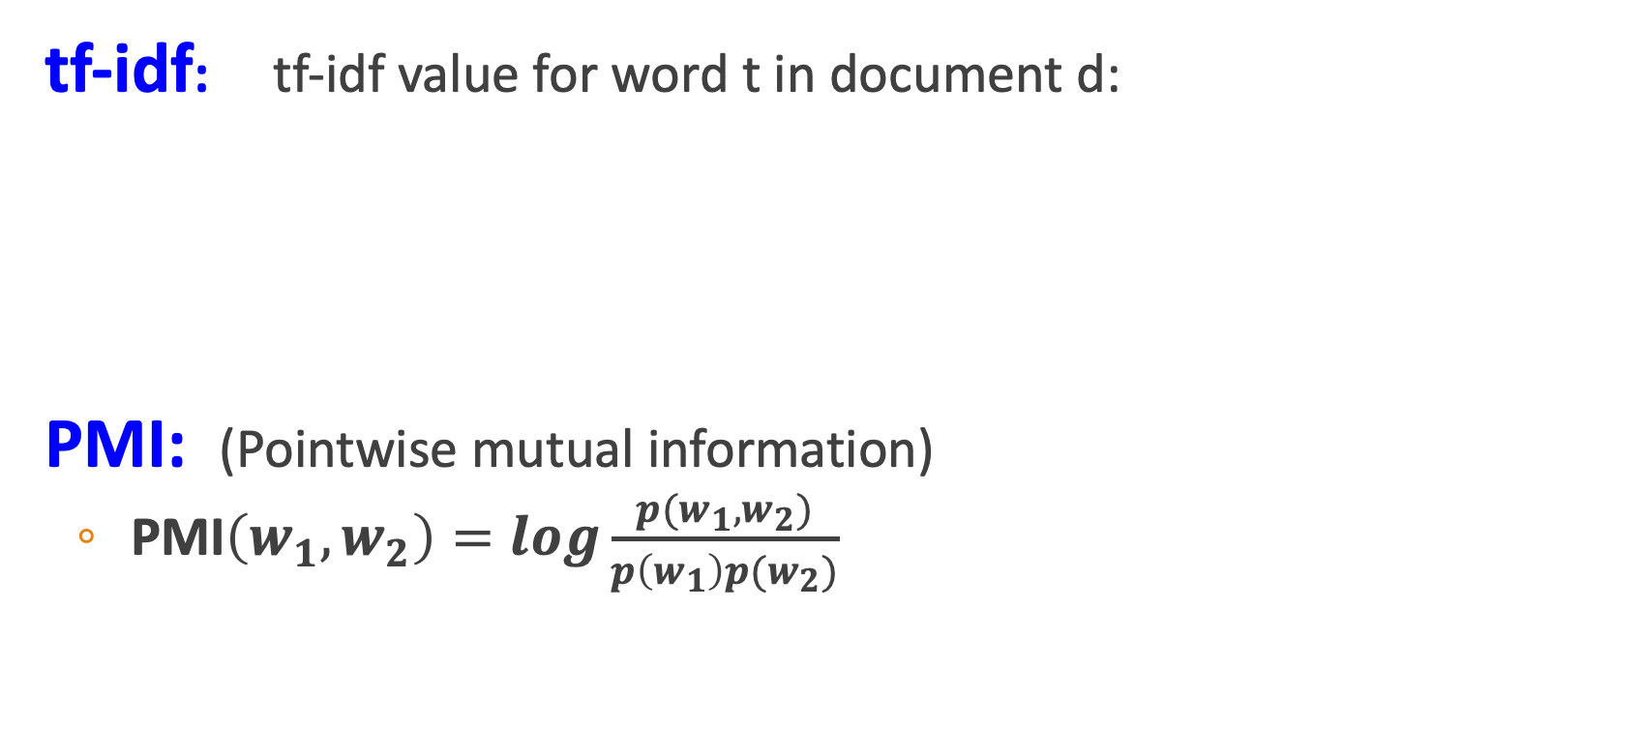
Two common solutions for word weighting
tf-idf: tf-idf value for word t in document d:
PMI: (Pointwise mutual information)
  $\text{PMI}\left(w_{1},w_{2}\right)=log\frac{p(w_{1},w_{2})}{p\left(w_{1}\right)p(w_{2})}$
Words like "the" or "good" have very low idf
See if words like "good" appear more often with "great" than we would expect by chance

Slide 69
Term frequency (tf)
tf_{t,d} = count(t,d)
Instead of using raw count, we squash a bit:
tf_{t,d} = log₁₀(count(t,d)+1)

Slide 70
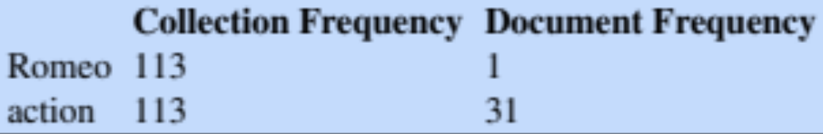
Document frequency (df)
df_{t} is the number of documents t occurs in.
(note this is not collection frequency: total count across all documents)
"Romeo" is very distinctive for one Shakespeare play:
Important: documents can be anything; we can call each paragraph a document

Slide 71
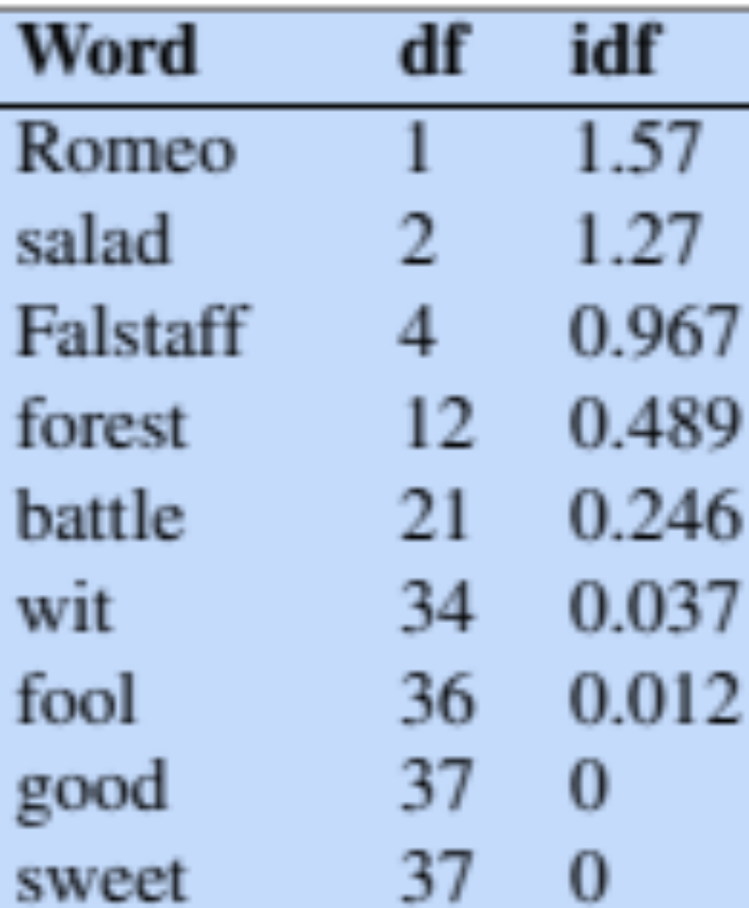
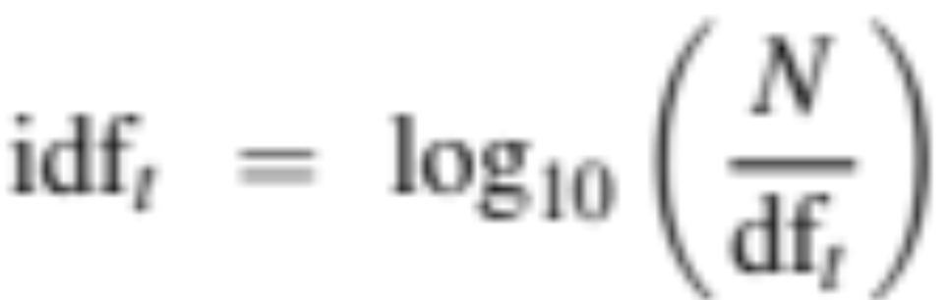
Inverse document frequency (idf)
N is the total number of documents
in the collection

Slide 72
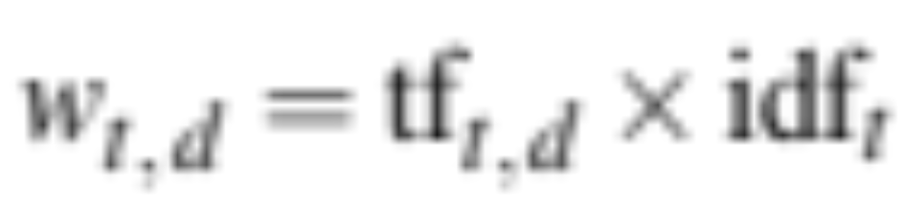
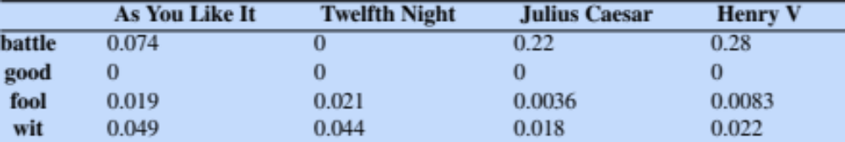
Final tf-idf weighted value for a word
Raw counts:
Tf=idf:

Slide 73
Vector Semantics & Embeddings
TF-IDF

Slide 74
Vector Semantics & Embeddings
PPMI

Slide 75
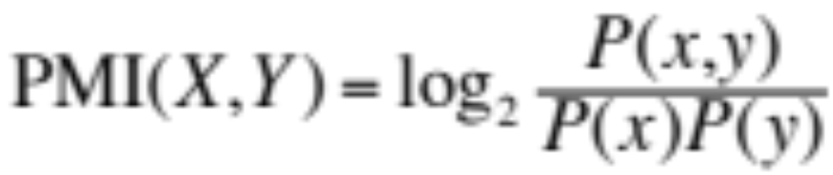
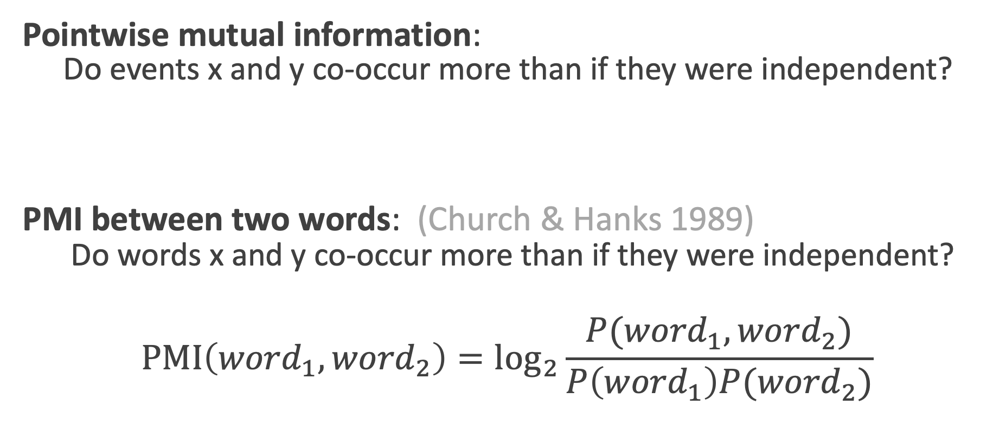
Pointwise Mutual Information
Pointwise mutual information:
  Do events x and y co-occur more than if they were independent?
  PMI between two words: (Church & Hanks 1989)
  Do words x and y co-occur more than if they were independent?
$$\text{PMI}\left({word}_{1}, {word}_{2}\right)={\text{log}}_{2}\frac{P({word}_{1}, {word}_{2})}{P\left({word}_{1}\right)P({word}_{2})}$$

Slide 76
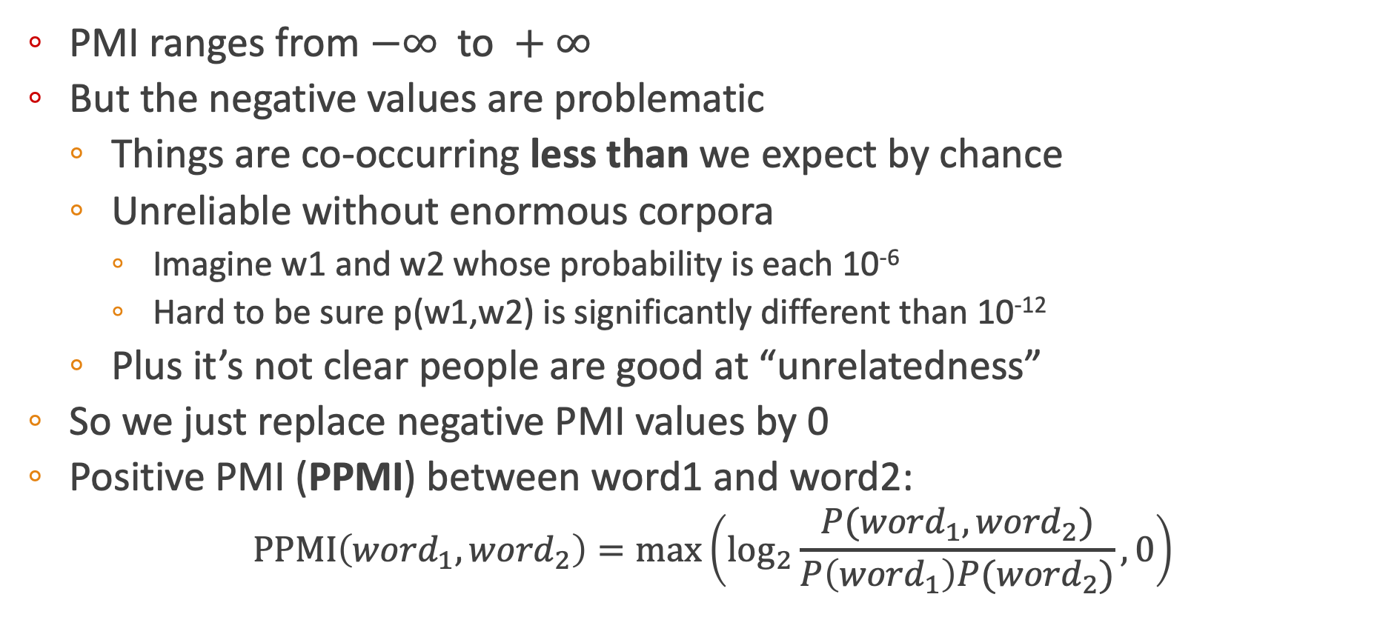
Positive Pointwise Mutual Information
  PMI ranges from $−∞ \text{to} +∞$
  But the negative values are problematic
    Things are co-occurring less than we expect by chance
    Unreliable without enormous corpora
      Imagine w1 and w2 whose probability is each 10⁻⁶
      Hard to be sure p(w1,w2) is significantly different than 10⁻¹²
    Plus it’s not clear people are good at “unrelatedness”
  So we just replace negative PMI values by 0
  Positive PMI (PPMI) between word1 and word2:
$$\text{PPMI}\left({word}_{1}, {word}_{2}\right)=\max\left({\text{log}}_{2}\frac{P({word}_{1}, {word}_{2})}{P\left({word}_{1}\right)P({word}_{2})},0\right)$$

Slide 77
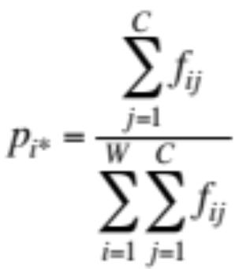
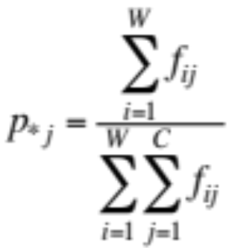
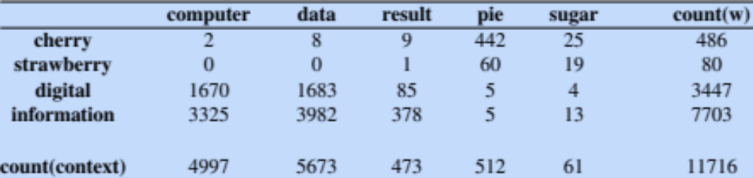
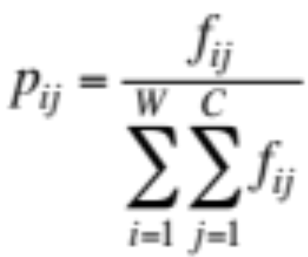
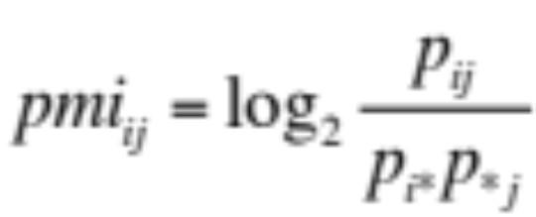
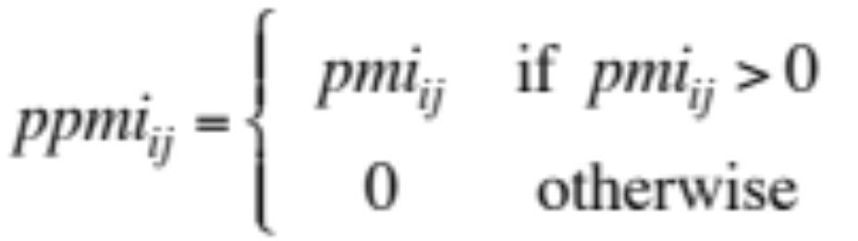
Computing PPMI on a term-context matrix
Matrix F with W rows (words) and C columns (contexts)
f_{ij} is # of times w_{i} occurs in context c_{j}

Slide 78
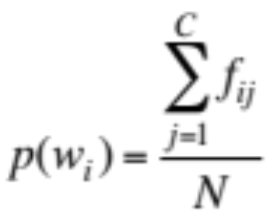
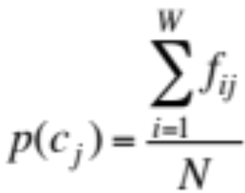
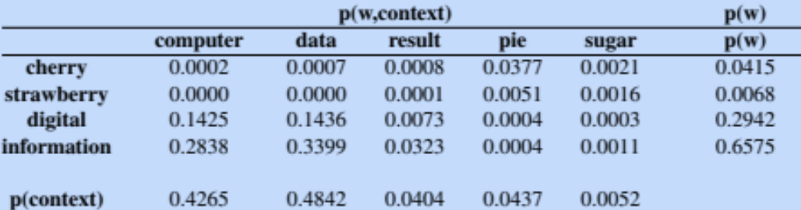
p(w=information,c=data) =
p(w=information) =
p(c=data) =
3982/111716
= .3399
7703/11716
= .6575
5673/11716
= .4842

Slide 79


pmi(information,data) = log₂ (
.3399 /
(.6575*.4842) )
= .0944
Resulting PPMI matrix (negatives replaced by 0)

Slide 80
Weighting PMI
PMI is biased toward infrequent events
  Very rare words have very high PMI values
Two solutions:
  Give rare words slightly higher probabilities
  Use add-one smoothing (which has a similar effect)

Slide 81


Weighting PMI: Giving rare context words slightly higher probability
Raise the context probabilities to $α=0.75$:
This helps because $P_{α}\left(c\right)>P\left(c\right)$ for rare c
Consider two events, P(a) = .99 and P(b)=.01
${ P}_{α}\left(a\right)=\frac{{.99}^{.75}}{{.99}^{.75}+{.01}^{.75}}=.97$ $P_{α}\left(b\right)=\frac{{.01}^{.75}}{{.01}^{.75}+{.01}^{.75}}=.03$

Slide 82
Vector Semantics & Embeddings
Dense vectors

Slide 83
Sparse versus dense vectors
tf-idf vectors are
  long (length |V|= 20,000 to 50,000)
  sparse (most elements are zero)
Alternative: learn vectors which are
  short (length 50-1000)
  dense (most elements are non-zero)

Slide 84
Sparse versus dense vectors
Why dense vectors?
  Short vectors may be easier to use as features in machine learning (fewer weights to tune)
  Dense vectors may generalize better than explicit counts
  They may do better at capturing synonymy:
    car and automobile are synonyms; but are distinct dimensions
      a word with car as a neighbor and a word with automobile as a neighbor should be similar, but aren't
  In practice, they work better

Slide 85
Common methods for getting short dense vectors
“Neural Language Model”-inspired models
  Word2vec (skipgram, CBOW), Glove
Singular Value Decomposition (SVD)
  A special case of this is called LSA – Latent Semantic Analysis
Alternative to these "static embeddings":
  Contextual Embeddings (ELMo, BERT)
  Compute distinct embeddings for a word in its context
  Separate embeddings for each token of a word
  We'll return to this in a later chapter

Slide 86
Vector Semantics & Embeddings
Dense vectors

Slide 87
Vector Semantics & Embeddings
Word2vec: The classifier

Slide 88
Embeddings you can download!
Word2vec (Mikolov et al)
https://code.google.com/archive/p/word2vec/
Glove (Pennington, Socher, Manning)
http://nlp.stanford.edu/projects/glove/

Slide 89
Word2vec
Popular embedding method
Very fast to train
Code available on the web
Idea: predict rather than count

Slide 90
Word2vec
Instead of counting how often each word w occurs near "apricot"
  Train a classifier on a binary prediction task:
    Is w likely to show up near "apricot"?
We don’t actually care about this task
    But we'll take the learned classifier weights as the word embeddings
Big idea: self-supervision:
    A word c that occurs near apricot in the corpus asks as the gold "correct answer" for supervised learning
    No need for human labels
    Bengio et al. (2003); Collobert et al. (2011)

Slide 91
Word2Vec: Skip-Gram Task
Word2vec provides a variety of options. We'll do:
  skip-gram with negative sampling (SGNS)

Slide 92
Approach: predict if candidate word c is a "neighbor"
Treat the target word t and a neighboring context word c as positive examples.
Randomly sample other words in the lexicon to get negative examples
Use logistic regression to train a classifier to distinguish those two cases
Use the learned weights as the embeddings

Slide 93
Skip-Gram Training Data
Assume a +/- 2 word window, given training sentence:
  …lemon, a [tablespoon of apricot jam, a] pinch…
c1 c2 [target] c3 c4

Slide 94
Skip-Gram Classifier
(assuming a +/- 2 word window)
  …lemon, a [tablespoon of apricot jam, a] pinch…
c1 c2 [target] c3 c4
Goal: train a classifier that is given a candidate (word, context) pair
(apricot, tablespoon)
(apricot, aardvark)
…
And assigns each pair a probability:
P(+|w, c)

Slide 95
Similarity is computed from dot product
Remember: two vectors are similar if they have a high dot product
  Cosine is just a normalized dot product
So:
  Similarity(w,c) ∝ w ∙ c
We’ll need to normalize to get a probability
  (cosine isn't a probability either)

Slide 96


Turning dot products into probabilities
Sim(w,c) ≈ w ∙ c
To turn this into a probability
We'll use the sigmoid from logistic regression:

Slide 97

How Skip-Gram Classifier computes P(+|w, c)
This is for one context word, but we have lots of context words.
We'll assume independence and just multiply them:

Slide 98
Skip-gram classifier: summary
A probabilistic classifier that,
given a test target word w
its context window of L words c_{1:L},
assigns a probability that w occurs in this window.
To compute this, we just need embeddings for all the words.

Slide 99

These embeddings we'll need: a set for w, a set for c

Slide 100
Vector Semantics & Embeddings
Word2vec: The classifier

Slide 101
Vector Semantics & Embeddings
Word2vec: Learning the embeddings

Slide 102

Skip-Gram Training data
  …lemon, a [tablespoon of apricot jam, a] pinch…
c1 c2 [target] c3 c4

Slide 103
Skip-Gram Training data
  …lemon, a [tablespoon of apricot jam, a] pinch…
c1 c2 [target] c3 c4
For each positive example we'll grab k negative examples, sampling by frequency

Slide 104

Skip-Gram Training data
  …lemon, a [tablespoon of apricot jam, a] pinch…
c1 c2 [target] c3 c4

Slide 105
Word2vec: how to learn vectors
Given the set of positive and negative training instances, and an initial set of embedding vectors
The goal of learning is to adjust those word vectors such that we:
  Maximize the similarity of the target word, context word pairs (w , c_{pos}) drawn from the positive data
  Minimize the similarity of the (w , c_{neg}) pairs drawn from the negative data.

Slide 106

Loss function for one w with c_{pos} , c_{neg1} ...c_{negk}
Maximize the dot product of the word with the actual context words, and minimize the dot products of the word with the k negative sampled non-neighbor words.

Slide 107
Learning the classifier
How to learn?
  Stochastic gradient descent!
We’ll adjust the word weights to
  make the positive pairs more likely
  and the negative pairs less likely,
  over the entire training set.

Slide 108

Intuition of one step of gradient descent

Slide 109



The derivatives of the loss function

Slide 110

Update equation in SGD
Start with randomly initiatized C and W matrices, then incrementally do updates

Slide 111
Two sets of embeddings
SGNS learns two sets of embeddings
Target embeddings matrix W
Context embedding matrix C
It's common to just add them together, representing word i as the vector w_{i} + c_{i}

Slide 112
Summary: How to learn word2vec (skip-gram) embeddings
Start with V random d-dimentional vectors as initial embeddings
Train a classifier based on embedding similarity
  Take a corpus and take pairs of words that co-occur as positive examples
  Take pairs of words that don't co-occur as negative examples
  Train the classifier to distinguish these by slowly adjusting all the embeddings to improve the classifier performance
  Throw away the classifier code and keep the embeddings.

Slide 113
Vector Semantics & Embeddings
Word2vec: Learning the embeddings

Slide 114
Vector Semantics & Embeddings
Properties of Embeddings

Slide 115
The kinds of neighbors depend on window size
Large windows (C= +/- 5) : nearest words are related words in same semantic field
  Hogwarts nearest neighbors are Harry Potter world:
    Dumbledore, Half-blood, Malfoy
Small windows (C= +/- 2) : nearest words are similar nouns, words in same taxonomy
  Hogwarts nearest neighbors are other fictional schools
    Sunnydale, Evernight, Blandings

Slide 116

Analogical relations
The classic parallelogram model of analogical reasoning (Rumelhart and Abrahamson 1973)
To solve: "apple is to tree as grape is to _____"
Add apple – tree to grape to get vine

Slide 117

Analogical relations via parallelogram
The parallelogram method can solve analogies with both sparse and dense embeddings (Turney and Littman 2005, Mikolov et al. 2013b)
king – man + woman is close to queen
Paris – France + Italy is close to Rome
For a problem a:a*::b:b*, the parallelogram method is:

Slide 118

Structure in GloVE Embedding space

Slide 119
Caveats with the parallelogram method
It only seems to work for frequent words, small distances and certain relations (relating countries to capitals, or parts of speech), but not others. (Linzen 2016, Gladkova et al. 2016, Ethayarajh et al. 2019a)
Understanding analogy is an open area of research (Peterson et al. 2020)

Slide 120

Embeddings as a window onto historical semantics
Train embeddings on different decades of historical text to see meanings shift
~30 million books, 1850-1990, Google Books data
William L. Hamilton, Jure Leskovec, and Dan Jurafsky. 2016. Diachronic Word Embeddings Reveal Statistical Laws of Semantic Change. Proceedings of ACL.

Slide 121
Embeddings reflect cultural bias!
Bolukbasi, Tolga, Kai-Wei Chang, James Y. Zou, Venkatesh Saligrama, and Adam T. Kalai. "Man is to computer programmer as woman is to homemaker? debiasing word embeddings." In NeurIPS, pp. 4349-4357. 2016.
Ask “Paris : France :: Tokyo : x”
  x = Japan
Ask “father : doctor :: mother : x”
  x = nurse
Ask “man : computer programmer :: woman : x”
  x = homemaker
Algorithms that use embeddings as part of e.g., hiring searches for programmers, might lead to bias in hiring

Slide 122
Historical embedding as a tool to study cultural biases
Garg, N., Schiebinger, L., Jurafsky, D., and Zou, J. (2018). Word embeddings quantify 100 years of gender and ethnic stereotypes. Proceedings of the National Academy of Sciences 115(16), E3635–E3644.
  Compute a gender or ethnic bias for each adjective: e.g., how much closer the adjective is to "woman" synonyms than "man" synonyms, or names of particular ethnicities
  Embeddings for competence adjective (smart, wise, brilliant, resourceful, thoughtful, logical) are biased toward men, a bias slowly decreasing 1960-1990
  Embeddings for dehumanizing adjectives (barbaric, monstrous, bizarre) were biased toward Asians in the 1930s, bias decreasing over the 20th century.
These match the results of old surveys done in the 1930s

Slide 123
Vector Semantics & Embeddings
Properties of Embeddings

