Slide 1
Basic Text Processing
Regular Expressions

Slide 2
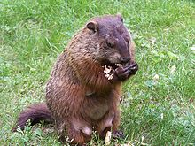
Regular expressions
A formal language for specifying text strings
How can we search for any of these?
  woodchuck
  woodchucks
  Woodchuck
  Woodchucks

Slide 3
Regular Expressions: Disjunctions
Letters inside square brackets []
Ranges [A-Z]
Pattern | Matches
[wW]oodchuck | Woodchuck, woodchuck
[1234567890] | Any digit
Pattern | Matches
[A-Z] | An upper case letter | Drenched Blossoms
[a-z] | A lower case letter | my beans were impatient
[0-9] | A single digit | Chapter 1: Down the Rabbit Hole

Slide 4
Regular Expressions: Negation in Disjunction
Negations [^Ss]
  Carat means negation only when first in []
Pattern | Matches
[^A-Z] | Not an upper case letter | Oyfn pripetchik
[^Ss] | Neither ‘S’ nor ‘s’ | I have no exquisite reason”
[^e^] | Neither e nor ^ | Look here
a^b | The pattern a carat b | Look up a^b now

Slide 5
Regular Expressions: More Disjunction
Woodchuck is another name for groundhog!
The pipe | for disjunction
Pattern | Matches
groundhog|woodchuck | woodchuck
yours|mine | yours
a|b|c | = [abc]
[gG]roundhog|[Ww]oodchuck | Woodchuck

Slide 6
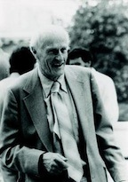
Regular Expressions: ? *+.
Pattern | Matches
colou?r | Optional previous char | color colour
oo*h! | 0 or more of previous char | oh! ooh! oooh! ooooh!
o+h! | 1 or more of previous char | oh! ooh! oooh! ooooh!
baa+ |  | baa baaa baaaa baaaaa
beg.n |  | begin begun begun beg3n
Stephen C Kleene
Kleene *, Kleene +

Slide 7
Regular Expressions: Anchors ^ $
Pattern | Matches
^[A-Z] | Palo Alto
^[^A-Za-z] | 1 “Hello”
\.$ | The end.
.$ | The end? The end!

Slide 8
Example
Find me all instances of the word “the” in a text.
  the
    Misses capitalized examples
  [tT]he
    Incorrectly returns other or theology
  [^a-zA-Z][tT]he[^a-zA-Z]

Slide 9
Errors
The process we just went through was based on fixing two kinds of errors:
  Matching strings that we should not have matched (there, then, other)
    False positives (Type I errors)
  Not matching things that we should have matched (The)
    False negatives (Type II errors)

Slide 10
Errors cont.
In NLP we are always dealing with these kinds of errors.
Reducing the error rate for an application often involves two antagonistic efforts:
  Increasing accuracy or precision (minimizing false positives)
  Increasing coverage or recall (minimizing false negatives).

Slide 11
Substitutions
Substitution in Python and UNIX commands:
s/regexp1/pattern/
e.g.:
s/colour/color/

Slide 12
Capture Groups
Say we want to put angles around all numbers:
  the 35 boxes → the <35> boxes
Use parens () to "capture" a pattern into a numbered register (1, 2, 3…)
Use \1 to refer to the contents of the register
  s/([0-9]+)/<\1>/

Slide 13
Capture groups: multiple registers
/the (.*)er they (.*), the \1er we \2/
Matches
the faster they ran, the faster we ran
But not
the faster they ran, the faster we ate

Slide 14
But suppose we don't want to capture?
Parentheses have a double function: grouping terms, and capturing
Non-capturing groups: add a ?: after paren:
/(?:some|a few) (people|cats) like some \1/
matches
  some cats like some cats
But not
  some cats like some a few

Slide 15
Simple Application: ELIZA
Early NLP system that imitated a Rogerian psychotherapist (Weizenbaum, 1966).
Uses pattern matching to match, e.g.,:
  “I need X”
  and translates them into, e.g.
  “What would it mean to you if you got X?

Slide 16
Simple Application: ELIZA
Men are all alike.
IN WHAT WAY
They're always bugging us about something or other. CAN YOU THINK OF A SPECIFIC EXAMPLE
Well, my boyfriend made me come here.
YOUR BOYFRIEND MADE YOU COME HERE
He says I'm depressed much of the time.
I AM SORRY TO HEAR YOU ARE DEPRESSED

Slide 17
How ELIZA works
s/.* I’M (depressed|sad) .*/I AM SORRY TO HEAR YOU ARE \1/
s/.* I AM (depressed|sad) .*/WHY DO YOU THINK YOU ARE \1/
s/.* all .*/IN WHAT WAY?/
s/.* always .*/CAN YOU THINK OF A SPECIFIC EXAMPLE?/

Slide 18
Summary
Regular expressions play a surprisingly large role
  Sophisticated sequences of regular expressions are often the first model for any text processing text
For hard tasks, we use machine learning classifiers
  But regular expressions are still used for pre-processing, or as features in the classifiers
  Can be very useful in capturing generalizations

Slide 19
Lookahead assertions
(?= pattern) is true if pattern matches, but is zero-width; doesn't advance character pointer
(?! pattern) true if a pattern does not match
How to match, at the beginning of a line, any single word that doesn’t start with “Volcano”:
/ˆ(?!Volcano)[A-Za-z]+/

Slide 20
Basic Text Processing
Regular Expressions

Slide 21
Basic Text Processing
Words and Corpora

Slide 22
How many words?
"I do uh main- mainly business data processing"
  Fragments, filled pauses
"Seuss’s cat in the hat is different from other cats!"
  Lemma: same stem, part of speech, rough word sense
    cat and cats = same lemma
  Wordform: the full inflected surface form
    cat and cats = different wordforms

Slide 23
How many words?
they lay back on the San Francisco grass and looked at the stars and their
Type: an element of the vocabulary.
Token: an instance of that type in running text.
How many?
  15 tokens (or 14)
  13 types (or 12) (or 11?)

Slide 24

How many words?
N = number of tokens
V = vocabulary = set of types, |V| is size of vocabulary
Heaps Law = Herdan's Law = where often .67 < β < .75
i.e., vocabulary size grows with > square root of the number of word tokens
 | Tokens = N | Types = |V|
Switchboard phone conversations | 2.4 million | 20 thousand
Shakespeare | 884,000 | 31 thousand
COCA | 440 million | 2 million
Google N-grams | 1 trillion | 13+ million

Slide 25
Corpora
Words don't appear out of nowhere.
A text is produced by a specific writer(s), at a specific time, in a specific variety of a specific language, for a specific function.

Slide 26
Corpora vary along dimension like
  Language: 7097 languages in the world
  Variety, like African American Language varieties.
    AAL Twitter posts might include forms like "iont" (I don't)
  Code switching, e.g., Spanish/English, Hindi/English:
    S/E: Por primera vez veo a @username actually being hateful! It was beautiful:)
    [For the first time I get to see @username actually being hateful! it was beautiful:) ]
    H/E: dost tha or ra- hega ... dont wory ... but dherya rakhe
    [“he was and will remain a friend ... don’t worry ... but have faith”]
  Genre: newswire, fiction, non-fiction, scientific articles, Wikipedia
  Author Demographics: writer's age, gender, race, socioeconomic status, etc.

Slide 27
Corpus datasheets
Gebru et al (2020), Bender and Friedman (2018)
Motivation: Why was the corpus collected, by whom, and who funded it?
Situation: In what situation was the text written?
Collection process: If it is a subsample how was it sampled? Was there consent? Pre-processing?
+Annotation process, Language variety, speaker demographics

Slide 28
Basic Text Processing
Word tokenization

Slide 29
Text Normalization
Every NLP task requires text normalization:
  Tokenzing (segmenting) words
  Normalizing word formats
  Segmenting sentences

Slide 30
Simple Tokenization in UNIX
(Inspired by Ken Church’s UNIX for Poets.)
Given a text file, output the word tokens and their frequencies
tr -sc ’A-Za-z’ ’\n’ < shakes.txt
| sort
| uniq –c
1945 A
72 AARON
19 ABBESS
5 ABBOT
... ...
Change all non-alpha to newlines
Sort in alphabetical order
Merge and count each type
25 Aaron
6 Abate
1 Abates
5 Abbess
6 Abbey
3 Abbot
.... …

Slide 31
The first step: tokenizing
tr -sc ’A-Za-z’ ’\n’ < shakes.txt | head
THE
SONNETS
by
William
Shakespeare
From
fairest
creatures
We
...

Slide 32
The second step: sorting
tr -sc ’A-Za-z’ ’\n’ < shakes.txt | sort | head
A
A
A
A
A
A
A
A
A
...

Slide 33
More counting
Merging upper and lower case
tr ‘A-Z’ ‘a-z’ < shakes.txt | tr –sc ‘A-Za-z’ ‘\n’ | sort | uniq –c
Sorting the counts
tr ‘A-Z’ ‘a-z’ < shakes.txt | tr –sc ‘A-Za-z’ ‘\n’ | sort | uniq –c | sort –n –r
23243 the
22225 i
18618 and
16339 to
15687 of
12780 a
12163 you
10839 my
10005 in
8954 d
What happened here?

Slide 34
Issues in Tokenization
Can't just blindly remove punctuation:
  m.p.h., Ph.D., AT&T, cap’n.
  prices ($45.55) and dates (01/02/06); URLs; (http://www.stanford.edu), hashtags (#nlproc), email addresses (someone@cs.colorado.edu).
Clitics: a part of a word that can't stand on its own
  we're → we are, French j'ai, l'honneur
Can "Multiword Expressions (MWE) be words?
  New York, rock ’n’ roll

Slide 35
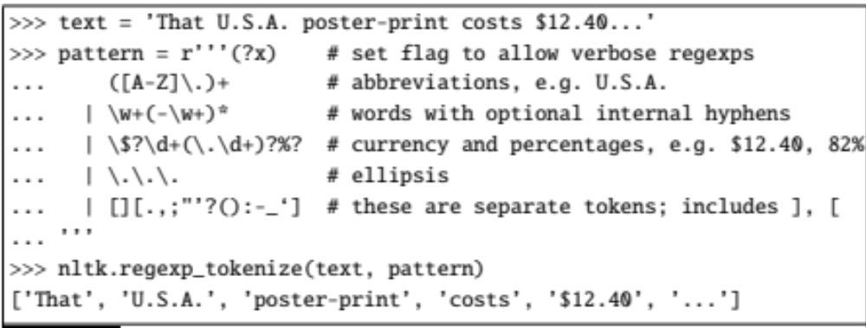
Tokenization in NLTK
Bird et al. (2009)

Slide 36
Tokenization without spaces
Chinese, Japanese, Thai, don't use spaces to separate words

Slide 37
Word tokenization in Chinese
Chinese words are composed of characters called hanzi
Each one represents a meaning unit called a morpheme.
Each word has on average 2.4 of them.
But deciding what counts as a word is complex and not agreed upon.

Slide 38
How to do word tokenization in Chinese?
姚明进入总决赛 “Yao Ming reaches the finals”
3 words?
姚明 进入 总决赛
YaoMing reaches finals
5 words?
姚 明 进入 总 决赛
Yao Ming reaches overall finals
7 characters? (don't use words at all):
姚 明 进 入 总 决 赛
Yao Ming enter enter overall decision game

Slide 39
Word tokenization
So in Chinese it's common not to do word segmentation at all
But in Thai and Japanese, it's required
The standard algorithms are neural sequence models trained by supervised machine learning.

Slide 40
Basic Text Processing
Word tokenization

Slide 41
Basic Text Processing
Byte Pair Encoding tokenization

Slide 42
A third option for word segmentation
Use the data to tell us how to tokenize.
Subword tokenization (because tokens are often parts of words)
Can include common morphemes like -est or -er.
  (A morpheme is the smallest meaning-bearing unit of a language; unlikeliest has morphemes un-, likely, and -est.)

Slide 43
Subword tokenization
Three common algorithms:
  Byte-Pair Encoding (BPE) (Sennrich et al., 2016)
  unigram language modeling tokenization (Kudo, 2018)
  WordPiece (Schuster and Nakajima, 2012)
All have 2 parts:
  A token learner that takes a raw training corpus and induces a vocabulary (a set of tokens).
  A token segmenter that takes a raw test sentence and tokenizes it according to that vocabulary

Slide 44
Byte Pair Encoding (BPE)
Let vocabulary be the set of all individual characters
= {A, B, C, D,…,a, b, c, d….}
Repeat:
  choose the two symbols that are most frequently adjacent in training corpus (say ‘A’, ‘B’),
  adds a new merged symbol ‘AB’ to the vocabulary
  replace every adjacent ’A’ ’B’ in corpus with ‘AB’.
Until k merges have been done.

Slide 45
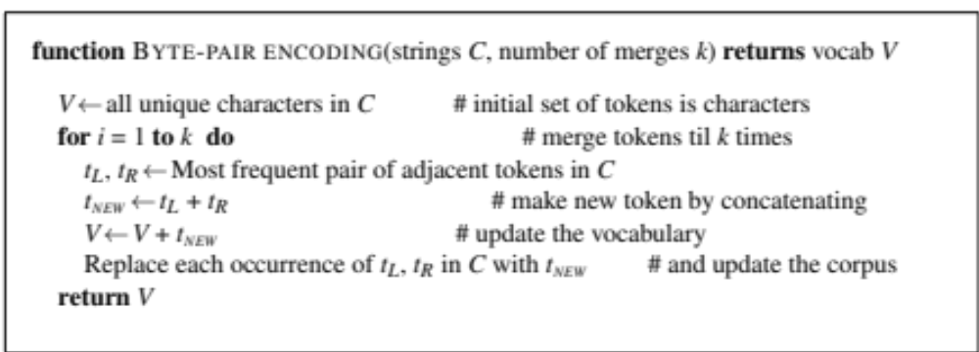
BPE token learner algorithm

Slide 46
Byte Pair Encoding (BPE)
Most subword algorithms are run inside white-space separated tokens.
So first add a special end-of-word symbol '__' before whitespace in training corpus
Next, separate into letters.

Slide 47
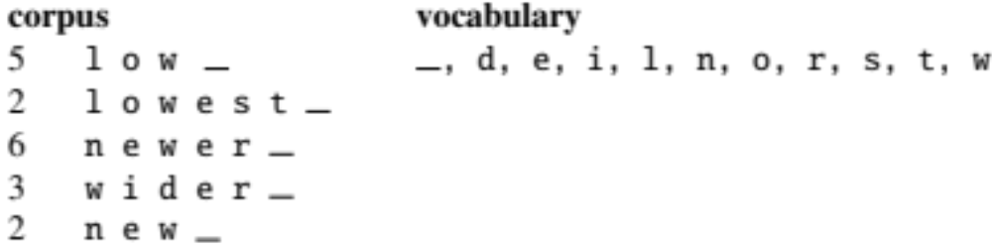
BPE token learner
Original (very fascinating🙄) corpus:
low low low low low lowest lowest newer newer newer newer newer newer wider wider wider new new
Add end-of-word tokens and segment:

Slide 48
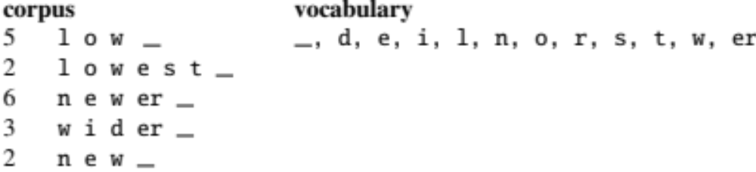
BPE token learner
Merge e r to er

Slide 49
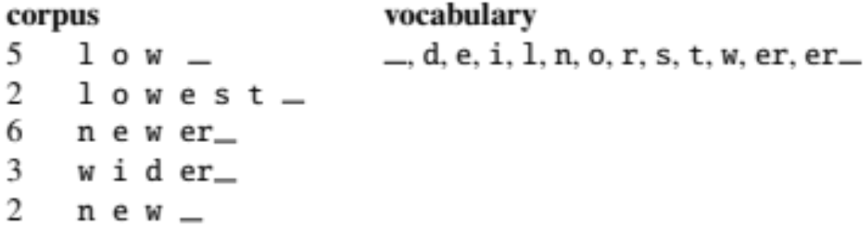
BPE
Merge er _ to er_

Slide 50
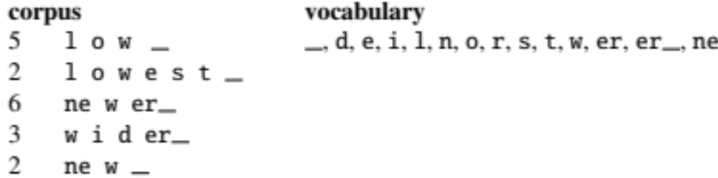
BPE
Merge n e to ne

Slide 51
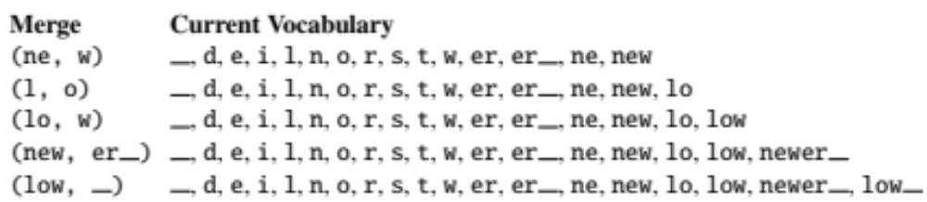
BPE
The next merges are:

Slide 52
BPE token learner algorithm
On the test data, run each merge learned from the training data:
  Greedily
  In the order we learned them
  (test frequencies don't play a role)
So: merge every e r to er, then merge er _ to er_, etc.
Result:
  Test set "n e w e r _" would be tokenized as a full word
  Test set "l o w e r _" would be two tokens: "low er_"

Slide 53
Basic Text Processing
Byte Pair Encoding tokenization

Slide 54
Basic Text Processing
Word Normalization and other issues

Slide 55
Word Normalization
Putting words/tokens in a standard format
    U.S.A. or USA
    uhhuh or uh-huh
    Fed or fed
    am, is be, are

Slide 56
Case folding
Applications like IR: reduce all letters to lower case
  Since users tend to use lower case
  Possible exception: upper case in mid-sentence?
    e.g., General Motors
    Fed vs. fed
    SAIL vs. sail
For sentiment analysis, MT, Information extraction
  Case is helpful (US versus us is important)

Slide 57
Lemmatization
Represent all words as their shared root, = dictionary headword form:
  am, are, is → be
  car, cars, car's, cars' → car
  Spanish quiero (‘I want’), quieres (‘you want’) → querer ‘want'
He is reading detective stories → He be read detective story

Slide 58
Lemmatization is done by Morphological Parsing
Morphemes:
  The small meaningful units that make up words
  Stems: The core meaning-bearing units
  Affixes: Parts that adhere to stems, often with grammatical functions
Morphological Parsers:
  Parse cats into two morphemes cat and s
  Parse Spanish amaren (‘if in the future they would love’) into morpheme amar ‘to love’, and the morphological features 3PL and future subjunctive.

Slide 59
Stemming
Reduce terms to stems, chopping off affixes crudely
This was not the map we found in Billy Bones’s chest, but an accurate copy, complete in all things-names and heights and soundings-with the single exception of the red crosses and the written notes.
Thi wa not the map we found in Billi Bone s chest but an accur copi complet in all thing name and height and sound with the singl except of the red cross and the written note
.

Slide 60
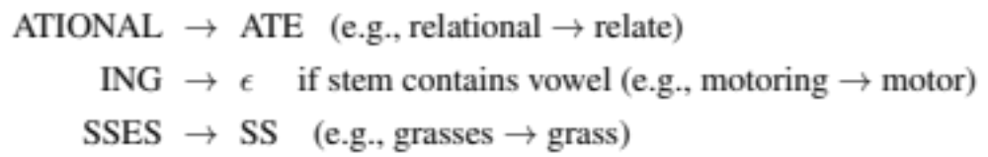
Porter Stemmer
Based on a series of rewrite rules run in series
  A cascade, in which output of each pass fed to next pass
Some sample rules:

Slide 61
Dealing with complex morphology is necessary for many languages
  E.g., the Turkish word:
  Uygarlastiramadiklarimizdanmissinizcasina
  `(behaving) as if you are among those whom we could not civilize’
  Uygar `civilized’ + las `become’
    + tir `cause’ + ama `not able’
    + dik `past’ + lar ‘plural’
    + imiz ‘p1pl’ + dan ‘abl’
    + mis ‘past’ + siniz ‘2pl’ + casina ‘as if’

Slide 62
Sentence Segmentation
!, ? are relatively unambiguous but period “.” is quite ambiguous
  Sentence boundary
  Abbreviations like Inc. or Dr.
  Numbers like .02% or 4.3
Common Algorithm: decide (using rules or ML) whether a period is part of the word or is a sentence-boundary marker.
  An abbreviation dictionary can help
Sentence segmentation can then often be done by rules based on this tokenization.

Slide 63
Basic Text Processing
Word Normalization and other issues

