Slide 1
Language Modeling
Introduction to N-grams

Slide 2
Probabilistic Language Models
Today’s goal: assign a probability to a sentence
      Machine Translation:
        P(high winds tonite) > P(large winds tonite)
      Spell Correction
        The office is about fifteen minuets from my house
          P(about fifteen minutes from) > P(about fifteen minuets from)
      Speech Recognition
        P(I saw a van) >> P(eyes awe of an)
      + Summarization, question-answering, etc., etc.!!
Why?

Slide 3
Probabilistic Language Modeling
Goal: compute the probability of a sentence or sequence of words:
  P(W) = P(w₁,w₂,w₃,w₄,w₅…w_{n})
Related task: probability of an upcoming word:
  P(w₅|w₁,w₂,w₃,w₄)
A model that computes either of these:
  P(W) or P(w_{n}|w₁,w₂…w_{n-1}) is called a language model.
Better: the grammar But language model or LM is standard

Slide 4
How to compute P(W)
How to compute this joint probability:
  P(its, water, is, so, transparent, that)
Intuition: let’s rely on the Chain Rule of Probability

Slide 5
Reminder: The Chain Rule
Recall the definition of conditional probabilities
  p(B|A) = P(A,B)/P(A) Rewriting: P(A,B) = P(A)P(B|A)
More variables:
  P(A,B,C,D) = P(A)P(B|A)P(C|A,B)P(D|A,B,C)
The Chain Rule in General
P(x₁,x₂,x₃,…,x_{n}) = P(x₁)P(x₂|x₁)P(x₃|x₁,x₂)…P(x_{n}|x₁,…,x_{n-1})

Slide 6
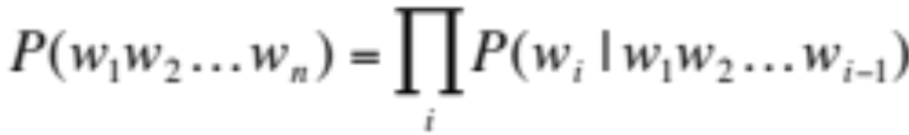
The Chain Rule applied to compute joint probability of words in sentence
P(“its water is so transparent”) =
P(its) × P(water|its) × P(is|its water)
× P(so|its water is) × P(transparent|its water is so)

Slide 7
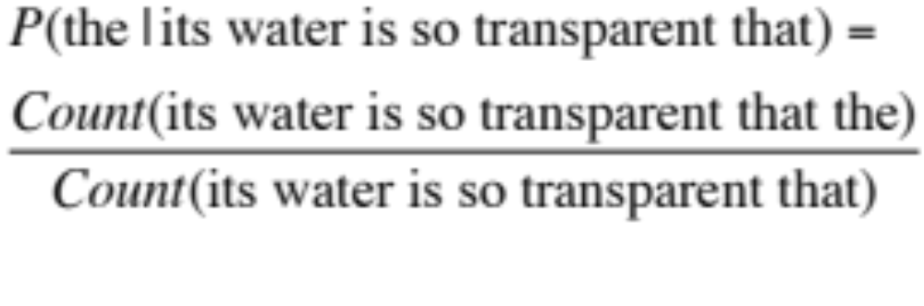
How to estimate these probabilities
Could we just count and divide?
No! Too many possible sentences!
We’ll never see enough data for estimating these

Slide 8
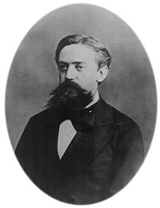
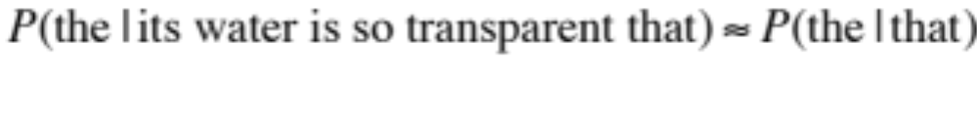
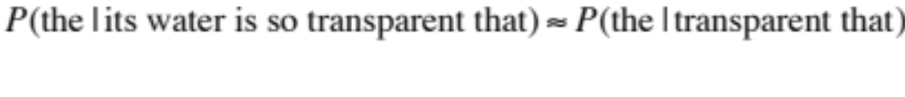
Markov Assumption
Simplifying assumption:
Or maybe
Andrei Markov

Slide 9
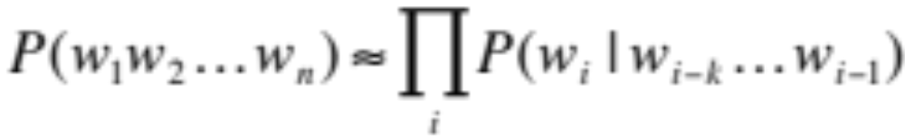
Markov Assumption
In other words, we approximate each component in the product

Slide 10
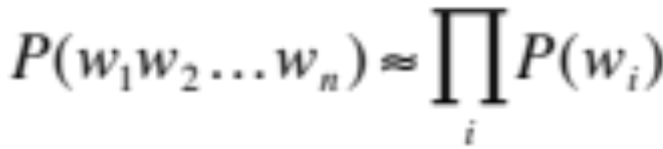
Simplest case: Unigram model
Some automatically generated sentences from a unigram model
fifth, an, of, futures, the, an, incorporated, a, a, the, inflation, most, dollars, quarter, in, is, mass
thrift, did, eighty, said, hard, 'm, july, bullish
that, or, limited, the

Slide 11
Bigram model
Condition on the previous word:
texaco, rose, one, in, this, issue, is, pursuing, growth, in, a, boiler, house, said, mr., gurria, mexico, 's, motion, control, proposal, without, permission, from, five, hundred, fifty, five, yen
outside, new, car, parking, lot, of, the, agreement, reached
this, would, be, a, record, november

Slide 12
N-gram models
We can extend to trigrams, 4-grams, 5-grams
In general this is an insufficient model of language
  because language has long-distance dependencies:
  “The computer which I had just put into the machine room on the fifth floor crashed.”
But we can often get away with N-gram models

Slide 13
Language Modeling
Introduction to N-grams

Slide 14
Language Modeling
Estimating N-gram Probabilities

Slide 15
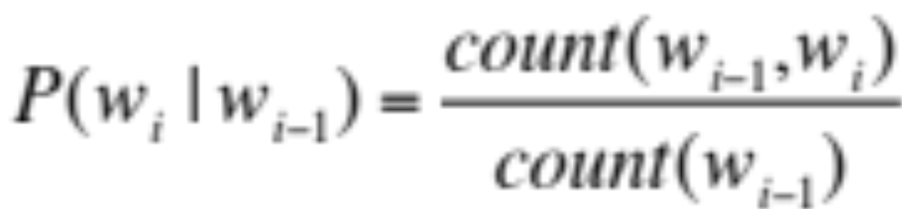
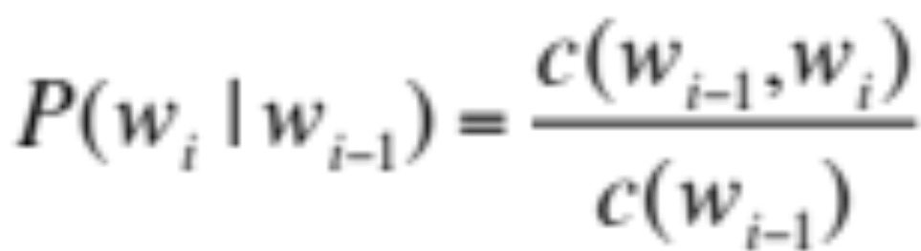
Estimating bigram probabilities
The Maximum Likelihood Estimate

Slide 16

An example
<s> I am Sam </s>
<s> Sam I am </s>
<s> I do not like green eggs and ham </s>

Slide 17
More examples:
Berkeley Restaurant Project sentences
can you tell me about any good cantonese restaurants close by
mid priced thai food is what i’m looking for
tell me about chez panisse
can you give me a listing of the kinds of food that are available
i’m looking for a good place to eat breakfast
when is caffe venezia open during the day

Slide 18
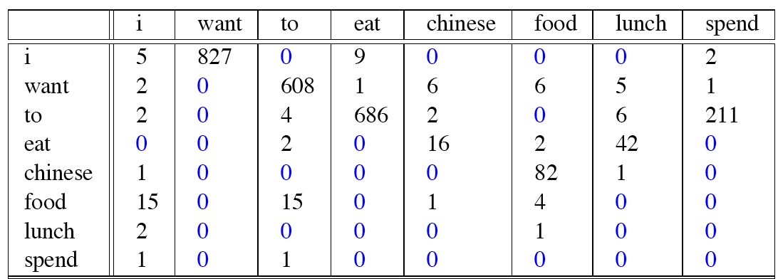
Raw bigram counts
Out of 9222 sentences

Slide 19
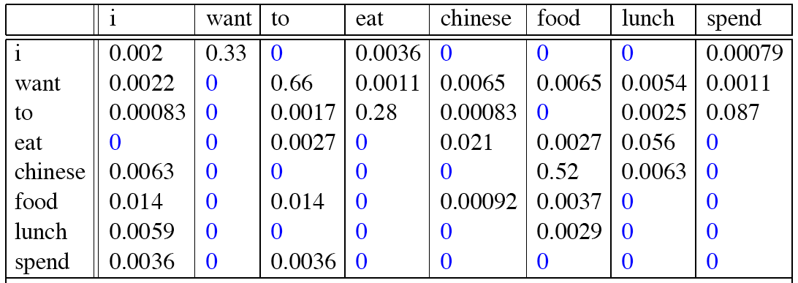
Raw bigram probabilities
Normalize by unigrams:
Result:

Slide 20
Bigram estimates of sentence probabilities
P(<s> I want english food </s>) =
P(I|<s>)
× P(want|I)
× P(english|want)
× P(food|english)
× P(</s>|food)
= .000031

Slide 21
What kinds of knowledge?
P(english|want) = .0011
P(chinese|want) = .0065
P(to|want) = .66
P(eat | to) = .28
P(food | to) = 0
P(want | spend) = 0
P (i | <s>) = .25

Slide 22
Practical Issues
We do everything in log space
  Avoid underflow
  (also adding is faster than multiplying)

Slide 23
Language Modeling Toolkits
SRILM
  http://www.speech.sri.com/projects/srilm/
KenLM
  https://kheafield.com/code/kenlm/

Slide 24
Google N-Gram Release, August 2006
…

Slide 25
Google N-Gram Release
serve as the incoming 92
serve as the incubator 99
serve as the independent 794
serve as the index 223
serve as the indication 72
serve as the indicator 120
serve as the indicators 45
serve as the indispensable 111
serve as the indispensible 40
serve as the individual 234
http://googleresearch.blogspot.com/2006/08/all-our-n-gram-are-belong-to-you.html

Slide 26
Google Book N-grams
http://ngrams.googlelabs.com/

Slide 27
Language Modeling
Estimating N-gram Probabilities

Slide 28
Language Modeling
Evaluation and Perplexity

Slide 29
Evaluation: How good is our model?
Does our language model prefer good sentences to bad ones?
  Assign higher probability to “real” or “frequently observed” sentences
    Than “ungrammatical” or “rarely observed” sentences?
We train parameters of our model on a training set.
We test the model’s performance on data we haven’t seen.
  A test set is an unseen dataset that is different from our training set, totally unused.
  An evaluation metric tells us how well our model does on the test set.

Slide 30
Training on the test set
We can’t allow test sentences into the training set
We will assign it an artificially high probability when we set it in the test set
“Training on the test set”
Bad science!
And violates the honor code

Slide 31
Extrinsic evaluation of N-gram models
Best evaluation for comparing models A and B
  Put each model in a task
    spelling corrector, speech recognizer, MT system
  Run the task, get an accuracy for A and for B
    How many misspelled words corrected properly
    How many words translated correctly
  Compare accuracy for A and B

Slide 32
Difficulty of extrinsic (in-vivo) evaluation of N-gram models
Extrinsic evaluation
  Time-consuming; can take days or weeks
So
  Sometimes use intrinsic evaluation: perplexity
  Bad approximation
    unless the test data looks just like the training data
    So generally only useful in pilot experiments
  But is helpful to think about.

Slide 33
Intuition of Perplexity
mushrooms 0.1
pepperoni 0.1
anchovies 0.01
….
fried rice 0.0001
….
and 1e-100
The Shannon Game:
  How well can we predict the next word?
  Unigrams are terrible at this game. (Why?)
A better model of a text
  is one which assigns a higher probability to the word that actually occurs
I always order pizza with cheese and ____
The 33rd President of the US was ____
I saw a ____

Slide 34
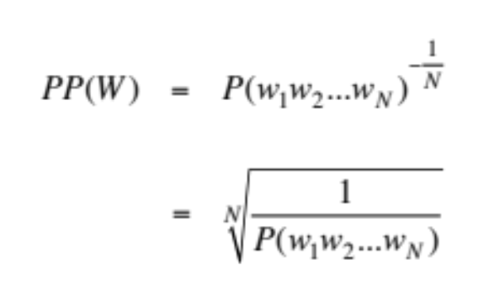
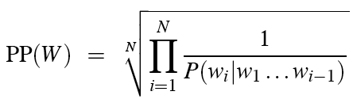
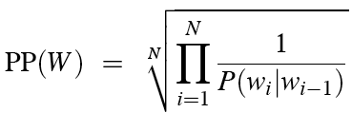
Perplexity
The best language model is one that best predicts an unseen test set
  Gives the highest P(sentence)
Perplexity is the inverse probability of the test set, normalized by the number of words:
Chain rule:
For bigrams:
Minimizing perplexity is the same as maximizing probability

Slide 35
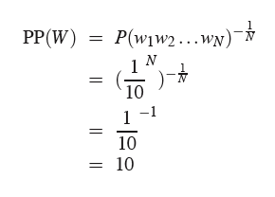
Perplexity as branching factor
Let’s suppose a sentence consisting of random digits
What is the perplexity of this sentence according to a model that assign P=1/10 to each digit?

Slide 36
Lower perplexity = better model
Training 38 million words, test 1.5 million words, WSJ
N-gram Order | Unigram | Bigram | Trigram
Perplexity | 962 | 170 | 109

Slide 37
Language Modeling
Evaluation and Perplexity

Slide 38
Language Modeling
Generalization and zeros

Slide 39
The Shannon Visualization Method
Choose a random bigram
(<s>, w) according to its probability
Now choose a random bigram (w, x) according to its probability
And so on until we choose </s>
Then string the words together
<s> I
I want
want to
to eat
eat Chinese
Chinese food
food </s>
I want to eat Chinese food

Slide 40
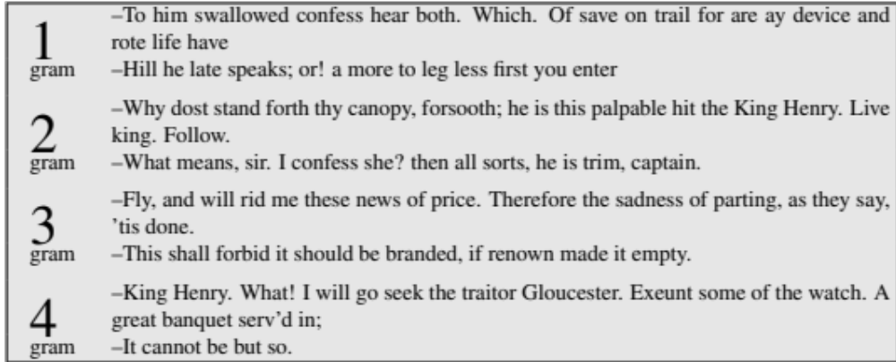
Approximating Shakespeare

Slide 41
Shakespeare as corpus
N=884,647 tokens, V=29,066
Shakespeare produced 300,000 bigram types out of V²= 844 million possible bigrams.
  So 99.96% of the possible bigrams were never seen (have zero entries in the table)
Quadrigrams worse: What's coming out looks like Shakespeare because it is Shakespeare

Slide 42
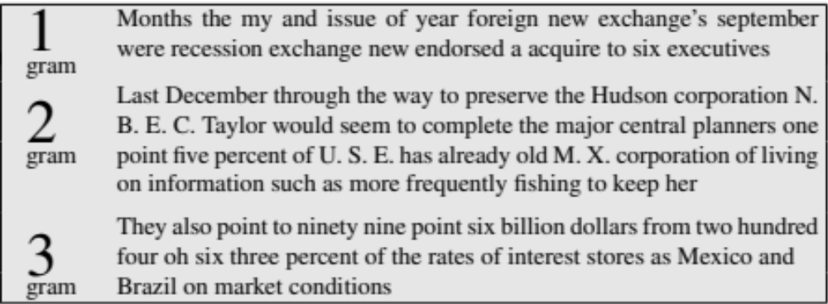
The wall street journal is not shakespeare (no offense)

Slide 43
Can you guess the author of these random 3-gram sentences?
They also point to ninety nine point six billion dollars from two hundred four oh six three percent of the rates of interest stores as Mexico and gram Brazil on market conditions
This shall forbid it should be branded, if renown made it empty.
“You are uniformly charming!” cried he, with a smile of associating and now and then I bowed and they perceived a chaise and four to wish for.

Slide 44
The perils of overfitting
N-grams only work well for word prediction if the test corpus looks like the training corpus
  In real life, it often doesn’t
  We need to train robust models that generalize!
  One kind of generalization: Zeros!
    Things that don’t ever occur in the training set
      But occur in the test set

Slide 45
Zeros
Training set:
  … denied the allegations
  … denied the reports
  … denied the claims
  … denied the request
  P(“offer” | denied the) = 0
Test set
  … denied the offer
  … denied the loan

Slide 46
Zero probability bigrams
Bigrams with zero probability
  mean that we will assign 0 probability to the test set!
And hence we cannot compute perplexity (can’t divide by 0)!

Slide 47
Language Modeling
Generalization and zeros

Slide 48
Language Modeling
Smoothing: Add-one (Laplace) smoothing

Slide 49
The intuition of smoothing (from Dan Klein)
When we have sparse statistics:
Steal probability mass to generalize better
P(w | denied the)
3 allegations
2 reports
1 claims
1 request
7 total
allegations
attack
man
reports
outcome
…
claims
request
P(w | denied the)
2.5 allegations
1.5 reports
0.5 claims
0.5 request
2 other
7 total
allegations
allegations
attack
man
outcome
reports
…
claims
request

Slide 50
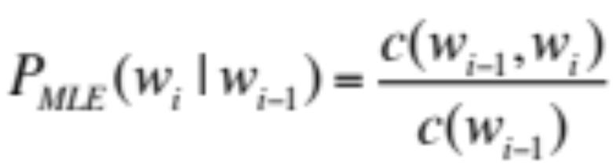
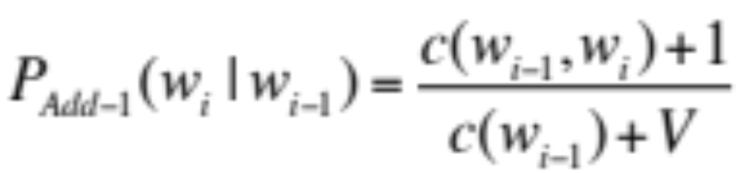
Add-one estimation
Also called Laplace smoothing
Pretend we saw each word one more time than we did
Just add one to all the counts!
MLE estimate:
Add-1 estimate:

Slide 51
Maximum Likelihood Estimates
The maximum likelihood estimate
  of some parameter of a model M from a training set T
  maximizes the likelihood of the training set T given the model M
Suppose the word “bagel” occurs 400 times in a corpus of a million words
What is the probability that a random word from some other text will be “bagel”?
MLE estimate is 400/1,000,000 = .0004
This may be a bad estimate for some other corpus
  But it is the estimate that makes it most likely that “bagel” will occur 400 times in a million word corpus.

Slide 52
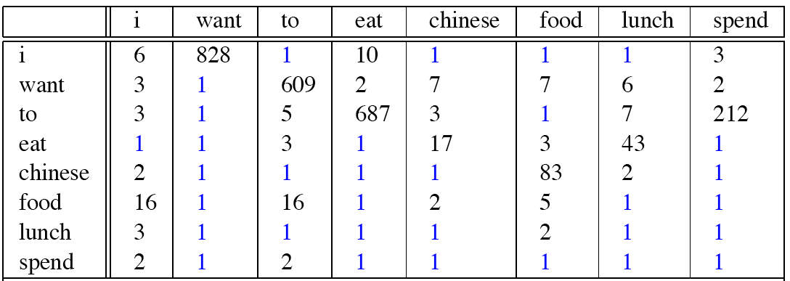
Berkeley Restaurant Corpus: Laplace smoothed bigram counts

Slide 53

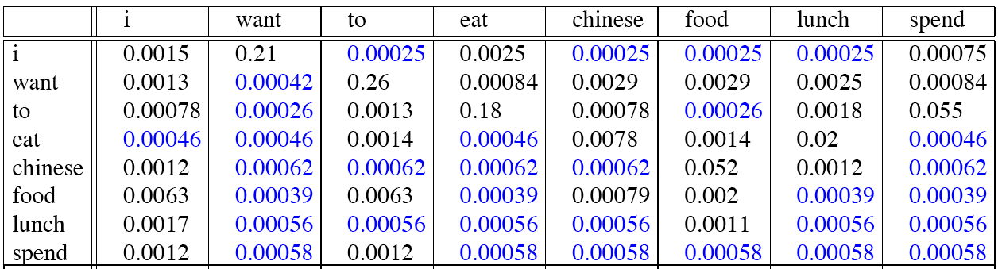
Laplace-smoothed bigrams

Slide 54
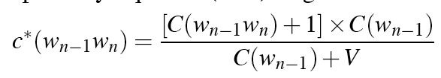
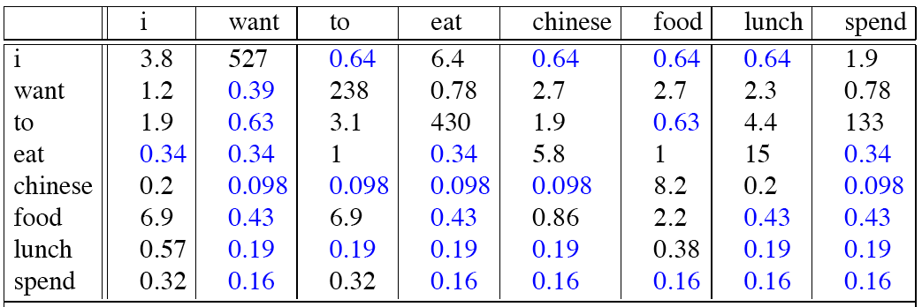
Reconstituted counts

Slide 55
Compare with raw bigram counts
Notes:
C(want to) went from 608 to 238, P(to|want) from .66 to .26!
Discount d= c*/c
d for “chinese food” =.10!!! A 10x reduction

Slide 56
Add-1 estimation is a blunt instrument
So add-1 isn’t used for N-grams:
  We’ll see better methods
But add-1 is used to smooth other NLP models
  For text classification
  In domains where the number of zeros isn’t so huge.

Slide 57
Language Modeling
Smoothing: Add-one (Laplace) smoothing

Slide 58
Language Modeling
Interpolation, Backoff, and Web-Scale LMs

Slide 59
Backoff and Interpolation
Sometimes it helps to use less context
  Condition on less context for contexts you haven’t learned much about
Backoff:
  use trigram if you have good evidence,
  otherwise bigram, otherwise unigram
Interpolation:
  mix unigram, bigram, trigram
Interpolation works better

Slide 60
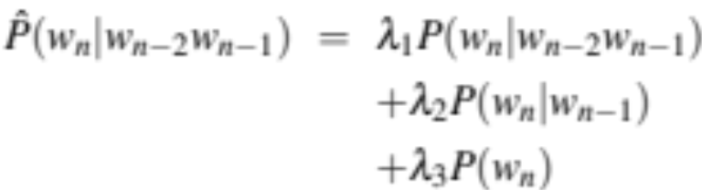
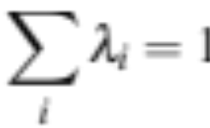
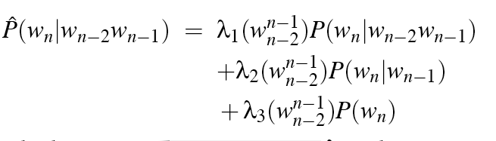
Linear Interpolation
Simple interpolation
Lambdas conditional on context:

Slide 61
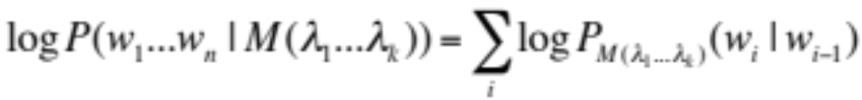
How to set the lambdas?
Use a held-out corpus
Choose λs to maximize the probability of held-out data:
  Fix the N-gram probabilities (on the training data)
  Then search for λs that give largest probability to held-out set:
Training Data
Held-Out Data
Test
Data

Slide 62
Unknown words: Open versus closed vocabulary tasks
If we know all the words in advanced
  Vocabulary V is fixed
  Closed vocabulary task
Often we don’t know this
  Out Of Vocabulary = OOV words
  Open vocabulary task
Instead: create an unknown word token <UNK>
  Training of <UNK> probabilities
    Create a fixed lexicon L of size V
    At text normalization phase, any training word not in L changed to <UNK>
    Now we train its probabilities like a normal word
  At decoding time
    If text input: Use UNK probabilities for any word not in training

Slide 63
Huge web-scale n-grams
How to deal with, e.g., Google N-gram corpus
Pruning
  Only store N-grams with count > threshold.
    Remove singletons of higher-order n-grams
  Entropy-based pruning
Efficiency
  Efficient data structures like tries
  Bloom filters: approximate language models
  Store words as indexes, not strings
    Use Huffman coding to fit large numbers of words into two bytes
  Quantize probabilities (4-8 bits instead of 8-byte float)

Slide 64
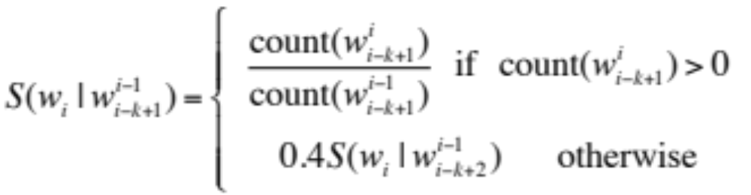
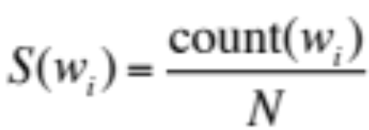
Smoothing for Web-scale N-grams
“Stupid backoff” (Brants et al. 2007)
No discounting, just use relative frequencies

Slide 65
N-gram Smoothing Summary
Add-1 smoothing:
  OK for text categorization, not for language modeling
The most commonly used method:
  Extended Interpolated Kneser-Ney
For very large N-grams like the Web:
  Stupid backoff

Slide 66
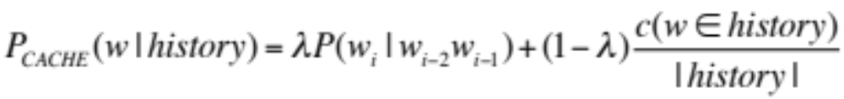
Advanced Language Modeling
Discriminative models:
  choose n-gram weights to improve a task, not to fit the training set
Parsing-based models
Caching Models
  Recently used words are more likely to appear
  These perform very poorly for speech recognition (why?)

Slide 67
Language Modeling
Interpolation, Backoff, and Web-Scale LMs

Slide 68
Language Modeling
Advanced:
Kneser-Ney Smoothing

Slide 69
Absolute discounting: just subtract a little from each count
Suppose we wanted to subtract a little from a count of 4 to save probability mass for the zeros
How much to subtract ?
Church and Gale (1991)’s clever idea
Divide up 22 million words of AP Newswire
  Training and held-out set
  for each bigram in the training set
  see the actual count in the held-out set!
It sure looks like c* = (c - .75)
Bigram count in training | Bigram count in heldout set
0 | .0000270
1 | 0.448
2 | 1.25
3 | 2.24
4 | 3.23
5 | 4.21
6 | 5.23
7 | 6.21
8 | 7.21
9 | 8.26

Slide 70
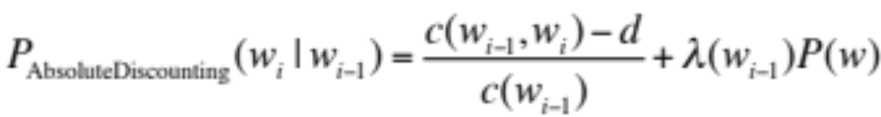
Absolute Discounting Interpolation
Save ourselves some time and just subtract 0.75 (or some d)!
  (Maybe keeping a couple extra values of d for counts 1 and 2)
But should we really just use the regular unigram P(w)?
discounted bigram
Interpolation weight
unigram

Slide 71
Kneser-Ney Smoothing I
Better estimate for probabilities of lower-order unigrams!
  Shannon game: I can’t see without my reading___________?
  “Francisco” is more common than “glasses”
  … but “Francisco” always follows “San”
The unigram is useful exactly when we haven’t seen this bigram!
Instead of P(w): “How likely is w”
P_{continuation}(w): “How likely is w to appear as a novel continuation?
  For each word, count the number of bigram types it completes
  Every bigram type was a novel continuation the first time it was seen
Francisco
glasses

Slide 72
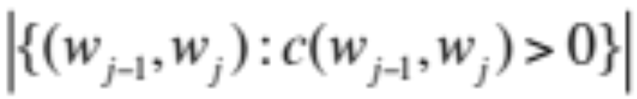
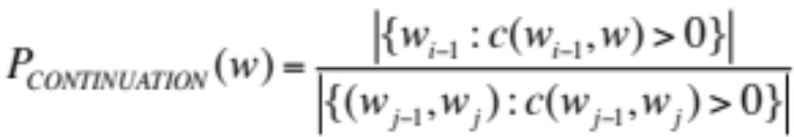
Kneser-Ney Smoothing II
How many times does w appear as a novel continuation:
Normalized by the total number of word bigram types

Slide 73

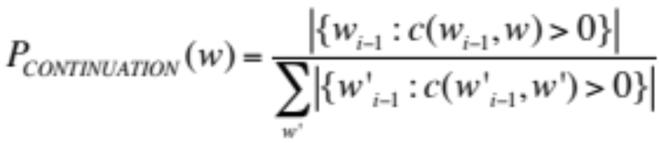
Kneser-Ney Smoothing III
Alternative metaphor: The number of # of word types seen to precede w
normalized by the # of words preceding all words:
A frequent word (Francisco) occurring in only one context (San) will have a low continuation probability

Slide 74
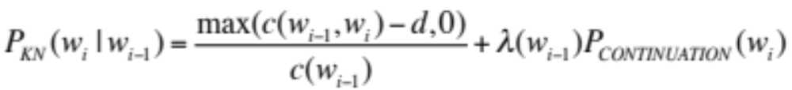
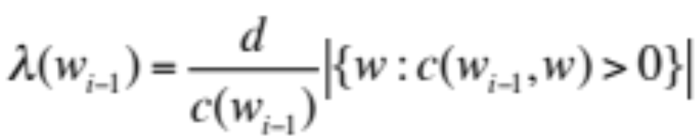
Kneser-Ney Smoothing IV
λ is a normalizing constant; the probability mass we’ve discounted
The number of word types that can follow w_{i-1}
= # of word types we discounted
= # of times we applied normalized discount
the normalized discount

Slide 75
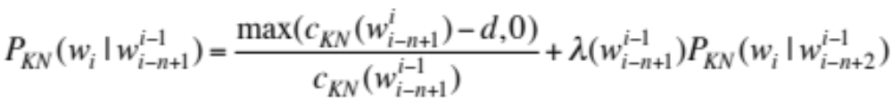
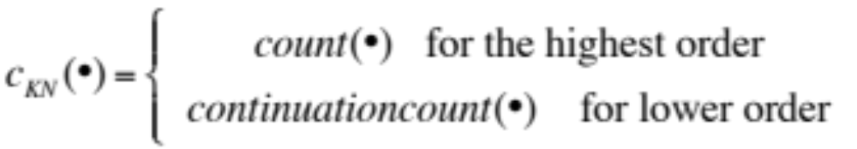
Kneser-Ney Smoothing: Recursive formulation
Continuation count = Number of unique single word contexts for •

Slide 76
Language Modeling
Advanced:
Kneser-Ney Smoothing

