Slide 1
Dan Jurafsky and James Martin
Speech and Language Processing
Chapter 6:
Vector Semantics

Slide 2
What do words mean?
First thought: look in a dictionary
http://www.oed.com/

Slide 3
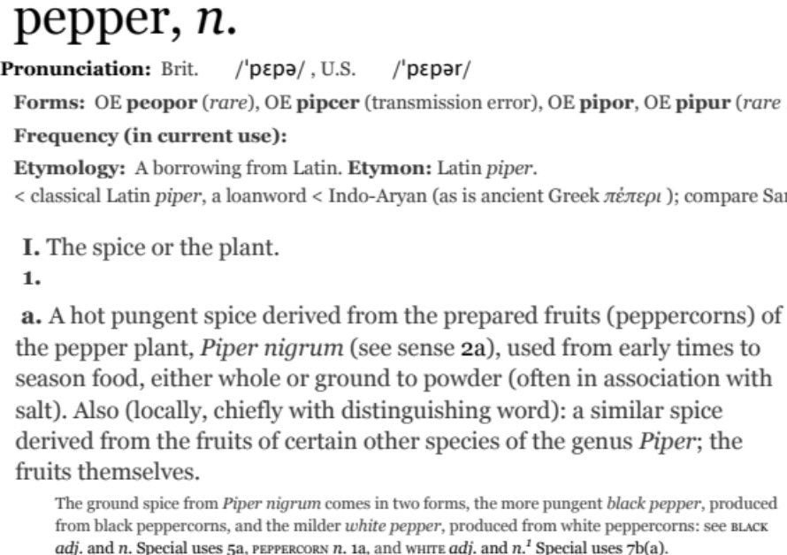
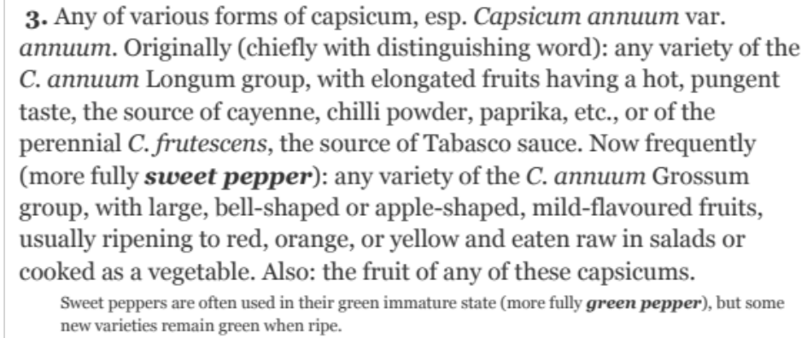
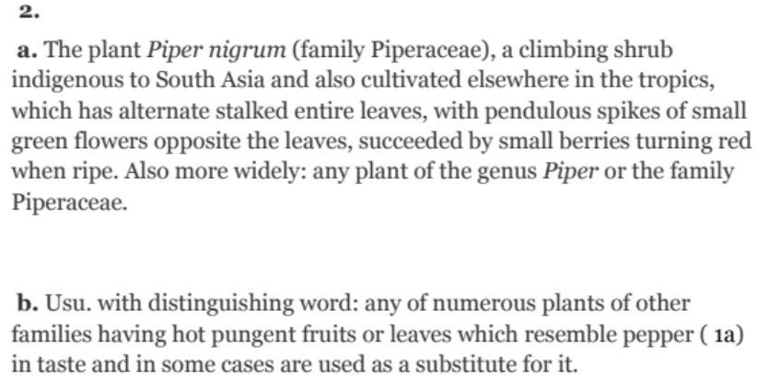
Words, Lemmas, Senses, Definitions
lemma
sense
definition

Slide 4
Lemma pepper
Sense 1: spice from pepper plant
Sense 2: the pepper plant itself
Sense 3: another similar plant (Jamaican pepper)
Sense 4: another plant with peppercorns (California pepper)
Sense 5: capsicum (i.e. chili, paprika, bell pepper, etc)

Slide 5
A sense or “concept” is the meaning component of a word

Slide 6
There are relations between senses

Slide 7
Relation: Synonymity
Synonyms have the same meaning in some or all contexts.
  filbert / hazelnut
  couch / sofa
  big / large
  automobile / car
  vomit / throw up
  Water / H₂0

Slide 8
Relation: Synonymity
Note that there are probably no examples of perfect synonymy.
  Even if many aspects of meaning are identical
  Still may not preserve the acceptability based on notions of politeness, slang, register, genre, etc.
The Linguistic Principle of Contrast:
  Difference in form -> difference in meaning

Slide 9
Relation: Synonymity?
  Water/H₂0
  Big/large
  Brave/courageous

Slide 10
Relation: Antonymy
Senses that are opposites with respect to one feature of meaning
Otherwise, they are very similar!
  dark/light short/long fast/slow rise/fall
  hot/cold up/down in/out
More formally: antonyms can
  define a binary opposition
    or be at opposite ends of a scale
    long/short, fast/slow
  Be reversives:
    rise/fall, up/down

Slide 11
Relation: Similarity
    Words with similar meanings. Not synonyms, but sharing some element of meaning
    car, bicycle
    cow, horse

Slide 12
Ask humans how similar 2 words are
word1 | word2 | similarity
vanish | disappear | 9.8
behave | obey | 7.3
belief | impression | 5.95
muscle | bone | 3.65
modest | flexible | 0.98
hole | agreement | 0.3
SimLex-999 dataset (Hill et al., 2015)

Slide 13
Relation: Word relatedness
Also called "word association"
Words be related in any way, perhaps via a semantic frame or field
    car, bicycle: similar
    car, gasoline: related, not similar

Slide 14
Semantic field
Words that
  cover a particular semantic domain
  bear structured relations with each other.
  hospitals
  surgeon, scalpel, nurse, anaesthetic, hospital
  restaurants
  waiter, menu, plate, food, menu, chef),
  houses
  door, roof, kitchen, family, bed

Slide 15
Relation: Superordinate/ subordinate
One sense is a subordinate of another if the first sense is more specific, denoting a subclass of the other
  car is a subordinate of vehicle
  mango is a subordinate of fruit
Conversely superordinate
  vehicle is a superordinate of car
  fruit is a subodinate of mango
Superordinate | vehicle | fruit | furniture
Subordinate | car | mango | chair

Slide 16
These levels are not symmetric
One level of category is distinguished from the others
The "basic level"

Slide 17
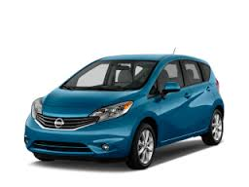
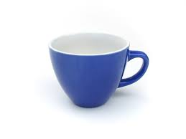
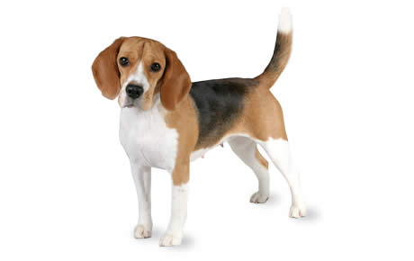

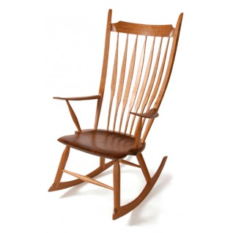
Name these items

Slide 18
Superordinate Basic Subordinate
chair office chair
piano chair rocking chair
furniture lamp torchiere
desk lamp
table end table coffee table
Notes:
So if you look at the hierarchical category structure for, say, furniture.
At one end, have furniture, and at the other end, very specific types of furniture {read}.
In between, in the middle level – e.g. chair, table, lamp – are basic-level categories
The other levels can be named too:
Superordinate – the level above the basic-level category, contains basic level categories
Subordinate is the level below
But in what respects are these basic-level categories considered psychologically or cognitively basic? [next slide]

Slide 19
Cluster of Interactional Properties
Basic level things are “human-sized”
Consider chairs
  We know how to interact with a chair (sitting)
  Not so clear for superordinate categories like furniture
    “Imagine a furniture without thinking of a bed/table/chair/specific basic-level category”

Slide 20
The basic level
Is the level of distinctive actions
Is the level which is learned earliest and at which things are first named
It is the level at which names are shortest and used most frequently

Slide 21
Connotation
Words have affective meanings
positive connotations (happy)
negative connotations (sad)
positive evaluation (great, love)
negative evaluation (terrible, hate).

Slide 22
So far
Concepts or word senses
  Have a complex many-to-many association with words (homonymy, multiple senses)
Have relations with each other
  Synonymy
  Antonymy
  Similarity
  Relatedness
  Superordinate/subordinate
  Connotation

Slide 23
But how to define a concept?

Slide 24
Classical (“Aristotelian”) Theory of Concepts
The meaning of a word:
a concept defined by necessary and sufficient conditions
A necessary condition for being an X is a condition C that X must satisfy in order for it to be an X.
    If not C, then not X
    ”Having four sides” is necessary to be a square.
A sufficient condition for being an X is condition such that if something satisfies condition C, then it must be an X.
    If and only if C, then X
    The following necessary conditions, jointly, are sufficient to be a square
      x has (exactly) four sides
      each of x's sides is straight
      x is a closed figure
      x lies in a plane
      each of x's sides is equal in length to each of the others
      each of x's interior angles is equal to the others (right angles)
      the sides of x are joined at their ends
Example from Norman Swartz, SFU

Slide 25
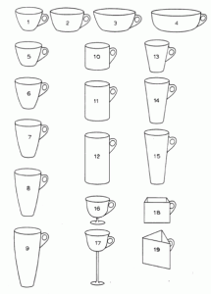
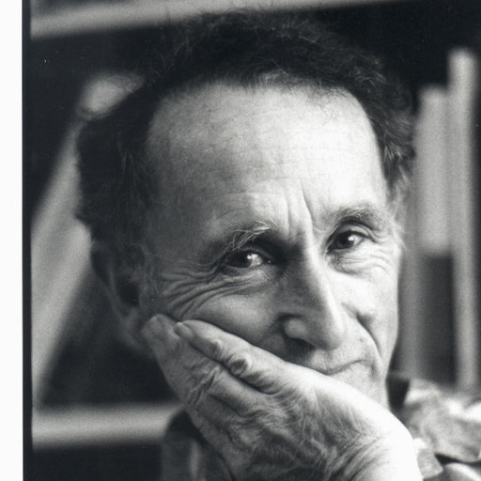
Problem 1: The features are complex and may be context-dependent
William Labov. 1975
What are these?
Cup or bowl?

Slide 26
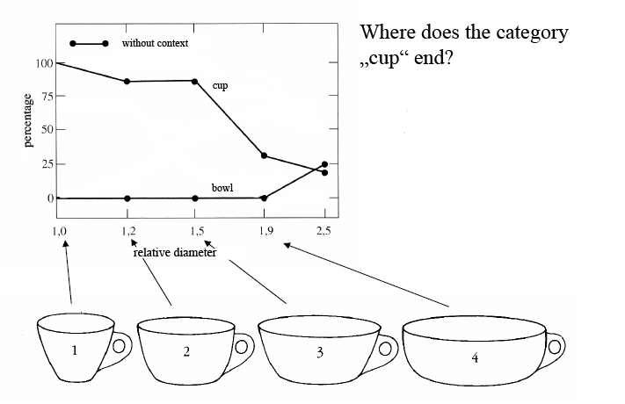
The category depends on complex features of the object (diameter, etc)

Slide 27
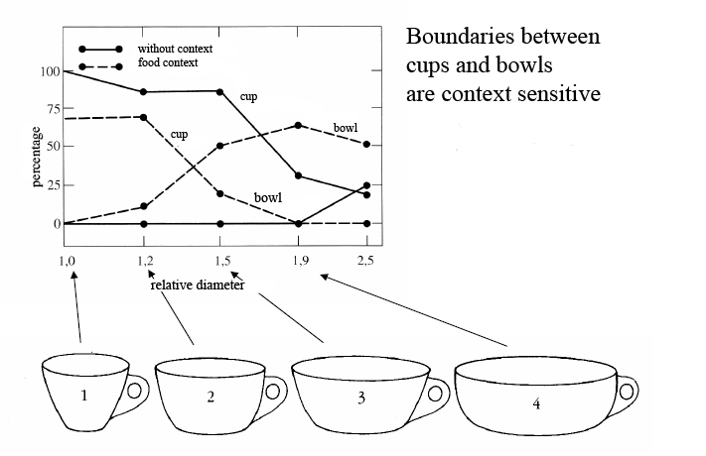
The category depends on the context! (If there is food in it, it’s a bowl)

Slide 28
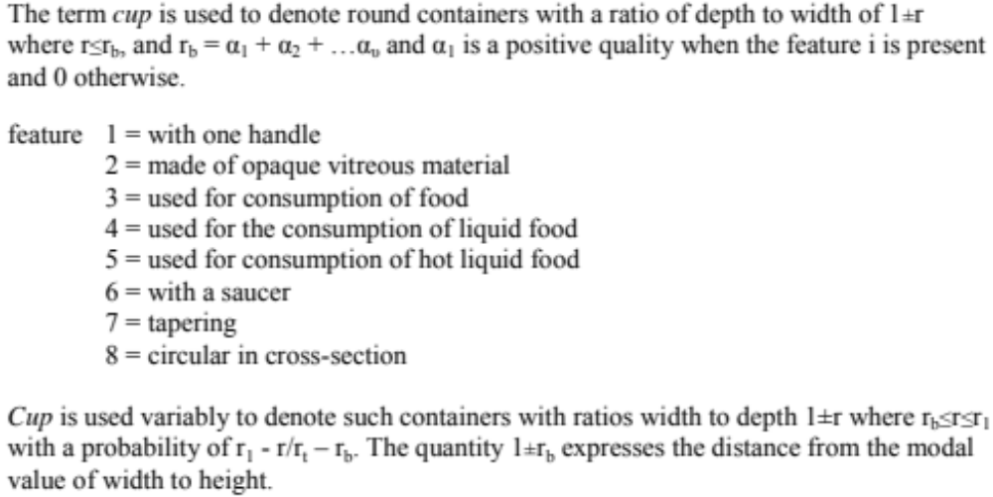
Labov’s definition of cup

Slide 29
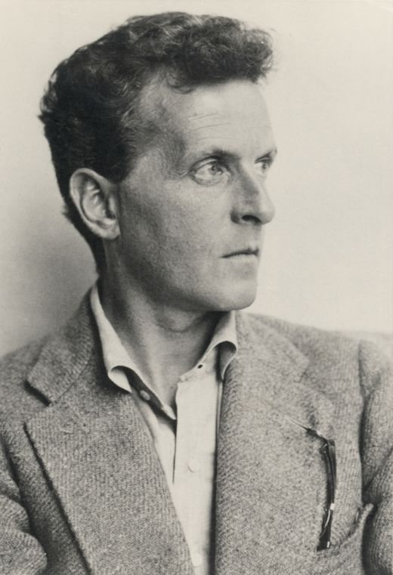
Ludwig Wittgenstein (1889-1951)
Philosopher of language
In his late years, a proponent of studying “ordinary language”

Slide 30
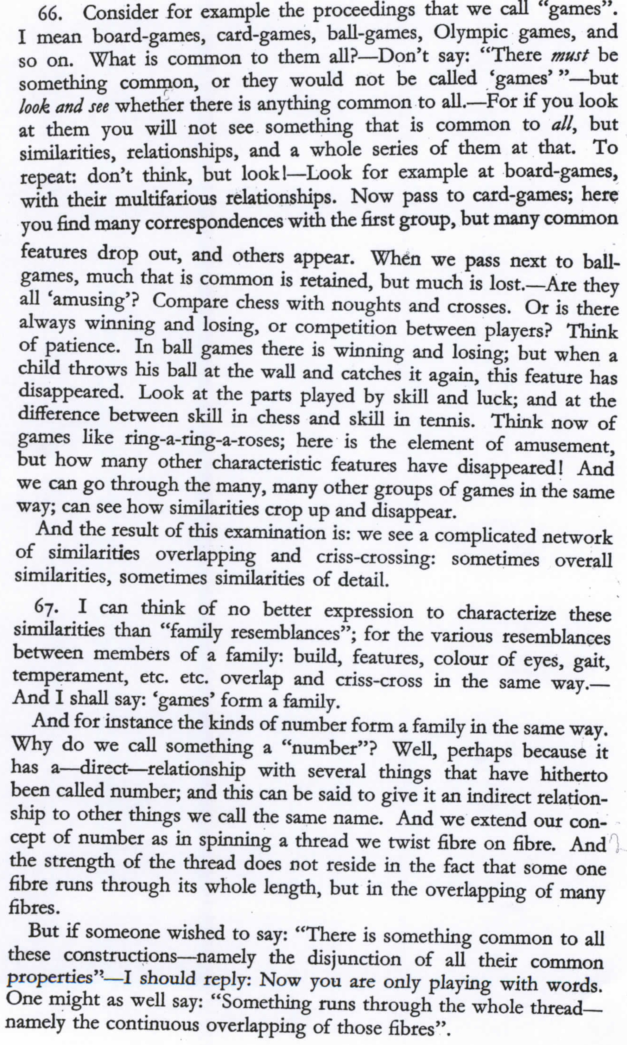
Wittgenstein (1945)
Philosophical
Investigations.
Paragraphs 66,67

Slide 31
What is a game?

Slide 32
Wittgenstein’s thought experiment on "What is a game”:
PI #66:
  ”Don’t say “there must be something common, or they would not be called `games’”—but look and see whether there is anything common to all”
    Is it amusing?
    Is there competition?
    Is there long-term strategy?
    Is skill required?
    Must luck play a role?
    Are there cards?
    Is there a ball?

Slide 33
Family Resemblance
Game 1 | Game 2 | Game 3 | Game 4
ABC | BCD | ACD | ABD
“each item has at least one, and probably several, elements in common with one or more items, but no, or few, elements are common to all items” Rosch and Mervis

Slide 34
How about a radically different approach?

Slide 35
Ludwig Wittgenstein
PI #43:
  "The meaning of a word is its use in the language"

Slide 36
Let's define words by their usages
In particular, words are defined by their environments (the words around them)
Zellig Harris (1954): If A and B have almost identical environments we say that they are synonyms.

Slide 37
What does ongchoi mean?
Suppose you see these sentences:
Ong choi is delicious sautéed with garlic.
Ong choi is superb over rice
Ong choi leaves with salty sauces
And you've also seen these:
…spinach sautéed with garlic over rice
Chard stems and leaves are delicious
Collard greens and other salty leafy greens
Conclusion:
  Ongchoi is a leafy green like spinach, chard, or collard greens

Slide 38
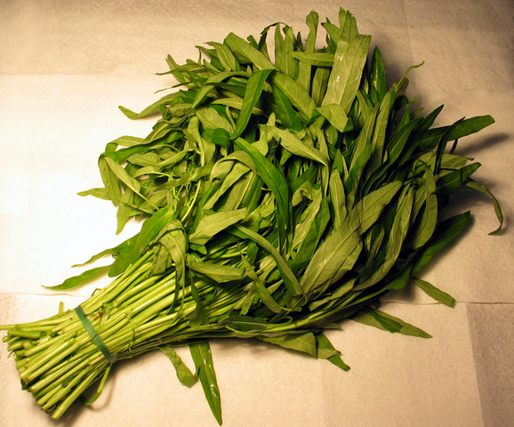
Ong choi: Ipomoea aquatica
"Water Spinach"
Yamaguchi, Wikimedia Commons, public domain

Slide 39
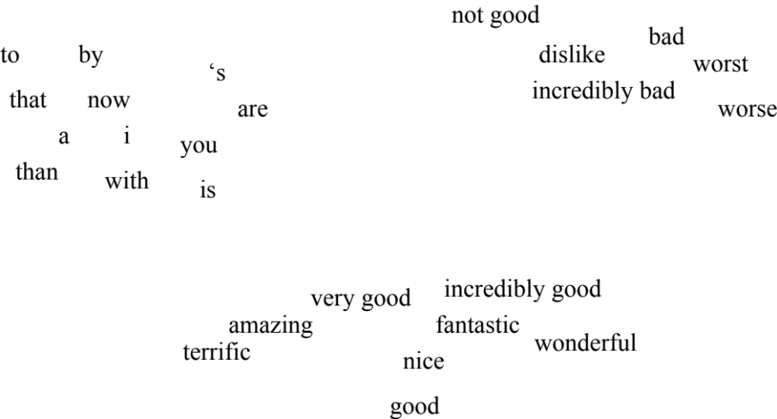
We'll build a new model of meaning focusing on similarity
Each word = a vector
  Not just "word" or word45.
Similar words are "nearby in space"

Slide 40
We define a word as a vector
Called an "embedding" because it's embedded into a space
The standard way to represent meaning in NLP
Fine-grained model of meaning for similarity
  NLP tasks like sentiment analysis
    With words, requires same word to be in training and test
    With embeddings: ok if similar words occurred!!!
  Question answering, conversational agents, etc

Slide 41
We'll introduce 2 kinds of embeddings
Tf-idf
  A common baseline model
  Sparse vectors
  Words are represented by a simple function of the counts of nearby words
Word2vec
  Dense vectors
  Representation is created by training a classifier to distinguish nearby and far-away words

Slide 42
Review: words, vectors, and co-occurrence matrices

Slide 43
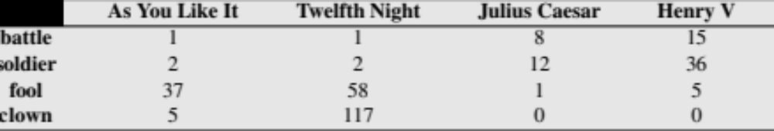
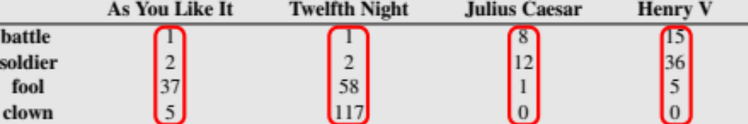
Term-document matrix
Each document is represented by a vector of words

Slide 44
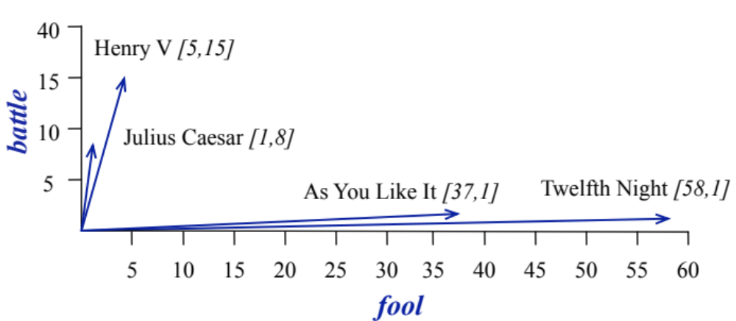
Visualizing document vectors

Slide 45
Vectors are the basis of information retrieval
Vectors are similar for the two comedies
As You like It [1,2,37,5],
Twelfth Night [1,2,58,117]
Different than the history:
Henry V [15,36,5,0]
Comedies have more fools and clowns and fewer soldiers and battles.

Slide 46
Words can be vectors too
Battle is "the kind of word that occurs in Julius Caesar and Henry V"
Clown is "the kind of word that occurs a lot in Twelfth Night and a bit in As You Like It"

Slide 47
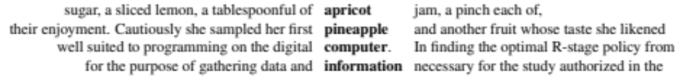
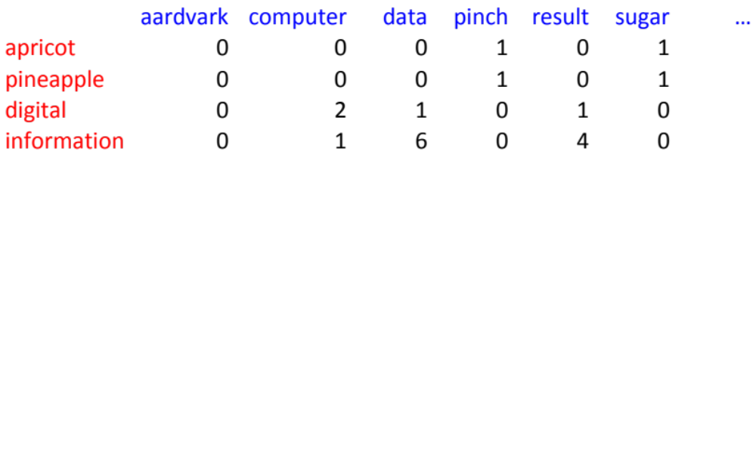
More common: word-word matrix
(or "term-context matrix")
Two words are similar in meaning if their context vectors are similar

Slide 48
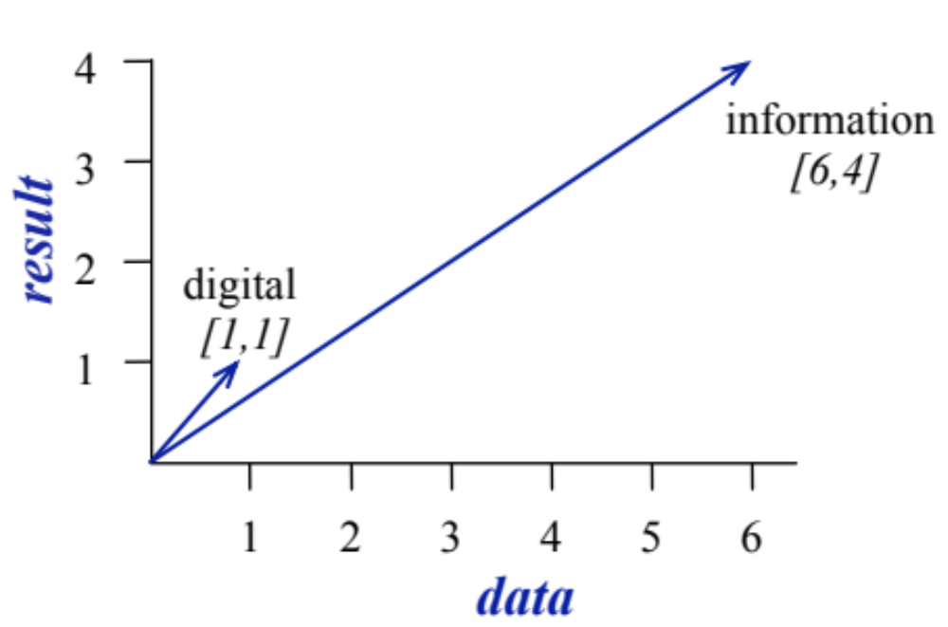

Slide 49
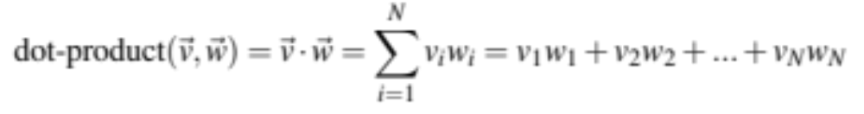
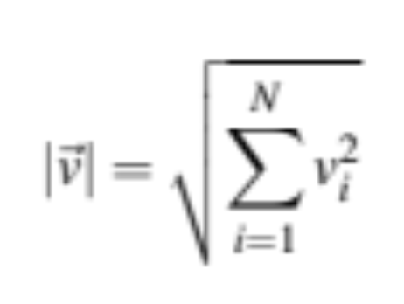
Reminders from linear algebra
vector length

Slide 50
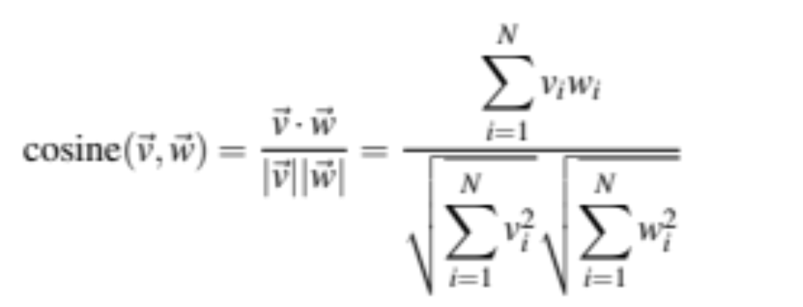
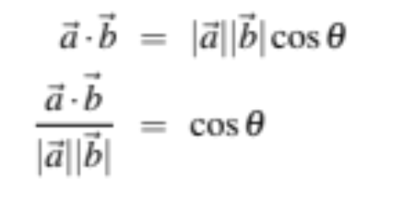
Cosine for computing similarity
Sec. 6.3
v_{i} is the count for word v in context i
w_{i} is the count for word w in context i.
Cos(v,w) is the cosine similarity of v and w
Notes:
See Law of Cosines (Cosine Rule) wikipedia page

Slide 51

Cosine as a similarity metric
-1: vectors point in opposite directions
+1: vectors point in same directions
0: vectors are orthogonal
Frequency is non-negative, so cosine range 0-1

Slide 52
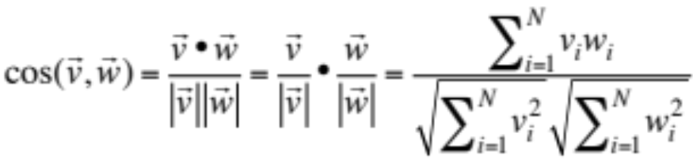
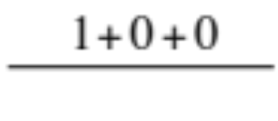
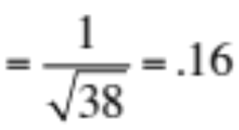


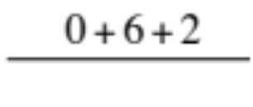
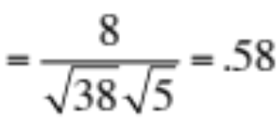

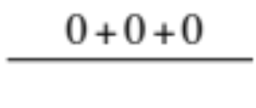

 | large | data | computer
apricot | 1 | 0 | 0
digital | 0 | 1 | 2
information | 1 | 6 | 1
Which pair of words is more similar?
cosine(apricot,information) =
cosine(digital,information) =
cosine(apricot,digital) =

Slide 53
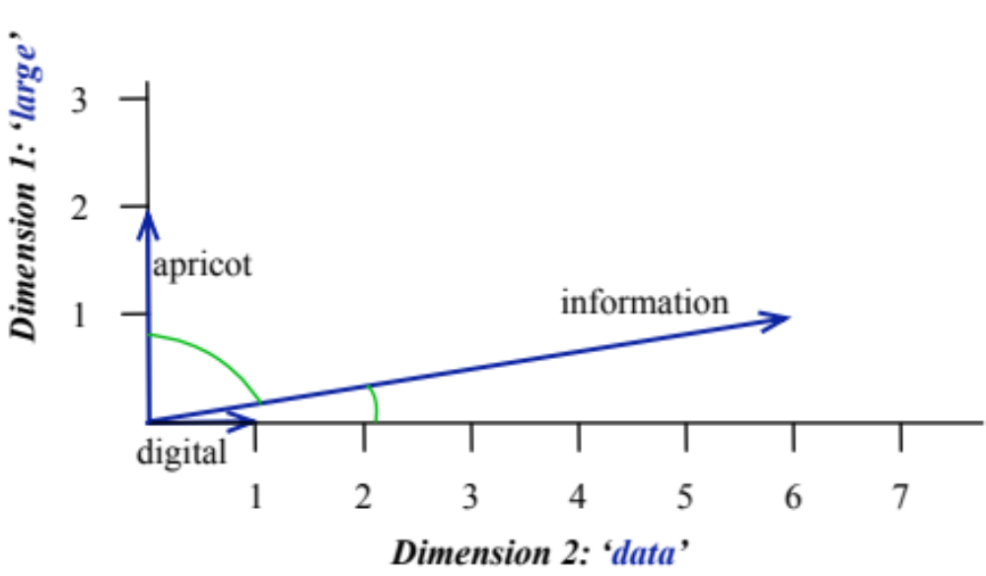
Visualizing cosines
(well, angles)

Slide 54
But raw frequency is a bad representation
Frequency is clearly useful; if sugar appears a lot near apricot, that's useful information.
But overly frequent words like the, it, or they are not very informative about the context
Need a function that resolves this frequency paradox!

Slide 55
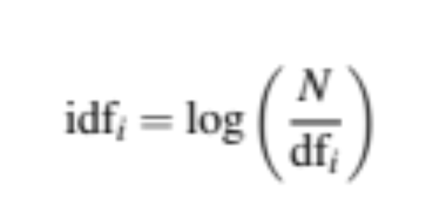
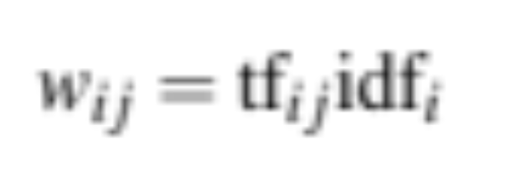
tf-idf: combine two factors
tf: term frequency. Just raw frequency count (or possible log frequency)
Idf: inverse document frequency: tf-
Total # of docs in collection
Words like "the" have very low idf
# of docs that have word i
tf-idf value for word i in document j:

Slide 56
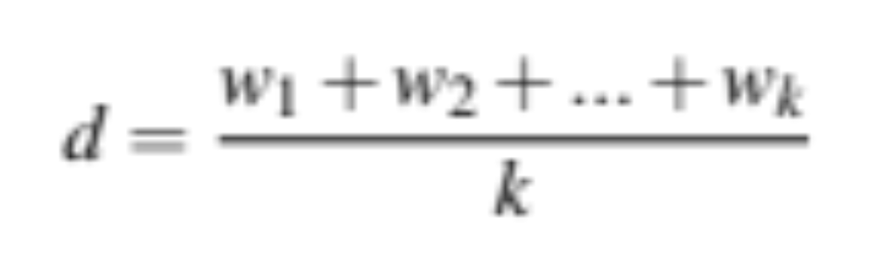
Summary: tf-idf
Compare two words using tf-idf cosine to see if they are similar
Compare two documents
  Take the centroid of vectors of all the words in the document
  Centroid document vector is:

Slide 57
Tf-idf is a sparse representation
Tf-idf vectors are
  long (length |V|= 20,000 to 50,000)
  sparse (most elements are zero)

Slide 58
Alternative: dense vectors
vectors which are
  short (length 50-1000)
  dense (most elements are non-zero)

Slide 59
Sparse versus dense vectors
Why dense vectors?
  Short vectors may be easier to use as features in machine learning (less weights to tune)
  Dense vectors may generalize better than storing explicit counts
  They may do better at capturing synonymy:
    car and automobile are synonyms; but are distinct dimensions
      a word with car as a neighbor and a word with automobile as a neighbor should be similar, but aren't
  In practice, they work better

Slide 60


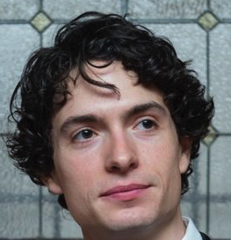

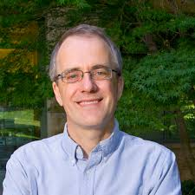
Dense embeddings you can download!
Word2vec (Mikolov et al.)
https://code.google.com/archive/p/word2vec/
Glove (Pennington, Socher, Manning)
http://nlp.stanford.edu/projects/glove/

Slide 61
Word2vec
Popular embedding method
Very fast to train
Code available on the web
Idea: predict rather than count

Slide 62
Word2vec
  Instead of counting how often each word w occurs near "apricot"
  Train a classifier on a binary prediction task:
    Is w likely to show up near "apricot"?
  We don’t actually care about this task
    But we'll take the learned classifier weights as the word embeddings

Slide 63
Brilliant insight: Use running text as implicitly supervised training data!
A word s near apricot
  Acts as gold ‘correct answer’ to the question
  “Is word w likely to show up near apricot?”
No need for hand-labeled supervision
The idea comes from neural language modeling
  Bengio et al. (2003)
  Collobert et al. (2011)

Slide 64
Word2Vec: Skip-Gram Task
Word2vec provides a variety of options. Let's do
  "skip-gram with negative sampling" (SGNS)

Slide 65
Skip-gram algorithm
Treat the target word and a neighboring context word as positive examples.
Randomly sample other words in the lexicon to get negative samples
Use logistic regression to train a classifier to distinguish those two cases
Use the weights as the embeddings

Slide 66
Skip-Gram Training Data
Training sentence:
... lemon, a tablespoon of apricot jam a pinch ...
c1 c2 target c3 c4
Asssume context words are those in +/- 2 word window

Slide 67
Skip-Gram Goal
Given a tuple (t,c) = target, context
  (apricot, jam)
  (apricot, aardvark)
Return probability that c is a real context word:
P(+|t,c)
P(−|t,c) = 1−P(+|t,c)

Slide 68
How to compute p(+|t,c)?
Intuition:
  Words are likely to appear near similar words
  Model similarity with dot-product!
  Similarity(t,c) ∝ t ∙ c
Problem:
  Dot product is not a probability!
    (Neither is cosine)

Slide 69
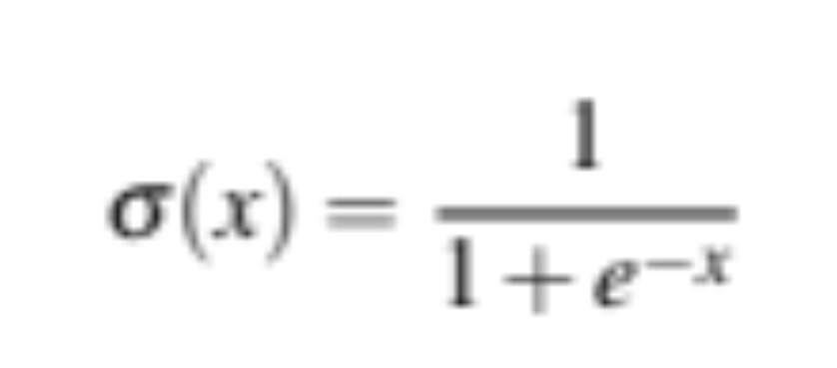
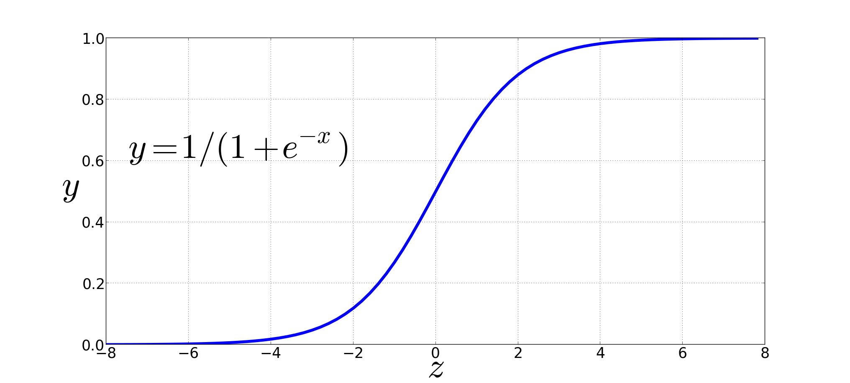
Turning dot product into a probability
The sigmoid lies between 0 and 1:

Slide 70
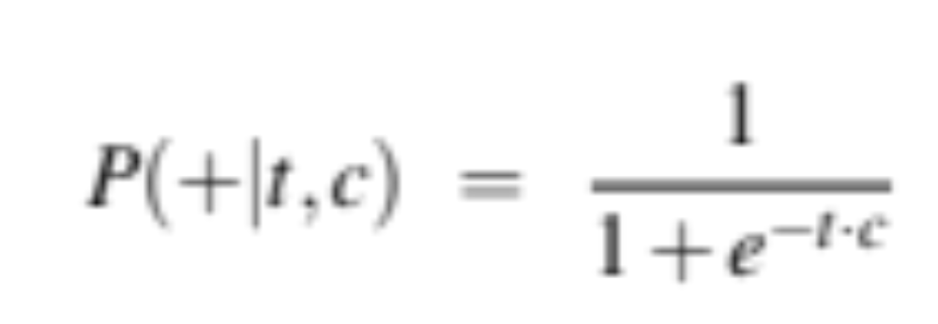
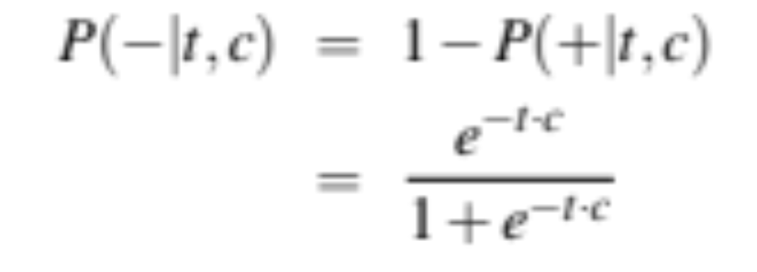
Turning dot product into a probability

Slide 71
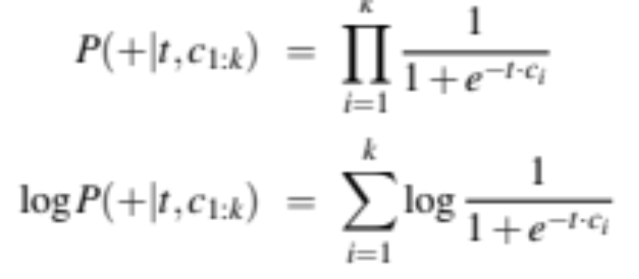
For all the context words:
Assume all context words are independent

Slide 72
Skip-Gram Training Data
Training sentence:
... lemon, a tablespoon of apricot jam a pinch ...
c1 c2 t c3 c4
Training data: input/output pairs centering on apricot
Asssume a +/- 2 word window

Slide 73
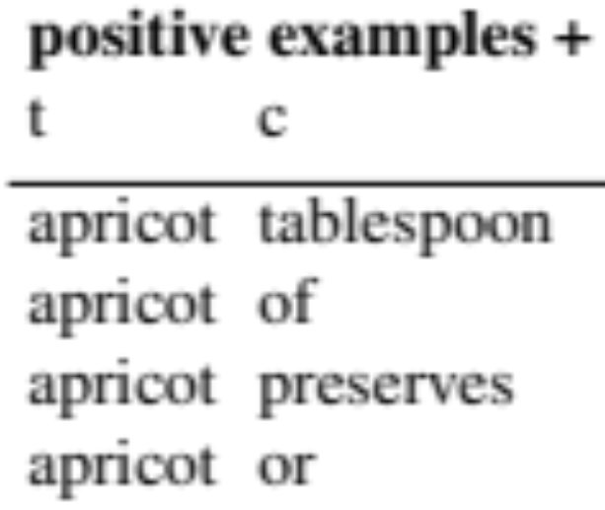
Skip-Gram Training
Training sentence:
... lemon, a tablespoon of apricot jam a pinch ...
c1 c2 t c3 c4
For each positive example, we'll create k negative examples.
Using noise words
  Any random word that isn't t

Slide 74
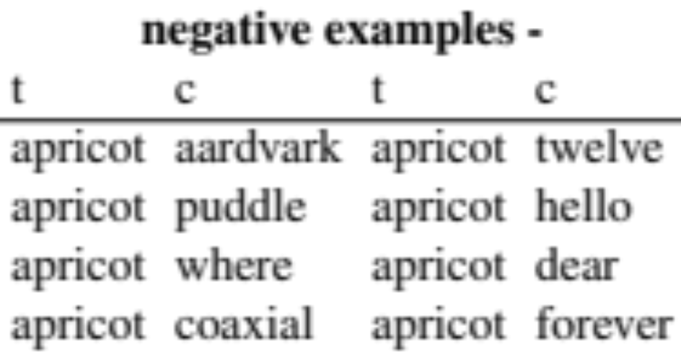
Skip-Gram Training
Training sentence:
... lemon, a tablespoon of apricot jam a pinch ...
c1 c2 t c3 c4
k=2

Slide 75
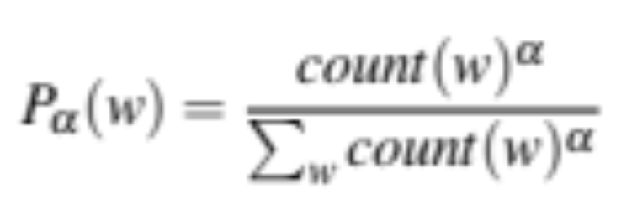
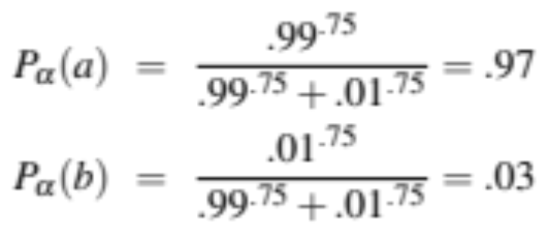
Choosing noise words
Could pick w according to their unigram frequency P(w)
More common to chosen then according to p_{α}(w)
α= ¾ works well because it gives rare noise words slightly higher probability
To show this, imagine two events p(a)=.99 and p(b) = .01:

Slide 76
Setup
Let's represent words as vectors of some length (say 300), randomly initialized.
So we start with 300 * V random parameters
Over the entire training set, we’d like to adjust those word vectors such that we
  Maximize the similarity of the target word, context word pairs (t,c) drawn from the positive data
  Minimize the similarity of the (t,c) pairs drawn from the negative data.

Slide 77
Learning the classifier
Iterative process.
We’ll start with 0 or random weights
Then adjust the word weights to
  make the positive pairs more likely
  and the negative pairs less likely
over the entire training set:

Slide 78
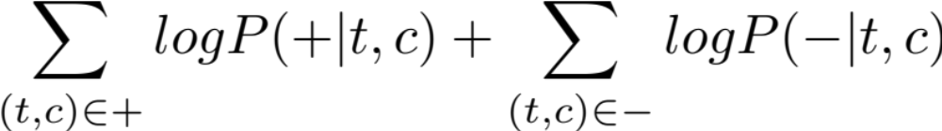
Objective Criteria
We want to maximize…
Maximize the + label for the pairs from the positive training data, and the – label for the pairs sample from the negative data.

Slide 79
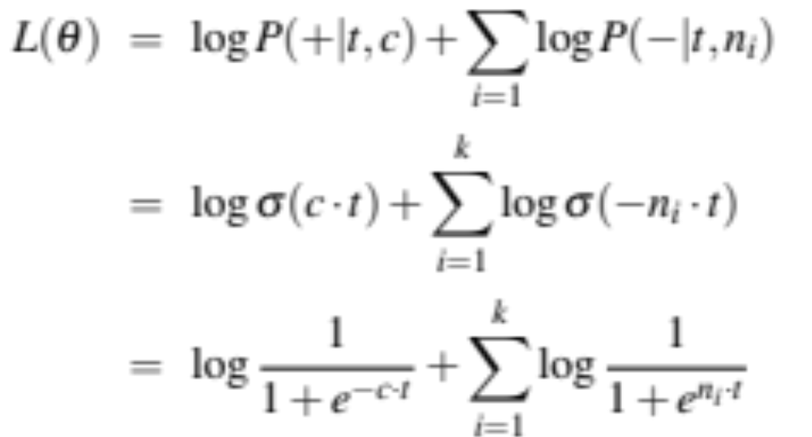
Focusing on one target word t:

Slide 80
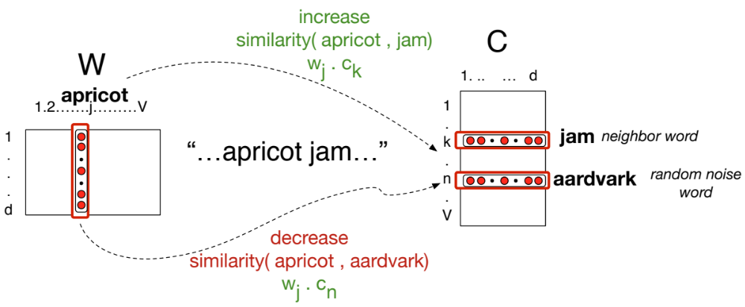

Slide 81
Train using gradient descent
Actually learns two separate embedding matrices W and C
Can use W and throw away C, or merge them somehow

Slide 82
Summary: How to learn word2vec (skip-gram) embeddings
Start with V random 300-dimensional vectors as initial embeddings
Use logistic regression, the second most basic classifier used in machine learning after naïve bayes
  Take a corpus and take pairs of words that co-occur as positive examples
  Take pairs of words that don't co-occur as negative examples
  Train the classifier to distinguish these by slowly adjusting all the embeddings to improve the classifier performance
  Throw away the classifier code and keep the embeddings.

Slide 83
Evaluating embeddings
Compare to human scores on word similarity-type tasks:
WordSim-353 (Finkelstein et al., 2002)
SimLex-999 (Hill et al., 2015)
Stanford Contextual Word Similarity (SCWS) dataset (Huang et al., 2012)
TOEFL dataset: Levied is closest in meaning to: imposed, believed, requested, correlated

Slide 84
Properties of embeddings
Similarity depends on window size C
C = ±2 The nearest words to Hogwarts:
  Sunnydale
  Evernight
C = ±5 The nearest words to Hogwarts:
  Dumbledore
  Malfoy
  halfblood

Slide 85


Analogy: Embeddings capture relational meaning!
vector(‘king’) - vector(‘man’) + vector(‘woman’) $≈$vector(‘queen’)
vector(‘Paris’) - vector(‘France’) + vector(‘Italy’) $≈$ vector(‘Rome’)

Slide 86


Slide 87


Slide 88

Embeddings can help study word history!
Train embeddings on old books to study changes in word meaning!!
Will Hamilton

Slide 89





Diachronic word embeddings for studying language change!
Word vectors for 1920
Word vectors 1990
“dog” 1990 word vector
“dog” 1920 word vector
vs.
1900
1950
2000
￼
￼

Slide 90

Visualizing changes
Project 300 dimensions down into 2
~30 million books, 1850-1990, Google Books data

Slide 91

The evolution of sentiment words
Negative words change faster than positive words

Slide 92
Embeddings and bias

Slide 93
Embeddings reflect cultural bias
Bolukbasi, Tolga, Kai-Wei Chang, James Y. Zou, Venkatesh Saligrama, and Adam T. Kalai. "Man is to computer programmer as woman is to homemaker? debiasing word embeddings." In Advances in Neural Information Processing Systems, pp. 4349-4357. 2016.
Ask “Paris : France :: Tokyo : x”
  x = Japan
Ask “father : doctor :: mother : x”
  x = nurse
Ask “man : computer programmer :: woman : x”
  x = homemaker

Slide 94
Embeddings reflect cultural bias
Caliskan, Aylin, Joanna J. Bruson and Arvind Narayanan. 2017. Semantics derived automatically from language corpora contain human-like biases. Science 356:6334, 183-186.
Implicit Association test (Greenwald et al 1998): How associated are
  concepts (flowers, insects) & attributes (pleasantness, unpleasantness)?
  Studied by measuring timing latencies for categorization.
Psychological findings on US participants:
  African-American names are associated with unpleasant words (more than European-American names)
  Male names associated more with math, female names with arts
  Old people's names with unpleasant words, young people with pleasant words.
Caliskan et al. replication with embeddings:
  African-American names (Leroy, Shaniqua) had a higher GloVe cosine with unpleasant words (abuse, stink, ugly)
  European American names (Brad, Greg, Courtney) had a higher cosine with pleasant words (love, peace, miracle)
Embeddings reflect and replicate all sorts of pernicious biases.

Slide 95
Directions
Debiasing algorithms for embeddings
  Bolukbasi, Tolga, Chang, Kai-Wei, Zou, James Y., Saligrama, Venkatesh, and Kalai, Adam T. (2016). Man is to computer programmer as woman is to homemaker? debiasing word embeddings. In Advances in Neural Infor- mation Processing Systems, pp. 4349–4357.
Use embeddings as a historical tool to study bias

Slide 96
Embeddings as a window onto history
Garg, Nikhil, Schiebinger, Londa, Jurafsky, Dan, and Zou, James (2018). Word embeddings quantify 100 years of gender and ethnic stereotypes. Proceedings of the National Academy of Sciences, 115(16), E3635–E3644
Use the Hamilton historical embeddings
The cosine similarity of embeddings for decade X for occupations (like teacher) to male vs female names
  Is correlated with the actual percentage of women teachers in decade X

Slide 97
History of biased framings of women
Garg, Nikhil, Schiebinger, Londa, Jurafsky, Dan, and Zou, James (2018). Word embeddings quantify 100 years of gender and ethnic stereotypes. Proceedings of the National Academy of Sciences, 115(16), E3635–E3644
Embeddings for competence adjectives are biased toward men
  Smart, wise, brilliant, intelligent, resourceful, thoughtful, logical, etc.
This bias is slowly decreasing

Slide 98
Embeddings reflect ethnic stereotypes over time
Garg, Nikhil, Schiebinger, Londa, Jurafsky, Dan, and Zou, James (2018). Word embeddings quantify 100 years of gender and ethnic stereotypes. Proceedings of the National Academy of Sciences, 115(16), E3635–E3644
Princeton trilogy experiments
Attitudes toward ethnic groups (1933, 1951, 1969) scores for adjectives
    industrious, superstitious, nationalistic, etc
Cosine of Chinese name embeddings with those adjective embeddings correlates with human ratings.

Slide 99

Change in linguistic framing 1910-1990
Garg, Nikhil, Schiebinger, Londa, Jurafsky, Dan, and Zou, James (2018). Word embeddings quantify 100 years of gender and ethnic stereotypes. Proceedings of the National Academy of Sciences, 115(16), E3635–E3644
Change in association of Chinese names with adjectives framed as "othering" (barbaric, monstrous, bizarre)

Slide 100

Changes in framing: adjectives associated with Chinese
Garg, Nikhil, Schiebinger, Londa, Jurafsky, Dan, and Zou, James (2018). Word embeddings quantify 100 years of gender and ethnic stereotypes. Proceedings of the National Academy of Sciences, 115(16), E3635–E3644

Slide 101
Conclusion
Concepts or word senses
  Have a complex many-to-many association with words (homonymy, multiple senses)
  Have relations with each other
    Synonymy, Antonymy, Superordinate
  But are hard to define formally (necessary & sufficient conditions)
Embeddings = vector models of meaning
  More fine-grained than just a string or index
  Especially good at modeling similarity/analogy
    Just download them and use cosines!!
  Can use sparse models (tf-idf) or dense models (word2vec, GLoVE)
  Useful in practice but know they encode cultural stereotypes

