Slide 1
Vector Semantics
Dense Vectors

Slide 2
Sparse versus dense vectors
PPMI vectors are
  long (length |V|= 20,000 to 50,000)
  sparse (most elements are zero)
Alternative: learn vectors which are
  short (length 200-1000)
  dense (most elements are non-zero)

Slide 3
Sparse versus dense vectors
Why dense vectors?
  Short vectors may be easier to use as features in machine learning (less weights to tune)
  Dense vectors may generalize better than storing explicit counts
  They may do better at capturing synonymy:
    car and automobile are synonyms; but are represented as distinct dimensions; this fails to capture similarity between a word with car as a neighbor and a word with automobile as a neighbor

Slide 4
Three methods for getting short dense vectors
Singular Value Decomposition (SVD)
  A special case of this is called LSA – Latent Semantic Analysis
“Neural Language Model”-inspired predictive models
  skip-grams and CBOW
Brown clustering

Slide 5
Vector Semantics
Dense Vectors via SVD

Slide 6
Intuition
Approximate an N-dimensional dataset using fewer dimensions
By first rotating the axes into a new space
In which the highest order dimension captures the most variance in the original dataset
And the next dimension captures the next most variance, etc.
Many such (related) methods:
  PCA – principle components analysis
  Factor Analysis
  SVD

Slide 7
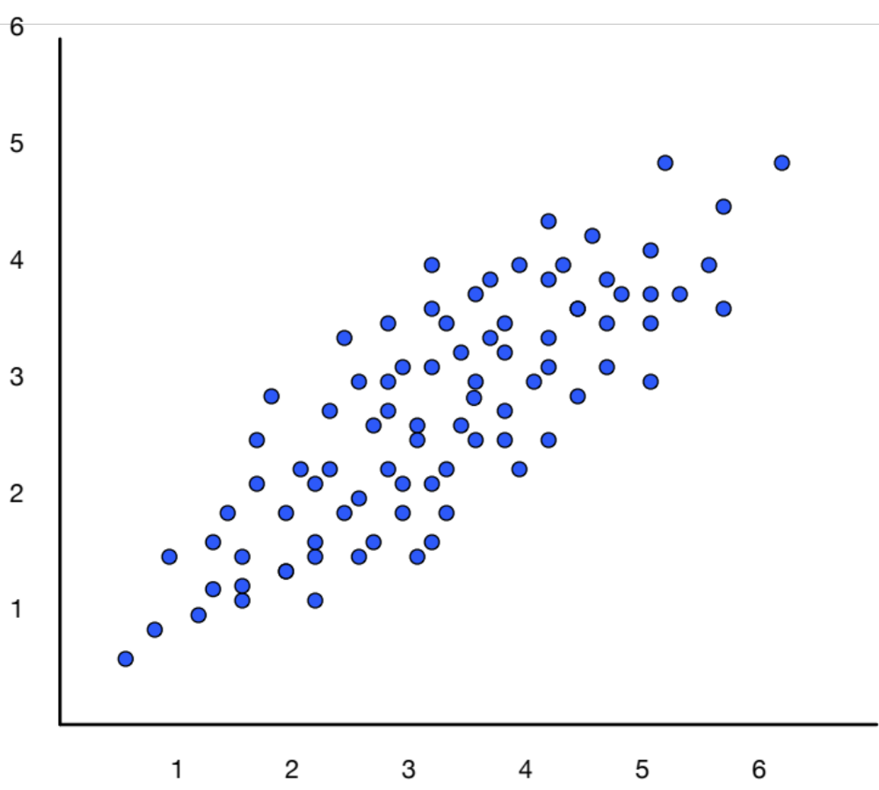
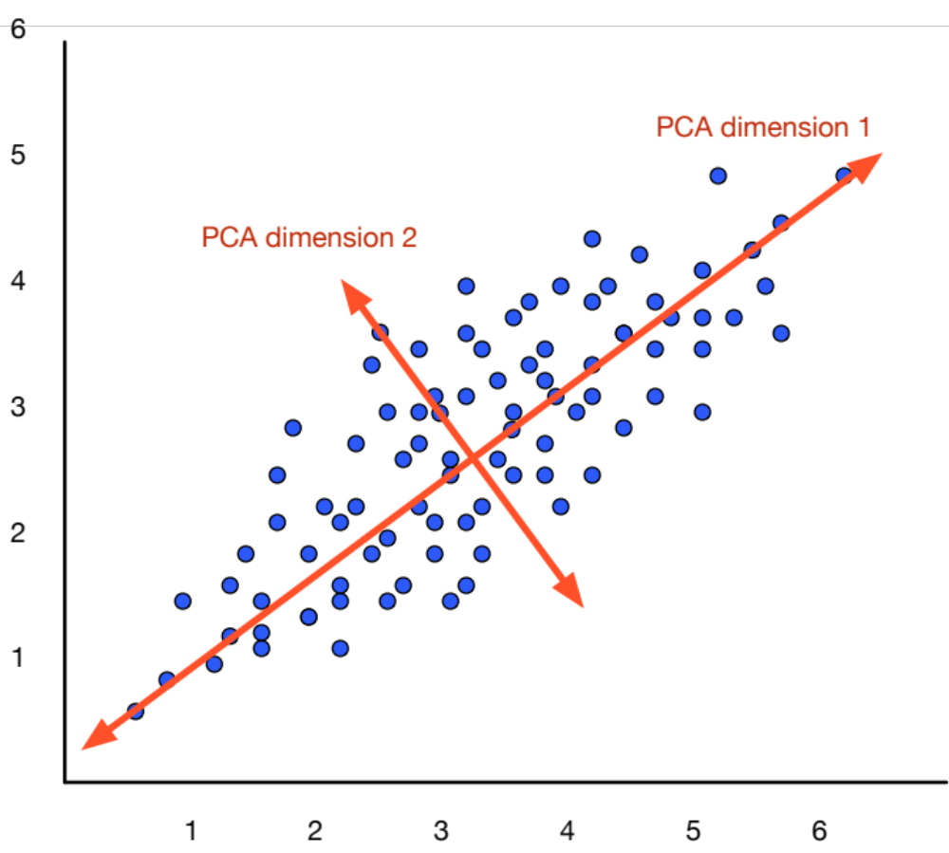
Dimensionality reduction

Slide 8
Singular Value Decomposition
Any rectangular w x c matrix X equals the product of 3 matrices:
W: rows corresponding to original but m columns represents a dimension in a new latent space, such that
  M column vectors are orthogonal to each other
  Columns are ordered by the amount of variance in the dataset each new dimension accounts for
S: diagonal m x m matrix of singular values expressing the importance of each dimension.
C: columns corresponding to original but m rows corresponding to singular values

Slide 9
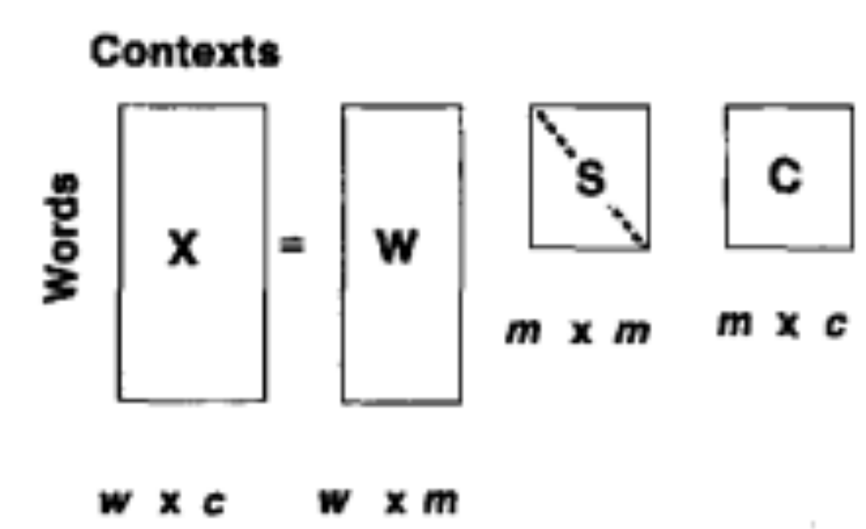
Singular Value Decomposition
Landuaer and Dumais 1997

Slide 10
SVD applied to term-document matrix:
Latent Semantic Analysis
Deerwester et al (1988)
If instead of keeping all m dimensions, we just keep the top k singular values. Let’s say 300.
The result is a least-squares approximation to the original X
But instead of multiplying, we’ll just make use of W.
Each row of W:
  A k-dimensional vector
  Representing word W
/
k
/
k
/
k
k
/

Slide 11
LSA more details
300 dimensions are commonly used
The cells are commonly weighted by a product of two weights
  Local weight: Log term frequency
  Global weight: either idf or an entropy measure

Slide 12
Let’s return to PPMI word-word matrices
Can we apply to SVD to them?

Slide 13
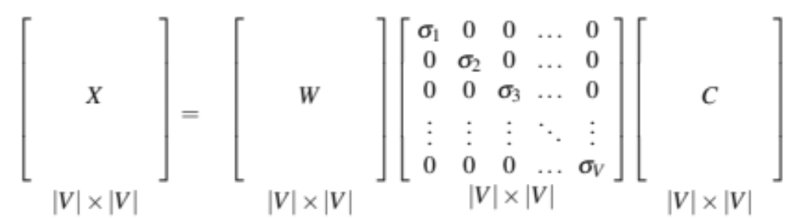
SVD applied to term-term matrix
(I’m simplifying here by assuming the matrix has rank |V|)

Slide 14
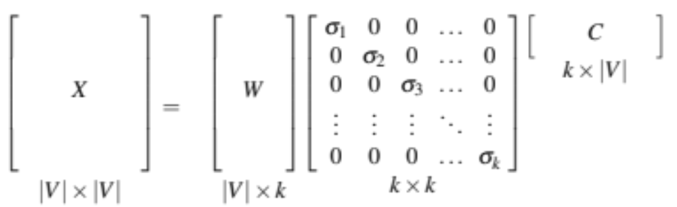
Truncated SVD on term-term matrix

Slide 15
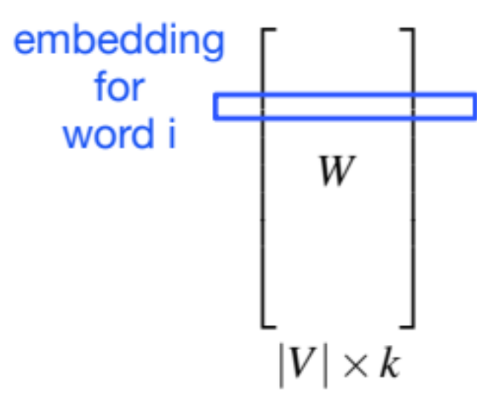
Truncated SVD produces embeddings
Each row of W matrix is a k-dimensional representation of each word w
K might range from 50 to 1000
Generally we keep the top k dimensions, but some experiments suggest that getting rid of the top 1 dimension or even the top 50 dimensions is helpful (Lapesa and Evert 2014).

Slide 16
Embeddings versus sparse vectors
Dense SVD embeddings sometimes work better than sparse PPMI matrices at tasks like word similarity
  Denoising: low-order dimensions may represent unimportant information
  Truncation may help the models generalize better to unseen data.
  Having a smaller number of dimensions may make it easier for classifiers to properly weight the dimensions for the task.
  Dense models may do better at capturing higher order co-occurrence.

Slide 17
Vector Semantics
Embeddings inspired by neural language models: skip-grams and CBOW

Slide 18
Prediction-based models:
An alternative way to get dense vectors
Skip-gram (Mikolov et al. 2013a) CBOW (Mikolov et al. 2013b)
Learn embeddings as part of the process of word prediction.
Train a neural network to predict neighboring words
    Inspired by neural net language models.
    In so doing, learn dense embeddings for the words in the training corpus.
Advantages:
  Fast, easy to train (much faster than SVD)
  Available online in the word2vec package
  Including sets of pretrained embeddings!

Slide 19
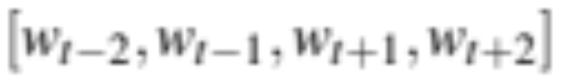
Skip-grams
Predict each neighboring word
  in a context window of 2C words
  from the current word.
So for C=2, we are given word w_{t} and predicting these 4 words:

Slide 20
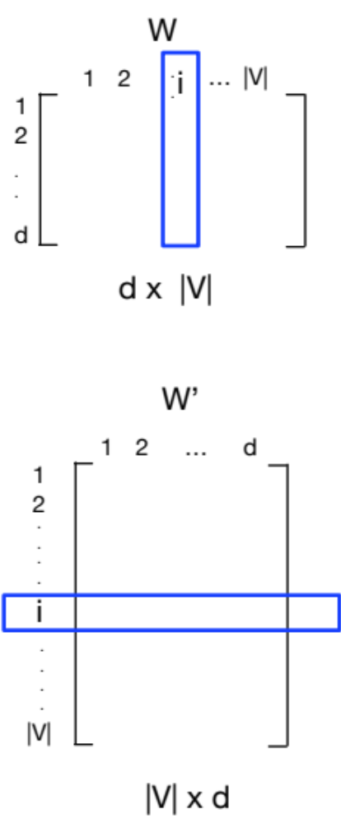
Skip-grams learn 2 embeddings for each w
input embedding v, in the input matrix W
Column i of the input matrix W is the 1×d embedding v_{i} for word i in the vocabulary.
output embedding v′, in output matrix W’
Row i of the output matrix W′ is a d × 1 vector embedding v′_{i} for word i in the vocabulary.

Slide 21
Setup
Walking through corpus pointing at word w(t), whose index in the vocabulary is j, so we’ll call it w_{j} (1 < j < |V |).
Let’s predict w(t+1) , whose index in the vocabulary is k (1 < k < |V |). Hence our task is to compute P(w_{k}|w_{j}).

Slide 22
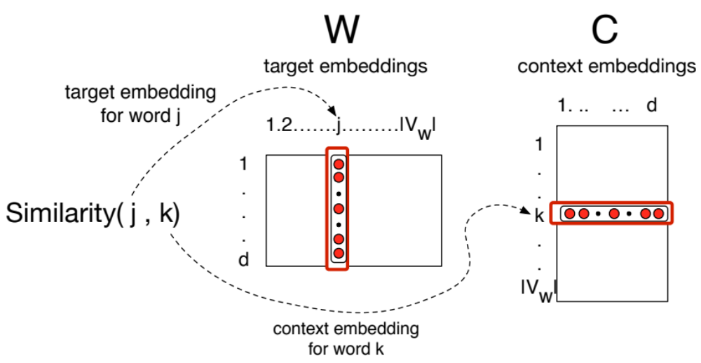
Intuition: similarity as dot-product between a target vector and context vector

Slide 23
Similarity is computed from dot product
Remember: two vectors are similar if they have a high dot product
  Cosine is just a normalized dot product
So:
  Similarity(j,k) ∝ c_{k} ∙ v_{j}
We’ll need to normalize to get a probability

Slide 24
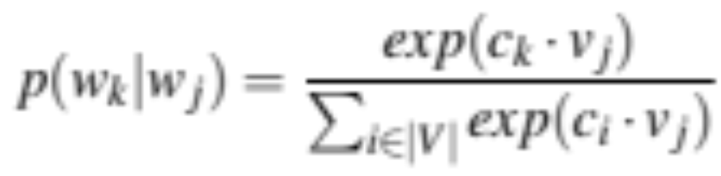
Turning dot products into probabilities
Similarity(j,k) = c_{k} ∙ v_{j}
We use softmax to turn into probabilities

Slide 25
Embeddings from W and W’
Since we have two embeddings, v_{j} and c_{j} for each word w_{j}
We can either:
  Just use v_{j}
  Sum them
  Concatenate them to make a double-length embedding

Slide 26
Learning
Start with some initial embeddings (e.g., random)
iteratively make the embeddings for a word
  more like the embeddings of its neighbors
  less like the embeddings of other words.

Slide 27
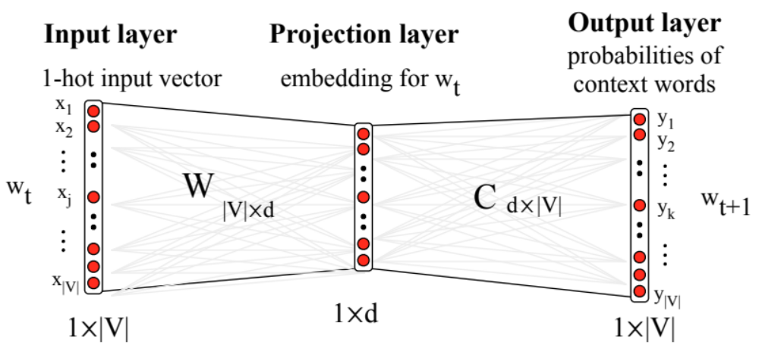
Visualizing W and C as a network for doing error backprop

Slide 28
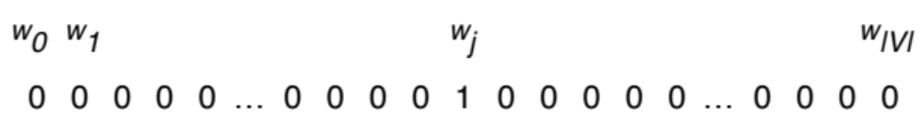
One-hot vectors
A vector of length |V|
1 for the target word and 0 for other words
So if “popsicle” is vocabulary word 5
The one-hot vector is
[0,0,0,0,1,0,0,0,0…….0]

Slide 29
Skip-gram
o = Ch
o_{k} = c_{k}h
h = v_{j}
o_{k} = c_{k}∙v_{j}

Slide 30
Problem with the softamx
The denominator: have to compute over every word in vocab
Instead: just sample a few of those negative words

Slide 31
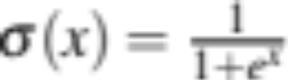
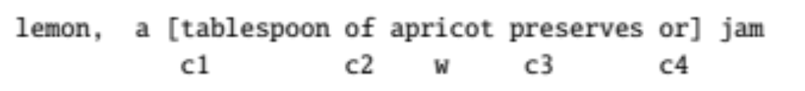


Goal in learning
Make the word like the context words
We want this to be high:
And not like k randomly selected “noise words”
We want this to be low:

Slide 32
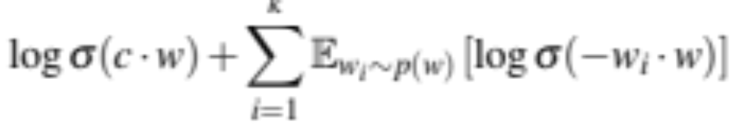
Skipgram with negative sampling:
Loss function

Slide 33
Relation between skipgrams and PMI!
If we multiply WW’^{T}
We get a |V|x|V| matrix M , each entry m_{ij} corresponding to some association between input word i and output word j
Levy and Goldberg (2014b) show that skip-gram reaches its optimum just when this matrix is a shifted version of PMI:
WW′^{T} =M^{PMI} −log k
So skip-gram is implicitly factoring a shifted version of the PMI matrix into the two embedding matrices.

Slide 34
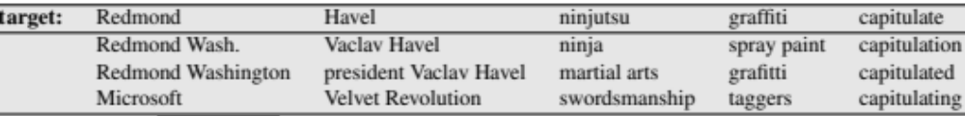
Properties of embeddings
Nearest words to some embeddings (Mikolov et al. 20131)

Slide 35
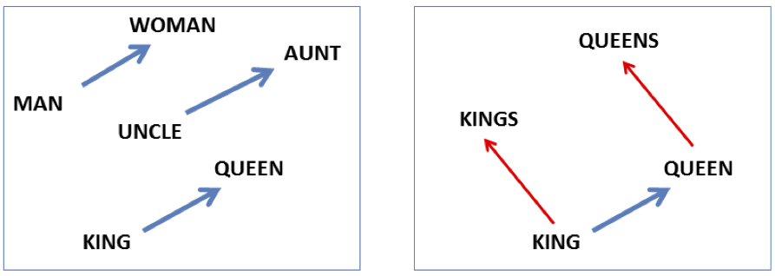
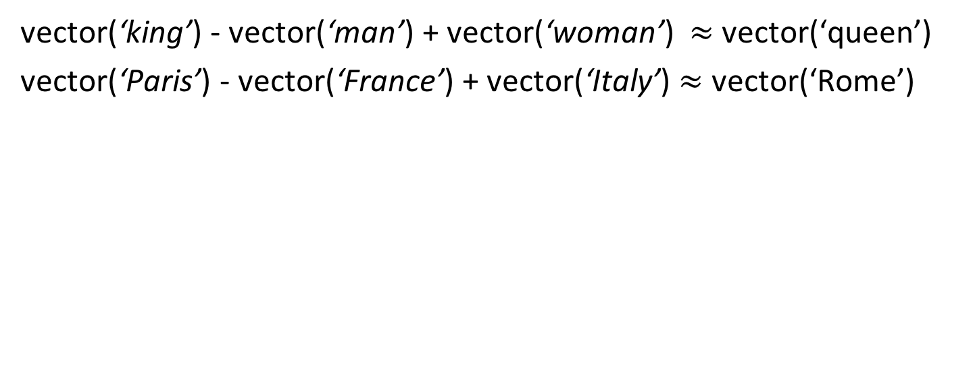
Embeddings capture relational meaning!
vector(‘king’) - vector(‘man’) + vector(‘woman’) $≈$vector(‘queen’)
vector(‘Paris’) - vector(‘France’) + vector(‘Italy’) $≈$ vector(‘Rome’)

Slide 36
Vector Semantics
Brown clustering

Slide 37
Brown clustering
An agglomerative clustering algorithm that clusters words based on which words precede or follow them
These word clusters can be turned into a kind of vector
We’ll give a very brief sketch here.

Slide 38
Brown clustering algorithm
Each word is initially assigned to its own cluster.
We now consider consider merging each pair of clusters. Highest quality merge is chosen.
  Quality = merges two words that have similar probabilities of preceding and following words
  (More technically quality = smallest decrease in the likelihood of the corpus according to a class-based language model)
Clustering proceeds until all words are in one big cluster.

Slide 39
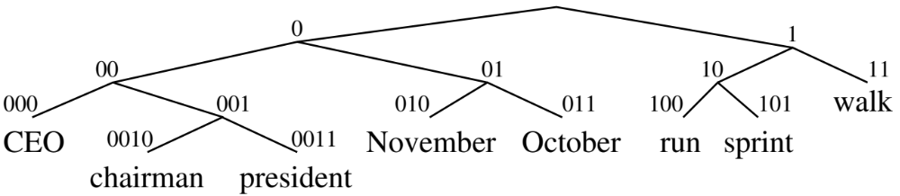
Brown Clusters as vectors
By tracing the order in which clusters are merged, the model builds a binary tree from bottom to top.
Each word represented by binary string = path from root to leaf
Each intermediate node is a cluster
Chairman is 0010, “months” = 01, and verbs = 1

Slide 40
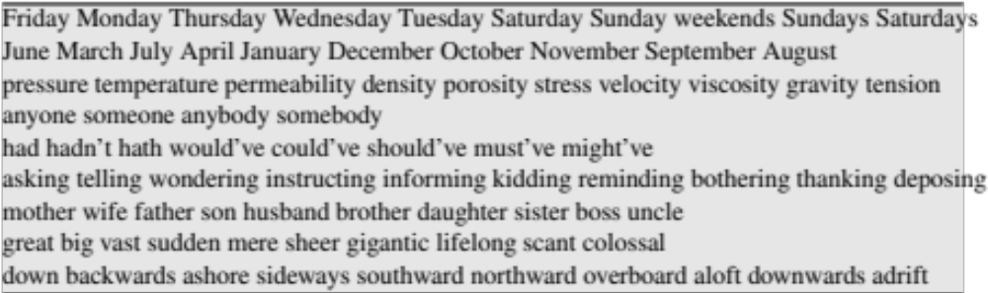
Brown cluster examples

Slide 41
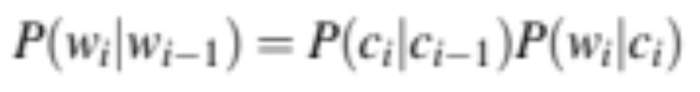
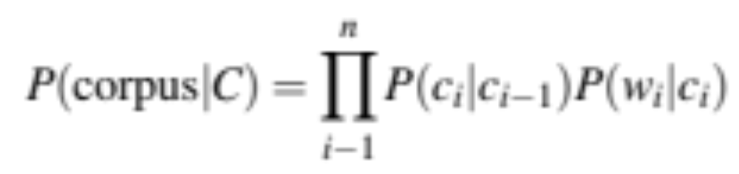
Class-based language model
Suppose each word was in some class c_{i:}

