Slide 1
Words and Tokens
Words

Slide 2
How many words in a sentence?
They picnicked by the pool, then lay back on the grass and looked at the stars.
16 words
  if we don’t count punctuation marks as words
18 if we count punctuation
Notes:
Let's look at a part of another sentence. How many words are in this sentence? Pause the video and count for yourself. Again, it depends how you count. We could count word types, the number of unique words that occur in the sentence. By that count we only count "the" once, even though it appears twice. Word tokens we're counting every word token on the page, so the two "the"s count twice. And what about San Francisco? One word or two? And how about "they and their". Different wordforms, same lemma. Again, it depends on our goals, and it's important to make that clear whenever you report word counts

Slide 3
How many words in an utterance?
"I do uh main- mainly business data processing"
Disfluencies
  Fragments main-
  Filled pauses: uh and um
  Should we consider these to be words?
Notes:
Let's start by asking how many words are in just one sentence? Here's a sentence: "I do uh main- mainly business data processing". How many words are in that sentence? It's a complicated question. Is "uh" a word? What about the cutoff "main" the first time I started to say "mainly". We call things like "main" here a fragment, and we call "uh" and "um" filled pauses. So for certain applications, like speech applications, we might want to be counting these. Or how about "cat" and "cats" in this Dr. Seuss sentence? It will help to introduce the distinction between "lemma" and "wordform". Two words are the same lemma if they have the same stem, the same part of speech, the same sense. Whereas wordform is the exact surface form of the word, with all its inflections or endings. So if we're counting lemmas, "cat" and "cats" count as the same lemma. If we're counting wordforms, "cat" and "cats" are different.

Slide 4
How many words in a sentence?
They picnicked by the pool, then lay back on the grass and looked at the stars.
Type: an element of the vocabulary V
  The number of types is the vocabulary size |V|
Instance: an instance of that type in running text.
  14 types and 16 instances (if we ignore punctuation).
  More questions: Are They and they the same word?
Notes:
Let's look at a part of another sentence. How many words are in this sentence? Pause the video and count for yourself. Again, it depends how you count. We could count word types, the number of unique words that occur in the sentence. By that count we only count "the" once, even though it appears twice. Word instances we're counting every word instance on the page, so the two "the"s count twice. And what about captalization? Should They and they be th same word?

Slide 5
How many words in a sentence?
I'm
Orthographically one word (in the English writing system)
But grammatically two words:
the subject pronoun I
the verb ’m, short for am.
Notes:
Let's look at a part of another sentence. How many words are in this sentence? Pause the video and count for yourself. Again, it depends how you count. We could count word types, the number of unique words that occur in the sentence. By that count we only count "the" once, even though it appears twice. Word instances we're counting every word instance on the page, so the two "the"s count twice. And what about captalization? Should They and they be th same word?

Slide 6
How many words in a sentence?
Not every written language uses spaces!!
Chinese, Japanese and Thai don't!

Slide 7
How to choose tokens in Chinese
Chinese words are composed of characters called "hanzi" (汉字) (or sometimes just "zi")
Each one represents a meaning unit called a morpheme.
Each word has on average 2.4 of them.
But deciding what counts as a word is complex and not agreed upon.

Slide 8
How to do choose tokens in Chinese?
姚明进入总决赛 “Yao Ming reaches the finals”
    yáo míng jìn rù zǒng jué sài
3 words?
姚明 进入 总决赛
YaoMing reaches finals
5 words?
姚 明 进入 总 决赛
Yao Ming reaches overall finals
7 words?
姚 明 进 入 总 决 赛
Yao Ming enter enter overall decision game
Chinese Treebank
Peking University
Just use characters

Slide 9
Tokenization across languages
So in Chinese we use characters (zi) as tokens
  But that doesn't work for, e.g., Thai and Japanese
  These differences make it hard to use words as tokens
And there's another reason why we don't use words as tokens!

Slide 10
There are simply too many words!
Notice that (roughly) the bigger the corpora, the more words we find!
 | Types = |V| | Instances = N
Shakespeare | 31 thousand | 884,000
Brown Corpus | 38 thousand | 1 million
Switchboard conversations | 20 thousand | 2.4 million
COCA | 2 million | 440 million
Google N-grams | 13+ million | 1 trillion
Notes:
In general, we'll refer to the number of tokens with capital N. And we'll use capital V to mean the vocabulary, the set of all words. So the cardinality of V is the size of vocabulary, the number of word types. although sometimes for simplification, we'll just use capital V to mean the vocabulary size when it's not ambiguous. There's a relationship between these two in running text, called Heaps Law or Herdan's Law, which is that the size of the vocabulary grows with spmething over the square root of the number of word tokens. So a large corpus of N words tokens, you can expect to see N to the .7 word types. Here are the numbers for some common corpora,… The switchboard corpus of phone conversations has 2.4 million word tokens. And there's 20,000 word types in those 2.4
millions words. Shakespeare has just under a million word tokens. Shakespeare is
quite a small corpus. He wrote, 800,000 words in his lifetime. And in that less
than a million words, he actually used 31,000 distinct words. So he had a very,
very broad vocabulary famously. And if you look at a very huge corpus, the Google
N-grams corpus that has a trillion different tokens, a very large number of
words, there's. Thirteen million types, so how many words are there in English? Well,
if you look at conversation, 20,000 different words. If you look at
Shakespeare, 30,000 words. And if you combine the two, probably somewhere, not
quite the sum of the two, but some larger number. But if you look at the Google
engrams, we have thirteen million. And of course, some of those are probably urls,
and. And email addresses, but even if you eliminate all of those, the number of
words in a language is very large, maybe there's a million words of English.

Slide 11
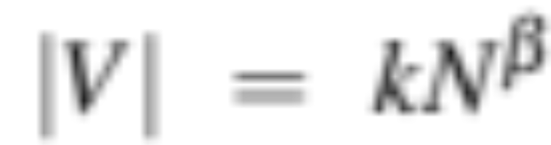
There are simply too many words!
N = number of instances
|V | = number of types in vocabulary V
Heaps Law = Herdan's Law
Vocab size for a text goes up with the square root of its length in words
Roughly 0.5
Notes:
In general, we'll refer to the number of tokens with capital N. And we'll use capital V to mean the vocabulary, the set of all words. So the cardinality of V is the size of vocabulary, the number of word types. although sometimes for simplification, we'll just use capital V to mean the vocabulary size when it's not ambiguous. There's a relationship between these two in running text, called Heaps Law or Herdan's Law, which is that the size of the vocabulary grows with spmething over the square root of the number of word tokens. So a large corpus of N words tokens, you can expect to see N to the .7 word types. Here are the numbers for some common corpora,… The switchboard corpus of phone conversations has 2.4 million word tokens. And there's 20,000 word types in those 2.4
millions words. Shakespeare has just under a million word tokens. Shakespeare is
quite a small corpus. He wrote, 800,000 words in his lifetime. And in that less
than a million words, he actually used 31,000 distinct words. So he had a very,
very broad vocabulary famously. And if you look at a very huge corpus, the Google
N-grams corpus that has a trillion different tokens, a very large number of
words, there's. Thirteen million types, so how many words are there in English? Well,
if you look at conversation, 20,000 different words. If you look at
Shakespeare, 30,000 words. And if you combine the two, probably somewhere, not
quite the sum of the two, but some larger number. But if you look at the Google
engrams, we have thirteen million. And of course, some of those are probably urls,
and. And email addresses, but even if you eliminate all of those, the number of
words in a language is very large, maybe there's a million words of English.

Slide 12
Two kinds of words
Function words
Content words

Slide 13
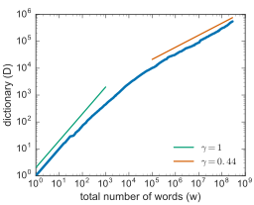
Tria, Loreto, Servedio, 2018

Slide 14
Why is too many words a problem?
No matter how big our vocabulary
There will always be words we missed!
We will always have unknown words!

Slide 15
Words and Subwords
Because of these problems:
  Many languages don't have orthographic words
  Defining words post-hoc is challenging
  The number of words grows without bound
NLP systems don't use words, but smaller units called subwords
In the next lecture we'll start by introducing smaller units like morphemes and characters

Slide 16
Words and Tokens
Words

Slide 17
Words and Tokens
Morphemes

Slide 18
Words have parts
Morpheme: a minimal meaning-bearing unit in a language.
fox: one morpheme
cats: two morphemes cat and –s
Morphology: the study of morphemes

Slide 19

Morphemes in English and Chinese
Doc work-ed care-ful-ly wash-ing the glass-es

Slide 20
Types of morphemes
root: central morpheme of the word
- supplying the main meaning
affix: adding additional meanings
worked
root work
affix -ed
glasses
root glass
affix -es

Slide 21
Types of affixes
Inflectional morphemes
  grammatical morphemes
  often syntactic role like agreement
      –ed past tense on verbs
      -s/-es plural on nouns
Derivational morphemes
  more idiosyncratic in application and meaning
  often change grammatical class
    care (noun)
    + -full → careful (adjective)
    + -ly → carefully (adverb)

Slide 22
Clitics
A morpheme that acts syntactically like a word but:
  is reduced in form
  and attached to another word
English: 've in I've ('ve can't appear alone)
English: ’s in the teacher’s book
French: l’ in l’opera
Arabic: b ‘by/with’, w ‘and’.

Slide 23
Morphological Typology
Dimensions along which languages vary
Two are salient for tokenization:
  number of morphemes per word
  how easy it is to segment the morphemes

Slide 24
Number of morphemes per word
Few. Cantonese, spoken in Guangdong, Guangxi, Hong Kong
keoi5 waa6 cyun4 gwok3 zeoi3 daai6 gaan1 uk1 hai6 ni1 gaan1
he say entire country most big building house is this building
“He said the biggest house in the country was this one”
Many. Koryak, Kamchatka peninsula in Russia,
t-ə-nk’e-mejŋ-ə-jetemə-nni-k
1SG.S-E-midnight-big-E-yurt.cover-E-sew-1SG.S[PFV]
“I sewed a lot of yurt covers in the middle of a night.”

Slide 25
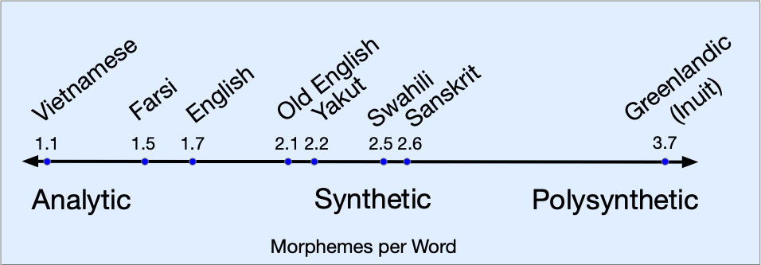
Joseph Greenberg (1960) scale

Slide 26
How easily segmentable
Agglutinative languages like Turkish
  Very clean boundaries between morphemes
Fusion languages
  a single affix may conflate multiple morphemes,
  Russian -om in stolom (table-SG-INSTR- DECL1)
    instrumental, singular, and first declension.
  English –s in "She reads the article"
    Means both "third person" and "present tense"
These are tendencies rather than absolutes

Slide 27
Words and Tokens
Morphemes

Slide 28
Words and Tokens
Unicode

Slide 29
Unicode
a method for representing text written using
  any character (more than 150,000!)
  in any script (168 to date!)
  of the languages of the world
    Chinese, Arabic, Hindi, Cherokee, Ethiopic, Khmer, N’Ko,…
    dead ones like Sumerian cuneiform
    invented ones like Klingon
    plus emojis, currency symbols, etc.

Slide 30
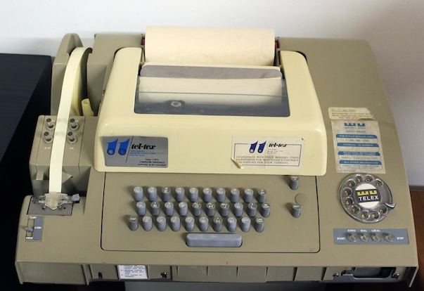
ASCII: Some history for English
1960s American Standard Code for Information Exchange
1 byte per character
  In principle 256 characters
  But high bit set to 0
  So 7 bits = 128
  However only 95 used
  The rest were for teletypes

Slide 31

ASCII: Some history for English
h e l l o
68 65 6C 6C 6F

Slide 32
ASCII wasn't enough!
Spanish: Señor- respondió Sancho
This sentence has non-ASCII ñ and ó
About 100,000 Chinese/CJKV characters (Chinese, Japanese, Korean, or Vietnamese)
Devanagari script for 120 languages like Hindi, Marathi, Nepali, Sindhi, Sanskrit, etc.

Slide 33
Code Points
Unicode assigns a unique ID, a code point, to each of its 150,000 characters
1.1 million possible code points
  0 – 0x10FFFF
Written in hex, with prefix "U+"
  a is U+0061 which = 0x0061
First 127 code points = ASCII
  For backwards compatibility

Slide 34
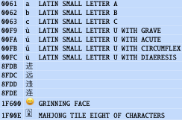
Some code points
A code point has no visuals; it is not a glyph!
Glyphs are stored in fonts: a or a or a or a
But all of them are U+0061, abstract "LATIN SMALL A"

Slide 35
Encodings and UTF-8
We don't stick code points directly in files
We store encodings of chars.
The most popular encoding is UTF-8
Most of the web is stored in UTF-8

Slide 36
Encodings
hello has these 5 code points:
U+0068 U+0065 U+006C U+006C U+006F
How to write in a file?
There are more than 1 million code points
So need 4 bytes (or 3 but 3 is inconvenient):
00 00 00 68 00 00 00 65 00 00 00 6C 00 00 00 6C 00 00 00 6F
But that makes files very long!
  Also zeros are bad (since mean "end of string" in ASCII)

Slide 37
Instead: Variable Length Encoding
UTF-8 (Unicode Transformation Format 8)
For the first 127 code points, same as ASCII
UTF-8 encoding of hello is :
  68 65 6C 6C 6F
Code points ≥128 are encoded as a sequence of 2, 3, or 4 bytes
  In range 128 - 255, so won’t be confused with ASCII
  First few bits say if its 2-byte, 3-byte, or 4-byte

Slide 38

UTF-8 Encoding
yyy yyxxxxxx
̃n, code point U+00F1, = 00000000 11110001
  Gets encoded with pattern 110yyyyy 10xxxxxx
  So is mapped to a two-byte bit sequence
  11000011 10110001 = 0xC3B1.

Slide 39
UTF-8 encoding
The first 127 characters (ASCII) map to 1 byte
Most remaining characters in European, Middle Eastern, and African scripts map to 2 bytes
Most Chinese, Japanese, and Korean characters map to 3 bytes
Rarer CJKV characters, emojis/symbols map to 4 bytes.

Slide 40
UTF-8 encoding
Efficient: fewer bytes for common characters,
Doesn't use zero bytes (except for NULL character U+0000),
Backwards compatible with ASCII,
Self-synchronizing,
  If a file is corrupted, the nearest character boundary is always findable by moving only up to 3 bytes

Slide 41
UTF-8 and Python 3
Python 3 strings stored internally as Unicode
  each string a sequence of Unicode code points
  string functions, regex apply natively to code points.
    len() returns string length in code points, not bytes
  Files need to be encoded/decoded when written or read
  Every file is stored in some encoding
  No such thing as a text file without an encoding
    If it's not UTF-8 it's something older like ASCII or iso_8859_1

Slide 42
Words and Tokens
Unicode

Slide 43
Words and Tokens
Byte Pair Encoding
Notes:
In this lecture, we introduce the Byte Pair Encoding or BPE algorithm that uses corpus statistics to decide how to segment a text into tokens.

Slide 44
The NLP standard for tokenization
Instead of
white-space / orthographic words
  Lots of languages don't have them
  The number of words grows without bound
Unicode characters
  Too small as tokens for many purposes
morphemes
  Very hard to define
We use the data to tell us how to tokenize.

Slide 45
Why tokenize?
Using a deterministic series of tokens means systems can be compared equally
  Systems agree on the length of a string
Eliminates the problem of unknown words

Slide 46
Subword tokenization
Two most common algorithms:
  Byte-Pair Encoding (BPE) (Sennrich et al., 2016)
  Unigram language modeling tokenization (Kudo, 2018) (sometimes confusingly called "SentencePiece" after the library it's in)
All have 2 parts:
  A token learner that takes a raw training corpus and induces a vocabulary (a set of tokens).
  A token segmenter that takes a raw test sentence and tokenizes it according to that vocabulary

Slide 47
Byte Pair Encoding (BPE) token learner
Iteratively merge frequent neighboring tokens to create longer tokens.
Repeat:
  Choose most frequent neighboring pair ('A', 'B')
  Add a new merged symbol ('AB') to the vocabulary
  Replace every 'A' 'B' in the corpus with 'AB'.
Until k merges
Vocabulary
[A, B, C, D, E]
[A, B, C, D, E, AB]
[A, B, C, D, E, AB, CAB]
Corpus
  A B D C A B E C A B
  AB D C AB E C AB
  AB D CAB E CAB

Slide 48
BPE algorithm
Generally run within words
Don't merge across word boundaries
  First separate corpus by whitespace
  This gives a set of starting strings, with whitespace attached to front of them
  Counts come from the corpus, but can only merge within strings.

Slide 49
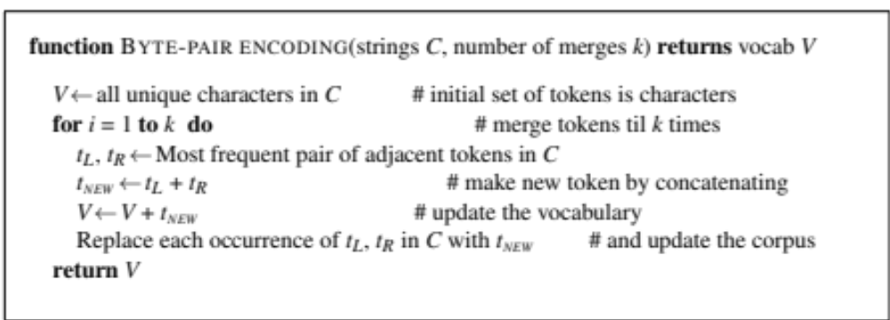
BPE token learner algorithm

Slide 50
Byte Pair Encoding (BPE) Addendum
Most subword algorithms are run inside space-separated tokens.
So we commonly first add a special end-of-word symbol '__' before space in training corpus
Next, separate into letters.

Slide 51

BPE token learner
Original (very fascinating🙄) corpus:
set␣new␣new␣renew␣reset␣renew
Put space token at start of words

Slide 52

BPE token learner
Merge n e to ne (count 4 = 2 new + 2 renew)

Slide 53

BPE token learner
Merge ne w to new (count 4)

Slide 54

BPE token learner
Merge ␣ r to ␣r (count 4) and ␣r e to ␣re (count 3)
System has learned prefix re- !

Slide 55

BPE
The next merges are:

Slide 56
BPE encoder algorithm
Tokenize a test sentence: run each merge learned from the training data:
  Greedily, in the order we learned them
  (test frequencies don't play a role)
First: segment each test word into characters
Then run rules: (1) merge every n e to ne, (2) merge ne w to new, (3) ␣r, (4) ␣re etc.
Result:
  Recreates training set words
  But also learns subwords like ␣re that might appear in new words like rearrange

Slide 57
BPE and Unicode
Run on large Unicode corpora, with vocabulary sizes of 50,000 to 200,000
On individual bytes of UTF-8-encoded text.
  BPE rediscovers 2-byte and common 3-byte UTF-8 sequences
  Only 256 possible values of a byte, so no unknown tokens
  (BPE might learn a few illegal UTF-8 sequences across character boundaries, but these can be filtered)

Slide 58
Visualizing GPT4o tokens
Tat Dat Duong’s Tiktokenizer visualizer
Tokens: 11865, 8923, 11, 31211, 6177, 23919, 885, 220, 19427, 7633, 18887, 147065, 0
Most words are tokens, w/initial space
Clitics like ’s
  Are segmented off Jane
  But part of frequent words like she’s
Numbers segmented into chunks of 3 digits
Some of this is from preprocessing
  regular expressions for chunking digits, stripping clitics

Slide 59
Tokenizing across languages
Even though BPE tokenizers are multilingual
LLM training data is still vastly dominated by English
    Most BPE tokens used for English, leaving less for other languages
    Words in other languages are often split up

Slide 60
Tokenization is better in English
Tat Dat Duong’s Tiktokenizer visualizer on GPT4o
A recipe sentence in two languages
English: 18 tokens; no words are split into multiple tokens):
Spanish: 33 tokens; 6/16 words are split

Slide 61
Words and Tokens
Byte Pair Encoding
Notes:
In this lecture, we introduce the Byte Pair Encoding or BPE algorithm that uses corpus statistics to decide how to segment a text into tokens.

Slide 62
Words and Tokens
Rule-based tokenization
and
Simple Unix tools

Slide 63
Rule-based tokenization
Although subword tokenization is the norm
Sometimes we need particular tokens
Like for parsing, where the parser needs grammatical words, or social science

Slide 64
Issues for rule-based tokenization
Mostly but not always remove punctuation:
  m.p.h., Ph.D., AT&T, cap’n
  prices ($45.55)
  dates (01/02/06)
  URLs (http://www.stanford.edu)
  hashtags (#nlproc)
  email addresses (someone@cs.colorado.edu)
Numbers are tokenized differently across languages
  English 555,500.50 = French 555 500,50
Multiword expressions (MWE)?
  New York, rock ’n’ roll
Notes:
Of course, tokenization in most real situations isn't as simple as I've suggested with the simple UNIX tools.

Slide 65

Penn Treebank Tokenization Standard

Slide 66
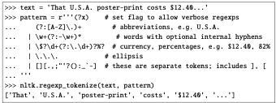
Tokenization in NLTK
Bird, Loper and Klein (2009), Natural Language Processing with Python. O’Reilly
Notes:
So most standard tokenization programs for English or languages with similar writing systems need to deal with each of these issues. Here's a simple python tokenizer in the Natural Language Toolkit that has little regular expressions for dealing with hypthens, and currency, and whatnot

Slide 67
Sentence Segmentation
!, ? mostly unambiguous but period “.” is very ambiguous
  Sentence boundary
  Abbreviations like Inc. or Dr.
  Numbers like .02% or 4.3
Common algorithm: Tokenize first: use rules or ML to classify a period as either (a) part of the word or (b) a sentence-boundary.
  An abbreviation dictionary can help
Sentence segmentation can then often be done by rules based on this tokenization.

Slide 68
Space-based tokenization
A very simple way to tokenize
  For languages that use space characters between words
    Arabic, Cyrillic, Greek, Latin, etc., based writing systems
  Segment off a token between instances of spaces
Unix tools for space-based tokenization
  The "tr" command
  Inspired by Ken Church's UNIX for Poets
  Given a text file, output the word tokens and their frequencies
Notes:
Let's now introduce some simple Unix tools for text processing, starting with the UNIX "tr" command for space-based word tokenization. Our goal will be to take a text file and output word tokens and their frequencies.

Slide 69
Simple Tokenization in UNIX
(Inspired by Ken Church’s UNIX for Poets.)
Given a text file, output the word tokens and their frequencies
tr -sc ’A-Za-z’ ’\n’ < shakes.txt
| sort
| uniq –c
1945 A
72 AARON
19 ABBESS
5 ABBOT
... ...
Change all non-alpha to newlines
Sort in alphabetical order
Merge and count each type
25 Aaron
6 Abate
1 Abates
5 Abbess
6 Abbey
3 Abbot
.... …

Slide 70
The first step: tokenizing
tr -sc ’A-Za-z’ ’\n’ < shakes.txt | head
THE
SONNETS
by
William
Shakespeare
From
fairest
creatures
We
...

Slide 71
The second step: sorting
tr -sc ’A-Za-z’ ’\n’ < shakes.txt | sort | head
A
A
A
A
A
A
A
A
A
...

Slide 72
More counting
Merging upper and lower case
tr ‘A-Z’ ‘a-z’ < shakes.txt | tr –sc ‘A-Za-z’ ‘\n’ | sort | uniq –c
Sorting the counts
tr ‘A-Z’ ‘a-z’ < shakes.txt | tr –sc ‘A-Za-z’ ‘\n’ | sort | uniq –c | sort –n –r
23243 the
22225 i
18618 and
16339 to
15687 of
12780 a
12163 you
10839 my
10005 in
8954 d
What happened here?

Slide 73
Words and Tokens
Rule-based tokenization
and
Simple Unix tools

Slide 74
Words and Tokens
Corpora
Notes:
In this lecture, we introduce the Byte Pair Encoding or BPE algorithm that uses corpus statistics to decide how to segment a text into tokens.

Slide 75
Corpora
Words don't appear out of nowhere!
A text is produced by
a specific writer(s),
at a specific time,
in a specific variety,
of a specific language,
for a specific function.
Notes:
Where did these corpora come from? …. These characteristics of a text influence properties of the text.

Slide 76
Corpora vary along dimensions like
Language: 7097 languages in the world
It's important to test algorithms on multiple languages
What may work for one may not work for another
Notes:
For example, what language is the text in? As we'll see when we get to talking about word tokenization, what counts as a word can be different in different languages.

Slide 77
Corpora vary along dimensions like
Variety, like African American English varieties
  AAE Twitter posts might include forms like "iont" (I don't)
Genre: newswire, fiction, scientific articles, Wikipedia
Author Demographics: writer's age, gender, ethnicity, socio-economic status
Notes:
For example, what language is the text in? As we'll see when we get to talking about word tokenization, what counts as a word can be different in different languages.

Slide 78
Code Switching
  Speakers use multiple languages in the same utterance
  This is very common around the world
  Especially in spoken language and related genres like texting and social media

Slide 79
Code Switching: Spanish/English
  Por primera vez veo a @username actually being hateful! It was beautiful:)
    [For the first time I get to see @username actually being hateful! it was beautiful:) ]

Slide 80
Code Switching: Hindi/English
    dost tha or ra- hega ... dont wory ... but dherya rakhe
    [“he was and will remain a friend ... don’t worry ... but have faith”]

Slide 81
Corpus datasheets
Gebru et al (2020), Bender and Friedman (2018)
Motivation:
Why was the corpus collected?
By whom?
Who funded it?
Situation: In what situation was the text written?
Collection process: If it is a subsample how was it sampled? Was there consent? Pre-processing?
+Annotation process, language variety, demographics, etc.
Notes:
You'll need to make sure you consider all those properties of a text when you are using it for processing purposes. And there are even more properties of corpora that it's important to consider. Who collected this corpus?
Whenever you build a corpus, you should be documenting these decisions in a datasheet for the corpus.

Slide 82
Words and Tokens
Corpora

Slide 83
Words and Tokens
Regular Expressions

Slide 84
Regular expressions are used everywhere
  A formal language for specifying text strings
  Part of every text processing task
    Often a useful pre-processing or text formatting step, for example for BPE tokenization
  Also necessary for data analysis of text
  A widely used tool in industry and academics
Notes:
Regular expressions are used everywhere in text processing, in every standard NLP toolkit and library, every programming language, and every industrial application of NLP. They are particularly useful for searching in text, and play a huge role in analyzing text data, in web scraping, in pattern-matching, in data formatting, and as a preprocessing step before applying some more sophisticated algorithms.

Slide 85
Regular expressions
We use regular expressions to search for a pattern in a string
For example, the Python function
re.search(pattern,string)
scans through the string and returns the first match inside it for the pattern

Slide 86
Python syntax
We'll show regex as raw string with double quotes:
r"regex"
Raw strings treat backslashes as literal characters
Many regex patterns use backslashes.

Slide 87
A note about Python regular expressions
  Regex and Python both use backslash "\" for special characters. You must type extra backslashes!
    "\\d+" to search for 1 or more digits
    "\n" in Python means the "newline" character, not a "slash" followed by an "n". Need "\\n" for two characters.
  Instead: use Python's raw string notation for regex:
    r"[tT]he"
    r"\d+" matches one or more digits
      instead of "\\d+"

Slide 88
Regular expressions
The pattern
r"Buttercup"
matches the substring Buttercup in any string, like the string
I’m called little Buttercup
Notes:
Suppose we're searching for mentions of woodchucks, the delightful small mammal also known as the groundhog. But they could appear with lower-case or upper-case w, with a final s or not, and as the synonym groundhog! Can we write a formal specification that accounts for all of these?

Slide 89
Regular Expressions: Disjunctions
Letters inside square brackets []
Ranges using the dash [A-Z]
Pattern | Matches
r"[mM]ary" | Mary or mary
r"[1234567890]" | Any one digit
Pattern | Matches
r"[A-Z]" | An upper case letter | Drenched Blossoms
r"[a-z]" | A lower case letter | my beans were impatient
r"[0-9]" | A single digit | Chapter 1: Down the Rabbit Hole
Notes:
Let's start with the square brackets which mean "any one character inside these brackets." So [wW] means "either lower w or upper W" and [1234567890] means "any digit"
It's a bit inefficient to write all that out, so we can use the dash or hyphen to specify a range. So [A-Z] means "any one uppercase letter" and [0-9] means "a digit". Note in the examples on the right we're showing in blue underline the first instance of a match; if we were showing all of them, we would also show the B in Blossoms

Slide 90
Regular Expressions: Negation in Disjunction
Carat as first character in [] negates the list
  Note: Carat means negation only when it's first in []
  Special characters (., *, +, ?) lose their special meaning inside []
Pattern | Matches | Examples
r"[^A-Z]" | Not upper case | Oyfn pripetchik
r"[^Ss]" | Neither ‘S’ nor ‘s’ | I have no exquisite reason”
r"[^.]" | Not a period | Our resident Djinn
r"[e^]" | Either e or ^ | Look up ^ now
Notes:
It's sometimes convenient to talk about characters we *don't* want to match. Maybe we want to search for any letter that is neither uppercase S or lowercase s. For that we use the special character carat, immediately after the open-square-bracket. So [^Ss] means "neither S nor s'. Or [^A-Z] means "not a capital letter". Or [^.] means any 1 character that is not a period. The carat has this negation meaning only immediately after the open-square bracket. So if use it later like in the pattern [e^] it means literally e or carat. IN a moment we'll introduce some special characters, like the period, a special wildcard regular expression that means "any character". But inside the square brackets, it just means "period".

Slide 91
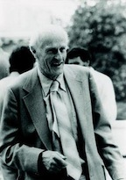
Kleene star and Kleene plus
baa!
baaa!
baaaa! ...
Kleene star * (0 or more of previous characters)
Kleene plus + (1 or more of previous character)
r"baaa*"
r"baa+"
Stephen C Kleene

Slide 92
Wildcard
The period means "any character"
r"." matches anything
r".*" matches any sequence of 0 or more of anything

Slide 93
Regular Expressions: Anchors ^ $
Pattern | Matches
r"^[A-Z]" | Palo Alto
r"\.$" | The end.
r".$" | The end? The end!
Notes:
And finally, two special characters that are about lines: The carat matches the start of the line, and the $ matches the end of the line. So carat [A-Z] means "a capital letter at the start of a line" (the carat has different meanings depending on placement; if we put the carat inside the square brackets, instead of meaning start, it means negation). Finally, we saw that dot means any character, so how do we refer to a literal period? By using the backslash command. Backlash period means a literally period. So \.$ matches a period at the end of a line. While just .$ matches anything at the end of ht eline

Slide 94
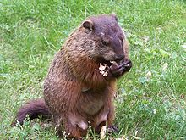
Regular Expressions: More Disjunction
Groundhog is another name for woodchuck!
The pipe symbol | for disjunction
Pattern | Matches
r"groundhog|woodchuck" | woodchuck
r"yours|mine" | yours
r"a|b|c" | = [abc]
r"[gG]roundhog|[Ww]oodchuck" | Woodchuck
Notes:
Another useful tool is the pipe symbol, the vertical bar, sometimes called just "or". It's used when we want to choose between two strings. So the square brackets choose between individual characters, but the pipe chooses between strings of characters. So this disjunction means "either the string groundhog or the string woodchuck". If we did want to speciy disjunctions of single letters we could use either the square brackets or the pipe. And we can combine both like in this pattern that finds lower or iupper case, groundhog or woodchuck.

Slide 95
Regular Expressions: Convenient aliases
Pattern | Expansion | Matches | Examples
r"\d" | [0-9] | Any digit | Fahreneit 451
r"\D" | [^0-9] | Any non-digit | Blue Moon
r"\w" | [a-ZA-Z0-9_] | Any alphanumeric or _ | Daiyu
r"\W" | [^\w] | Not alphanumeric or _ | Look!
r"\s" | [ \r\t\n\f] | Whitespace (space, tab) | Look␣up
r"\S" | [^\s] | Not whitespace | Look up
Notes:
Finally, we can use a special character, the backslash, to make even more aliases. So \d means "any one digit", \s means whitespace and \w means any alphanumeric (plus the underbar, slightly confusing). Using the capital letter means negated, so \D means any non-digit.

Slide 96
The iterative process of writing regex's
Find me all instances of the word “the” in a text.
  the
    Misses capitalized examples
  [tT]he
    Incorrectly returns other or Theology
  \W[tT]he\W

Slide 97
False positives and false negatives
The process we just went through was based on fixing two kinds of errors:
  Not matching things that we should have matched (The)
    False negatives
  Matching strings that we should not have matched (there, then, other)
    False positives

Slide 98
Characterizing work on NLP
In NLP we are always dealing with these kinds of errors.
Reducing the error rate for an application often involves two antagonistic efforts:
  Increasing coverage (or recall) (minimizing false negatives).
  Increasing accuracy (or precision) (minimizing false positives)
Notes:
It turns out in natural language processing we are constantly dealing with these kinds of errors. So reducing

Slide 99
Regular expressions play a surprisingly large role
  Widely used in both academics and industry
    Part of most text processing tasks, even for big neural language model pipelines
      including text formatting and pre-processing
    Very useful for data analysis of any text data

Slide 100
Words and Tokens
Regular Expressions

Slide 101
Words and Tokens
Substitutions, Capture Groups, and Lookahead

Slide 102
Regex Substitutions in Python
To change every instance of cherry to apricot in string:
re.sub(r"cherry", r"apricot", string)
Upper case all examples of a name:
re.sub(r"janet", r"Janet", string)

Slide 103
Substitutions often need capture groups
Change US format dates (mm/dd/yyyy) to EU : (dd-mm-yyyy)
Pattern to match US:
r"\d{2}/\d{2}/\d{4}"
How to specify in the replacement that we want to swap the date and month values?

Slide 104
Capture group
Use parentheses to capture (store) the values that we matched in the search,
Groups have numbers
In repl, we refer back to that group with a number command.

Slide 105
Capture group
re.sub(r"(\d{2})/(\d{2})/(\d{4})", r"\2-\1-\3", string)}
Parens ( and ) around the two month digits, the two day digits, and the four year digits,
This stores
  the first 2 digits in group 1,
  the second 2 digits in group 2,
  final digits in group 3.
Then in the repl string,
  \1, \2, and \3, refer to the 1st, 2nd, and 3rd registers.

Slide 106
That regex will
map
The date is 10/15/2011
to
The date is 15-10-2011

Slide 107
But suppose we don't want to capture?
Parentheses have a double function: grouping terms, and capturing
Non-capturing groups: add a ?: after paren:
r"(?:some|a few) (people|cats) like some \1/"
matches
  some cats like some cats
but not
  some cats like some some
Notes:
Here's a problem: parenthesis are used to specify capture groups. But they are also how we group terms, for example for disjunctions, like an expression for a string matching "people" or "cats". How do we specify that we are using the capture groups just for grouping and not for capturing? We simply add a "question mark colon" after the open paren.

Slide 108
Lookahead assertions
(?= pattern) is true if pattern matches, but is zero-width; doesn't advance character pointer
(?! pattern) true if a pattern does not match
How to capture the first word on the line, but only if it doesn’t start with the letter T:
r"ˆ(?![tT])(\w+)\b"
Notes:
Finally, there will be times when we need to predict the future: look ahead in the text to see if some pattern matches, but not advance the match cursor, so that we can then deal with the pattern if it occurs.
These "lookahead assertions" make use of the (? syntax that we just introduced for non-capture groups. The operator (?= pattern) is true if the pattern occurs, but is zero-width, meaning the match pointer doesn’t advance. And the negative lookahead, ?! pattern only returns true if a pattern does not match, but again is zero-width. Negative lookahead is commonly used when we are parsing some complex pattern but want to rule out a special case. For example this last pattern here matches, at the beginning of a line, any single word that doesn’t start with “T”.

Slide 109
Simple Application: ELIZA
Early NLP system that imitated a Rogerian psychotherapist
  Joseph Weizenbaum, 1966.
Uses pattern matching to match, e.g.,:
  “I need X”
  and translates them into, e.g.
  “What would it mean to you if you got X?
Notes:
Substitutions and capture groups are very useful in implementing simple chat-bots like ELIZA. ELIZA , one of the most important historical NLP systems, was created by pioneering AI researcher Joseph Weizenbaum in 1966, and simulates a Rogerian psychologist, a kind of therapist who emphasizes mirroring back what they hear. ELIZA is a surprisingly simple program that uses pattern matching to recognize phrases like “I need X” and translate them into suitable outputs like “What would it mean to you if you got X?”. This simple technique succeeds in this domain because ELIZA doesn’t actually need to know anything to mimic a Rogerian psychotherapist. This is one of the few dialogue genres where listeners can act as if they know nothing of the world.

Slide 110
Simple Application: ELIZA
Men are all alike.
IN WHAT WAY
They're always bugging us about something or other. CAN YOU THINK OF A SPECIFIC EXAMPLE
Well, my boyfriend made me come here.
YOUR BOYFRIEND MADE YOU COME HERE
He says I'm depressed much of the time.
I AM SORRY TO HEAR YOU ARE DEPRESSED
Notes:
Here's some fragments from a sample conversation with ELIZA in 1966. Eliza’s mimicry of human conversation was remarkably successful: many people who interacted with ELIZA came to believe that it really understood them and their problems, and in very prescient early work, Weizenbaum pointed out the ethical issues in this attribution of human qualities to an artificial agent. We'll return to this issue in the dialogue lectures.

Slide 111
How ELIZA works
r.sub(r".* I’M (depressed|sad) .*",r"I AM SORRY TO HEAR YOU ARE \1",input)
r.sub(r".* I AM (depressed|sad) .*,r"WHY DO YOU THINK YOU ARE \1",input)
r.sub(r".* all .*",r"IN WHAT WAY?",input)
r.sub(r".* always .*",r"CAN YOU THINK OF A SPECIFIC EXAMPLE?",input)
Notes:
ELIZA consists mainly of a series of substitution patterns, with some control for deciding what pattern to select, and some higher-level dialogue structure that we'll come back to. Here we can see examples of capture groups for capturing the adjectives the user writes to describes themselves, and simple patterns for asking more details when the user uses generic statements containing "all" or "always".

Slide 112
Words and Tokens
Substitutions, Capture Groups, and Lookahead

