Slide 1
Transformers
Introduction to Transformers

Slide 2
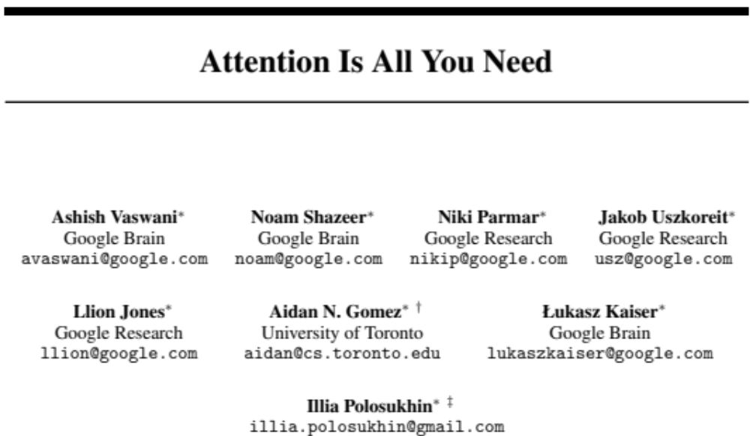
LLMs are built out of transformers
Transformer: a specific kind of network architecture, like a fancier feedforward network, but based on attention
Notes:
D

Slide 3
A very approximate timeline
1990 Static Word Embeddings
2003 Neural Language Model
2008 Multi-Task Learning
2015 Attention
2017 Transformer
2018 Contextual Word Embeddings and Pretraining
2019 Prompting

Slide 4
Transformers
Attention

Slide 5
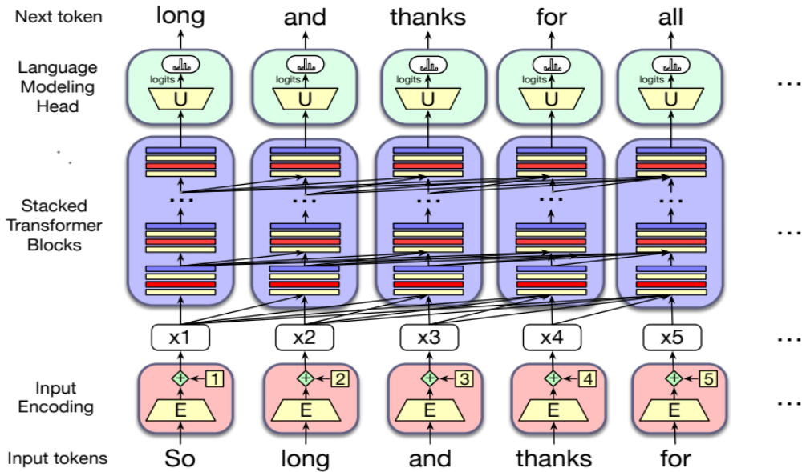


Instead of starting with the big picture
Let's consider the embeddings for an individual word from a particular layer

Slide 6

Problem with static embeddings (word2vec)
They are static! The embedding for a word doesn't reflect how its meaning changes in context.
The chicken didn't cross the road because it was too tired
What is the meaning represented in the static embedding for "it"?
Notes:
D

Slide 7
Contextual Embeddings
Intuition: a representation of meaning of a word should be different in different contexts!
Contextual Embedding: each word has a different vector that expresses different meanings depending on the surrounding words
How to compute contextual embeddings?
  Attention

Slide 8
Contextual Embeddings
The chicken didn't cross the road because it
What should be the properties of "it"?
The chicken didn't cross the road because it was too tired
The chicken didn't cross the road because it was too wide
At this point in the sentence, it's probably referring to either the chicken or the street
Notes:
But the static meaning of "it" can't represent that, it just means "I am a non-human pronoun".

Slide 9
Intuition of attention
Build up the contextual embedding from a word by selectively integrating information from all the neighboring words
We say that a word "attends to" some neighboring words more than others

Slide 10
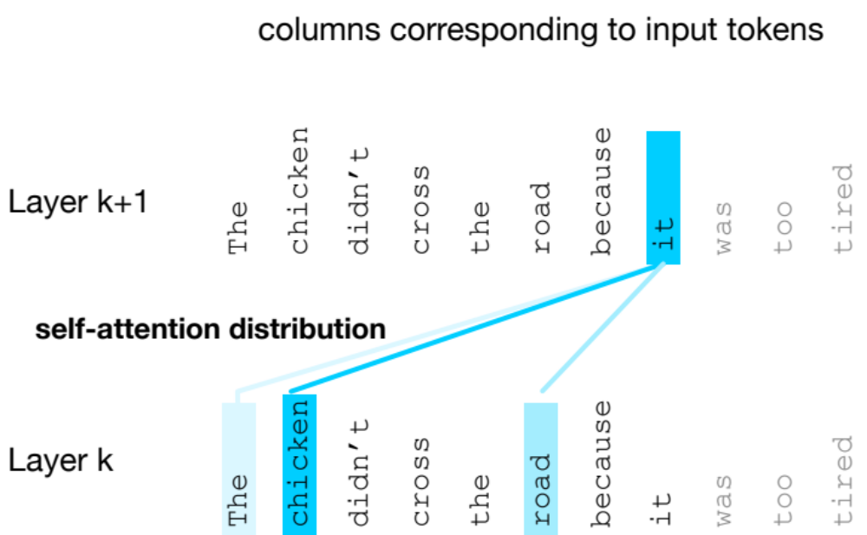
Intuition of attention:
test
Notes:
D

Slide 11
Attention definition
A mechanism for helping compute the embedding for a token by selectively attending to and integrating information from surrounding tokens (at the previous layer).
More formally: a method for doing a weighted sum of vectors.
Notes:
D

Slide 12
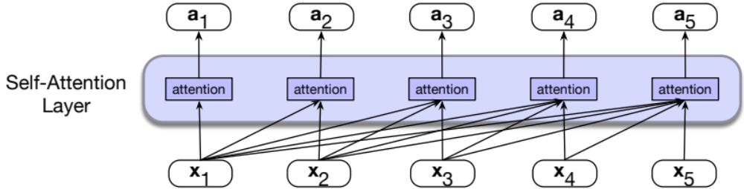
Attention is left-to-right

Slide 13
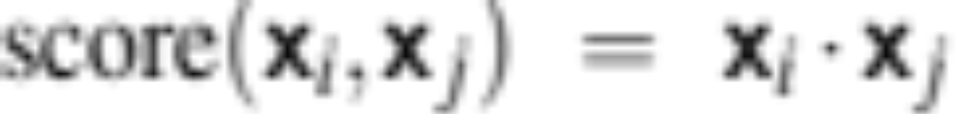
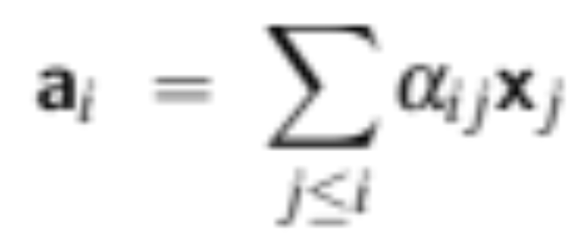
Simplified version of attention: a sum of prior words weighted by their similarity with the current word
Given a sequence of token embeddings:
x₁ x₂ x₃ x₄ x₅ x₆ x₇ x_{i}
Produce: a_{i} = a weighted sum of x₁ through x₇ (and x_{i})
Weighted by their similarity to x_{i}
Notes:
D

Slide 14
Intuition of attention:
test
x1 x2 x3 x4 x5 x6 x7 xi
Notes:
D

Slide 15
An Actual Attention Head: slightly more complicated
High-level idea: instead of using vectors (like x_{i} and x₄) directly, we'll represent 3 separate roles each vector x_{i} plays:
query: As the current element being compared to the preceding inputs.
key: as a preceding input that is being compared to the current element to determine a similarity
value: a value of a preceding element that gets weighted and summed
Notes:
The word head is used in transformers to refer to specific structured layers

Slide 16
Attention intuition
query
x1 x2 x3 x4 x5 x6 x7 xi
values
Notes:
D

Slide 17
Intuition of attention:
query
x1 x2 x3 x4 x5 x6 x7 xi
keys
k
k
k
k
k
k
k
k
values
v
v
v
v
v
v
v
v
Notes:
D

Slide 18
An Actual Attention Head: slightly more complicated
We'll use matrices to project each vector x_{i} into a representation of its role as query, key, value:
query: W^{Q}
key: W^{K}
value: W^{V}

Slide 19
An Actual Attention Head: slightly more complicated
Given these 3 representation of x_{i}
To compute similarity of current element x_{i} with some prior element x_{j}
We’ll use dot product between q_{i} and k_{j}.
And instead of summing up x_{j} , we'll sum up v_{j}

Slide 20
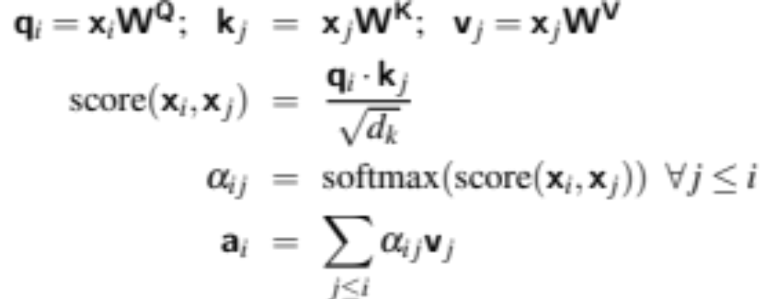
Final equations for one attention head
Notes:
the result of a dot product can be an arbitrarily large (positive or negative) value, and exponentiating large values can lead to numerical issues and loss of gradients during training. To avoid this, we scale the dot product by a factor related to the size of the embeddings, via diving by the square root of the dimensionality of the query and key vectors (dk).

Slide 21
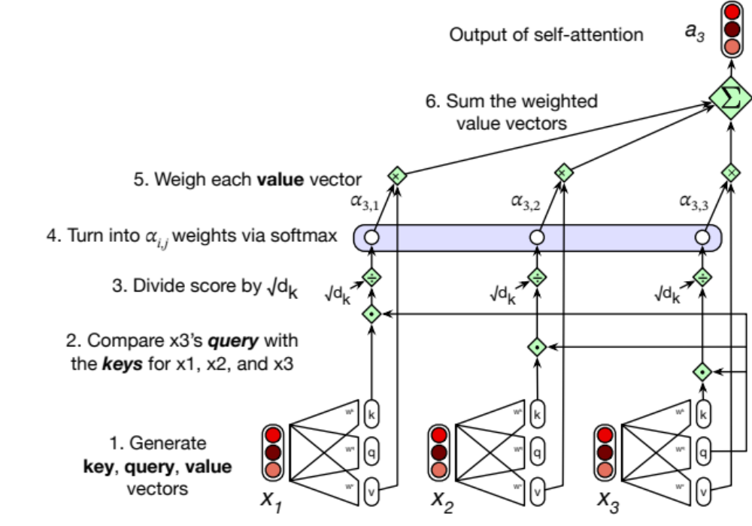
Calculating the value of a3

Slide 22
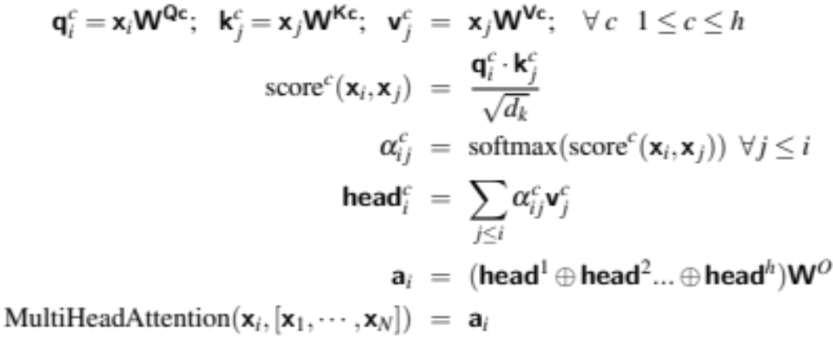
Actual Attention: slightly more complicated
Instead of one attention head, we'll have lots of them!
Intuition: each head might be attending to the context for different purposes
  Different linguistic relationships or patterns in the context
Notes:
Up to 128 in Lllama3 405B

Slide 23
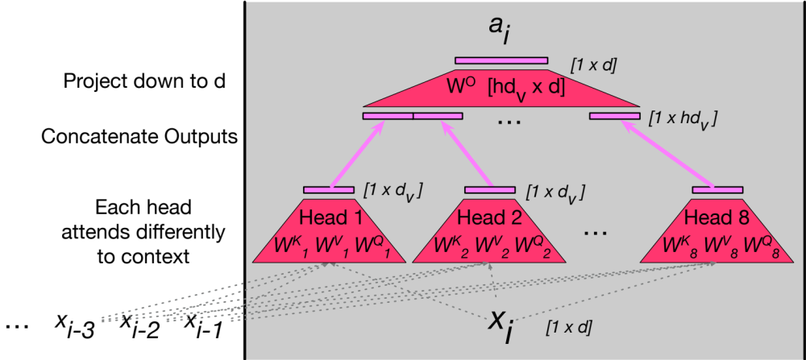
Multi-head attention

Slide 24
Summary
Attention is a method for enriching the representation of a token by incorporating contextual information
The result: the embedding for each word will be different in different contexts!
Contextual embeddings: a representation of word meaning in its context.
We'll see in the next lecture that attention can also be viewed as a way to move information from one token to another.

Slide 25
Transformers
Attention

Slide 26
Transformers
The Transformer Block

Slide 27

Reminder: transformer language model

Slide 28
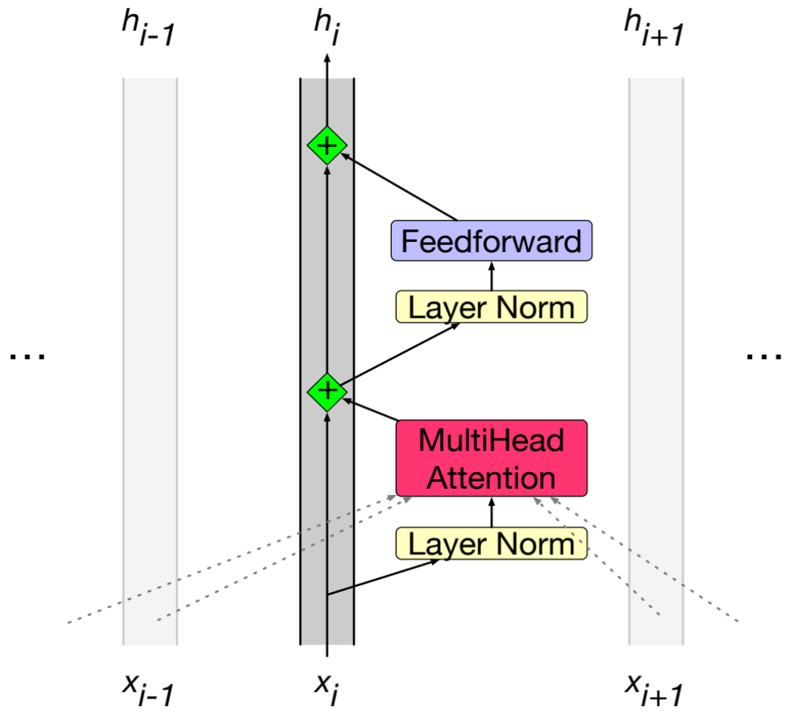
The residual stream: each token gets passed up and modified
Notes:
Technically this is the prenorm arechitrecture; there is an older "postnorm" architecture with the layer norms after the feedforward.

Slide 29
We'll need nonlinearities, so a feedforward layer
Notes:
The weights are the same for each token position i , but are different from layer to layer. It is common to make the dimensionality dff of the hidden layer of the feedforward network be larger than the model dimensionality d. (For example in the original transformer model, d = 512 and dff = 2048.)

Slide 30
Layer norm: the vector x_{i} is normalized twice
Notes:
The weights are the same for each token position i , but are different from layer to layer. It is common to make the dimensionality dff of the hidden layer of the feedforward network be larger than the model dimensionality d. (For example in the original transformer model, d = 512 and dff = 2048.)

Slide 31
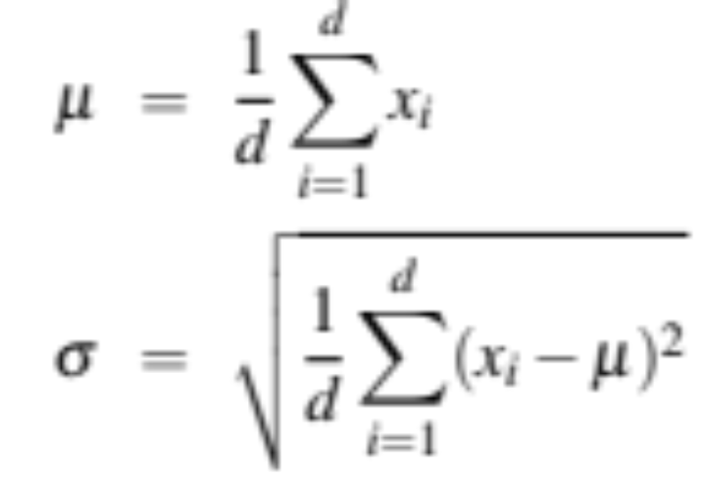
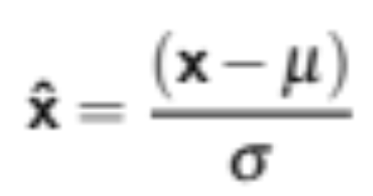
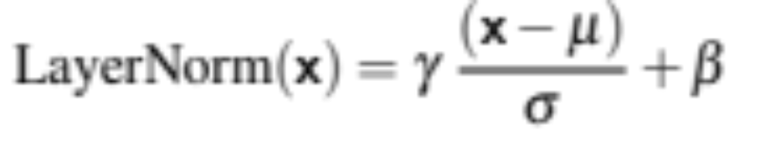
Layer Norm
Layer norm is a variation of the z-score from statistics, applied to a single vec- tor in a hidden layer
Notes:
the term layer norm is a bit confusing; layer norm is not applied to an entire transformer layer, but just to the embedding vector of a single token. Thus the input to layer norm is a single vector of dimensionality d and the output is that vector normalized, again of dimensionality d

Slide 32
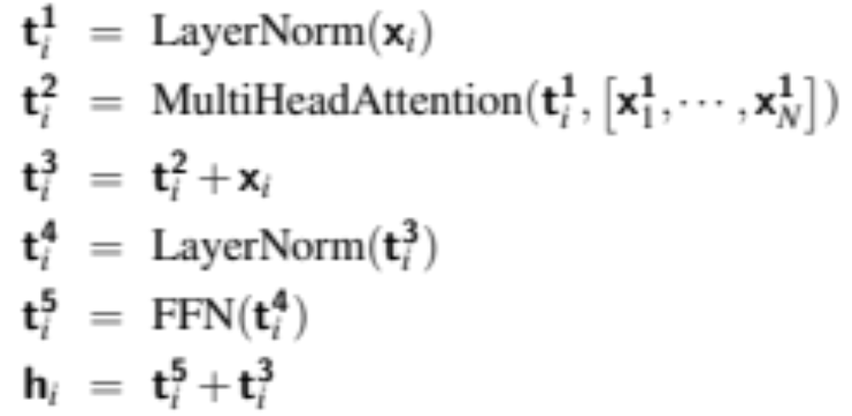
Putting together a single transformer block

Slide 33
A transformer is a stack of these blocks so all the vectors are of the same dimensionality d
Block 2
Block 1

Slide 34
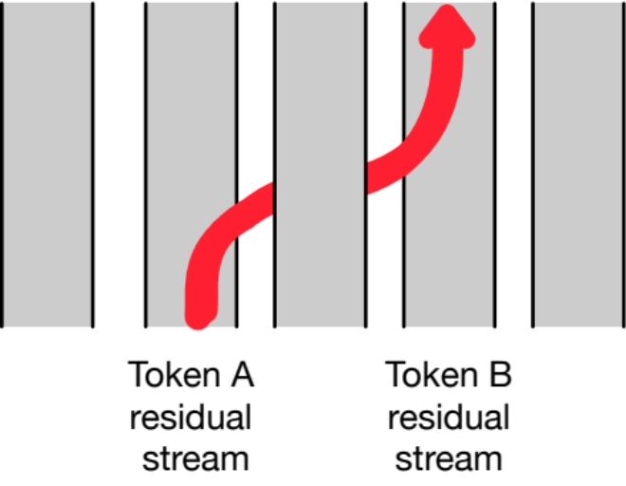
Residual streams and attention
Notice that all parts of the transformer block apply to 1 residual stream (1 token).
Except attention, which takes information from other tokens
Elhage et al. (2021) show that we can view attention heads as literally moving information from the residual stream of a neighboring token into the current stream .

Slide 35
Transformers
The Transformer Block

Slide 36
Transformers
Parallelizing Attention Computation

Slide 37
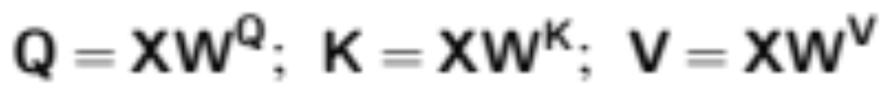
Parallelizing computation using X
For attention/transformer block we've been computing a single output at a single time step i in a single residual stream.
But we can pack the N tokens of the input sequence into a single matrix X of size [N × d].
Each row of X is the embedding of one token of the input.
X can have 1K-32K rows, each of the dimensionality of the embedding d (the model dimension)

Slide 38
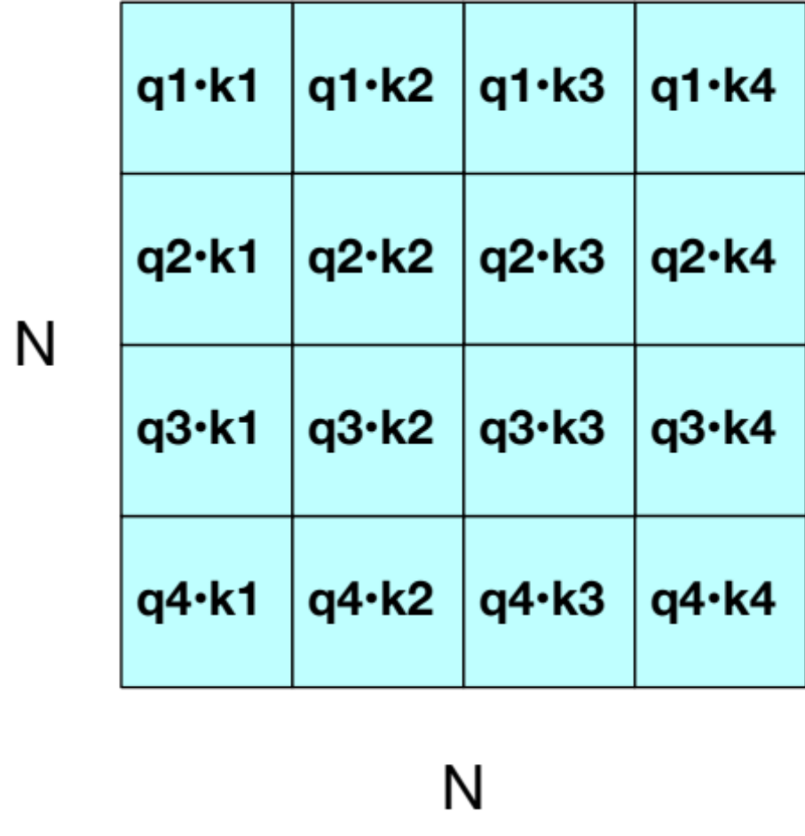
QK^{T}
Now can do a single matrix multiply to combine Q and K^{T}

Slide 39
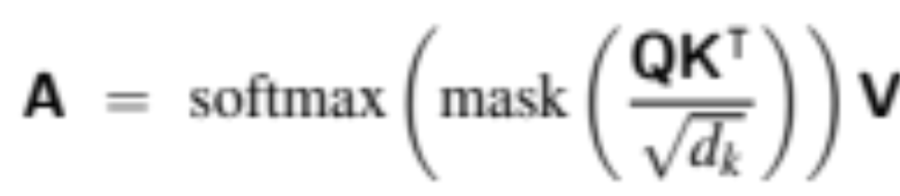
Parallelizing attention
Scale the scores, take the softmax, and then multiply the result by V resulting in a matrix of shape N × d
  An attention vector for each input token

Slide 40
Masking out the future
What is this mask function?
QK^{T} has a score for each query dot every key, including those that follow the query.
Guessing the next word is pretty simple if you already know it!

Slide 41
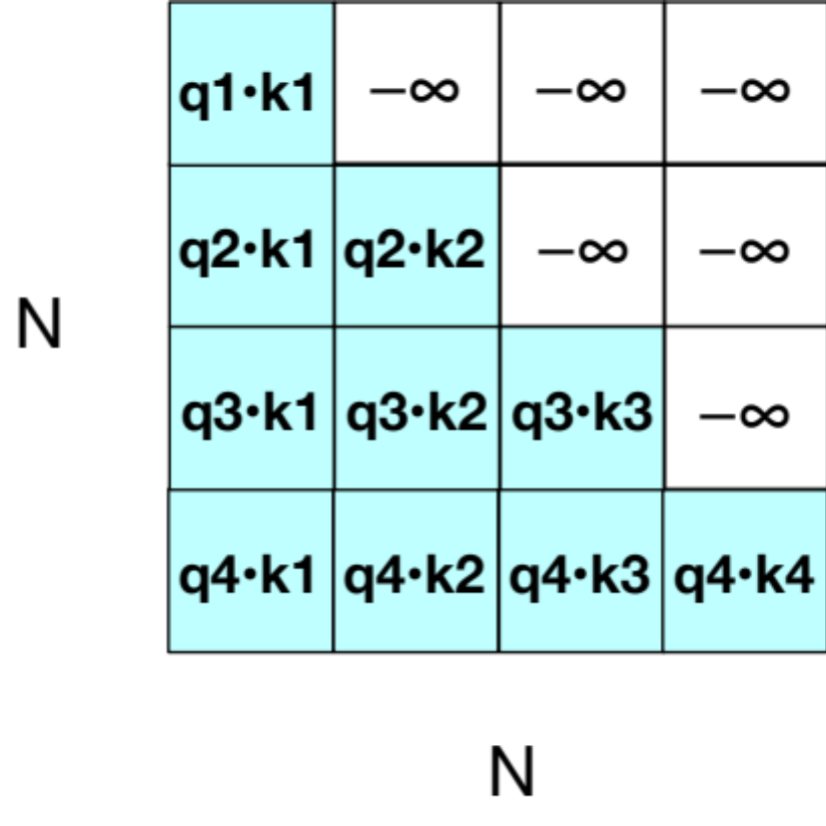
Masking out the future
Add –∞ to cells in upper triangle
The softmax will turn it to 0

Slide 42
Another point: Attention is quadratic in length

Slide 43
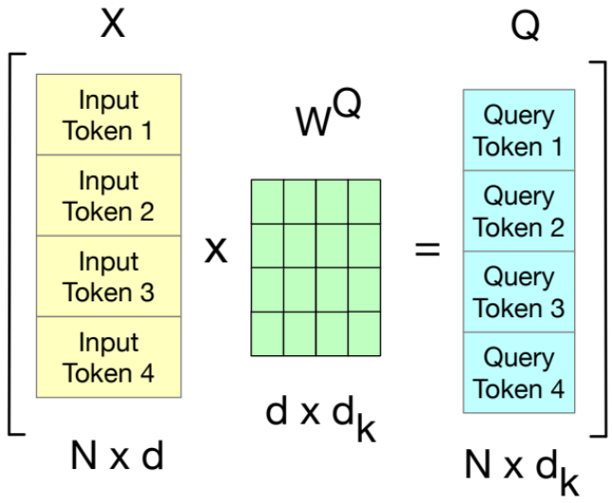
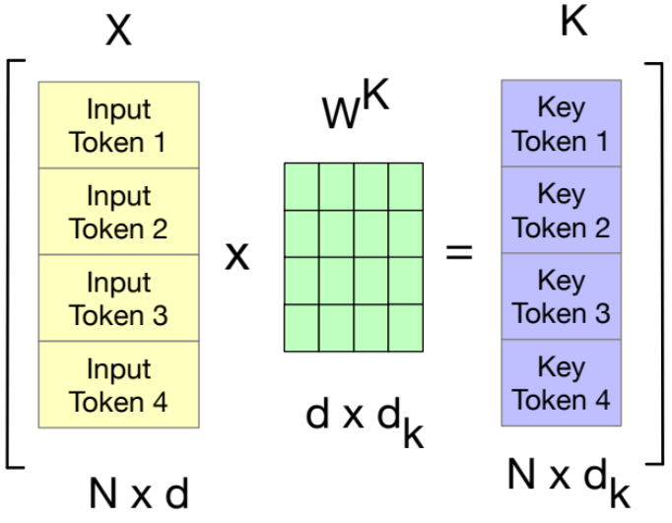
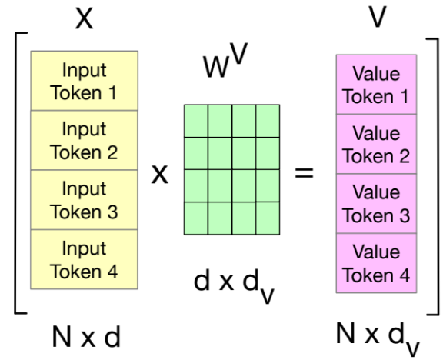
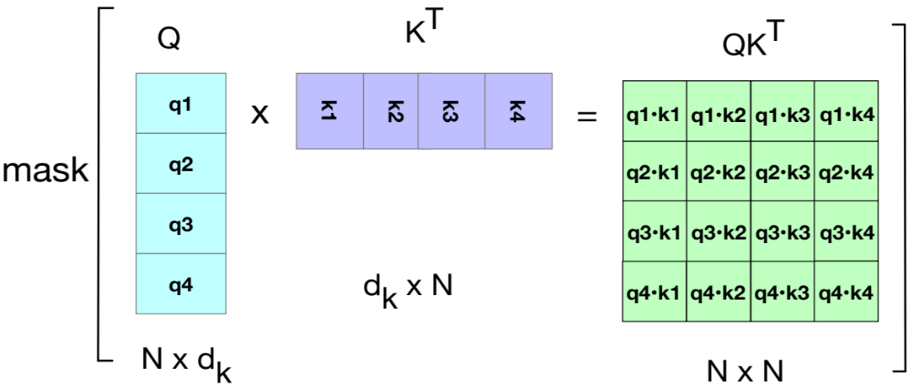
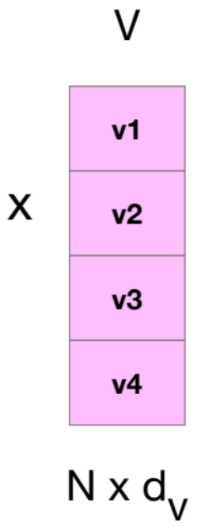
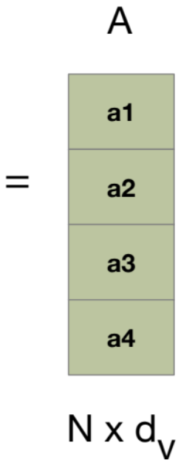
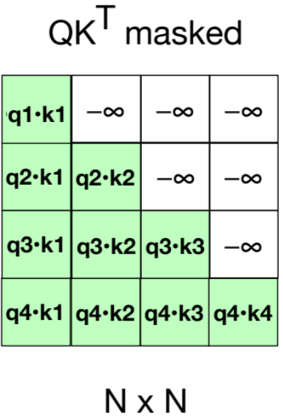
Attention again

Slide 44
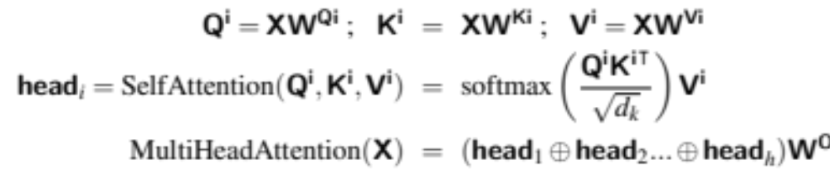
Parallelizing Multi-head Attention

Slide 45
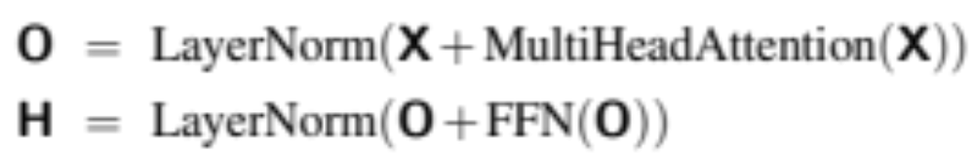
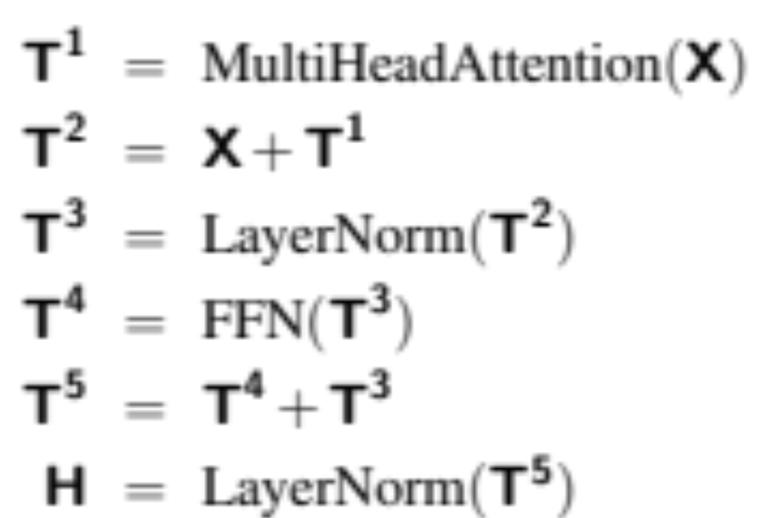
Parallelizing Multi-head Attention
or

Slide 46
Transformers
Parallelizing Attention Computation

Slide 47
Transformers
Input and output: Position embeddings and the Language Model Head

Slide 48
Token and Position Embeddings
The matrix X (of shape [N × d]) has an embedding for each word in the context.
This embedding is created by adding two distinct embedding for each input
token embedding
positional embedding

Slide 49
Token Embeddings
Embedding matrix E has shape [|V | × d ].
One row for each of the |V | tokens in the vocabulary.
Each word is a row vector of d dimensions
Given: string "Thanks for all the"
1. Tokenize with BPE and convert into vocab indices
w = [5,4000,10532,2224]
2. Select the corresponding rows from E, each row an embedding
(row 5, row 4000, row 10532, row 2224).

Slide 50
Position Embeddings
There are many methods, but we'll just describe the simplest: absolute position.
Goal: learn a position embedding matrix Epos of shape [1 × N ].
Start with randomly initialized embeddings
one for each integer up to some maximum length.
i.e., just as we have an embedding for token fish, we’ll have an embedding for position 3 and position 17.
As with word embeddings, these position embeddings are learned along with other parameters during training.

Slide 51
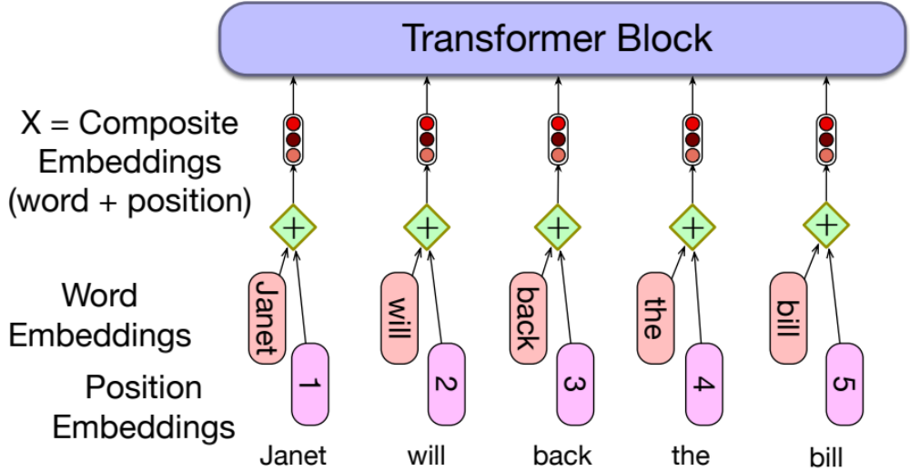
Each x is just the sum of word and position embeddings

Slide 52
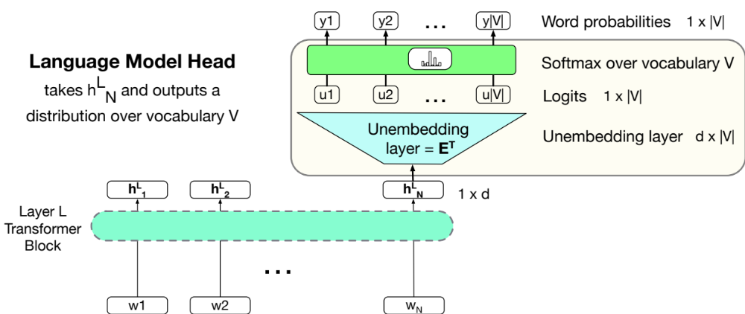
Language modeling head

Slide 53
Language modeling head
Unembedding layer: linear layer projects from h^{L}_{N} (shape [1 × d]) to logit vector
Why "unembedding"? Tied to E^{T}
Weight tying, we use the same weights for two different matrices
Unembedding layer maps from an embedding to a 1x|V| vector of logits

Slide 54
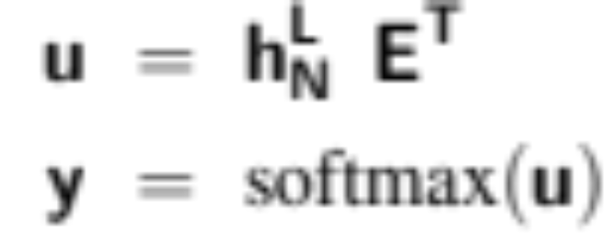
Language modeling head
Logits, the score vector u
One score for each of the |V | possible words in the vocabulary V . Shape 1 × |V |.
Softmax turns the logits into probabilities over vocabulary. Shape 1 × |V |.

Slide 55
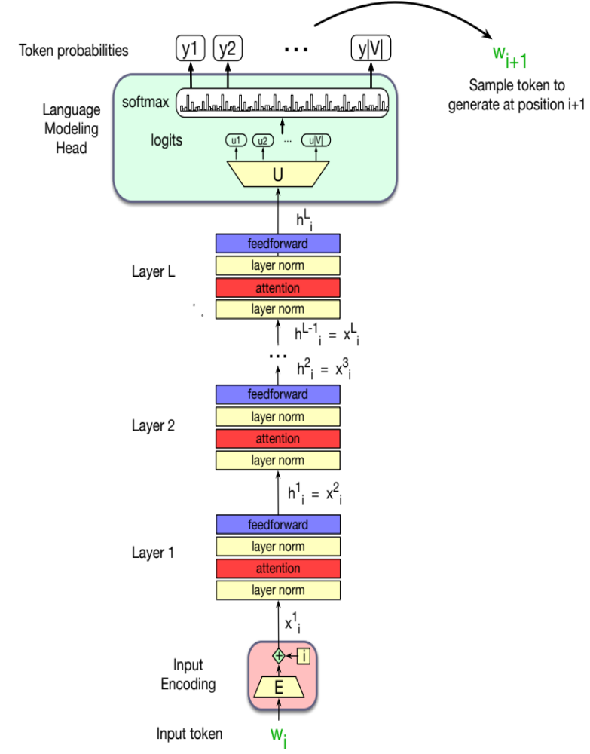
The final transformer model

Slide 56
Transformers
Input and output: Position embeddings and the Language Model Head

Slide 57
Large Language Models
Dealing with Scale

Slide 58
Scaling Laws
LLM performance depends on
Model size: the number of parameters not counting embeddings
Dataset size: the amount of training data
Compute: Amount of compute (in FLOPS or etc
Can improve a model by adding parameters (more layers, wider contexts), more data, or training for more iterations
The performance of a large language model (the loss) scales as a power-law with each of these three

Slide 59
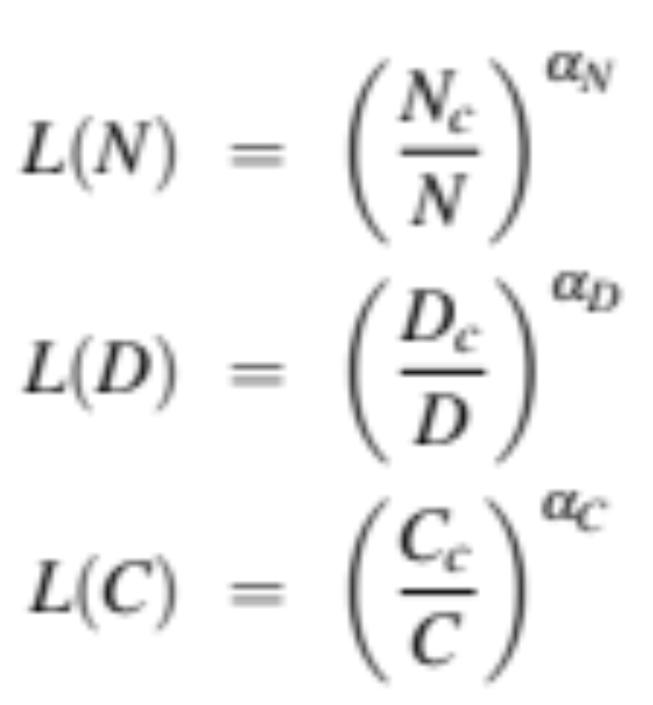
Scaling Laws
Loss L as a function of # parameters N, dataset size D, compute budget C (if other two are held constant)
Scaling laws can be used early in training to predict what the loss would be if we were to add more data or increase model size.
Notes:
The values of Nc, Dc, Cc, αN, αD, and αC depend on the exact transformer architecture, tokenization, and vocabulary size, so rather than all the precise values, scaling laws focus on the relationship with loss.2

Slide 60
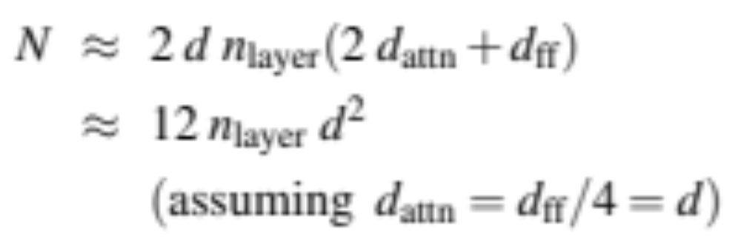
Number of non-embedding parameters N
Thus GPT-3, with n = 96 layers and dimensionality d = 12288, has 12 × 96 × 122882 ≈ 175 billion parameters.

Slide 61
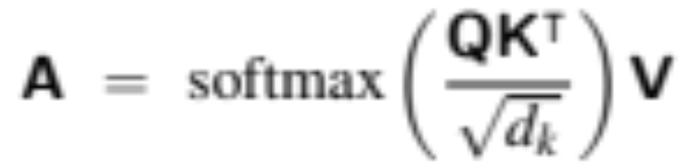
KV Cache
In training, we can compute attention very efficiently in parallel:
But not at inference! We generate the next tokens one at a time!
For a new token x, need to multiply by W^{Q}, W^{K}, and W^{V} to get query, key, values
But don't want to recompute the key and value vectors for all the prior tokens x_{<i}
Instead, store key and value vectors in memory in the KV cache, and then we can just grab them from the cache

Slide 62
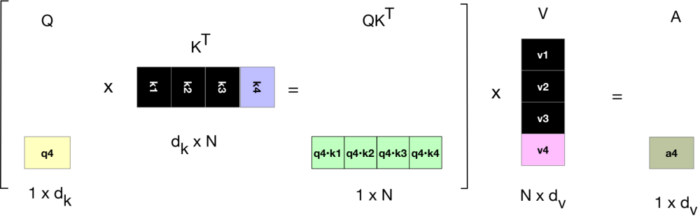
KV Cache
Notes:
showing, in black, the vectors that can be stored in the cache rather than recomputed when computing the atten- tion score for the 4th token.

Slide 63
Parameter-Efficient Finetuning
Adapting to a new domain by continued pretraining (finetuning) is a problem with huge LLMs.
Enormous numbers of parameters to train
Each pass of batch gradient descent has to backpropagate through many many huge layers.
Expensive in processing power, in memory, and in time.
Instead, parameter-efficient fine tuning (PEFT)
Efficiently select a subset of parameters to update when finetuning.
E.g., freeze some of the parameters (don’t change them),
And only update some a few parameters.

Slide 64
LoRA (Low-Rank Adaptation)
Trransformers have many dense matrix multiply layers
  Like W^{Q}, W^{K}, W^{V}, W^{O} layers in attention
Instead of updating these layers during finetuning,
  Freeze these layers
  Update a low-rank approximation with fewer parameters.

Slide 65
LoRA
Consider a matrix W (shape [N × d]) that needs to be updated during finetuning via gradient descent.
  Normally updates are ∆W (shape [N × d])
In LoRA, we freeze W and update instead a low-rank decomposition of W:
  A of shape [N×r],
  B of shape [r×d], r is very small (like 1 or 2)
  That is, during finetuning we update A and B instead of W.
  Replace W + ∆W with W + BA.
Forward pass: instead of
h = xW
We do
h = xW + xAB

Slide 66
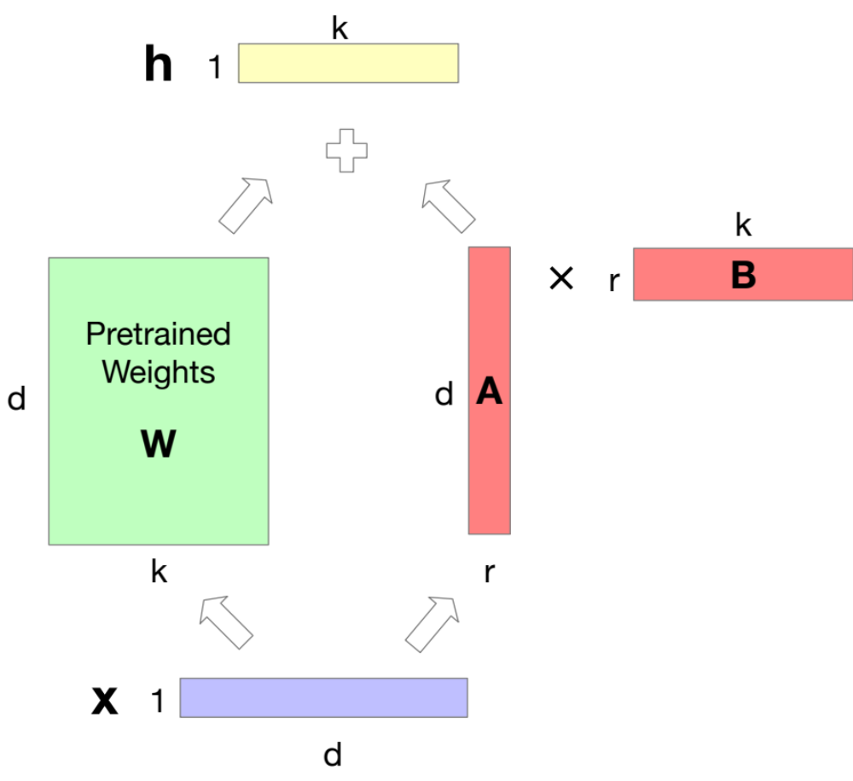
LoRA
Notes:
We freeze W to its pretrained values, and instead finetune by training a pair of matrices A and B, updating those instead of W, and just sum W and the updated AB.

Slide 67
Large Language Models
Dealing with Scale

