Slide 1
Where, Who, and How? Spatial Effects on Auction Outcomes and Bidder Strategy
Pratham Soni

Slide 2
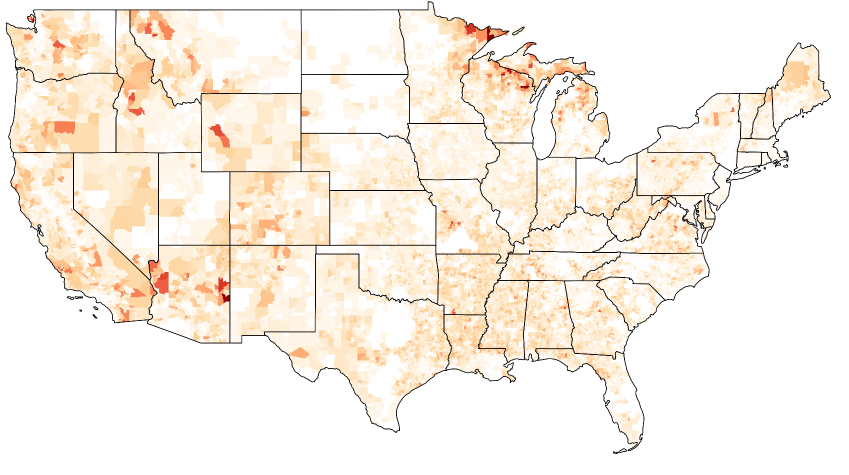
Notes:
Complain about stanford wifi but much of the us has far slower internet access
Universal service has long been limited by technological, demographic, and economic constraints
Huge sums of money mean huge desires for efficiency

Slide 3



Auction Inefficiencies
Unallocated
Unallocated
Total Subsidy Dollars
Locations
Unallocated
CBGs
Notes:
Experts have pointed out that auctions can provide an efficient solution
Lots of studies into allocative efficiency but still some CBGS not allocated
4600 CBGs and 75,000 locations unassigned
Can we use subsidy more efficiently to get the last mose expensive CBGs/locations

Slide 4
Motivation
Success dependent on (Baumol et al.):
Definition of project regions
Metrics for scoring project propositions, effective supply, and cost of bids
A variety of potential geospatial constraints
Pay-as-bid pricing
Notes:
Success dependent on these factors:
Of these geospatial considerations are the most varied with potential constraints like imposing a cap on winning regions for any particular bidder and limited budget per region across multiple regions as methods to improve competition and distribute resources geographically

Slide 5
Central Question
How does the geospatial organization of bidders relative to their existing footprints impact behavior and auction outcomes through valuation and competitive effects?
Notes:
Success dependent on these factors:
Of these geospatial considerations are the most varied with potential constraints like imposing a cap on winning regions for any particular bidder and limited budget per region across multiple regions as methods to improve competition and distribute resources geographically

Slide 6
Summary
Bidders with existing service go 0.2 rounds further than those without
Second-place bidders with existing service push winners by 0.7-0.8 rounds more than those without
Satellite bidders win 3.2 rounds earlier than bidders without existing service
Terrestrial bidders win 3.9 rounds earlier against satellite bidders
Results robust to bidder entity fixed effects
Notes:
Preview of results

Slide 7
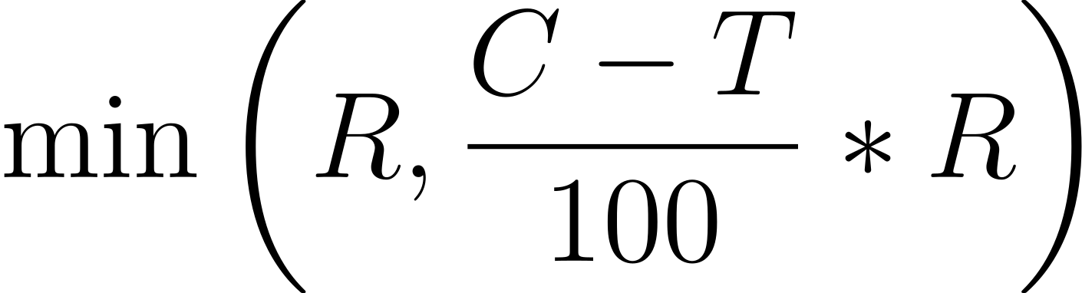
Auction Mechanism
Simultaneous reverse clock auction across 19 rounds (clock price C falls from 180 to 1 in increments of 10)
Reserve price R for each CBG set by FCC cost model
Each bidder is assigned penalty weight T
Min bid price:

Slide 8
Auction Mechanism
Clearing round is first round where total bids below allocated subsidy (round 13)
After round 13, only bidders with lowest T continue
We treat package bidding as regular bidding (7.6% of CBGs)

Slide 9
Modeling
Construct dummy variables representing relationship of bid to footprint (existing/neighboring/wild tract)
Terrestrial bidders only (satellite bidders separate)
We are also interested in the characteristics of second-place bidders

Slide 10



Dummy Variables
Satellite
Existing
Neighboring
Wild Tract
Notes:
Motivate geospatial effects because of infrastructure costs

Slide 11
Dummy Variables
Satellite
Existing
Neighboring
Wild Tract
Notes:
Motivate geospatial effects because of infrastructure costs

Slide 12
Dummy Variables
Satellite
Existing
Neighboring
Wild Tract
Notes:
Motivate geospatial effects because of infrastructure costs

Slide 13
Dummy Variables
Satellite
Existing
Neighboring
Wild Tract
Notes:
Motivate geospatial effects because of infrastructure costs

Slide 14
Dummy Variables
Satellite
Existing
Neighboring
Wild Tract
Notes:
Motivate geospatial effects because of infrastructure costs

Slide 15
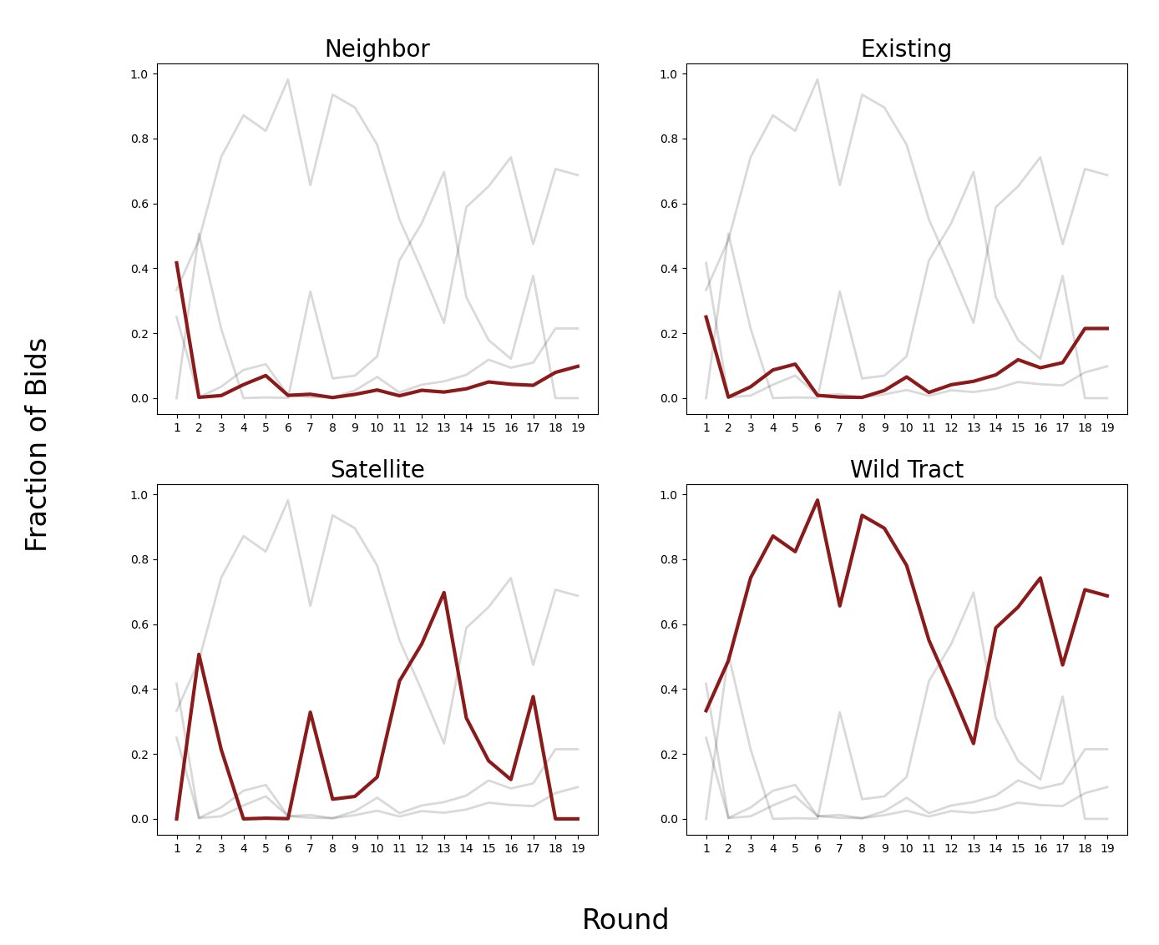
Composition of Bids
Notes:
Will convert this to sparklines for clarity

Slide 16
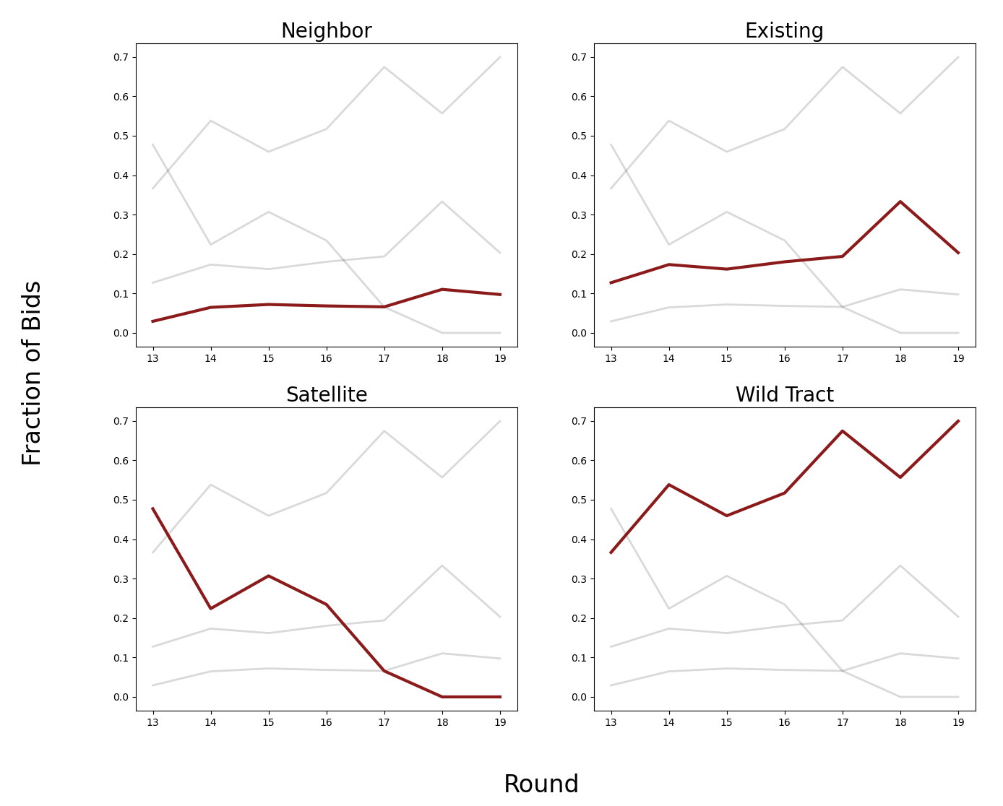
Composition of Winning Bids
Notes:
Will convert this to sparklines for clarity

Slide 17
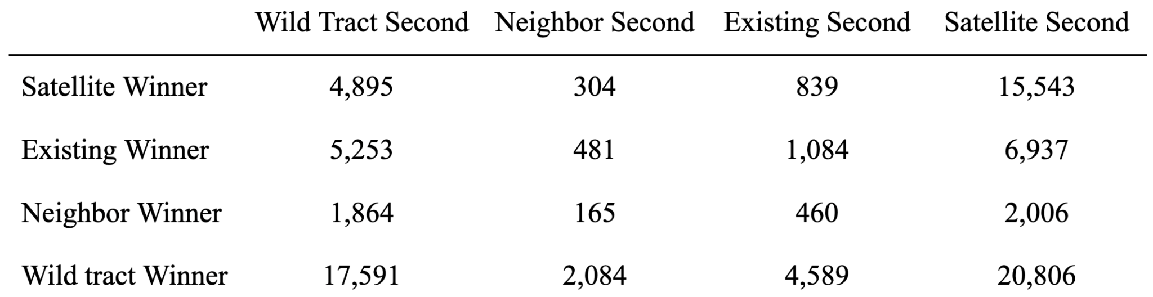
Competitive Interaction

Slide 18
Competitive Interaction

Slide 19
Competitive Interaction

Slide 20
Competitive Interaction

Slide 21
Modeling
Measure explicit distance between bid and closest CBG in footprint
Distance
Existing Service
Bid

Slide 22
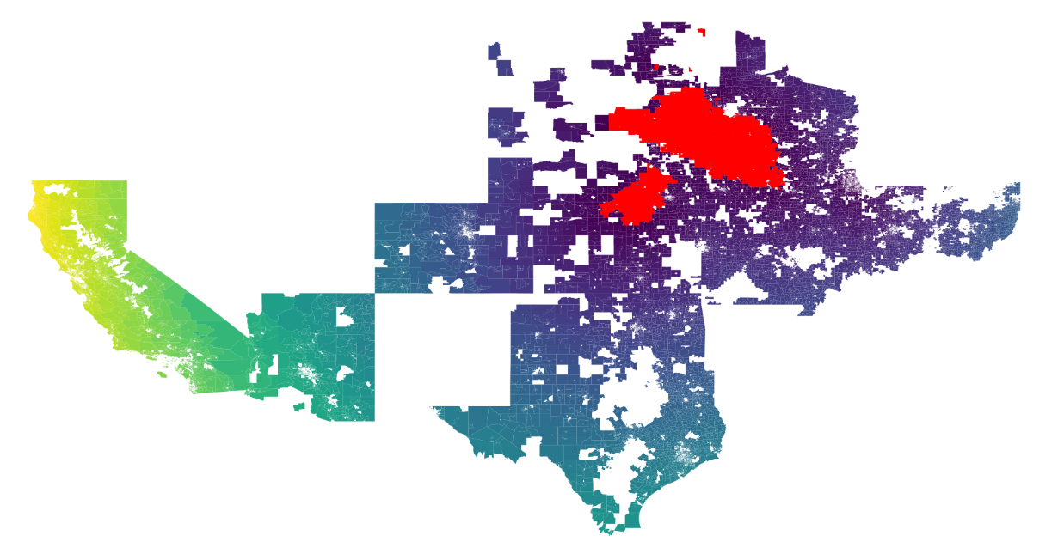
Bid Distances

Slide 23
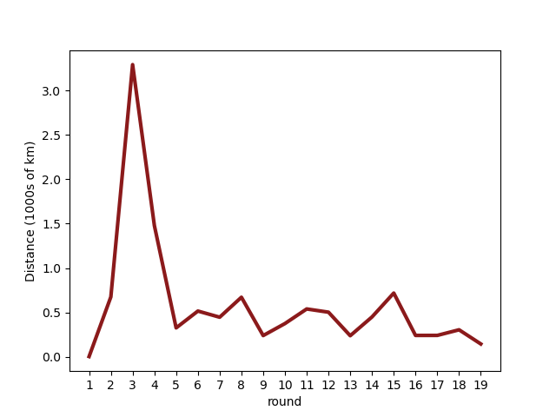
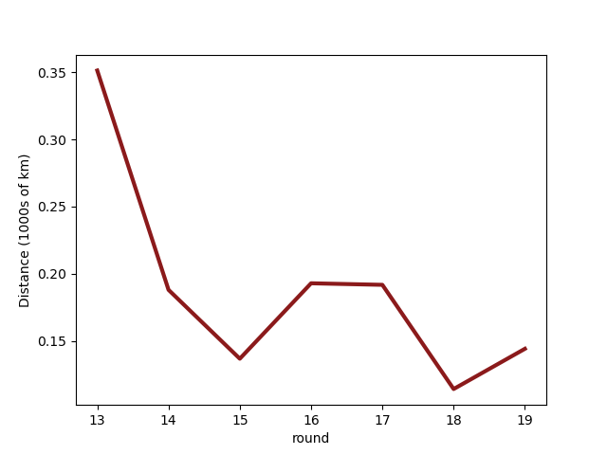
Bid Distances
Average Bid Distance
Average Winning Bid Distance

Slide 24
Modeling
Dummy Variables:
Distances:
c: population controls
l: number of locations
d: dummy variables (winner)
s: dummy variables (second-place)
distance: distance from bid to footprint

Slide 25
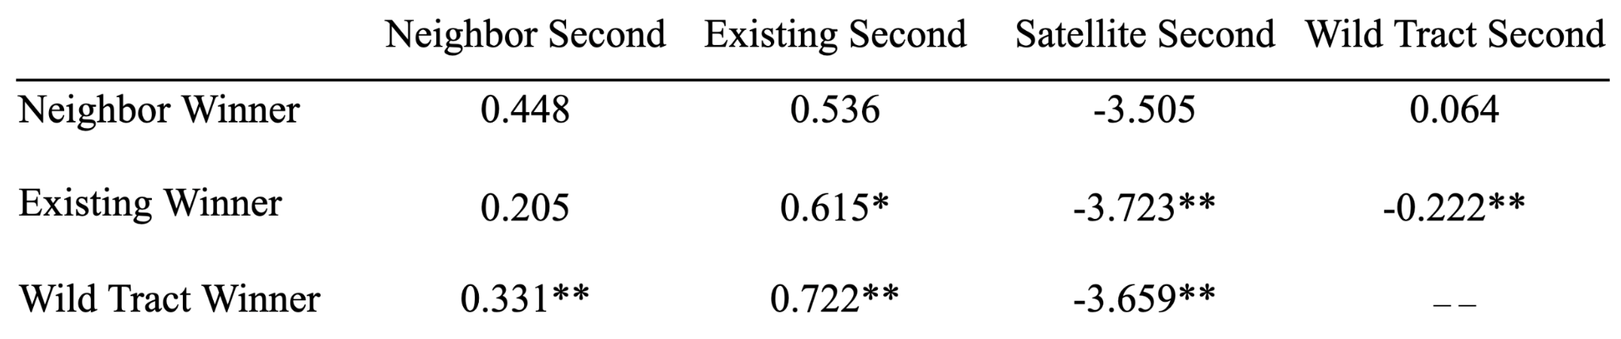
Dummy Variables

Slide 26
Dummy Variables

Slide 27
Dummy Variables

Slide 28
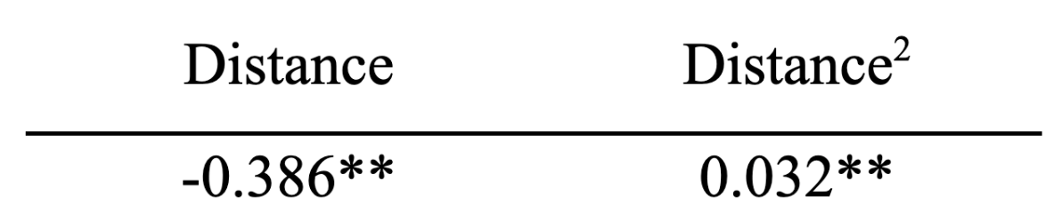
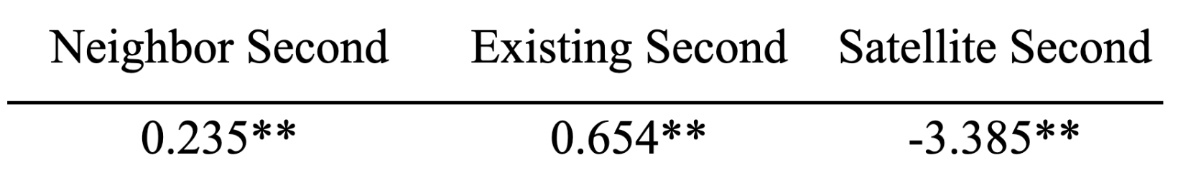
Distances

Slide 29
Distances

Slide 30
Distances

Slide 31
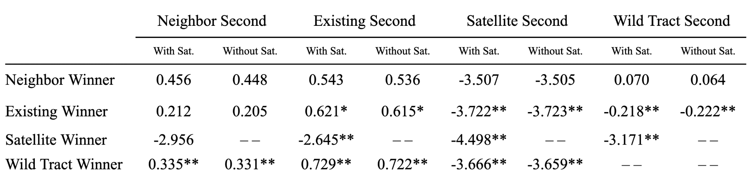
Including Satellite Winners

Slide 32
Including Satellite Winners

Slide 33
Including Satellite Winners

Slide 34
Including Satellite Winners

Slide 35
Including Satellite Winners

Slide 36
Conclusion
Explain bidder strategy in terms of neighboring/existing effects, competitive effects, and explicit distance-based effects
Competition is the dominating effect
  Terrestrial: geospatial organization determines competitive power
  Satellites: Limited by T+L penalty
Raw distance provides a good measurement for the difficulty of extending service

Slide 37
Conclusion
Gap between bidder value and auction outcome
Improve public good by adjusting CAM, T+L weight regime, or round discount scaling
Money saved in competitive CBGs can be reallocated for more expensive CBGs

Slide 39
Appendix

Slide 40
Reserve Price
capital expenses
operating expenses
annual charge factors
busy hour bandwidth
business and residential take rate
company size classifications
company size purchasing power
plant mix
property tax
regional cost adjustments
percentage of buried plant placed in conduit
state sales tax

Slide 41
Package Bidding
bidder specifies a package of CBGs to bid on and a “minimum scale percentage”
Decreases aggregate competition
Strengthens individual bidders
~62% of the CBGs won by package bids were won in round 13

Slide 42
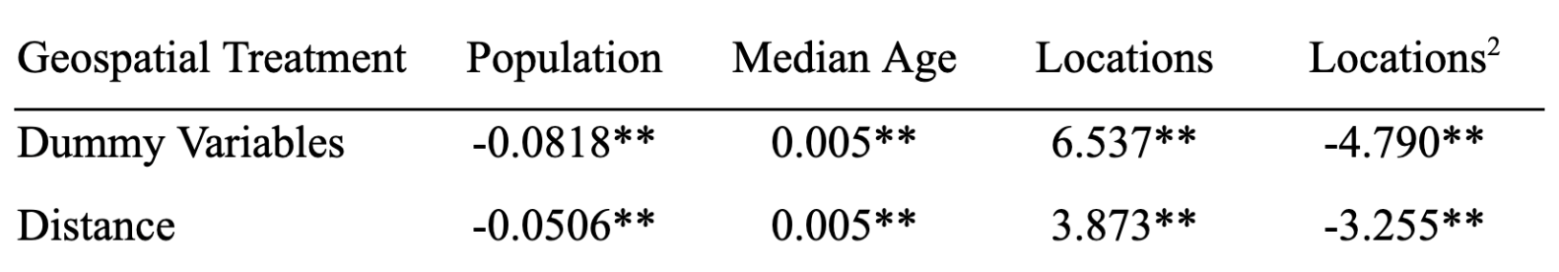
Comparing Controls

Slide 43
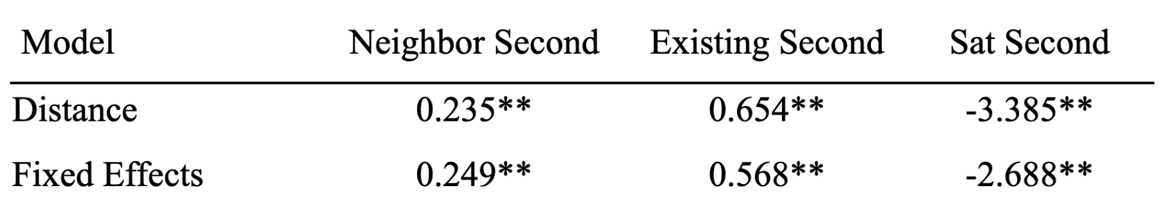
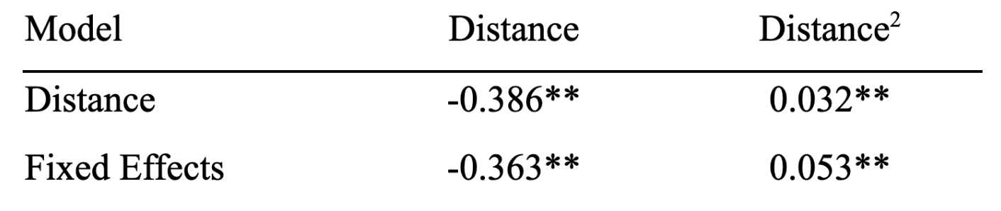
Bidder Fixed Effects

