Slide 1
Selectional Restrictions

Slide 2
Selectional Restrictions
Introduction

Slide 3
Selectional Restrictions
Consider the two interpretations of:
I want to eat someplace nearby.
sensible:
  Eat is intransitive and “someplace nearby” is a location adjunct
Speaker is Godzilla
Eat is transitive and “someplace nearby” is a direct object
How do we know speaker didn’t mean b) ?
Because the Theme of eating tends to be something edible

Slide 4
Selectional restrictions are associated with senses
The restaurant serves green-lipped mussels.
  Theme is some kind of food
Which airlines serve Denver?
  Theme is an appropriate location

Slide 5
Selectional restrictions vary in specificity
I often ask the musicians to imagine a tennis game.
To diagonalize a matrix is to find its eigenvalues.
Radon is an odorless gas that can’t be detected by human senses.

Slide 6
Representing selectional restrictions
Instead of representing “eat” as:
Just add:
And “eat a hamburger” becomes
But this assumes we have a large knowledge base of facts about edible things and hamburgers and whatnot.

Slide 7
Let’s use WordNet synsets to specify selectional restrictions
The theme of eat must be WordNet synset {food, nutrient}
  “any substance that can be metabolized by an animal to give energy and build tissue”
Similarly
  theme of imagine: synset {entity}
  theme of lift: synset {physical entity}
  theme of diagonalize: synset {matrix}
This allows
  imagine a hamburger and lift a hamburger,
Correctly rules out
  diagonalize a hamburger.

Slide 8
Selectional Restrictions
Selectional Preferences

Slide 9
Selectional Preferences
In early implementations, selectional restrictions were strict constraints (Katz and Fodor 1963)
  Eat [+FOOD]
But it was quickly realized selectional constraints are really preferences (Wilks 1975)
  But it fell apart in 1931, perhaps because people realized you can’t eat gold for lunch if you’re hungry.
  In his two championship trials, Mr. Kulkarni ate glass on an empty stomach, accompanied only by water and tea.

Slide 10
Selectional Association (Resnik 1993)
Selectional preference strength: amount of information that a predicate tells us about the semantic class of its arguments.
  eat tells us a lot about the semantic class of its direct objects
  be doesn’t tell us much
The selectional preference strength
  difference in information between two distributions:
    P(c) the distribution of expected semantic classes for any direct object
    P(c|v) the distribution of expected semantic classes for this verb
  The greater the difference, the more the verb is constraining its object

Slide 11
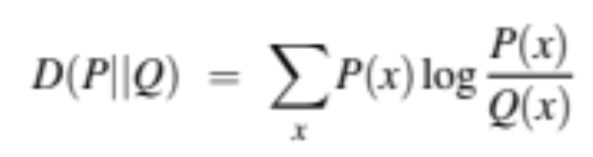
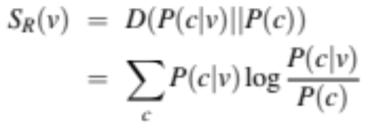
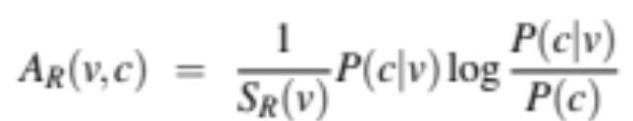
Selectional preference strength
Relative entropy, or the Kullback-Leibler divergence is the difference between two distributions
Selectional preference: How much information (in bits) the verb expresses about the semantic class of its argument
Selectional Association of a verb with a class: The relative contribution of the class to the general preference of the verb

Slide 12
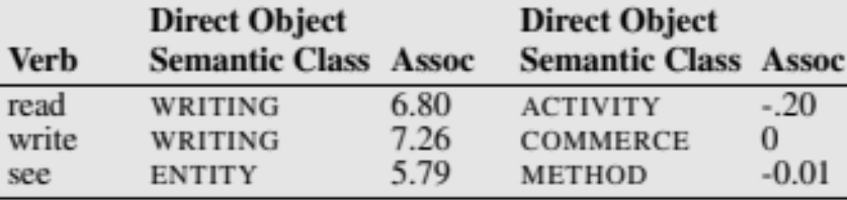
Computing Selectional Association
A probabilistic measure of the strength of association between a predicate and a semantic class of its argument
  Parse a corpus
  Count all the times each predicate appears with each argument word
  Assume each word is a partial observation of all the WordNet concepts associated with that word
  Some high and low associations:

Slide 13
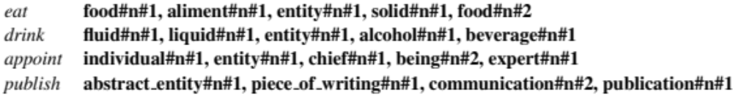
Results from similar models
Ó Séaghdha and Korhonen (2012)

Slide 14
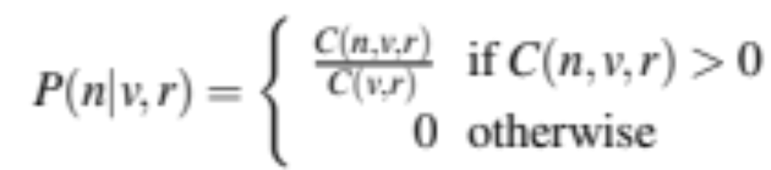
Instead of using classes, a simpler model of selectional association
Model just the association of predicate v with a noun n
  (one noun, as opposed to the whole semantic class in WordNet)
  Parse a huge corpus
  Count how often a noun n occurs in relation r with verb v:
    log count(n,v,r)
  Or the probability:

Slide 15
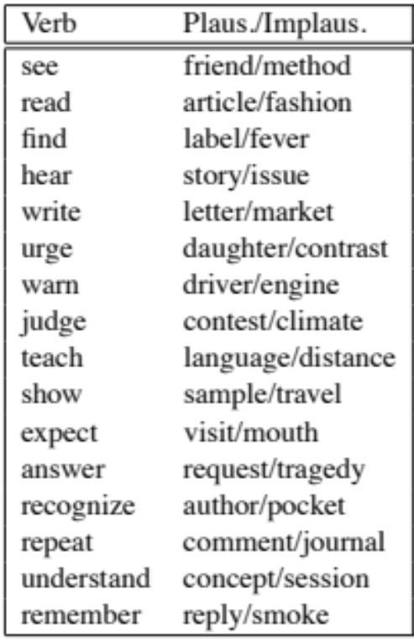
Evaluation from Bergsma, Lin, Goebel

Slide 16
Selectional Restrictions
Conclusion

Slide 17
Summary: Selectional Restrictions
Two classes of models of the semantic type constraint that a predicate places on its argument:
  Represent the constraint between predicate and WordNet class
  Represent the constraint between predicate and a word
One fun recent use case: detecting metonomy (type coercion)
  Coherent with selectional restrictions:
    The spokesman denied the statement (PROPOSITION).
    The child threw the stone (PHYSICAL OBJECT)
  Coercion:
    The president denied the attack (EVENT → PROPOSITION).
    The White House (LOCATION → HUMAN) denied the statement.
Pustejovsky et al (2010)

