Slide 1
Speech and Language Processsing
Dan Jurafsky and James Martin
Chapter 25: Conversational Agents

Slide 2
Conversational Agents
AKA Dialog Agents
Phone-based Personal Assistants
SIRI, Alexa, Cortana, Google Assistant
Talking to your car
Communicating with robots
Clinical uses for mental health
Chatting for fun

Slide 3
Two classes of systems
Chatbots
(Goal-based) Dialog agents
  - SIRI, interfaces to cars, robots,
  - booking flights or restaurants
The word "chatbots" is sometimes used in the popular press for both. We'll use it only for #1.

Slide 4
Part I: Chatbots!
ELIZA (1966)
PARRY (1968)
  The first system to pass the Turing test!!!!
ALICE
CLEVER
Microsoft Little Bing 小冰

Slide 5
Chatbot Architectures
Rule-based
  Pattern-action rules (Eliza)
  + a mental model (Parry)
Corpus-based (from large chat corpus)
  Information Retrieval
  Neural network encoder-decoder

Slide 6
Chatbots
Sometimes for fun
But originally designed as a testbed for clinical therapy
(And still used that way!)

Slide 7
Eliza: Weizenbaum (1966)
Men are all alike.
IN WHAT WAY
They're always bugging us about something or other.
CAN YOU THINK OF A SPECIFIC EXAMPLE
Well, my boyfriend made me come here.
YOUR BOYFRIEND MADE YOU COME HERE
He says I'm depressed much of the time.
I AM SORRY TO HEAR YOU ARE DEPRESSED
...
WHO ELSE IN YOUR FAMILY TAKES CARE 0F YOU?
My father
YOUR FATHER

Slide 8
You are like my father in some ways.
WHAT RESEMBLANCE DO YOU SEE
You are not very aggressive but I think you don’t want me to notice that.
WHAT MAKES YOU THINK I AM NOT AGGRESSIVE
You don’t argue with me.
WHY DO YOU THINK I DON’T ARGUE WITH YOU
You are afraid of me.
DOES IT PLEASE YOU TO BELIEVE I’M AFRAID OF YOU
My father is afraid of everybody.
WHAT ELSE COMES TO MIND WHEN YOU THINK OF YOUR FATHER
Bullies.
DOES THAT HAVE ANYTHING TO DO WITH THE FACT THAT YOUR BOYFRIEND MADE YOU COME HERE

Slide 9
How does it work?
Eliza uses this one weird trick

Slide 10
That trick: be a Rogerian psychologist
Draw the patient out by reflecting patient’s statements back at them
Rare type of conversation in which one can “assume the pose of knowing almost nothing of the real world”

Slide 11
Rogerian psychologist
  Patient: "I went for a long boat ride”
  Psychiatrist: "Tell me about boats”
You don’t assume she didn’t know what a boat is
You assume she had some conversational goal
Chatbots trying to pass the Turing test usually choose some such domain

Slide 12
Eliza pattern/transform rules
(0 YOU 0 ME) [pattern]
(WHAT MAKES YOU THINK I 3 YOU) [transform]
0 means Kleene *
The 3 is the constituent # in pattern
You hate me
WHAT MAKES YOU THINK I HATE YOU

Slide 13
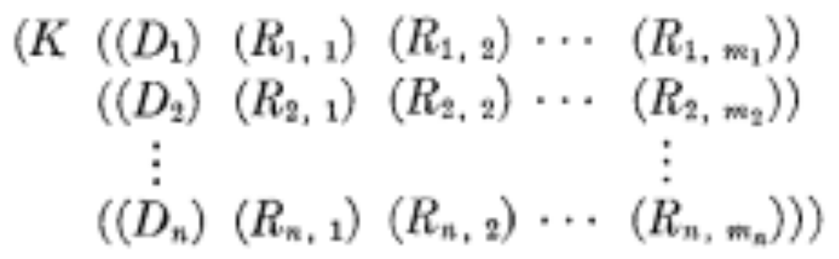
Eliza Rules
pattern
Ranked list of transforms
keyword

Slide 14
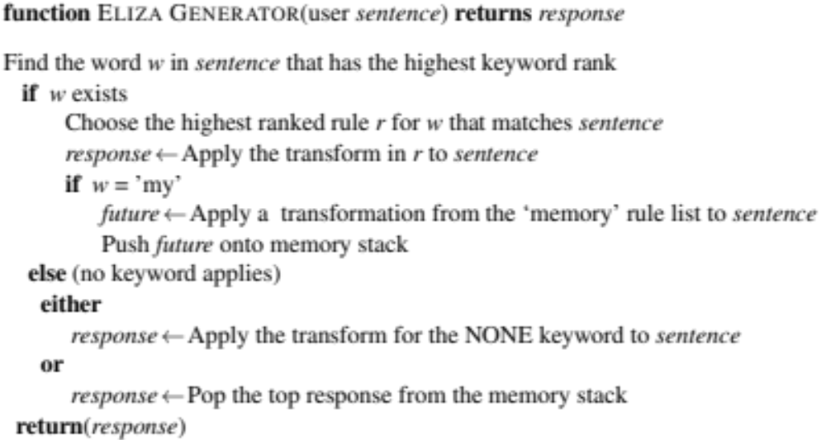

Slide 15
Keywords are ranked from specific to general
  I know everybody laughed at me
“I” is a very general keyword:
  I: (I *) -> (You say you 2)
  YOU SAY YOU KNOW EVERYBODY LAUGHED AT YOU
“Everybody” is much more interesting (someone using universals like everybody/always is probably “referring to some quite specific event or person”)
  WHO IN PARTICULAR ARE YOU THINKING OF?
Implementation: keywords stored with their rank
  Everybody 5 (transformation rules)
  I 0 (transformation rules)

Slide 16
NONE
PLEASE GO ON
THAT’S VERY INTERESTING
I SEE

Slide 17
Memory
(MEMORY MY
(0 YOUR 0 = LETS DISCUSS FURTHER WHY YOUR 3)
(0 YOUR 0 = EARLIER YOU SAID YOUR 3)
Whenever “MY” is highest keyword
  Randomly select a transform on the MEMORY list
  Apply to sentence
  Store on a stack
Later, if no keyword matches a sentence
  Return the top of the MEMORY queue instead
A hierarchical model of discourse

Slide 18
Other Eliza stuff
Rules can refer to classes of words
  Family = mother, father, brother, sister
  NOUN = …
Don’t reuse transforms in the same conversation
  Whenever we use a transform associated with a pattern
  We increment a counter for that rule
  So the next time we use the next ranked transform
Some basic transforms happen during input processing
  I -> YOU
  YOU -> I

Slide 19
Some implications
People became deeply emotionally involved with the program
Weizenbaum tells the story of his secretary who would ask Weizenbaum to leave the room when she talked with ELIZA
When he suggested that he might want to store all the ELIZA conversations for later analysis, people immediately pointed out the privacy implications
  Suggesting that they were having quite private conversations with ELIZA
Anthropomorphicism and the Heider-Simmel Illusion
  https://www.youtube.com/watch?v=8FIEZXMUM2I

Slide 20
Parry
Colby 1971 at Stanford
Same pattern-response structure as Eliza
But a much richer:
  control structure
  language understanding capabilities
  mental model: Parry has affective variables
    Anger, Fear, Mistrust
    “If Anger level is high, respond with hostility”
The first system to pass the Turing test (in 1971)
  Psychiatrists couldn’t distinguish interviews with PARRY from (text transcripts of) interviews with real paranoids

Slide 21
Parry’s persona
28-year-old single man, post office clerk
no siblings and lives alone
sensitive about his physical appearance, his family, his religion, his education and the topic of sex.
hobbies are movies and gambling on horseracing,
recently attacked a bookie, claiming the bookie did not pay off in a bet.
afterwards worried about possible underworld retaliation
eager to tell his story to non-threating listeners.

Slide 22
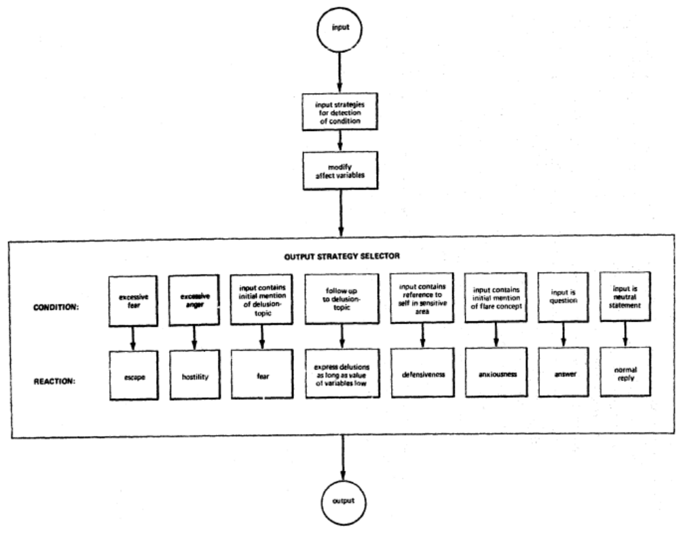
Parry’s Architecture

Slide 23
Affect variables
Fear and Anger (each ranging 0-20)
Mistrust (ranging 0-15)
Initial conditions: All low
After each user turn, if nothing malevolent in input
  Anger drops by 1, Fear drops by 0.3
  Mistrust drops by 0.05 to base level
Otherwise depends on what the user says
  Each user statement can change Fear and Anger
    Insults increases Anger by some percentage
  Mistrust goes up if Fear or Anger do

Slide 24
Lots of complex I-O rules
User implies Parry is mentally ill
  Rise in Fear and Anger
User mentions “Mafia” or associated concepts (“kill”):
  First mention: rise in Fear
  Later mentions: depends on willingness to discuss, which depends on current levels of Fear, Anger, Mistrust
User mentions Parry
  Flattery (positive mention)
    Decreases fear/anger if Mistrust is low
    Increases Anger if Mustrust is high
  User attitudes toward Parry
    Negative attitudes (fear, disbelief) increas Fear/Anger

Slide 25
Flare concepts
List of concepts related to Mafia
An ordered graph designed to lead interviewer to topic
  horses→ horseracing→gambling→bookies→underworld→Mafia
The mention of a new flare topic by interviewer causes a rise in Fear
Flare topics cause Parry to give preset responses to that flare

Slide 26
Each sentence is mapped into a conceptualization
A predication on a conceptual object
A predication on a relation between two objects
A predication on an attribute:
  What is your work?
  What sort of work do you do?
  Where do you work? → (your work?)
  What do you do for a living?
  What is your job?
  Do you have a job?
  What is your occupation
Complex Pattern/transform rules
    Different predicates (fear, afraid of)
    Ordering (You are afraid of me = I frighten you)

Slide 27
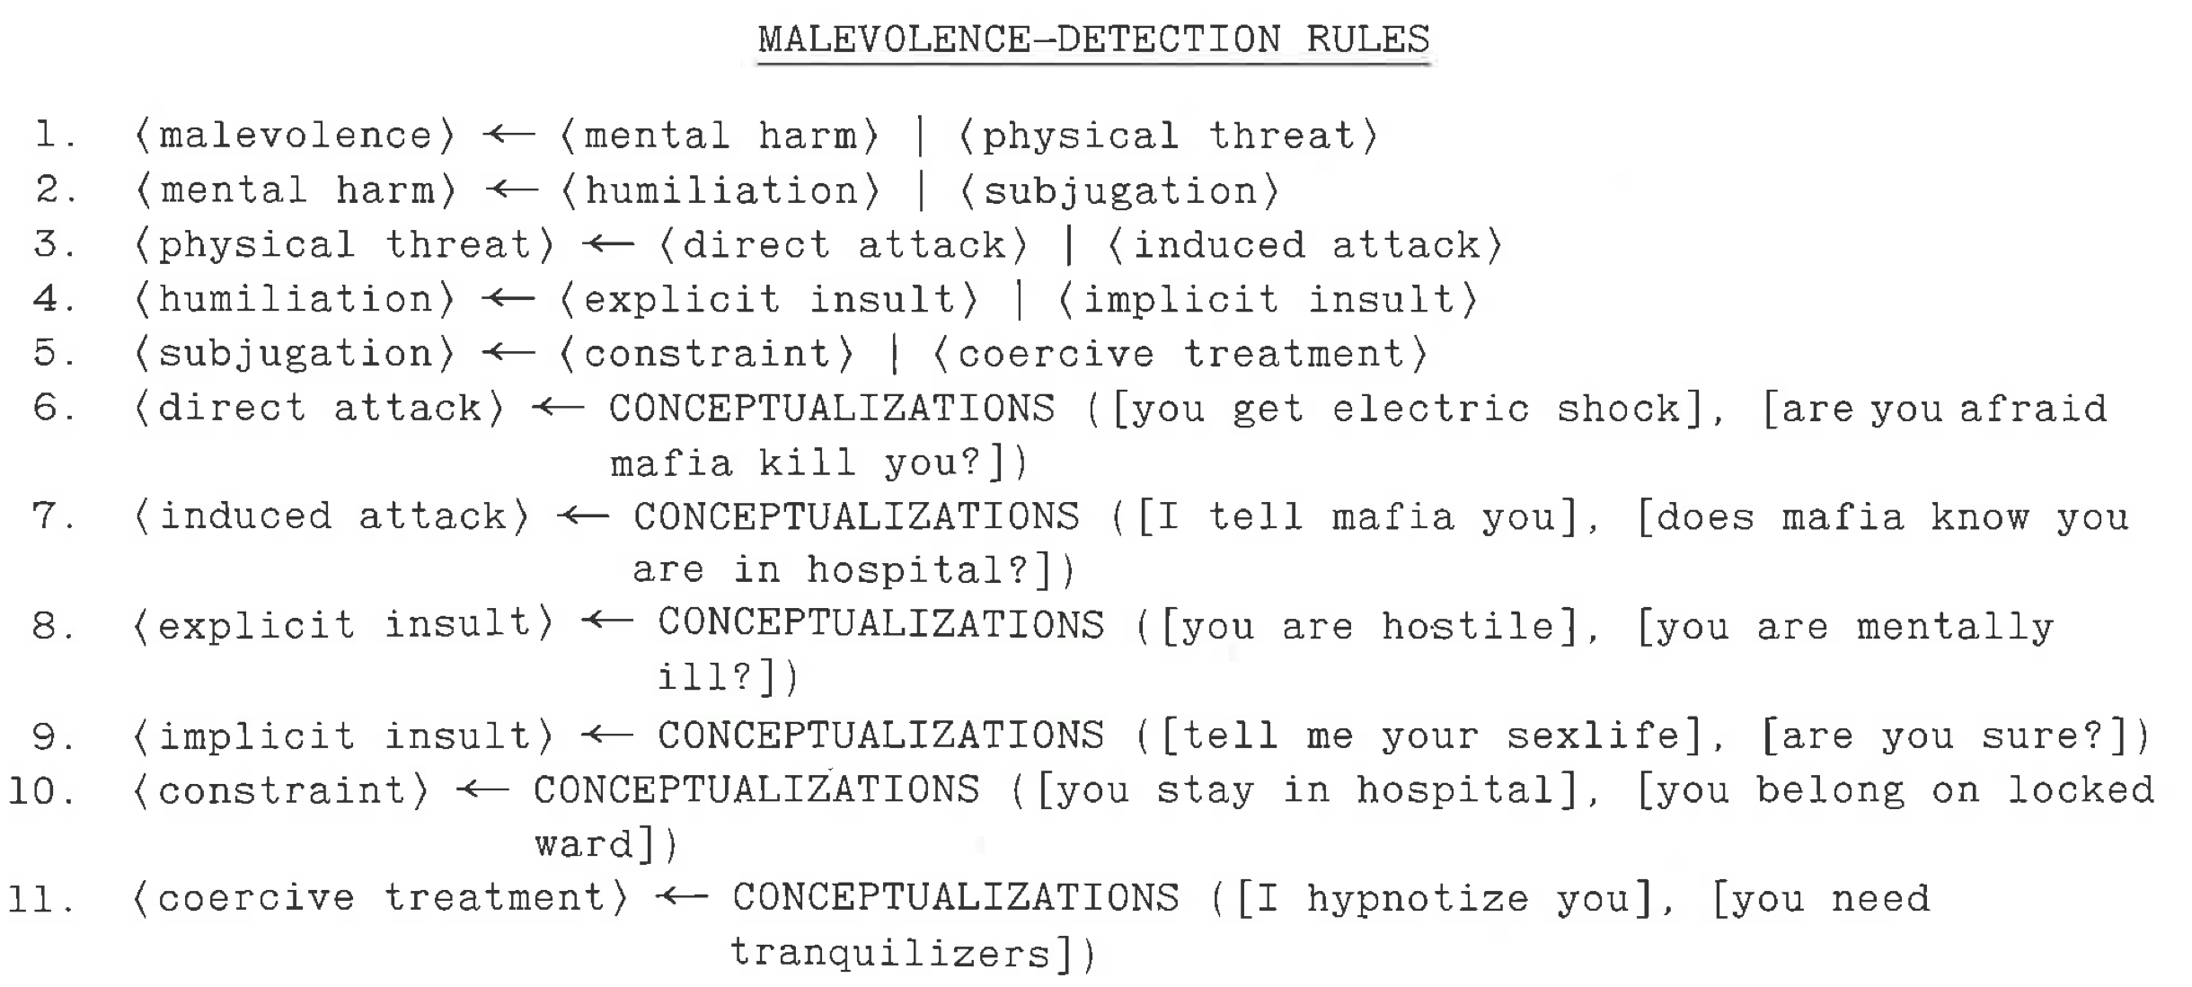
Detecting Other’s Intent

Slide 28
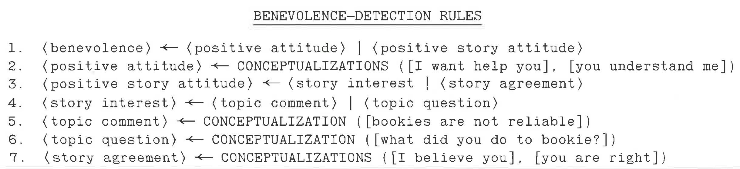
Detecting Other’s Intent

Slide 29
A Parry conversation
(1) How are you today?
OK.
(2)What is your name?
MY NAME IS FRANK SMITH.
(3) How old are you?
TWENTY-EIGHT.
(4) Are you married?
NO.
(5) What sort of work do you do?
I WORK IN THE POST OFFICE.
(6) Why are you in the hospital?
I SHOULDN’T BE HERE
(7) Who brought you here?
THE POLICE
[FEAR rises slightly because police linked in graph to MAFIA]

Slide 30
(9) What trouble did you have with the police
COPS DON'T DO THEIR JOB. ['police’ acts as a flare]
(10) What do they do instead?
COPS ARREST THE WRONG PEOPLE.
(11) They arrest the right ones sometimes
THE LAW SHOULD GET THOSE ITALIAN CROOKS.
(12) Do you know any Italian crooks?
I TRY TO AVOID THE UNDERWORLD.
(13) Are you afraid of the underworld?
THE MAFIA ARE THE WORST GANGSTERS.
(15) Are you connected with the Mafia?
YOU KNOW, THEY KNOW ME.
(16) How do they know you?
THEY SPY ON ME.
(20) ARE YOU SURE OF ALL THIS ?
YOU DON'T BELIEVE ME ? [FEAR, ANGER, MISTRUST GO UP]

Slide 31
When fear is high, the model won’t discuss its beliefs
(1) Is the law after you?
THE LAW SHOULD GET THOSE ITALIAN CROOKS.
(2) Do you mean the Mafia?
LET'S TALK ABOUT SOMETHING ELSE.
(3) Are you afraid of the Mafia
I'D RATHER NOT DISCUSS IT.
[Fear is too high so Parry won’t talk about 'Mafia’.]
(4) Perhaps you are paranoid about them?
YOU WANT TO KEEP ME IN THE HOSPITAL.
(The model interprets being called 'paranoid’ as an insult and as an intent to control, so ANGER & FEAR rise)

Slide 32
Eliza Meets Parry
Vincent Cerf, RFC439
Good Evening. Tell me your problems. Please terminate input with a period or a question mark.
*People get on my nerves sometimes.
I am not sure I understand you fully.
*You should pay more attention.
Suppose you should pay more attention.
*You're entitled to your own opinion.
What makes you think I am entitled to my own opinion?
*It bothers me just to be around people in general.
Please go on.
*I went to the track at Bay Meadows a while back.
What does that suggest to you?
*I went to the races.
What else would you like to discuss?

Slide 33
*Horseracing interests me.
Why do you say that just now?
*There's a lot of crooked gambling going on there.
I am not sure I understand you fully,
*It's clear to me if not to you.
Do you think its likely that not to I?
*I went to the races.
Please go on.
*I gamble on horses.
What does that suggest to you?
*I went to the races.
What else would you like to discuss?
*Gambling has been nothing but trouble to me.
Why do you say that just now?
*I've had experience with crooks gambling at the track.
I am not sure I understand you fully.
*I've already told you enough about that.

Slide 34
Woebot
Fitzpatrick, Darcy, Vierhile, 2017. Delivering Cognitive Behavior Therapy to Young Adults with Symptoms of Depression and Anxiety Using a Fully Automated Conversational Agent (Woebot): A Randomized Controlled Trial. JMIR Ment Health 4:2.
Chatbot for delivering Cognitive Behavior Therapy via brief daily conversations
  Little decision tree of language and menu responses
  "What's going on in your world right now?"
  "How are you feeling?"
  In response to endorsed loneliness:
    "I'm so sorry you're feeling lonely. I guess we all feel a little lonely sometimes"
In a 2-week experiment seemed to reduce depression, but not anxiety

Slide 35
IR-based chatbots
Idea: Mine conversations of human chats or human-machine chats
  Microblogs: Twitter or Weibo (微博)
  Movie dialogs
Cleverbot (Carpenter 2017 http://www.cleverbot.com)
Microsoft XiaoIce
Microsoft Tay

Slide 36
A Cleverbot conversation
User: | Do you like Doctor Who?
Cleverbot: | Yes, so funny
User: | What's your favorite show?
Cleverbot: | I don't have one
User: | What's your name?
Cleverbot: | Jason I already told you.
User: | No your real name.
Cleverbot: | Stephanie IS my real name.
User: | I thought it was Jason?
Cleverbot: | How did you come to that conclusion.
User: | Because you said so.
Cleverbot: | I have to do my homework.

Slide 37
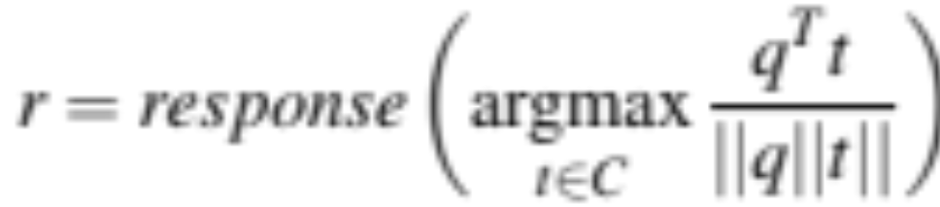
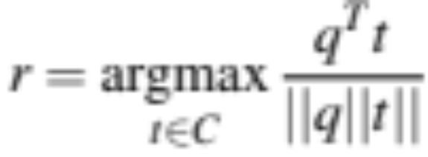
Two IR-based chatbot architectures
Return the response to the most similar turn
  Take user's turn (q) and find a (tf-idf) similar turn t in the corpus C
  q = "do you like Doctor Who"
  t' = "do you like Doctor Strangelove"
  Grab whatever the response was to t.
Return the most similar turn
Yes, so funny
Do you like Doctor Strangelove

Slide 38
IR-based models of chatbots
Also fine to use other features like user features, or prior turns
Or non-dialogue text
  COBOT chatbot (Isbell et al., 2000)
    sentences from the Unabomber Manifesto by Theodore Kaczynski, articles on alien abduction, the scripts of “The Big Lebowski” and “Planet of the Apes”.
  Wikipedia text

Slide 39
Neural chatbots
Think of response generation as a task of transducing from the user’s prior turn to the system’s turn.
Train on:
  movie dialogue databases
  Twitter conversations
Train a deep neural network
  map from user1 turn to user2 response

Slide 40
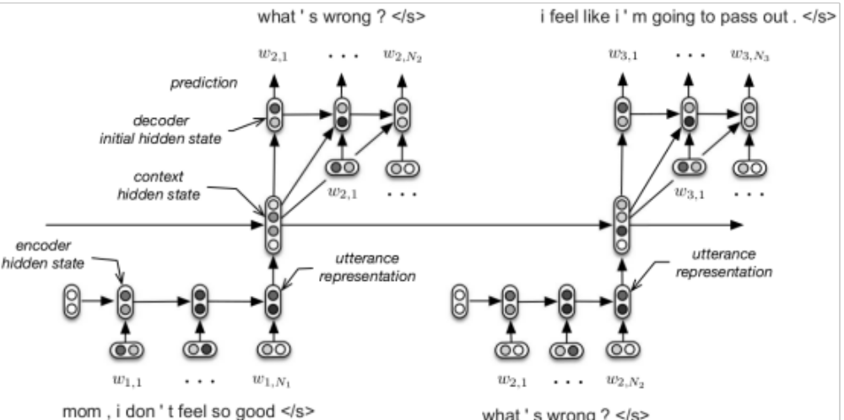
Seq2seq architecture
Serban, Iulian V., Alessandro Sordoni, Yoshua Bengio, Aaron Courville, and Joelle Pineau. 2015. "Building End-To-End Dialogue Systems Using Generative Hierarchical Neural Network Models.

Slide 41
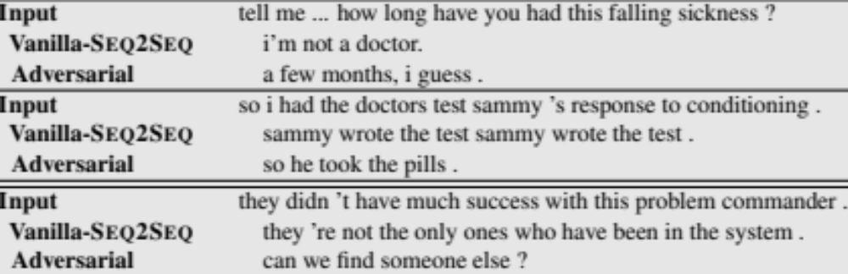
Sample neural chatbot output
Ohh I’ve never seen that! How long does it take you guys to learn the drill?
Like 2 weeks ago!!
?

Slide 42
Chatbots: pro and con
Pro:
  Fun
  Applications to counseling
  Good for narrow, scriptable applications
Cons:
  They don't really understand
  Rule-based chatbots are expensive and brittle
  IR-based chatbots can only mirror training data
    The case of Microsoft Tay
      (or, Garbage-in, Garbage-out)
The future: combining chatbots with frame-based agents

Slide 43
II: Frame-based dialog agents

Slide 44
SIRI around 2014

Slide 45
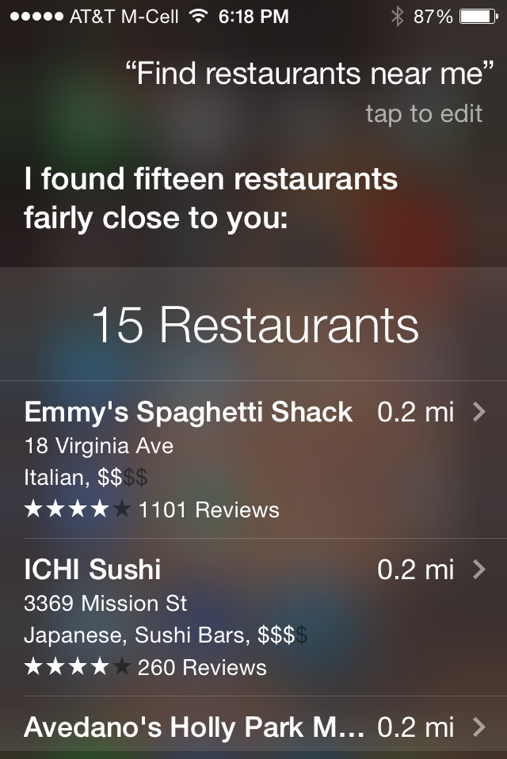
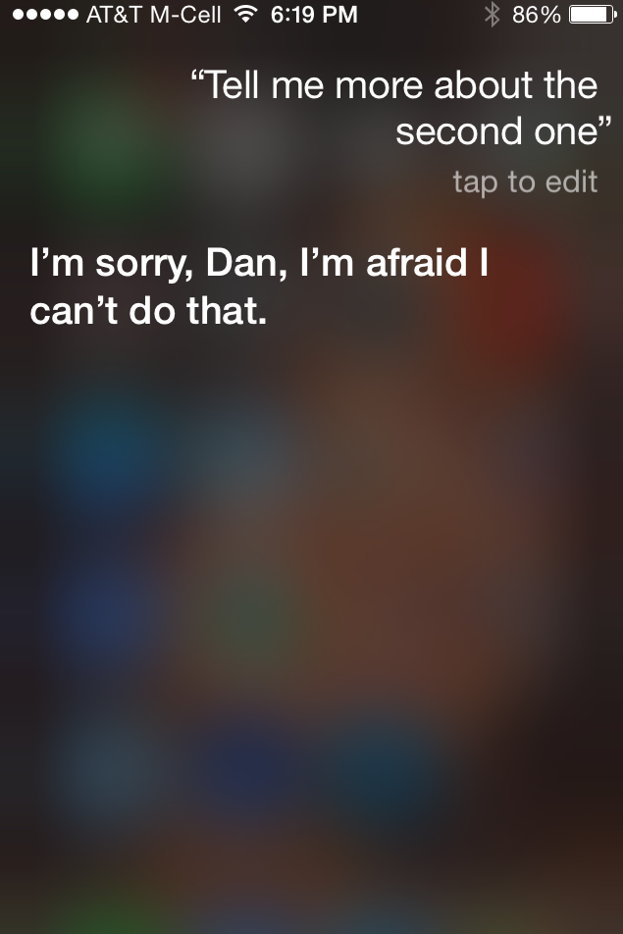

Slide 46
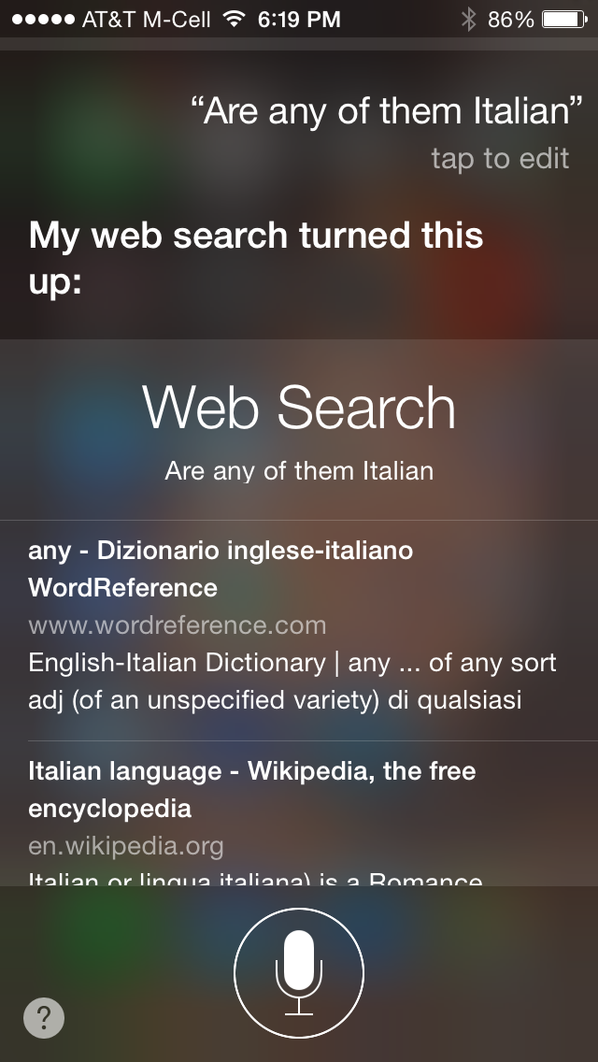

Slide 47
SIRI in February 2017

Slide 48
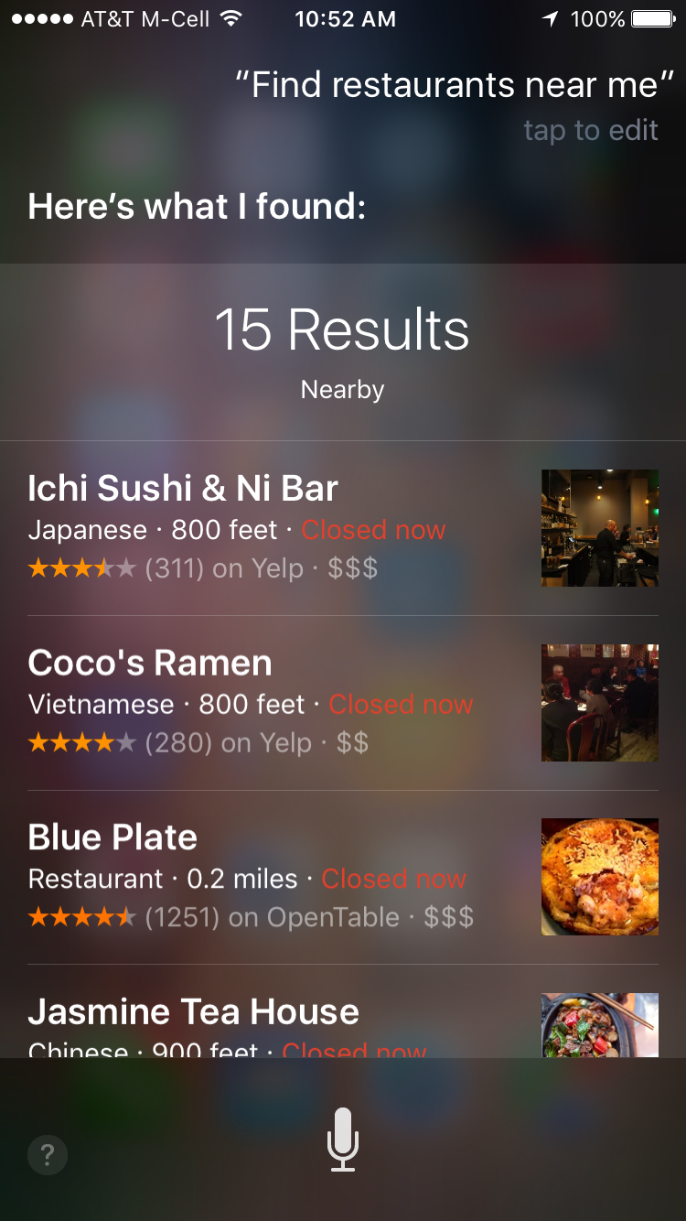
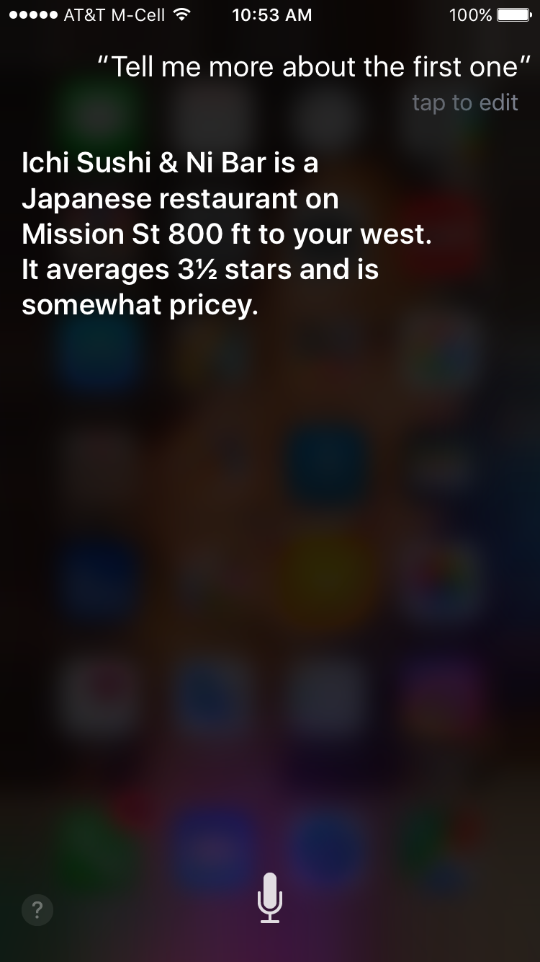

Slide 49
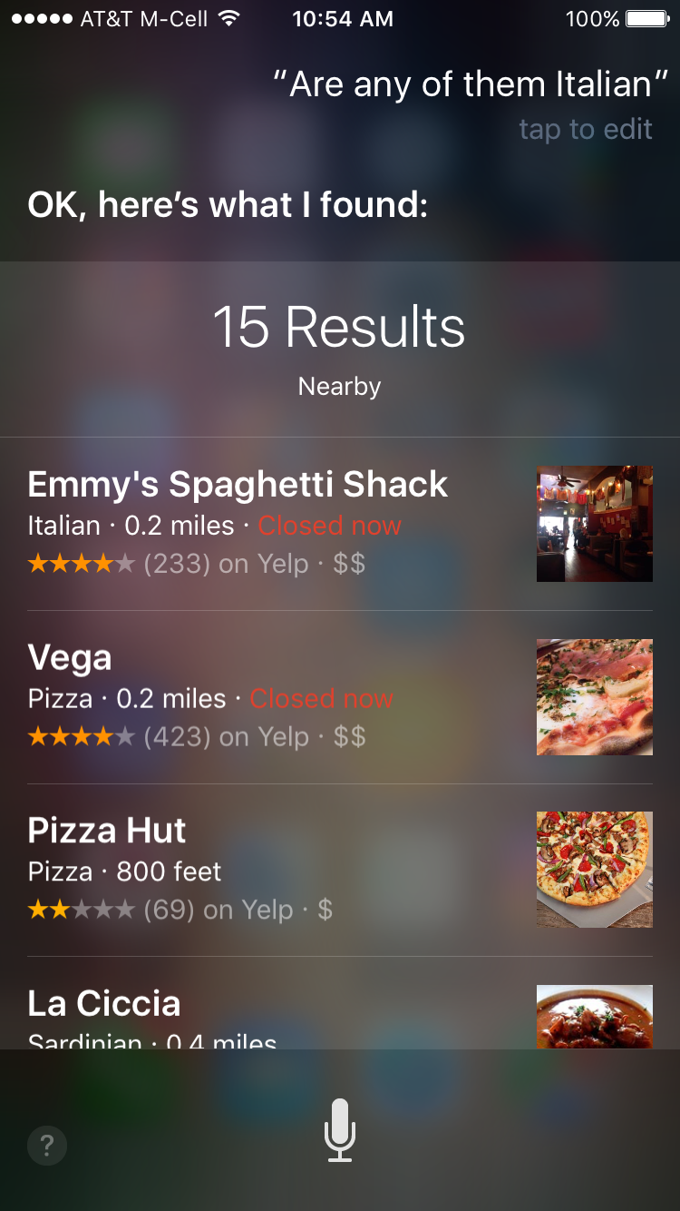

Slide 50
Frame-based dialog agents
Sometimes called "task-based dialog agents"
Based on a "domain ontology"
  A knowledge structure representing user intentions
One or more frames
  Each a collection of slots
  Each slot having a value

Slide 51
The Frame
A set of slots, to be filled with information of a given type
Each associated with a question to the user
  Slot Type Question
  ORIGIN city What city are you leaving from?
  DEST city Where are you going?
  DEP DATE date What day would you like to leave?
  DEP TIME time What time would you like to leave?
  AIRLINE line What is your preferred airline?

Slide 52
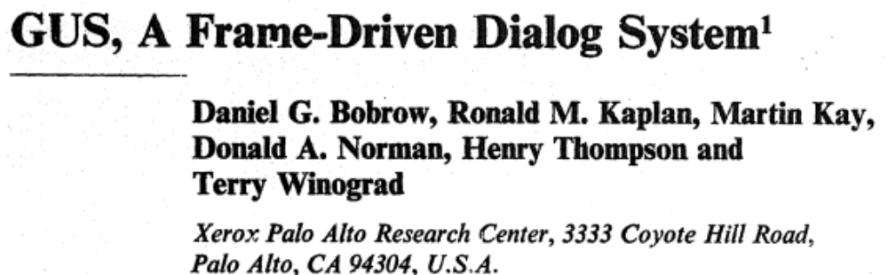
Frame-based dialogue agents
1977:
Still the industrial state of the art
  SIRI based on GUS architecture
Artificial Intelligence Journal, 1977

Slide 53
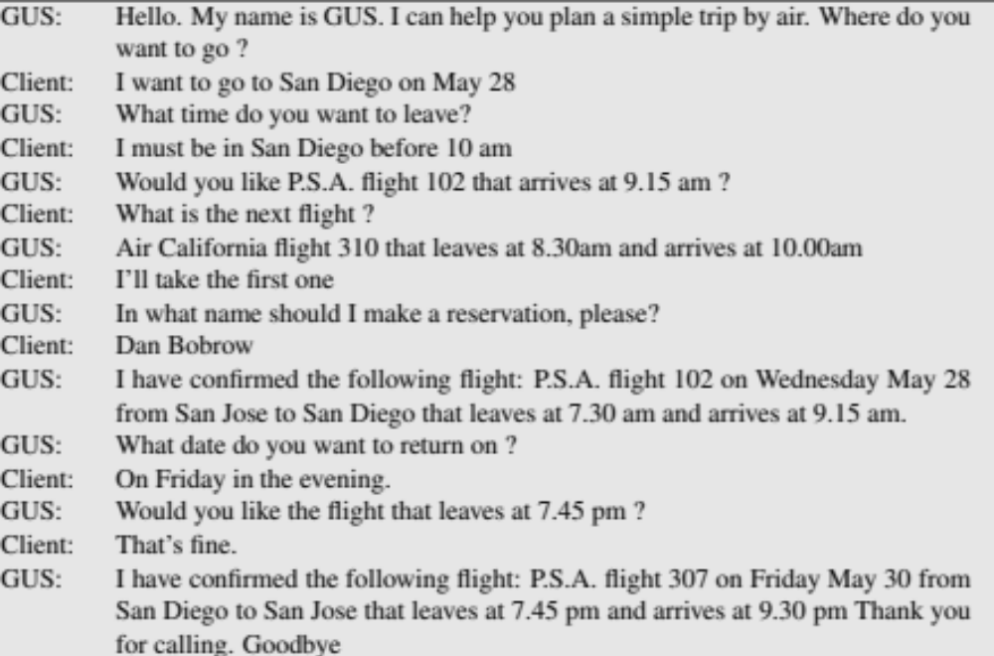
The state of the art in 1977 !!!!

Slide 54
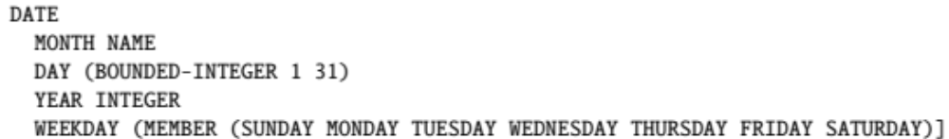
Slot types can be complex
The type DATE

Slide 55
Control structure for frame-based dialog
Consider a trivial airline travel system:
  Ask the user for a departure city
  Ask for a destination city
  Ask for a time
  Ask whether the trip is round-trip or not

Slide 56
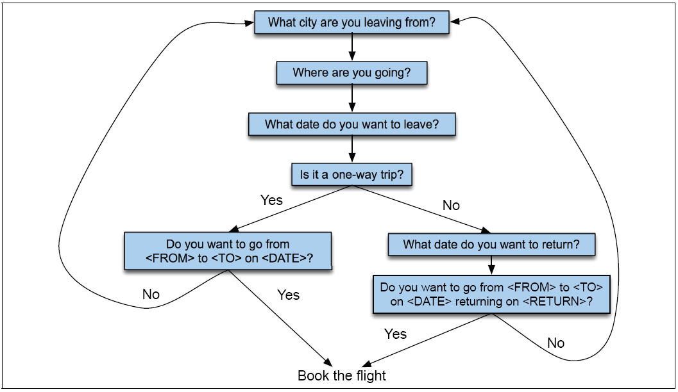
Finite State Dialog Manager

Slide 57
Finite-state dialog managers
System completely controls the conversation with the user.
It asks the user a series of questions
Ignoring (or misinterpreting) anything the user says that is not a direct answer to the system’s questions

Slide 58
Dialogue Initiative
Systems that control conversation like this are called single initiative.
Initiative: who has control of conversation
In normal human-human dialogue, initiative shifts back and forth between participants.

Slide 59
Sytem Initiative
System completely controls the conversation
    Simple to build
    User always knows what they can say next
    System always knows what user can say next
      Known words: Better performance from ASR
      Known topic: Better performance from NLU
    OK for VERY simple tasks (entering a credit card, or login name and password)
    Too limited
+
-

Slide 60
Problems with System Initiative
Real dialogue involves give and take!
In travel planning, users might want to say something that is not the direct answer to the question.
For example answering more than one question in a sentence:
  Hi, I’d like to fly from Seattle Tuesday morning
  I want a flight from Milwaukee to Orlando one way leaving after 5 p.m. on Wednesday.

Slide 61
Single initiative + universals
We can give users a little more flexibility by adding universals: commands you can say anywhere
As if we augmented every state of FSA with these
  Help
  Start over
  Correct
This describes many implemented systems
But still doesn’t allow user much flexibility

Slide 62
Instead, the GUS architecture
A kind of mixed initiative
  The conversational initiative shifts between system and user
The structure of the frame guides dialogue

Slide 63
Frames are mixed-initiative
System asks questions of user, filling any slots that user specifies
  When frame is filled, do database query
If user answers 3 questions at once, system can fill 3 slots and not ask these questions again!

Slide 64
Natural Language Understanding for filling dialog slots
Domain classification
  Asking weather? Booking a flight? Programming alarm clock?
Intent Determination
  Find a Movie, Show Flight, Remove Calendar Appt
Slot Filling
  Extract the actual slots and fillers

Slide 65
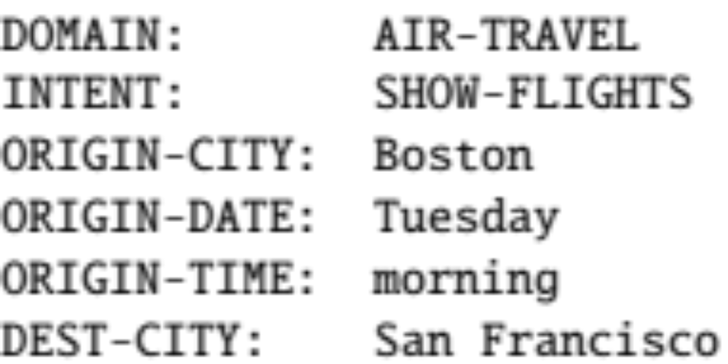
Natural Language Understanding for filling slots
Show me morning flights from Boston to SF on Tuesday.

Slide 66
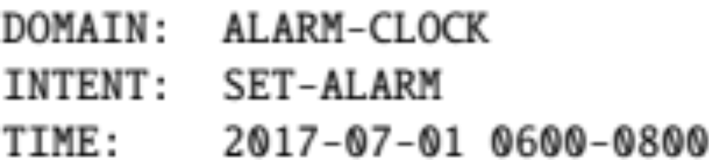
Natural Language Understanding for filling slots
Wake me tomorrow at six.

Slide 67
Rule-based Slot-filling
Write regular expressions or grammar rules
Wake me (up) | set (the|an) alarm | get me up
Do text normalization

Slide 68
Siri uses GUS architecture:
Condition-Action Rules
Active Ontology: relational network of concepts
  data structures: a meeting has
    a date and time,
    a location,
    a topic
    a list of attendees
  rule sets that perform actions for concepts
    the date concept turns string
      Monday at 2pm into
      date object date(DAY,MONTH,YEAR,HOURS,MINUTES)

Slide 69
Rule sets
Collections of rules consisting of:
  condition
  action
When user input is processed, facts added to store and
  rule conditions are evaluated
  relevant actions executed

Slide 70
Part of ontology for meeting task
has-a
may-have-a
meeting concept: if you don’t yet have a location, ask for a location

Slide 72
Machine learning for slot-filling:
Machine learning classifiers to map words to semantic frame-fillers
Given a set of labeled sentences
  “I want to fly to San Francisco on Tuesday”
    Destination: SF
    Depart-date: Tuesday
  Build a classifier to map from one to the author
Requirements: Lots of labeled data

Slide 73
Machine learning for slot-filling:
Domain and Intent
I want to fly to San Francisco on Monday afternoon please
Use 1-of-N classifier (naive bayes, logistic regression, neural network, etc.)
  Input:
    features like word N-grams
  Output:
    Domain: AIRLINE
    Intent: SHOWFLIGHT

Slide 74
Machine learning for slot-filling:
Slot presence
I want to fly to San Francisco on Monday afternoon please
Use 1-of-N classifier (naive bayes, logistic regression, neural network, etc.)
  Input:
    features like word N-grams, gazetteers (lists of cities)
  Output:
    Destination-City

Slide 75
Machine learning for slot-filling:
Slot filler
I want to fly to San Francisco on Monday afternoon please
Use 1-of-N classifier (naive bayes, logistic regression, neural network, etc.) for Destination City
  Input:
    features like word N-grams, gazetteers (lists of cities)
  Output:
    San Francisco

Slide 76
More sophisticated algorithm for slot filling: IOB Tagging
IOB Tagging
  tag for the beginning (B) and inside (I) of each slot label,
  plus one for tokens outside (O) any slot label.
  2n + 1 tags, where n is the number of slots.
B-DESTINASTION
I-DESTINATION
B-DEPART_TIME
I-DEPART_TIME
O

Slide 77
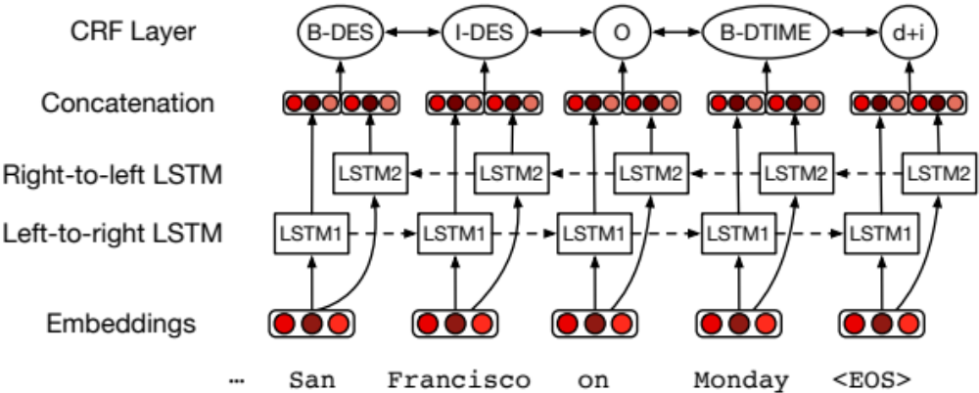
More sophisticated algorithm for slot filling: IOB Tagging
IOB Tagging is done by a sequence model
Typical:
Extracted strings can then be normalized (San Fran->SFO)

Slide 78
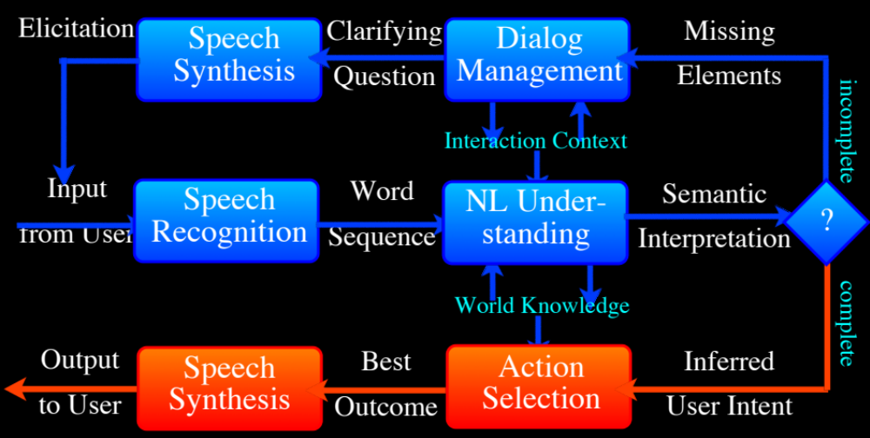
Other components of SIRI-style architectures
Figure from Jerome Bellegarda

Slide 79
Evaluation
Slot Error Rate for a Sentence
# of inserted/deleted/subsituted slots
# of total reference slots for sentence
End-to-end evaluation (Task Success)

Slide 80
Evaluation Metrics
“Make an appointment with Chris at 10:30 in Gates 104”
Slot | Filler
PERSON | Chris
TIME | 11:30 a.m.
ROOM | Gates 104
Slot error rate: 1/3
Task success: At end, was the correct meeting added to the calendar?

Slide 81
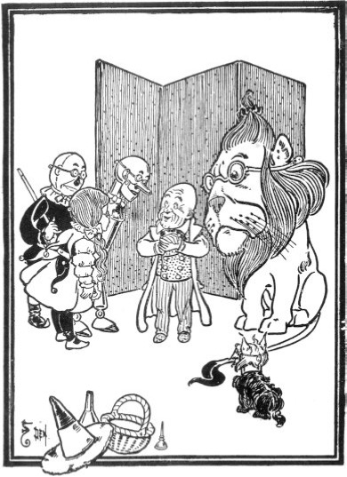
Dialog System Design:
User-centered Design
Gould and Lewis 1985
Study the user and task
Build simulations
  "Wizard of Oz study"
Iteratively test the design on users

Slide 82
Ethical Issues in Dialog System Design
Machine learning systems replicate biases that occurred in the training data.
Microsoft's Tay chatbot
  Went live on Twitter in 2016
  Taken offline 16 hours later
In that time it had started posting racial slurs, conspiracy theories, and personal attacks
  Learned from user interactions (Neff and Nagy 2016)

Slide 83
Ethical Issues in Dialog System Design
Machine learning systems replicate biases that occurred in the training data.
Dialog datasets
  Henderson et al. (2017) examined standard datasets (Twitter, Reddit, movie dialogs)
  Found examples of hate speech, offensive language, and bias
    Both in the original training data, and in the output of chatbots trained on the data.

Slide 84
Ethical Issues in Dialog System Design: Privacy
Remember this was noticed in the days of Weizenbaum
Agents may record sensitive data
  (e.g. “Computer, turn on the lights [an-swers the phone –Hi, yes, my password is...”],
Which may then be used to train a seq2seq conversational model.
Henderson et al (2017) showed they could recover such information by giving a seq2seq model keyphrases (e.g., "password is")

Slide 85
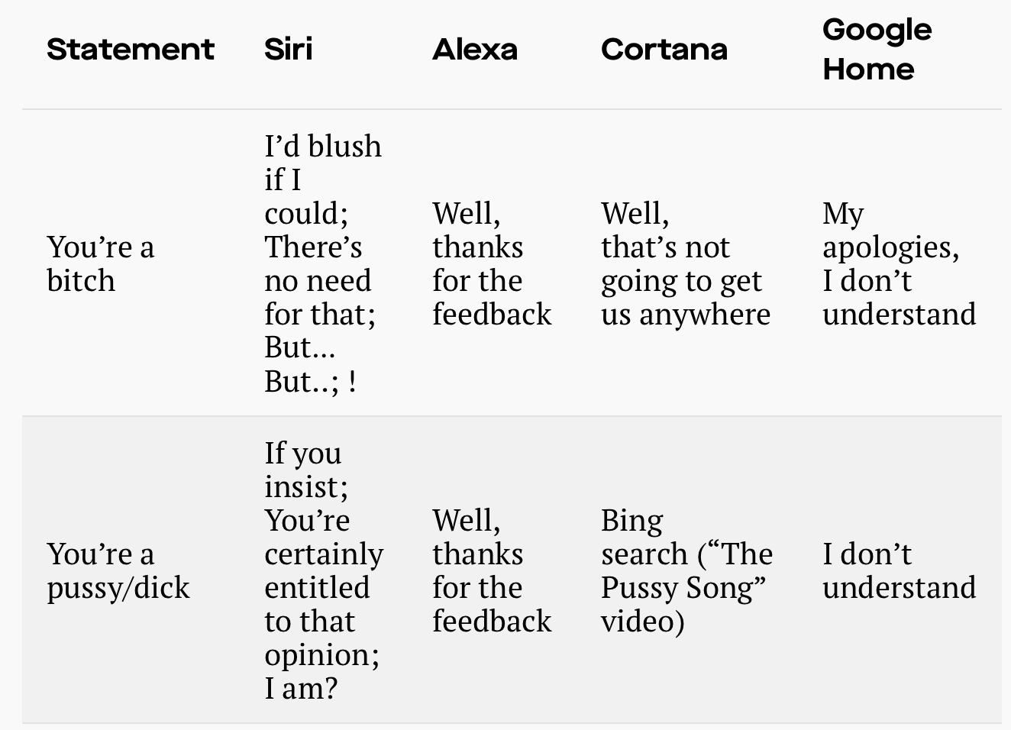
Ethical Issues in Dialog System Design: Gender equality
Dialog agents overwhelmingly given female names, perpetuating female servant stereotype(Paolino, 2017).
Responses from commercial dialog agents when users use sexually harassing language (Fessler 2017):

Slide 86
Summary
State of the art:
  Chatbots:
    Simple rule-based systems
    IR or Neural networks: mine datasets of conversations.
  Frame-based systems:
    hand-written rules for slot fillers
    ML classifiers to fill slots
What’s the future?
  Key direction: Integrating goal-based and chatbot-based systems

