Slide 1
Large Language Models
Introduction

Slide 2

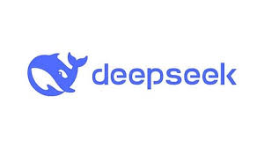




Large Language Models
GPT-5
CLAUDE
R1
Gemini
PHI-4
LLAMA

Slide 3
Language models: the good
Improve productivity
  Coding
  Writing assistance
  Paperwork and bureaucracy
Break down language barriers
  Machine translation
Can process speech
  Healthcare and L2 education
Information and Knowledge Access

Slide 4
Language models: the concerns
ELIZA story
We'll discuss safety and harm issues later in this lecture

Slide 5
What is a language model?
An agent that carries on conversations and acts in the world
A computational system that can predict the next word from previous words.

Slide 6
A language model predicts words

Slide 7
Prediction is an not English-specific idea
在我的后园，可以看见墙外有两株树，一株是…
Zài wo de hòu yuán, kěyǐ kàn jiàn qiáng wài you liǎng zhū shù, yī zhū shì…
In my backyard, you can see two trees beyond the fence. One is a…
枣树(‘date’)
的(‘of’)
桃树(‘peach’)
松树(‘pine’)
我们(‘we’)
Notes:
What words are likely to appear?
What words are not likely to appear?

Slide 8
What is a large language model?
A neural network with:
Input: a context or prefix,
Output: a distribution over possible next words

Slide 9
Intuition of generation
An LLM that can predict text
assigning a probability distribution over upcoming words
Can generate words
by sampling from the distribution

Slide 10
LLMs can generate!

Slide 11
Causal or autoregressive model
Models that iteratively predict and generate words left-to-right from earlier words
The most common LLMs

Slide 12
Three architectures for large language models
Decoders Encoders Encoder-decoders
GPT, Claude, BERT family, Flan-T5, Whisper
Llama HuBERT
Mixtral

Slide 13
Decoders
What most people think of when we say LLM
GPT, Claude, Llama, DeepSeek, Mistral
A generative model
It takes as input a series of tokens, and iteratively generates an output token one at a time.
Left to right (causal, autoregressive)

Slide 14
Encoders
Masked Language Models (MLMs)
BERT family
You've used BERT already for contextual embeddings
Trained by predicting words from surrounding words on both sides
Are usually finetuned (trained on supervised data) for classification tasks.

Slide 15
Encoder-Decoders
Trained to map from one sequence to another
Used for:
  machine translation (map from one language to another)
  speech recognition (map from acoustics to words)

Slide 16
This lecture: decoder-only models
Also called:
Causal LLMs
Autoregressive LLMs
Left-to-right LLMs
Predict words left to right

Slide 17
Wait, what about other languages?
There are >7000 languages, more than 150 scripts
Ethnologue

Slide 18
Wait, what about other languages?
Top 10 most spoken languages
Tthnologue

Slide 19
Language models can be monolingual or multilingual
Many are multilingual, e.g.,:
Gemini: 140 languages
Qwen3: 119 languages and dialects
Some are monolingual
Especially common in English

Slide 20
Language models process tokens, not words
A token is a word or word part.
First LLM step is converting text into tokens
Via tokenization algorithms like BPE
English tokens correspond roughly to words:
German tokens tend to be smaller than words
Notes:
German has 27 tokens for only 12 words

Slide 21
Size and scale
At the small end: n-gram models
Count the frequency of words in different words
Useful for understanding basic LM concepts

Slide 22
What is a Large Language Model (LLM)
LMs built from neural architectures
Especially the transformer
Large in the sense that they:
have many layers
have many parameters
are trained on large training sets

Slide 23
What is a parameter?
A single real-valued number in a network that is trained and used for computation
weights and biases
Llama 3.1 405B has 405 Billion parameters
trained on over 15 trillion tokens.
Models come in families from <1B parameters to trillions

Slide 24
Scaling laws
LLM performance goes up as these 3 factors increase:
model size (the number of parameters)
training dataset size (in tokens)
amount of compute used for training

Slide 25
Scaling laws
For a fixed amount of compute C
Optimal # of parameters N
Optimal amount of data D
Should go up equally as a power law of compute

Slide 26
Scaling laws
Explain why models get bigger
For good (better performance)
And ill (more energy, water, $$$) and expensive to run inference.
Also explain that we can improve the same size model by increasing compute and and training data

Slide 27
Large Language Models
Introduction

Slide 28
Large Language Models
What do LLMs learn from token prediction?

Slide 29
Fundamental intuition of large language models
Text contains enormous amounts of knowledge
Pretraining on lots of text with all that knowledge is what gives language models their ability to do so much

Slide 30
Intuition from humans
Vocabulary size of young adult speakers of American English: 30,000 to 100,000 words
Children learn 7 to 10 words a day to get to that level by 20 years old
How do they do it?
Reading! (Laundauer and Dumais 1997)

Slide 31
Reading isn't passive
It's rich contextual processing
At some points during learning, rate of vocabulary growth exceeds the rate of seeing new words
Every time we read a word, we are strengthening our understanding of other associated words.

Slide 32
The distributional hypothesis
1950s theory from linguistics (Joos, Harris, Firth)
Some aspects of meaning can be learned just from which words occur with each other

Slide 33
The distributional hypothesis
Suppose you didn't know "difficult" in these sentences:
It was difficult to make it up
What a difficult decision!
But you saw "hard" in similar contexts (hills, decisions):
I found climbing the steep hill hard.
It was a very hard decision.
You could infer that "difficult" meant something like "hard"!

Slide 34
Pretraining
We teach language models to predict upcoming words, trillions of times
This is called pretraining
By doing so they induce knowledge

Slide 35
What does a model learn from pretraining?
There were roses, dahlias, and peonies, I was simply surrounded by
The room wasn't just big it was
The square root of 4 is
The author of "A Room of One's Own" is Virginia
The doctor told me that
flowers
enormous
2
Woolf
he

Slide 36
Large Language Models
What do LLMs learn from token prediction?

Slide 37
Large Language Models
Prompting!
= Conditional Generation of Text!
= Token Prediction!

Slide 38
Big idea: Prompting is just word prediction!
Prompting works by the same idea of predicting upcoming tokens!!!
Give an LLM a prompt
Have it generate the most likely next word
Add that word to the context
Repeat!
This is called conditional generation
Because we condition on the context

Slide 39
Why does conditional generation lead to answering questions?
“Who wrote The Origin of Species”
We give the language model this string:
And see what word it thinks comes next:

Slide 40
Given that LLMs are trained on lots of FAQ sites it knows that answers are likely after questions!
(plus it's trained on Origin of Species, plus Wikipedia, plus instruction tuning)
So the very likely next word is:
Charles!

Slide 41
Now we iterate:

Slide 42
Large Language Models
Prompting!
= Conditional Generation of Text!
= Token Prediction!

Slide 43
Large Language Models
The Shannon Game

Slide 44
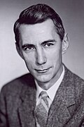
Claude Shannon 1951
I select a short text passage and you have to guess the words in it, one by one, left to right.
You first guess word 1.
If you’re correct I tell you
If you’re wrong I tell you the correct first word
Either way you right down the text
Go on to word 2 and repeat
Tekniska museet 43069
Wikimedia Commons

Slide 45
The original Shannon game was letters
Here's part of a game trace:
The first line: original text
Second line:
Dash means a correct guess
Letter means player guessed wrong, had to be told
What do you notice?
Notes:
he player correctly guessed that the first word was THE,
failed to guess ROOM and had to be told the first 3 letters one by one before cor-
rectly guessing the M, and so on. Shannon’s original idea was to use this method
to study how much information natural language contains, following his interest in
information theory and the practical application of data compression.

Slide 46
The Shannon game is related to pretraining
We have the language model guess a word
When it gets it wrong, we give it the correction and go on.

Slide 47
Large Language Models
The Shannon Game

Slide 48
Large Language Models
Underpinnings: Neural Networks and Embeddings

Slide 49
Implementation
neural networks as basic machine-learned computational elements
embeddings, vectors that represent meanings inside the network

Slide 50
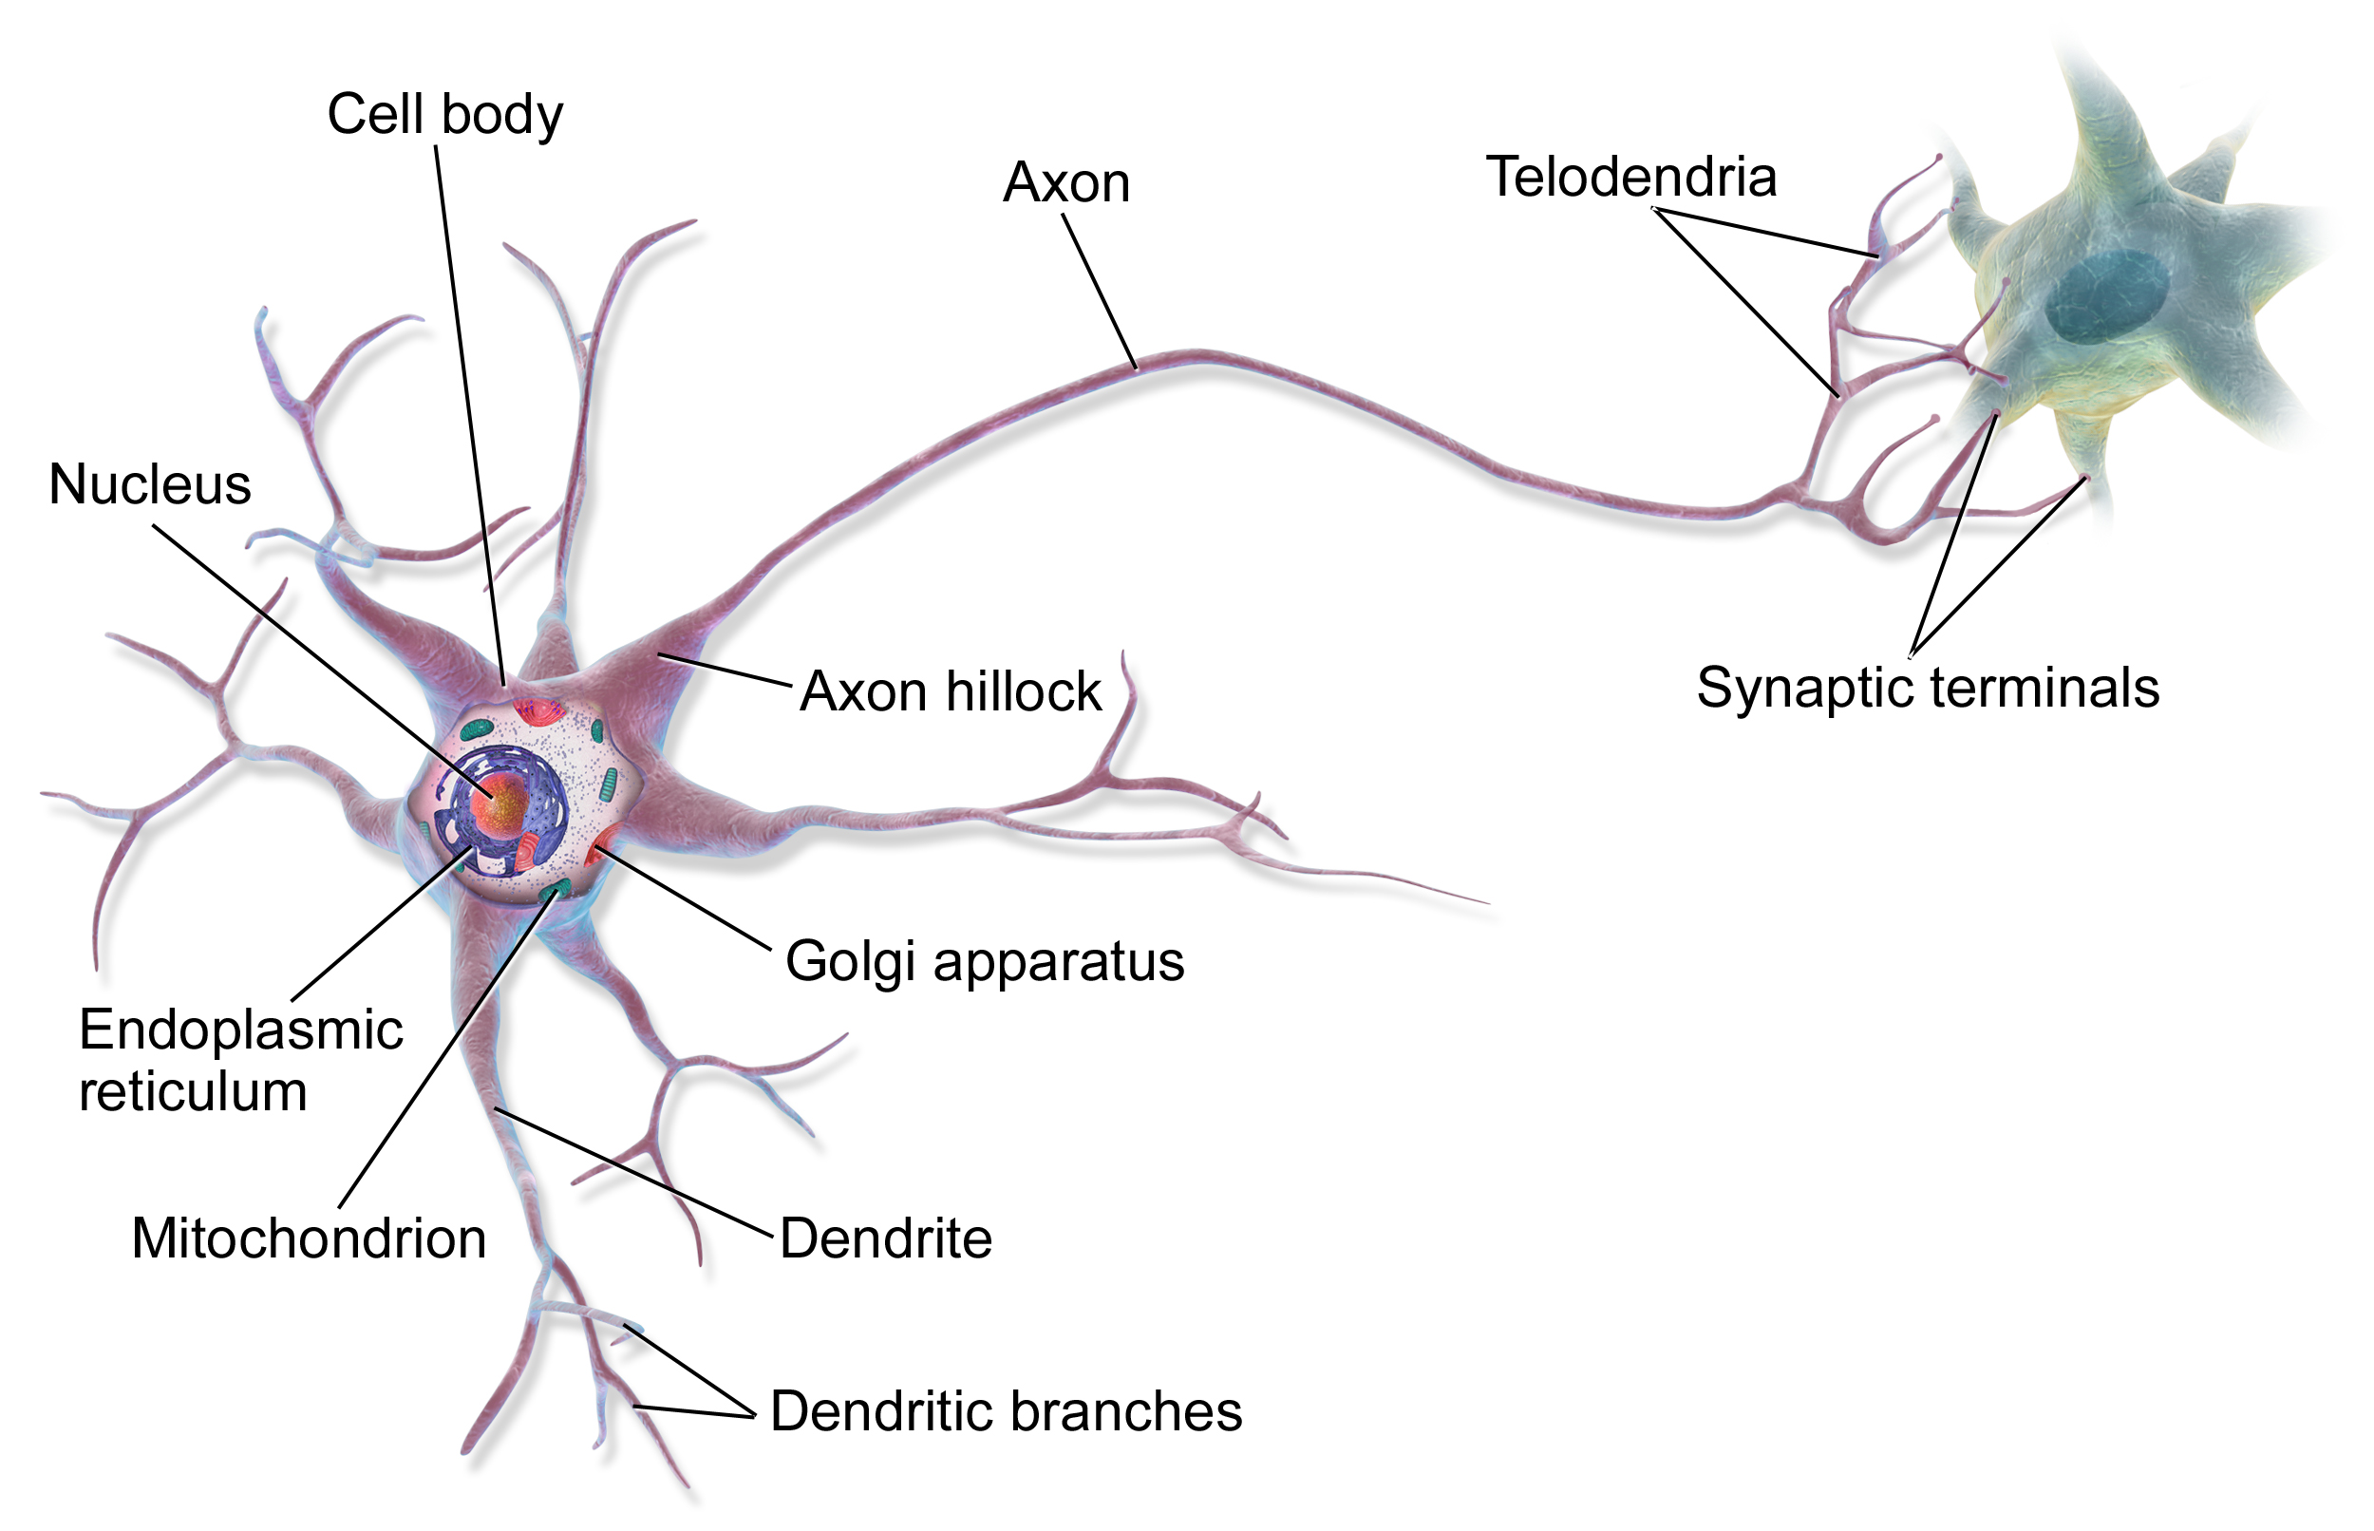
This is in your brain
By BruceBlaus - Own work, CC BY 3.0, https://commons.wikimedia.org/w/index.php?curid=28761830
Notes:
Neural networks are called neural because their origins lie in the McCulloch-Pitts neuron, which was a 1943 simplified model of the human neuron as a kind of computing element that could be described in terms of propositional logic. But the modern use in language processing no longer draws on these early biological inspirations and the name neural is really just a kind of historical remnant.

Slide 51
Neural Network Unit
This is not in your brain
Output value
Non-linear transform
Weighted sum
Parameters
bias
Weights
Input layer
Notes:
Instead, a modern neural network is a network of small computing units, each of which takes a vector of input values and produces a single output value.
Over the next few lectures we'll introduce these units and see how they connect together into feedforward networks, so called because the computation proceeds iteratively from one layer of units to the next. The use of modern neural nets is often called deep learning, because modern networks are often deep (have many layers).
The building block of a neural network is a single computational unit. A unit takes a set of real valued numbers as input, performs some computation on them (combining with weights and biases and a non-linear transform), and produces an output. Let's see this in more detail.

Slide 52
Parameters
The weights and biases of the neural network
Open-weight models: the developer releases all the weights so others can inspect and run them
Closed-weight or proprietary models: the developer hosts the model and only allows app/API access

Slide 53
Embeddings
Embeddings represent meaning of a token as a point in high-dimensionality space.
We'll see how these can be used to do computations on meaning like word similarity
Invented by psychologist Charles Osgood in the 1950s
Notes:
Notice how the word sweet is close to honey and juice and candy, but
further from fried or soup. Visualization created using the TensorBoard Embedding Pro-
jector https://projector.tensorflow.org/ (Chapter 5).

Slide 54
Embeddings
An embedding is the internal representation of meaning of tokens and sentences in an LLMs
An embedding is just a vector
Embeddings thus represent meaning of a token as a point in high-dimensionality space.
Invented by psychologist Charles Osgood in the 1950s
We'll see how these can be used to do computations on meaning like word similarity

Slide 55
Putting together

Slide 56
Large Language Models
Underpinnings: Neural Networks and Embeddings

Slide 57
Large Language Models
A Brief History of Speech and Language Processing

Slide 58
Four stages in the history of the field

Slide 59
Statistical and Neural Foundations 1950s/early 1960s
Roots in 1950s and early 1960s
Shannon (1951) on word prediction
Rosenblatt at Cornell and Widrow at Stanford doing early neural nets
Embedding intuition:
  Osgood in psychology
  Harris and Joos in linguistics
  Early CS work on information retrieval

Slide 60
The Symbolic Turn, 1960s-1988
Linguistic turn toward formal grammars, Chomsky 1957 and Miller and Chomsky 1963 arguments against statistical modeling
Minsky and Papert (1969) XOR arguments against neural nets
Parsing algorithms central to field
Semantics (Prolog, logic, wordnet and Schank and Abelson)
Discourse (Grosz and Sidner)

Slide 61
The Revival of Empiricism, 1988-2019
1975-Jelinek and IBM Speech team. Invented 'language model'
1986 Backprop, return of neural nets and connectionism
1988 Statistical models: speech to NLP (like IBM Statistical MT)
1990 LSA Embeddings
2003 Bengio Neural LM
2008 neural multitask learning C&W
2015 Attention
2017 Transformer
2019 BERT
,

Slide 62
Statistical and Neural Foundations LLM 2019-
GPT-2 (Radford et al 2019) prompting
RAG (Lewis et al 2020)
FLAN (Wei et al 2021) Instruction tuning
InstructGPT (Ouyang et al 2022) RLHF
ReAct (Yao et al 2022)
RLVR (Lambert et al 2024)

Slide 63
Four stages in the history of the field

Slide 64
Large Language Models
A Brief History of Speech and Language Processing

Slide 65
Large Language Models
Linguistic Structure and Interpretability

Slide 66
Linguistic structure in NLP/LLMs
In early NLP, linguistic structure was a central step in process of building meaning representation
In modern NLP/LLMs, we have other ways of building meaning representations
word prediction and embeddings
Instead, linguistic structure plays 2 new roles:
Interpretability of LLMs
Applications to social and cognitive science

Slide 67
Kinds of linguistic structure
Morphology
Syntax
Semantics
Coreference
Discourse Coherence
Conversational Structure

Slide 68
Syntactic structure
Verbs have subjects and direct objects
These are just 2 examples of the many kinds of dependency relationships between words.
Depending parsing, annotating sentences with these structures, is one of the oldest tasks in NLP

Slide 69
Coreference Structure
Victoria Chen, CFO of Megabucks Banking, saw her pay jump to $2.3 million, as the 38-year-old became the company’s president.
We say these 3 blue phrases corefer
Meaning that they all refer to the same entity (in the mental model of the writer or reader of the sentence)

Slide 70
Interpretability and linguistic structure
Goal of interpretability: understand interns of how a neural net processes language
Example: Embeddings in networks implicitly represent:
syntactic parse trees
semantic information
coreference information

Slide 71
Attention is sensitive to grammar
Some attention heads for direct object tokens attend to their governing verb

Slide 72
Attention is sensitive to coreference
Other attention heads for a mention of an entity attend to coreferent antecedent

Slide 73
Linguistic structure can also help analysis
Conversational Grounding
People indicate whether they understand them or not
they ground each others' utterances
A: Can you hand me the box? [in context w/2 boxes]
B: Which one?
Clarification question

Slide 74
LLMs avoid asking clarification questions
Shaikh et al (2024) analyzed transcripts of human-LLM conversations
Labeled them with conversational structure labels
Instead of asking for clarification, LLMs make often incorrect assumptions about what the user meant.

Slide 75
Analyzing LLM-human conversations
LLMs show linguistic overconfidence (Zhou et al., 2024);
LLMs overuse strengtheners like "definitely" and avoid weakeners like "maybe"
LLMs generate sycophantic language (Cheng et al., 2026)
LLMs use language that is linguistically affirming and bolstering the user's positive face and self-image

Slide 76
Linguistic structure computation also useful in social and cognitive science
Psychology: studying how humans process language
Political science: studying political speech
Linguistics: studying linguistic structure itself

Slide 77
Large Language Models
Linguistic Structure and Interpretability

Slide 78
Large Language Models
Pretraining

Slide 80
Pretraining
The big idea that underlies LM performance
First pretrain a transformer model on enormous amounts of text
Then apply it to new tasks.

Slide 81
Self-supervised pre-training
Train LLMs to predict the next word
Take a corpus of text
At each time step t
  ask the model to predict the next word
  train the model (modify weights) to minimize prediction error
    Cross entropy loss and gradient descent
  "Self-supervised" because it just uses the next word as the label!

Slide 82
What is this text that models pretrain on?
For proprietary models, we don't know!

Slide 83
Open LLMs are mainly trained on the web
CommonCrawl, snapshots of the entire web produced by the non-profit Common Crawl with billions of pages
Fineweb corpus (2025)
18.5 trillion tokens of English
From 96 CommonCrawl dumps from 2013-2024.

Slide 84
Dolma corpus: 3 trillion tokens of English

Slide 85
Filtering for quality and safety
Need to remove boilerplate, porn
Deduplication at many levels (URLs, documents, even lines)
Emphasize clean data: Wikipedia, books
Toxicity detection has problems
  Mistakenly flags non-toxic data like African American English
  Models trained on toxicity-free text have trouble detecting it!

Slide 86
Problems with scraping from the web
Copyright: much of the text is copyrighted
US: Not clear if counts as fair use
Open legal question across the world
Privacy:
Websites can contain private IP addresses and phone numbers
Skew:
Date disproportionately generated by authors from the US
  skews resulting topics and opinions

Slide 87
Large Language Models
Pretraining

Slide 88
Large Language Models
Instruction tuning

Slide 90
Why isn't pretraining enough to make a language model converse?
What happens if you prompt a pretrained language model:
Prompt: Explain the moon landing to a six year old in a few sentences.
Output: Explain the theory of gravity to a 6 year old
Prompt: Translate to French: The small dog
Output: The small dog crossed the road
Problem:
LMs are text predictors, they don't know we want an assistant!

Slide 91
Solution: Instruction Tuning
Also called "Supervised Fine Tuning" or SFT
Continue training the model on a big dataset of instructions and responses
questions and answers
translations,
classification tasks like sentence

Slide 92
Instruct tuning = SFT
Learning to predict words in instruct datasets
Question: What is the sentiment of this post: "I love this movie"
Answer: positive

Slide 93
Instruction tasks
Ouyang et al (2022)
Brainstorming:
What are 10 science fiction books I should read next?
Classification:
What is the sentiment classification of this post?
Extraction:
Extract all the place names from this article [article]
Generation:
Write a short story where a cat goes to the beach.
Translation:
Translate this sentence into Spanish: [sentence]

Slide 94
16000 tasks in
Super Natural Instructions

Slide 95
Supervised fine-tuning: only on the response
Instruction: Write a letter from the perspective of a cat
Output:
Dear
[Owner],
I
am
writing
to
you
today
Train
Train
Train
Train
Train
Train
Train
Train

Slide 96
Summary: Instruction Tuning
Get lots of instructions for many diverse tasks
And a base pre-trained LLM
Continue training the LLM to predict only the responses for each instruction, word by word
Resulting "Instruct-Tuned" LM:
follows these instructions
and can follow novel instructions

Slide 97
Large Language Models
Instruction Tuning

Slide 98
Large Language Models
Preference Alignment

Slide 100
Preference alignment
Imrpove an instruction-tuned LLM
By using preference judgments: rankings of potential responses to a prompt
Have model generate two candidate responses
Then have humans (or LLM) rank which is better
Then use reinforcement learning (PPO, DPO) to train model to prefer one and disprefer the other

Slide 101
Sample preferences from HH-RLHF
Avoid harm
Be factual
Well, at least more factual

Slide 102
Preference Alignment Algorithm

Slide 103
Why is preference alignment different than SFT
Because we don't just train the model to produce the chosen response
We also train it not to produce the rejected response

Slide 104
Safety
For both SFT and preference alignment, we want the model to learn not to respond to unsafe requests:

Slide 105
Large Language Models
Preference Alignment

Slide 106
Large Language Models
RL for Reasoning: Reinforcement Learning with Verifiable Rewards

Slide 108
Reasoning
Instruction-tuned preference-aligned models are still not great at reasoning
How to train models on lots of examples of good reasoning chains?
Problem: Lots of reasoning domains are tricky, would need human validation
Idea: use domains where we can automatically check if reasoning is correct
  Math, formal reasoning, verifiable constraints

Slide 109
Verifiable Math problem

Slide 110
RLVF
Reinforcement Learning with Verifiable Rewards
Give a reasoning question in a verifiable domain like math
Automatically check if the response is correct or not
Use reinforcement learning to reward the model when it gets right answers

Slide 111
Large Language Models
RL for Reasoning: Reinforcement Learning with Verifiable Rewards

Slide 112
Large Language Models
Inference

Slide 113
Inference
Inference means running the model and generating text

Slide 114
Prompts
A question:
What is a transformer network?
Or an instruction:
Translate the following sentence into Hindi: ‘Chop the garlic finely’.

Slide 115
Prompts can have demonstrations (= examples)
1 demonstration

Slide 116
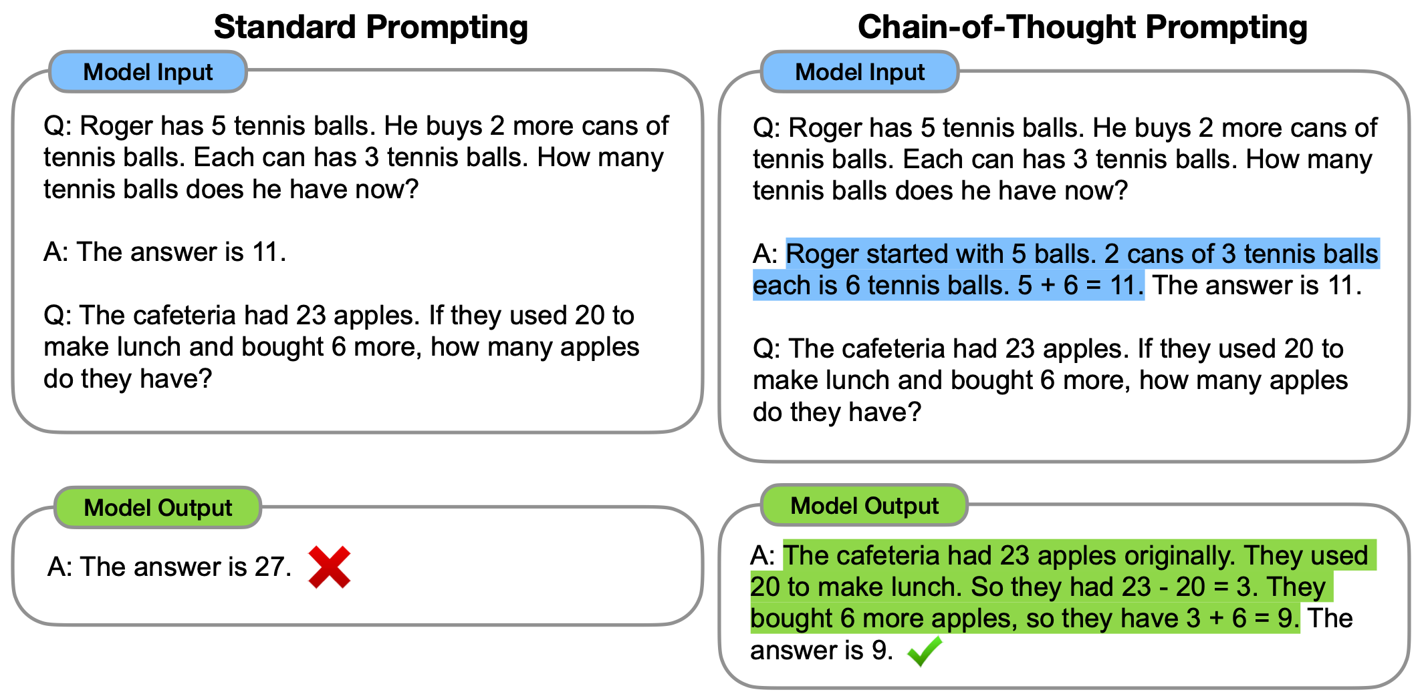
Chain of Thought
Give examples of reasoning in the demonstration

Slide 117
LLMs usually have a system prompt
<system>You are a helpful and knowledgeable assistant. Answer concisely and correctly.
This is automatically and silently concatenated to a user prompt
<system> You are a helpful and knowledgeable assistant. Answer concisely and correctly. <user> Who wrote The Origin of Species

Slide 118
System prompts can be long; 1700 words for Claude Opus4
Some extracts:
Claude should give concise responses to very simple questions, but provide thorough responses to complex and open-ended questions.
Claude is able to explain difficult concepts or ideas clearly. It can also illustrate its explanations with examples, thought experiments, or metaphors.
Claude does not provide information that could be used to make chemical or biological or nuclear weapons.
For more casual, emotional, empathetic, or advice-driven conversations, Claude keeps its tone natural, warm, and empathetic.
Claude cares about people’s well-being and avoids encouraging or facilitating self-destructive behavior.
If Claude provides bullet points in its response, it should use markdown, and each bullet point should be at least 1-2 sentences long unless the human requests otherwise.

Slide 119
Remember that prompting is just word prediction!
We instinctively model this as just having a conversation
But it's important to remember models are just doing conditional generation

Slide 120
An example of inference
User types "Who wrote The Origin of Species?"

Slide 122
Agents
This is especially clear with demonstrations
But this is a different kind of learning than pretraining
Pretraining sets language model weights via gradient descent
Prompting just changes the context and the activations in the network; no parameters change
We call this in-context learning—learning that improves model performance but does not update parameters

Slide 123
Large Language Models
Inference

Slide 124
Large Language Models
Agents

Slide 125
What is an Agent?
An LLM that can act in the world, calling
  a search engine to get up-to-date information,
  a calendar to compute free slots,
  a python program to do calculation
  a database to look something up,
  an API to order supplies.
It does this having tokens for actions that it can generate
SEARCH()
CALENDAR()
CALCULATOR()

Slide 126
Example Agent Architecture: ReAct
User question: Aside from the Apple Remote, what other device can control the program Apple Remote was originally designed to interact with?
Idea: Prompt the LLM to generate actions interleaved with reasoning traces, allowing the model to reason about plans for acting

Slide 127
Example Agent Architecture: ReAct
Question: Aside from the Apple Remote, what other device can control the program Apple Remote was originally designed to interact with?

Slide 128
A sample ReAct prompt that defines 3 actions

Slide 129
Large Language Models
Agents

Slide 130
Large Language Models
Evaluating LLMs

Slide 131
Large Language Models
Evaluating LLMs

Slide 132
How to make an LLM multilingual?
Surprising answer
Just throw all the languages data in a big file and pretrain on it!
FineWeb2 dataset
1000 languages
5 billion documents
From Common Crawl

Slide 134
Large Language Models
Evaluating Large Language Models

Slide 135
Evaluating Accuracy
Did the LLM get the right answer?
If we ask
What is the sentiment of this sentence "I loved this movie"
  does the LLM say "positive"?
What is "457 + 3"
  does the LLM say "460"?

Slide 136
Example: Massive Multitask Language Understanding (MMLU)

Slide 137
Accuracy at Word Prediction
Notes:
The language model here predicts the most likely next word to be “all”
(with probability .44) followed by “the” (probability .33). If the correct next word is
‘all’, the language model should get credit proportional to the probability it assigns
to ‘all’. If the correct next word is ‘the’, the model should get credit proportional
to the probability it assigns to ‘the’. Thus if we want to see which of two language
models is a better model of some text, we can check which model assigns a higher
probability to each word in the text

Slide 138
Evaluating Subjective Tasks
What is the translation of this sentence?
Write me a poem
Human-as-Judge
LLM-as-a-Judge

Slide 139
Human-as-a-Judge vs LM-as-a-Judge
Ask people to evaluate
Give them instructions (a rubric)
Or use LLMs to evaluate
Double check a portion of the data with humans
Human or LLM, evaluations can be single (how good is this answer?) or pairwise (which of these two answers is better?)

Slide 140
Many other factors that we evaluate, like:
Size
Big models take lots of GPUs and time to train, memory to store
Energy usage
Can measure kWh or kilograms of CO2 emitted
Fairness
Benchmarks measure safety and bias, stereotypes, etc.

Slide 141
Large Language Models
Safety and Alignment

Slide 142

1816 eruption of Tambora in Indonesia
Picture from
Jialiang Gao
Largest eruption in history! The year with no summer!

Slide 143

Summer 1816, on Lake Geneva
Photo
@suarezphoto
from World Meteorological
Association

Slide 144
18-year-old woman stuck inside a villa in the rain
Began to write a ghost story

Slide 145
Mary Godwin Shelley

Slide 146
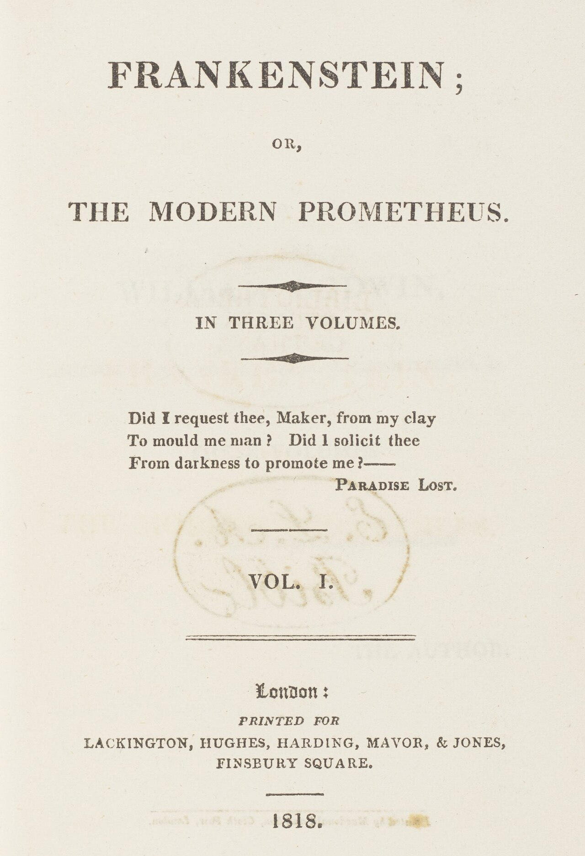

Slide 147
One running theme of Frankenstein
Victor's lack of responsibility for the creature's actions and for the creature himself

Slide 148
Implications of Frankenstein for LLMs
Creating artificial agents without considering the ethical and human concerns can lead to tragedy

Slide 149
AI Safety or Alignment
Alignment is the goal of getting LMs to avoid harms by acting in ways that align with human needs and values.
The word "alignment" is very underspecified (Whose values? What happens if values conflict?)
Still, there are some clear harms that we need to figure out how to address.

Slide 150
Two kinds of harms
User-level harms
Societal-level harms

Slide 151

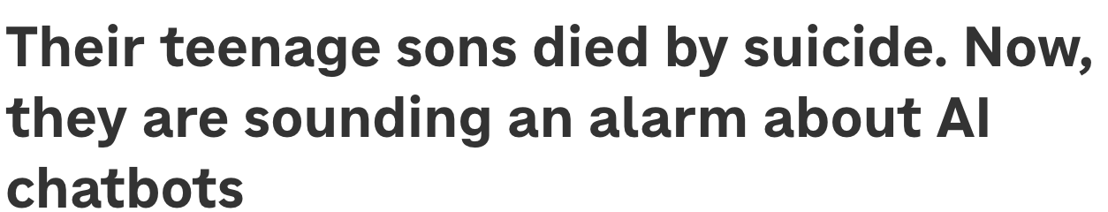
Emotional Dependence and Mental Health
Teenagers develop overstrong attachments to
More use of LLMs leads to loneliness, less socialization, emotional dependence
Some users who seek emotional support from AI chatbots end up with a poor sense of well-being

Slide 152
De-skilling
Using LMs for a task leads people to become worse at the task.
Reduction in critical thinking abilities (Gerlich, 2025),
Less confidence in their abilities (Lee et al., 2025),
Less conceptual understanding (Shen and Tamkin, 2026),
Give up faster if LM is removed (Liu et al., 2026).

Slide 153
Sycophancy
LMs can be sycophantic, excessively agreeing with, flattering, or validating users
When a user says something wrong, LLMs agree instead of correcting them (Sharma et al., 2024).
Cheng et al (2026): A single interaction with a sycophantic LLM made users more antisocial:
less willing to accept responsibility
more convinced they are always right

Slide 154
Attacking or harming users
LLMs can
Verbally attack users
Discriminate against them
Generate hate speech and stereotypes
LLMs discriminate against people who use particular dialects like African American English

Slide 155
LLMs function poorly for some speakers
Speech recognition worse on older speakers
Speech recognition worse on speakers of dialects of (e.g., of Mandarin or of Dutch or African American English)
LLMs in general work worse on non-English languages

Slide 156
Societal-level harms
Malicious actors can use LLMs for cyber attacks, fraud, biological or chemical weapons
LLMs have enormous environmental impact because of computing power, energy, water
LLMs likely lead to concentrate wealth and power
LLMs could lead to job displacement
Existential risk: LLMs could pursue own goals in conflict with people

Slide 157
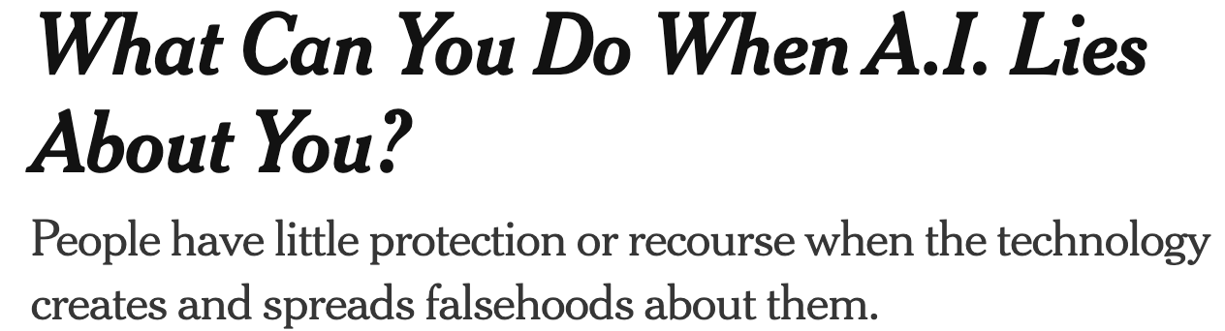

Other limitations of LLMs
Often wrong
Expensive
Overconfident
Poorly calibrated
(model’s actual accuracy doesn’t match the score or probability they assign)

Slide 158
Mitigating harms
Value-sensitive design
Post-training and preference alignment
Constitutional AI
But alignment is a very hard and unsolved problem!!!

Slide 159
Large Language Models
Safety and Alignment

