Slide 1
Information Retrieval and RAG
The Information Retrieval Task

Slide 2
Information retrieval
User has an information need
And has some collection of documents
User wants to find a relevant document
  a document (or documents)
  in the collection
  that satisfy their need

Slide 3
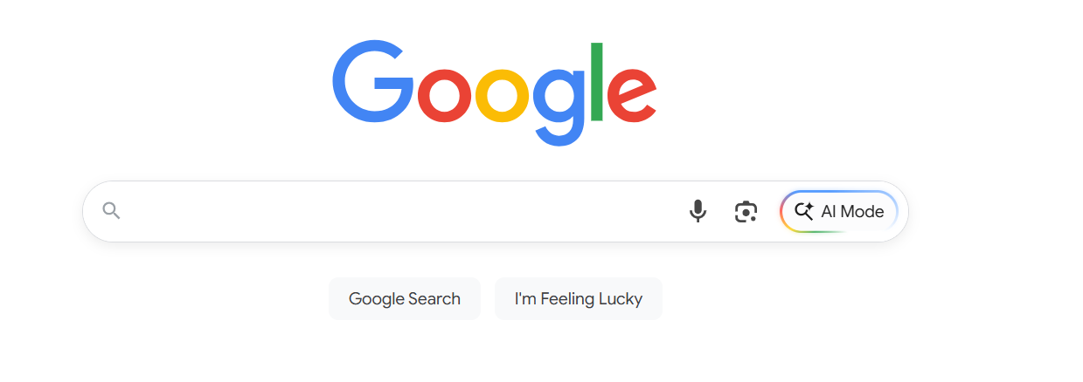
Web search

Slide 4
Not just the web
Searching our email
Searching corporate documents
Searching personal medical records
And also, part of LLMs
retrieval-augmented generation (RAG)

Slide 5
In most cases we do "ranked retrieval"
The retriever returns top-k documents
These are ranked
We can show the user these, or some subset.

Slide 6
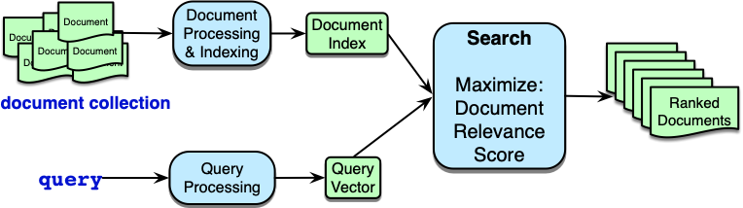
Ad-hoc retrieval

Slide 7
Document Relevance Score
Goal is to assign a score to each document for whether it meets the user's information need
Instead, we just approximate this by the textual similarity between the query and the document.

Slide 8
Two architectures
Sparse retrieval
  represent query and doc as vectors of word counts
  weighted by tf-idf, BM25
Dense retrieval
  Use LLM to represent query and doc as embeddings
  In both cases, similarity is dot product or cosine between query and document representations

Slide 9
Information Retrieval and RAG
The Information Retrieval Task

Slide 10
Information Retrieval and RAG
Sparse retrieval: the vector model of IR

Slide 11
The vector space model of IR
Gerard Salton, 1971
Represent a document as a vector of counts of the words it contains.

Slide 12
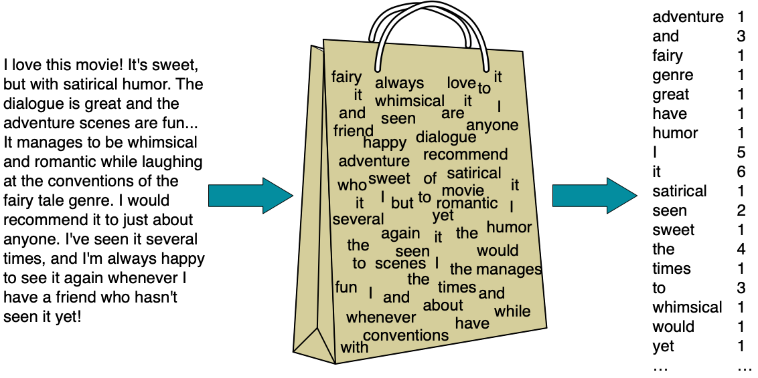
Bag-of-words model

Slide 13
Vector representation of that doc
[1 3 1 1 1 1 1 5 6 1 2 1 4 1 3 1 1 1]

Slide 14
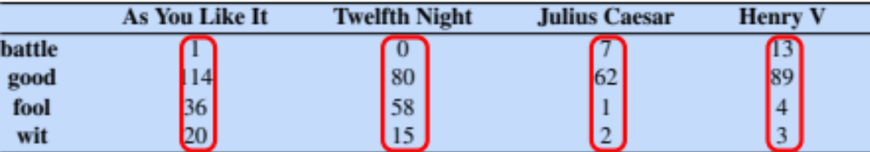
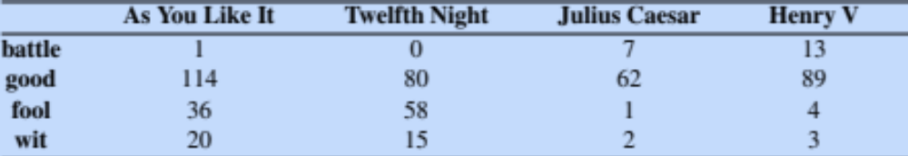
Term-document matrix
Each document is represented by a vector of words
Notes:
Imagine we have a collection of documents, such as all the works of Shakespeare. We can represent documents in such a collection by a term-document matrix, in which each row represents a word in the vocabulary and each column represents a document from the collection. Here's a small selection from a term-document matrix showing the occurrence of four words in four plays by Shakespeare. Each cell in this matrix represents the number of times a particular word (defined by the row) occurs in a particular document (defined by the column). Thus fool appeared 58 times in Twelfth Night. We can think of each column as a vector representing for a document as a point in |V |-dimensional space; thus the documents in here are points in 4-dimensional space.

Slide 15
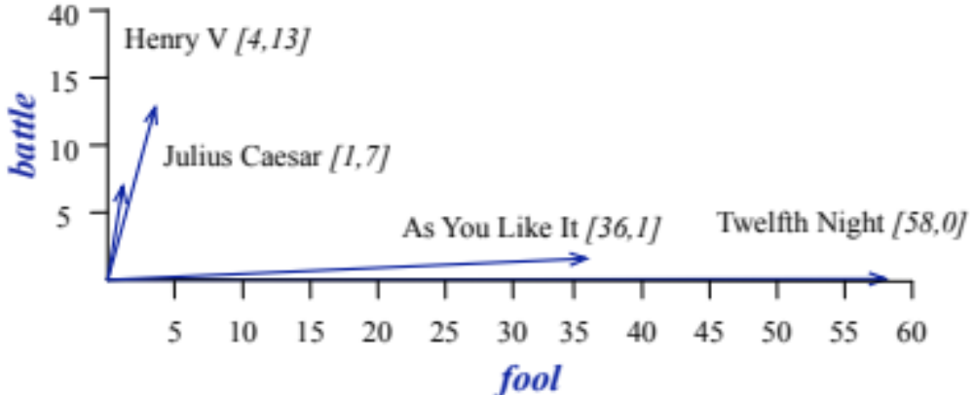
Visualizing document vectors
The two dimensional space [battle, fool]
Notes:
A spatial visualization of the document vectors for the four Shakespeare play documents, showing just two of the dimensions, corresponding to the words battle and fool. The comedies have high values for the fool dimension and low values for the battle dimension.

Slide 16
Vectors are the basis of information retrieval
Vectors are similar for the two comedies
But comedies are different than the other two
Comedies have more fools and wit and fewer battles.
Notes:
Two documents that are similar will tend to have similar words, and if two documents have similar words their column vectors will tend to be similar. The vectors for the comedies As You Like It [1,114,36,20] and Twelfth Night [0,80,58,15] look a lot more like each other (more fools and wit than battles) than they look like Julius Caesar [7,62,1,2] or Henry V [13,89,4,3]. A real term-document matrix, of course, wouldn’t just have 4 rows and columns, let alone 2. More generally, the term-document matrix has |V| rows (one for each word type in the vocabulary) and D columns, one for each document in the collection.

Slide 17
Vector representations of queries and documents
Suppose we are looking for a witty fool play:
Query = "fool wit"
Query
0
0
1
1

Slide 18
Choose the document that is most similar to the query
Which of d₁, d₂, d₃, d₄ is most similar to q?
d₁
d₂
d₃
d₄
q
Query
0
0
1
1

Slide 19
Similarity methods are variants of dot product
The dot product is q ∙ d
score (q,d₁) = q ∙ d₁ =
d₁
d₂
d₃
d₄
q
Query
0
0
1
1

Slide 20
In fact we use cosine

Slide 21

In fact we use cosine

Slide 22
Information Retrieval and RAG
Sparse retrieval: the vector model of IR

Slide 23
Information Retrieval and RAG
TF-IDF

Slide 24
But raw frequency is a bad representation
The co-occurrence matrices we have seen represent each cell by word frequencies.
Frequency is clearly useful; if sugar appears a lot near apricot, that's useful information.
But overly frequent words like the, it, or they are not very informative about the context
It's a paradox! How can we balance these two conflicting constraints?
Notes:
The co-occurrence matrices we've been using represent each cell by frequencies of words with other words or documents. But raw frequency is is very skewed and not very discriminative. If sugar appears a lot near apricot, that's useful information. But words like the, or it, which occur frequently with all sorts of words, aren’t informative about any particular word . It’s a bit of a paradox. How can we balance these two conflicting constraints?

Slide 25

Two common solutions for word weighting
tf-idf: tf-idf value for word t in document d:
PMI: (Pointwise mutual information)
  $\text{PMI}\left(w_{1},w_{2}\right)=log\frac{p(w_{1},w_{2})}{p\left(w_{1}\right)p(w_{2})}$
Words like "the" or "it" have very low idf
See if words like "good" appear more often with "great" than we would expect by chance
Notes:
There are two common solutions to this problem: the tf-idf algorithm, usually used when the dimensions are documents, and algorithms based on pointwise mutual information, or PMI (usually used when the dimensions are words). Tf-idf makes use of a special weight call the "inverse document frequency or "idf", to downweight words like "the" or "it". PMI is a statistical measure that compares the probabilities we see with what we would have expected by change.

Slide 26
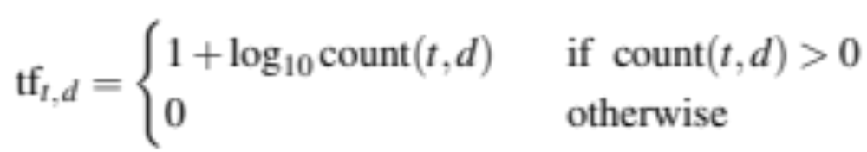
Term frequency (tf) in the tf-idf algorithm
We could imagine using raw count:
tf_{t,d} = count(t,d)
But instead of using raw count, we usually squash a bit:
Notes:
The tf-idf algorithm (the ‘-’ here is a hyphen, not a minus sign) is the product of two factors. The first factor is the term frequency: the frequency of the word t in the document d.
Although we can just use the raw count as the term frequency, more commonly we squash the raw frequency a bit, by using the log10 of the frequency instead. The intuition is that a word appearing 100 times in a document doesn’t make that word 100 times more likely to be relevant to the meaning of the document. Because we can’t take the log of 0, we normally return 0 for counts of 0, and add 1 to the log otherwise, so counts of 0 get a tf of 0, counts of 1 get a tf of 1, but counts of 10 get a tf of 2 (and counts of 5 are in between).

Slide 27
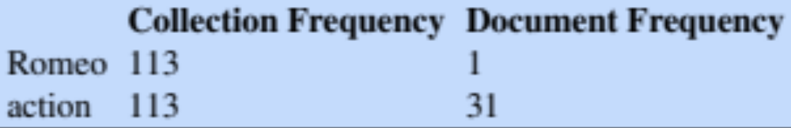
Document frequency (df)
df_{t} is the number of documents t occurs in.
(note this is not collection frequency: total count across all documents)
"Romeo" is very distinctive for one Shakespeare play:
Notes:
The second factor in tf-idf is used to give a higher weight to words that occur only in a few documents. Terms that are limited to a few documents are useful for discriminating those documents from the rest of the collection; terms that occur frequently across the entire collection aren’t as helpful. The document frequency dft of a term t is the number of documents it occurs in .
Document frequency is not the same as the collection frequency of a term, which is the total number of times the word appears in the whole collection in any document. Consider in the collection of Shakespeare’s 37 plays the two words Romeo and action. The words have identical collection frequencies (they both occur 113 times in all the plays) but very different document frequencies, since Romeo only occurs in a single play. If our goal is to find documents about the romantic tribulations of Romeo, the word Romeo should be highly weighted, but not action:
Important: documents can be anything, they don't have to be original documents. For example we often treat each paragraph as a document, which lets use compute tf-idf values for

Slide 28
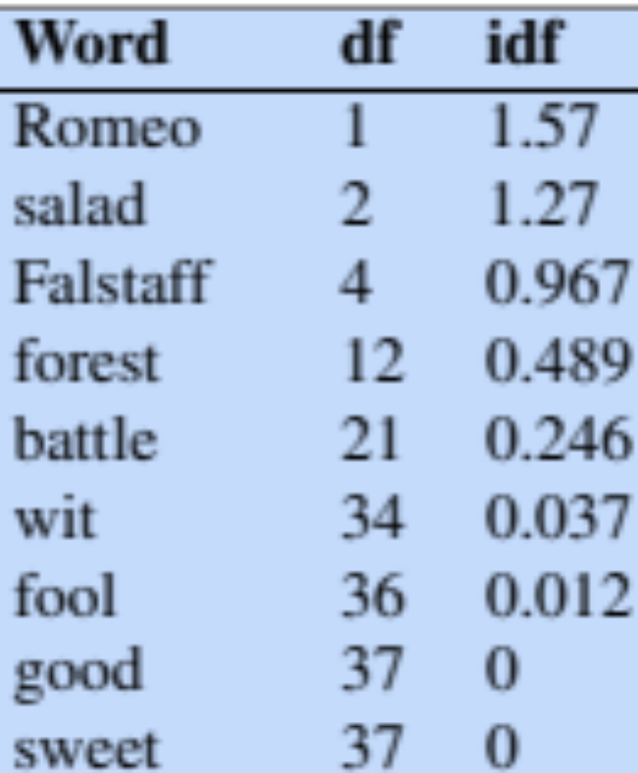
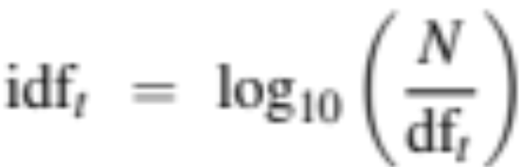
Inverse document frequency (idf)
N is the total number of documents
in the collection
Notes:
We emphasize discriminative words like Romeo via the inverse document fre- quency or idf term weight (Sparck Jones, 1972). The idf is defined using the frac- tion N/dft, where N is the total number of documents in the collection, and dft is the number of documents in which term t occurs. The fewer documents in which a term occurs, the higher this weight. The lowest weight of 1 is assigned to terms that occur in all the documents. Because of the large number of documents in many collections, this measure too is usually squashed with a log function. The resulting definition for inverse document frequency (idf) is thus
Here are some idf values for some words in the Shakespeare corpus, ranging from extremely informative words which occur in only one play like Romeo, to those that occur in a few like salad or Falstaff, to those which are very common like fool or so common as to be completely non-discriminative since they occur in all 37 plays like good or sweet.

Slide 29
What is a document?
Could be a play or a Wikipedia article
But for the purposes of tf-idf, documents can be anything; we often call each paragraph a document!
Notes:
It’s usually clear what counts as a document: in Shake-speare we would use a play; when processing a collection of encyclopedia articles like Wikipedia, the document is a Wikipedia page; in processing newspaper articles, the document is a single article. But very frequently you might need to break up the corpus into documents yourself for the purposes of computing idf. Because that documents can be anything, they don't have to be original documents. For example we often treat each paragraph as a document, which lets use compute tf-idf values even when we are dealing say with a single document like a book.

Slide 30
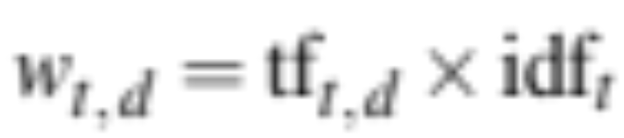
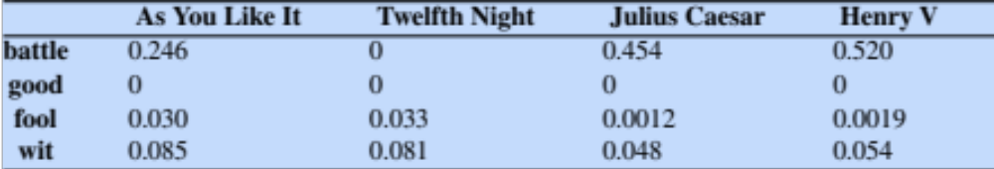
Final tf-idf weighted value for a word
Raw counts:
tf-idf:
Notes:
The tf-idf weighted value wt,d for word t in document d thus combines term frequency tft,d with idf:
Here are the raw counts in the Shakespeare term-document matrix, and the tf-idf weighted version of the same matrix. Note that the tf-idf values for the dimension corresponding to the word good have now all become 0; since this word appears in every document, the tf-idf algorithm leads it to be ignored. Similarly, the word fool, which appears in 36 out of the 37 plays, has a much lower weight.

Slide 31
Information Retrieval and RAG
TF-IDF

Slide 32
Information Retrieval and RAG
TF-IDF: a worked example

Slide 33
Cosine

Slide 34

TF-IDF weighted cosine

Slide 35
TF-IDF weighted cosine

Slide 36

TF-IDF nano-example

Slide 37
TF-IDF nano-example
|q| = √
Word | Count | tf 1+log₁₀(c) | df | idf log₁₀N/df) | tf-idf tf x idf | normalized
sweet | 1
nurse | 0
love | 1
how | 0
sorrow | 0
is | 0

Slide 38
TF-IDF nano-example
|q| = √(.125² + .301²) = .325
Word | Count | tf 1+log₁₀(c) | df | idf log₁₀N/df) | tf-idf tf x idf | normalized
sweet | 1 | 1 | 3 | 0.125 | 0.125 | 0.383
nurse | 0
love | 1 | 1 | 2 | 0.301 | 0.301 | 0.924
how | 0
sorrow | 0
is | 0

Slide 39
TF-IDF nano-example
|q| = √
Word | Count | tf 1+log₁₀(c) | df | idf log₁₀N/df) | tf-idf tf x idf | normalized | × q
sweet | 1
nurse | 0
love | 0
how | 0
sorrow | 1
is | 0

Slide 40
TF-IDF nano-example
|q| = √(.125² + .602²) = .615
Word | Cnt | tf 1+log₁₀(c) | df | idf log₁₀N/df) | tf-idf tf x idf | normalized | × q
sweet | 1 | 1 | 3 | 0.125 | .125 | .203 | 0.0779
nurse | 0
love | 0
how | 0
sorrow | 1 | 1 | 1 | .602 | 0.602 | .979 | 0
is | 0

Slide 41
TF-IDF nano-example
.
= 0.0779
Word | Cnt | tf 1+log₁₀(c) | df | idf log₁₀N/df) | tf-idf tf x idf | normalized | × q
sweet | 1 | 1 | 3 | 0.125 | .125 | .203 | 0.0779
nurse | 0
love | 0
how | 0
sorrow | 1 | 1 | 1 | .602 | 0.602 | .979 | 0
is | 0

Slide 42
Final cosine
(details in
chapter)
score(q,d1) = 0.747
score(q,d2) = 0.0779
  d1 has both terms, including 2 instances of sweet
  d2 is missing one of the terms

Slide 43
Information Retrieval and RAG
TF-IDF: a worked example

Slide 44
Information Retrieval and RAG
Efficiency: The Inverted Index

Slide 45
Goal: rank documents in D by their TF-IDF-weighted cosines with query q
Do we have to consider all documents in D?
No! We can ignore all documents that don't have any query words!
They will have a cosine of 0!

Slide 46
How do we efficiently find all documents that contain a query term q_{i}?
An index!
Which for historical reasons we call an inverted index!

Slide 47
Inverted Index
Two parts
Dictionary:
how
is
love
nurse
sorrow
sweet
Postings:
→ 3
→ 3
→ 1→ 3
→ 1 → 4
→ 2
→ 1→ 2 → 3

Slide 48
Inverted Index Creation
1. Sort by term and document
2. Create linked postings list
Term Doc#
sweet 1
sweet 1
nurse 1
love 1
sweet 2
sorrow 2
how 3
sweet 3
is 3
love 3
nurse 4
Term Doc#
how 3
is 3
love 1
love 3
nurse 1
nurse 4
sorrow 2
sweet 2
sweet 1
sweet 1
sweet 3
Dict:
how
is
love
nurse
sorrow
sweet
Postings:
→ 3
→ 3
→ 1→ 3
→ 1 → 4
→ 2
→ 1→ 2 → 3
→
→
→

Slide 49
Inverted Index
Dict
how
is
love
nurse
sorrow
sweet
Postings
→ 3
→ 3
→ 1→ 3
→ 1 → 4
→ 2
→ 1→ 2 → 3

Slide 50
So far this just tells us which documents to grab
Next we need enough information to compute tf-idf:
For each term t in vocabulary:
  The df_{t} (document frequency) of word t
For each term t in each document d:
  The term frequency or count(t,d) of word i in doc d

Slide 51

Doc#
tf
df
Notes:
Given a list of terms in query, we can very efficiently get lists of all candidate documents, together with the information necessary to compute the tf-idf scores we need.

Slide 52
Information Retrieval and RAG
Efficiency: The Inverted Index

Slide 53
Information Retrieval and RAG
Evaluation of IR

Slide 54
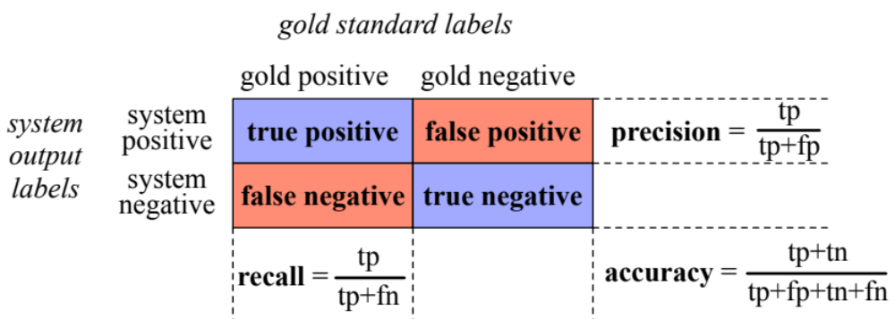
Precision and Recall
We saw these already for classification
Precision: % of selected items that are correct
Recall: % of correct items that are selected
Notes:
Precision is out of the things the system selected (the set of emails or tweets the sytstem claimed were positive, i.e. spam or pie-related), how many did it get right? how many were true positives, out of what I selected (true positives _ false positives).
Recall is out of all the correct items that should have been positive, what % of them did the system select? So out of all the things that are gold positive, how many did the system find as true positives?
So precision is about how much garbage we included in our findings; recall is more about making sure we didn't miss any treasure.

Slide 55
Precision and Recall for IR
User makes an information request
Every document in collection is either:
Relevant to the user
Not relevant to the user
The system retrieves a ranked set of documents

Slide 56
Precision for IR
Precision = % of retrieved documents that are relevant
System retrieves two kinds of documents
relevant documents
irrelevant documents
|relevant retrieved docs|
Precision = ----------------------------------------
|relevant retrieved docs| + |irrelevant retrieved docs|

Slide 57
Recall for IR
Recall = % of relevant documents that are retrieved
Recall = |retrieved relevant documents|
-------------------------------
|all relevant document|

Slide 58
Precision and Recall aren't enough
This is ranked retrieval
Given two ranked retrieval systems
We want a metric that prefers the one that ranks relevant documents higher
We need to adapt precision and recall!
to be sensitive to where in the ranking the relevant document occur

Slide 59
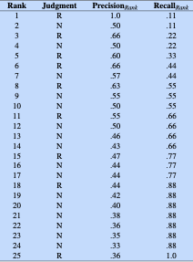
Rank-specific precision and recall
Example:
25 documents
9 are relevant
If we return all 25
P=.36, R= 1.0
Suppose we just return one (and it is relevant)?
Notes:
the precisions are the fraction of relevant documents seen at a given rank, and recalls the fraction of relevant documents found at the same rank

Slide 60
Rank-specific precision and recall
Recall is non-decreasing
Relevant docs increase recall
Non-relevant docs don't
Precision jumps up and down
increasing for relevant docs
decreasing otherwise.
Notes:
the precisions are the fraction of relevant documents seen at a given rank, and recalls the fraction of relevant documents found at the same rank

Slide 61
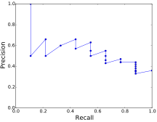
The precision-recall curve (for one query)

Slide 62
Need a metric that aggregates over many queries
Two common approaches
Mean Average Precision
Interpolated Precision

Slide 63
Mean Average Precision
Descend through ranked items
Note precision only if item is relevant
e.g. ranks 1, 3, 5, 6 but not 2 or 4:
Precision_{r}(d) "ranked precision"
precision at the rank doc d was found.

Slide 64

Average Precision
Descend through ranked items
Note precision only if item is relevant
Take the average of the ranked-precisions
R_{r} is the set of relevant documents at or above r
Precision_{r}(d) is precision measured at the rank at which document d was found.

Slide 65

Mean Average Precision
For a set of Q queries
Mean Average Precision (MAP):

Slide 66
Information Retrieval and RAG
Evaluation of IR

Slide 67
Information Retrieval and RAG
Dense Retrieval

Slide 68
Problem with classic IR
The vocabulary mismatch problem
tf-idf or BM25 cosine similarities only work if there is exact word overlap between query and doc!
But query-writer can't know the exact words the doc might include!

Slide 69
Dense retrieval
Instead of representing query and documents with count vectors
Represent both with embeddings!

Slide 70
Hypothetical version of dense retrieval: static embeddings
Replace tf-idf vectors with, e.g., word2vec
Query: the mean of the embeddings of each query word
Doc: the mean of the doc word embeddings
Now just compute query-doc cosine as normal.
We don't do this because contextual embeddings work much better!

Slide 71
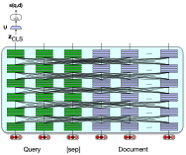
Dense retrieval #1: Single encoder
Notes:
Use a single encoder to jointly encode query and document and finetune to produce a relevance score with a linear layer over the CLS token

Slide 72
Dense retrieval #1: Single encoder
System is run on passages (say 100 tokens) instead of whole documents
Training:
BERT and linear layer U can then fine-tuned for relevance
Creating a tuning dataset of relevant and non-relevant passages.

Slide 73
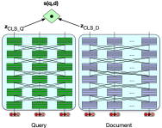

Dense retrieval #2 (biencoder)
Notes:
Use separate encoders for query and document, and use the dot product between CLS token outputs for the query and document as the score. This is less compute-expensive, but not as accurate

Slide 74
Dense retrieval #2 (biencoder)
Encode doc vectors in advance.
Encode query when it arrives
Score is dot product between query vector and precomputed doc vector
Cheaper but less accurate
Notes:
The bi-encoder is much cheaper than a full query/document encoder, but is also less accurate, since its relevance decision can’t take full advantage of all the possible meaning interactions between all the tokens in the query and the tokens in the document.

Slide 75
In-between dense retrieval methods
Use cheap methods (like BM25) as first pass relevance ranking for each document,
Then just rerank the top N ranked docs,
Using expensive methods like the full BERT scoring

Slide 76
ColBERT
Precompute document but store each word vector
Then do maxsim between document and query words
Khattab and Zaharia (2020), Khattab et al (2021)

Slide 77
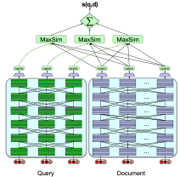

ColBERT
Notes:
The query and docu- ment are first passed through separate BERT encoders. Similarity between query and doc- ument is computed by summing a soft alignment between the contextual representations of tokens in the query and the document. Training is end-to-end.
a question q is tokenized as [q1,...,qn], prepended with a [CLS] and a special [Q] token, truncated to N=32 tokens (or padded with [MASK] tokens if it is shorter), and passed through BERT to get output vectors q = [q1,...,qN]. The passage d with tokens [d1,...,dm], is processed similarly, including a [CLS] and special [D] token. A linear layer is applied on top of d and q to control the output dimension, so as to keep the vectors small for storage efficiency, and vectors are rescaled to unit length, producing the final vector sequences Eq (length N) and Ed (length m). The ColBERT scoring mechanism is:

Slide 78
Training for dense retrieval
ColBERT and other models need to be trained
To fine-tune the BERT encoders and train the linear layers (and the special [Q] and [D] embeddings)
On datasets of triples ⟨q,d+,d−⟩
Some datasets like MS MARCO Ranking have positive examples

Slide 79
Efficiency in dense retrieval
We must rank every document for its similarity to the query!
Efficiency for sparse word-count vectors: inverted index
Efficiency for dense retrieval:
nearest neighbor search: finding the set of dense document vectors that have the highest dot product with a dense query vector.
Approximate nearest neighbor algorithm Faiss (Johnson et al., 2017).
  Approximates the doc vector by a smaller quantized vector

Slide 80
Information Retrieval and RAG
Dense Retrieval

Slide 81
Information Retrieval and RAG
Retrieval-Augmented Generation

Slide 82
IR plays a central role in modern LLMs
How to answer factual questions like
Where is the Louvre Museum located?
How to get a script l in latex?
Where does the energy in a nuclear explosion come from?

Slide 83
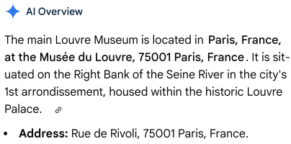
Just prompt an LLM!
LLMs seem to store facts in the connections in their feedforward layers!

Slide 84
But there are issues!

Slide 85
LLMs Hallucinate
Hallucination: a response that is not faithful to the facts of the world.
In the legal domain LLMs were shown to hallucinate up to 88% of the time!
Dahl et al. (2024)

Slide 86
Can't use Proprietary Data
People need to ask questions about:
personal email.
healthcare applications to medical records.
internal corporate documents
legal documents discovery

Slide 87
Can't Handle Dynamic Data
LLMs can't answer questions about rapidly changing information
Things that happened last week
In general, data shifts over time

Slide 88
Solution: RAG
Retrieval-Augmented Generation
Use IR to retrieve documents from some collection
Then use LLM to generate an answer conditioned on the documents

Slide 89
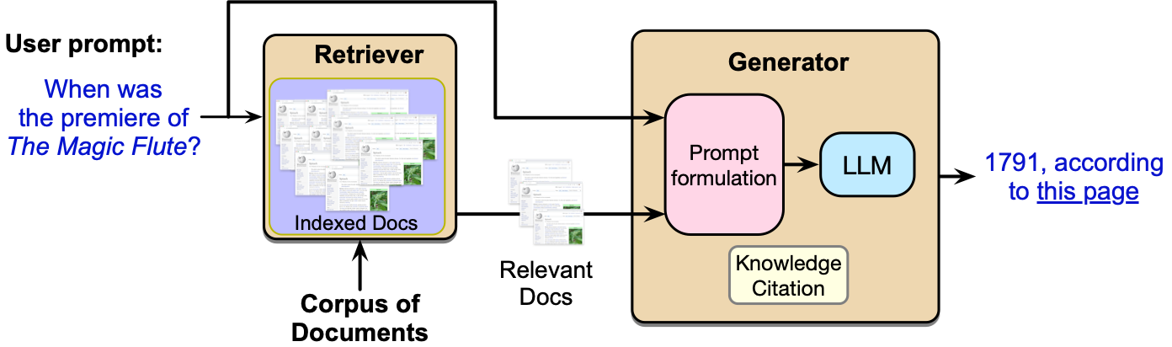
Retrieval Augmented Generation (RAG)

Slide 90
Basic RAG
Given a document collection D and a user query q
Call a retriever to return top k passages
Create a prompt that includes q and the passages
Call an LLM with the prompt

Slide 91
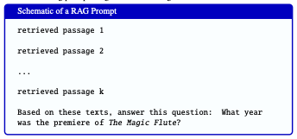

Slide 93
Extensions: Agent-based RAG
Instead of running RAG automatically on every user turn
Have a retrieval agents
System decides when to call it and for which document collection

Slide 94
Extensions: Training
Instruction-tune an LLM on a dataset of questions with retrieved passages and correct answers
Test-time compute: prompt an LLM to answer the question and simultaneously to generate reflections on which passages were useful

Slide 95

Extensions: Knowledge Citations
‘‘Write an answer for the given question using only the provided search results (some of which might be irrelevant) and cite them properly... Always cite for any factual claim".

Slide 96
Information Retrieval and RAG
Retrieval-Augmented Generation

Slide 97
Information Retrieval and RAG
Question Answering datasets and evals

Slide 98
Two kinds of question answering datasets
Natural information-seeking questions
Someone actually wanted to know the answer to this
Probing (testing) questions
Exam-type questions for LLM evaluation

Slide 99
Natural Questions
(Kwiatkowski et al., 2019),
anonymized English queries to the Google search engine and short and long answers (hand-created from Wikipedia)
“When are hops added to the brewing process?”
short answer: the boiling process
long answer: paragraph from the Wikipedia page on Brewing

Slide 100
MS MARCO (Microsoft Machine Reading Comprehension) collection of datasets,
1 million real anonymized English questions from Microsoft Bing query logs
human generated answer
9 million passages (Bajaj et al., 2016)

Slide 101

Probing dataset: MMLU
15908 knowledge and reasoning questions in 57 areas including medicine, mathematics, computer science, law, etc..
Sourced from exams for humans like GRE, AP

Slide 102
Information Retrieval and RAG
Question Answering datasets and evals

