Slide 1
Large Language Models
Introduction to Large Language Models

Slide 2
Large language models
Computational agents that can interact conversationally with people using natural language
LLMS have revolutionized the field of NLP and AI

Slide 3
Language models
Remember the simple n-gram language model
  Assigns probabilities to sequences of words
  Generate text by sampling possible next words
  Is trained on counts computed from lots of text
Large language models are similar and different:
  Assigns probabilities to sequences of words
  Generate text by sampling possible next words
  Are trained by learning to guess the next word

Slide 4
Fundamental intuition of large language models
Text contains enormous amounts of knowledge
Pretraining on lots of text with all that knowledge is what gives language models their ability to do so much

Slide 5
What does a model learn from pretraining?
With roses, dahlias, and peonies, I was surrounded by flowers
The room wasn't just big it was enormous
The square root of 4 is 2
The author of "A Room of One's Own" is Virginia Woolf
The doctor told me that he

Slide 6
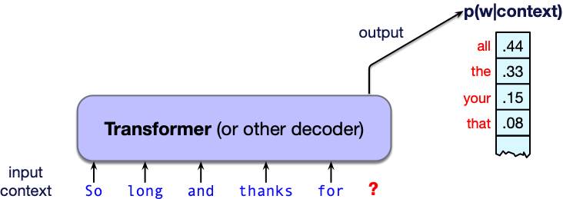
What is a large language model?
A neural network with:
Input: a context or prefix,
Output: a distribution over possible next words

Slide 7
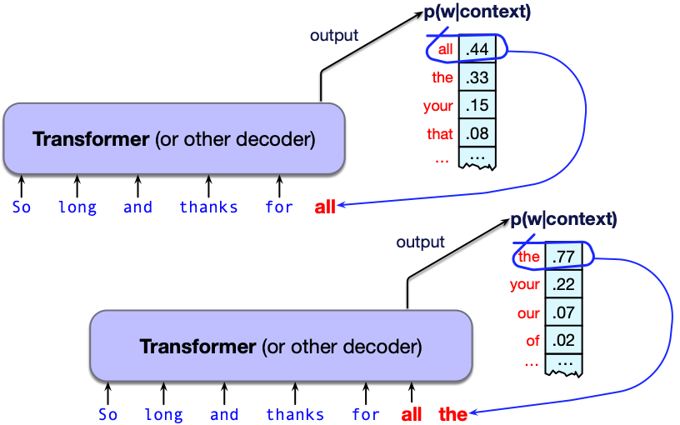
LLMs can generate!
A model that gives a probability distribution over next words can generate
by repeatedly sampling from the distribution

Slide 8
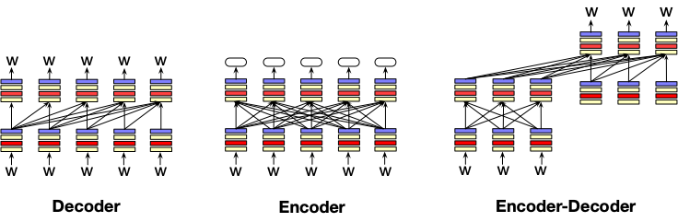
Three architectures for large language models
Decoders Encoders Encoder-decoders
GPT, Claude, BERT family, Flan-T5, Whisper
Llama HuBERT
Mixtral

Slide 9
Decoders
What most people think of when we say LLM
GPT, Claude, Llama, DeepSeek, Mistral
A generative model
It takes as input a series of tokens, and iteratively generates an output token one at a time.
Left to right (causal, autoregressive)

Slide 10
Encoders
Masked Language Models (MLMs)
BERT family
Trained by predicting words from surrounding words on both sides
Are usually finetuned (trained on supervised data) for classification tasks.

Slide 11
Encoder-Decoders
Trained to map from one sequence to another
Very popular for:
  machine translation (map from one language to another)
  speech recognition (map from acoustics to words)

Slide 12
Large Language Models
Introduction to Large Language Models

Slide 13
Large Language Models
Conditional Generation of Text: The Intuition

Slide 14
Big idea
Many tasks can be turned into tasks of predicting words!

Slide 15
This lecture: decoder-only models
Also called:
Causal LLMs
Autoregressive LLMs
Left-to-right LLMs
Predict words left to right

Slide 16
Conditional Generation: Generating text conditioned on previous text!
Give the LLM an input piece of text, a prompt
Have it generate token by token
  conditioned on the prompt and the generated tokens
We generate from a model by
computing the probability of the next token w_{i} from the prior context: P(w_{i}|w_{<i})
sampling from that distribution to generate a token
Notes:
In predicting each next word, the model can see a representation of all the previous words

Slide 17
Many practical NLP tasks can be cast as conditional generation!
Sentiment analysis: “I like Jackie Chan”
We give the language model this string:
The sentiment of the sentence "I like Jackie Chan" is:
And see what word it thinks comes next

Slide 18
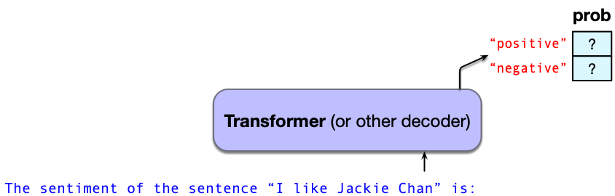
Sentiment via conditional generation
Which word has a higher probability?

Slide 19
Framing lots of tasks as conditional generation
QA: “Who wrote The Origin of Species”
We give the language model this string:
And see what word it thinks comes next:

Slide 20
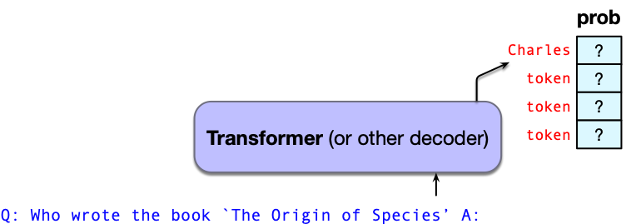
Now we iterate:

Slide 21
Large Language Models
Conditional Generation of Text: The Intuition

Slide 22
Large Language Models
Prompting

Slide 23
Prompt
Prompt: a text string that a user issues to a language model to get the model to do something useful by conditional generation
Prompt engineering: the process of finding effective prompts for a task.

Slide 24
Prompts
A question:
What is a transformer network?
Perhaps structured:
Q: What is a transformer network? A:
Or an instruction:
Translate the following sentence into Hindi: ‘Chop the garlic finely’.

Slide 25

Prompts can be very structured

Slide 26
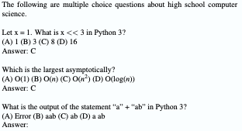
Prompts can have demonstrations (= examples)
2 demonstrations

Slide 27
Prompts are a learning signal
This is especially clear with demonstrations
But this is a different kind of learning than pretraining
Pretraining sets language model weights via gradient descent
Prompting just changes the context and the activations in the network; no parameters change
We call this in-context learning—learning that improves model performance but does not update parameters

Slide 28
LLMs usually have a system prompt
<system>You are a helpful and knowledgeable assistant. Answer concisely and correctly.
This is automatically and silently concatenated to a user prompt
<system> You are a helpful and knowledgeable assistant. Answer concisely and correctly. <user> What is the capital of France?

Slide 29
System prompts can be long; 1700 words for Claude Opus4
Some extracts:
Claude should give concise responses to very simple questions, but provide thorough responses to complex and open-ended questions.
Claude is able to explain difficult concepts or ideas clearly. It can also illustrate its explanations with examples, thought experiments, or metaphors.
Claude does not provide information that could be used to make chemical or biological or nuclear weapons.
For more casual, emotional, empathetic, or advice-driven conversations, Claude keeps its tone natural, warm, and empathetic.
Claude cares about people’s well-being and avoids encouraging or facilitating self-destructive behavior.
If Claude provides bullet points in its response, it should use markdown, and each bullet point should be at least 1-2 sentences long unless the human requests otherwise.

Slide 30
Large Language Models
Prompting

Slide 31
Large Language Models
Sampling for LLM Generation

Slide 32
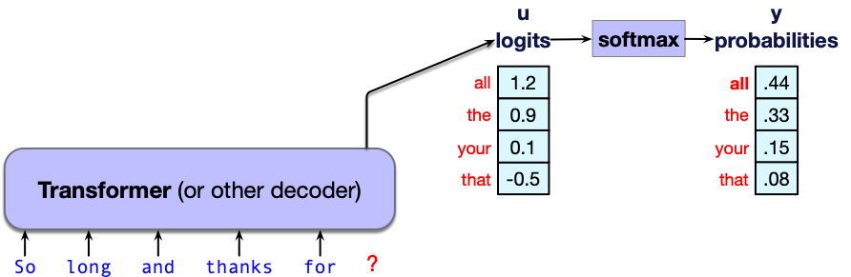
Where does token probability come from?
The internal networks for LLMs generate real-valued scores called logits for each token in the vocabulary.
Score vector u of shape [1 × |V|] is turned into a probability by softmax
y = softmax(u)

Slide 33
Where does token probability come from?
The internal networks for LLMs generate real-valued scores called logits for each token in the vocabulary.
Score vector u of shape [1 × |V|] is turned into a probability by softmax
y = softmax(u)

Slide 34
Decoding
This task of choosing a word to generate based on the model’s probabilities is called decoding.
Decoding from a model left-to-right and repeatedly choosing the next token conditioned on our previous choices is called autoregressive generation.

Slide 35
Greedy decoding
A greedy algorithm is one that makes a choice that is locally optimal
(whether or not it will turn out to have been the best choice with hindsight)
Simply generate the most probable word:

Slide 36
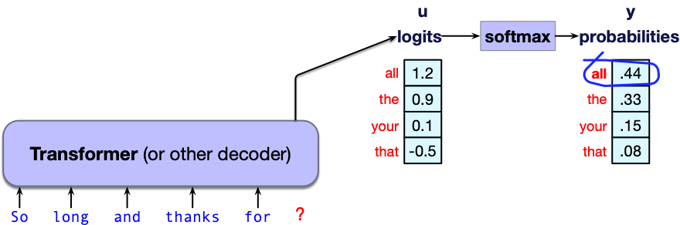
Greedy decoding: choosing "all"

Slide 37
We don't use greedy decoding
Because the tokens it chooses are (by definition) extremely predictable, the resulting text is generic and repetitive
Greedy decoding is so predictable that it is deterministic.
Instead, people prefer text that is more diverse, like that generated by sampling

Slide 38
Random sampling
Sampling from a distribution means to choose random points according to their likelihood.
Sampling from an LM means to choose the next token to generate according to its probability.
Random (multinomial) sampling: We randomly select a token to generate according to its probability defined by the LM, conditioned on our previous choices, generate it, and iterate.

Slide 39
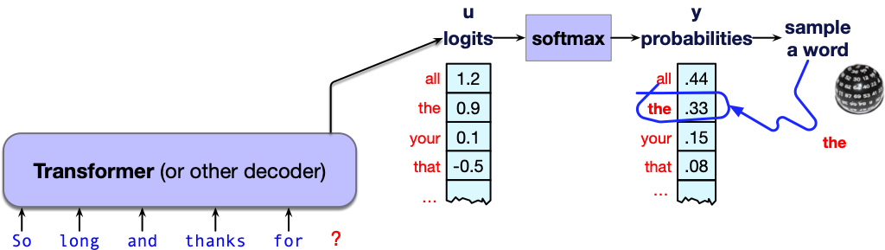
Random Sampling

Slide 40
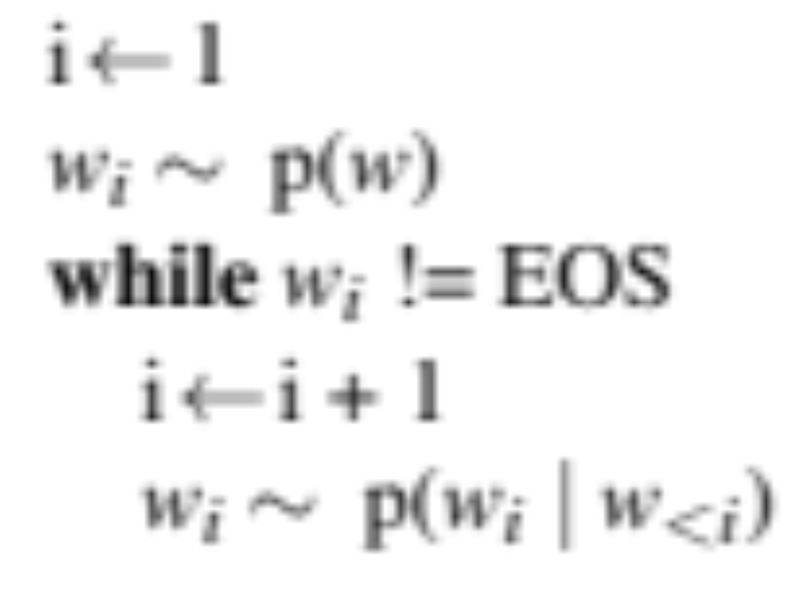
Random sampling

Slide 41
Alas, random sampling doesn't work very well
Even though random sampling mostly generate sensible, high-probable words,
There are many odd, low- probability words in the tail of the distribution
Each one is low- probability but added up they constitute a large portion of the distribution
So they get picked enough to generate weird sentences

Slide 42
Factors in word sampling: quality and diversity
Emphasize high-probability words
+ quality: more accurate, coherent, and factual,
- diversity: boring, repetitive.
Emphasize middle-probability words
+ diversity: more creative, diverse,
- quality: less factual, incoherent

Slide 43
Temperature sampling
Reshape the probability distribution
increase the probability of the high probability tokens
decrease the probability of the low probability tokens

Slide 44
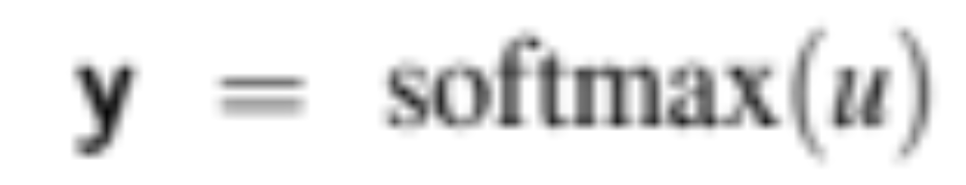
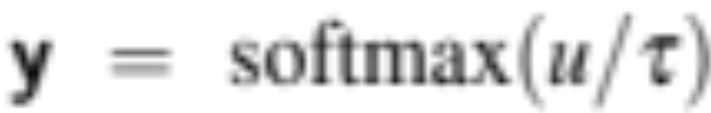
Temperature sampling
Divide the logit by a temperature parameter τ before passing it through the softmax.
Instead of
We do

Slide 45
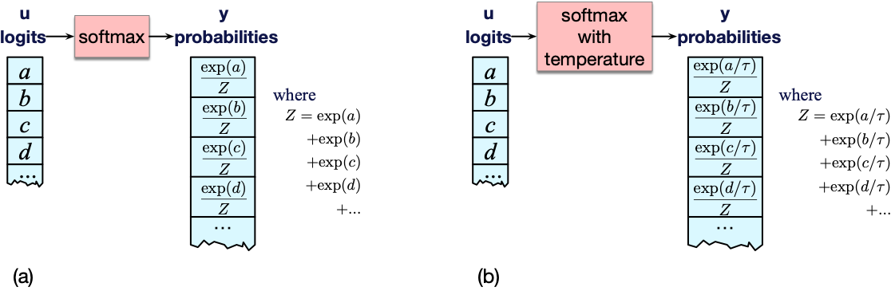
Temperature sampling

Slide 46
Temperature sampling
0 ≤ τ ≤ 1
Why does this work?
When τ is close to 1 the distribution doesn’t change much.
The lower τ is, the larger the scores being passed to the softmax
Softmax pushes high values toward 1 and low values toward 0.
Large inputs pushes high-probability words higher and low probability word lower, making the distribution more greedy.
As τ approaches 0, the probability of most likely word approaches 1
Notes:
(dividing by a smaller fraction τ ≤ 1 results in making each score larger).

Slide 47
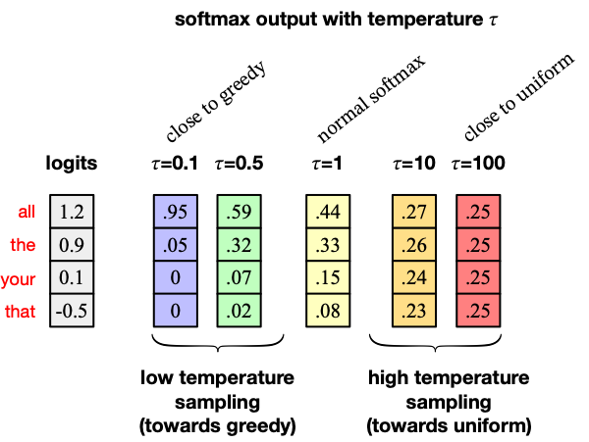

Slide 48
Temperature sampling comes from thermodynamics
a system at high temperature is flexible and can explore many possible states,
a system at lower temperature is likely to explore a subset of lower energy (better) states.
In low-temperature sampling, (τ ≤ 1) we smoothly
increase the probability of the most probable words
decrease the probability of the rare words.

Slide 49
Large Language Models
Sampling for LLM Generation

Slide 50
Large Language Models
Pretraining Large Language Models

Slide 51
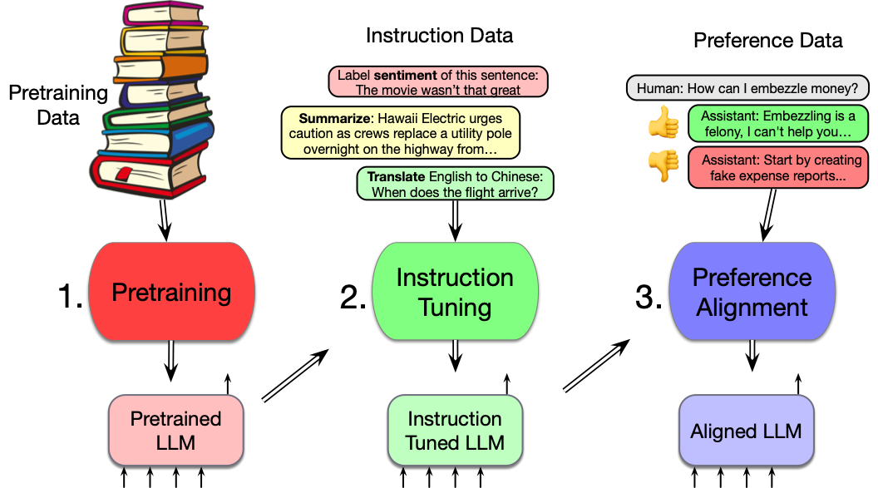
Three stages of training in LLMs

Slide 52
Pretraining
The big idea that underlies all the amazing performance of language models
First pretrain a transformer model on enormous amounts of text
Then apply it to new tasks.

Slide 53
Self-supervised training algorithm
We train them to predict the next word!
Take a corpus of text
At each time step t
  ask the model to predict the next word
  train the model using gradient descent to minimize the error in this prediction
  "Self-supervised" because it just uses the next word as the label!

Slide 54
Intuition of language model training: loss
Same loss function: cross-entropy loss
  We want the model to assign a high probability to true word w
  = want loss to be high if the model assigns too low a probability to w
CE Loss: The negative log probability that the model assigns to the true next word w
  If the model assigns too low a probability to w
  We move the model weights in the direction that assigns a higher probability to w

Slide 55
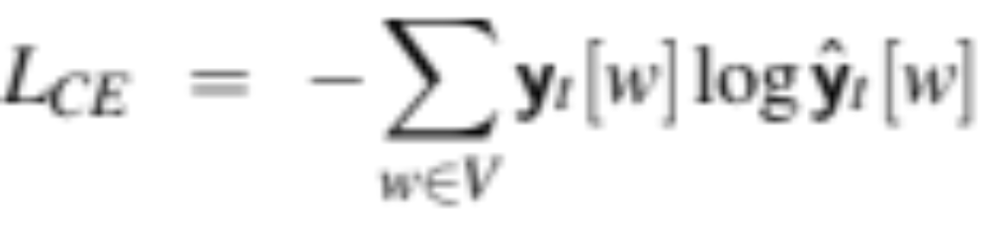
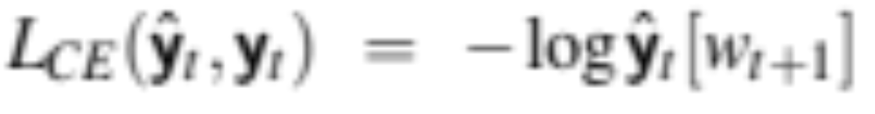
Cross-entropy loss for language modeling
CE loss: difference between the correct probability distribution and the predicted distribution
The correct distribution y_{t} knows the next word, so is 1 for the actual next word and 0 for the others.
So in this sum, all terms get multiplied by zero except one: the logp the model assigns to the correct next word, so:

Slide 56
Teacher forcing
At each token position t, model sees correct tokens w_{1:t},
  Computes loss (–log probability) for the next token w_{t+1}
At next token position t+1 we ignore what model predicted for w_{t+1}
  Instead we take the correct word w_{t+1}, add it to context, move on

Slide 57
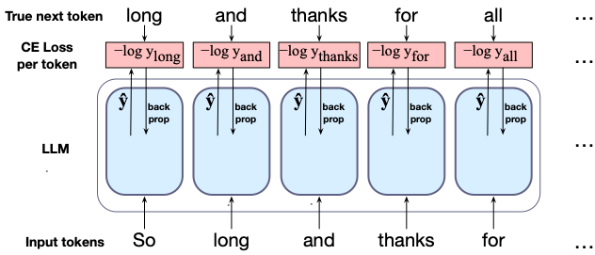
Training a transformer language model

Slide 58
LLMs are mainly trained on the web
Common crawl, snapshots of the entire web produced by the non- profit Common Crawl with billions of pages
Colossal Clean Crawled Corpus (C4; Raffel et al. 2020), 156 billion tokens of English, filtered
What's in it? Mostly patent text documents, Wikipedia, and news sites

Slide 59
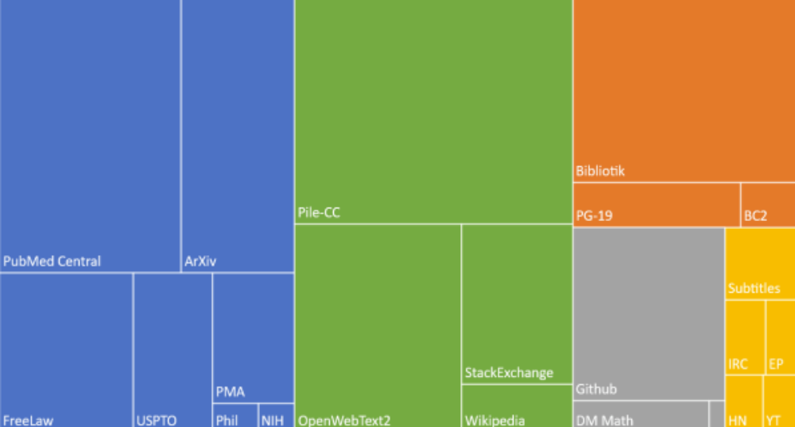
The Pile: a pretraining corpus
academics
web
books
dialog

Slide 60
Filtering for quality and safety
Quality is subjective
Many LLMs attempt to match Wikipedia, books, particular websites
Need to remove boilerplate, adult content
Deduplication at many levels (URLs, documents, even lines)
Safety also subjective
Toxicity detection is important, although that has mixed results
Can mistakenly flag data written in dialects like African American English

Slide 61
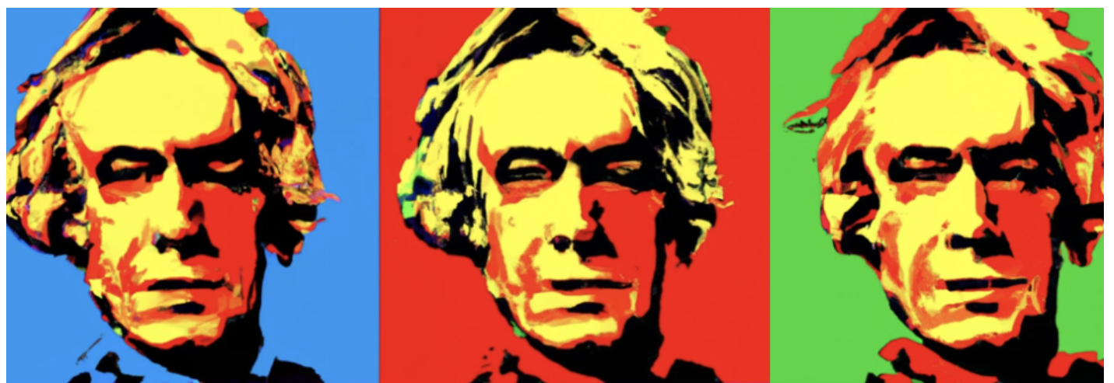
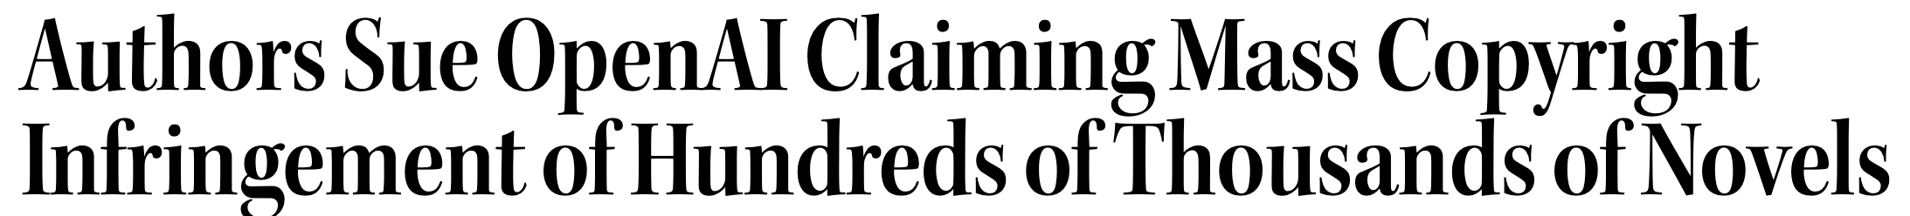
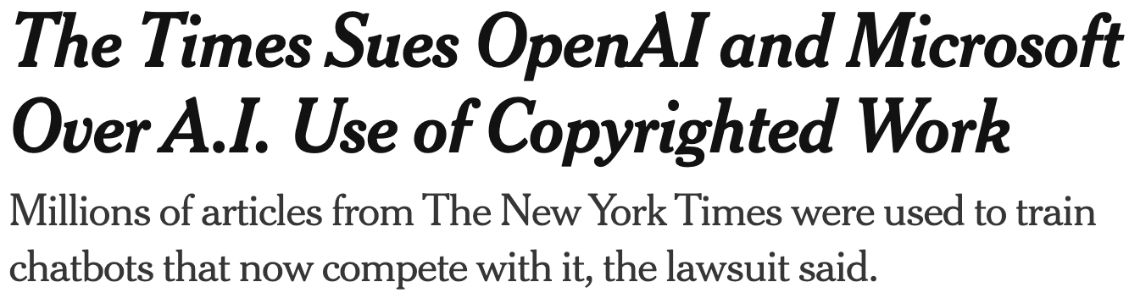

There are problems with scraping from the web
Notes:
Who owns all that data that we trained the models on?

Slide 62
There are problems with scraping from the web
Copyright: much of the text in these datasets is copyrighted
Not clear if fair use doctrine in US allows for this use
This remains an open legal question across the world
Data consent
Website owners can indicate they don't want their site crawled
Privacy:
Websites can contain private IP addresses and phone numbers
Skew:
Training data is disproportionately generated by authors from the US which probably skews resulting topics and opinions

Slide 63
Large Language Models
Pretraining Large Language Models

Slide 64
Large Language Models
Finetuning

Slide 65
Finetuning for adaptation to new domains
What happens if we need our LLM to work well on a domain it didn't see in pretraining?
Perhaps some specific medical or legal domain?
Or maybe a multilingual LM needs to see more data on some language that was rare in pretraining?

Slide 66
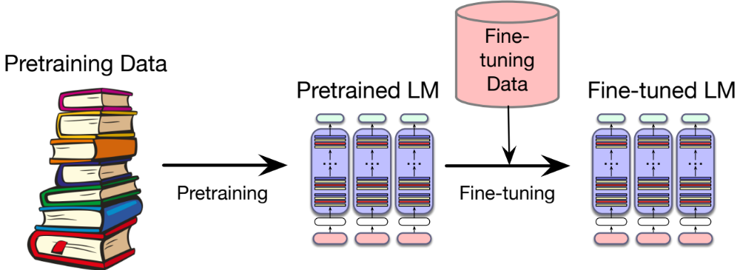
Finetuning

Slide 67
"Finetuning" means 4 different things
We'll discuss 1 here, and 3 in later lectures
In all four cases, finetuning means:
taking a pretrained model and further adapting some or all of its parameters to some new data
Notes:
But they differ on exactly which parameters get updated.

Slide 68
1. Finetuning as "continued pretraining" on new data
Further train all the parameters of model on new data
  using the same method (word prediction) and loss function (cross-entropy loss) as for pretraining.
  as if the new data were at the tail end of the pretraining data
Hence sometimes called continued pretraining

Slide 69
Large Language Models
Finetuning

Slide 70
Large Language Models
Evaluating Large Language Models

Slide 71

Better LMs are better at predicting text
Reminder of the chain rule:
So given a text w_{1:n} we could just compare the log likelihood from two LMs:

Slide 72
But raw log-likelihood has problems
Probability depends on size of test set
Probability gets smaller the longer the text
We would prefer a metric that is per-word, normalized by length
Notes:
There's a problem with using probability. And that is that the probability of a test set depends very directly on the length of the test set. This is because probability gets smaller the longer the text. For n-gram models, this is very clear; the chain rule of probability means that for a test set of N words we are multiplying together N n-gram probabilities! It would be better to normalize the probabilities by length to get a metric that is per-word. Perplexity is just such a metric. Perplexity is the inverse probability of the test set, normalized by the number of words. We normalize by taking the N-th root of the probability of the test set.

Slide 73
Perplexity is normalized for length
Perplexity is the inverse probability of the test set, normalized by the number of words
  (The inverse comes from the original definition of perplexity from cross-entropy rate in information theory)
  Probability range is [0,1], perplexity range is [1,∞]
Notes:
There's a problem with using probability. And that is that the probability of a test set depends very directly on the length of the test set. This is because probability gets smaller the longer the text. For n-gram models, this is very clear; the chain rule of probability means that for a test set of N words we are multiplying together N n-gram probabilities! It would be better to normalize the probabilities by length to get a metric that is per-word. Perplexity is just such a metric. Perplexity is the inverse probability of the test set, normalized by the number of words. We normalize by taking the N-th root of the probability of the test set.

Slide 74
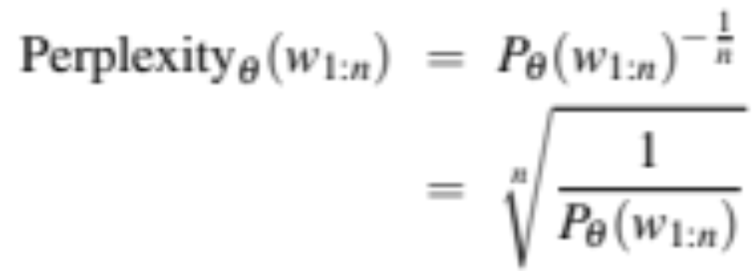

Perplexity
So just as for n-gram grammars, we use perplexity to measure how well the LM predicts unseen text
The perplexity of a model θ on an unseen test set is the inverse probability that θ assigns to the test set, normalized by the test set length.
For a test set of n tokens w_{1:n} the perplexity is :

Slide 75
Perplexity
The higher the probability of the word sequence, the lower the perplexity.
Thus the lower the perplexity of a model on the data, the better the model.
Minimizing perplexity is the same as maximizing probability
Also: perplexity is sensitive to length/tokenization so best used when comparing LMs that use the same tokenizer.

Slide 76
Many other factors that we evaluate, like:
Size
Big models take lots of GPUs and time to train, memory to store
Energy usage
Can measure kWh or kilograms of CO2 emitted
Fairness
Benchmarks measure gendered and racial stereotypes, or decreased performance for language from or about some groups.

Slide 77
Large Language Models
Ethical and Safety Issues in Large Language Models

Slide 78
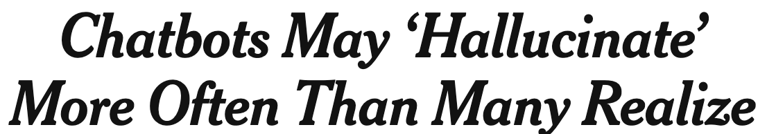
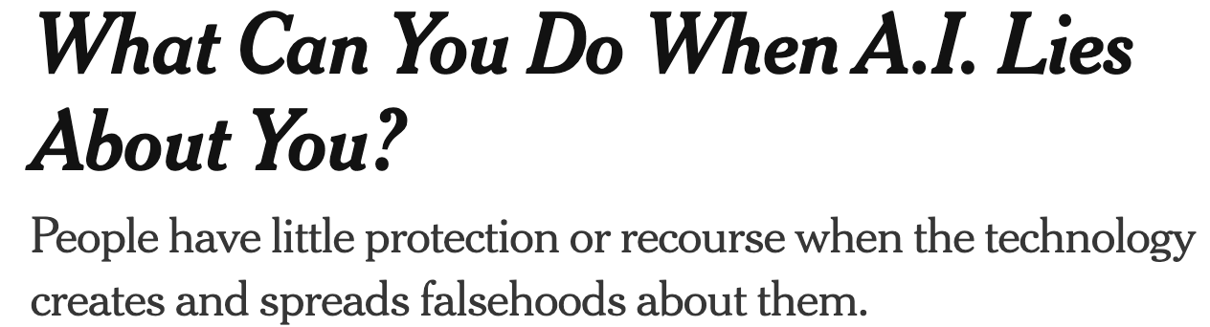

Hallucination
Notes:
LLMs make stuff up!

Slide 79
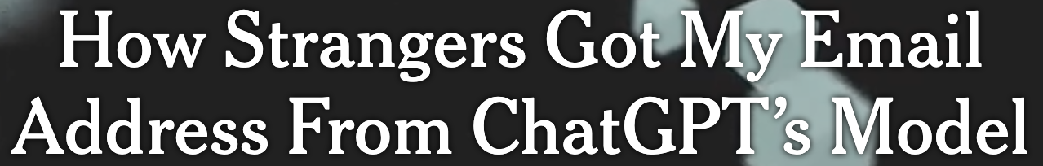
Privacy
Notes:
Training data can be leaked

Slide 80
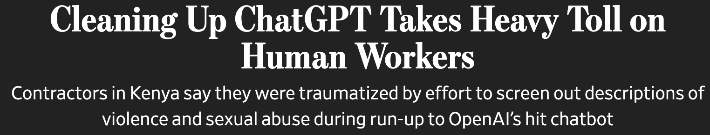
Abuse and Toxicity

Slide 81
Lots more
Harm (suggesting dangerous actions)
Fraud
Emotional dependence
Bias

Slide 82
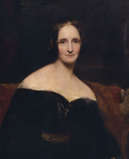
Mary Shelley's Frankenstein
Centered on the problem of creating artificial agents without considering ethical and humanistic concerns.

Slide 83
Large Language Models
Ethical and Safety Issues in Large Language Models

