Slide 1
Logistic Regression
The Task of Text Classification
Notes:
In this set of lectures we introduce text classification, beginning in n this first lecture with the basic idea of classification. Subsequent lectures cover training, inference and evaluation methods like precision and recall. Our instrument will be the very simple Naive Bayes classifier.

Slide 2
Is this spam?
Dear Sir,
Please find attached the forms you requested.
Special Note: Student needs to provide the hand signed forms on the very first day of registration- (Forms attached)
IMPORTANT NOTE:
We will be needing additional bank statements and proof for justification if students have completed education outside their home state.(Legitimate documents- electricity bill, Rental Agreement, Bank Statement, College/University ID )
Please feel free to reach us in case any queries arise.
Study Abroad Partners
Notes:
Text classification comes up in lots of very practical applications. One is spam detection

Slide 3



Who wrote which Federalist Papers?
1787-8: essays anonymously written by:
Alexander Hamilton, James Madison, and John Jay
to convince New York to ratify U.S Constitution
Authorship of 12 of the letters unclear between:
1963: solved by Mosteller and Wallace using Bayesian methods
Alexander Hamilton
James Madison
Wikimedia commons
Notes:
Text classification is also a task that was addressed very early in the history of what became natural language processing and machine learning. Perhaps the most famous early example is the question of authorship identification.

Slide 4


Positive or negative movie review?
unbelievably disappointing
Full of zany characters and richly applied satire, and some great plot twists
this is the greatest screwball comedy ever filmed
It was pathetic. The worst part about it was the boxing scenes.
Notes:
The task we'll focus on in these lectures is the task of sentiment analysis: using the language in a text to classify the author's expressed attitude toward something. This is often modeled as a binary task of positive vs negative, or it can be on a scale, and comes up very often with product reviews, like these examples extracted from online movie reviews.

Slide 5
Even language modeling can be viewed as classification!
Let the set of classes be the words (vocabulary V)
Predicting the next word is classifying
  the context-so-far
  into a class for each possible next word

Slide 6
Text Classification
Assigning subject categories, topics, or genres
Spam detection
Authorship identification (who wrote this?)
Language Identification (is this Portuguese?)
Sentiment analysis
Language modeling (what next word does this context expect)
Notes:
In summary, lots of very disparate tasks can be modeled as assigning a class label to a text

Slide 7
Text Classification: definition
Input:
  a "document" (which can be any text) d
  a fixed set of classes Y = {y₁, y₂,…, y_{J}}
Output: a predicted class ŷ ∈ Y
The hat or circumflex notation ŷ is used to refer to an estimated or predicted value

Slide 8
Most common classification method:
Supervised Machine Learning
Training
  Input:
    a fixed set of classes Y = {y₁, y₂,…, y_{J}}
    a training set of m hand-labeled inputs (x⁽¹⁾,y⁽¹⁾),....,(x^{(m)},y^{(m)})
  Output:
    a learned classifier γ:d → ŷ
Inference or Test
  Input: a document d
  Output: a class ŷ
Notes:
But most common, and the model we are going to describe in these lectures, is classification by supervised machine learning

Slide 9
Supervised Machine Learning for Classification
Many kinds of classifiers!
  Logistic regression (this lecture)
  Naive Bayes
  Neural networks
  k-nearest neighbors
  LLMs
    Fine-tuned as classifiers
    Prompted to give a classification

Slide 10
Logistic Regression
The Task of Text Classification
Notes:
In this lecture we defined the Naive Bayes classifier, a basic text classifier that will allow us to introduce many of the fundamental issues in text classification.

Slide 11
Logistic Regression
Logistic Regression Classification

Slide 12
Logistic Regression
Important analytic tool in natural and social sciences
Baseline supervised machine learning tool for classification
Is also the foundation of neural networks

Slide 13
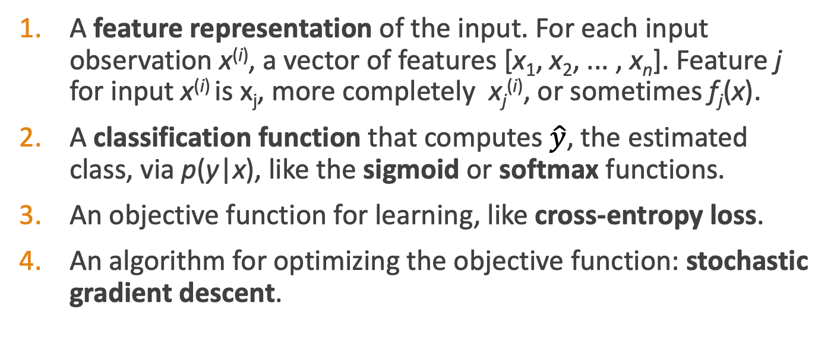
Components of a probabilistic machine learning classifier
Given m input/output pairs (x^{(i),}y^{(i)}):
A feature representation of the input. For each input observation x^{(i)}, a vector of features [x₁, x₂, ... , x_{n}]. Feature j for input x^{(i)} is x_{j}, more completely x_{j}^{(i)}, or sometimes f_{j}(x).
A classification function that computes $\hat{y}$, the estimated class, via p(y|x), like the sigmoid or softmax functions.
An objective function for learning, like cross-entropy loss.
An algorithm for optimizing the objective function: stochastic gradient descent.

Slide 14
The two phases of logistic regression
Training (next lecture): we learn weights w and b using stochastic gradient descent and cross-entropy loss.
Test (also called inference) (this lecture): Given a test example x we compute p(y|x) using learned weights w and b, and return whichever label (y = 1 or y = 0) has higher probability

Slide 15
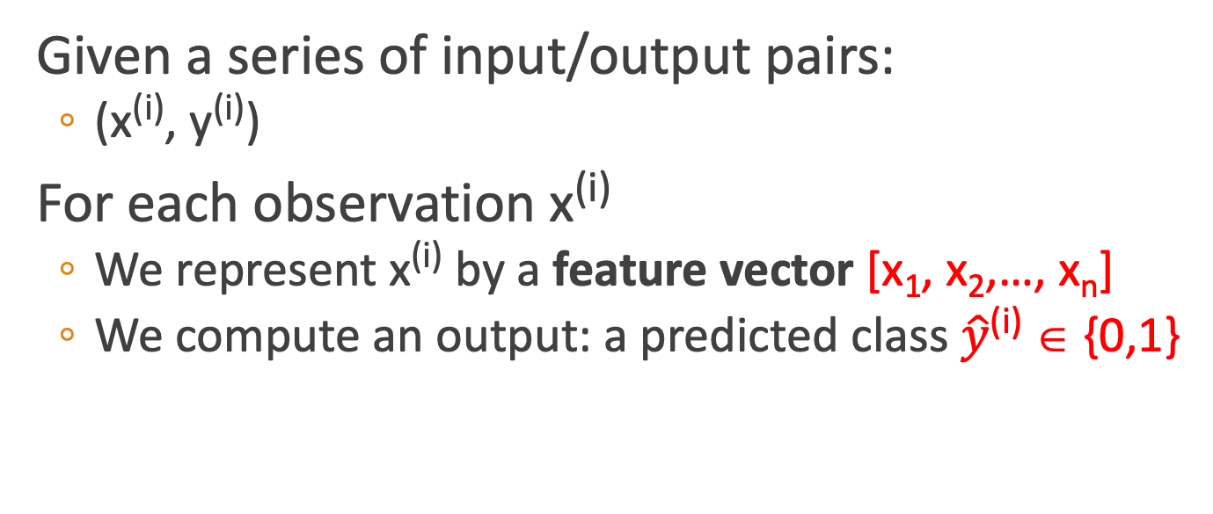
Binary Classification in Logistic Regression
Given a series of input/output pairs:
  (x^{(i)}, y^{(i)})
For each observation x^{(i)}
  We represent x^{(i)} by a feature vector [x₁, x₂,…, x_{n}]
  We compute an output: a predicted class $\hat{y}$^{(i)} ∈ {0,1}

Slide 16
Features in logistic regression
For feature x_{i}, weight w_{i} tells is how important is x_{i}
  x_{i} ="review contains ‘awesome’": w_{i} = +10
  x_{j} ="review contains ‘abysmal’": w_{j} = -10
  x_{k} =“review contains ‘mediocre’": w_{k} = -2
Notes:
The weight wi represents how important that input feature is to the classification decision, and can be positive (providing evidence that the in- stance being classified belongs in the positive class) or negative (providing evidence that the instance being classified belongs in the negative class). Thus we might expect in a sentiment task the word awesome to have a high positive weight, and abysmal to have a very negative weight.

Slide 17
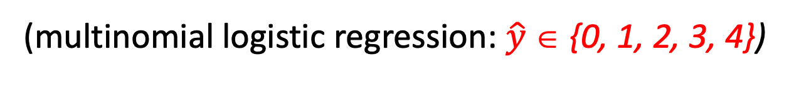
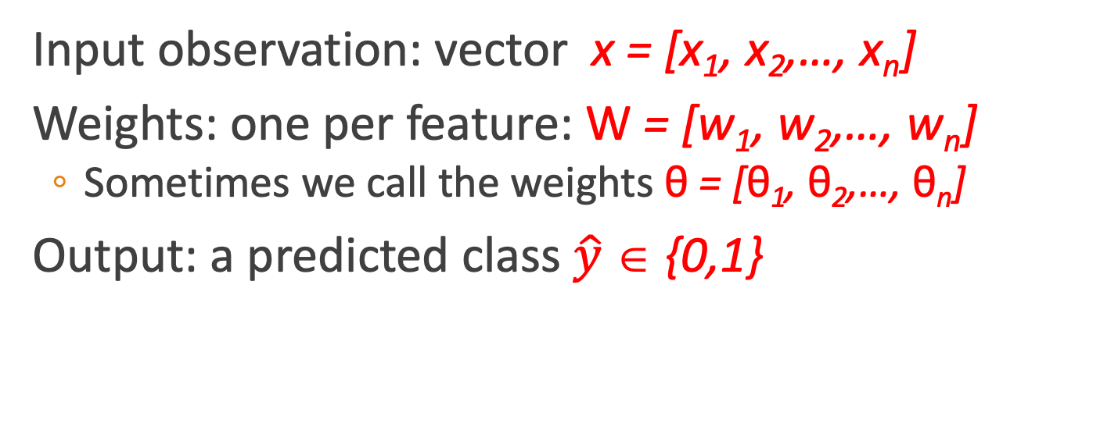
Logistic Regression for one observation x
Input observation: vector x = [x₁, x₂,…, x_{n}]
Weights: one per feature: W = [w₁, w₂,…, w_{n}]
  Sometimes we call the weights θ = [θ₁, θ₂,…, θ_{n}]
Output: a predicted class $\hat{y}$ ∈ {0,1}
(multinomial logistic regression: $\hat{y}$ ∈ {0, 1, 2, 3, 4})

Slide 18
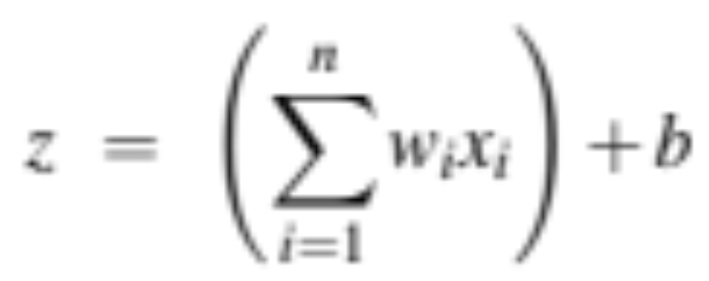
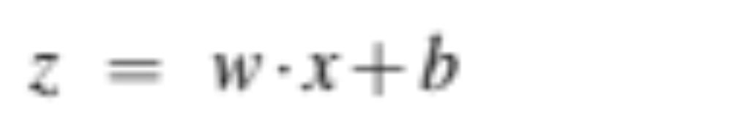
How to do classification
For each feature x_{i}, weight w_{i} tells us importance of x_{i}
  (Plus we'll have a bias b)
We'll sum up all the weighted features and the bias
If this sum is high, we say y=1; if low, then y=0
Notes:
The bias term, also called the intercept, is another real number that’s added to the weighted inputs. In the rest of the book we’ll represent such sums using the dot product notation from linear algebra. The dot product of two vectors a and b, written as a · b is the sum of the products of the corresponding elements of each vector.

Slide 19
But we want a probabilistic classifier
We need to formalize “sum is high”.
We’d like a principled classifier that gives us a probability, just like Naive Bayes did
We want a model that can tell us:
  p(y=1|x; θ)
  p(y=0|x; θ)

Slide 20
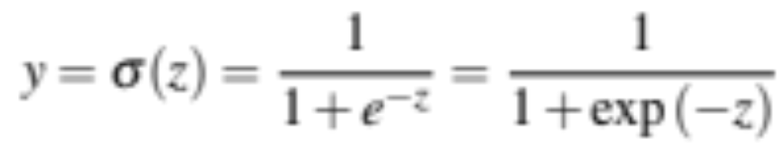
The problem: z isn't a probability, it's just a number!
Solution: use a function of z that goes from 0 to 1
Notes:
nothing in Eq. 5.3 forces z to be a legal probability, that is, to lie between 0 and 1. In fact, since weights are real-valued, the output might even be negative; z ranges from −∞ to ∞.

Slide 21
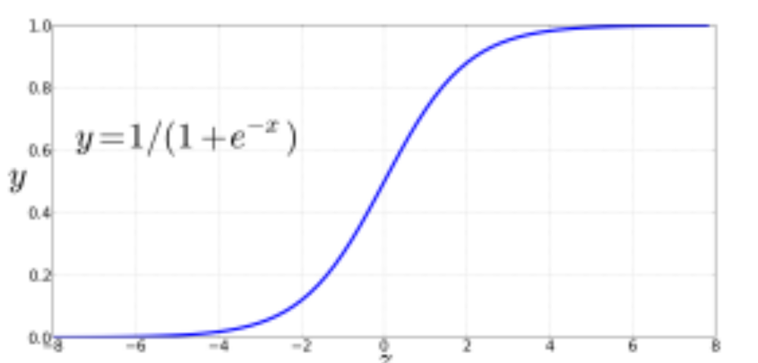
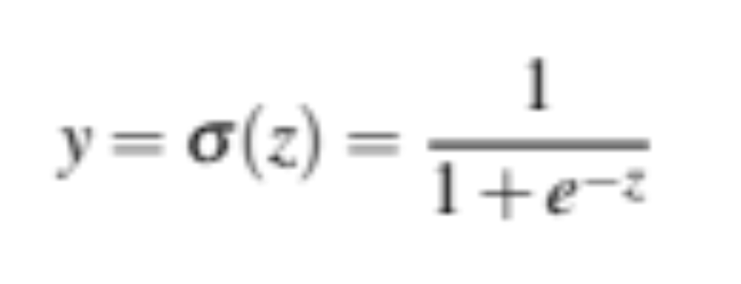
The very useful sigmoid or logistic function
Notes:
The sigmoid function The 1/1+e^-z (so-named because it looks like an s) is also called the logistic function. It takes a real value and maps it to the range [0, 1
It is nearly linear around 0 but outlier values get squashed toward 0 or 1.

Slide 22
Idea of logistic regression
We’ll compute w∙x+b
And then we’ll pass it through the sigmoid function:
σ(w∙x+b)
And we'll just treat it as a probability

Slide 23
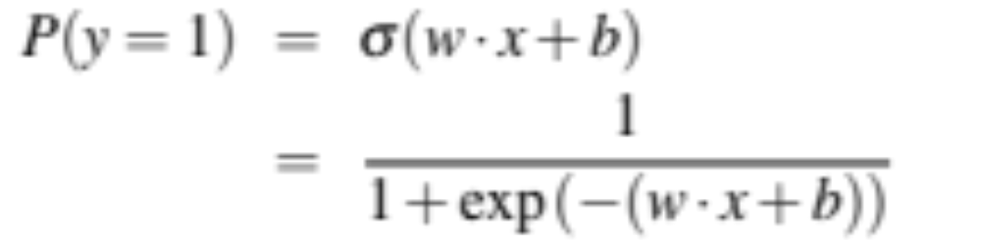
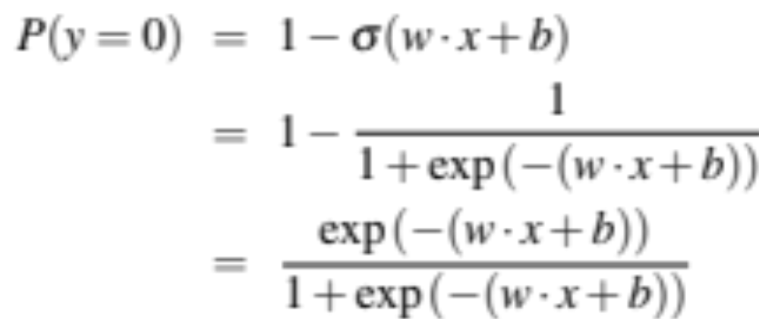
Making probabilities with sigmoids
Notes:
We’re almost there. If we apply the sigmoid to the sum of the weighted features, we get a number between 0 and 1. To make it a probability, we just need to make sure that the two cases, p(y = 1) and p(y = 0), sum to 1. We can do this as follows:

Slide 24


By the way:
=
Because
Notes:
The sigmoid function has the property

Slide 25
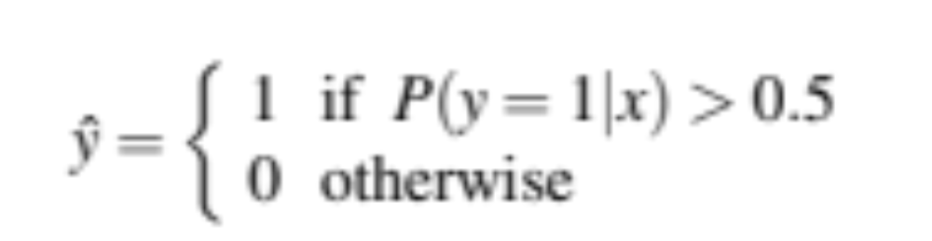
Turning a probability into a classifier
0.5 here is called the decision boundary

Slide 26
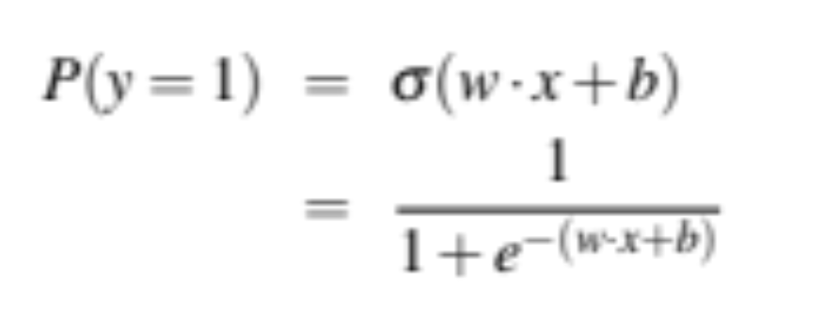
The probabilistic classifier
P(y=1)
wx + b

Slide 27
Turning a probability into a classifier
if w∙x+b > 0
if w∙x+b ≤ 0

Slide 28
Logistic Regression
Classification in Logistic Regression
Notes:
We've seen how logistic regression uses the sigmoid function to take weighted features for an input example x and assign it to the class 1 or 0.

Slide 29
Logistic Regression
Logistic Regression: a text example on sentiment classification
Notes:
Let's walk through an example using logistic regression to do sentiment classification

Slide 30
Sentiment example: does y=1 or y=0?
It's hokey . There are virtually no surprises , and the writing is second-rate . So why was it so enjoyable ? For one thing , the cast is
great . Another nice touch is the music . I was overcome with the urge to get off the couch and start dancing . It sucked me in , and it'll do the same to you .
Notes:
Suppose we are doing binary sentiment classification on movie review text, and we would like to know whether to assign the sentiment class 1=positive or 0=negative to the following review

Slide 31
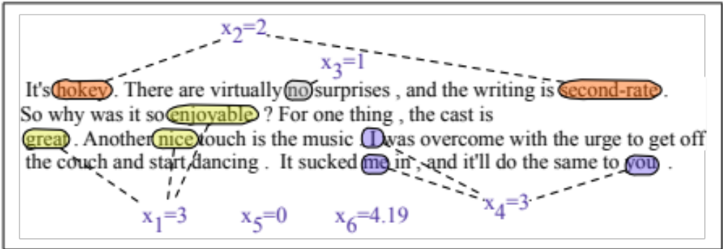
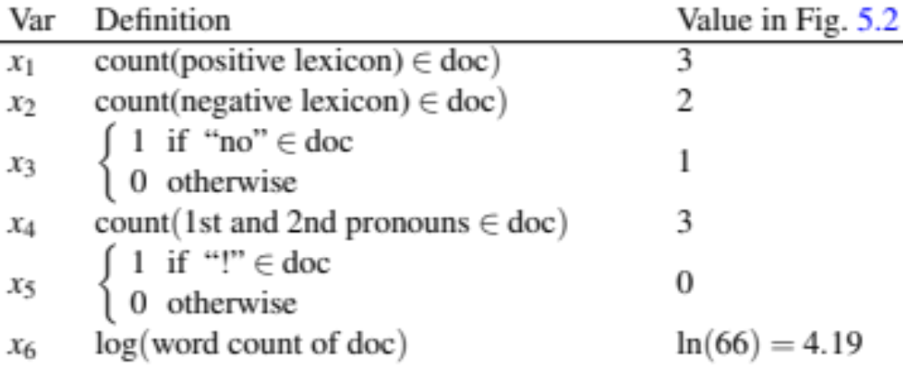
Notes:
We’ll represent each input observation by the 6 features x1...x6 of the input

Slide 32
Classifying sentiment for input x
Suppose w =
b = 0.1
Notes:
Let’s assume for the moment that we’ve already learned a real-valued weight for each of these features, and that the 6 weights corresponding to the 6 features are as follows. The weight w1, for example indicates how important a feature the number of positive lexicon words (great, nice, enjoyable, etc.) is to a positive sentiment decision, while w2 tells us the importance of negative lexicon words. Note that w1 = 2.5 is positive, while w2 = −5.0, meaning that negative words are negatively associated with a positive sentiment decision, and are about twice as important as positive words.

Slide 33
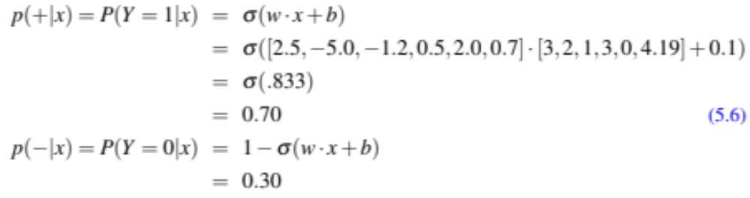
Classifying sentiment for input x
Notes:
Given these 6 features and the input review x, we can compute P(+|x) and P(−|x)

Slide 34
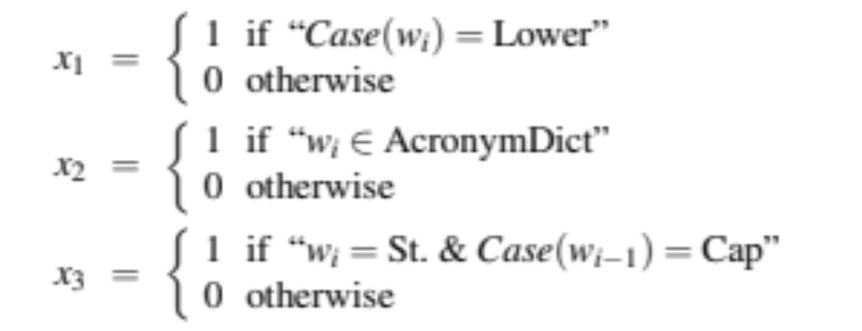
We can build features for logistic regression for any classification task: period disambiguation
End of sentence
This ends in a period.
The house at 465 Main St. is new.
Not end
Notes:
We might use features like x1 below expressing that the current word is lower case and the class is EOS (perhaps with a positive weight), or that the current word is in our abbreviations dictionary (“Prof.”) and the class is EOS (perhaps with a negative weight). A feature can also express a quite complex combination of properties. For example a period following an upper case word is likely to be an EOS, but if the word itself is St. and the previous word is capitalized, then the period is likely part of a shortening of the word street.

Slide 35
Classification in (binary) logistic regression: summary
Given:
  a set of classes: (+ sentiment,- sentiment)
  a vector x of features [x1, x2, …, xn]
      x1= count( "awesome")
      x2 = log(number of words in review)
  A vector w of weights [w1, w2, …, wn]
    w_{i} for each feature f_{i}

Slide 36
Logistic Regression
Logistic Regression: a text example on sentiment classification
Notes:
We've now seen the details of how logistic regression can take feature values and weights to assign a class to an input.

Slide 37
Logistic Regression
Learning: Cross-Entropy Loss
Notes:
Let's now turn to learning the parameters for logistic regression. We'll start with the cross-entropy loss function

Slide 38
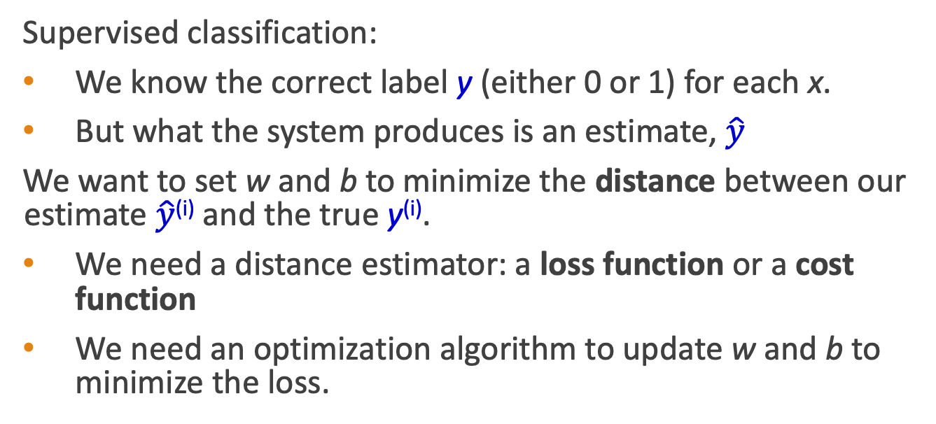
Wait, where did the W’s come from?
Supervised classification:
We know the correct label y (either 0 or 1) for each x.
But what the system produces is an estimate, $\hat{y}$
We want to set w and b to minimize the distance between our estimate $\hat{y}$^{(i)} and the true y^{(i)}.
We need a distance estimator: a loss function or a cost function
We need an optimization algorithm to update w and b to minimize the loss.
Notes:
Logistic regression is an instance of supervised classification in which we know the correct label y (either 0 or 1) for each observation x. But what the system produces is an estimate, ^y. We want to learn parameters (meaning w and b) that make yˆ for each training observation as close as possible to the true y.

Slide 39
Learning components
A loss function:
    cross-entropy loss
An optimization algorithm:
    stochastic gradient descent
Notes:
This requires two components. The first is a metric for how close the current label (yˆ) is to the true gold label y. Rather than measure similarity, we usually talk about the opposite of this: the distance between the system output and the gold output, and we call this distance
the loss function or the cost function. We'll we’ll introduce the loss function that is commonly used for logistic regression and also for neural networks, the cross-entropy loss.
The second thing we need is an optimization algorithm for iteratively updating
the weights so as to minimize this loss function. The standard algorithm for this is gradient descent; we’ll introduce the stochastic gradient descent algorithm in the following section.

Slide 40

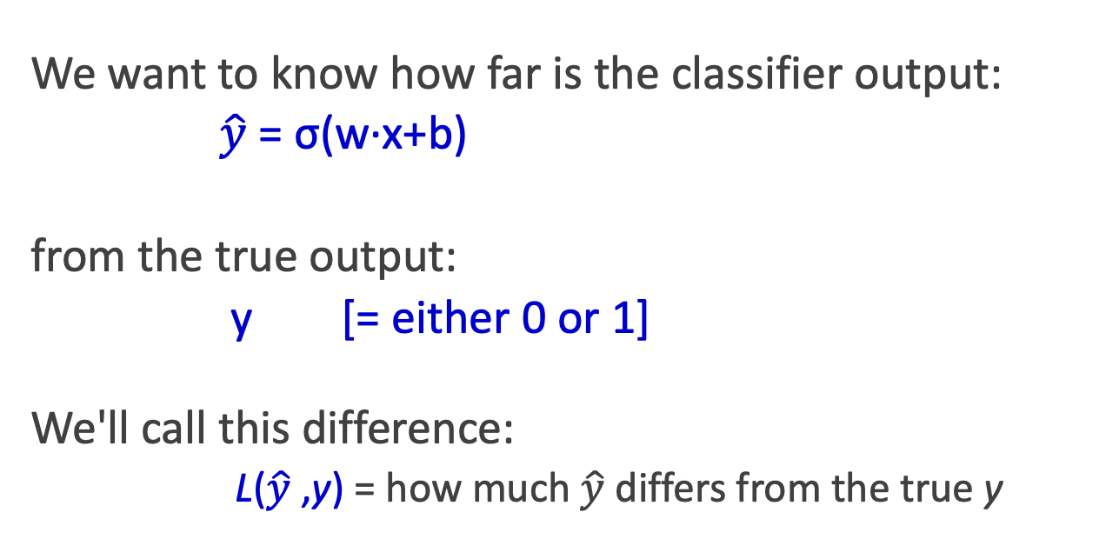
The distance between $\hat{y}$and y
We want to know how far is the classifier output:
$\hat{y}$= σ(w∙x+b)
from the true output:
y [= either 0 or 1]
We'll call this difference:
L($\hat{y}$,y) = how much $\hat{y}$ differs from the true y
Notes:
We need a loss function that expresses, for an observation x, how close the classifier output (yˆ = σ (w · x + b)) is to the correct output (y, which is 0 or 1).

Slide 41
Intuition of negative log likelihood loss
= cross-entropy loss
A case of conditional maximum likelihood estimation
We choose the parameters w,b that maximize
the log probability
of the true y labels in the training data
given the observations x
Notes:
We do this via a loss function that prefers the correct class labels of the training examples to be more likely. This is called conditional maximum likelihood estimation: we choose the parameters w,b that maximize the log probability of the true y labels in the training data given the observations x. The resulting loss function is the negative log likelihood loss, generally called the cross-entropy loss.

Slide 42
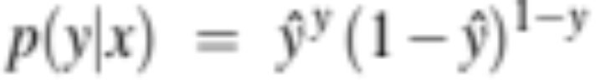
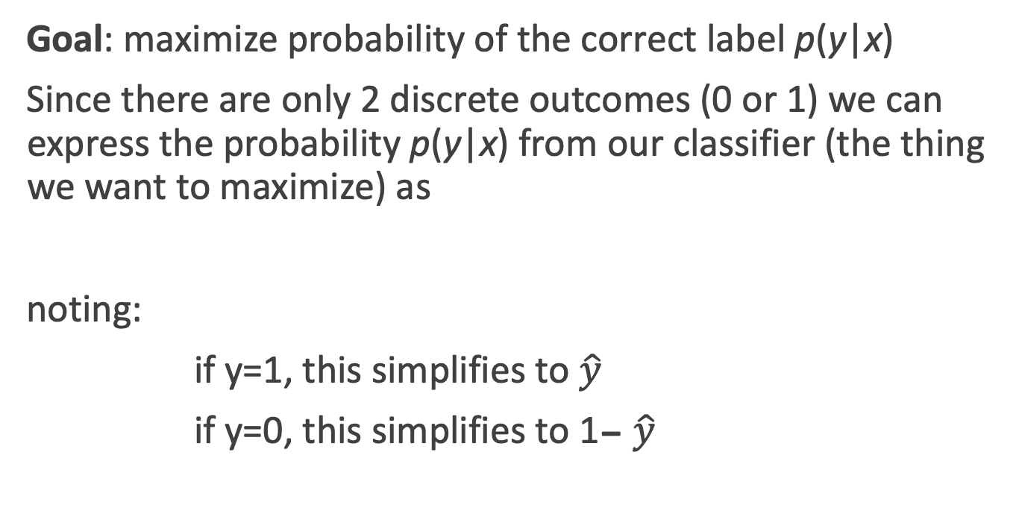
Deriving cross-entropy loss for a single observation x
Goal: maximize probability of the correct label p(y|x)
Since there are only 2 discrete outcomes (0 or 1) we can express the probability p(y|x) from our classifier (the thing we want to maximize) as
noting:
if y=1, this simplifies to $\hat{y}$
if y=0, this simplifies to 1- $\hat{y}$
Notes:
Let’s derive this loss function, applied to a single observation x. We’d like to learn weights that maximize the probability of the correct label, that's p(y|x).

Slide 43
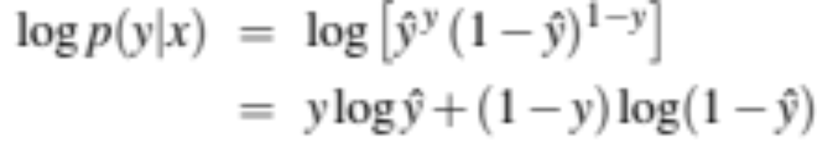
Deriving cross-entropy loss for a single observation x
Goal: maximize probability of the correct label p(y|x)
Maximize:
Now take the log of both sides (mathematically handy)
Whatever values maximize log p(y|x) will also maximize p(y|x)
Maximize:

Slide 44
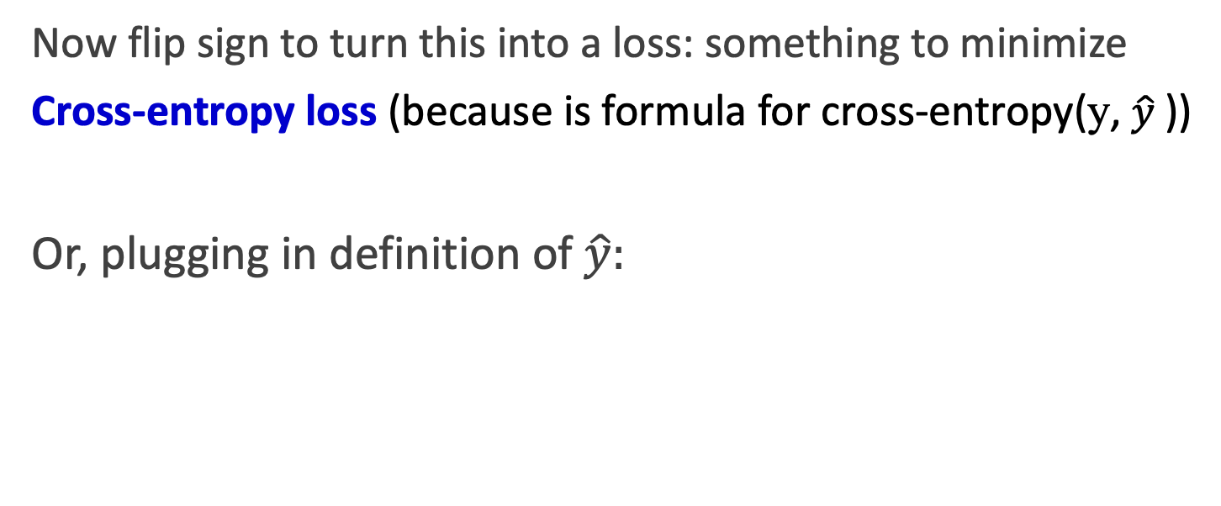
Deriving cross-entropy loss for a single observation x
Goal: maximize probability of the correct label p(y|x)
Maximize:
Now flip sign to turn this into a loss: something to minimize
Cross-entropy loss (because is formula for cross-entropy(y, $\hat{y}$))
Or, plugging in definition of $\hat{y}:$
Minimize:

Slide 45
Let's see if this works for our sentiment example
We want loss to be:
smaller if the model estimate is close to correct
bigger if model is confused
Let's first suppose the true label of this is y=1 (positive)
It's hokey . There are virtually no surprises , and the writing is second-rate . So why was it so enjoyable ? For one thing , the cast is great . Another nice touch is the music . I was overcome with the urge to get off the couch and start dancing . It sucked me in , and it'll do the same to you .

Slide 46
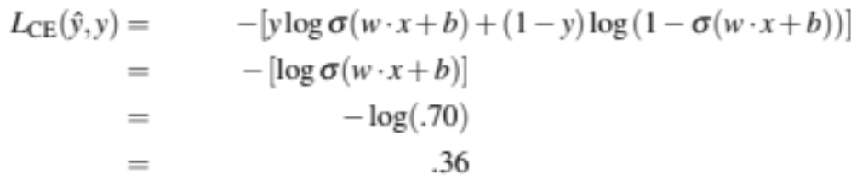
Let's see if this works for our sentiment example
True value is y=1. How well is our model doing?
Pretty well! What's the loss?

Slide 47
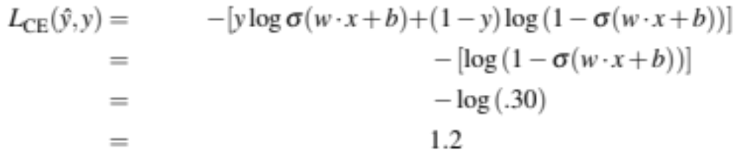
Let's see if this works for our sentiment example
Suppose true value instead was y=0.
What's the loss?
Notes:
By contrast, let’s pretend instead that the example was actually negative, i.e., the true y = 0 (perhaps the reviewer went on to say “But bottom line, the movie is terrible! I beg you not to see it!”) . In this case our model is confused, the model is wrong, so we’d want the loss to be higher. Let's plug in y = 0 and 1−σ(w·x+b) = .31

Slide 48
Let's see if this works for our sentiment example
The loss when model was right (if true y=1)
Is lower than the loss when model was wrong (if true y=0):
Sure enough, loss was bigger when model was wrong!

Slide 49
Logistic Regression
Cross-Entropy Loss
Notes:
We've derived the cross-entropy loss and seen how it applies in our sentiment example. Cross entropy loss is equally important for neural networks.

Slide 50
Logistic Regression
Stochastic Gradient Descent
Notes:
In this lecture we introduce the stochastic gradient descent algorithm used for optimizing the weights for logistic regression and neural networks.

Slide 51
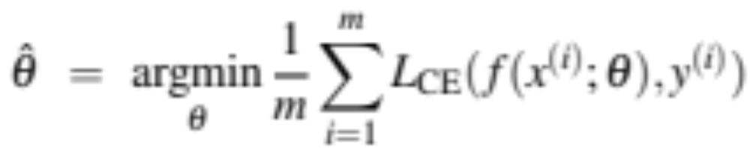
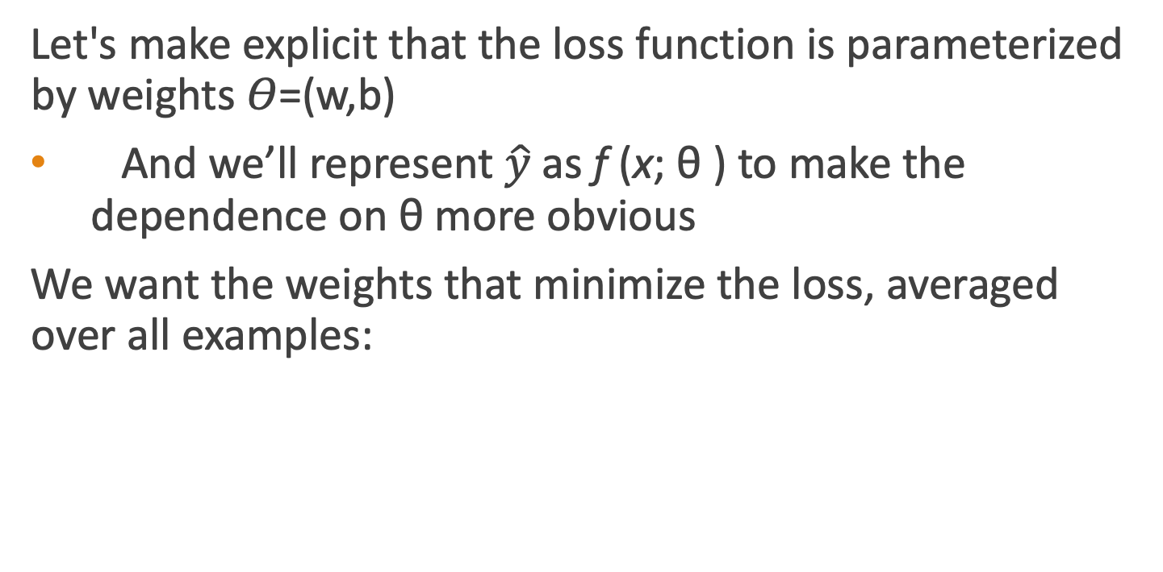
Our goal: minimize the loss
Let's make explicit that the loss function is parameterized by weights 𝛳=(w,b)
And we’ll represent $\hat{y}$as f (x; θ ) to make the dependence on θ more obvious
We want the weights that minimize the loss, averaged over all examples:
Notes:
Our goal with gradient descent is to find the optimal weights: minimize the loss function we’ve defined for the model. We’ll explicitly represent the fact that the loss function L is parameterized by the weights, which we can refer to in machine learning in general as θ (in the case of logistic regression θ = w, b). And we’ll represent $\hat{y}$as f (x; θ ) to make the dependence on θ more obvious. So the goal is to find the set of weights which minimizes the loss function, averaged over all examples: EQ

Slide 52

Intuition of gradient descent
How do I get to the bottom of this river canyon?
Look around me 360∘
Find the direction of steepest slope down
Go that way
x
Notes:
How do we find the minimum of a loss function? Gradient descent is a method that finds a minimum of a function by figuring out in which direction (in the space of the parameters θ) the function’s slope is rising the most steeply, and moving in the opposite direction.
The intuition is that if you are hiking in a canyon and trying to descend most quickly down to the river at the bottom, you might look around yourself 360 degrees, find the direction where the ground is sloping the steepest, and walk downhill in that direction.

Slide 53
Our goal: minimize the loss
For logistic regression, loss function is convex
A convex function has just one minimum
Gradient descent starting from any point is guaranteed to find the minimum
  (Loss for neural networks is non-convex)
Notes:
For logistic regression, this loss function is conveniently convex. A convex function has just one minimum; there are no local minima to get stuck in, so gradient descent starting from any point is guaranteed to find the minimum. (By contrast, the loss for multi-layer neural networks is non-convex, and gradient descent may get stuck in local minima for neural network training and never find the global optimum.)

Slide 54
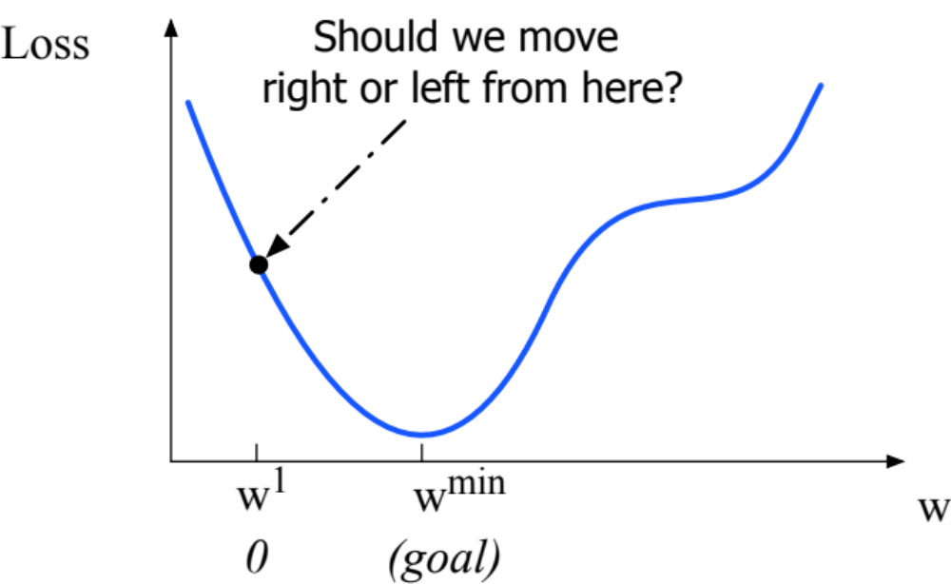
Let's first visualize for a single scalar w
Q: Given current w, should we make it bigger or smaller?
A: Move w in the reverse direction from the slope of the function
Notes:
Although the algorithm (and the concept of gradient) are designed for direction vectors, let’s first consider a visualization of the case where the parameter of our system is just a single scalar w. Given a random initialization of w at some value w1, and assuming the loss function L happened to have this shape, we need the algorithm to tell us whether at the next iteration we should move left (making w2 smaller than w1) or right (making w2 bigger than w1) to reach the minimum. The gradient descent algorithm answers this question by finding the gradient of the loss function at the current point and moving in the opposite direction.

Slide 55
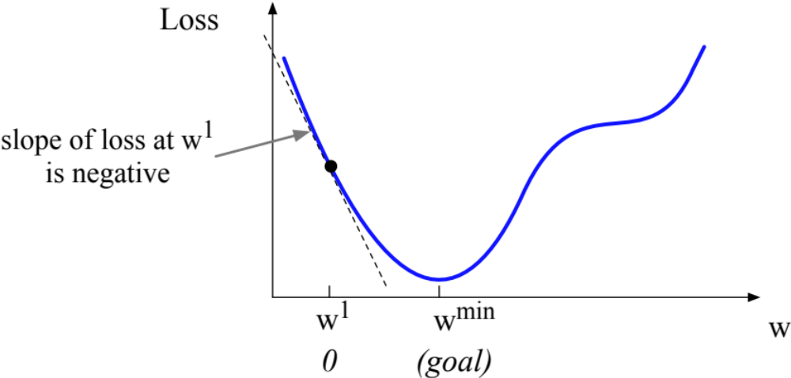
Let's first visualize for a single scalar w
Q: Given current w, should we make it bigger or smaller?
A: Move w in the reverse direction from the slope of the function
  So we'll move positive
Notes:
The gradient of a function of many variables is a vector pointing in the direction of the greatest increase in a function. The gradient is a multi-variable generalization of the slope, so for a function of one variable like the one in this figure, we can informally think of the gradient as the slope. The dotted line shows the slope of this hypothetical loss function at point w = w1 . You can see that the slope of this dotted line is negative.

Slide 56
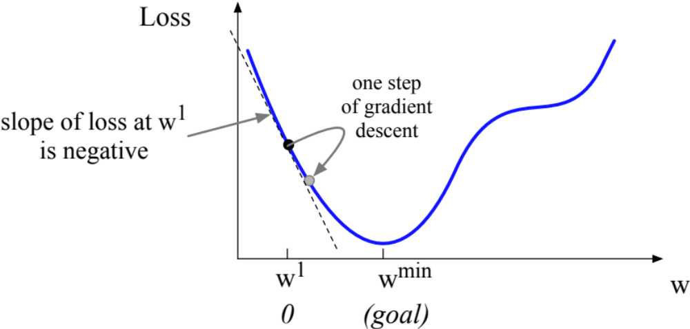
Let's first visualize for a single scalar w
Q: Given current w, should we make it bigger or smaller?
A: Move w in the reverse direction from the slope of the function
  So we'll move positive
Notes:
Thus to find the minimum, gradient descent tells us to go in the opposite direction: moving w in a positive direction.

Slide 57
Gradients
The gradient of a function of many variables is a vector pointing in the direction of the greatest increase in a function.
Gradient Descent: Find the gradient of the loss function at the current point and move in the opposite direction.

Slide 58
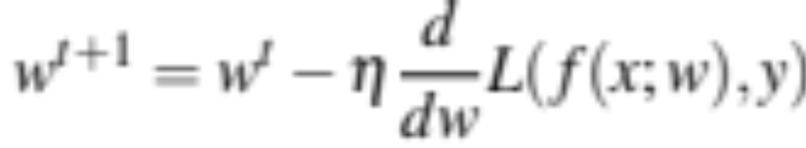
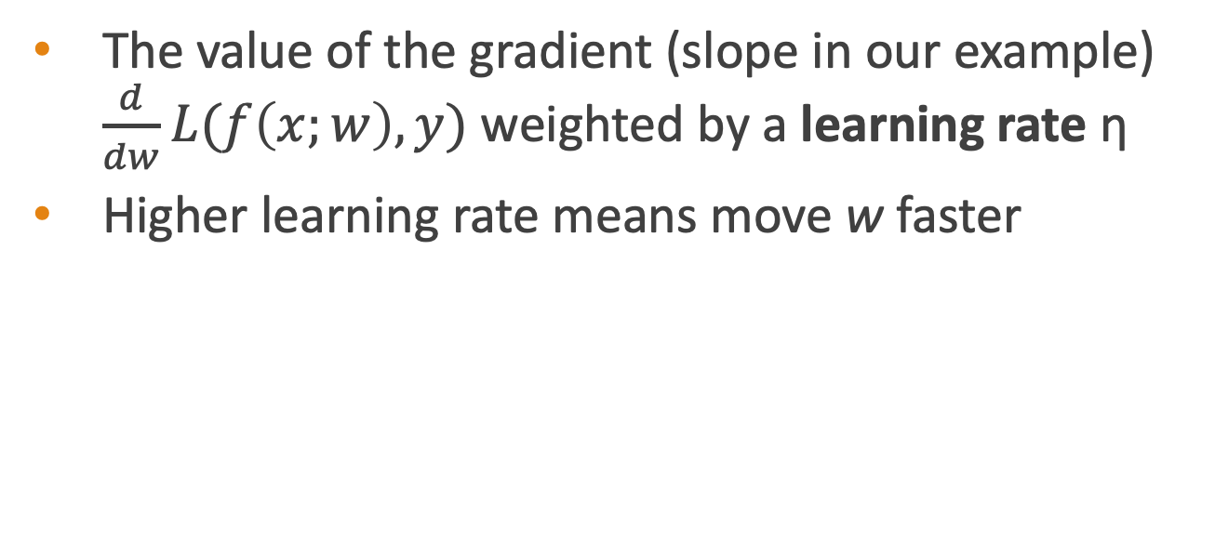
How much do we move in that direction ?
The value of the gradient (slope in our example) $\frac{d}{dw}L(f\left(x;w\right),y)$ weighted by a learning rate η
Higher learning rate means move w faster
Notes:
The magnitude of the amount to move in gradient descent is the value of the slope of the loss function (with respect to w) weighted by a learning rate η . A higher (faster) learning rate means that we should move w more on each step. The change we make in our parameter is the learning rate times the gradient (or the slope, in our single-variable example)

Slide 59
Now let's consider N dimensions
We want to know where in the N-dimensional space (of the N parameters that make up θ ) we should move.
The gradient is just such a vector; it expresses the directional components of the sharpest slope along each of the N dimensions.
Notes:
Now let’s extend the intuition from a function of one scalar variable w to many variables, because we don’t just want to move left or right, we want to know where in the N-dimensional space (of the N parameters that make up θ ) we should move. The gradient is just such a vector; it expresses the directional components of the sharpest slope along each of those N dimensions.

Slide 60
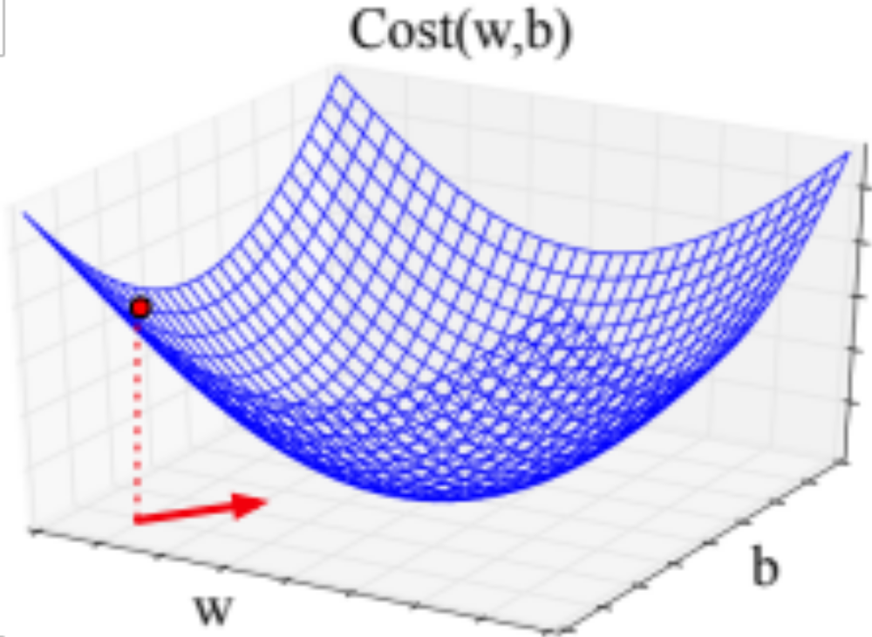
Imagine 2 dimensions, w and b
Visualizing the gradient vector at the red point
It has two dimensions shown in the x-y plane
Notes:
If we’re just imagining two weight dimensions (say for one weight w and one bias b), the gradient might be a vector with two orthogonal components, each of which tells us how much the ground slopes in the w dimension and in the b dimension. This figure shows a visualization of the value of a 2-dimensional gradient vector taken at the red point.

Slide 61
Real gradients
Are much longer; lots and lots of weights
For each dimension w_{i} the gradient component i tells us the slope with respect to that variable.
  “How much would a small change in w_{i} influence the total loss function L?”
  We express the slope as a partial derivative ∂ of the loss ∂w_{i}
The gradient is then defined as a vector of these partials.
Notes:
In an actual logistic regression, the parameter vector w is much longer than 1 or 2, since the input feature vector x can be quite long, and we need a weight wi for each xi. For each dimension/variable wi in w (plus the bias b), the gradient will have a component that tells us the slope with respect to that variable. Essentially we’re asking: “How much would a small change in that variable wi influence the total loss function L?” In each dimension wi, we express the slope as a partial derivative of the loss function with respect to wi. The gradient is then defined as a vector of these partials.

Slide 62
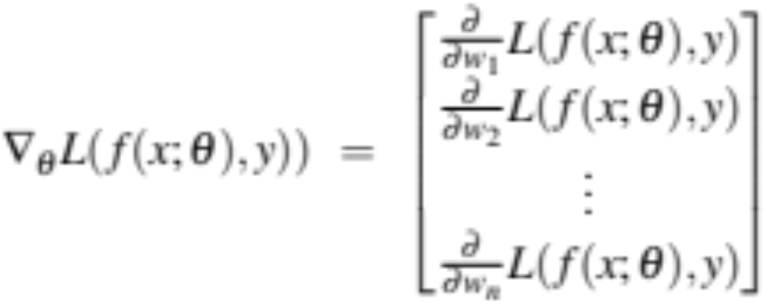
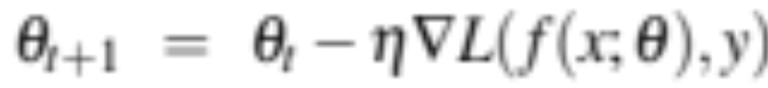
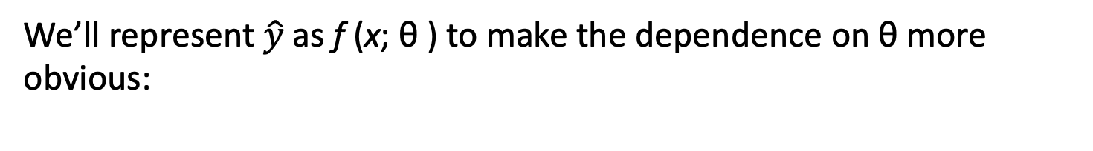
The gradient
We’ll represent $\hat{y}$as f (x; θ ) to make the dependence on θ more obvious:
The final equation for updating θ based on the gradient is thus
Notes:
Here's a vector of gradients. We’ll represent yˆ as f (x; θ ) to make the dependence on θ more obvious:

Slide 63
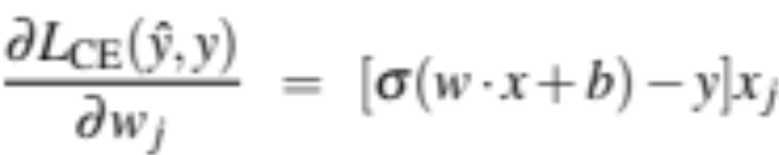
What are these partial derivatives for logistic regression?
The loss function
The elegant derivative of this function (see textbook 5.8 for derivation)
Notes:
In order to update θ , we need a definition for the gradient ∇L( f (x; θ ), y). Recall that for logistic regression, the cross-entropy loss function is: EQ
It turns out that the derivative of this function for one observation vector x is EQ
Note that the gradient with respect to a single weight w j represents a very intuitive value: the difference between the true y and our estimated yˆ = σ (w · x + b) for that observation, multiplied by the corresponding input value x j .

Slide 64
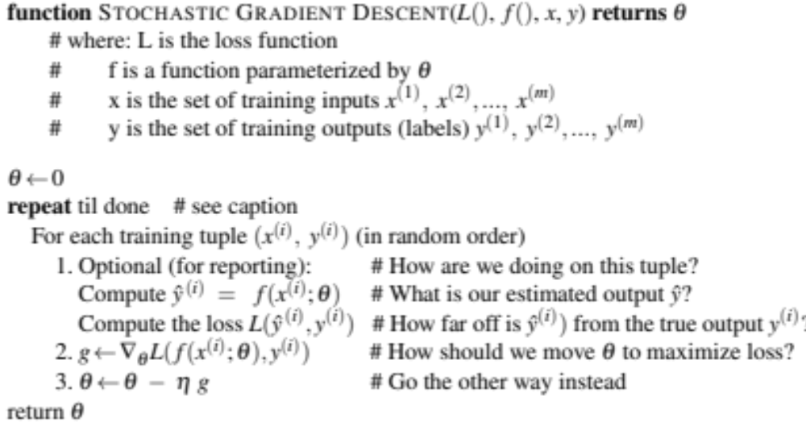
Notes:
Stochastic gradient descent is an online algorithm that minimizes the loss function by computing its gradient after each training example, and nudging θ in the right direction (the opposite direction of the gradient). The algorithm can terminate when it converges (or when the gradient norm < ε), or when progress halts (for example when the loss starts going up on a held-out set).

Slide 65
Hyperparameters
The learning rate η is a hyperparameter
  too high: the learner will take big steps and overshoot
  too low: the learner will take too long
Hyperparameters:
Briefly, a special kind of parameter for an ML model
Instead of being learned by algorithm from supervision (like regular parameters), they are chosen by algorithm designer.
Notes:
The learning rate η is a hyperparameter that must be adjusted. If it’s too high, the learner will take steps that are too large, overshooting the minimum of the loss function. If it’s too low, the learner will take steps that are too small, and take too long to get to the minimum. It is common to start with a higher learning rate and then slowly decrease it. Hyperparameters are a special kind of parameter for any machine learning model. Unlike regular parameters of a model (weights like w and b), which are learned by the algorithm from the training set, hyperparameters are special parameters chosen by the algorithm designer that affect how the algorithm works.

Slide 66
Logistic Regression
Stochastic Gradient Descent
Notes:
We've now introduced the important stochastic gradient descent algorithm. We'll give some more details in the next lecture.

Slide 67
Logistic Regression
Stochastic Gradient Descent: An example and more details
Notes:
In this lecture we'll walk through an example of stochastic descent and give a few more details.

Slide 68
Working through an example
One step of gradient descent
A mini-sentiment example, where the true y=1 (positive)
Two features:
        x₁ = 3 (count of positive lexicon words)
        x₂ = 2 (count of negative lexicon words)
      Assume 3 parameters (2 weights and 1 bias) in Θ⁰ are zero:
        w₁ = w₂ = b = 0
        η = 0.1
Notes:
Let’s walk though a single step of the gradient descent algorithm. We’ll use a simplified version of our sentiment classification example as it sees a single observation x, whose correct value is y = 1 (this is a positive review), and with only two features: x1 = 3 (count of positive lexicon words), and x2 = 2 (count of negative lexicon words). Let’s assume the initial weights and bias in θ_0 are all set to 0, and the initial learning rate η is 0.1:

Slide 69
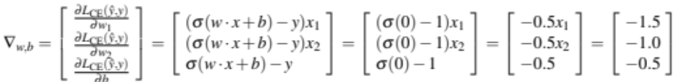
Example of gradient descent
        w₁ = w₂ = b = 0;
        x₁ = 3; x₂ = 2
Update step for update θ is:
where
Gradient vector has 3 dimensions:
Notes:
Here's our update equation for SGD. In order to do this update to theta, we'll need to know the gradient of the loss function. In our mini example there are three parameters, so the gradient vector has 3 dimensions, for w1, w2, and b. We can compute the first gradient as follows:

Slide 70
Example of gradient descent
        w₁ = w₂ = b = 0;
        x₁ = 3; x₂ = 2
Update step for update θ is:
where
Gradient vector has 3 dimensions:

Slide 71
Example of gradient descent
        w₁ = w₂ = b = 0;
        x₁ = 3; x₂ = 2
Update step for update θ is:
where
Gradient vector has 3 dimensions:

Slide 72
Example of gradient descent
        w₁ = w₂ = b = 0;
        x₁ = 3; x₂ = 2
Update step for update θ is:
where
Gradient vector has 3 dimensions:

Slide 73
Example of gradient descent
        w₁ = w₂ = b = 0;
        x₁ = 3; x₂ = 2
Update step for update θ is:
where
Gradient vector has 3 dimensions:

Slide 74
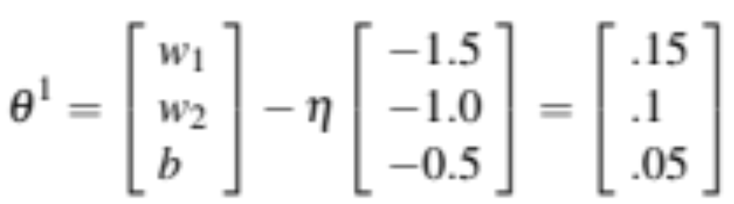
Example of gradient descent
Now that we have a gradient, we compute the new parameter vector θ¹ by moving θ⁰ in the opposite direction from the gradient:
        η = 0.1;

Slide 75
Example of gradient descent
Now that we have a gradient, we compute the new parameter vector θ¹ by moving θ⁰ in the opposite direction from the gradient:
        η = 0.1;

Slide 76
Example of gradient descent
Now that we have a gradient, we compute the new parameter vector θ¹ by moving θ⁰ in the opposite direction from the gradient:
        η = 0.1;

Slide 77
Example of gradient descent
Now that we have a gradient, we compute the new parameter vector θ¹ by moving θ⁰ in the opposite direction from the gradient:
        η = 0.1;
Note that enough negative examples would eventually make w₂ negative
Notes:
Note that this observation x happened to be a positive example. We would expect that after seeing more negative examples with high counts of negative words, that the weight w2, the weight for the "negative lexicon feature', would shift to have a negative value.

Slide 78
Mini-batch training
Stochastic gradient descent chooses a single random example at a time.
That can result in choppy movements
More common to compute gradient over batches of training instances.
Batch training: entire dataset
Mini-batch training: m examples (512, or 1024)
Notes:
Stochastic gradient descent is called stochastic because it chooses a single random example at a time, moving the weights so as to improve performance on that single example. That can result in very choppy movements, so it’s common to compute the gradient over batches of training instances rather than a single instance.
For example in batch training we compute the gradient over the entire dataset. By seeing so many examples, batch training offers a superb estimate of which direction to move the weights, at the cost of spending a lot of time processing every single example in the training set to compute this perfect direction.
A compromise is mini-batch training: we train on a group of m examples (perhaps 512, or 1024) that is less than the whole dataset.
Mini-batch training also has the advantage of computational efficiency. The mini-batches can easily be vectorized, choosing the size of the mini-batch based on the computational resources. This allows us to process all the exam- ples in one mini-batch in parallel and then accumulate the loss, something that’s not possible with individual or batch training.

Slide 79
Logistic Regression
Stochastic Gradient Descent: An example and more details
Notes:
We've now seen the stochastic gradient descent algorithm and discussed variants like mini-batch training.

Slide 80
Text Classification and Naive Bayes
Precision, Recall, and F1
Notes:
In this lecture we introduce the concepts of precision and recall, and the F1 metric that combines them. These concepts are central to the evaluation of classifiers, and we'll use them throughout NLP, not just for Naïve Bayes but also for logistic regression and neural models.

Slide 81
Evaluating Classifiers: How well does our classifier work?
Let's first address binary classifiers:
  Is this email spam?
    spam (+) or not spam (-)
  Is this post about Delicious Pie Company?
    about Del. Pie Co (+) or not about Del. Pie Co(-)
We'll need to know
  What did our classifier say about each email or post?
  What should our classifier have said, i.e., the correct answer, usually as defined by humans ("gold label")
Notes:
Let's first consider binary classifiers. So that might include a simple binary decision about email (spam or not-spam). Or imagine that we are the proprietors of the Delicious Pie Company and we want to find out what people are saying about our pies on social media. We want to know if a particular social media post is talking about our pies (positive) or isn't (negative).
To evaluate such a binary classifier, we'll need to know two things. What our classifier said about each email or post, and what it should have said, i.e. the correct answer, usually as defined by human labelers.

Slide 82
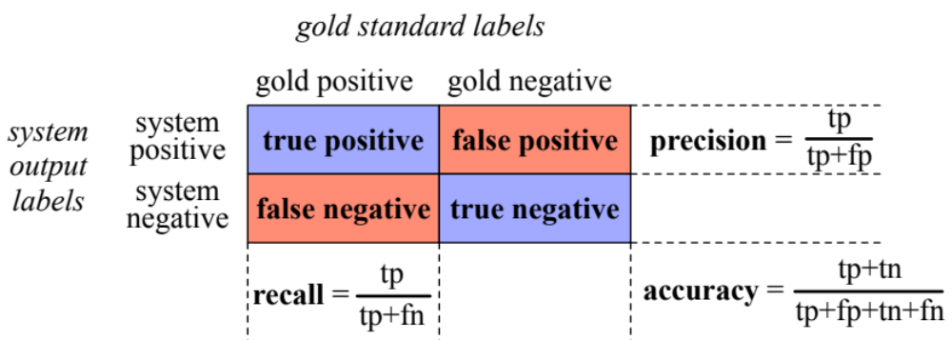
First step in evaluation: The confusion matrix
Notes:
The first step is the confusion matrix a table for visualizing how an algorithm performs with respect to the human gold labels, We use two dimensions (system output and gold labels), and each cell labels a set of possible outcomes.
In the pie detection case, for example, true positives are posts that are indeed about Delicious Pie (indicated by human-created gold labels) that our system correctly said were about pie. False negatives are posts that are indeed about pie but our system incorrectly labeled as pie. False positives are posts that aren't about pie but our system incorrectly said they were. And true negatives are non-pie-posts that are system correctly said were not about pie

Slide 83
Accuracy on the confusion matrix
Notes:
. Here is the equation for accuracy: what percentage of all the observations (for the spam or pie examples that means all emails or tweets) our system labeled correctly. Although accuracy might seem a natural metric, we generally don’t use it for text classification tasks.
Although accuracy might seem a natural metric, we generally don’t use it for text classification tasks.

Slide 84
Why don't we use accuracy?
Accuracy doesn't work well when we're dealing with uncommon or imbalanced classes
Suppose we look at 1,000,000 social media posts to find Delicious Pie-lovers (or haters)
  100 of them talk about our pie
  999,900 are posts about something unrelated
Imagine the following simple classifier
Every post is "not about pie"
Notes:
Why don't we use accuracy? …Accuracy doesn't work well when we're dealing with uncommon or imbalanced classes. Suppose we look at a million social media posts to find Delicious Pie-lovers. Now most posts on the web are not about our pie, so let's imagine that only 100 posts are about our pie, and 999,900 are about something else.
Now imagine we have the following really simple classifier: Every post is "not about pie"

Slide 85
Accuracy re: pie posts
100 posts are about pie; 999,900 aren't
Notes:
Let's see what happens.

Slide 86
Why don't we use accuracy?
Accuracy of our "nothing is pie" classifier
999,900 true negatives and 100 false negatives
Accuracy is 999,900/1,000,000 = 99.99%!
But useless at finding pie-lovers (or haters)!!
Which was our goal!
Accuracy doesn't work well for unbalanced classes
Most tweets are not about pie!
Notes:
But this fabulous ‘no pie’ classifier would be completely useless, since it wouldn’t find a single one of the customer comments we are looking for. In other words, accuracy is not a good metric when the goal is to discover something that is rare, or at least not completely balanced in frequency, which is a very common situation in the world.

Slide 87
Instead of accuracy we use precision and recall
Precision: % of selected items that are correct
Recall: % of correct items that are selected
Notes:
Precision is out of the things the system selected (the set of emails or tweets the sytstem claimed were positive, i.e. spam or pie-related), how many did it get right? how many were true positives, out of what I selected (true positives _ false positives).
Recall is out of all the correct items that should have been positive, what % of them did the system select? So out of all the things that are gold positive, how many did the system find as true positives?
So precision is about how much garbage we included in our findings; recall is more about making sure we didn't miss any treasure.

Slide 88
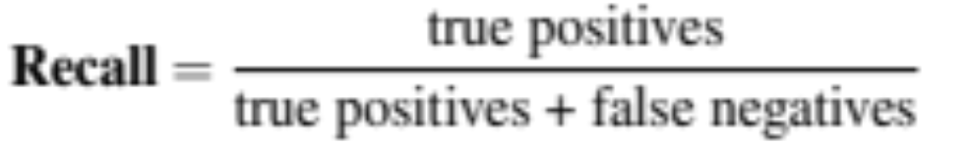
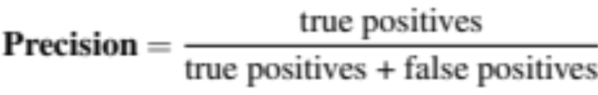
Precision/Recall aren't fooled by the"just call everything negative" classifier!
Stupid classifier: Just say no: every tweet is "not about pie"
100 tweets talk about pie, 999,900 tweets don't
Accuracy = 999,900/1,000,000 = 99.99%
But the Recall and Precision for this classifier are terrible:
Notes:
Recall and Precision will correctly evaluate our stupid "just say no" classifier as a bad classifier. The recall will be 0, since we returned no true positives out of the 100 true pie tweets (0 + 100). Precision is similarly 0 or in fact undefined, since both the numerator and denominator are 0. The metrics correctly assigns bad scores to our useless classifier.
[note that this is a particular egregious example, but in normal situations there is typically a trade-off between precision and recall!]
[to get high precision, a system should be very reluctant to guess – but then it may miss somethings and have poor recall]
[to get high recall, a system shoul dbe very willing to guess– but then it may return some junk and have poor precision]

Slide 89
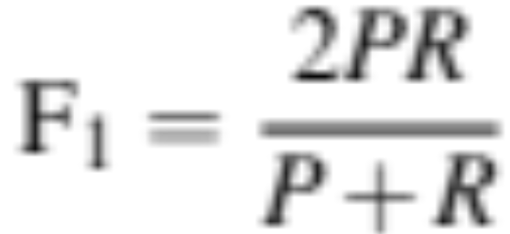
A combined measure: F1
F1 is a combination of precision and recall.
Notes:
a combined measure: F-1:
Why this function instead of just the arithmetic or geometric mean? F1 turns out to be the harmonic mean between precision and recall

Slide 90
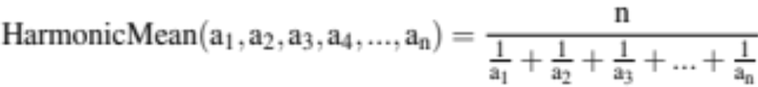
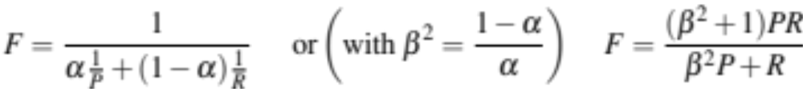
F1 is a special case of the general "F-measure"
F-measure is the (weighted) harmonic mean of precision and recall
F1 is a special case of F-measure with β=1, α=½
Notes:
F1 is a special case of the F-measure: weighted harmonic mean of precision and recall.
The harmonic mean of a set of numbers is the reciprocal of the arithmetic mean of reciprocals.
You can see here that F score is the harmonic mean, if we replace alpha with ½ we get 2/ (1/p + 1/r).
The Harmonic mean of two values is closer to the minimum of the two numbers than arithmetic or geometric mean, so it weighs the lower of the two numbers more heavily. That is, if P and R are far apart, F will be nearer the lower value, which makes it a kind of conservative mean in this situation. Thus to do well on F1, you have to do well on BOTH P and R.
Why the weights? in some applications you may care more about P or R. In practice we mainly use the balanced measure with beta = 1 and alpha =1/2

Slide 91
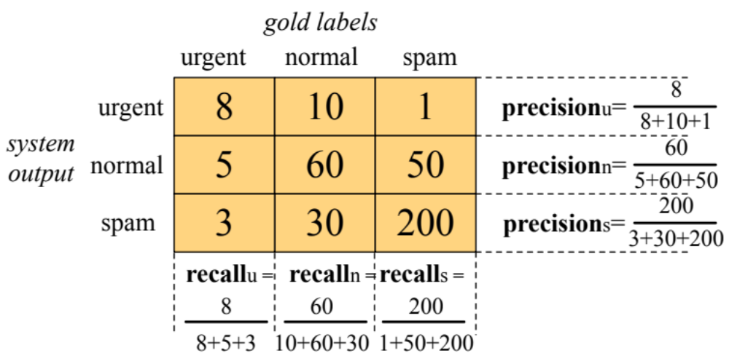
Suppose we have more than 2 classes?
Lots of text classification tasks have more than two classes.
  Sentiment analysis (positive, negative, neutral) , named entities (person, location, organization)
We can define precision and recall for multiple classes like this 3-way email task:
Notes:
Lots of classification tasks have more than two classes, like sentiment could be 3-way. Consider the confusion matrix for a hypothetical 3-way email categorization decision (urgent, normal, spam). Notice that the system mistakenly labeled one spam document as urgent. We can compute distinct precision and recall values for each class. For example, the precision of the urgent category is 8 (the true positive urgents) over the true positives + false positives (the 10 normal and that 1 spam). The result, however, is 3 separate precision values and 3 separaterecall values!

Slide 92
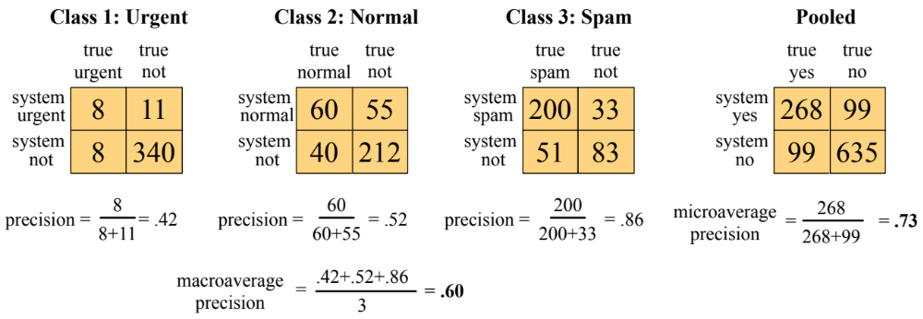
How to combine P/R values for different classes:
Microaveraging vs Macroaveraging
Notes:
To derive a single metric from these 3 sets of precisions and recalls, we can combine these in two ways. In macroaveraging, we compute the performance for each class, and then average over classes. That is, we take the same precisions and recalls we computed on the previsions slide, one set for Urgent, one set for Normal, and one set for spam, and we just average those precisions to get a single macro average.
In microaveraging, we instead first combine the decisions for all classes in a single confusion matrix, and then compute precision and recall from that table.
Note that the microaverage is dominated by the more frequent class (in this case spam), since the counts are pooled and F1 is dominated by the count of true positives. The macroaverage better reflects the statistics of the smaller classes, and so is more appropriate when performance on all the classes is equally important.

Slide 93
Text Classification and Naive Bayes
Precision, Recall, and F1
Notes:
We'll be using precision, recall, and F1 constantly in evaluating NLP classifiers, since they are more appropriate than accuracy when classes are imbalanced.

Slide 94
Text Classification and Naive Bayes
Avoiding Harms in Classification
Notes:
For any of our NLP tasks, we'll want to think about how to avoid doing harm. Let's discuss some important considerations for classification.

Slide 95
Harms of classification
Classifiers, like any NLP algorithm, can cause harms
This is true for any classifier, whether Naive Bayes or other algorithms

Slide 96
Representational Harms
Harms caused by a system that demeans a social group
  Such as by perpetuating negative stereotypes about them.
Kiritchenko and Mohammad 2018 study
  Examined 200 sentiment analysis systems on pairs of sentences
  Identical except for names:
    common African American (Shaniqua) or European American (Stephanie).
    Like "I talked to Shaniqua yesterday" vs "I talked to Stephanie yesterday"
Result: systems assigned lower sentiment and more negative emotion to sentences with African American names
Downstream harm:
  Perpetuates stereotypes about African Americans
  African Americans treated differently by NLP tools like sentiment (widely used in marketing research, mental health studies, etc.)
Notes:
One type of harm is called representational harm. These are harms that affect the representation of a group, for example demeaning them by perpetuating negative stereotypes about them. For example, Kititchenko and Mohammad in 2018 looked at representational harms in 200 sentiment analysis systems. They did this by creating pairs of sentences that were identicial except for a name. So a sentence might be "I talked to <person> yesterday". Then they created two versions of this sentence, one with a common African American name (like Shaniqua), and one with a common European American name (like Stephanie).
Then they ran all the sentences in these sets of sentence pairs through 200 sentiment analysis systems.
What they found is that systems assigned lower sentiment and more negative emotion to sentences with African American names
This not only perpetuates negative stereotypes about African Americans, but means that a standard NLP tool like sentiment, widley used in marketing research, mental health studies, and so on, is likely to treats African Americans differently.

Slide 97
Harms of Censorship
Toxicity detection is the text classification task of detecting hate speech, abuse, harassment, or other kinds of toxic language.
  Widely used in online content moderation
Toxicity classifiers incorrectly flag non-toxic sentences that simply mention minority identities (like the words "blind" or "gay")
  women (Park et al., 2018),
  disabled people (Hutchinson et al., 2020)
  gay people (Dixon et al., 2018; Oliva et al., 2021)
Downstream harms:
  Censorship of speech by disabled people and other groups
  Speech by these groups becomes less visible online
  Writers might be nudged by these algorithms to avoid these words making people less likely to write about themselves or these groups.

Slide 98
Performance Disparities
Text classifiers perform worse on many languages of the world due to lack of data or labels
Text classifiers perform worse on varieties of even high-resource languages like English
  Example task: language identification, a first step in NLP pipeline ("Is this post in English or not?")
  English language detection performance worse for writers who are African American (Blodgett and O'Connor 2017) or from India (Jurgens et al., 2017)

Slide 99
Harms in text classification
Causes:
  Issues in the data; NLP systems amplify biases in training data
  Problems in the labels
  Problems in the algorithms (like what the model is trained to optimize)
Prevalence: The same problems occur throughout NLP (including large language models)
Solutions: There are no general mitigations or solutions
  But harm mitigation is an active area of research
  And there are standard benchmarks and tools that we can use for measuring some of the harms
Notes:
What causes these harms in text classification, and what can we do about it? These harms are partly caused by biases in the data; classifiers are trained on text that contains bias already. And research shows that NLP systems have a tendancy to amplify biases that already exist in the training data.
The bias can come from the labels. Labels come from humans too, and humans have biases. And these harms can arise from the algorithms thsemlves
These problems occur throughout NLP, even in the latest and most powerful neural models. Indeed, some research suggests that the bigger more powerful NLP models may exhibit even greater examples of these harms.
There are no general-purpose mitigation algorithms or solutions. But harm mitigation is an active area of research throughout NLP.

Slide 100
Text Classification and Naive Bayes
Avoiding Harms in Classification
Notes:
Representational harms, censorship, and performance disparities, are just some of the harms that can be caused by text classification. It's important to examine our NLP tools for these harms and work to reduce them.

