Slide 1
Masked Language Models
BERT

Slide 2
Masked Language Modeling
We've seen autoregressive (causal, left-to-right) LMs.
But what about tasks for which we want to peak at future tokens?
  Especially true for tasks where we map each input token to an output token
Bidirectional encoders use masked self-attention to
  map sequences of input embeddings (x1,...,xn)
  to sequences of output embeddings of the same length (h1,...,hn),
  where the output vectors have been contextualized using information from the entire input sequence.

Slide 3
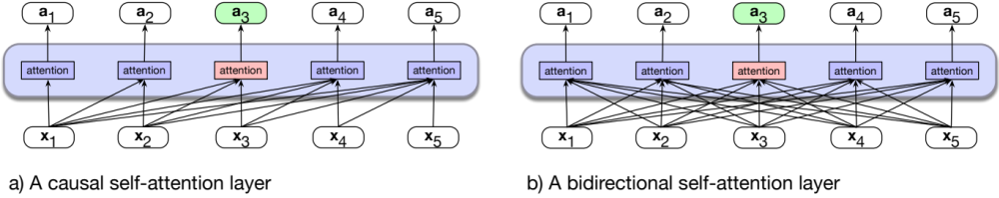
Bidirectional Self-Attention
Notes:
Recall that we applied feedforward networks to lan- guage modeling by having them look only at a fixed-size window of words, and then sliding this window over the input, making independent predictions along the way.

Slide 4
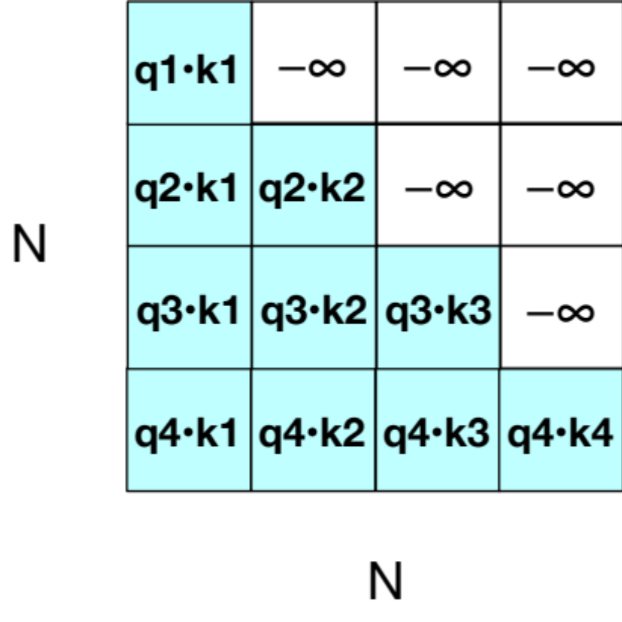
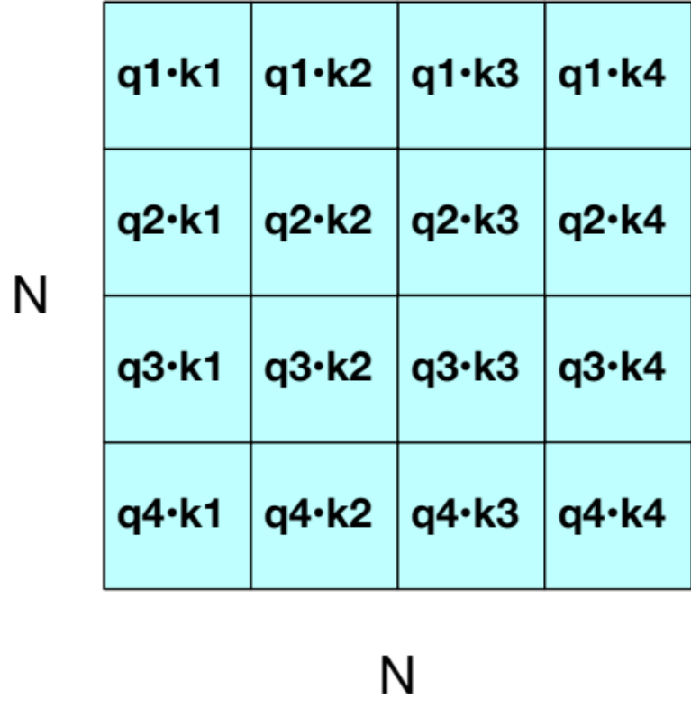
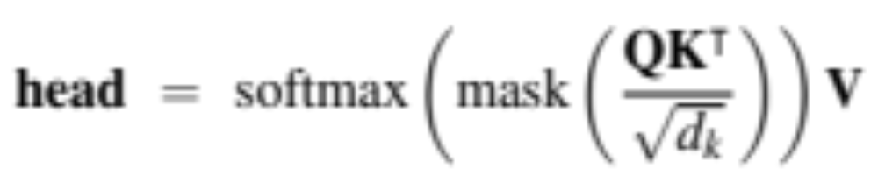
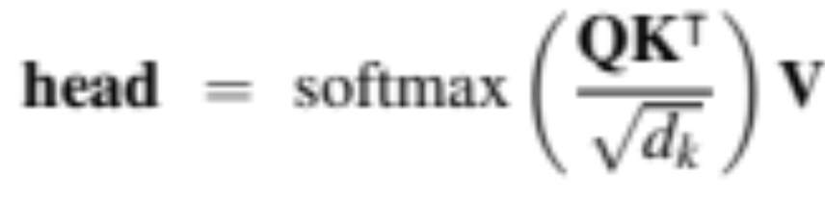
Easy! We just remove the mask
Casual self-attention
Bidirectional self-attention

Slide 5
BERT: Bidirectional Encoder Representations from Transformers
BERT (Devlin et al., 2019)
30,000 English-only tokens (WordPiece tokenizer)
Input context window N=512 tokens, and model dimensionality d=768
L=12 layers of transformer blocks, each with A=12 (bidirectional) multihead-attention layers.
The resulting model has about 100M parameters.
XLM-RoBERTa (Conneau et al., 2020)
250,000 multilingual tokens (SentencePiece Unigram LM tokenizer)
Input context window N=512 tokens,model dimensionality d=1024
L=24 layers of transformer blocks, with A=16 multihead attention layers each
The resulting model has about 550M parameters.

Slide 6
Masked Language Models
BERT

Slide 7
Masked Language Models
Masked LM training

Slide 8
Masked training intuition
For left-to-right LMs, the model tries to predict the last word from prior words:
The water of Walden Pond is so beautifully
  And we train it to improve its predictions.
For bidirectional masked LMs, the model tries to predict one or more words from all the rest of the words:
The of Walden Pond so beautifully blue
  The model generates a probability distribution over the vocabulary for each missing token
  We use the cross-entropy loss from each of the model’s predictions to drive the learning process.

Slide 9
MLM training in BERT
15% of the tokens are randomly chosen to be part of the masking
Example: "Lunch was delicious", if delicious was randomly chosen:
Three possibilities:
80%: Token is replaced with special token [MASK]
Lunch was delicious -> Lunch was [MASK]
10%: Token is replaced with a random token (sampled from unigram prob)
Lunch was delicious -> Lunch was gasp
10%: Token is unchanged
Lunch was delicious -> Lunch was delicious
Notes:
Why the three possible manipulations? Adding the [MASK] token creates a mismatch be- tween pretraining and downstream fine-tuning or inference, since when we employ the MLM model to perform a downstream task, we don’t use any [MASK] tokens. If we just replaced tokens with the [MASK], the model might only predict tokens when it sees a [MASK], but we want the model to try to always predict the input token.

Slide 10
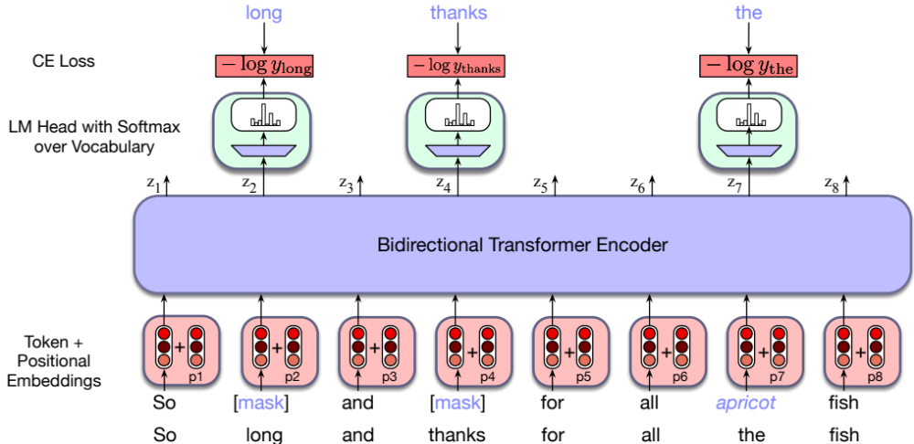
In detail
Notes:
To train the model to make the prediction, the original input sequence is to- kenized using a subword model and tokens are sampled to be manipulated. Word embeddings for all of the tokens in the input are retrieved from the E embedding ma- trix and combined with positional embeddings to form the input to the transformer, passed through the stack of bidirectional transformer blocks, and then the language modeling head. The MLM training objective is to predict the original inputs for each of the masked tokens and the cross-entropy loss from these predictions drives the training process for all the parameters in the model. That is, all of the input tokens play a role in the self-attention process, but only the sampled tokens are used for learning.

Slide 11
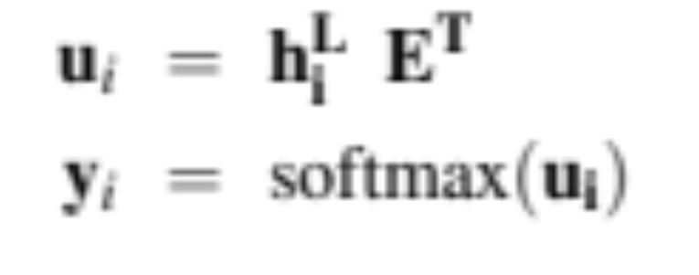
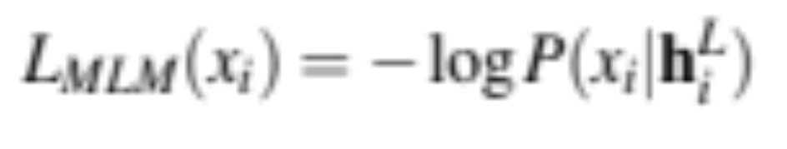
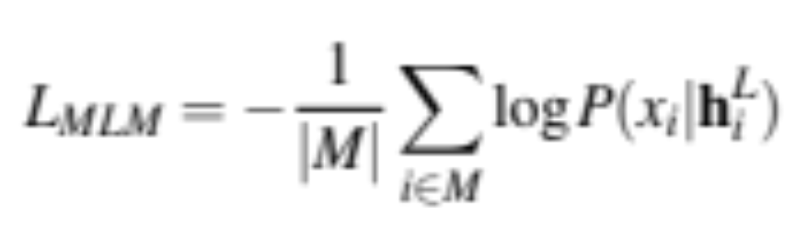
MLM loss
The LM head takes output of final transformer layer L, multiplies it by unembedding layer and turns into probabilities:
E.g., for the x_{i} corresponding to "long", the loss is the probability of the correct word long, given output h^{L}_{i} ):
We get the gradients by taking the average of this loss over the batch

Slide 12
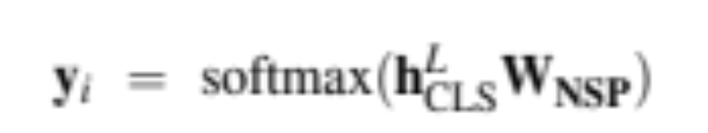
Next Sentence Prediction
Given 2 sentences the model predicts if they are a real pair of adjacent sentences from the training corpus or a pair of unrelated sentences.
BERT introduces two special tokens
[CLS] is prepended to the input sentence pair,
[SEP] is placed between the sentences, and also after second sentence
And two more special tokens
[1st segment] and [2nd segment]
These are added to the input embedding and positional embedding
h^{L}_{CLS} from the final layer [CLS] token is input to classifier head (weights W_{NSP} ) that predicts two classes:.

Slide 13
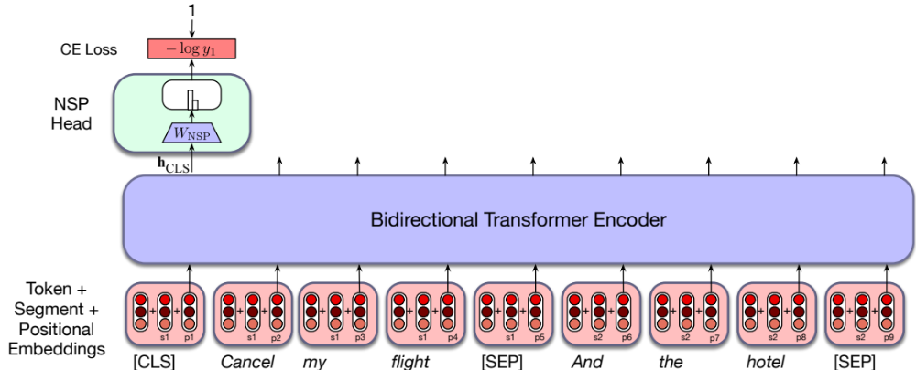
NSP Loss with classification head

Slide 14
More details
Original model was trained with 40 passes over training data
Some models (like RoBERTa) drop NSP loss
Tokenizer for multilingual models is trained from stratified sample of languages (some data from each language)
Multilingual models are better than monolingual models with small numbers of languages
With large numbers of languages, monolingual models in that language can be better
The "curse of multilinguality"

Slide 15
Masked Language Models
Masked LM training

Slide 16
Masked Language Models
Contextual Embeddings

Slide 17
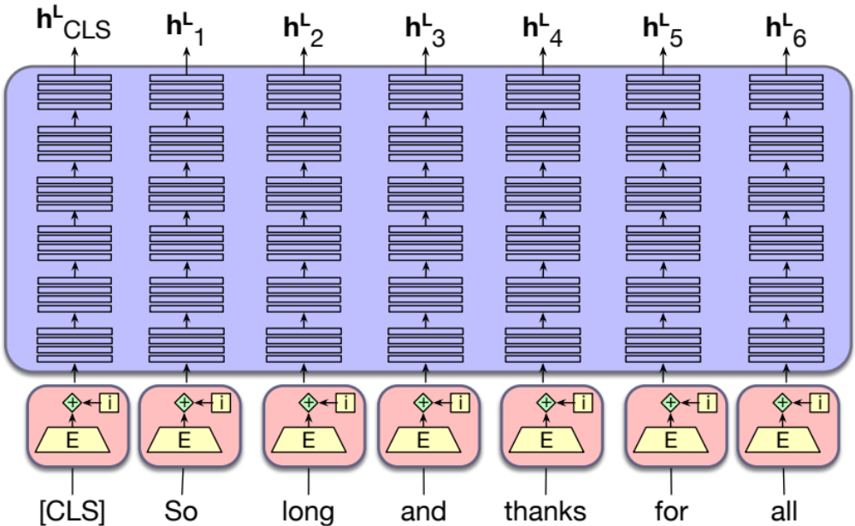
Contextual Embeddings to represent words

Slide 18
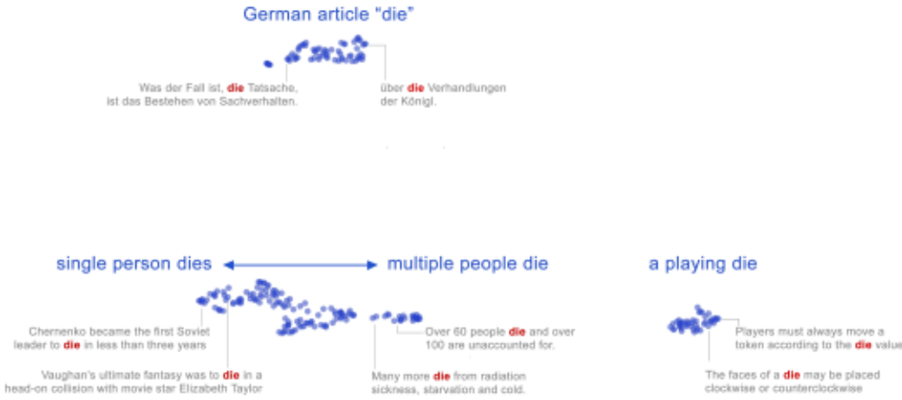
Static vs Contextual Embeddings
Static embeddings represent word types (dictionary entries)
Contextual embeddings represent word instances (one for each time the word occurs in any context/sentence)

Slide 19
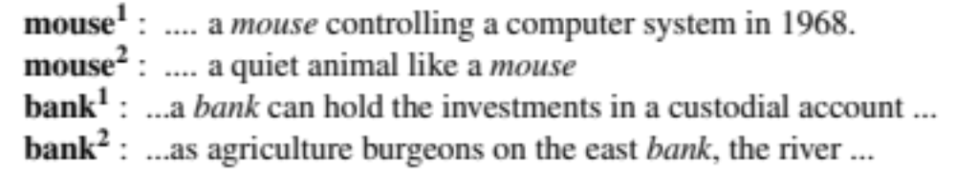
Word sense
Words are ambiguous
A word sense is a discrete representation of one aspect of meaning
Contextual embeddings offer a continuous high-dimensional model of meaning that is more fine grained than discrete senses.

Slide 20
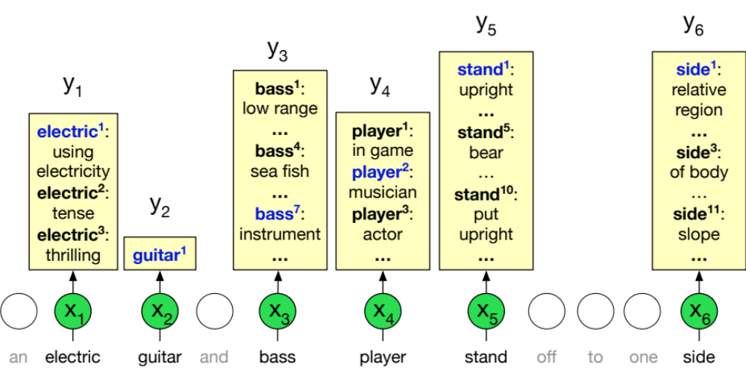
Word sense disambiguation (WSD)
The task of selecting the correct sense for a word.

Slide 21
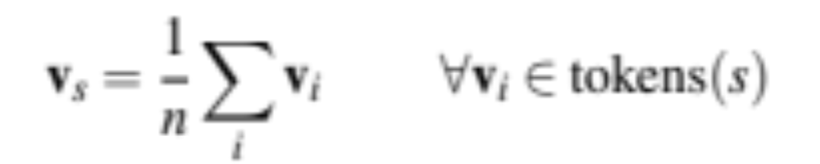
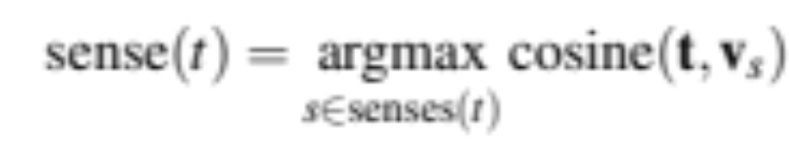
1-nearest neighbor algorithm for WSD
Melamud et al (2016), Peters et al (2018)
At training time, take a sense-labeled corpus like SEMCOR
Run corpus through BERT to get contextual embedding for each token
E.g., pooling representations from last 4 BERT transformer layer
Then for each sense s of word w for n tokens of that sense, pool embeddings:
At test time, given a token of a target word t, compute contextual embedding t and choose its nearest neighbor sense from training set

Slide 22
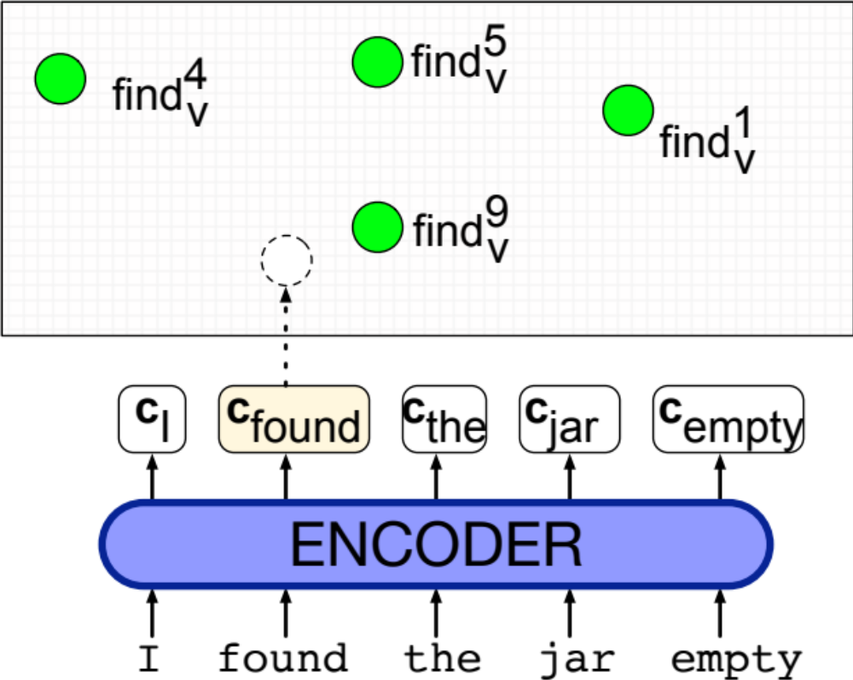
1-nearest neighbor algorithm for WSD
Notes:
In green are the contextual embed- dings precomputed for each sense of each word; here we just show a few of the senses for find. A contextual embedding is computed for the target word found, and then the nearest neighbor sense (in this case find9v ) is chosen.

Slide 23
Similarity and contextual embeddings
We generally use cosine as for static embeddings
But some issues:
  Contextual embeddings tend to be anisotropic: all point in roughly the same direction so have high inherent cosines (Ethayarajh 2019)
  Cosine measure are dominated by a small number of "rogue" dimensions with very high values (Timkey and van Schijndel 2021)
  Cosine tends to underestimate human judgments on similarity of word meaning for very frequent words (Zhou et al., 2022)

Slide 24
Masked Language Models
Contextual Embeddings

Slide 25
Masked Language Models
Fine-Tuning for Classification

Slide 26
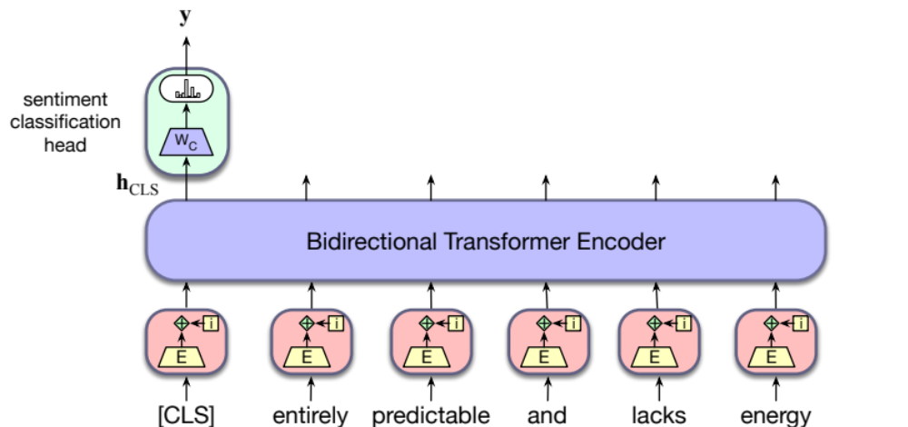
Adding a sentiment classification head
Notes:
Finetuning the values in WC requires supervised training data consisting of input sequences labeled with the appropriate sentiment class. Training proceeds in the usual way; cross-entropy loss between the softmax output and the correct answer is used to drive the learning that produces WC.
Note that can ba

Slide 27
Sequence-Pair classification
Assign a label to pairs of sentences:
paraphrase detection (are the two sentences paraphrases of each other?)
logical entailment (does sentence A logically entail sentence B?)
discourse coherence (how coherent is sentence B as a follow-on to sentence A?)

Slide 28
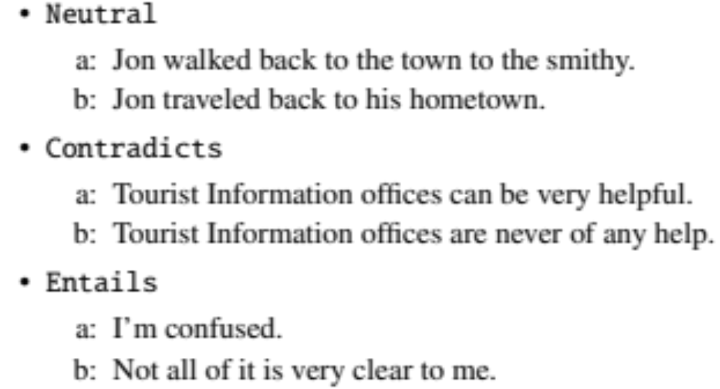
Example: Natural Language Inference
Pairs of sentences are given one of 3 labels
Algorithm: pass the premise/hypothesis pairs through a bidirectional encoder and use the output vector for the [CLS] token as the input to the classification head .

Slide 29
Fine-tuning for sequence labeling
Assign a label from a small fixed set of labels to each token in the sequence.
Named entity recognition
Part of speech tagging
.

Slide 30
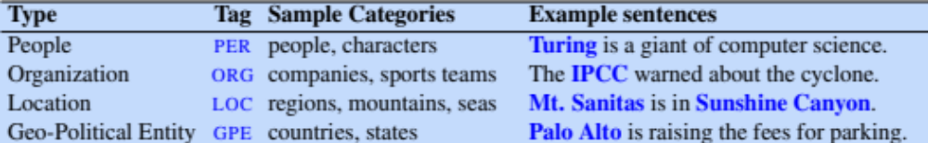
Named Entity Recognition
A named entity is anything that can be referred to with a proper name: a person, a location, an organization
Named entity recognition (NER): find spans of text that constitute proper names and tag the type of the entity

Slide 31
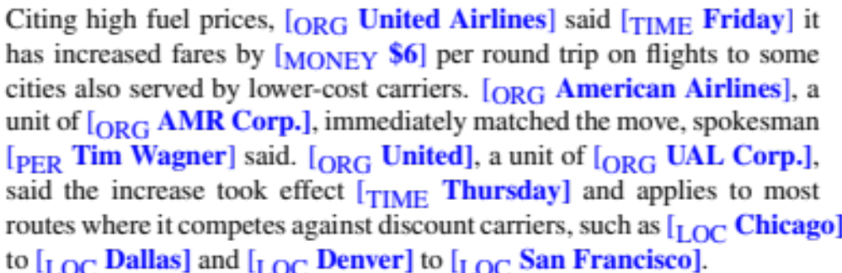
Named Entity Recognition

Slide 32
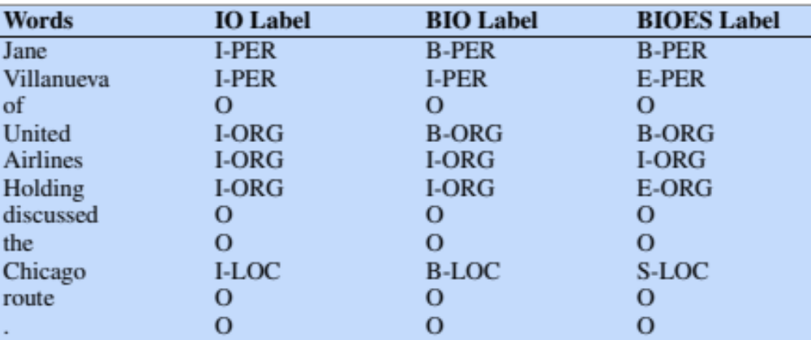
BIO Tagging
Ramshaw and Marcus (1995)
A method that lets us turn a segmentation task (finding boundaries of entities) into a classification task

Slide 33
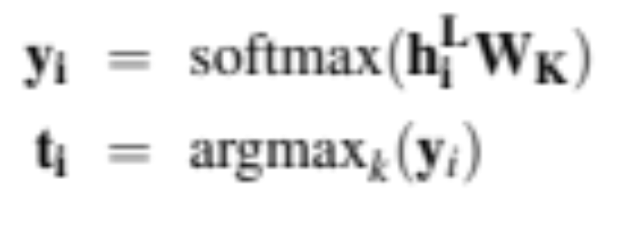
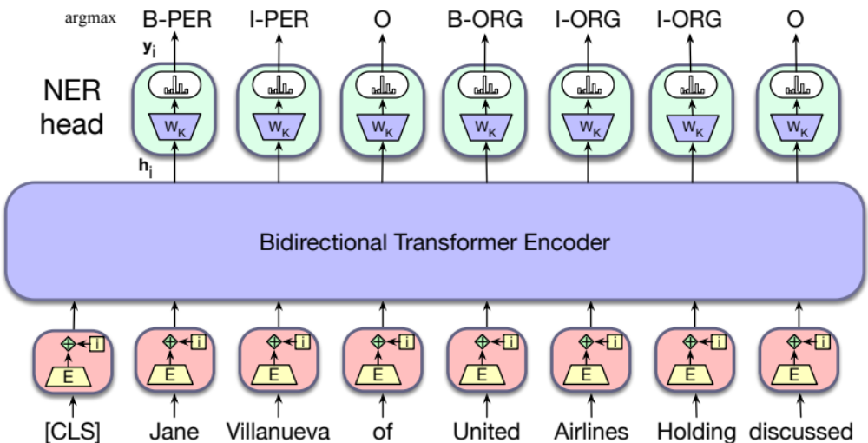
Sequence labeling

Slide 34
More details
We need to map between tokens (used by LLM) and words (used in definition of name entities)
We evaluate NER with F1 (precision/recall)

Slide 35
Masked Language Models
Fine-Tuning for Classification

