Slide 1
Simple Neural Networks and Neural Language Models
Units in Neural Networks
Notes:
Here we introduce the individual computing unit that makes up neural networks.

Slide 2
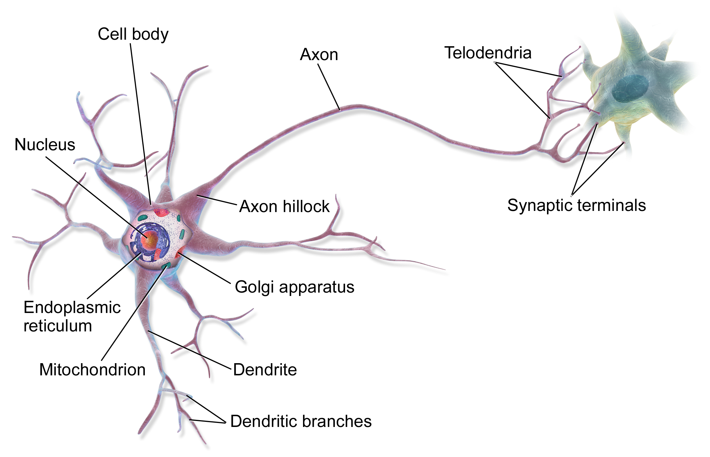
This is in your brain
By BruceBlaus - Own work, CC BY 3.0, https://commons.wikimedia.org/w/index.php?curid=28761830
Notes:
Neural networks are called neural because their origins lie in the McCulloch-Pitts neuron, which was a 1943 simplified model of the human neuron as a kind of computing element that could be described in terms of propositional logic. But the modern use in language processing no longer draws on these early biological inspirations and the name neural is really just a kind of historical remnant.

Slide 3
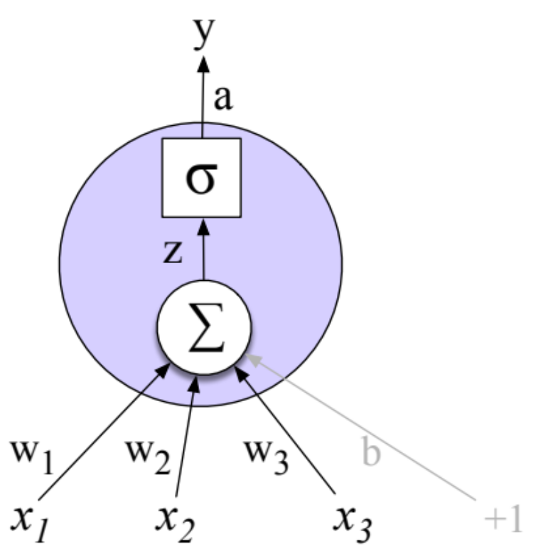
Neural Network Unit
This is not in your brain
Output value
Non-linear transform
Weighted sum
bias
Weights
Input layer
Notes:
Instead, a modern neural network is a network of small computing units, each of which takes a vector of input values and produces a single output value.
Over the next few lectures we'll introduce these units and see how they connect together into feedforward networks, so called because the computation proceeds iteratively from one layer of units to the next. The use of modern neural nets is often called deep learning, because modern networks are often deep (have many layers).
The building block of a neural network is a single computational unit. A unit takes a set of real valued numbers as input, performs some computation on them (combining with weights and biases and a non-linear transform), and produces an output. Let's see this in more detail.

Slide 4
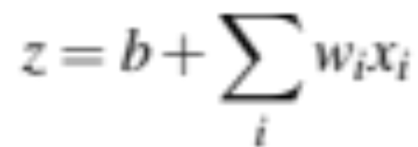


Neural unit
Take weighted sum of inputs, plus a bias
Instead of just using z, we'll apply a nonlinear activation function f:
Notes:
At its heart, a neural unit is taking a weighted sum of its inputs, with one additional term in the sum called a bias term. Given a set of inputs x1...xn, a unit has a set of corresponding weights w1...wn and a bias b, so the weighted sum z can be represented as:
Often it’s more convenient to express this weighted sum using vector notation, i.e. a scalar z computed from the dot product of a weight vector w and an input vector x, plus a scalar bias b
Finally, instead of using z, a linear function of x, as the output, neural units
apply a non-linear function f to z. We will refer to the output of this function as the activation value for the unit, a. Since we are just modeling a single unit, the activation for the node is in fact the final output of the network, which we’ll generally call y. So the value y is defined as: y=a= f(z)

Slide 5
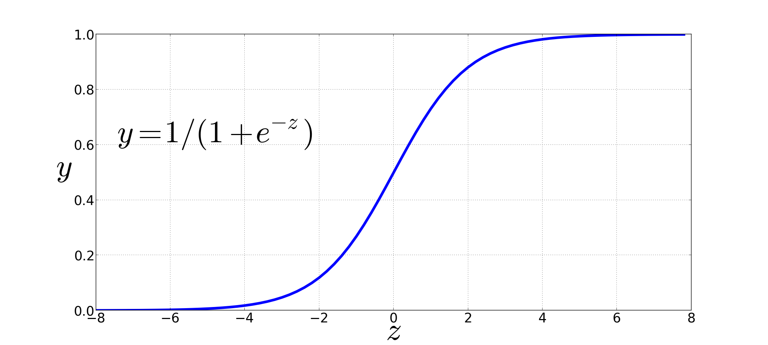
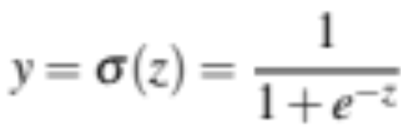
Non-Linear Activation Functions
We're already seen the sigmoid for logistic regression:
Sigmoid
Notes:
We're already seen the sigmoid for logistic regression: 1 over 1 plus exp (-z).
The sigmoid has a number of advantages; it maps the output into the range [0,1], which is useful in squashing outliers toward 0 or 1. And it’s differentiable, which as we saw is handy for learning

Slide 6
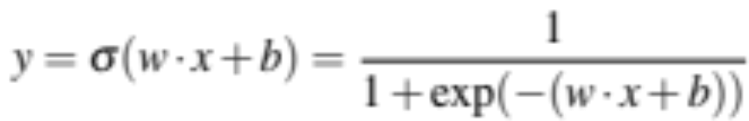
Final function the unit is computing
Notes:
So here's the function that a simple unit with a sigmoid activation function is computing from an input x, a weight vector w, and a bias term b

Slide 7
Final unit again
Output value
Non-linear activation function
Weighted sum
bias
Weights
Input layer
Notes:
And here's our picture of the unit again, showing the pieces

Slide 8
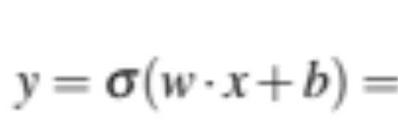
An example
Suppose a unit has:
w = [0.2,0.3,0.9]
b = 0.5
What happens with input x:
x = [0.5,0.6,0.1]
Notes:
Let’s walk through an example just to get an intuition. Let’s suppose we have a unit with the following weight vector and bias , and given the input

Slide 9
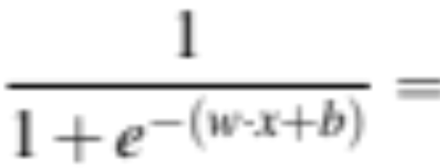
An example
Suppose a unit has:
w = [0.2,0.3,0.9]
b = 0.5
What happens with the following input x?
x = [0.5,0.6,0.1]

Slide 10
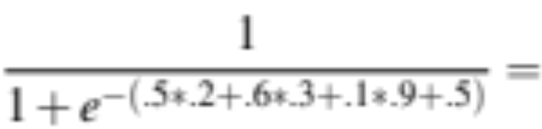
An example
Suppose a unit has:
w = [0.2,0.3,0.9]
b = 0.5
What happens with input x:
x = [0.5,0.6,0.1]

Slide 11
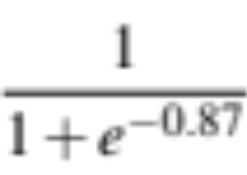
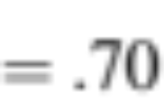
An example
Suppose a unit has:
w = [0.2,0.3,0.9]
b = 0.5
What happens with input x:
x = [0.5,0.6,0.1]

Slide 12
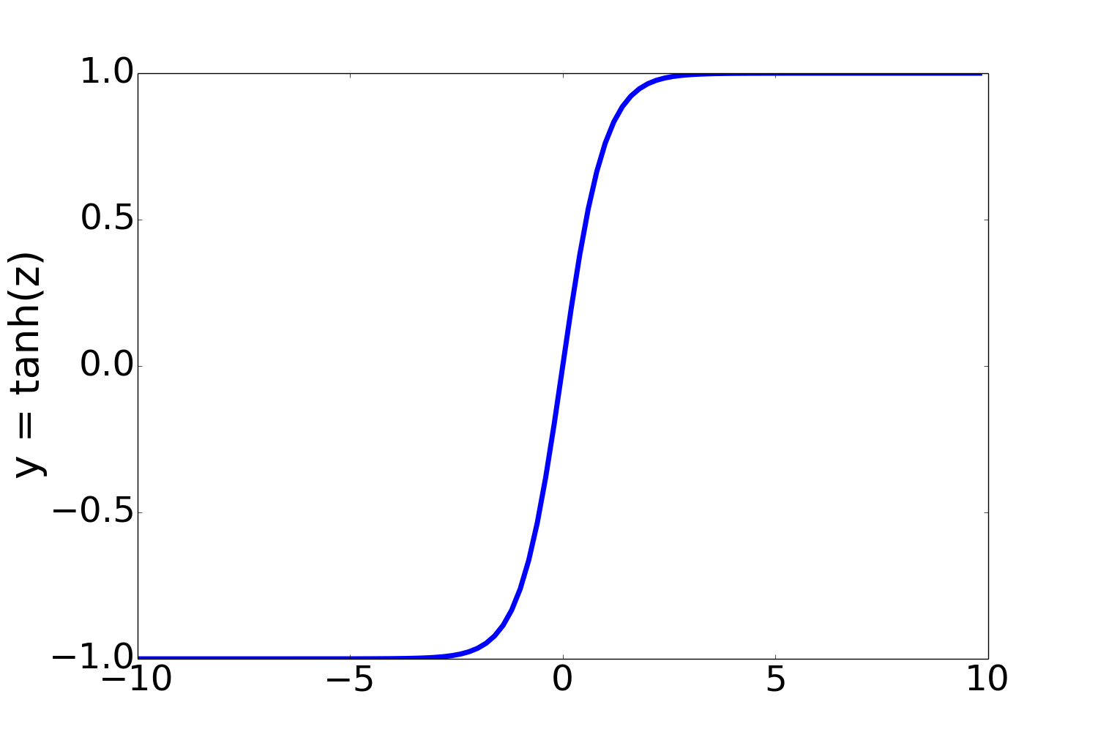
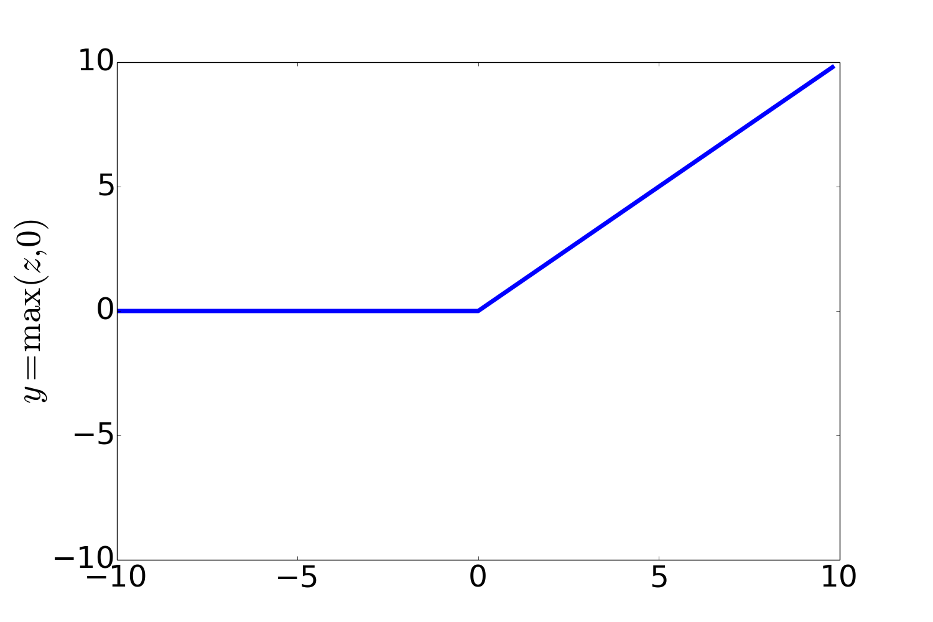
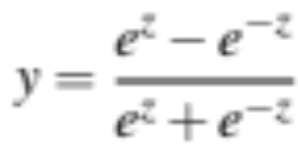
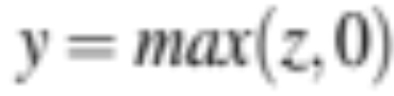
Non-Linear Activation Functions besides sigmoid
Most Common:
ReLU
Rectified Linear Unit
tanh
Notes:
In practice, the sigmoid is not commonly used as an activation function. A function that is very similar but almost always better is the tanh function; tanh is a variant of the sigmoid that ranges from -1 to +1:
The tanh function has the nice properties of being smoothly differentiable and mapping outlier values toward the mean.
The simplest activation function, and perhaps the most commonly used, is the rectified linear unit, also called the ReLU,. It’s just the same as z
when z is positive, and 0 otherwise:
The Rectified Linear Unit function, has nice properties that result from it being very close to linear. In the sigmoid or tanh functions, very high values of z result in values of y that are saturated, i.e., extremely close to 1 and have derivatives very close to 0. Zero derivatives cause problems for learning: gradients that are almost 0 cause the error signal to get smaller and smaller until it is too small to be used for training, a problem called the vanishing gradient problem. Rectifiers don’t have this problem, since the derivative of ReLU for high values of z is 1 rather than very close to 0.

Slide 13
Simple Neural Networks and Neural Language Models
Units in Neural Networks
Notes:
We've introduced the basic neural computing unit that underlies modern neural networks.

Slide 14
Simple Neural Networks and Neural Language Models
The XOR problem
Notes:
The power of neural networks comes from combining these units into larger networks. One of the most clever demonstrations of the need for multi-layer networks was the early proof by Minsky and Papert (1969) that a single neural unit cannot compute some very simple functions of its input.

Slide 15
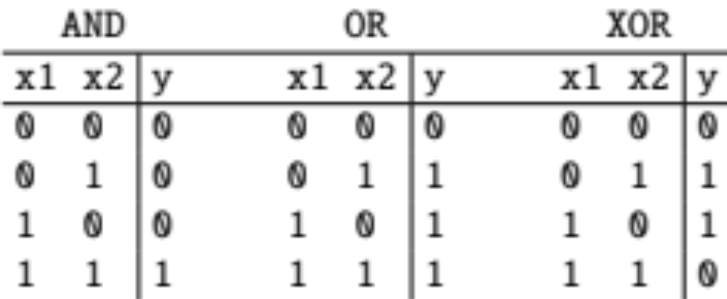
The XOR problem
Minsky and Papert (1969)
Can neural units compute simple functions of input?
Notes:
Consider the task of computing elementary logical functions of two inputs, like AND, OR, and XOR. As a reminder, here are the truth tables for those functions:

Slide 16
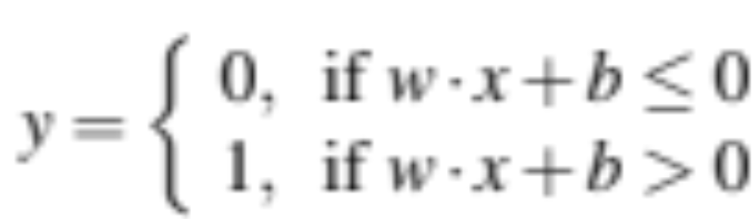
Perceptrons
A very simple neural unit
Binary output (0 or 1)
No non-linear activation function
Notes:
This example was first shown for the perceptron, which is a very simple neural unit that has a binary output and does not have a non-linear activation function. The output y of a perceptron is 0 or 1, and is computed as follows (using the same weight
w, input x, and bias b we've seen already

Slide 17
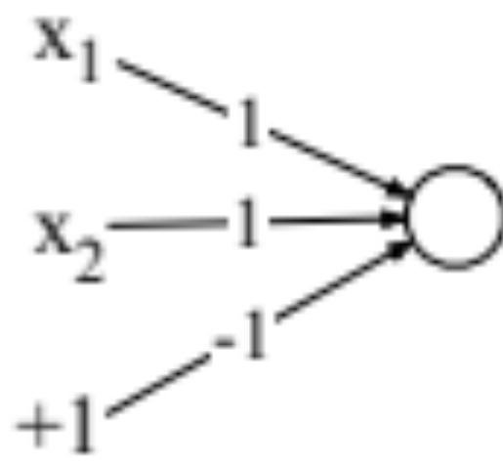
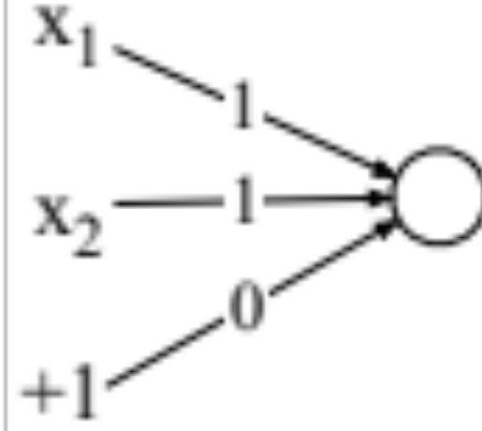
Easy to build AND or OR with perceptrons
AND
OR
Notes:
It’s very easy to build a perceptron that can compute the logical AND and OR functions of its binary inputs
Here's an example of
logical AND, showing weights w1 = 1 and w2 = 1 and bias weight b = −1 and logical OR, showing weights w1 = 1 and w2 = 1 and bias weight b = 0. These weights/biases are just one from an infinite number of possible sets of weights and biases that would implement the functions.

Slide 18
Easy to build AND or OR with perceptrons
AND
OR
Notes:
Let's see what happens with values 1 and 0:

Slide 19
Easy to build AND or OR with perceptrons
AND
OR
Notes:
How about OR? Let's see 0 and 1?

Slide 20
Not possible to capture XOR with perceptrons
Pause the lecture and try for yourself!

Slide 21
Why? Perceptrons are linear classifiers
Perceptron equation given x₁ and x₂, is the equation of a line
w₁x₁ + w₂x₂ + b = 0
(in standard linear format: x₂ = (−w₁/w₂)x₁ + (−b/w₂) )
This line acts as a decision boundary
0 if input is on one side of the line
1 if on the other side of the line
Notes:
Why? Crucially, the perceptron is a linear classifier. For a two-dimensional input x1 and x2, the perception equation, w1 x1 + w2 x2 + b = 0 is the equation of a line. (We can see this by putting it in the standard linear format: x2 = (−w1/w2)x1 + (−b/w2).)
This line acts as a decision boundary in two-dimensional space in which the output 0 is assigned to all inputs lying on one side of the line, and the output 1 to all input points lying on the other side of the line
If we had more than 2 inputs, the decision boundary becomes a hyperplane instead of a line, but the idea is the same, separating the space into two categories.

Slide 22
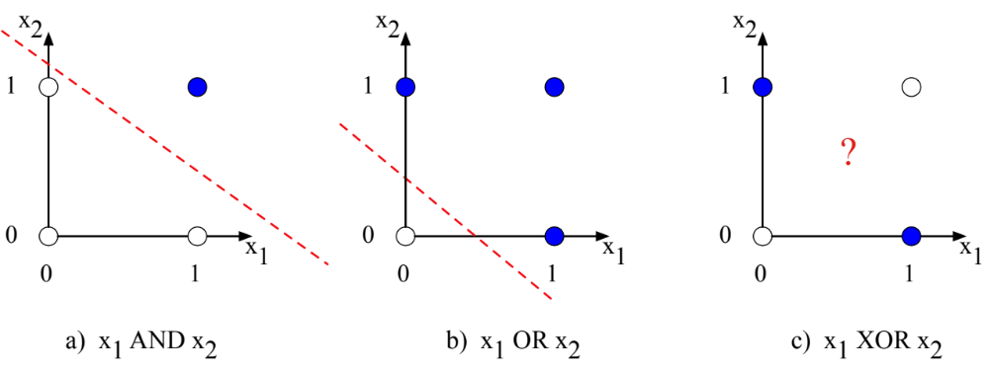
Decision boundaries
XOR is not a linearly separable function!
Notes:
These figures shows the possible logical inputs (00, 01, 10, and 11) and the line drawn by one possible set of parameters for an AND and an OR classifier. Notice that there is simply no way to draw a line that separates the positive cases of XOR (01 and 10) from the negative cases (00 and 11).
CLICK
We say that XOR is not a linearly separable function. Of course we could draw a boundary with a curve, or some other function, but not a single line.

Slide 23
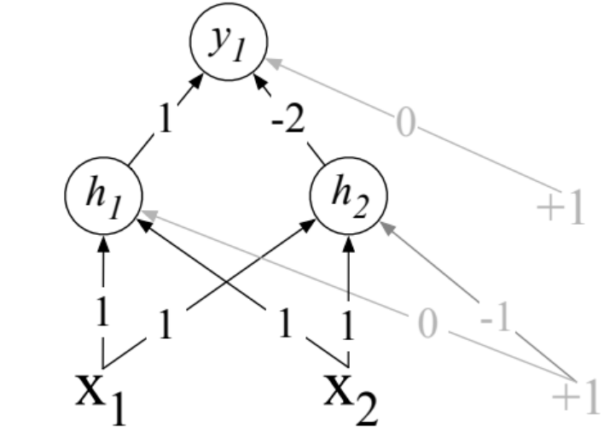
Solution to the XOR problem
XOR can't be calculated by a single perceptron
XOR can be calculated by a layered network of units.
ReLU
ReLU
Notes:
Let’s see an example of how to compute XOR using two layers of ReLU-based units.
The middle layer (called h) has two units, and the output layer (called y) has one unit. These weights and biases will computes XOR.
Consider input x = [0, 0] ]. If we multiply each input value by the appropriate weight, sum, and then add the bias b, DO THIS ON SLIDE we get the vector [0 -1] apply the ReLU and we get [0 0], and the final value is 0.

Slide 24
Solution to the XOR problem
XOR can't be calculated by a single perceptron
XOR can be calculated by a layered network of units.
Notes:
I recommend you pause the video and work through the computation of the remaining 3 possible input pairs to see that the resulting y values are 1 for the inputs [0 1] and [1 0] and 0 for [0 0] and [1 1].

Slide 25

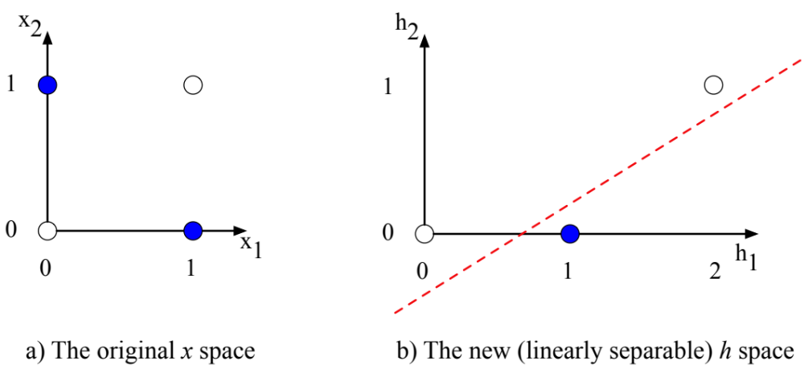
The hidden representation h
(With learning: hidden layers will learn to form useful representations)
Notes:
It’s also instructive to look at the intermediate results, the outputs of the two hidden nodes h1 and h2.
Here are the values of the h layer for all 4 inputs. Notice that hidden representations of the two input points x = [0 1] and x = [1 0] (the two cases with XOR output = 1) are merged to the single point h = [1 0]. The merger makes it easy to linearly separate the positive and negative cases of XOR. In other words, we can view the hidden layer of the network as forming a useful representation for the input.
In this example we just stipulated the weights. But for real examples the weights for neural networks are learned automatically using the error backpropagation algorithm we'll turn to. That means the hidden layers will learn to form useful representations. This intuition, that neural networks can automatically learn useful representations of the input, is one of their key advantages,

Slide 26
Simple Neural Networks and Neural Language Models
The XOR problem
Notes:
We've shown why single units cannot compute XOR, and how multilayer networks with non-linearities are able to form new representations that make it possible to solve the problem!

Slide 27
Simple Neural Networks and Neural Language Models
Feedforward Neural Networks
Notes:
Here we introduce the simple feedforward network. While NLP uses many more complex kinds of networks (the RNN, the Transformer, attention), the simple feed-forward network is still an important tool, and underlies these more complex kinds of networks.

Slide 28
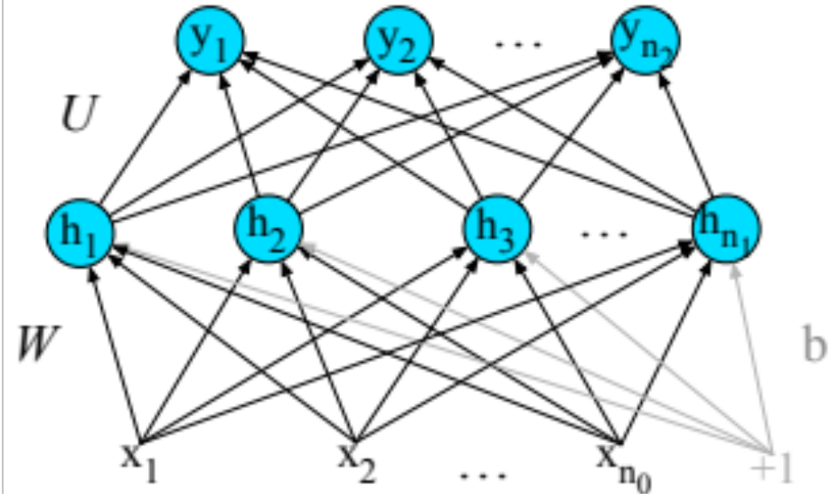
Feedforward Neural Networks
Can also be called multi-layer perceptrons (or MLPs) for historical reasons
Notes:
A feedforward network is a multilayer network in which the units are connected with no cycles; the outputs from units in each layer are passed to units in the next higher layer, and no outputs are passed back to lower layers.
For historical reasons feed-forward netowrks can also be called multi-layer perceptrons or MLPs (although they aren't technically composed of perceptrons any more).
Simple feedforward networks have three kinds of nodes: input units, hidden units, and output units.

Slide 29
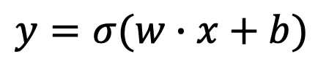
Binary Logistic Regression as a 1-layer Network
(we don't count the input layer in counting layers!)
σ
$$y=σ(w∙x+b)$$
Output layer
(σ node)
(y is a scalar)
w
w₁
w_{n}
b
(scalar)
(vector)
Input layer
vector x
x₁
x_{n}
+1
Notes:
Let's go back to logistic regression. We can think of binary logistic regression as a 1-layer network (we don't count the input layer in counting layers!). So we have an input layer we could call layer 0 consisting of a vector x, we multiply x b a weight matrix, add a scalar bias, and then the 1st layer, the output layer computes a a scalar y as a sigmoid of w dot x + b.

Slide 30
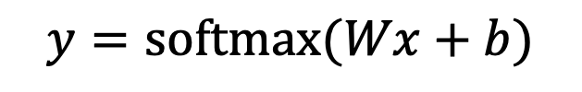
Multinomial Logistic Regression as a 1-layer Network
Fully connected single layer network
y₁
y_{n}
s
s
s
$$y=\text{softmax}(Wx+b)$$
Output layer
(softmax nodes)
y is a vector
W
b
W is a matrix
b is a vector
Input layer
scalars
x₁
x_{n}
+1
Notes:
Remember multinomial Logistic Regression, where instead of a single sigmoid at the output, we have a softmax to turn the output values into probabilities

Slide 31
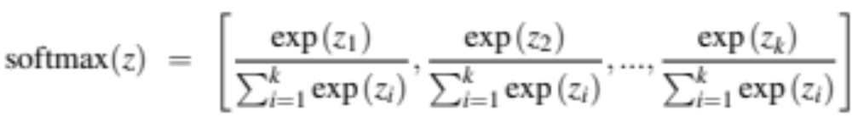
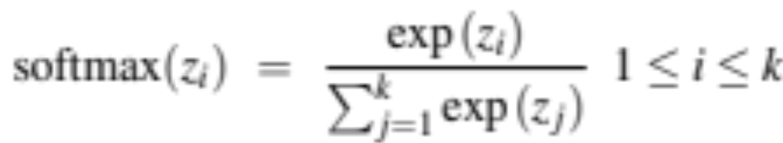

Reminder: softmax: a generalization of sigmoid
For a vector z of dimensionality k, the softmax is:
Example:

Slide 32

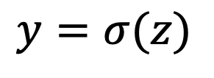

Two-Layer Network with scalar output
$$y=σ(z)$$
y is a scalar
Output layer
(σ node)
$$z=Uh$$
U
hidden units
(σ node)
Could be ReLU
Or tanh
W
b
Input layer
(vector)
x₁
x_{n}
+1
Notes:
Here are the final equations for a feedforward network with a single hidden layer, which takes an input vector x, outputs a probability distribution y, and is parameterized by weight matrices W and U and a bias vector b:

Slide 33
Two-Layer Network with scalar output
$$y=σ(z)$$
y is a scalar
Output layer
(σ node)
$$z=Uh$$
U
hidden units
(σ node)
j
W_{ji}
W
b
vector
Input layer
(vector)
x₁
i
x_{n}
+1
Notes:
Each element Wji of the weight matrix W represents the weight of the connection from the ith input unit xi to the jth hidden unit hj.

Slide 34
Two-Layer Network with scalar output
$$y=σ(z)$$
y is a scalar
Output layer
(σ node)
$$z=Uh$$
U
hidden units
(σ node)
Could be ReLU
Or tanh
W
b
Input layer
(vector)
x₁
x_{n}
+1
Notes:
We're showing the activation function here as sigma, but it can be the sigmoid, tanh, or ReLU activation function we defined earlier.
Notice that we’re applying the σ function here to a vector, allowing σ(·), to apply to a vector element-wise, so g[z1,z2,z3] = [g(z1),g(z2),g(z3)].
As we saw in the lecture on XOR, the resulting value h (for hidden) forms a representation of the input. The role of the output layer is to take this new representation h and compute a final output. This output could be a real- valued number, but in many cases the goal of the network is to make some sort of classification decision, and so we will focus on the case of classification.
If we are doing a binary task like sentiment classification, we might have a single output node, and its value y is the probability of positive versus negative sentiment.
The output layer has a weight matrix U, but some models don’t include a bias vector b in the output layer, so we’ll simplify by eliminating the bias vector in this example. The weight matrix is multiplied by its input vector (h) to produce the intermediate output z.
z=Uh
And then we use the sigmoid to turn this into a probability.

Slide 35
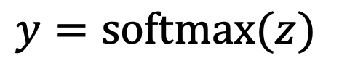
Two-Layer Network with softmax output
Output layer
(σ node)
$$y=\text{softmax}(z)$$
$$z=Uh$$
U
y is a vector
hidden units
(σ node)
Could be ReLU
Or tanh
W
b
Input layer
(vector)
x₁
x_{n}
+1
Notes:
What if you have more than two output classes?
If we are doing multinomial classification, such as assigning a part-of-speech tag, we just add more output units (one for each class).
So we might have one output node for each potential part-of-speech, whose output value is the probability of that part-of-speech,
The output layer thus gives a probability distribution across the output nodes. We use the softmax to compute this distribution, just as for multinomial logistic regression
That means we can think of a neural network classifier with one hidden layer as building a vector h which is a hidden layer representation of the input, and then running standard logistic regression on the features that the network develops in h. By contrast, in Chapter 5 the features were mainly designed by hand via feature templates. So a neural network is like logistic regression, but (a) with many layers, since a deep neural network is like layer after layer of logistic regression classifiers, and (b) rather than forming the features by feature templates, the prior layers of the network induce the feature representations themselves.

Slide 36






Multi-layer Notation
$${y=a}^{[2]}$$
$$a^{[2]}=g^{\left[2\right]}(z^{\left[2\right]})$$
sigmoid or softmax
W^{[2]}
$$z^{[2]}=W^{[2]}a^{[1]}+b^{[2]}$$
b^{[2]}
j
$$a^{[1]}=g^{\left[1\right]}(z^{\left[1\right]})$$
ReLU
W^{[1]}
$$z^{[1]}=W^{[1]}a^{[0]}+b^{[1]}$$
b^{[1]}
x₁
i
x_{n}
+1
$$a^{[0]}$$
Notes:
Let’s now set up some notation to make it easier to talk about deeper networks of depth more than 2.
We’ll use superscripts in square brackets to mean layer num- bers, starting at 0 for the input layer. So W [1] will mean the weight matrix for the (first) hidden layer, and b[1] will mean the bias vector for the (first) hidden layer. We’ll use g(·) to stand for the activation function, which will tend to be ReLU or tanh for intermediate layers and softmax for output layers. We’ll use a[i] to mean the output from layer i, and z[i] to mean the combination of weights and biases. The inputs x we’ll refer to more generally as a ^[0]
Thus we can re-represent our 2-layer net as follows:

Slide 37
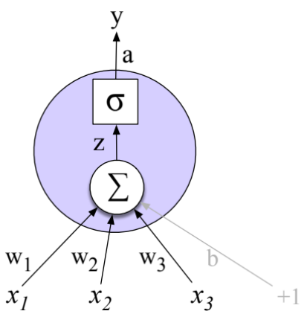
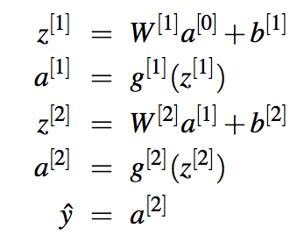
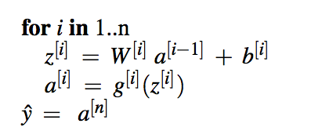
Multi Layer Notation
Notes:
Note that with this notation, the equations for the computation done at each layer are the same. The algorithm for computing the forward step in an n-layer feedforward network, given the input vector a[0] is thus simply

Slide 38
Replacing the bias unit
Let's switch to a notation without the bias unit
Just a notational change
Add a dummy node a₀=1 to each layer
Its weight w₀ will be the bias
So input layer a^{[0]}₀=1,
  And a^{[1]}₀=1 , a^{[2]}₀=1,…
Notes:
In describing networks, we will often use a slightly simplified notation that represents exactly the same function without referring to an explicit bias node b. Instead, we add a dummy node a0 to each layer whose value will always be 1. Thus layer 0, the input layer, will have a dummy node a_0^[0] = 1, layer 1 0
will have a_0^[1] = 1, and so on. This dummy node still has an associated weight, and that weight represents the bias value b.

Slide 39

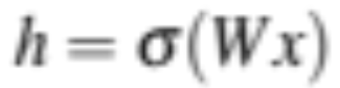
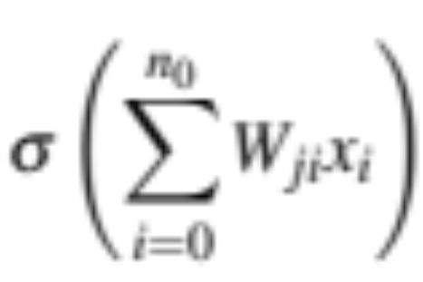
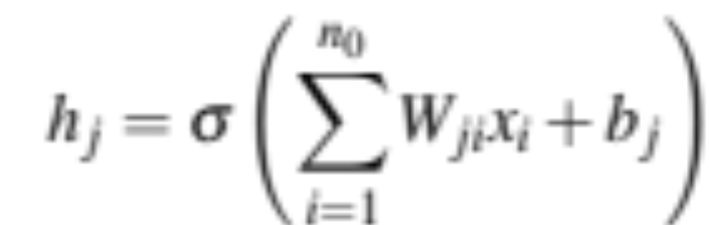
Replacing the bias unit
Instead of: We'll do this:
x= x₁, x₂, …, x_{n0}
x= x₀, x₁, x₂, …, x_{n0}
Notes:
But now our vector x has one extra value.

Slide 40
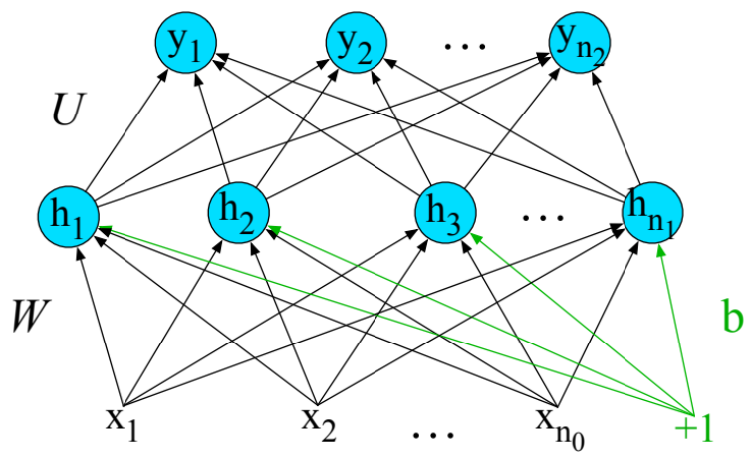
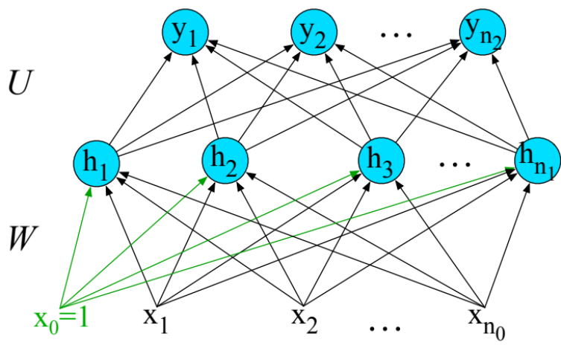
Replacing the bias unit
Instead of: We'll do this:
Notes:
We’ll continue showing the bias as b for the learning example in the next lectures, but afterwards we'll switch to this simplified notation without explicit bias terms.

Slide 41
Simple Neural Networks and Neural Language Models
Feedforward Neural Networks
Notes:
We've seen the feedforward neural networks, the most basic neural network architecture.

Slide 42
Simple Neural Networks and Neural Language Models
Feedforward networks for simple classification
Notes:
Let's see how the simple feedforward network can be applied to NLP tasks.

Slide 43
Use cases for feedforward networks
Let's consider 2 (simplified) sample tasks:
  Text classification
  Language modeling
State of the art systems use more powerful neural classifiers like BERT/MLM classifiers, but simple models will introduce some important ideas

Slide 44
Classification: Sentiment Analysis
We could do exactly what we did with logistic regression
Input layer are binary features as before
Output layer is 0 or 1
σ
U
W
x₁
x_{n}

Slide 45
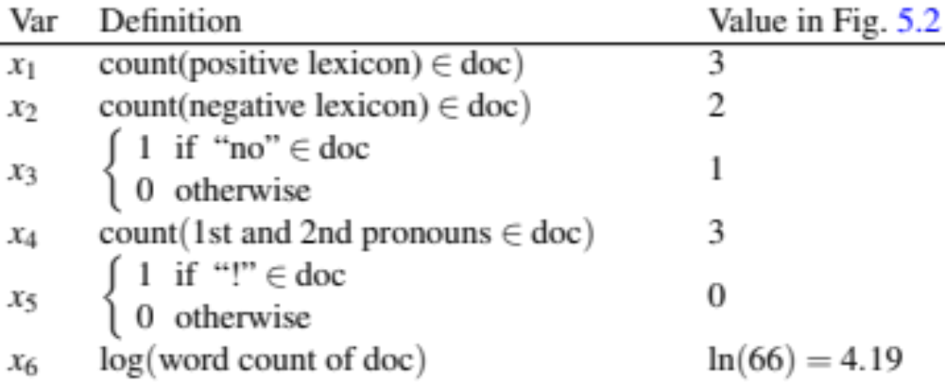
Sentiment Features

Slide 46
Feedforward nets for simple classification
σ
U
σ
2-layer
feedforward
network
Logistic
Regression
W
W
x₁
x_{n}
f₁
f_{n}
x₁
x_{n}
f₂
f₁
f₂
f_{n}
Just adding a hidden layer to logistic regression
allows the network to use non-linear interactions between features
which may (or may not) improve performance.
46

Slide 47
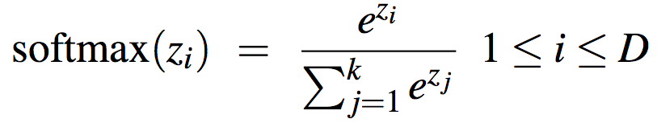
Reminder: Multiclass Outputs
What if you have more than two output classes?
  Add more output units (one for each class)
  And use a “softmax layer”
U
W
x₁
x_{n}

Slide 48
The output layer
ŷ could have two nodes (one each for positive and negative), or 3 nodes (positive, negative, neutral).
ŷ₁ estimated probability of positive sentiment
ŷ₂ probability of negative
ŷ₃ probability of neutral

Slide 49

Equations for NN classification with hand features

Slide 50
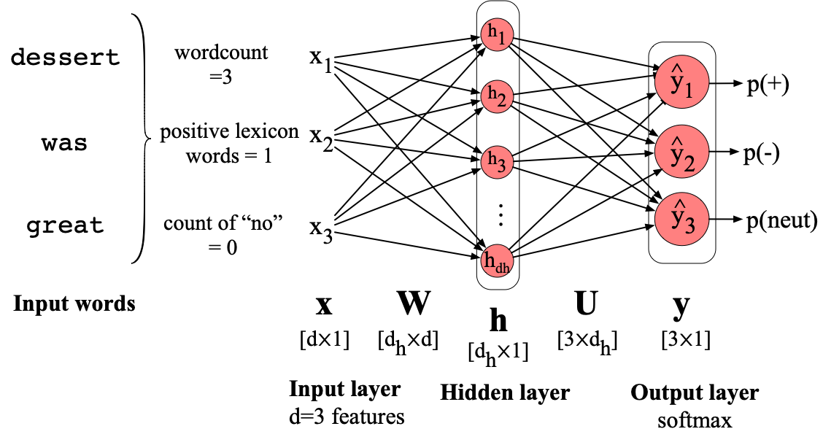

Slide 51
Vectoring for parallelizing inference
We would like to efficiently classify the whole test set of m observations.
So we vectorize: pack all the input features into X
Each row x^{(i)} of X is a row vector with all the features for example x^{(i)}
Feature dimensionality is d, X is [m x d]

Slide 52

Slight changes to equations
Each input is now a row vector
X is of shape [m x d]
W is of shape [d_{h} x d]
We'll need to do some reordering and transposing
Bias vector b that used to be [1 x d_{h}] is now [m x d_{h}]

Slide 53
Simple Neural Networks and Neural Language Models
Feedforward networks for simple classification
Notes:
Let's see how the simple feedforward network can be applied to NLP tasks.

Slide 54
Simple Neural Networks and Neural Language Models
Embeddings as input to feedforward classifiers
Notes:
Let's see how the simple feedforward network can be applied to NLP tasks.

Slide 55
Even better: representation learning
σ
U
The real power of deep learning comes from the ability to learn features from the data
Instead of using hand-built human-engineered features for classification
Use learned representations like embeddings!
W
x₁
x_{n}
e₁
e₂
e_{n}

Slide 56
Embedding matrix E
An embedding is a vector of dimension [1 x d] that represents the input token.
An embedding matrix E is a dictionary, one row per token of vocab V
E has shape [|V| × d]
Embedding matrices are central to NLP; they represent input text in LLMs and all NLP tools

Slide 57
Text classification from embeddings
Given tokenized input: dessert was great
Select the embedding vectors from E:
  Convert BPE tokens into vocabulary indices
    w = [3, 9824, 226]
  Use indexing to select the corresponding rows from E
    row 3, row 4000, row 10532

Slide 58
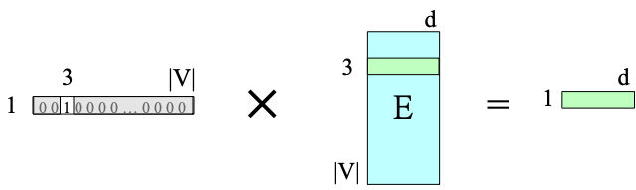
Another way to think of indexing from E
Treat each input word as one-hot vector
  If dessert is index 3:
Multiply it by E to select out the embedding for dessert

Slide 59
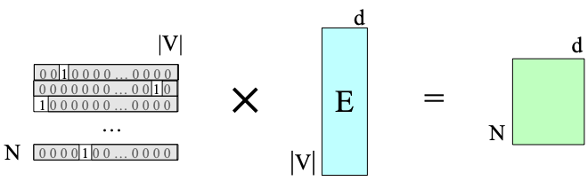
Collecting embeddings from E for N words
Given window of N tokens, represented by N [1 × d] embeddings
Need to return a single class (e.g., pos or neg)

Slide 60
Text comes in different lengths
Given window of N tokens, represented by N [1 × d] embeddings, return a single class (e.g., pos or neg)
Concatenate all the inputs into one long vector of shape [1×dN], i.e. input is length N of longest review
  If shorter then pad with zero embeddings
  Truncate if you get longer reviews at test time
Pool the inputs into a single short [1 × d] vector. A single "sentence embedding" (the same dimensionality as a word) to represent all the words. Less info, but very efficient and fast.

Slide 61


Pooling
Intuition: exact position not so important for sentiment.
We'll just do some sort of averaging of all the vectors.
Mean pooling:

Slide 62
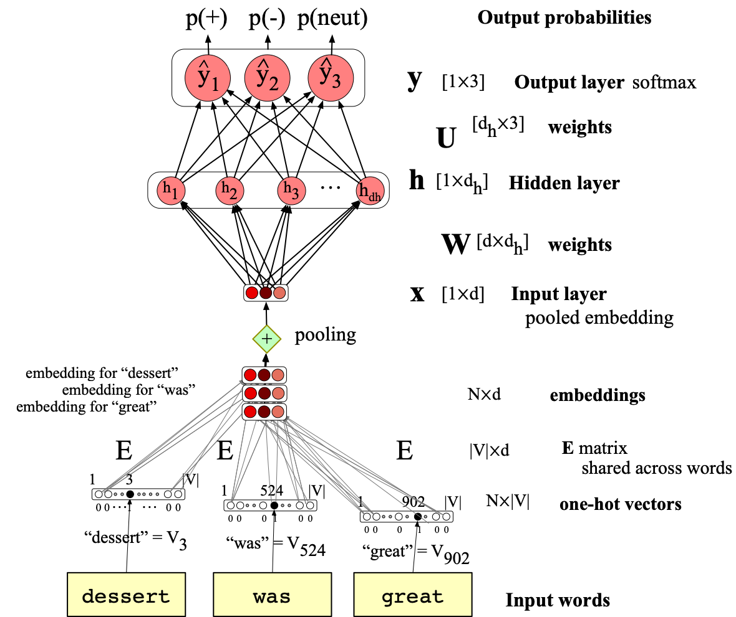
Pooling

Slide 63
Simple Neural Networks and Neural Language Models
Embeddings as input to feedforward classifiers
Notes:
Let's see how the simple feedforward network can be applied to NLP tasks.

Slide 64
Simple Neural Networks and Neural Language Models
Neural language modeling with feedforward networks
Notes:
Let's see how the simple feedforward network can be applied to language modeling

Slide 65
Neural Language Models (LMs)
Language Modeling: Calculating the probability of the next word in a sequence given some history.
We've seen N-gram based LMs
But neural network LMs far outperform n-gram language models
State-of-the-art neural LMs are based on more powerful neural network technology like Transformers
But simple feedforward LMs introduce many of the important concepts

Slide 66
Simple feedforward Neural Language Models
Task: predict next word w_{t}
given prior words w_{t-1}, w_{t-2}, w_{t-3}, …
Problem: Now we’re dealing with sequences of arbitrary length.
Solution: Sliding windows (of fixed length)

Slide 67
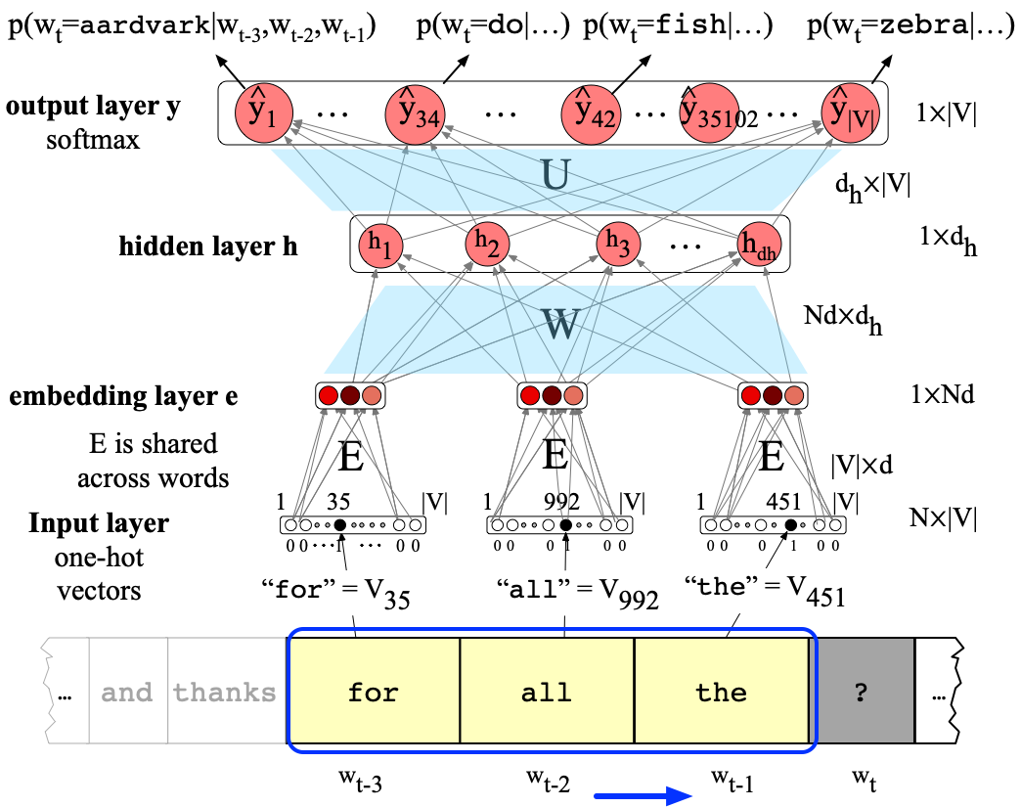
Inference in a Feedforward Language Model
Notes:
Here's a sketch of this simplified feedforward neural language model with N=3; we have a moving window at time t with an embedding vector representing each of the 3 previous words (words wt−1, wt−2, and wt−3). These 3 vectors are concatenated together to produce x, the input layer of a neural network whose output is a softmax with a probability distribution over words. Thus y42, the value of output node 42 is the probability of the next word wt being V42, the vocabulary word with index 42.

Slide 68

Feedforward language model equations
So ŷ₄₂ is the probability of the next word w_{t} being V₄₂ = fish

Slide 69
Why Neural LMs work better than N-gram LMs
Training data:
We've seen: I have to make sure that the cat gets fed.
Never seen: dog gets fed
Test data:
I forgot to make sure that the dog gets ___
N-gram LM can't predict "fed"!
Neural LM can use similarity of "cat" and "dog" embeddings to generalize and predict “fed” after dog

Slide 70
Simple Neural Networks and Neural Language Models
Neural language modeling with feedforward networks
Notes:
Let's see how the simple feedforward network can be applied to language modeling

Slide 71
Simple Neural Networks and Neural Language Models
Training Neural Nets: Overview
Notes:
How do we train neural networks? Let's start with an overview

Slide 72
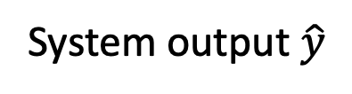
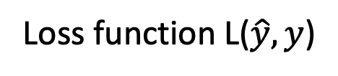
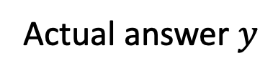
Intuition: training a 2-layer Network
Actual answer $y$
Loss function L($\hat{y},y$)
System output $\hat{y}$
U
Backward pass
Forward pass
W
x₁
x_{n}
Training instance
Notes:
The intuition of neural net training is the forward computation of the loss and the backward computation of the weight updates. Given an input x,
CLICK
we run a forward pass through the network, computing the system output y-hat. CLICK
Then we compare y-hat to the true answer y, CLICK to get a loss for this example. CLICK Then CLICK we do a backward pass through the network, computing the gradients we need to update the weights.

Slide 73
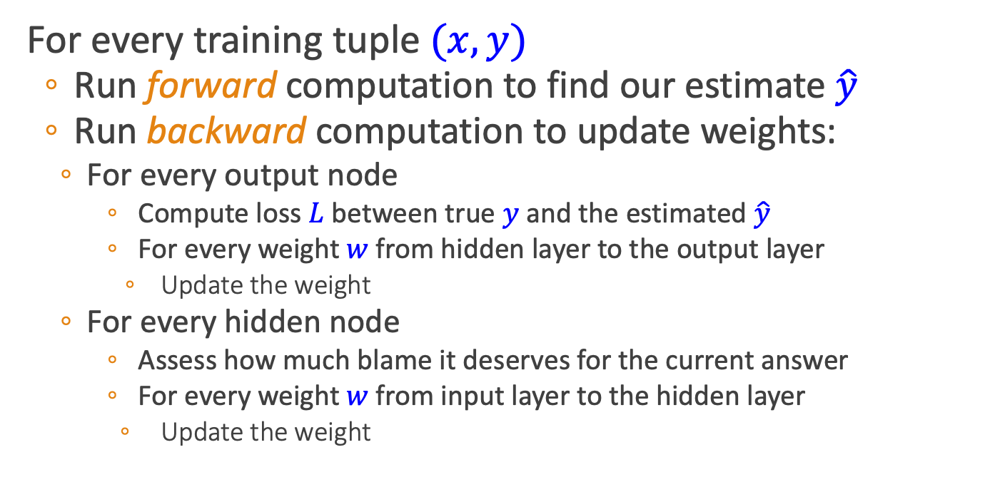
Intuition: Training a 2-layer network
For every training tuple $(x,y)$
  Run forward computation to find our estimate $\hat{y}$
  Run backward computation to update weights:
    For every output node
      Compute loss $L$between true $y$ and the estimated $\hat{y}$
      For every weight $w$from hidden layer to the output layer
        Update the weight
    For every hidden node
      Assess how much blame it deserves for the current answer
      For every weight $w$from input layer to the hidden layer
        Update the weight
Notes:
Let's

Slide 74
Reminder: Loss Function for binary logistic regression
A measure for how far off the current answer is to the right answer
Cross entropy loss for logistic regression:
Notes:
Let's next get an intuition from what we did for logistic regression. Remember our loss function for binary logistic regression. We’d like to learn weights that maximize the log probability of the correct label p(y|x). To turn this into loss function (something that we need to minimize), we flipped the sign, and then we can plug in our estimate of the probability from the sigmoid of the weights

Slide 75
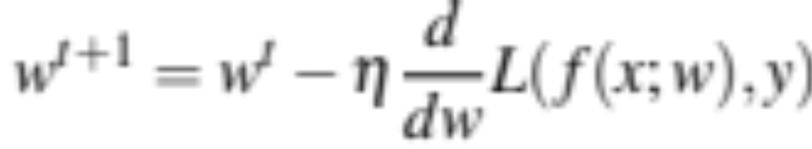
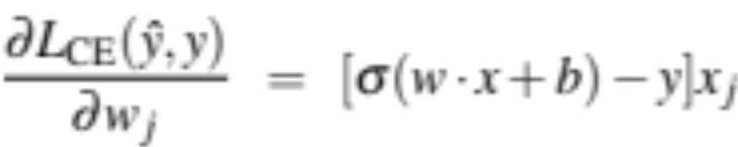

Reminder: gradient descent for weight updates
Use the derivative of the loss function with respect to weights $\frac{d}{dw}L(f\left(x;w\right),y)$
To tell us how to adjust weights for each training item
  Move them in the opposite direction of the gradient
  For logistic regression
Notes:
And let's recall from the lecture on logistic regression how gradient descent works for weight updates. The magnitude of the amount to move in gradient descent is the value of the graident of the loss function (with respect to w) weighted by a learning rate η . A higher (faster) learning rate means that we should move w more on each step. The change we make in our parameter is the learning rate times the gradient.
For logistic regression, we saw that the derivative of the loss function with respect to one weight w_j coming from input x_j is

Slide 76



Where did that derivative come from?
Using the chain rule! f (x) = u(v(x))
Intuition (see the text for details)
Derivative of the weighted sum
Derivative of the Activation
Derivative of the Loss
$\frac{∂L}{∂w_{i}}=\frac{∂L}{∂y}$ $\frac{∂y}{∂z}$ $\frac{∂z}{∂w_{i}}$
Notes:
Where did that derivative come from?
Using the chain rule! Remember the chain rule says that if we have a compositive function f(x)= u(v(x)), the derivative of f (x) is the derivative of u(x) with respect to v(x) times the derivative of v(x) with respect to x
Here's our neural unit, which is the same as logistic regression. It's computing the loss as a function of y, which is computed as the sigmoid of the sum of the weights time values. If we want to do the derivative of the entire loss function with respect to one weight w_i, we can compute this using the chain rule: the derivative of L with respective to w_i is the product of the derivative of L with respect to y times the derivative of y with respect to z times the derivative of z with respect to w_i

Slide 77
How can I find that gradient for every weight in the network?
These derivatives on the prior slide only give the updates for one weight layer: the last one!
What about deeper networks?
Lots of layers, different activation functions?
Solution in the next lecture:
Even more use of the chain rule!!
Computation graphs and backward differentiation!

Slide 78
Simple Neural Networks and Neural Language Models
Training Neural Nets: Overview
Notes:
We've seen an overview of neural net training. In the next lecture we'll see the details of computation graphs and backward differentiation

Slide 79
Simple Neural Networks and Neural Language Models
Computation Graphs and Backward Differentiation

Slide 80
Why Computation Graphs
For training, we need the derivative of the loss with respect to each weight in every layer of the network
But the loss is computed only at the very end of the network!
Solution: error backpropagation (Rumelhart, Hinton, Williams, 1986)
Backprop is a special case of backward differentiation
Which relies on computation graphs.
Notes:
For training a neural network with gradient descent, we need the relevant gradients for each weight: the derivative of the loss with respect to each weight in every layer of the network.
But the loss is computed only at the very end of the network. How do we find these gradients for weights in the early layers?
The solution is a method called error backpropagation, or backprop in the neural network world. It turns out that backprop is a special case of backward differentiation, a method that relies on computation graphs.

Slide 81
Computation Graphs
A computation graph represents the process of computing a mathematical expression
Notes:
A computation graph is a representation of the process of computing a mathematical expression, in which the computation is broken down into separate operations, each of which is modeled as a node in a graph.

Slide 82



Example:
Computations:
Notes:
Consider computing the function L(a, b, c) = c(a + 2b). If we make each of the component addition and multiplication operations explicit, and add names (d and e) for the intermediate outputs, the resulting series of computations is:
D=2*b
E=a+d
L=c*e
We can now represent this as a graph, with nodes for each operation, and directed edges showing the outputs from each operation as the inputs to the next.. The simplest use of computation graphs is to compute the value of the function with some given inputs. Lets assume the inputs a = 3, b = 1, c = −2,
We can walk forward and compute a value for d, and then a value for e, and then a value for C

Slide 83

Example:
Computations:
Notes:
Here it is without my messy handwriting.

Slide 84
Backwards differentiation in computation graphs
The importance of the computation graph comes from the backward pass
This is used to compute the derivatives that we’ll need for the weight update.
Notes:
The importance of the computation graph comes from the backward pass, which is used to compute the derivatives that we’ll need for the weight update.

Slide 85


Example
We want:
The derivative $\frac{∂L}{∂a}$, tells us how much a small change in a affects L.
Notes:
In this example our goal is to compute the derivative of the output function L with respect to each of the input variables, i.e., ∂L /∂a, ∂L /∂b, and ∂L/∂c . The derivative ∂L/∂a tells us how much a small change in a affects L, while holding the others constant"

Slide 86

The chain rule
Computing the derivative of a composite function:
f (x) = u(v(x))
f (x) = u(v(w(x)))
Notes:
Consider a composite function f(x) = u(v(x)). CLICK. The derivative of f (x) is the derivative of u(x) with respect to v(x) times the derivative of v(x) with respect to x
The chain rule extends to more than two functions. If computing the derivative of a composite function f (x) = u(v(w(x))), the derivative of f (x) is:

Slide 87


Example
Notes:
Let’s now compute the 3 derivatives we need. Since in the computation graph L = ce, we can directly compute the derivative ∂ L /∂c: it will be e.
For the other two, we'll need to use the chain rule

Slide 88

Example
Notes:
Those equations, we've put them here on the top, thus require five intermediate derivatives: ∂L/∂e , ∂L/∂c , ∂e/∂a , ∂e/∂d , and ∂d/∂b , which are as follows (making use of the fact that the derivative of a sum is the sum
of the derivatives):

Slide 89


Example
Notes:
In the backward pass, we compute each of these partials along each edge of the graph
from right to left, multiplying the necessary partials to result in the final derivative
we need. Thus we begin by annotating the final node with ∂ L/∂L = 1. Moving to the
left, we then compute ∂ L/ ∂c and ∂L/∂e , and so on, until we have annotated the graph all the way to the input variables. The forward pass conveniently already will have computed the values of the forward intermediate variables we need (like d and e) to compute these derivatives.

Slide 90

Example
Notes:
n the backward pass, we compute each of these partials along each edge of the graph
from right to left, multiplying the necessary partials to result in the final derivative
we need.
At each node we need to compute the local partial derivative with respect to the parent, multiply it by the partial derivative that is being passed down from the parent, and then pass it to the child.
Thus we begin by annotating the final node with ∂ L/∂L = 1. Moving to the
left, we then compute ∂ L/ ∂c and ∂L/∂e , and so on, until we have annotated the graph all the way to the input variables. The forward pass conveniently already will have computed the values of the forward intermediate variables we need (like d and e) to compute these derivatives.

Slide 91

Backward differentiation on a two layer network
y
Sigmoid activation
σ
W^{[2]}
b^{[2]}
1
ReLU activation
W^{[1]}
b^{[1]}
1
x₁
x₂
Notes:
Of course computation graphs for real neural networks are much more complex. Here's a sample computation graph for a 2-layer neural network with n0 = 2, n1 = 2, and n2 = 1,

Slide 92


Backward differentiation on a two layer network
Notes:
In order to do the backward pass, we’ll need to know the derivatives of all the functions in the graph. We already saw in Section ?? the derivative of the sigmoid σ :
The derivative of the ReLU is

Slide 93

Backward differentiation on a 2-layer network
Notes:
The weights that need updating (those for which we need to know the partial derivative of the loss function) are shown in orange .
So for a particular example x1,x2, we would run the forward pass, assign values to each of our nodes, and then starting with this last node, run backwards pass

Slide 94




Starting off the backward pass: $\frac{∂L}{∂z}$
(I'll write $a$ f$or a^{[2]}$ and $z$ for $z^{[2]}$ )
$$L\left(\hat{y},y\right)=−\left(\text{y}\log{(\hat{y})}+\left(1−y\right)log⁡(1−\hat{y}\text{)}\right)$$
$$L\left(a,y\right)=−\left(y log{a}+\left(1−y\right)log⁡(1−a)\right)$$
$\frac{∂L}{∂z}=\frac{∂L}{∂a}$ $\frac{∂a}{∂z}$
$$\frac{∂L}{∂a}=−\left(\left(y\frac{∂\log\left(a\right)}{∂a}\right)+(1−y) \frac{∂\log\left(1−a\right)}{∂a}\right)$$
$$=−\left(\left(y\frac{1}{a}\right)+\left(1−y\right) \frac{1}{1−a}\left(−1\right)\right)=−\left(\frac{y}{a}+\frac{y−1}{1−a}\right)$$
$$\frac{∂a}{∂z}=a(1−a)$$
$$\frac{∂L}{∂z}=−\left(\frac{y}{a}+\frac{y−1}{1−a}\right)a\left(1−a\right)=a−y$$

Slide 95
Summary
For training, we need the derivative of the loss with respect to weights in early layers of the network
But loss is computed only at the very end of the network!
Solution: backward differentiation
Given a computation graph and the derivatives of all the functions in it we can automatically compute the derivative of the loss with respect to these early weights.

Slide 96
Simple Neural Networks and Neural Language Models
Computation Graphs and Backward Differentiation

