Slide 1
RNNs and LSTMs
Simple Recurrent Networks (RNNs or Elman Nets)

Slide 2
Modeling Time in Neural Networks
Language is inherently temporal
Yet the simple NLP classifiers we've seen (for example for sentiment analysis) mostly ignore time
(Feedforward neural LMs (and the transformers we'll see later) use a "moving window" approach to time.)
Here we introduce a deep learning architecture with a different way of representing time
RNNs and their variants like LSTMs
Notes:
Recall that we applied feedforward networks to lan- guage modeling by having them look only at a fixed-size window of words, and then sliding this window over the input, making independent predictions along the way.

Slide 3
Recurrent Neural Networks (RNNs)
Any network that contains a cycle within its network connections.
The value of some unit is directly, or indirectly, dependent on its own earlier outputs as an input.

Slide 4
Simple Recurrent Nets (Elman nets)
y_{t}
h_{t}
x_{t}
The hidden layer has a recurrence as part of its input
The activation value h_{t} depends on x_{t} but also h_{t-1}!

Slide 5
Forward inference in simple RNNs
Very similar to the feedforward networks we've seen!

Slide 6
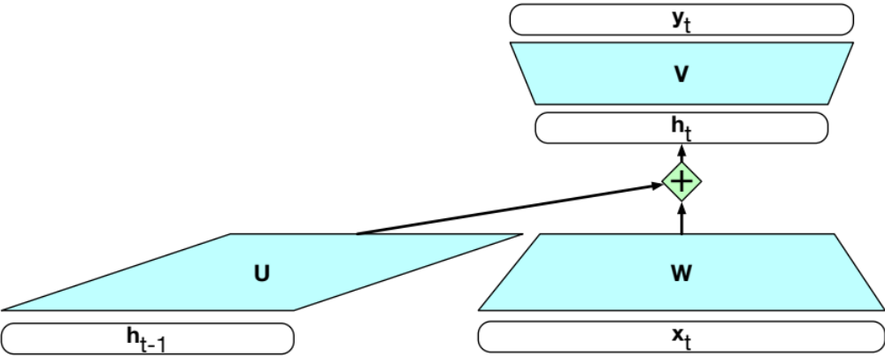
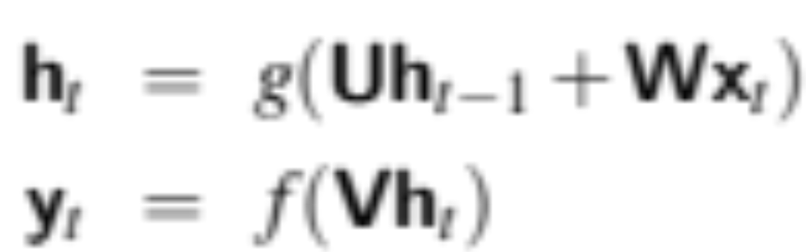
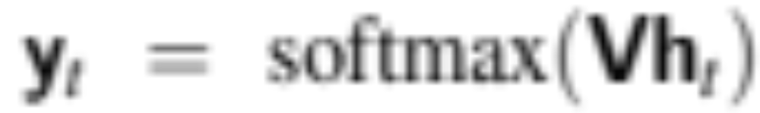
Simple recurrent neural network illustrated as a feedforward network
Notes:
h_{t−1} from prior time step is multiplied by U and then added to the current time step's feedforward Wx_{t}

Slide 7
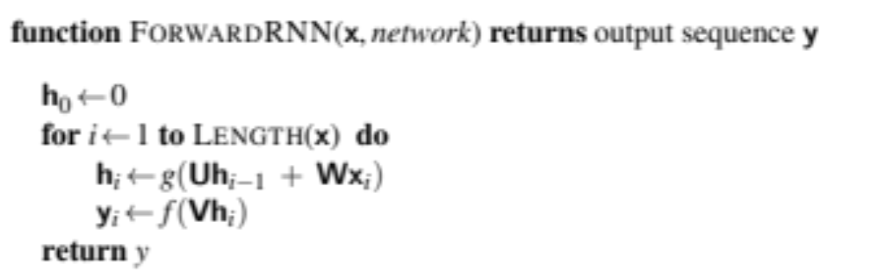
Inference has to be incremental
Computing h at time t requires that we first computed h at the previous time step!

Slide 8
Training in simple RNNs
Just like feedforward training:
training set,
a loss function,
backpropagation
Weights that need to be updated:
W, the weights from the input layer to the hidden layer,
U, the weights from the previous hidden layer to the current hidden layer,
V, the weights from the hidden layer to the output layer.

Slide 9
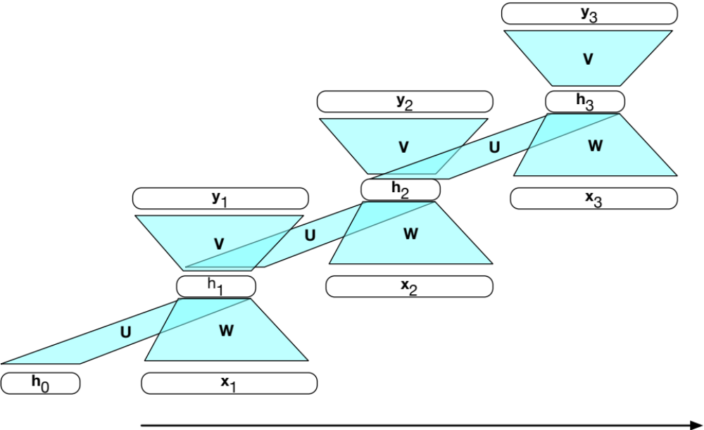
Training in simple RNNs: unrolling in time
Unlike feedforward networks:
1. To compute loss function for the output at time t we need the hidden layer from time t − 1.
2. hidden layer at time t influences the output at time t and hidden layer at time t+1 (and hence the output and loss at t+1).
So: to measure error accruing to h_{t},
need to know its influence on both the current output as well as the ones that follow.

Slide 10
Unrolling in time (2)
We unroll a recurrent network into a feedforward computational graph eliminating recurrence
Given an input sequence,
Generate an unrolled feedforward network specific to input
Use graph to train weights directly via ordinary backprop (or can do forward inference)

Slide 11
RNNs and LSTMs
Simple Recurrent Networks (RNNs or Elman Nets)

Slide 12
RNNs and LSTMs
RNNs as Language Models

Slide 13
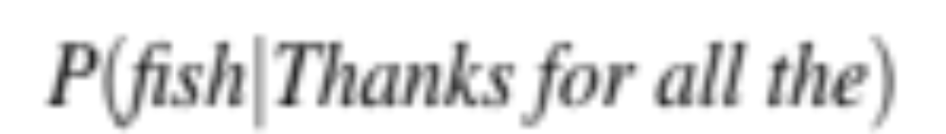
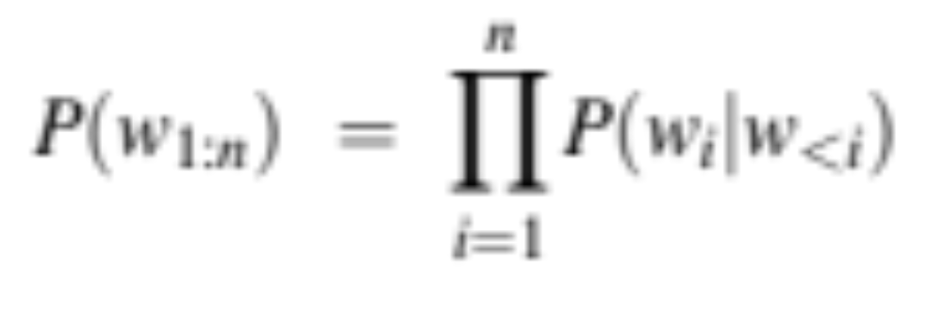
Reminder: Language Modeling

Slide 14
The size of the conditioning context for different LMs
The n-gram LM:
Context size is the n − 1 prior words we condition on.
The feedforward LM:
Context is the window size.
The RNN LM:
No fixed context size; h_{t-1} represents entire history

Slide 15
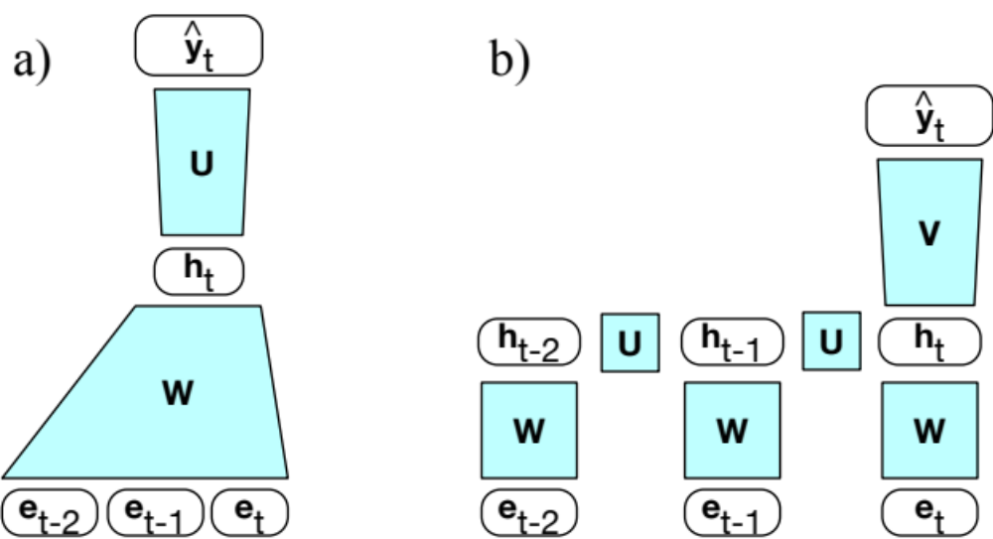
FFN LMs vs RNN LMs
…
FFN
RNN
Notes:
RNNs don’t have the limited context problem that n-gram models have, or the fixed context that feedforward language models have, since the hidden state can in principle represent information about all of the preceding words all the way back to the beginning of the sequence. Here's an FFN language model and an RNN language model, showing that the RNN language model uses ht−1, the hidden state from the previous time step, as a representation of the past context.

Slide 16
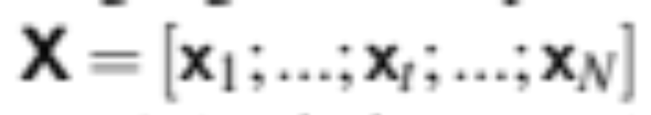
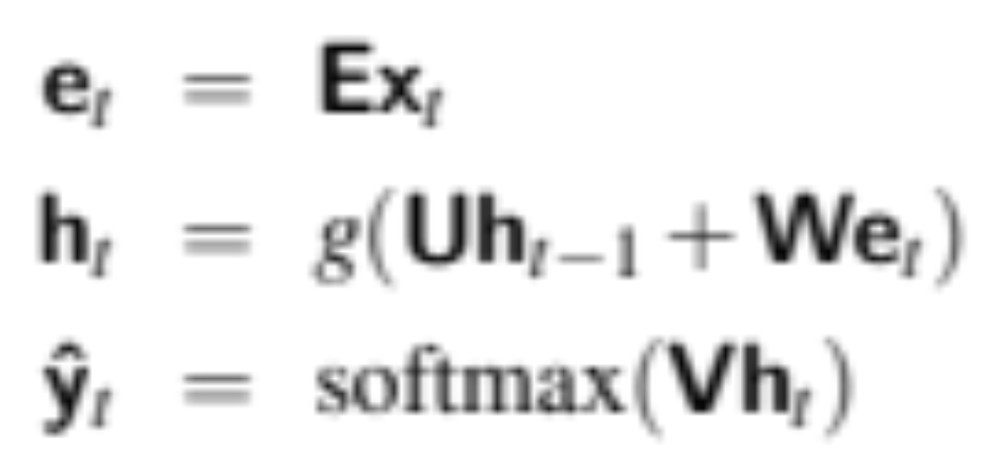
Forward inference in the RNN LM
Given input X of of N tokens represented as one-hot vectors
Use embedding matrix to get the embedding for current token x_{t}
_{Combine …}

Slide 17

Shapes
|V| x 1
|V| x d
d x d
d x 1
d x 1
d x d
d x 1

Slide 18
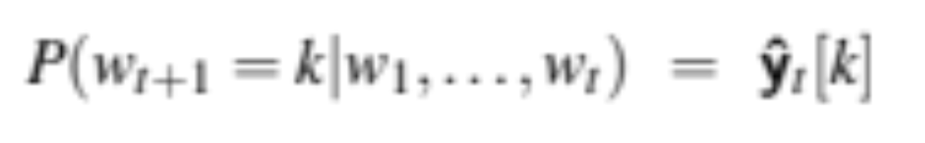
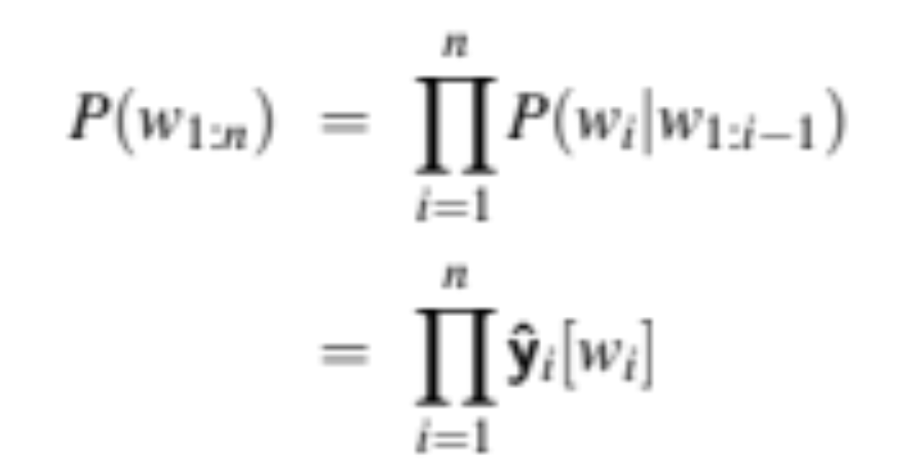
Computing the probability that the next word is word k

Slide 19
Training RNN LM
Self-supervision
  take a corpus of text as training material
  at each time step t
  ask the model to predict the next word.
Why called self-supervised: we don't need human labels; the text is its own supervision signal
We train the model to
  minimize the error
  in predicting the true next word in the training sequence,
  using cross-entropy as the loss function.

Slide 20
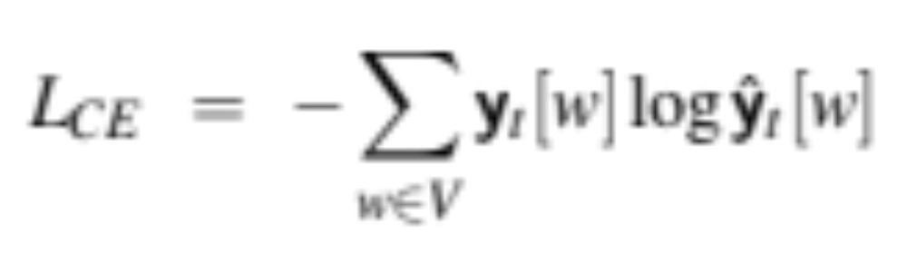
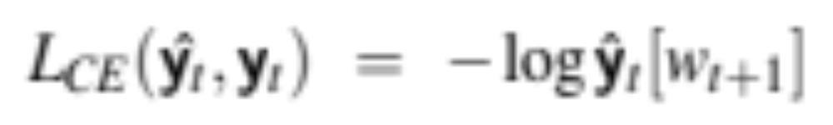
Cross-entropy loss
The difference between:
a predicted probability distribution
the correct distribution.
CE loss for LMs is simpler!!!
the correct distribution y_{t} is a one-hot vector over the vocabulary
  where the entry for the actual next word is 1, and all the other entries are 0.
So the CE loss for LMs is only determined by the probability of next word.
So at time t, CE loss is:
Notes:
. So at time t the CE loss is the negative log probability the model assigns to the next word in the training sequence.

Slide 21
Teacher forcing
We always give the model the correct history to predict the next word (rather than feeding the model the possible buggy guess from the prior time step).
This is called teacher forcing (in training we force the context to be correct based on the gold words)
What teacher forcing looks like:
At word position t
the model takes as input the correct word wt together with ht−1, computes a probability distribution over possible next words
That gives loss for the next token wt+1
Then we move on to next word, ignore what the model predicted for the next word and instead use the correct word wt+1 along with the prior history encoded to estimate the probability of token wt+2.

Slide 22
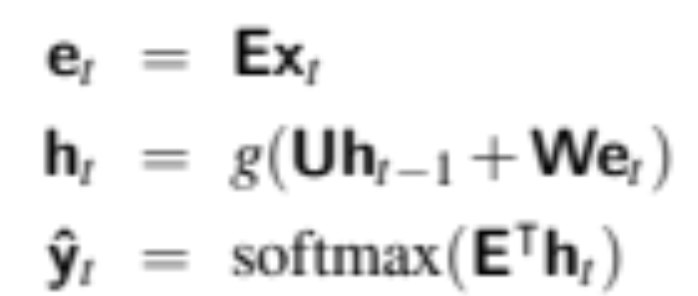
Weight tying
The input embedding matrix E and the final layer matrix V, are similar
The columns of E represent the word embeddings for each word in vocab. E is [d x |V|]
The final layer matrix V helps give a score (logit) for each word in vocab . V is [|V| x d ]
Instead of having separate E and V, we just tie them together, using E^{T} instead of V:

Slide 23
RNNs and LSTMs
RNNs as Language Models

Slide 24
RNNs and LSTMs
RNNs for Sequences

Slide 25
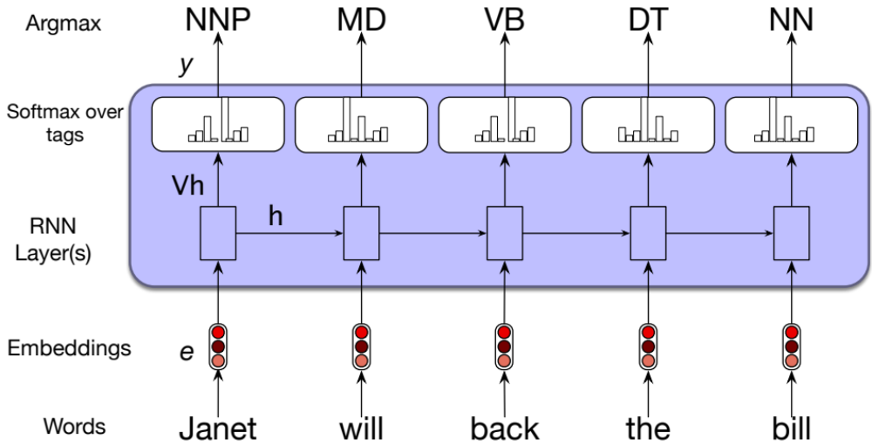
RNNs for sequence labeling
Assign a label to each element of a sequence
Part-of-speech tagging

Slide 26
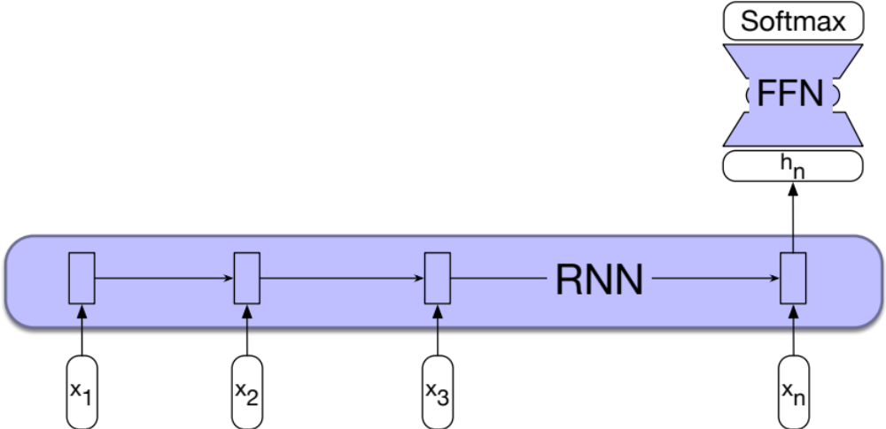
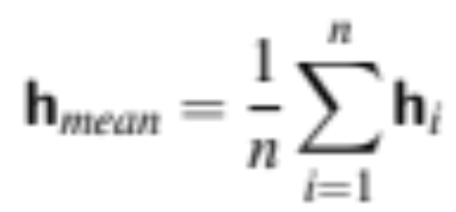
RNNs for sequence classification
Text classification
Instead of taking the last state, could use some pooling function of all the output states, like mean pooling

Slide 27
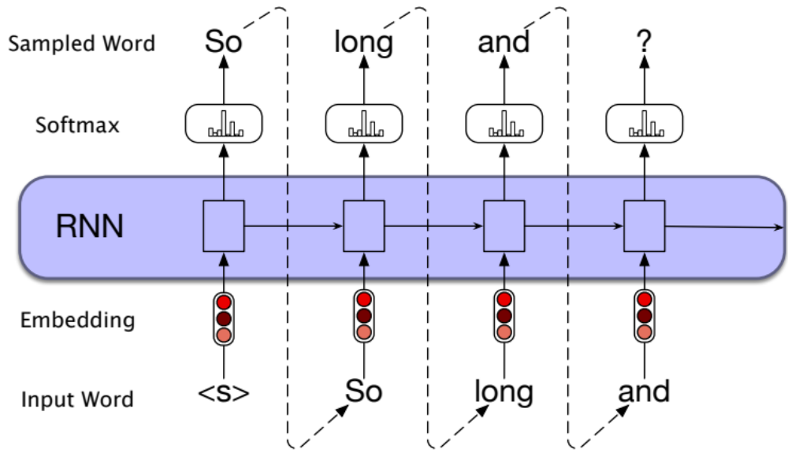
Autoregressive generation

Slide 28
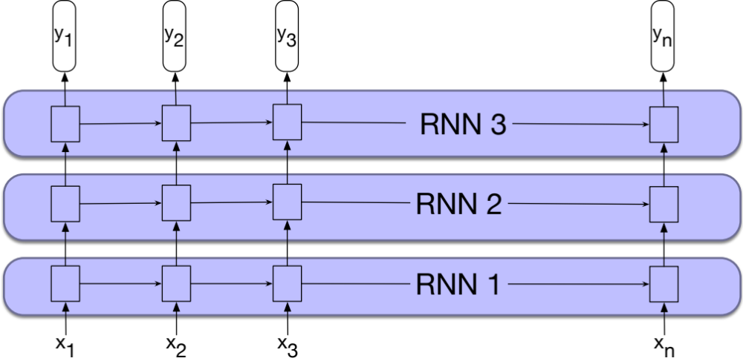
Stacked RNNs

Slide 29
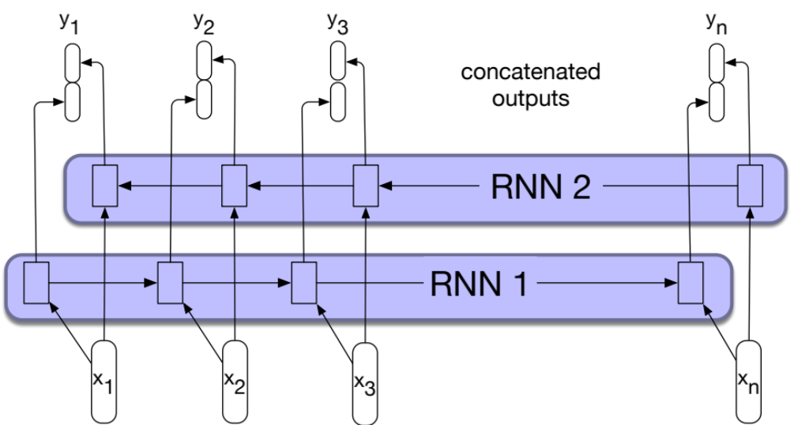
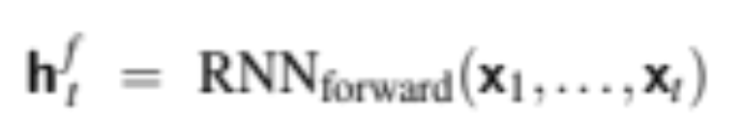
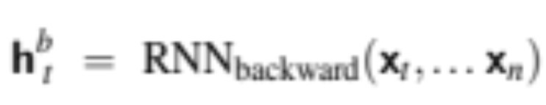
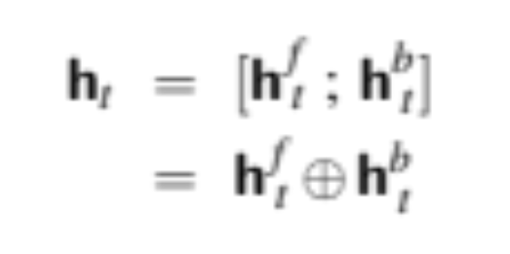
Bidirectional RNNs

Slide 30
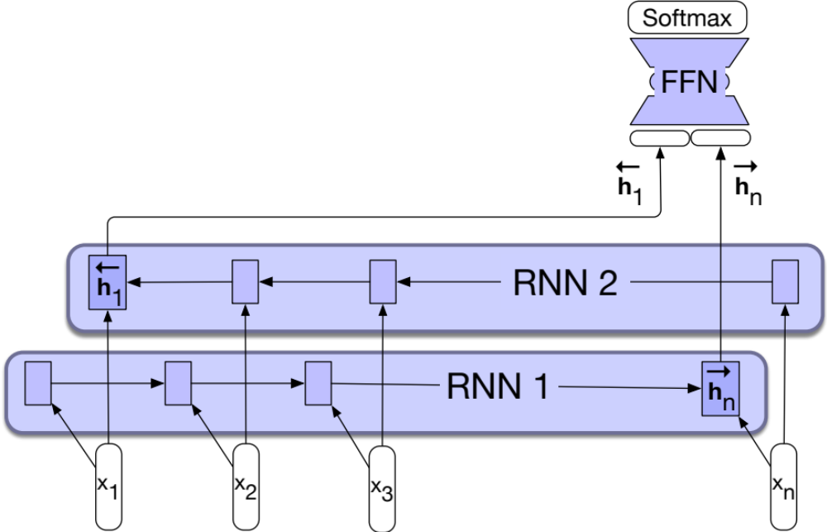
Bidirectional RNNs for classification

Slide 31
RNNs and LSTMs
RNNs for Sequences

Slide 32
RNNs and LSTMs
The LSTM

Slide 33
Motivating the LSTM: dealing with distance
It's hard to assign probabilities accurately when context is very far away:
  The flights the airline was canceling were full.
Hidden layers are being forced to do two things:
  Provide information useful for the current decision,
  Update and carry forward information required for future decisions.
Another problem: During backprop, we have to repeatedly multiply gradients through time and many h's
  The "vanishing gradient" problem
Notes:
Assigning a high probability to was following airline is straightforward since airline provides a strong local context for the singular agreement. However, assigning an appropriate probability to were is quite difficult, not only because the plural flights is quite distant, but also because the singular noun airline is closer in the intervening context. Ideally, a network should be able to retain the distant information about plural flights until it is needed, while still processing the intermediate parts of the sequence correctly.

Slide 34
The LSTM: Long short-term memory network
LSTMs divide the context management problem into two subproblems:
removing information no longer needed from the context,
adding information likely to be needed for later decision making
LSTMs add:
  explicit context layer
  Neural circuits with gates to control information flow

Slide 35
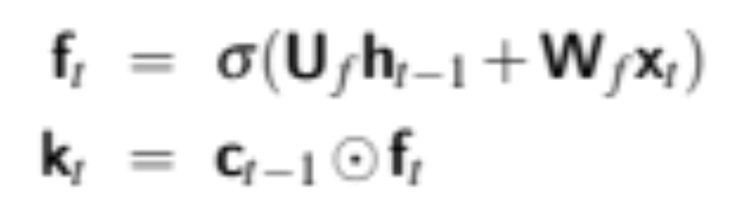
Forget gate
Deletes information from the context that is no longer needed.
Notes:
computes a weighted sum of the previous state’s hidden layer and the current in- put and passes that through a sigmoid. This mask is then multiplied element-wise by the context vector to remove the information from context that is no longer re- quired.

Slide 36
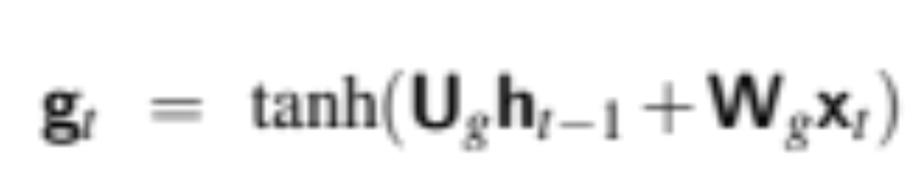
Regular passing of information

Slide 37
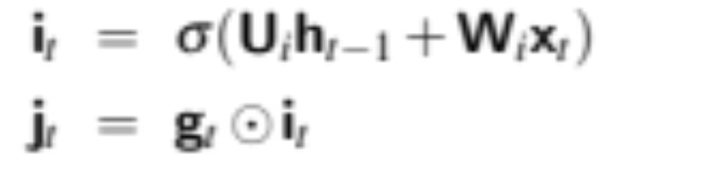
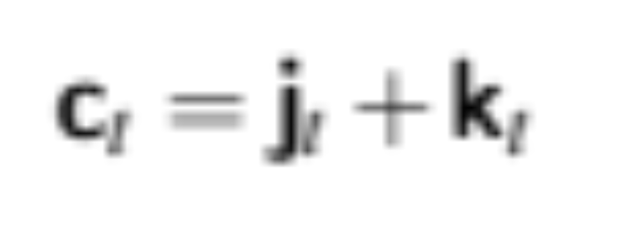
Add gate
Selecting information to add to current context
Add this to the modified context vector to get our new context vector.

Slide 38
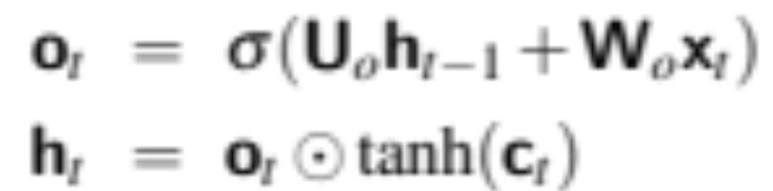
Output gate
Decide what information is required for the current hidden state (as opposed to what information needs to be preserved for future decisions).

Slide 39
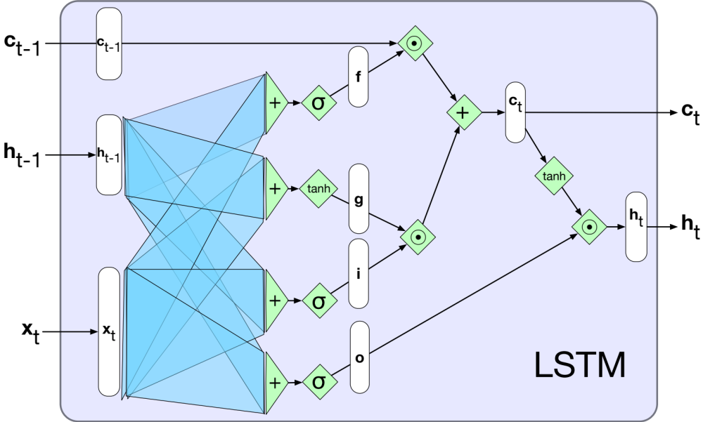
The LSTM

Slide 40
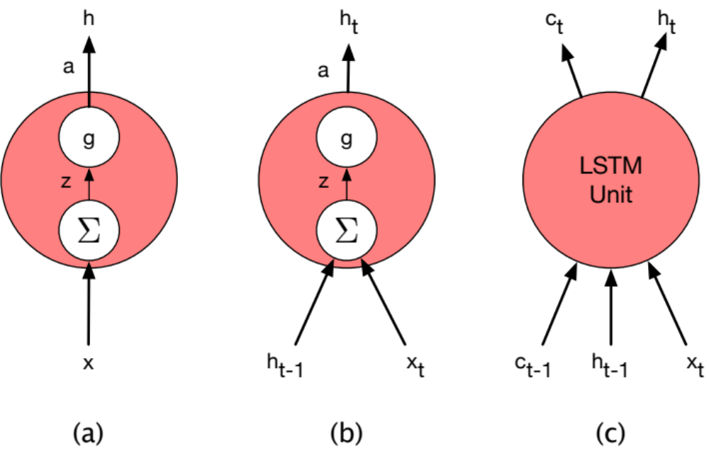
Units
FFN
SRN
LSTM

Slide 41
RNNs and LSTMs
The LSTM

Slide 42
RNNs and LSTMs
The LSTM Encoder-Decoder Architecture

Slide 43
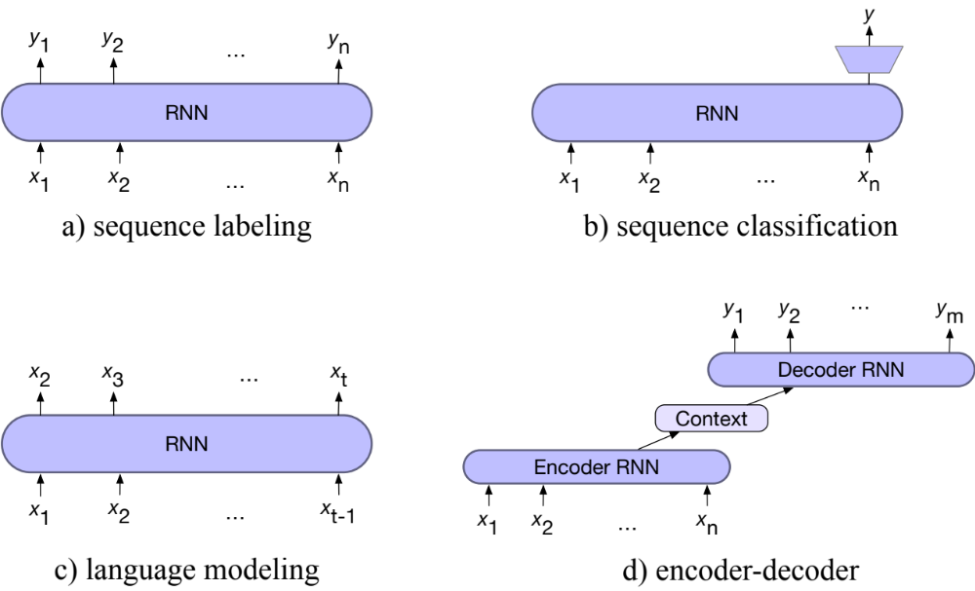
Four architectures for NLP tasks with RNNs

Slide 44
3 components of an encoder-decoder
An encoder that accepts an input sequence, x1:n, and generates a corresponding sequence of contextualized representations, h1:n.
A context vector, c, which is a function of h1:n, and conveys the essence of the input to the decoder.
A decoder, which accepts c as input and generates an arbitrary length sequence of hidden states h1:m, from which a corresponding sequence of output states y1:m, can be obtained

Slide 45
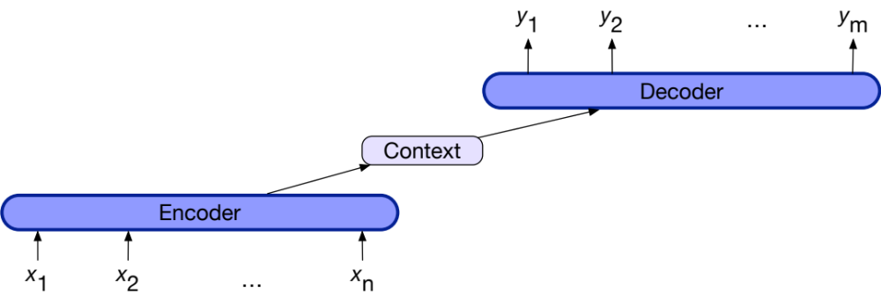
Encoder-decoder

Slide 46
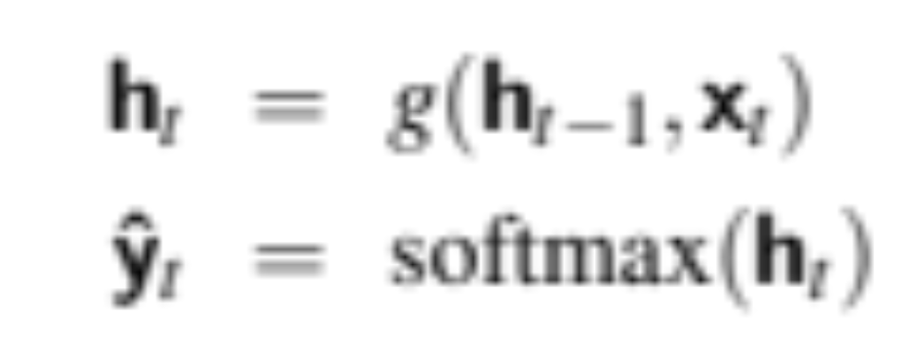
Encoder-decoder for translation
Regular language modeling

Slide 47
Encoder-decoder for translation
Let x be the source text plus a separate token <s> and y the target
Let x = The green witch arrive <s>
Let y = llego ́ la bruja verde

Slide 48
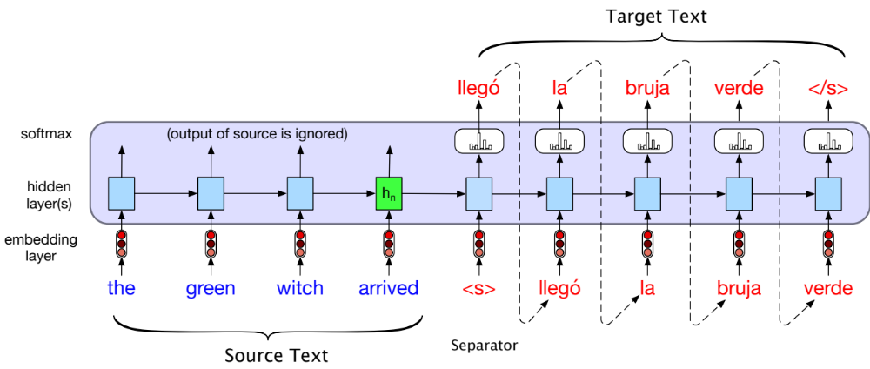
Encoder-decoder simplified

Slide 49
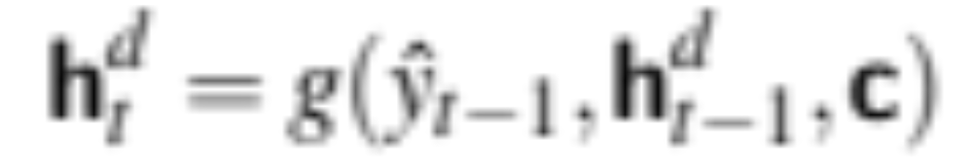
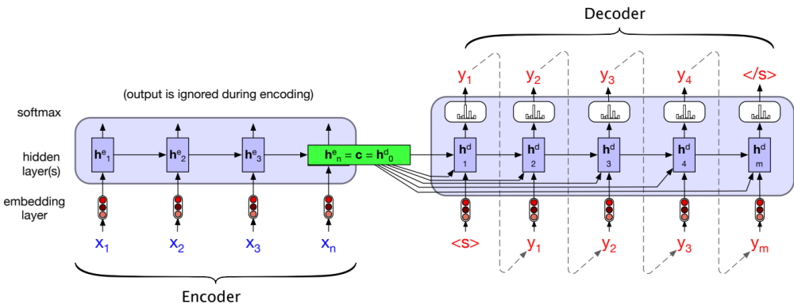
Encoder-decoder showing context

Slide 50
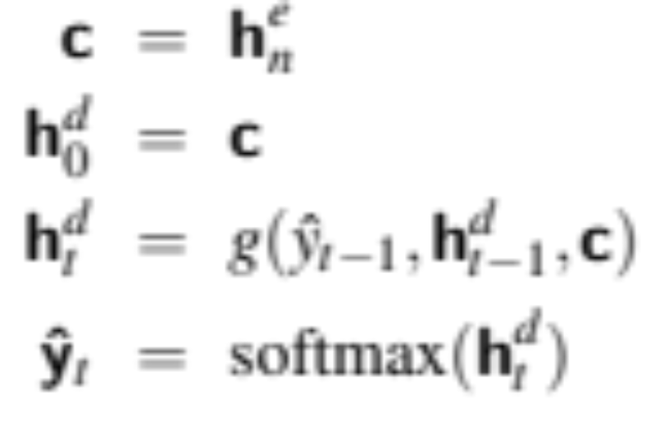
Encoder-decoder equations
g is a stand-in for some flavor of RNN
yˆ_{t−1} is the embedding for the output sampled from the softmax at the previous step
ˆy_{t} is a vector of probabilities over the vocabulary, representing the probability of each word occurring at time t. To generate text, we sample from this distribution ˆy_{t} .

Slide 51
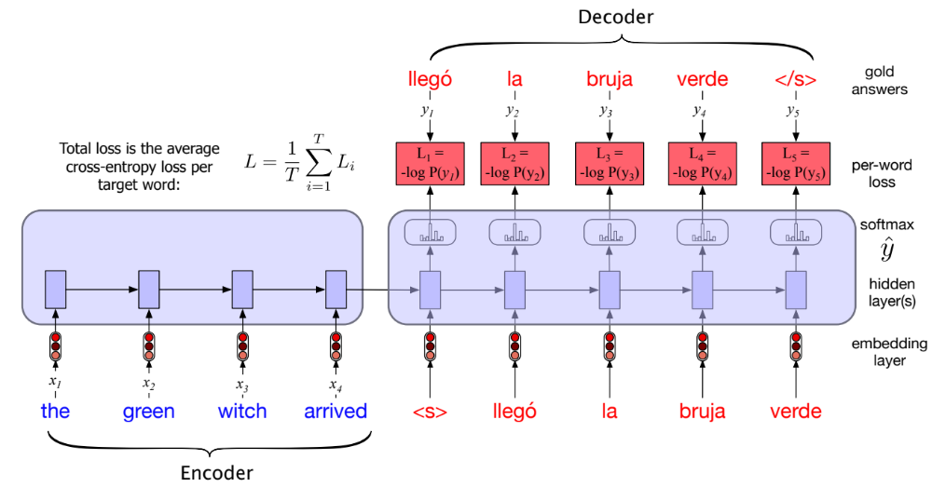
Training the encoder-decoder with teacher forcing

Slide 52
RNNs and LSTMs
The LSTM Encoder-Decoder Architecture

Slide 53
RNNs and LSTMs
LSTM Attention

Slide 54
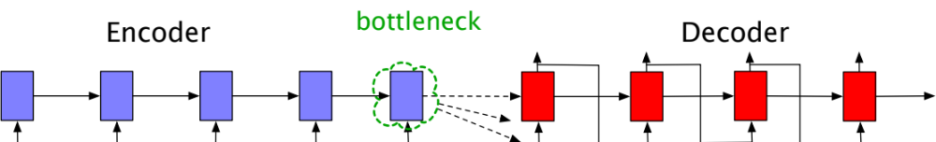
Problem with passing context c only from end
Requiring the context c to be only the encoder’s final hidden state forces all the information from the entire source sentence to pass through this representational bottleneck.

Slide 55
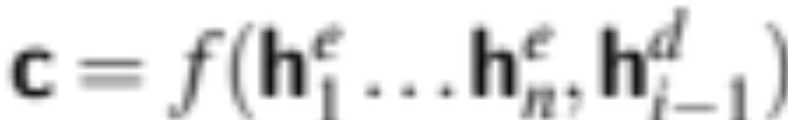
Solution: attention
instead of being taken from the last hidden state, the context it’s a weighted average of all the hidden states of the decoder.
this weighted average is also informed by part of the decoder state as well, the state of the decoder right before the current token i.

Slide 56
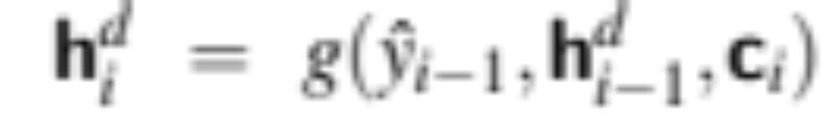
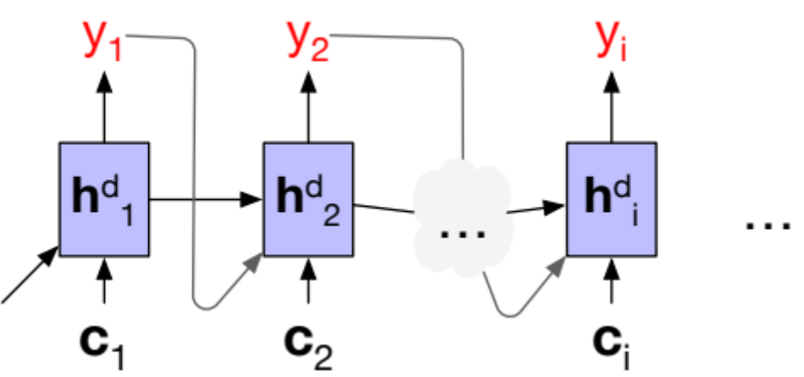
Attention

Slide 57
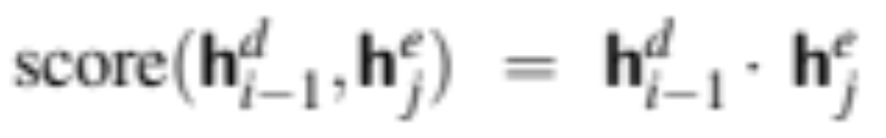
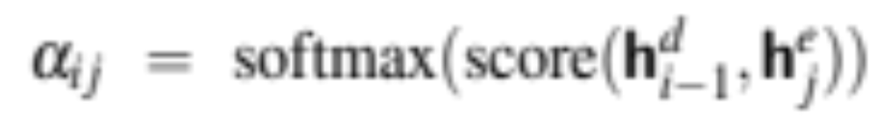
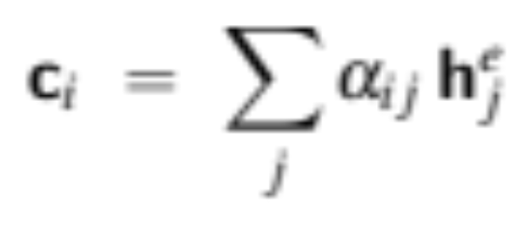
How to compute c?
We'll create a score that tells us how much to focus on each encoder state, how relevant each encoder state is to the decoder state:
We’ll normalize them with a softmax to create weights α_{i j} , that tell us the relevance of encoder hidden state j to hidden decoder state, h^{d}_{i-1}
And then use this to help create a weighted average:

Slide 58
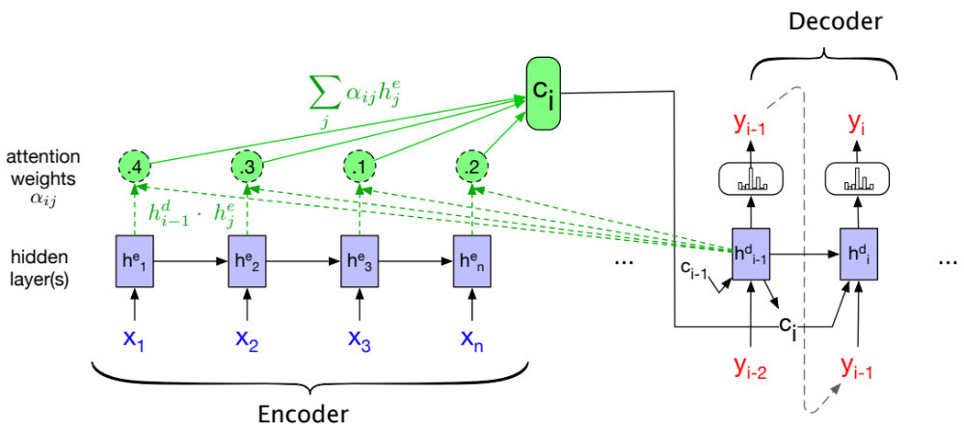
Encoder-decoder with attention, focusing on the computation of c

Slide 59
RNNs and LSTMs
LSTM Attention

