Slide 1
Ferguson, Missouri: A Historical View with Social Explorer
By Jimmy Vang

Slide 2
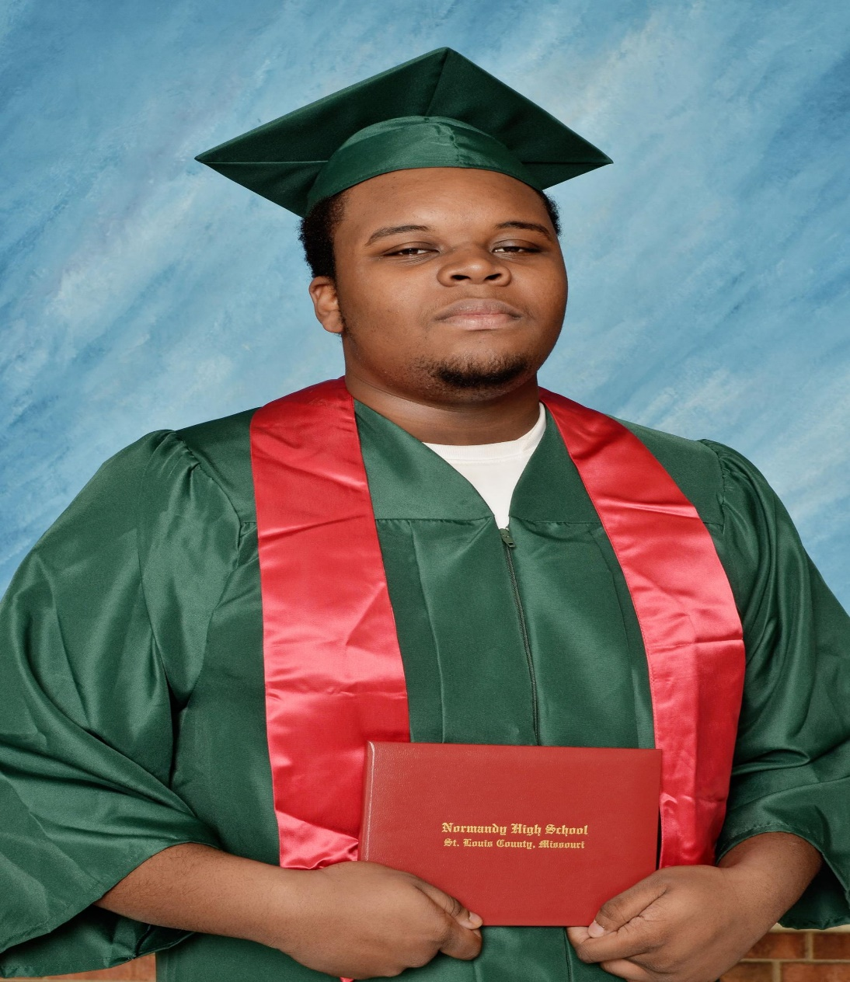
August 9th, 2014: Michael Brown, stopped by White police officer Darren Wilson for jaywalking
2 minutes later, 12 bullets are fired
Michael Brown was unarmed
Michael Brown was shot 6 times (twice in the head)
A few months later, Darren Wilson walks free

Slide 3
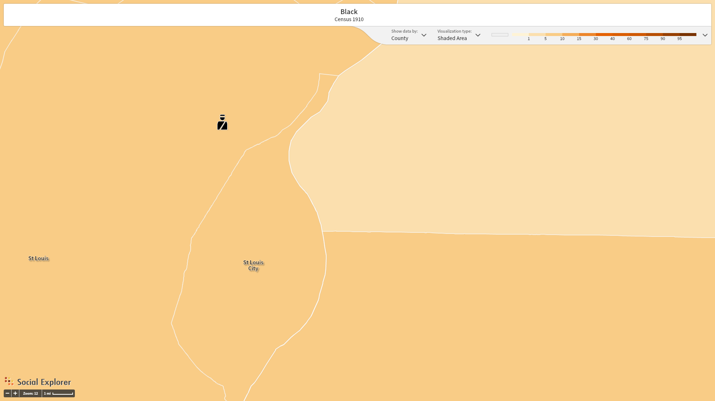
St. Louis County Black Population, 1910, 6.4% Black (43,960)

Slide 4
Great Black Migration
WWI
Great Depression

Slide 5
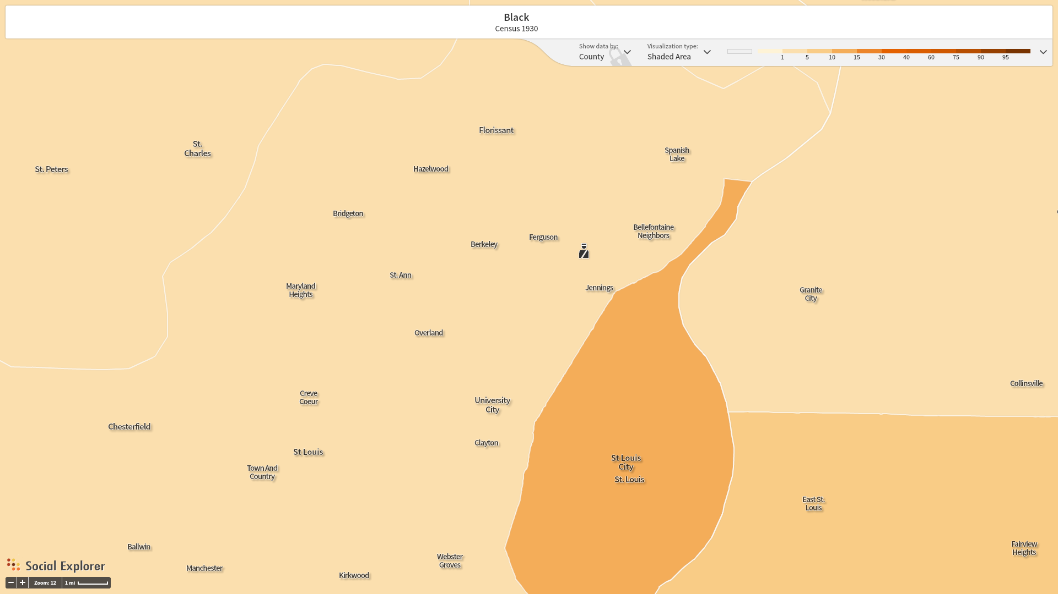
St. Louis County Black Population, 1930, 11.38% Black (93,580)

Slide 6
Shelley v. Kraemer
1945, outlawed restrictive covenants

Slide 7
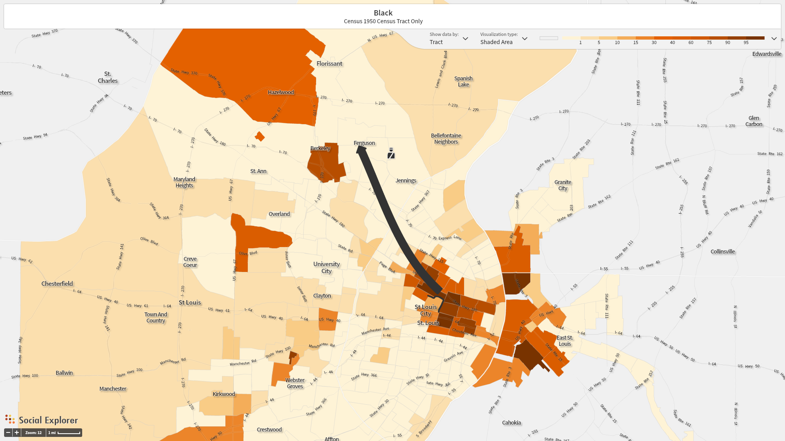
White Flight, from St. Louis to Ferguson, 1950

Slide 8
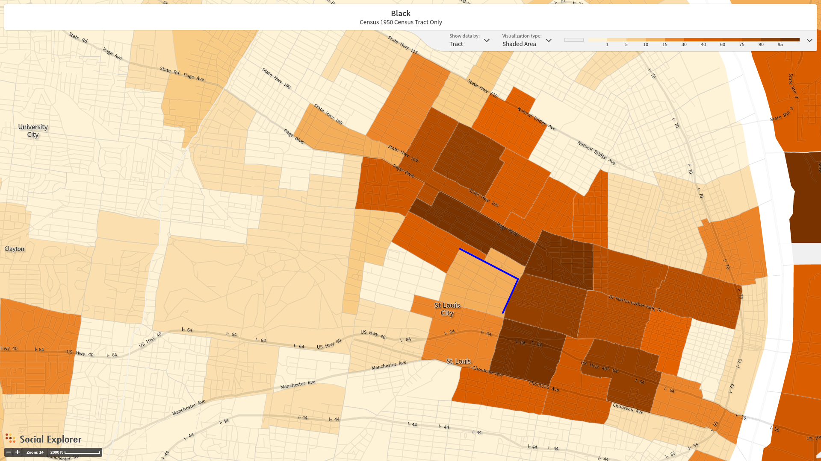
Blue outlines are Delmar (horizontal) and Grand (vertical) Blvds. Blacks were contained to the north and east, respectively, of these two streets in St. Louis, 1950

Slide 9
Federal court order, 1975
Background: some towns in the northern St. Louis suburb ignored Brown v. Board of Education ruling and kept their schools segregated into the 70s
1975: These towns are ordered to desegregate their schools and black migration begins to flow out of the city and into the suburbs

Slide 10
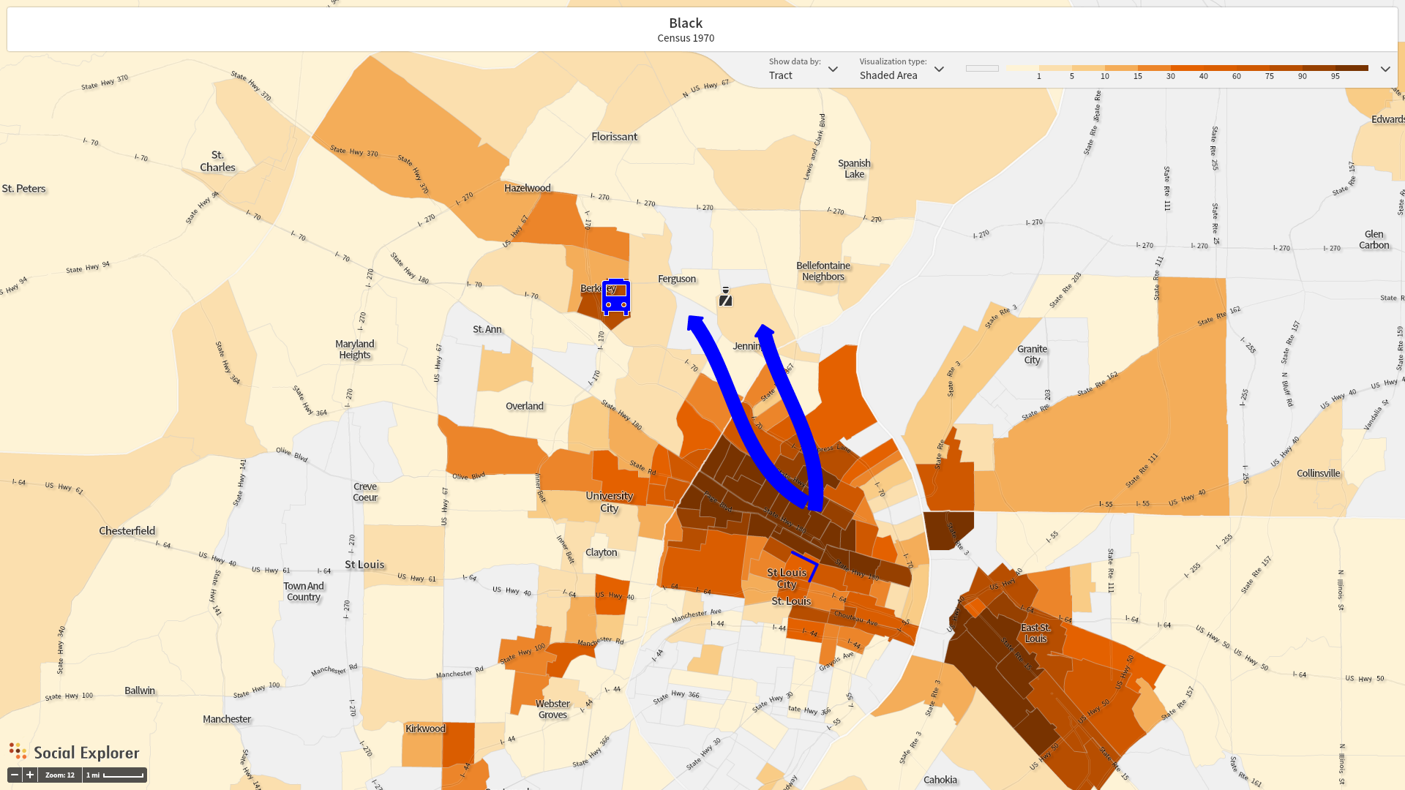
Map of St. Louis County in 1970. Blue bus marks Kinloch High School. Arrows represent where Blacks migrated after federal court order

Slide 11
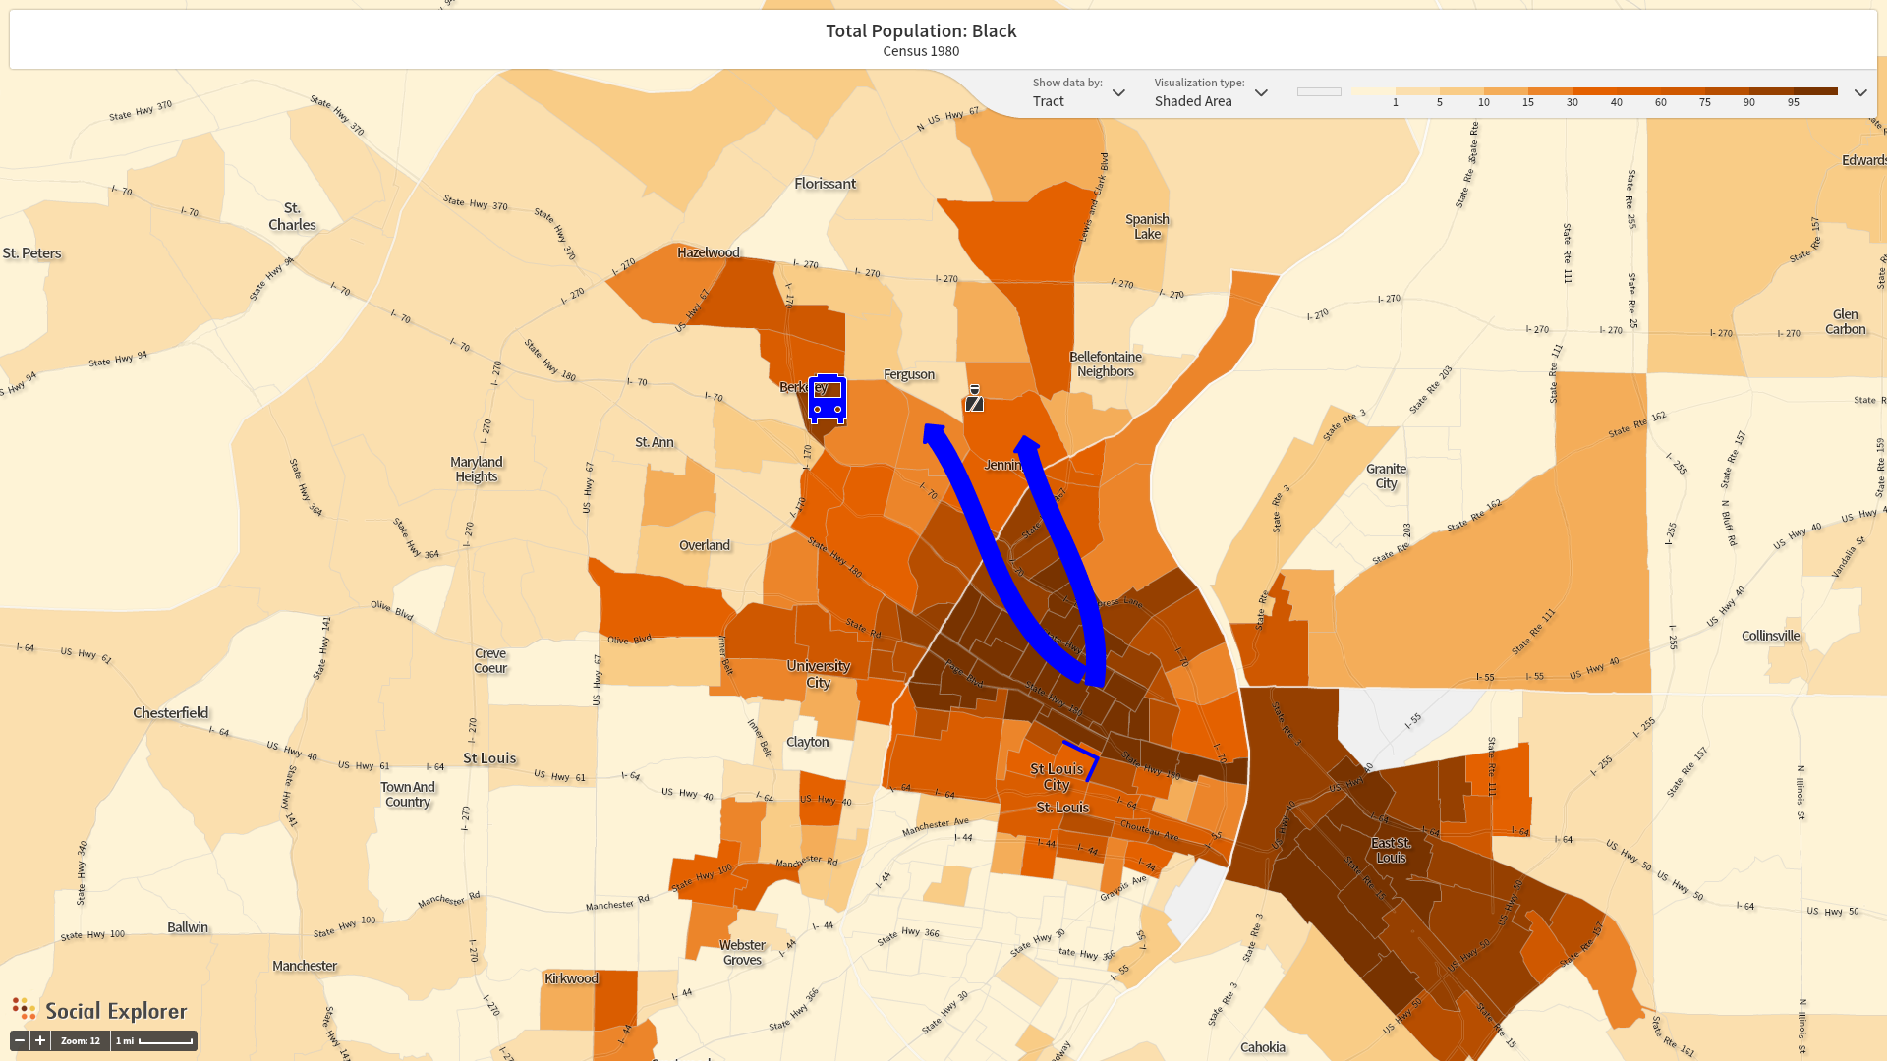
Map of St. Louis County in 1980. Affect Federal Court Order of Desegregation in Kinloch and surrounding areas. Compared to previous figure, one can visibly see Jennings, Ferguson, and other areas have become more Black.

Slide 12
Changing demographics of Canfield Drive

Slide 13
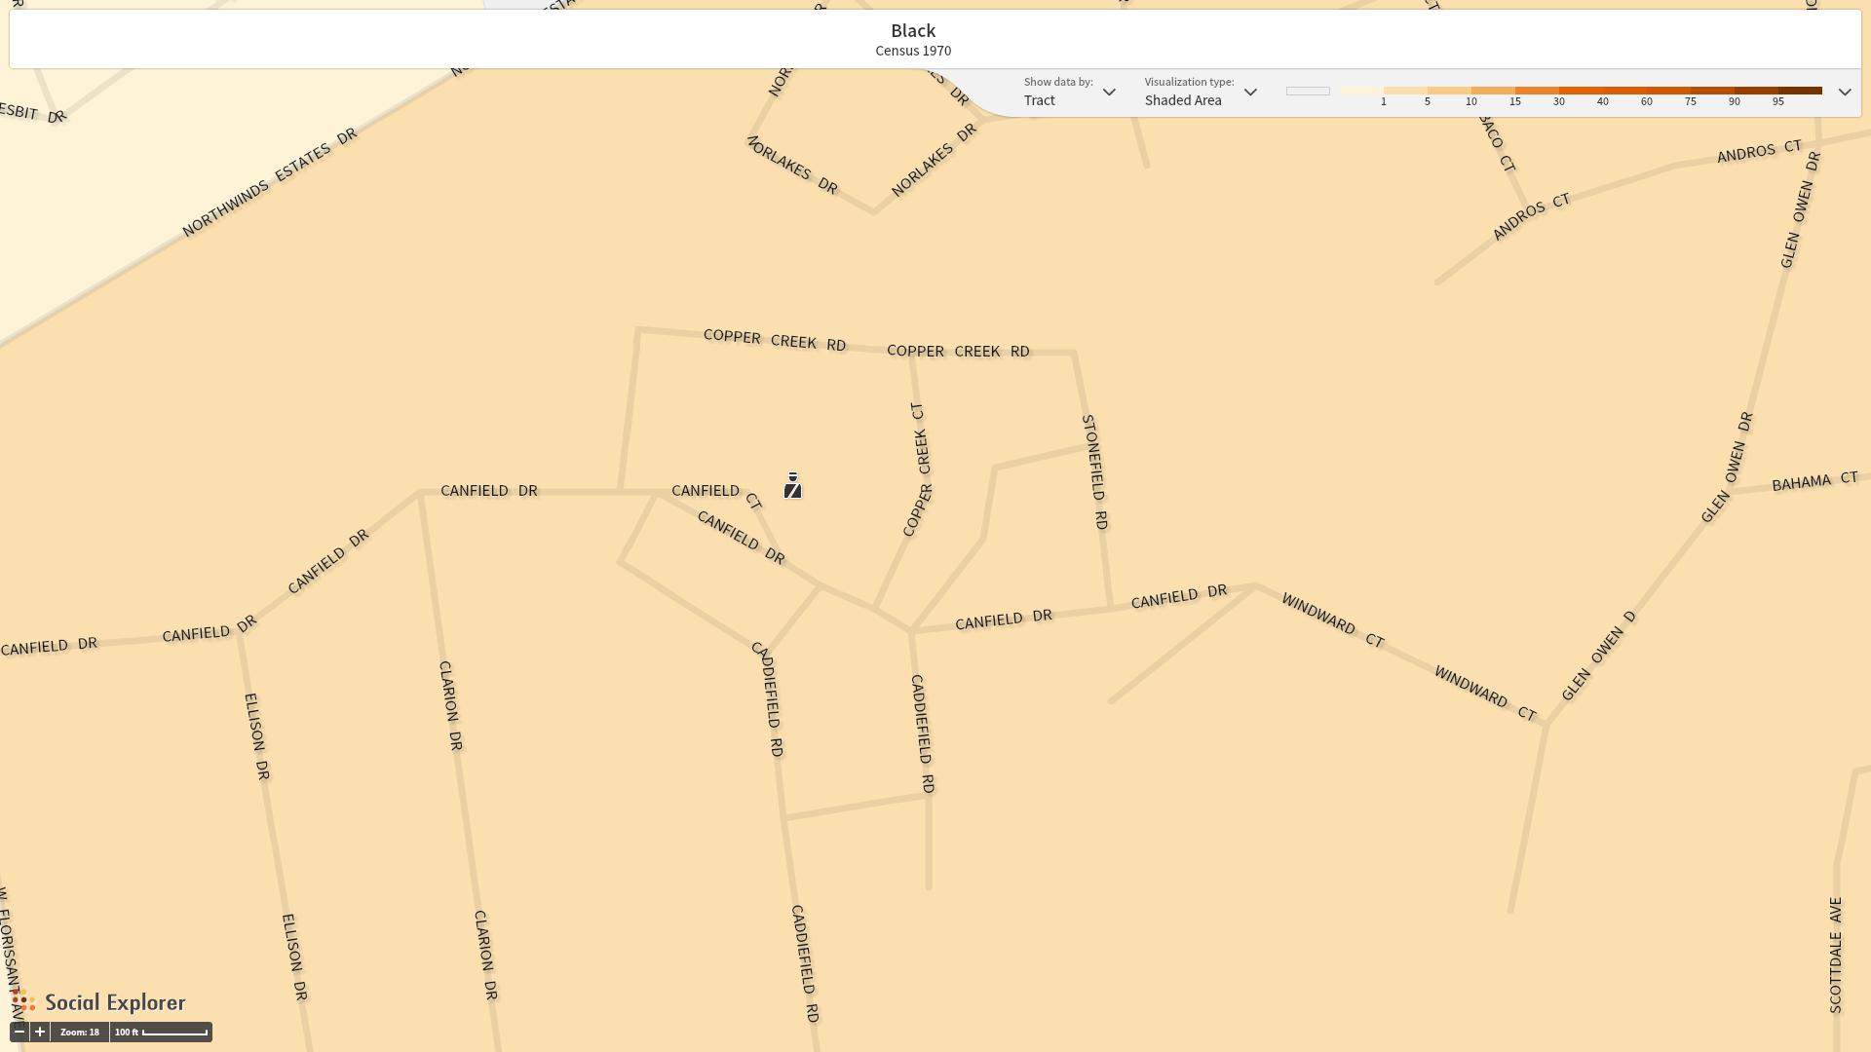
Black population 1970: 1%

Slide 14
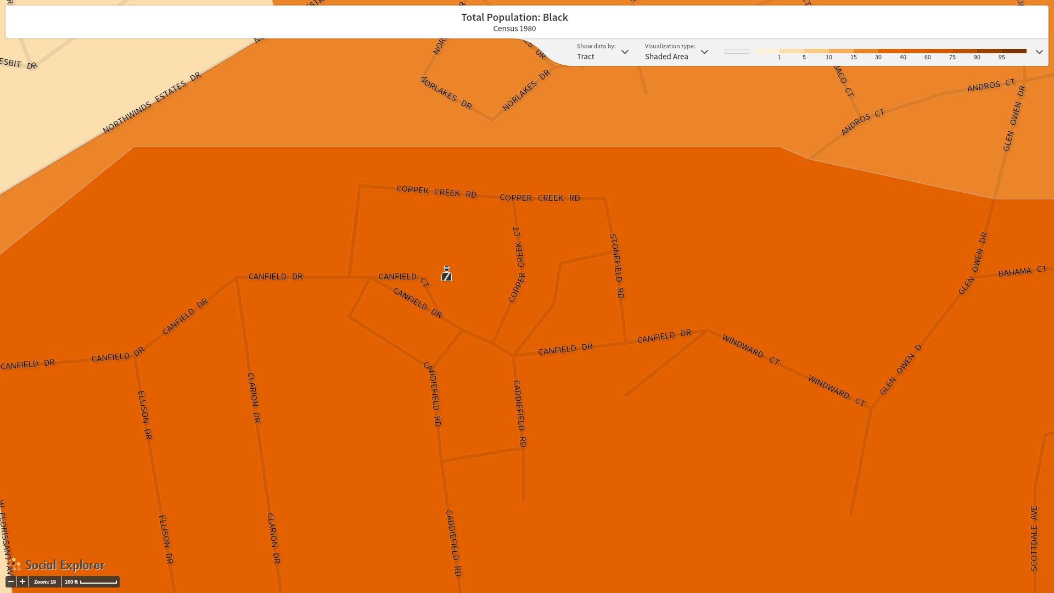
Black population 1980: 31%

Slide 15
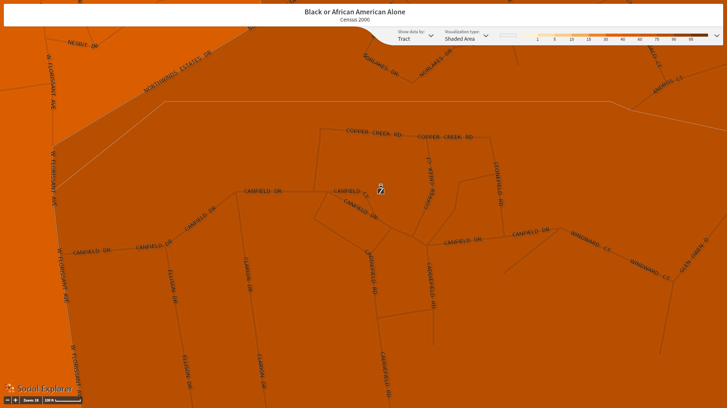
Black population 2000: 80%

Slide 16
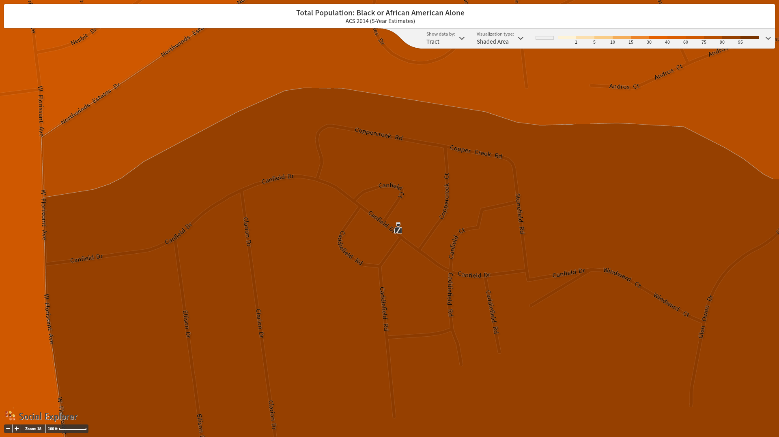
Black population 2014: 91%

Slide 17
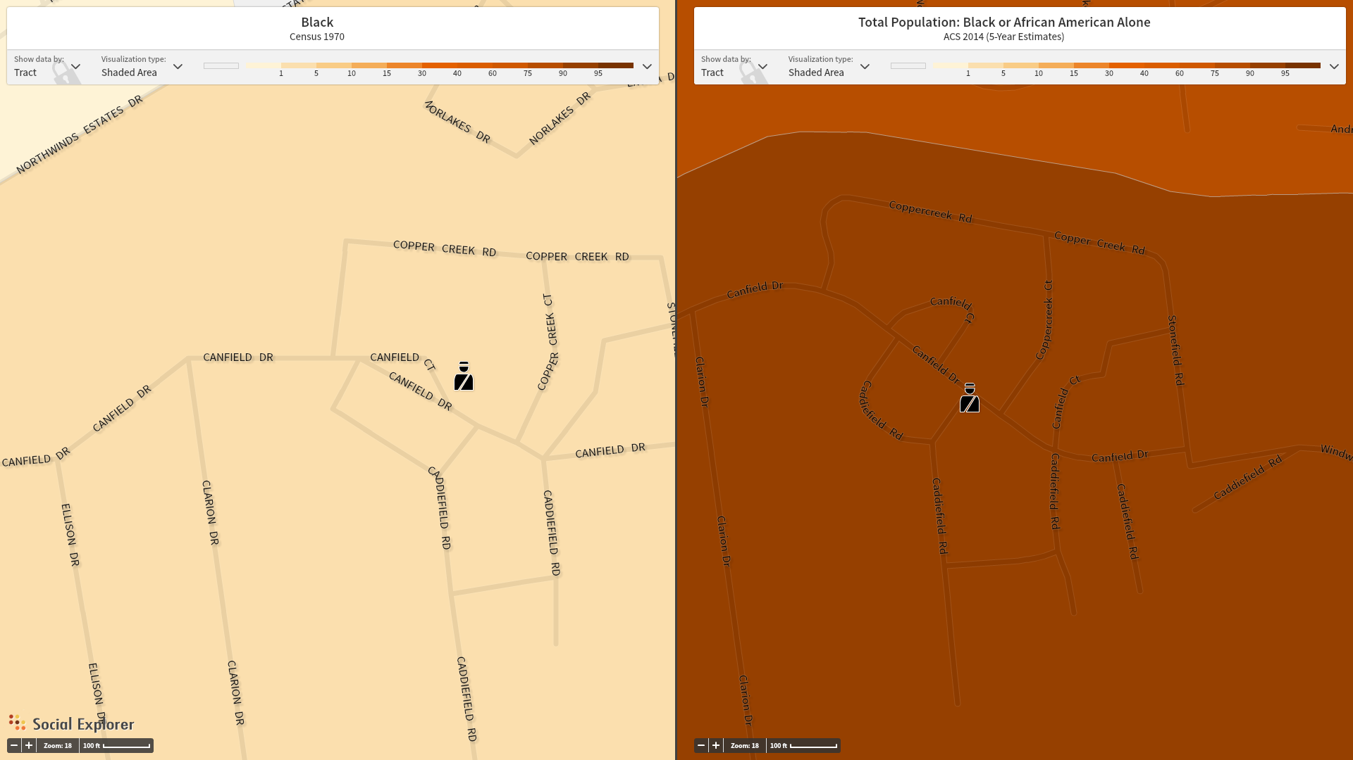
Canfield Drive Black Population, 1970 (1%) vs. 2014 (91%)

Slide 18
 | Year | 1940 | 1970 | 1980 | 1990 | 2000 | 2010** | 2014**
Total Population Identifying as Black | Census Tract 2120 | 4 | 157 | 3,804 | 6,116 | 9,715 | 3,376 | 2,613
% of population Identifying as Black | Census Tract 2120 | 0.09% | 1% | 30.78% | 51.25% | 80.29% | 90.17% | 91.33%
Table logs the growth of the Black population in the census tracts containing Canfield Drive from 1940 to 2014.
*All Census Tracts include Canfield Drive, Ferguson, MO
**2010 and 2014 Census Tract changes from 2120 to 2120.02

Slide 19
US DoJ Report
Ferguson Law Enforcement efforts are focused on generating revenue
Ferguson Law Enforcement practices violate the law and undermine community trust, especially among African Americans

