Slide 1
Introduction to CS 106A
Eric Roberts
CS 106A
April 2, 2012

Slide 2
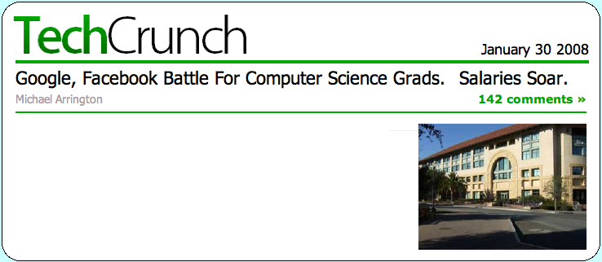


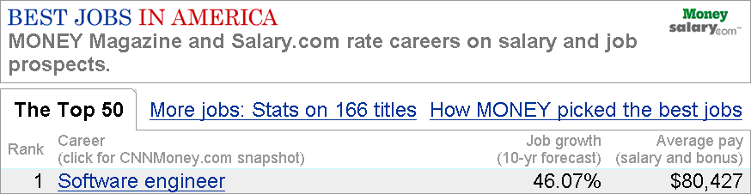
Why Study Computer Science
The computing industry offers some of the best employment opportunities for college graduates in the United States today:
  The number of jobs in the domestic software industry are at an all-time high and are projected to grow dramatically over the next decade.
  Salaries for newly minted B.S. graduates in Computer Science are high, sometimes exceeding the $100,000 mark.
  In 2005, Money magazine rated software engineer as the number one job in America.
  Employment in this area is vital for the economy.
Employment
(thousands)
Top 10 job growth categories (2006-2016)
2006
2016
Growth
1.
Network systems and data communications analysts
262
402
53.4
2.
Personal and home care aides
767
1,156
50.6
3.
Home health aides
787
1,171
48.7
4.
Computer software engineers, applications
507
733
44.6
5.
Veterinary technologists and technicians
71
100
41.0
6.
Personal financial advisors
176
248
41.0
Google and Facebook are fighting hard to hire this year’s crop of computer science graduates, we’ve heard, and ground zero is Stanford. Most of the class of 2008 already have job offers even though graduation is months away.
Last year, salaries of up to $70,000 were common for the best students. This year, Facebook is said to be offering $92,000, and Google has increased some offers to $95,000 to get their share of graduates. Students with a Master’s degree in Computer Science are being offered as much as $130,000 for associate product manager jobs at Google.
7.
Makeup artists, theatrical and performance
2
3
39.8
8.
Medical assistants
465
148
35.4
9.
Veterinarians
62
84
35.0
10.
Substance abuse and behavioral disorder counselors
83
112
34.3
Source:
U.S. Department of Labor, Bureau of Labor Statistics, Employment Projections: 2006-16, December 2007.

Slide 3
Why Study Computer Science
Phil Levis, http://csl.stanford.edu/~pal/ed/
Doctorate
161,857
Master’s
Bachelor’s
Job openings
129,045
94,889
49,200
57,127
55,208
31,357
10,075
Physical Sciences
Biological Sciences
Engineering
Computer Science
The educational data comes from the National Center for Education Statistics IPEDS (Integrated Postsecondary Education Data System) Data Center. The data used is for degrees granted in the 2008-2009 academic year.
The employment data comes from the Department of Labor’s Occupational Outlook Handbook for 2010-11. This handbook includes employment for 2008 as well as a 10-year projection to 2018. I manually selected which occupations mapped to which degrees. I calculated job openings per year as 10% of the expected job growth over 2008-2018 plus 2.5% of the number of jobs in 2008. This second term describes the number of jobs opening as people retire. It assumes that people work for 40 years and leave a job at a uniform rate; the latter is of course not true in difficult economic times.
We are very happy with the students that we get from this university. . . . We just wish we could hire two to three times as many of them.
—
Bill Gates at Stanford, February 19, 2008

Slide 4
Why Study Computer Science
The computing industry offers some of the best employment opportunities for college graduates in the United States today:
  The number of jobs in the domestic software industry are at an all-time high and are projected to grow dramatically over the next decade.
  Salaries for newly minted B.S. graduates in Computer Science are high, sometimes exceeding the $100,000 mark.
  In 2005, Money magazine rated software engineer as the number one job in America.
  Employment in this area is vital for the economy.
Beyond its marketability, computer science is an intellectually challenging and highly creative discipline. It can also be a great deal of fun.
In CS 106A, we will cover many of the ideas and skills you need to begin a career in this field. At the same time, we try as hard as we can not to lose sight of the creativity and fun, making sure you have ample opportunities for both.

Slide 5
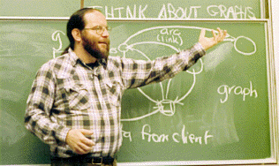
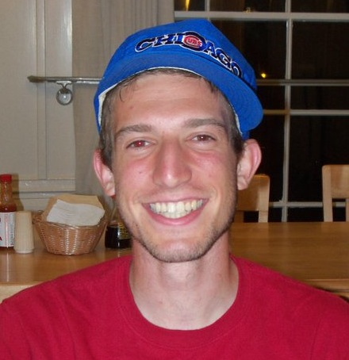
CS 106A Staff
Professor: Eric Roberts
eroberts@cs.stanford.edu
Office Hours (Gates 202):
Tuesdays 9:30-11:30
Head TA: Jeremy Keeshin
jkeeshin@cs.stanford.edu
Office Hours (Gates 160):
TBA

Slide 6
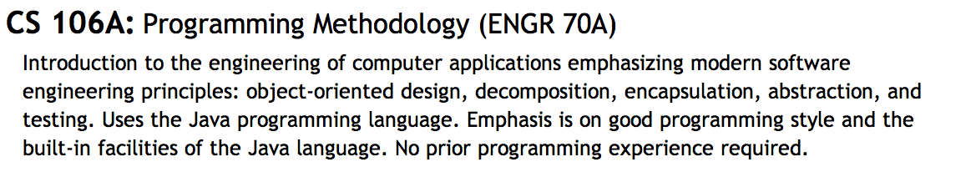
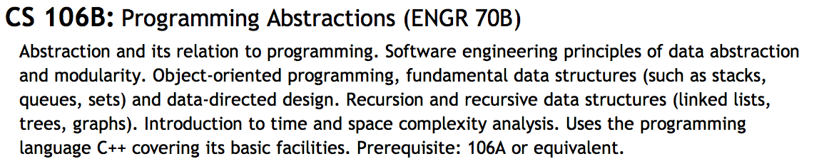
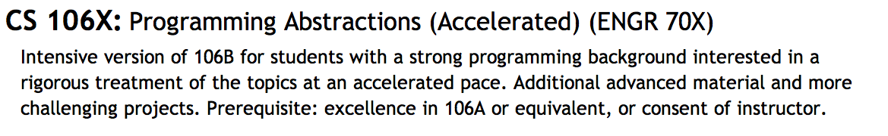
Is CS 106A the Right Course?

Slide 7
Important Administrative Notes
You must sign up for a section to be enrolled in the course. Section signups will start at 5:00P.M. on Thursday and close at 5:00P.M. on Saturday. Be sure to sign up during that time at
http://cs198.stanford.edu/section/
Undergraduates must take CS 106A for 5 units. Unfortunately, the default on Axess is 3 units, so make sure that you change this value as you register.
All handouts, assignments, lecture slides, and announcements are posted on the course web site at
http://cs106a.stanford.edu/
Both the midterm and the final are given at two scheduled times as shown in Handout #2. Special arrangements can be made for those who cannot make either time.

Slide 8


Syllabus—Week 1
April 2
4
6
Administration
CS and the Honor Code
Meet Karel the Robot
Simple Karel programs
Extending the Karel class
The concept of inheritance
Control structures in Karel
Problem-solving in Karel
Program decomposition
The idea of an algorithm
Friday Four-Square
Read: Karel, Chapters 1-3
Read: Karel, Chapters 4-6

Slide 9
Syllabus—Week 2
9
11
13
Programming by example
Classes and objects
The Program hierarchy
Simple graphical objects
Variables and values
Arithmetic expressions
Common idioms
Control statements
Boolean data
Simple animations
Read: Java, Chapter 1
Read: Chapters 2 and 3
Read: Chapter 4
Due: HW #1 (Karel)

Slide 10
Syllabus—Week 3
16
18
20
Methods
The role of parameters
Pseudorandom numbers
The RandomGenerator class
Reading javadoc
Objects and classes
Constructors
Inheritance
Read: Chapter 5
Due: Karel contest
Read: Sections 6.1-6.2
Due: HW #2 (Simple Java)
Read: Sections 6.3-6.6

Slide 11
Syllabus—Week 4
23
25
27
The acm.graphics package
Responding to mouse events
The Java listener model
Graphical structures
The GPolygon class
Creating compound objects
Character data
Using Java’s String class
Read: Sections 9.1-9.3
Read: Sections 10.1-10.3
Read: Section 9.4
Due: Parameter Problem Set
Read: Sections 8.1-8.4

Slide 12
Syllabus—Week 5
30
May 2
4
String manipulation
Problem-solving with strings
Data representation
Objects and memory
Arrays in Java
Read: Section 8.5
Read: Chapter 7
Due: HW #3 (Breakout)
Read: Sections 8.1-8.4

Slide 13
Syllabus—Week 6
7
9
11
Debugging strategies
Multidimensional arrays
Pixel arrays
Image manipulation
Midterm Exam
Tuesday, May 8
9:00 A.M. or 3:15 P.M.
Due: Graphics contest
Read: Section 11.6
Read: Section 11.7
Due: HW #4 (TurtleGraphics)

Slide 14
Syllabus—Week 7
14
16
18
Swing interactors
The JComponent hierarchy
Action listeners
The ArrayList class
Simple file I/O
Java collection classes
The HashMap class
Iterators
Read: Sections 10.5-10.6
Read: Sections 11.8, 12.4
Read: Chapter 13
Due: HW #5 (ImageShop)

Slide 15
Syllabus—Week 8
21
23
25
The acm.gui package
The TableLayout class
Designing GUIs
Large-scale data structures
Data-driven programs
Overview of Adventure!
Read: Sections 10.7-10.8
Read: Adventure handout
Due: HW #6 (NameSurfer)

Slide 16
Syllabus—Week 9
28
30
June 1
Memorial Day
(no class)
Sorting and searching
Algorithmic analysis
Looking ahead: Recursion
Concurrency
Programming patterns
Read: Sections 12.1-12.3
Read: Chapter 14

Slide 17
Dead Week and Beyond
4
6
8
Frontiers of computing
(optional)
Review session:
Wednesday, June 6
7:00-9:00 P.M.
Final Exam times:
Friday, June 8
Monday, June 11
8:30-11:30 A.M.
Due: HW #7 (Adventure)
Due: Adventure contest

Slide 18
Assignments in CS 106A
Assignments in CS 106A are due at 5:00P.M. Assignments that come in after 5:00 will be considered late.
Everyone in CS 106A starts the quarter with two “late days” that you can use at any time you need some extra time. In my courses, late days correspond to class meetings, so that, if an assignment is due on Wednesday and you turn it in on Friday, that counts as one late day.
Extensions can be approved only by the TA, Jeremy Keeshin.
Assignments are graded by your section leader, who discusses your work in an interactive, one-on-one grading session.
Each assignment is given two grades: one on functionality and one on programming style. Style matters. Companies in Silicon Valley expect Stanford graduates to understand how to write code that other programmers can maintain.

Slide 19


The CS 106A Grading Scale
Functionality and style grades for the assignments use the following scale:
A submission so good it “makes you weep.”
Exceeds requirements.
Satisfies all requirements of the assignment.
Meets most requirements, but with some problems.
Some more serious problems.
Even worse than that.
Why did you turn this in?

Slide 20
Contests
CS 106A will have three contests as follows:
  The Karel Contest associated with Assignment #1
  The Graphics Contest associated with Assignment #3
  The Adventure Contest associated with Assignment #7
First prize in the contest is a score of 100% on one of the graded components of the course, typically the final exam.
As an additional incentive, entering any of the contests gives you chances to win an additional grand prize in a random drawing at the end of the quarter.
Entering a contest also earns “house points” for your class in the style of the Hogwarts School from Harry Potter.
Securing a runner-up prize or an honorable mention on any contest gives you additional chances in the random drawing, as does having an assignment submitted as a + + candidate.

Slide 21
Honor Code Rules
Rule 1:
You must indicate on your submission any assistance you received.
Rule 2:
You must not share actual program code with other students.
Rule 3:
You must not look at solution sets or program code from other years
Rule 4:
You must be prepared to explain any program code you submit.

Slide 22
Encouraging Academic Integrity
No one likes exams. Unfortunately, as long as the rate of Honor Code violations remains high, we have no real option.
This quarter, I will adopt the following strategy to encourage academic integrity. The weight of the final exam will be
15% + 5% for each Honor Code case filed this quarter
The weight assigned to the homework will be whatever is left after the announced weights are assigned to the various other components, subject to a minimum of 15%.
For example, if no Honor Code cases come up this quarter, the final will count for 15% and the homework will count for 60%. If, however, there are three cases (as there were when I taught 106A in 2009), the final will count for 30% and the homework for 45%. And so on . . .

Slide 23
Meet Karel the Robot
Karel the Robot was developed here at Stanford by Richard Pattis over 30 years ago. Since then Karel has given many generations of CS 106A students a “gentle introduction” to programming and problem solving.
Karel’s world is composed of streets and avenues numbered from the southwest corner. (As in Manhattan, streets run east-west and avenues run north-south.) In this world, Karel is facing east at the corner of 1st Street and 1st Avenue.
Karel’s world is surrounded by a solid wall through which it cannot move. Depending on the problem, there may also be walls in the interior of the world that block Karel’s passage.
The only other objects that exist in Karel’s world are beepers, which are small plastic cones that emit a quiet beeping noise. In this world, for example, I’ve added a beeper to the corner of 1st Street and 2nd Avenue.
Initially, Karel understands only four primitive commands:
move()
Move forward one square
turnLeft()
Turn 90 degrees to the left
pickBeeper()
Pick up a beeper from the current square
putBeeper()
Put down a beeper on the current square
3
+
+
+
+
+
2
+
+
+
+
+
1
+
+
+
+
+
1
2
3
4
5

Slide 24
Your First Challenge
How would you program Karel to pick up the beeper and transport it to the top of the ledge? Karel should drop the beeper at the corner of 2nd Street and 4th Avenue and then continue one more corner to the east, ending up on 5th Avenue.
3
+
+
+
+
+
2
+
+
+
+
+
1
+
+
+
+
+
1
2
3
4
5

Slide 25
The End

