Slide 1
Programming in Karel
Eric Roberts
CS 106A
April 4, 2012

Slide 2
Once upon a time . . .

Slide 3

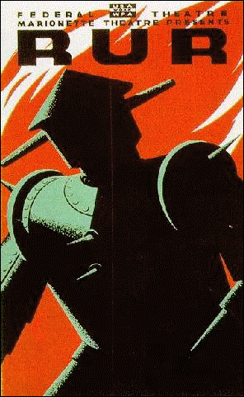


Rich Pattis and Karel the Robot
Karel the Robot was developed by Rich Pattis in the 1970s when he was a graduate student at Stanford.
In 1981, Pattis published Karel the Robot: A Gentle Introduction to the Art of Programming, which became a best-selling introductory text.
Pattis chose the name Karel in honor of the Czech playwright Karel Capek, who introduced the word robot in his 1921 play R.U.R.
In 2006, Pattis received the annual award for Outstanding Contributions to Computer Science Education given by the ACM professional society.
ˇ
Rich Pattis

Slide 4
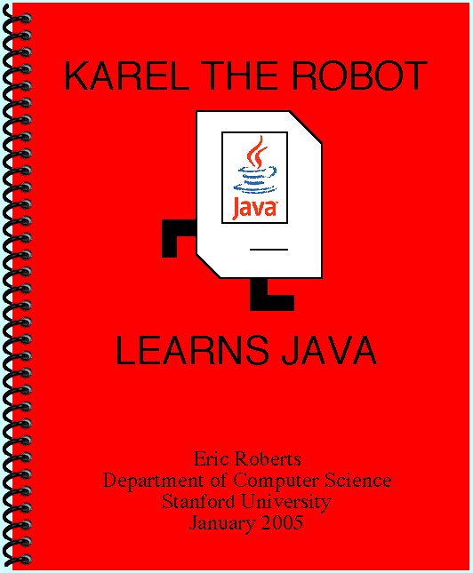

Slide 5
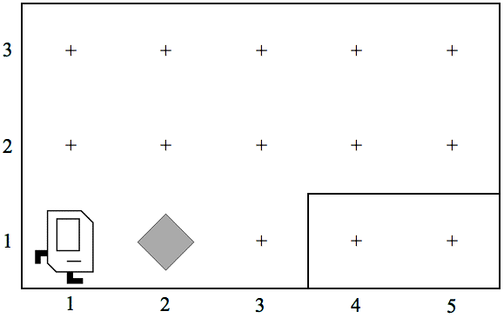
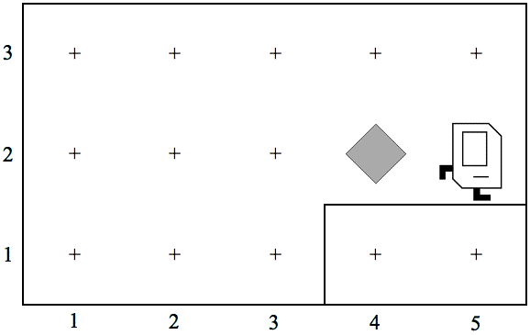
Review: Primitive Karel Commands
On Monday, you learned that Karel understands the following commands:
move()
Move forward one square
turnLeft()
Turn 90 degrees to the left
pickBeeper()
Pick up a beeper from the current square
putBeeper()
Put down a beeper on the current square
At the end of class, we designed a Karel program to solve the following problem:

Slide 6
Our First Karel Program
/*
* File: FirstKarelProgram.java
* ----------------------------
* This program moves a beeper up to a ledge.
*/
import stanford.karel.*;
public class FirstKarelProgram extends Karel {
public void run() {
move();
pickBeeper();
move();
turnLeft();
move();
turnLeft();
turnLeft();
turnLeft();
move();
putBeeper();
move();
}
}
/*
* File: FirstKarelProgram.java
* ----------------------------
* This program moves a beeper up to a ledge.
*/
import stanford.karel.*;
public class FirstKarelProgram extends Karel {
public void run() {
move();
pickBeeper();
move();
turnLeft();
move();
turnLeft();
turnLeft();
turnLeft();
move();
putBeeper();
move();
}
}
Comments
Import the Stanford Karel libraries
A Karel program class
The run method, which specifies the operations

Slide 7
Syntactic Rules and Patterns
The definition of FirstKarelProgram on the preceding slide includes various symbols (curly braces, parentheses, and semicolons) and special keywords (such as class, extends, and void) whose meaning may not be immediately clear. These symbols and keywords are required by the rules of the Karel programming language, which has a particular syntax just as human languages do.
When you are learning a programming language, it is usually wise to ignore the details of the language syntax and instead focus on learning a few general patterns. Karel programs, for example, fit a common pattern in that they all import the stanford.karel library and define a method named run. The statements that are part of the run method change to fit the application, but the rest of the pattern remains the same.

Slide 8
Defining New Methods
A Karel program consists of methods, which are sequences of statements that have been collected together and given a name. Every program includes a method called run, but most define helper methods to you can use as part of the program.
The pattern for defining a helper method looks like this:
private void name() {
statements that implement the desired operation
}
In patterns of this sort, the boldfaced words are fixed parts of the pattern; the italicized parts represent the parts you can change. Thus, every helper method will include the keywords private and void along with the parentheses and braces shown. You get to choose the name and the sequence of statements performs the desired operation.

Slide 9
The turnRight Method
As a simple example, the following method definition allows Karel to turn right by executing three turnLeft operations:
private void turnRight() {
turnLeft();
turnLeft();
turnLeft();
}
Once you have made this definition, you can use turnRight in your programs in exactly the same way you use turnLeft.
In a sense, defining a new method is analogous to teaching Karel a new word. The name of the method becomes part of Karel’s vocabulary and extends the set of operations the robot can perform.

Slide 10
Helper Methods in a Program
import stanford.karel.*;
public class ImprovedFirstKarelProgram extends Karel {
public void run() {
move();
pickBeeper();
move();
turnLeft();
move();
turnRight();
move();
putBeeper();
move();
}
private void turnRight() {
turnLeft();
turnLeft();
turnLeft();
}
}

Slide 11
Exercise: Defining Methods
Define a method called turnAround that turns Karel around 180 degrees without moving.
private void turnAround() {
turnLeft();
turnLeft();
}
Define a method backup that moves Karel backward one square, leaving Karel facing in the same direction.
private void backup() {
turnAround();
move();
turnAround();
}

Slide 12
Control Statements
In addition to allowing you to define new methods, Karel also includes three statement forms that allow you to change the order in which statements are executed. Such statements are called control statements.
The control statements available in Karel are:
  The for statement, which is used to repeat a set of statements a predetermined number of times.
  The while statement, which repeats a set of statements as long as some condition holds.
  The if statement, which applies a conditional test to determine whether a set of statements should be executed at all.
  The if-else statement, which uses a conditional test to choose between two possible actions.

Slide 13
The for Statement
In Karel, the for statement has the following general form:
for (int i = 0; i < count; i++) {
statements to be repeated
}
for (int i = 0; i < count; i++) {
statements to be repeated
}
As with most control statements, the for statement pattern consists of two parts:
  The header line, which specifies the number of repetitions
  The body, which is the set of statements affected by the for
Note that most of the header line appears in boldface, which means that it is a fixed part of the for statement pattern. The only thing you are allowed to change is the number of repetitions, which is indicated by the placeholder count.

Slide 14
Using the for Statement
You can use for to redefine turnRight as follows:
private void turnRight() {
for (int i = 0; i < 3; i++) {
turnLeft();
}
}
The following method creates a square of four beepers, leaving Karel in its original position:
private void makeBeeperSquare() {
for (int i = 0; i < 4; i++) {
putBeeper();
move();
turnLeft();
}
}

Slide 15
Conditions in Karel
Karel can test the following conditions:
positive condition
negative condition
frontIsClear()
frontIsBlocked()
leftIsClear()
leftIsBlocked()
rightIsClear()
rightIsBlocked()
beepersPresent()
noBeepersPresent()
beepersInBag()
noBeepersInBag()
facingNorth()
notFacingNorth()
facingEast()
notFacingEast()
facingSouth()
notFacingSouth()
facingWest()
notFacingWest()

Slide 16
The while Statement
The general form of the while statement looks like this:
while (condition) {
statements to be repeated
}
The simplest example of the while statement is the method moveToWall, which comes in handy in lots of programs:
private void moveToWall() {
while (frontIsClear()) {
move();
}
}

Slide 17
The if and if-else Statements
The if statement in Karel comes in two forms:
  A simple if statement for situations in which you may or may not want to perform an action:
if (condition) {
statements to be executed if the condition is true
}
  An if-else statement for situations in which you must choose between two different actions:
if (condition) {
statements to be executed if the condition is true
} else {
statements to be executed if the condition is false
}

Slide 18
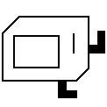
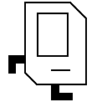
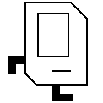


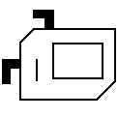

Climbing Mountains
For the rest of today, we’ll explore the use of methods and control statements in the context of teaching Karel to climb stair-step mountains that look something like this:
d
i
a
r
y
F
F
e
o
r
u
a
u
4
r-s
q
3
2
1
1
2
3
4
5
6
7
The initial version will work only in this world, but later examples will be able to climb mountains of any height.

Slide 19
The End

