Slide 1
Simple Java
Eric Roberts
CS 106A
April 9, 2012

Slide 2
Once upon a time . . .

Slide 3
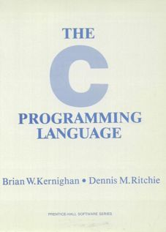
The “Hello World” Program
One of the important influences on the design of Java was the C programming language, which was developed at Bell Labs in the early 1970s. The primary reference manual for C was written by Brian Kernighan and Dennis Ritchie.
1.1 Getting Started
The only way to learn a new programming language is to write programs in it. The first program to write is the same for all languages:
Print the words
hello, world
This is the big hurdle; to leap over it you have to be able to create the program text somewhere, compile it, load it, run it, and find out where your output went. With these mechanical details mastered, everything else is comparatively easy.
In C, the program to print “hello, world” is
#include <stdio.h>
main() {
printf("hello, world");
}
On the first page of their book, the authors suggest that the first step in learning any language is to write a simple program that prints the message “hello, world” on the display. That advice remains sound today.

Slide 4
Simple Java

Slide 5
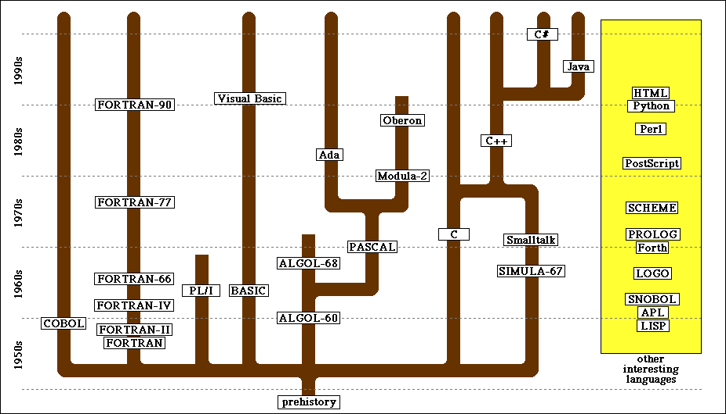
Evolution of Computer Languages

Slide 6


The 2002 ACM Turing Award
The most prestigious prize in computer science, the ACM Turing Award, was given in 2002 to two Norwegian computing pioneers, who developed the first object-oriented programming language in 1967.
Kristen Nygaard
Ole Johan Dahl

Slide 7
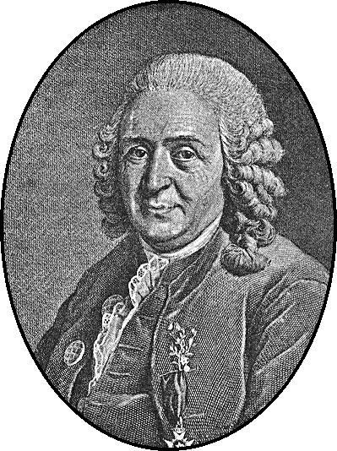
Systems of Classification
In the mid-18th century, the Scandinavian botanist Carl Linnaeus revolutionized the study of biology by developing a new system for classifying plants and animals in a way that revealed their structural relationships and paved the way for Darwin’s theory of evolution a century later.
Linnaeus’s great contribution was to recognize that organisms fit into a hierarchical classification scheme in which the placement of individual species within the hierarchy reflects their anatomical similarities.
Carl Linnaeus (1707–1778)

Slide 8
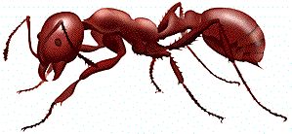
Biological Class Hierarchy
Living Things
Living Things
Plants
Animals
Kingdom
Animals
Fungi
Annelida
Brachiopoda
Arthropoda
Phylum
Arthropoda
Mollusca
Chordata
Crustacea
Insecta
Order
Insecta
Arachnida
Class
Hymenoptera
Every red ant is also an animal, an arthropod, and an insect, as well as the other superclasses in the chain.
Classification of the red ant Iridomyrmex purpureus
Family
Formicidae
Genus
Iridomyrmex
Species
purpureus

Slide 9
Instances vs. Patterns
Drawn after you, you pattern of all those.
—William Shakespeare, Sonnet 98
In thinking about any classification scheme—biological or otherwise—it is important to draw a distinction between the category defined by a particular class and specific instances of that class. In the most recent example, the designation Iridomyrmex purpureus is not itself an ant, but rather a class of ant. There can be (and usually are) many ants, each of which is an individual of that class.
Each of these fire ants is an instance of the general category encompassing all ants of its class. Each instance is of the species purpureus, the genus Iridomyrmex, the family Formicidae (which makes it an ant), and so on. Thus, each ant is not only an ant, but also an insect, an arthropod, and an animal.

Slide 10
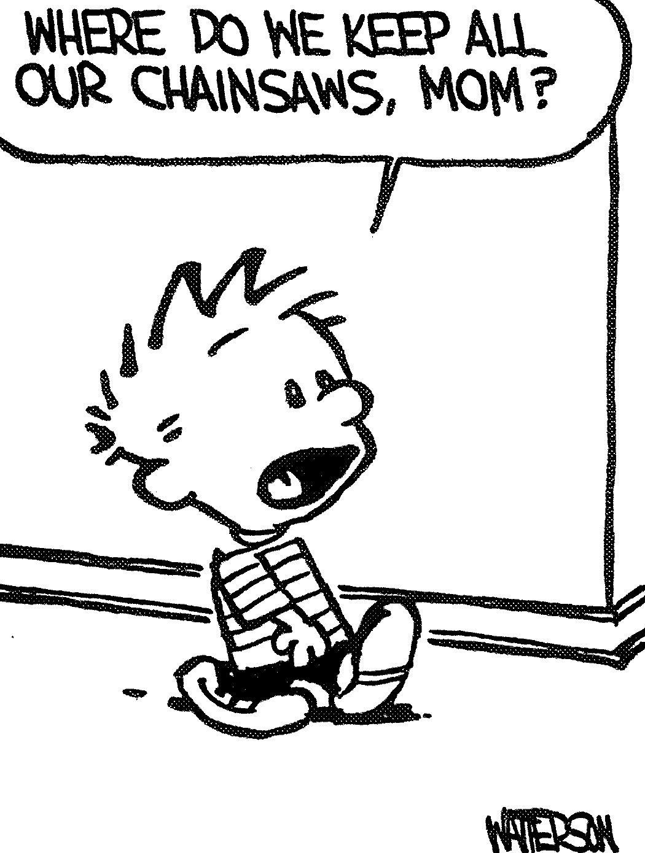
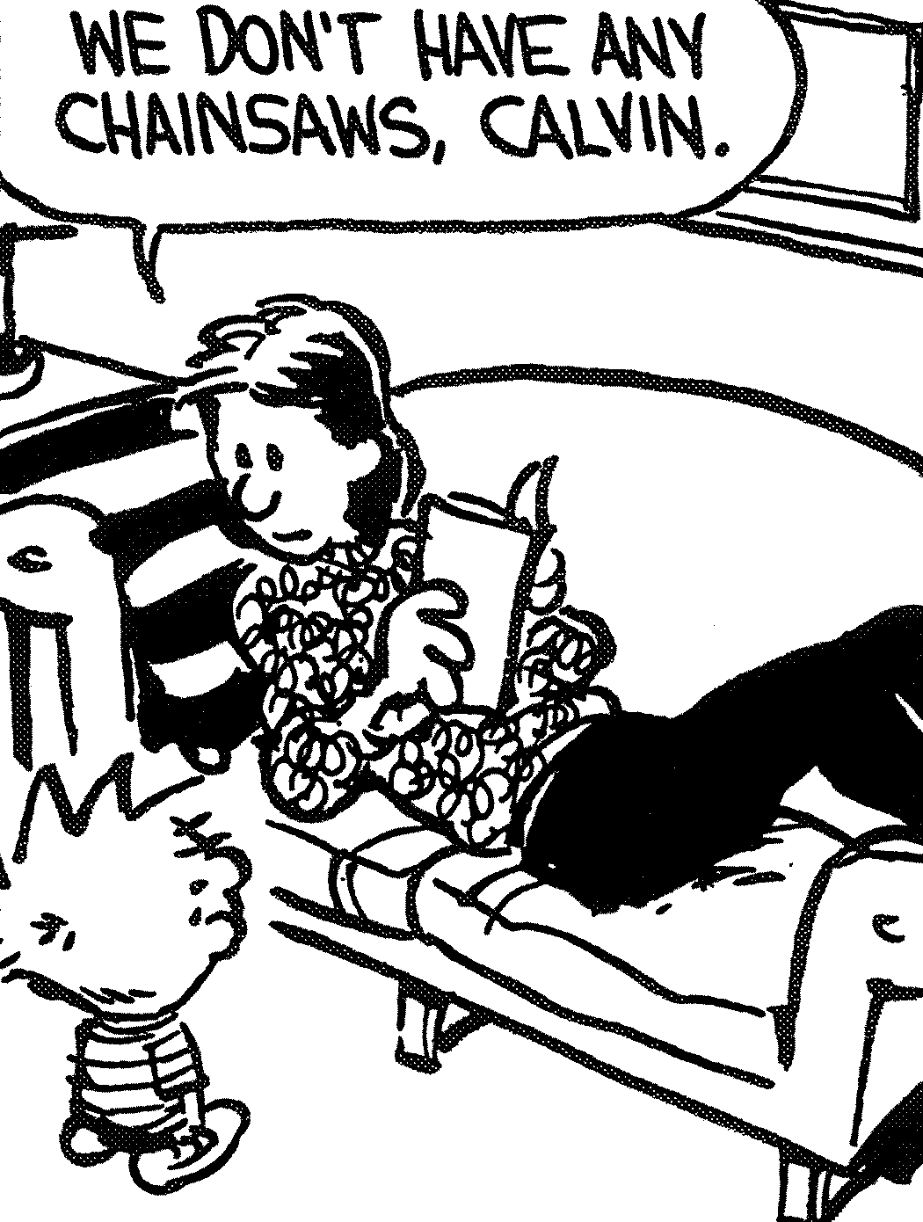
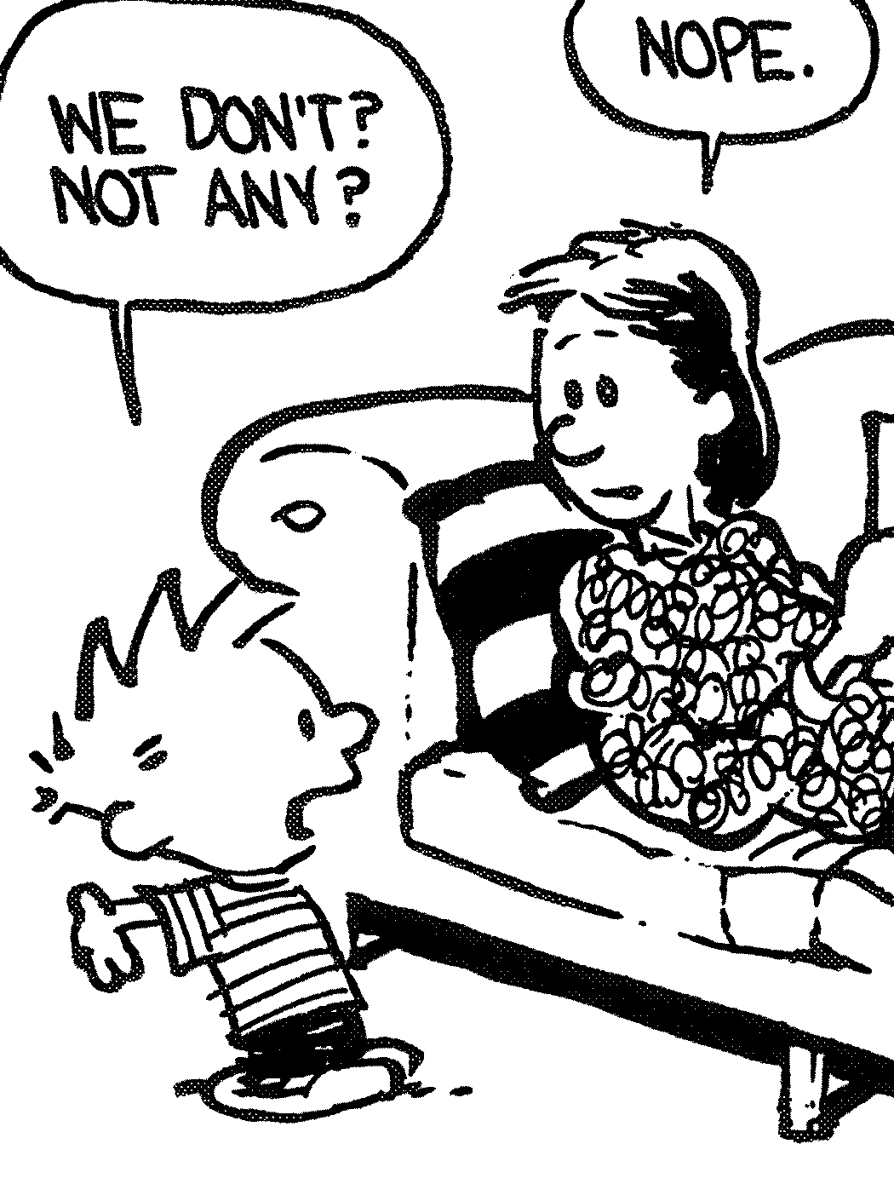
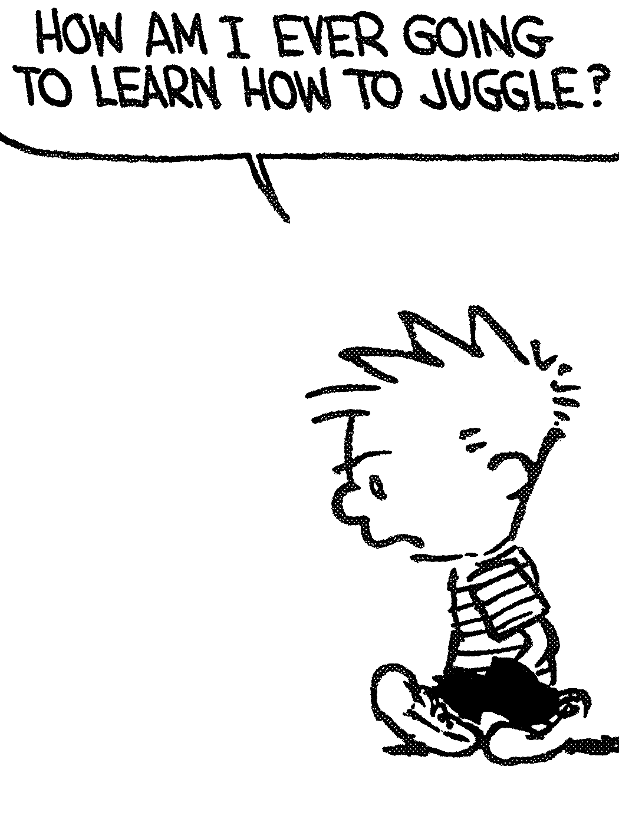
Another Hierarchy Example
Object
JugglingObject
JugglingBall
JugglingRing
JugglingClub

Slide 11
The Program Hierarchy
Java class hierarchies are similar to the biological class hierarchy from the previous slide. This diagram shows the hierarchy formed by the classes in the acm.program package.
Applet
Every ConsoleProgram is also a Program, a JApplet, and an Applet. That means that every ConsoleProgram can run as an applet on the web. The same is true for every DialogProgram and GraphicsProgram.
JApplet
Program
ConsoleProgram
DialogProgram
GraphicsProgram

Slide 12

Hello World as a Console Program
import acm.program.*;
public class HelloProgram extends ConsoleProgram {
public void run() {
println("hello, world");
}
}
import acm.program.*;
public class HelloProgram extends ConsoleProgram {
public void run() {
println("hello, world");
}
}
HelloConsole
hello, world

Slide 13
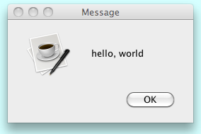
Hello World as a Dialog Program
import acm.program.*;
public class HelloProgram extends DialogProgram {
public void run() {
println("hello, world");
}
}
import acm.program.*;
public class HelloProgram extends DialogProgram {
public void run() {
println("hello, world");
}
}

Slide 14

Hello World as a Graphics Program
import acm.graphics.*;
import acm.program.*;
public class HelloProgram extends GraphicsProgram {
public void run() {
add( new GLabel("hello, world", 100, 75) );
}
}
import acm.graphics.*;
import acm.program.*;
public class HelloProgram extends GraphicsProgram {
public void run() {
add( new GLabel("hello, world", 100, 75) );
}
}
HelloProgram
hello, world

Slide 15


The Java Coordinate System
Creating a JLabel at a particular x and y position means that the baseline of the first character in the label appears at that point, as follows:
HelloProgram
(100, 100)
hello, world
Positions and distances in a graphics program are measured in terms of pixels, which are the individual dots that cover the screen.
Unlike traditional mathematics, Java defines the origin of the coordinate system to be in the upper left corner. Values for the x coordinate increase as you move rightward across the screen; y coordinate values increase as you move downward.

Slide 16
The GObject Hierarchy
The classes that represent graphical objects form a hierarchy, part of which looks like this:
GObject
GLabel
GRect
GOval
GLine
The GObject class represents the collection of all graphical objects. The four subclasses shown in this diagram correspond to particular types of objects: labels, rectangles, ovals, and lines. The class diagram makes it clear that any GLabel, GRect, GOval, or GLine is also a GObject.
Operations on graphical objects are defined at each level of the hierarchy. Operations that apply to all graphical objects are specified at the GObject level, where they are inherited by each subclass. Operations that apply to a particular subclass are specified as part of the definition of that class.

Slide 17
Operations on the GObject Class
The following operations apply to all GObjects:
object.setColor(color)
Sets the color of the object to the specified color constant.
object.setLocation(x, y)
Changes the location of the object to the point (x, y).
object.move(dx, dy)
Moves the object on the screen by adding dx and dy to its current coordinates.
The standard color names are defined in the java.awt package:
Color.BLACK
Color.DARK_GRAY
Color.GRAY
Color.LIGHT_GRAY
Color.WHITE
Color.RED
Color.YELLOW
Color.GREEN
Color.CYAN
Color.BLUE
Color.MAGENTA
Color.ORANGE
Color.PINK

Slide 18
Drawing Geometrical Objects
Constructors
new GRect( x, y, width, height)
Creates a rectangle whose upper left corner is at (x, y) of the specified size.
new GOval( x, y, width, height)
Creates an oval that fits inside the rectangle with the same dimensions.
new GLine( x₀, y₀, x₁, y₁)
Creates a line extending from (x₀, y₀) to (x₁, y₁).
Methods shared by the GRect and GOval classes
object.setFilled( fill)
If fill is true, fills in the interior of the object; if false, shows only the outline.
object.setFillColor( color)
Sets the color used to fill the interior, which can be different from the border.

Slide 19
Operations on the GLabel Class
Constructor
new GLabel(text, x, y)
Creates a label containing the specified text that begins at the point (x, y).
Methods specific to the GLabel class
label.setFont( font)
Sets the font used to display the label as specified by the font string.
The font is typically specified as a string in the form
"family-style-size"
where
family is the name of a font family
style is either PLAIN, BOLD, ITALIC, or BOLDITALIC
size is an integer indicating the point size

Slide 20
The End

