Slide 1
Multidimensional Arrays
Eric Roberts
CS 106A
May 9, 2012

Slide 2
Multidimensional Arrays
Because the elements of an array can be of any Java type, those elements can themselves be arrays. Arrays of arrays are called multidimensional arrays.
In Java, you can create a multidimensional array by using multiple brackets in both the type and the initialization parts of the declaration. For example, you can create array space for a 3 ^{x} 3 tic-tac-toe board using the following declaration:
char[][] board = new char[3][3];
This declaration creates a two-dimensional array of characters that is organized like this:
board[0][0]
board[0][1]
board[0][2]
board[1][0]
board[1][1]
board[1][2]
board[2][0]
board[2][1]
board[2][2]

Slide 3
Arrays of Arrays
Internally, Java represents multidimensional arrays as arrays of arrays. It is often important to keep this fact in mind when you are creating array structures.
In Java, it is often necessary to initialize the rows of a two-dimensional array individually, as in the following revised code for creating the tic-tac-toe board:
char[][] board = new char[3][];
for (int i = 0; i < 3; i++) {
board[i] = new char[3];
}

Slide 4
Static Initialization
Java makes it easy to initialize the elements of an array as part of a declaration. The syntax is
type[] name = { elements };
where elements is a list of the elements of the array separated by commas. The length of the array is automatically set to be the number of values in the list.
For example, the following declaration initializes the variable powersOfTen to the values 10⁰, 10¹, 10², 10³, and 10⁴:
int[] powersOfTen = { 1, 10, 100, 1000, 10000 };
This declaration creates an integer array of length 5 and initializes the elements as specified.

Slide 5
Initializing Multidimensional Arrays
You can initialize a multidimensional array when you declare it by using nested braces to reflect the levels of array nesting.
For example, you can declare and initialize a multiplication table for the digits 0 to 9 like this:
private static final int[][] MULTIPLICATION_TABLE = {
{ 0, 0, 0, 0, 0, 0, 0, 0, 0, 0 },
{ 0, 1, 2, 3, 4, 5, 6, 7, 8, 9 },
{ 0, 2, 4, 6, 8, 10, 12, 14, 16, 18 },
{ 0, 3, 6, 9, 12, 15, 18, 21, 24, 27 },
{ 0, 4, 8, 12, 16, 20, 24, 28, 32, 36 },
{ 0, 5, 10, 15, 20, 25, 30, 35, 40, 45 },
{ 0, 6, 12, 18, 24, 30, 36, 42, 48, 56 },
{ 0, 7, 14, 21, 28, 35, 42, 49, 56, 63 },
{ 0, 8, 16, 24, 32, 40, 48, 56, 64, 72 },
{ 0, 9, 18, 27, 36, 45, 54, 63, 72, 81 }
};

Slide 6
Exercise: Dreaming up Applications
The plan for today is to go through a series of data structure design exercises and then pick one or two to embellish into larger programs.
Your first exercise, however, is to spend a few minutes thinking about real-world examples of multidimensional arrays other than the ones that appear on the subsequent slides. Use your imagination!

Slide 7





















Exercise: Representing a Chess Board
r
r
n
n
b
b
q
q
k
k
b
b
n
n
r
0
r
p
p
p
p
p
p
p
p
p
p
p
p
p
p
p
1
p
2
3
4
5
P
P
P
P
P
P
P
P
P
P
P
P
P
P
P
6
P
R
R
N
N
B
B
Q
Q
K
K
B
B
N
N
R
7
R
0
1
2
3
4
5
6
7

Slide 8
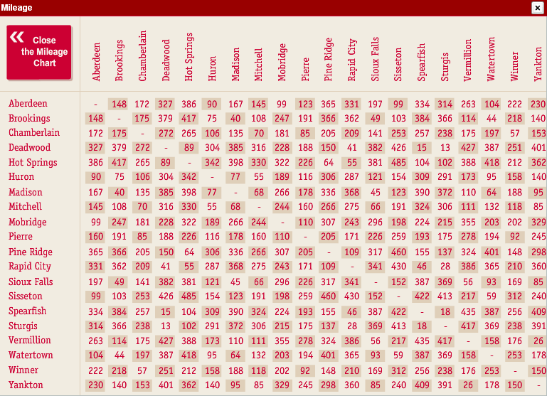
Exercise: Mileage Chart
I was intrigued to discover that the top Google Images hit for “mileage chart” was the following table for South Dakota:

Slide 9
Exercise: Sudoku
Design a program that checks legality of a Sudoku position, in which each digit between 1 and 9 must appear exactly once in each row, column, and 3x3 square.
3
9
2
4
6
5
8
1
7
2
4
5
8
7
7
4
1
8
9
3
6
2
5
4
1
8
6
2
6
8
5
2
7
1
4
3
9
6
8
7
3
9
2
5
4
1
3
8
7
9
6
2
3
9
6
8
3
9
6
2
7
1
5
4
9
6
7
1
1
7
6
9
5
4
2
8
3
1
7
5
3
9
6
7
5
8
2
3
4
1
9
6
8
1
4
2
3
7
1
9
5
6
8
2
9
5
6
5
1
8
3
4
6
9
7
2
8
3
6
9

Slide 10
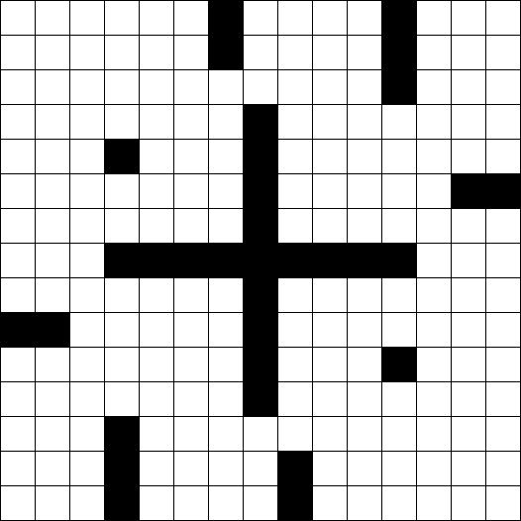
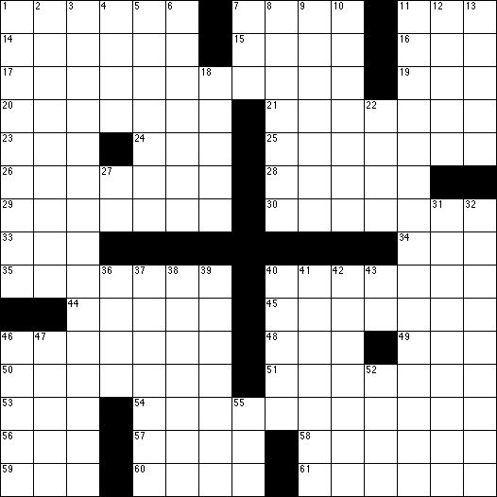
Exercise: Crossword Numbering
What structure might you use to represent the black squares on a crossword puzzle grid?

Slide 11
The End

