Slide 1
Image Manipulation
Eric Roberts
CS 106A
May 11, 2012

Slide 2
Once upon a time . . .

Slide 3
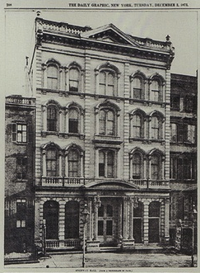
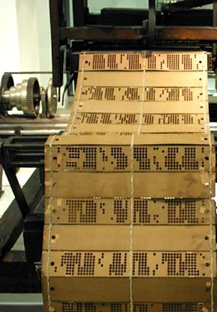
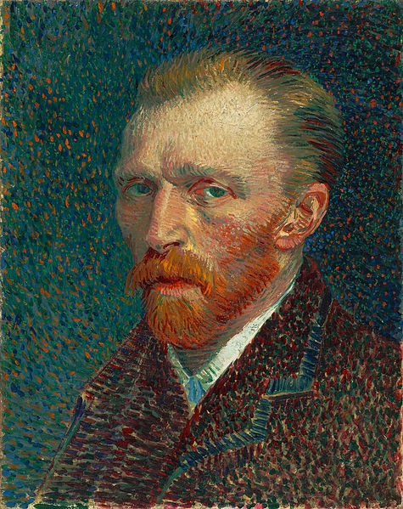
Pictures and Pixels
The focus of today’s lecture is on how to represent images using two-dimensional arrays of tiny dots called pixels.
The idea of representing an image as a two-dimensional array of dots is much older than modern computing and has several antecedents:
  Halftone pictures in newspapers
  Pointillist art
  Mechanical weaving
Of these examples, the most amazing connections to modern computing are in weaving, which contributed substantially to early computing.
Vincent Van Gogh, Self Portrait, 1887
First printed halftone picture
The Daily Graphic, December 7, 1873
Jacquard Loom, invented in 1801

Slide 4
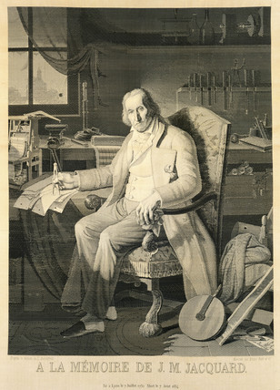
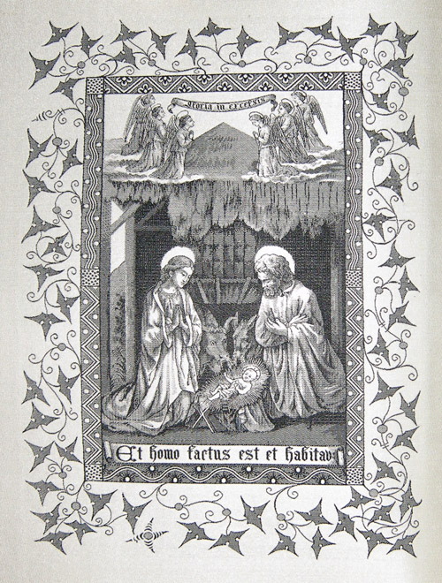
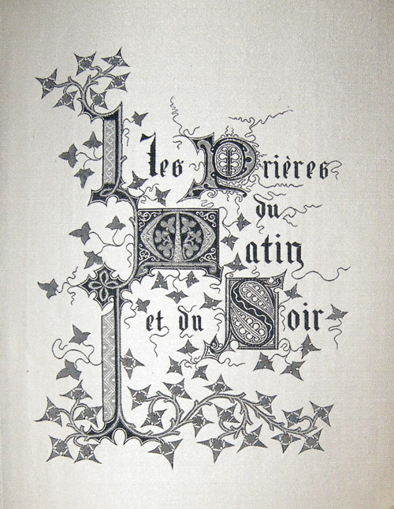
Weavings on the Jacquard Loom

Slide 5
Image Manipulation

Slide 6


Multidimensional Arrays and Images
One of the best examples of multidimensional arrays is a Java image, which is logically a two-dimensional array of pixels.
Consider, for example, the logo for the Java Task Force at the top right. That logo is actually an array of pixels as shown in the expanded diagram at the bottom.
The GImage class allows you to convert the data for the image into a two-dimensional array of pixel values. Once you have this array, you can work with the data to change the image.

Slide 7
Pixel Arrays
If you have a GImage object, you can obtain the underlying pixel array by calling the getPixelArray, which returns a two-dimensional array of type int.
For example, if you wanted to get the pixels from the image file JTFLogo.png, you could do so with the following code:
GImage logo = new GImage("JTFLogo.png");
int[][] pixels = logo.getPixelArray();
The first subscript in a pixel array selects a row in the image, beginning at the top. The height of the image is therefore given by the expression pixels.length.
The second subscript in a pixel array selects an individual pixel within a row, beginning at the left. You can use the expression pixels[0].length to determine the width of the image.

Slide 8
Pixel Values
Each individual element in a pixel array is an int in which the 32 bits are interpreted as follows:
1
1
1
1
1
1
1
1
1
0
0
1
1
0
0
1
0
1
1
0
0
1
1
0
0
0
1
1
0
0
1
1
transparency (α)
red
green
blue
The first byte of the pixel value specifies the transparency of the color, which is described in more detail on a later slide.
The next three bytes indicate the amount of red, green, and blue in the pixel, in which each value varies from 0 to 255. Together, these three bytes form the RGB value of the color, which is typically expressed using six hexadecimal digits, as in the following examples:
0xFF0000
Color.RED
0x0000FF
Color.BLUE
0xFF00FF
Color.MAGENTA
0xFFC800
Color.ORANGE
0x808080
Color.GRAY

Slide 9



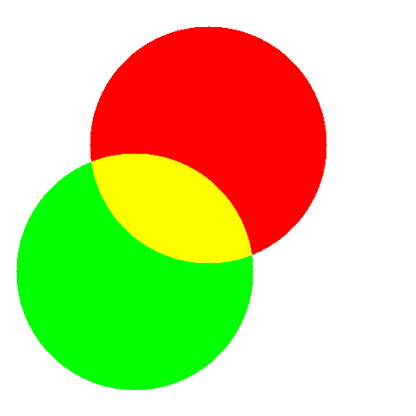
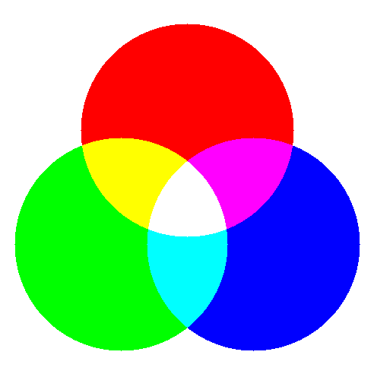
Combining Colors of Light

Slide 10

Transparency
The first byte of the pixel value specifies the transparency of the color, which indicates how much of the background shows through. This value is often denoted using the Greek letter alpha (α).
Transparency values vary from 0 to 255. The value 0 is used to indicate a completely transparent color in which only the background appears. The value 255 indicates an opaque color that completely obscures the background. The standard color constants all have alpha values of 255.
Fully transparent colors are particularly useful in images, because they make it possible to display images that do not have rectangular outlines. For example, if the gray pixels in the corners of the JTFLogo.png image have an alpha value of 0, the background will show through those parts of the logo.

Slide 11
Image Manipulation
You can use the facilities of the GImage class to manipulate images by executing the following steps:
1.
Read an existing image from a file into a GImage object.
2.
Call getPixelArray to get the pixels.
3.
Write the code to manipulate the pixel values in the array.
4.
Call the GImage constructor to create a new image.
The program on the next slide shows how you can apply this technique to flip an image vertically. The general strategy for inverting the image is simply to reverse the elements of the pixel array, using the same technique as the reverseArray method on an earlier slide.

Slide 12

The FlipVertical Program
public void run() {
GImage original = new GImage("Candle.png");
GImage flipped = flipVertical(original);
double y = (getHeight() - original.getHeight()) / 2;
double x1 = (getWidth() - IMAGE_SEP) / 2;
double x0 = x1 - original.getWidth() - IMAGE_SEP;
add(original, x0, y);
add(flipped, x1, y);
}
public void run() {
GImage original = new GImage("Candle.png");
GImage flipped = flipVertical(original);
double y = (getHeight() - original.getHeight()) / 2;
double x1 = (getWidth() - IMAGE_SEP) / 2;
double x0 = x1 - original.getWidth() - IMAGE_SEP;
add(original, x0, y);
add(flipped, x1, y);
}
private GImage flipVertical(GImage image) {
int[][] array = image.getPixelArray();
int height = array.length;
for (int p1 = 0; p1 < height / 2; p1++) {
int p2 = height - p1 - 1;
int[] temp = array[p1];
array[p1] = array[p2];
array[p2] = temp;
}
return new GImage(array);
}
private GImage flipVertical(GImage image) {
int[][] array = image.getPixelArray();
int height = array.length;
for (int p1 = 0; p1 < height / 2; p1++) {
int p2 = height - p1 - 1;
int[] temp = array[p1];
array[p1] = array[p2];
array[p2] = temp;
}
return new GImage(array);
}
flipped
original
x0
x1
y
array
array
image
image
164
305
24
height
height
100
100
FlipVertical
skip simulation

Slide 13
Selecting Color Components
If you want to work with the colors of individual pixels inside a pixel array, you can adopt either of two strategies:
  You can use the bitwise operators described in the text to select or change individual bits in the pixel value.
  You can use the static methods provided by the GImage class for that purpose.
Although it is useful to remember that all information is stored as bits, there doesn’t seem to be much point in going into all the details, at least in CS 106A. We will therefore use the second strategy and employ the static methods getRed, getGreen, getBlue, getAlpha, and createRGBPixel.
The definitions of these methods (along with the underlying implementations, which you are free to ignore) are shown on the next slide.

Slide 14
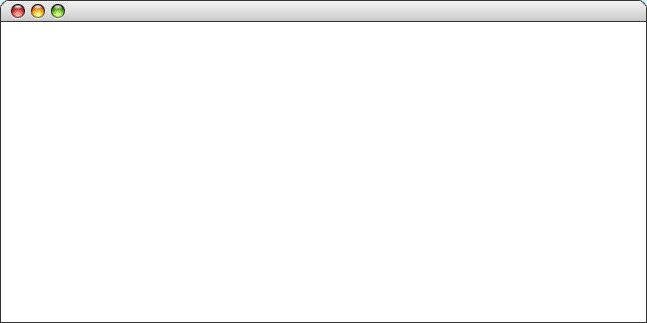
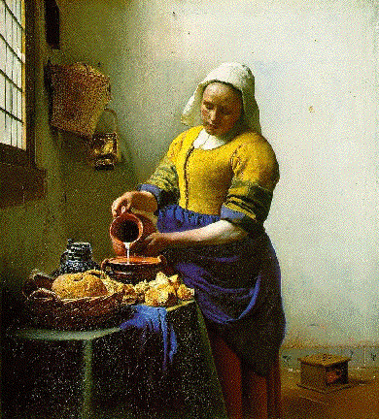
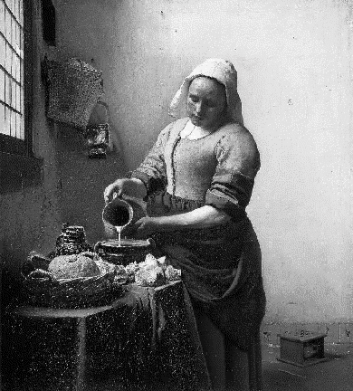
Creating a Grayscale Image
As an illustration of how to use the bitwise operators to manipulate colors in an image, the text implements a method called createGrayscaleImage that converts a color image into a black-and-white image, as shown in the sample run at the bottom of this slide.
The code to implement this method appears on the next slide.
CreateGrayscale

Slide 15
The createGrayscaleImage Method
/* Creates a grayscale version of the original image */
private GImage createGrayscaleImage(GImage image) {
int[][] array = image.getPixelArray();
int height = array.length;
int width = array[0].length;
for (int i = 0; i < height; i++) {
for (int j = 0; j < width; j++) {
int pixel = array[i][j];
int r = GImage.getRed(pixel);
int g = GImage.getGreen(pixel);
int b = GImage.getBlue(pixel);
int xx = computeLuminosity(r, g, b);
array[i][j] = GImage.createRGBPixel(xx, xx, xx);
}
}
return new GImage(array);
}
/* Calculates the luminosity of a pixel using the NTSC formula */
private int computeLuminosity(int r, int g, int b) {
return GMath.round(0.299 * r + 0.587 * g + 0.114 * b);
}

Slide 16
Exercise: Creating an Image
How might you write a program to create the image used to illustrate combining colors:

Slide 17
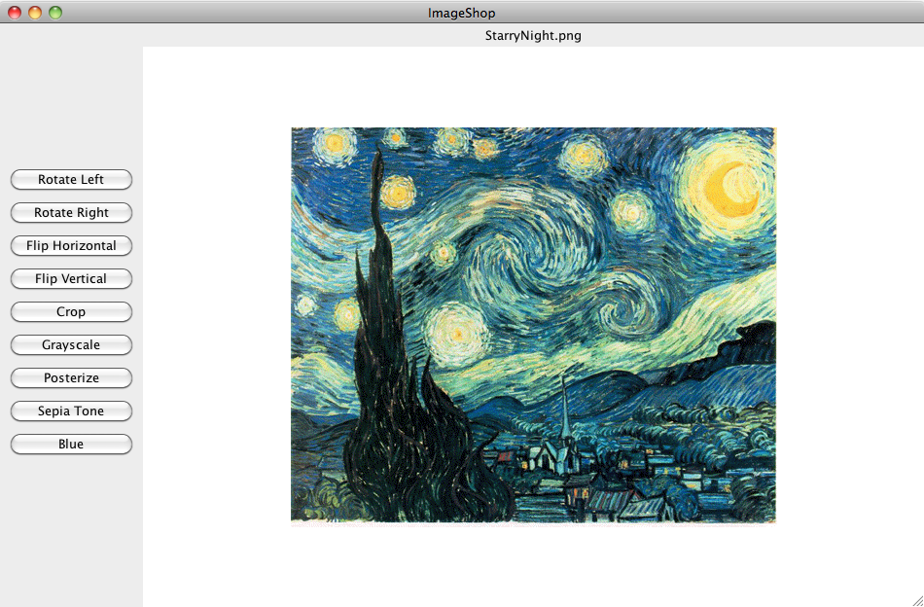
The ImageShop Application

Slide 18
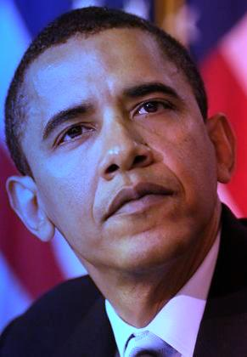
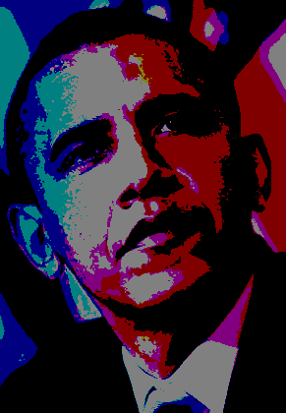
Exercise: Posterize
Write a posterize method that takes a GImage and returns a new GImage in which every red, blue, and green component is either 0 or 255, as illustrated in the following conversion:

Slide 19
The End

