Slide 1
Collections and Maps
Eric Roberts
CS 106A
May 18, 2012

Slide 2
Once upon a time . . .
Notes:
2

Slide 3

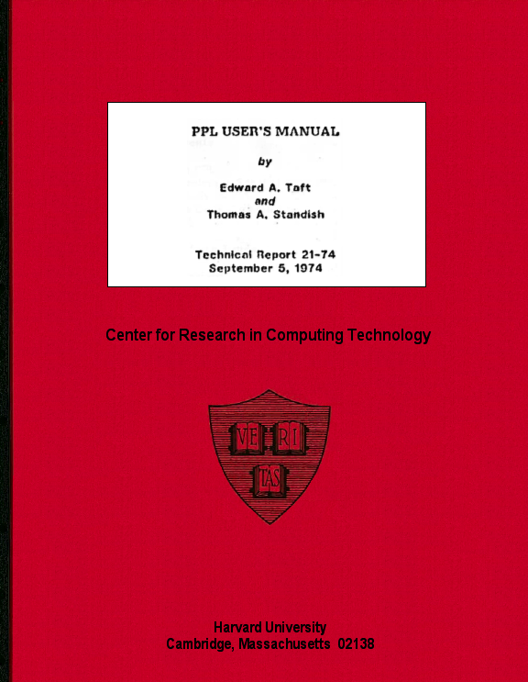
Extensible vs. Extended Languages
As an undergraduate at Harvard, I worked for several years on the PPL (Polymorphic Programming Language) project under the direction of Professor Thomas Standish.
In the early 1970s, PPL was widely used as a teaching language, including here in Stanford’s CS 106A.
Although PPL is rarely remembered today, it was one of the first languages to offer syntactic extensibility, paving the way for similar features in more modern languages like C++.
Richard Stallman
In a reflective paper entitled “PPL: The Extensible Language That Failed,” Standish concluded that programmers are less interested in languages that are extensible than they are in languages that have already been extended to offer the capabilities those programmers need. Java’s collection classes certainly fall into this category.

Slide 4
Collections and Maps
Notes:
4

Slide 5
The Java Collections Framework
The ArrayList class from Wednesday’s lecture is part of a larger set of classes called the Java Collections Framework defined as part of the java.util package.
The classes in the Java Collections Framework fall into three general categories:
1.
Lists are ordered collections of values that allow the client to add and remove elements. As you would expect, ArrayList falls into this category.
2.
Sets are unordered collections of values in which a particular object can appear at most once.
3.
Maps are structures that define an association between keys and values.

Slide 6
The Collection Hierarchy
The following diagram shows the portion of the Java Collections Framework that implements the Collection interface. The dotted lines specify that a class implements a particular interface.
«interface»
Collection
«interface»
List
AbstractCollection
«interface»
Set
AbstractList
AbstractSet
«interface»
SortedSet
ArrayList
LinkedList
HashSet
TreeSet

Slide 7
ArrayList vs. LinkedList
If you look at the left side of the collections hierarchy on the preceding slide, you will discover that there are two classes in the Java Collections Framework that implement the List interface: ArrayList and LinkedList.
Because these classes implement the same interface, it is generally possible to substitute one for the other.
The fact that these classes have the same effect, however, does not imply that they have the same performance characteristics.
  The ArrayList class is more efficient if you are selecting a particular element or searching for an element in a sorted array.
  The LinkedList class can be more efficient if you are adding or removing elements from a large list.
Choosing which list implementation to use is therefore a matter of evaluating the performance tradeoffs.

Slide 8
The Set Interface
The right side of the collections hierarchy diagram contains classes that implement the Set interface, which is used to represent an unordered collection of objects. The two concrete classes in this category are HashSet and TreeSet.
Both sets and lists allow you to add and remove elements, but sets do not support the notion of an index position. All you can know is whether an object is present or absent from a set.
The difference between the HashSet and TreeSet classes is primarily a difference in implementation. The HashSet class is built on an structure called a hash table, while the TreeSet class is based on a structure called a binary tree. In practice, the only difference arises when you iterate over the elements of a set, as described on the next slide.
You will have a chance to learn the details of these techniques if you take CS106B.

Slide 9
Iteration in Collections
One of the most useful operations for any collection is the ability to run through each of the elements in a loop. This process is called iteration.
The java.util package includes a class called Iterator that supports iteration over the elements of a collection. In older versions of Java, the programming pattern for using an iterator looks like this:
Iterator iterator = collection.elements();
while (iterator.hasNext()) {
type element = (type) iterator.next();
. . . statements that process this particular element . . .
}
Java Standard Edition 5.0 allows you to simplify this code to
for (type element : collection) {
. . . statements that process this particular element . . .
}

Slide 10
Iteration Order
For a collection that implements the List interface, the order in which iteration proceeds through the elements of the list is defined by the underlying ordering of the list. The element at index 0 comes first, followed by the other elements in order.
The ordering of iteration in a Set is more difficult to specify because a set is, by definition, an unordered collection. A set that implements only the Set interface, for example, is free to deliver up elements in any order, typically choosing an order that is convenient for the implementation.
If, however, a Set also implements the SortedSet interface (as the TreeSet class does), the iterator sorts its elements so they appear in ascending order according to the compareTo method for that class. An iterator for a TreeSet of strings therefore delivers its elements in alphabetical order.

Slide 11
Maps
A map is a data structure that implements an associative relationship between keys and values. A key is an object that never appears more than once in a map and can therefore be used to identify a value, which is the object associated with a particular key.
Maps are one of the most useful tools in the Java Collections Framework and come up in all sorts of applications, including NameSurfer.
Although maps export other methods as well, the following operations are the most useful:
map.put(key, value)
Sets the association for key in the map to value.
map.get(key)
Returns the value associated with key, or null if none.
map.containsKey(key)
Returns true if the map contains an association for key.

Slide 12
The Map Hierarchy
The following diagram shows the portion of the Java Collections Framework that implements the Map interface. The structure matches that of the Set interface in the Collection hierarchy. The distinction between HashMap and TreeMap is the same as that between HashSet and TreeSet and affects the iteration order.
«interface»
Map
AbstractMap
«interface»
SortedMap
HashMap
TreeMap

Slide 13
Constructing Maps
Even though it represents the root of the hierarchy on the previous slide, the Map type in Java is an interface rather than a class. One implication of this design decision is that you cannot use the identifier Map as a constructor. You must instead create either a HashMap or a TreeMap.
As with the ArrayList class, Java allows you to specify the types for keys and values by enclosing that information in angle brackets after the class name. For example, the type designation HashMap<String,Integer> indicates a HashMap that uses strings as keys to obtain integer values.
The textbook goes to some length to describe how to use the HashMap in older versions of Java that do not support generic types. Although this strategy was necessary when the book first came out, Java 5.0 and its successors are now so widely available that it doesn’t make sense to learn the older style.

Slide 14
A Simple HashMap Application
Suppose that you want to write a program that displays the name of a state given its two-letter postal abbreviation.
This program is an ideal application for the HashMap class because what you need is a map between two-letter codes and state names. Each two-letter code uniquely identifies a particular state and therefore serves as a key for the HashMap; the state names are the corresponding values.
To implement this program in Java, you need to perform the following steps, which are illustrated on the following slide:
1.
Create a HashMap containing all 50 key/value pairs.
2.
Read in the two-letter abbreviation to translate.
3.
Call get on the HashMap to find the state name.
4.
Print out the name of the state.

Slide 15
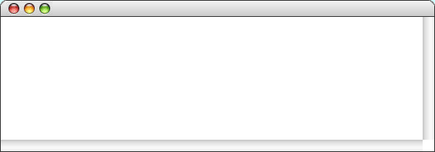
The PostalLookup Application
public void run() {
HashMap<String,String> stateMap = new HashMap<String,String>();
initStateMap(stateMap);
while (true) {
String code = readLine("Enter two-letter state abbreviation: ");
if (code.length() == 0) break;
String state = stateMap.get(code);
if (state == null) {
println(code + " is not a known state abbreviation");
} else {
println(code + " is " + state);
}
}
}
public void run() {
HashMap<String,String> stateMap = new HashMap<String,String>();
initStateMap(stateMap);
while (true) {
String code = readLine("Enter two-letter state abbreviation: ");
if (code.length() == 0) break;
String state = stateMap.get(code);
if (state == null) {
println(code + " is not a known state abbreviation");
} else {
println(code + " is " + state);
}
}
}
private void initStateMap(HashMap<String,String> map) {
map.put("AL", "Alabama");
map.put("AK", "Alaska");
map.put("AZ", "Arizona");
map.put("FL", "Florida");
map.put("GA", "Georgia");
map.put("HI", "Hawaii");
map.put("WI", "Wisconsin");
map.put("WY", "Wyoming");
}
. . .
. . .
state
code
stateMap
stateMap
null
HI
map
WI
Hawaii
VE
Wisconsin
PostalLookup
AL=Alabama
Enter two-letter state abbreviation:
AK=Alaska
HI
AZ=Arizona
HI is Hawaii
. . .
Enter two-letter state abbreviation:
WI
FL=Florida
WI is Wisconsin
GA=Georgia
Enter two-letter state abbreviation:
VE
HI=Hawaii
VE is not a known state abbreviation
. . .
Enter two-letter state abbreviation:
WI=Wisconsin
WY=Wyoming
skip simulation

Slide 16
Iteration and Maps
In Java, the classes in the Map hierarchy don’t support iteration directly. If you want to go through all the keys in a map, you have to call the keySet method, which returns a set consisting of all the keys in the map. Once you have the set of keys, you can then iterate through that.
The iteration order for a map depends on whether you have created a HashMap or a TreeMap. The keySet method for a HashMap returns a HashSet, which has an undefined iteration order. The keySet method for a TreeMap returns a TreeSet, which guarantees that the keys will be returned in increasing order.
The HashMap class is slightly more efficient than TreeMap and is much more common in practice. As a Java programmer, you do have both options.

Slide 17
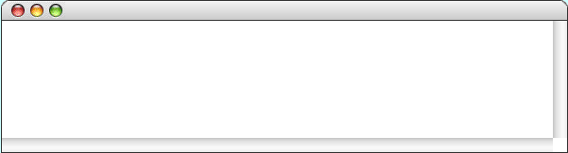
Iteration Order in a HashMap
The following method iterates through the keys in a map:
private void listKeys(Map<String,String> map) {
String className = map.getClass().getName();
int lastDot = className.lastIndexOf(".");
String shortName = className.substring(lastDot + 1);
println("Using " + shortName + ", the keys are:");
for (String key : map.keySet()) {
print(key + " ");
}
println();
}
If you call this method on a HashMap containing the two-letter state codes, you get:
MapIterator
Using HashMap, the keys are:
RI VT HI ME VA MI DE ID IA MD MA AR IL UT IN MN AZ MO MT MS NH NJ NM AK AL TX NC ND NE NY GA NV TN CA OK OH WY FL SD SC CT WV KY WI KS OR LA WA CO PA

Slide 18
Iteration Order in a TreeMap
The following method iterates through the keys in a map:
private void listKeys(Map<String,String> map) {
String className = map.getClass().getName();
int lastDot = className.lastIndexOf(".");
String shortName = className.substring(lastDot + 1);
println("Using " + shortName + ", the keys are:");
for (String key : map.keySet()) {
print(key + " ");
}
println();
}
If you call instead this method on a TreeMap containing the same values, you get:
MapIterator
Using TreeMap, the keys are:
AK AL AR AZ CA CO CT DE FL GA HI IA ID IL IN KS KY LA MA MD ME MI MN MO MS MT NC ND NE NH NJ NM NV NY OH OK OR PA RI SC SD TN TX UT VA VT WA WI WV WY

Slide 19
Exercise: Trigraph Frequency
In the lecture on arrays, one of the examples was a program to count letter frequencies in a series of lines, which was useful in solving cryptograms. As Edgar Allan Poe explained in his short story The Gold Bug, it is often equally useful to look at how often particular sequences of two or three letters appear in a given text. In cryptography, such sequences are called digraphs and trigraphs.
For the rest of today’s lecture, our job is to write a program that reads data from a text file and writes out a complete list of the trigraphs within it, along with the number of times each trigraph occurs. To be included in the list, a trigraph must consist only of letters; sequences of characters that contain spaces or punctuation should not be counted.

Slide 20
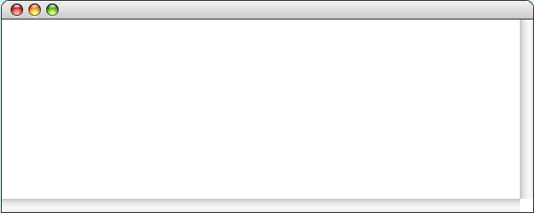
Trigraph Example
For example, if a data file contains the short excerpt
OneFish.txt
One fish, two fish, red fish, blue fish.
the trigraph program should report the following:
TrigraphFrequency
Enter name of text file: OneFish.txt
BLU = 1
FIS = 4
ISH = 4
LUE = 1
ONE = 1
RED = 1
TWO = 1

Slide 21
The End

