Slide 1
Data Structure Design
Eric Roberts
CS 106A
May 21, 2012

Slide 2
Once upon a time . . .
Notes:
2

Slide 3
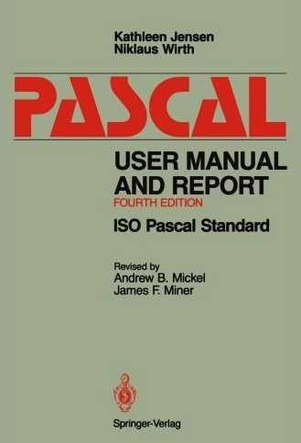
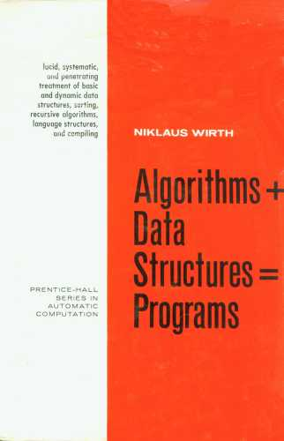
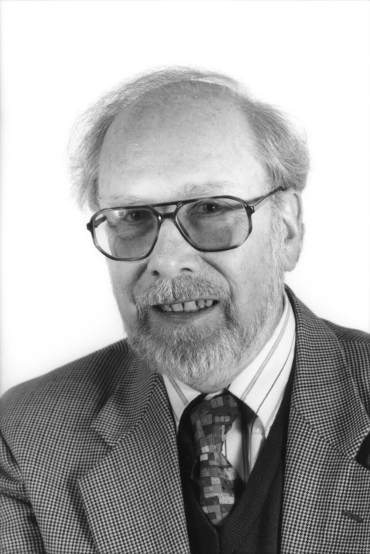
Niklaus Wirth and Programming
When Stanford launched its Computer Science Department in 1963, one of its first faculty members was the young Swiss computer scientist Niklaus Wirth. He later returned to ETH in Zurich.
Wirth is known primarily as a language designer. He is best known for inventing Pascal but is also the principal designer of Euler, Algol W, Modula, and Oberon.
In 1975, Wirth wrote a classic textbook whose title captured as an equation his view of programming:
Niklaus Wirth (1934–)
Algorithms + Data Structures = Programming
Professor Wirth won the ACM Turing Award in 1984.

Slide 4
Data Structure Design
Notes:
4

Slide 5
Modeling Data in the Real World
Particularly as the volume of available data skyrockets, one of the most important aspects of programming consists of defining data structures to represent that information.
The tools you have at your disposal to define new data structures include the following:
  Classes. Class definitions make it possible to combine related pieces of information into an integrated unit.
  Arrays. Arrays make it possible to store ordered lists of data. Although are not as flexible as the ArrayList class, they remain the best tool for many applications.
  Collections. If your data structures grow dynamically, the Java collection classes—primarily ArrayList but sometimes the Set classes as well—come in extremely handy.
  Maps. The HashMap and TreeMap classes come up in a wide variety of applications. In general, it makes sense to use the HashMap class unless the ordering of elements is important.

Slide 6
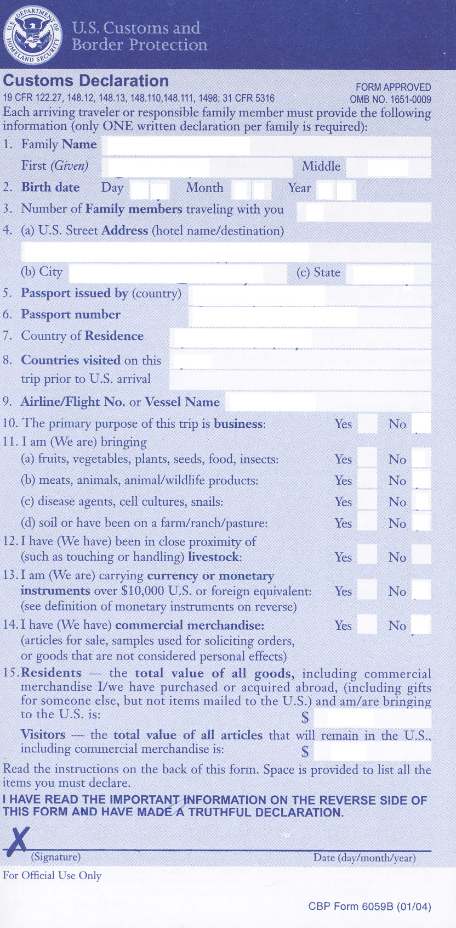
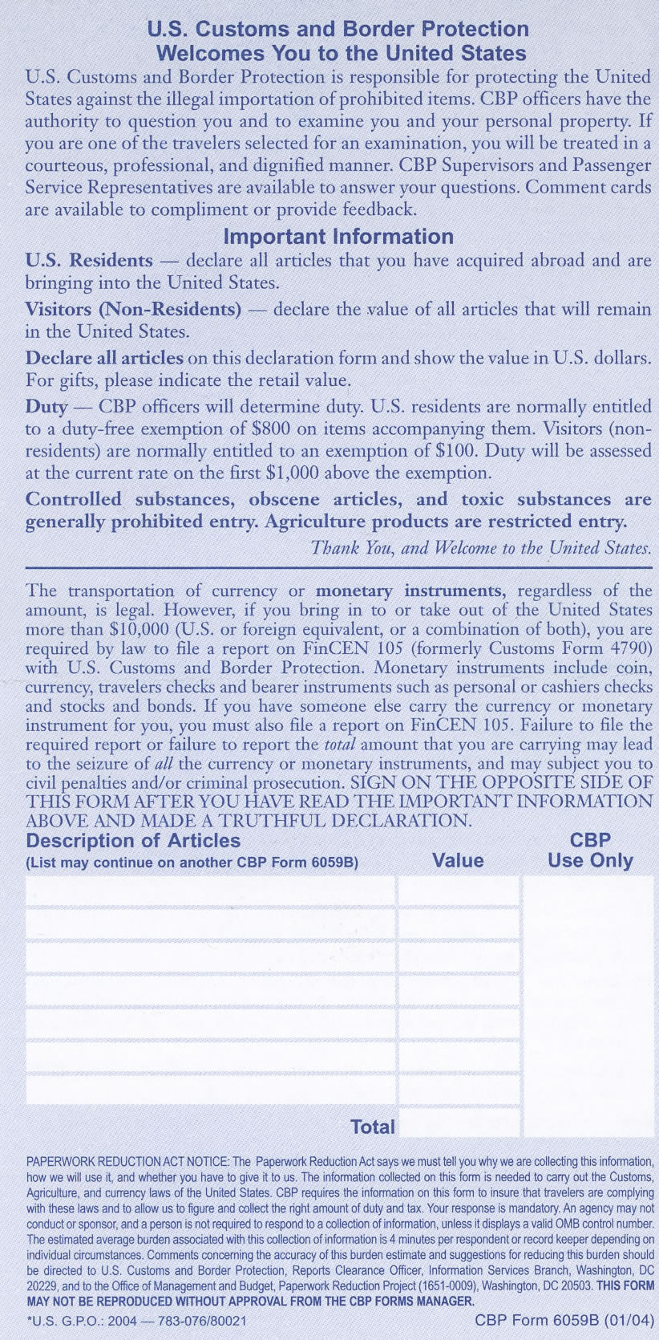
Example: The U.S. Customs Form

Slide 7
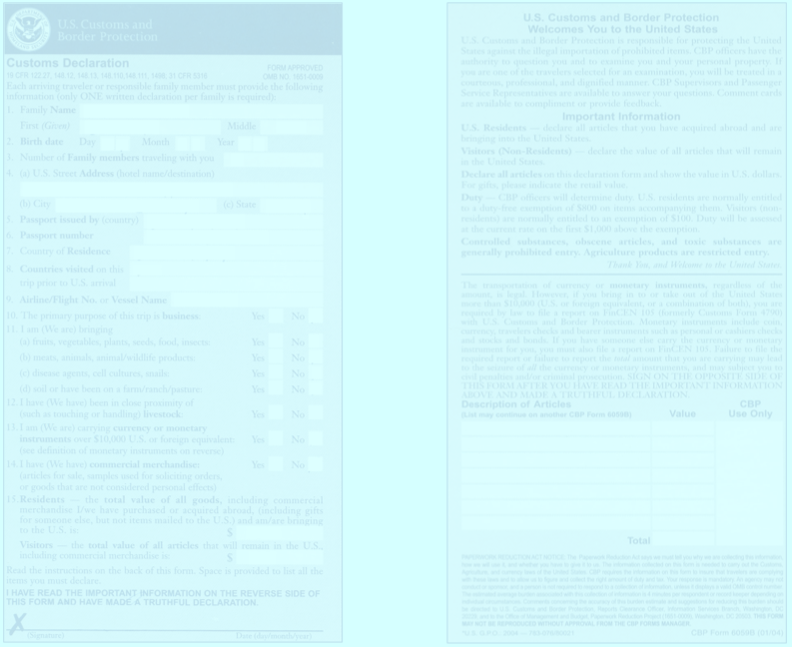
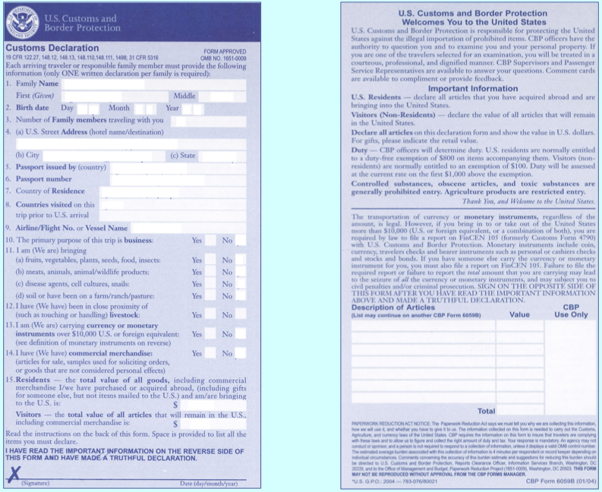
Example: The U.S. Customs Form

Slide 8


Exercise: A Currency Converter
For the rest of this class, we’re going to work together on a program that converts monetary values from one currency to another. In many ways, the program is similar to the temperature converter on the preceding slides, with the following exceptions:
1.
It uses more complex interactors (JComboBox).
2.
The exchange-rate data is read in from a file.
3.
The program uses formatting for the numeric fields.
CurrencyData.txt
CurrencyConverter
Argentine Peso=0.256213
Australian Dollar=0.8954
Botswana Pula=0.1442
Brazilian Real=0.552694
British Pound=1.49167
Euro=1.3525
US Dollar=1.00
US Dollar
Euro
100.00
73.94
.
.
.
Convert –>
<– Convert
.
.
.

Slide 9
The End

