Slide 1
Adventure!
Eric Roberts
CS 106A
May 25, 2012

Slide 2
Once upon a time . . .
Notes:
2

Slide 3
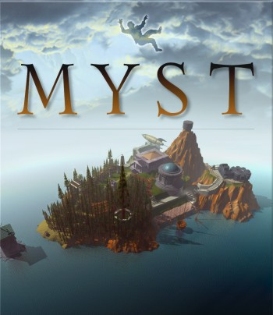
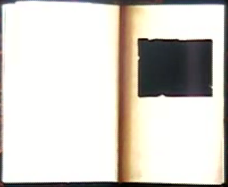
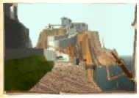

Myst
When Myst appeared in 1993 (back when computers were too slow to animate more than a small part of the screen), the most common question I got from CS 106A students was: Can I write Myst?

Slide 4
Adventure
Notes:
4

Slide 5
The Origins of the Internet
The Internet that has become so much a part of today’s world got its start as the ARPANET in the late 1960s.
The contract to build the ARPANET was awarded to Bolt Beranek and Newman Inc. (BBN), a small, Cambridge-based research and development firm founded by MIT engineers. A prototype implementation of the ARPANET connecting four nodes (one at Stanford) came on line in December 1969.
The initial design for the ARPANET allowed for a maximum of 127 connected computers. Larger networks were possible only after the TCP/IP protocols were adopted in the 1980s.

Slide 6
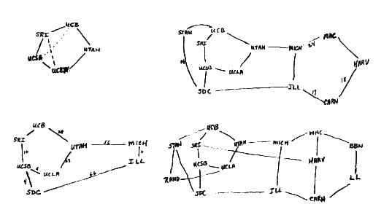
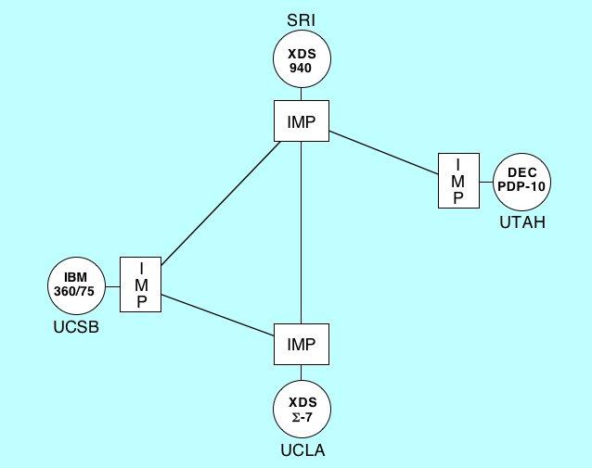
Early Designs for the ARPANET
As Larry Roberts envisioned it in his notebooks:
As deployed in 1969:

Slide 7
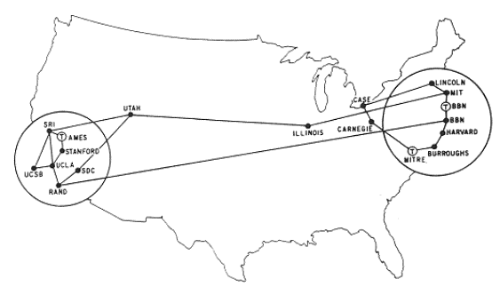
The ARPANET in 1971

Slide 8
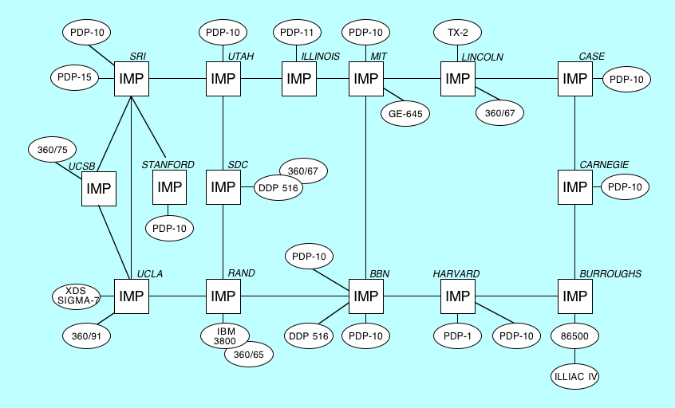
The ARPANET in 1971

Slide 9

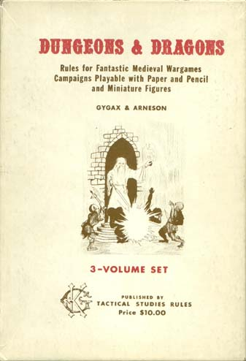

Life among the Wizards
The history of the Internet has been told in several books. One tells the following interesting story:
A small circle of friends at BBN had gotten hooked on Dungeons and Dragons, an elaborate fantasy role-playing game in which one player invents a setting and populates it with monsters and puzzles, and the other players then make their way through that setting. The game exists only in the minds of the players.
Dave Walden got his introduction to the game one night when Eric Roberts, a student from a class he was teaching at Harvard, took him to a D&D session. Walden immediately rounded up a group of friends from the ARPANET team for continued sessions. Roberts created the Mirkwood Tales. . . .
One of the regulars was Will Crowther . . .

Slide 10
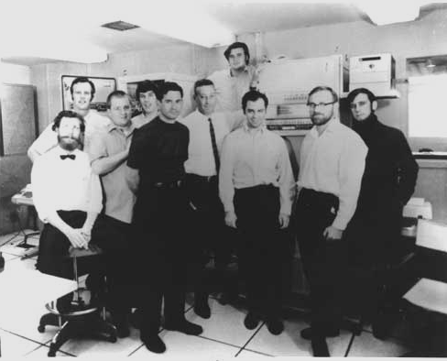
The BBN ARPANET Team
Dave
Walden
Willie
Crowther

Slide 11

Willie Crowther’s Adventure Game
Adventure
Welcome to ADVENTURE!! Would you like instructions?
YES
Somewhere nearby is Colossal Cave, where others have found fortunes in
treasure and gold, though it is rumored that some who enter are never
seen again. Magic is said to work in the cave. I will be your eyes
and hands. Direct me with natural English commands; I don't under-
stand all of the English language, but I do a pretty good job.
(Should you get stuck, type "HELP" or "?" for some general hints.)
Good Luck!
- - - -
You are standing at the end of a road before a small brick building.
Around you is a forest. A small stream flows out of the building and
down a gully to the south. The road runs up a small hill to the west.
GO INSIDE
You are inside a building, a well house for a large spring.
There are some keys on the ground here. . . .

Slide 12
Willie Crowther’s Adventure Game
Adventure
You are in the Hall of the Mountain King, with passages off in most directions, some of which appear to be newly constructed.
A huge green fierce snake bars the way!
RELEASE BIRD
The little bird attacks the green snake, and in an astounding flurry
drives the snake away.
. . . some time later . . .
You are in a secret canyon which exits to the north and east.
A huge green fierce dragon bars the way!
The dragon is sprawled out on a persian rug!!
RELEASE BIRD
The little bird attacks the green dragon, and in an astounding flurry
gets burnt to a cinder. The ashes blow away.
Welcome to ADVENTURE!! Would you like instructions?
YES
Somewhere nearby is Colossal Cave, where others have found fortunes in
treasure and gold, though it is rumored that some who enter are never
seen again. Magic is said to work in the cave. I will be your eyes
and hands. Direct me with natural English commands; I don't under-
stand all of the English language, but I do a pretty good job.
(Should you get stuck, type "HELP" or "?" for some general hints.)
Good Luck!
- - - -
You are standing at the end of a road before a small brick building.
Around you is a forest. A small stream flows out of the building and
down a gully to the south. The road runs up a small hill to the west.
GO INSIDE
You are inside a building, a well house for a large spring.
There are some keys on the ground here. . . .

Slide 13
A Brief History of Adventure
Eric Roberts begins the Mirkwood Tales in early 1975.
Will Crowther creates Adventure later that year.
Will moves to Xerox/PARC in 1976.
Stanford graduate student Don Woods releases an expanded version of Adventure in early 1977.
Dave Lebling and others from MIT release the first version of Zork in 1977. That game later becomes the foundation of the computer game company Infocom.
Adventure is ported to a wide variety of platforms by 1980.
Eric Roberts creates an expanded version in 1984 and uses it as the basis for his first Adventure Contest at Wellesley.

Slide 14
Structures in the Adventure Game
AdventureMagicSuperclass
AdvRoomMagicSuperclass
AdvObjectMagicSuperclass
Complete implementation in compiled form.
Complete implementation in compiled form.
Complete implementation in compiled form.
Adventure
AdvRoom
AdvObject
Main program call that ties the application together and implements the commands.
Maintains the data structure for each room in the cave.
Maintains the data structure for each object that can be carried by the player.
AdvMotionTableEntry
Structure for recording what passages lead from a room.

Slide 15
The SmallRooms.txt Data File
1
Outside building
You are standing at the end of a road before a small brick
building. A small stream flows out of the building and
down a gully to the south. A road runs up a small hill
to the west.
-----
WEST 2
UP 2
NORTH 3
IN 3
SOUTH 4
DOWN 4
2
End of road
You are at the end of a road at the top of a small hill.
You can see a small building in the valley to the east.
-----
EAST 1
DOWN 1
page 1 of 3

Slide 16
The SmallRooms.txt Data File
3
Inside building
You are inside a building, a well house for a large spring.
-----
SOUTH 1
OUT 1
4
Valley beside a stream
You are in a valley in the forest beside a stream tumbling
along a rocky bed. The stream is flowing to the south.
-----
NORTH 1
UP 1
SOUTH 5
DOWN 5
5
Slit in rock
At your feet all the water of the stream splashes into a
two-inch slit in the rock. To the south, the streambed is
bare rock.
-----
NORTH 4
UP 4
SOUTH 6
DOWN 6
1
Outside building
You are standing at the end of a road before a small brick
building. A small stream flows out of the building and
down a gully to the south. A road runs up a small hill
to the west.
-----
WEST 2
UP 2
NORTH 3
IN 3
SOUTH 4
DOWN 4
2
End of road
You are at the end of a road at the top of a small hill.
You can see a small building in the valley to the east.
-----
EAST 1
DOWN 1
page 2 of 3

Slide 17
The SmallRooms.txt Data File
3
Inside building
You are inside a building, a well house for a large spring.
-----
SOUTH 1
OUT 1
4
Valley beside a stream
You are in a valley in the forest beside a stream tumbling
along a rocky bed. The stream is flowing to the south.
-----
NORTH 1
UP 1
SOUTH 5
DOWN 5
5
Slit in rock
At your feet all the water of the stream splashes into a
two-inch slit in the rock. To the south, the streambed is
bare rock.
-----
NORTH 4
UP 4
SOUTH 6
DOWN 6
6
Outside grate
You are in a 25-foot depression floored with bare dirt.
Set into the dirt is a strong steel grate mounted in
concrete. A dry streambed leads into the depression from
the north.
-----
NORTH 5
UP 5
DOWN 8/KEYS
DOWN 7
7
Above locked grate
The grate is locked and you don't have any keys.
-----
FORCED 6
8
Beneath grate
You are in a small chamber beneath a 3x3 steel grate to
the surface. A low crawl over cobbles leads inward to
the west.
-----
UP 6
OUT 6
IN 9
WEST 9
page 3 of 3

Slide 18
Locked Passages and Forced Motions
The segment of the rooms data file on the previous slide illustrates two features of the Adventure game that you need to implement: locked passages and forced motions.
In room 6, you can only descend below the grate if you are holding the keys. This fact is represented by the lines
DOWN 8/KEYS
DOWN 7
in the data file. The /KEYS marker indicates that the DOWN passage to room 8 is only open if the player is carrying the keys. If not, the DOWN verb takes the player to room 7.
The motion table for room 7 is the single line
FORCED 6
which indicates that a player entering room 7 always goes directly to room 6 without reading asking for a command.

Slide 19
The SmallObjects.txt Data File
KEYS
a set of keys
3
LAMP
a brightly shining brass lamp
8
ROD
a black rod with a rusty star
12

Slide 20
The SmallSynonyms.txt Data File
Q=QUIT
L=LOOK
I=INVENTORY
N=NORTH
S=SOUTH
E=EAST
W=WEST
U=UP
D=DOWN

Slide 21
The End

