Slide 1
Searching and Sorting
Eric Roberts
CS 106A
May 30, 2012

Slide 2

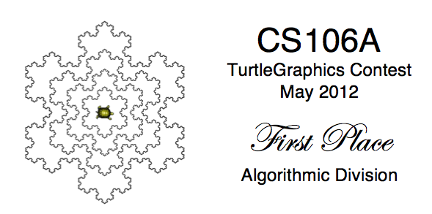
TurtleGraphics Contest Results

Slide 3
TurtleGraphics Contest Results
First place (algorithmic):
Olexandra Onosova, Futurama
Runner-up (algorithmic):
Suzanne Bertram, Hail, Stanford, Hail
Runner-up (algorithmic):
Brian Guyman, Checkers
Runner-up (algorithmic):
Dragos Bucurenci, Aromatic Nucleus
First place (aesthetic):
Marco Solis, Scene Drawing
Runner-up (aesthetic):
Suzanne Bertram, Hail, Stanford, Hail
Runner-up (aesthetic):
Brian Guyman, Checkers
Runner-up (aesthetic):
Jacob Smith, Turtle Love
First place (“cute” division):
Ellen Sebastian, Happy Mother’s Day
Honorable mention:
Luke Pappas, Letter Writing
Honorable mention:
Qi Wu, Bicycle Accident

Slide 4




Class Standings
22/48
0.46
30/53
0.57
28/48
0.58
41/100
0.41
47/100
0.47
17/53
0.32
36/87
0.41
18/87
0.21
Freshman
Sophomore
Junior
Senior+

Slide 5
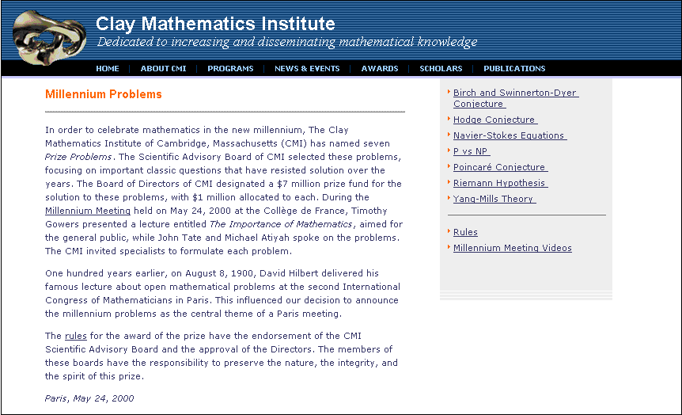
The Millennium Challenge Problems

Slide 6
Searching and Sorting
Notes:
6

Slide 7
Searching
Chapter 12 looks at two operations on arrays—searching and sorting—both of which turn out to be important in a wide range of practical applications.
The simpler of these two operations is searching, which is the process of finding a particular element in an array or some other kind of sequence. Typically, a method that implements searching will return the index at which a particular element appears, or -1 if that element does not appear at all. The element you’re searching for is called the key.
The goal of Chapter 12, however, is not simply to introduce searching and sorting but rather to use these operations to talk about algorithms and efficiency. Many different algorithms exist for both searching and sorting; choosing the right algorithm for a particular application can have a profound effect on how efficiently that application runs.

Slide 8
Linear Search
The simplest strategy for searching is to start at the beginning of the array and look at each element in turn. This algorithm is called linear search.
Linear search is straightforward to implement, as illustrated in the following method that returns the first index at which the value key appears in array, or -1 if it does not appear at all:
private int linearSearch(int key, int[] array) {
for (int i = 0; i < array.length; i++) {
if (key == array[i]) return i;
}
return -1;
}

Slide 9
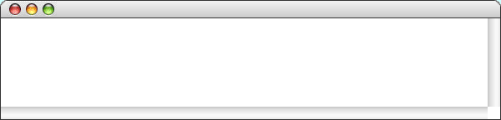
Simulating Linear Search
public void run() {
int[] primes = { 2, 3, 5, 7, 11, 13, 17, 19, 23, 29 };
println("linearSearch(17) -> " + linearSearch(17, primes));
println("linearSearch(27) -> " + linearSearch(27, primes));
}
public void run() {
int[] primes = { 2, 3, 5, 7, 11, 13, 17, 19, 23, 29 };
println("linearSearch(17) -> " + linearSearch(17, primes));
println("linearSearch(27) -> " + linearSearch(27, primes));
}
private int linearSearch(int key, int[] array) {
for ( int i = 0 ; i < array.length ; i++ ) {
if (key == array[i]) return i;
}
return -1;
}
private int linearSearch(int key, int[] array) {
for ( int i = 0 ; i < array.length ; i++ ) {
if (key == array[i]) return i;
}
return -1;
}
private int linearSearch(int key, int[] array) {
for ( int i = 0 ; i < array.length ; i++ ) {
if (key == array[i]) return i;
}
return -1;
}
primes
i
i
i
key
key
key
array
array
array
0
1
2
3
4
5
6
0
1
2
3
4
5
6
7
8
9
10
10
17
27
27
2
3
5
7
11
13
17
19
23
29
2
3
5
7
11
13
17
19
23
29
0
1
2
3
4
5
6
7
8
9
0
1
2
3
4
5
6
7
8
9
LinearSearch
linearSearch(17) -> 6
linearSearch(27) -> -1
skip simulation

Slide 10
Searching for Area Codes
To illustrate the efficiency of linear search, it is useful to work with a somewhat larger example.
The example on the next slide works with an array containing many of the area codes assigned to the United States.
The specific task in this example is to search this list to find the area code for the Silicon Valley area, which is 650.
The linear search algorithm needs to examine each element in the array to find the matching value. As the array gets larger, the number of steps required for linear search grows in the same proportion.
As you watch the slow process of searching for 650 on the next slide, try to think of a more efficient way in which you might search this particular array for a given area code.

Slide 11
Linear Search (Area Code Example)
201
202
203
205
206
207
208
209
210
212
213
214
215
216
217
218
219
224
225
228
229
231
0
1
2
3
4
5
6
7
8
9
10
11
12
13
14
15
16
17
18
19
20
21
234
239
240
248
251
252
253
254
256
260
262
267
269
270
276
281
283
301
302
303
304
305
22
23
24
25
26
27
28
29
30
31
32
33
34
35
36
37
38
39
40
41
42
43
307
308
309
310
312
313
314
315
316
317
318
319
320
321
323
325
330
331
334
336
337
339
44
45
46
47
48
49
50
51
52
53
54
55
56
57
58
59
60
61
62
63
64
65
347
351
352
360
361
364
385
386
401
402
404
405
406
407
408
409
410
412
413
414
415
416
66
67
68
69
70
71
72
73
74
75
76
77
78
79
80
81
82
83
84
85
86
87
417
419
423
424
425
430
432
434
435
440
443
445
469
470
475
478
479
480
484
501
502
503
88
89
90
91
92
93
94
95
96
97
98
99
100
101
102
103
104
105
106
107
108
109
504
505
507
508
509
510
512
513
515
516
517
518
520
530
540
541
551
559
561
562
563
564
110
111
112
113
114
115
116
117
118
119
120
121
122
123
124
125
126
127
128
129
130
131
567
570
571
573
574
575
580
585
586
601
602
603
605
606
607
608
609
610
612
614
615
616
132
133
134
135
136
137
138
139
140
141
142
143
144
145
146
147
148
149
150
151
152
153
617
618
619
620
623
626
630
631
636
641
646
650
651
660
661
662
678
682
701
702
703
704
154
155
156
157
158
159
160
161
162
163
164
165
166
167
168
169
170
171
172
173
174
175
706
707
708
712
713
714
715
716
717
718
719
720
724
727
731
732
734
740
754
757
760
762
176
177
178
179
180
181
182
183
184
185
186
187
188
189
190
191
192
193
194
195
196
197
763
765
769
770
772
773
774
775
779
781
785
786
801
802
803
804
805
806
808
810
812
813
198
199
200
201
202
203
204
205
206
207
208
209
210
211
212
213
214
215
216
217
218
219
814
815
816
817
818
828
830
831
832
835
843
845
847
848
850
856
857
858
859
860
862
863
220
221
222
223
224
225
226
227
228
229
230
231
232
233
234
235
236
237
238
239
240
241
864
865
870
878
901
903
904
906
907
908
909
910
912
913
914
915
916
917
918
919
920
925
242
243
244
245
246
247
248
249
250
251
252
253
254
255
256
257
258
259
260
261
262
263
928
931
936
937
940
941
947
949
951
952
954
956
959
970
971
972
973
978
979
980
985
989
264
265
266
267
268
269
270
271
272
273
274
275
276
277
278
279
280
281
282
283
284
285

Slide 12
The Idea of Binary Search
The fact that the area code array is in ascending order makes it possible to find a particular value much more efficiently.
The key insight is that you get more information by starting at the middle element than you do by starting at the beginning.
When you look at the middle element in relation to the value you’re searching for, there are three possibilities:
  If the value you are searching for is greater than the middle element, you can discount every element in the first half of the array.
  If the value you are searching for is less than the middle element, you can discount every element in the second half of the array.
  If the value you are searching for is equal to the middle element, you can stop because you’ve found the value you’re looking for.
You can repeat this process on the elements that remain after each cycle. Because this algorithm proceeds by dividing the list in half each time, it is called binary search.

Slide 13
Binary Search (Area Code Example)
143 + 177
143 + 213
143 + 285
161 + 177
161 + 168
165 + 165
0 + 285
165 + 168
, which is the 650 at index 165:
Continue with element
, which is the 630 at index 160:
Continue with element
, which is the 708 at index 178:
Binary search needs to look at only eight elements to find 650.
The key 650 is greater than 602, so discard the first half.
Continue with element
The key 650 is less than 805, so discard the second half.
The key 650 is less than 708, so discard the second half.
The key 650 is greater than 630, so discard the first half.
Continue with element
The key 650 is less than 662, so discard the second half.
Continue with element
The key 650 is greater than 646, so discard the first half.
The key 650 is less than 651, so discard the second half.
The key 650 is equal to 650, so the process is finished.
, which is the 805 at index 214:
, which is the 662 at index 169:
, which is the 646 at index 164:
Start with the element at index
Continue with element
, which is the 602 at index 142:
Continue with element
, which is the 651 at index 166:
2
2
2
2
2
2
2
2
201
202
203
205
206
207
208
209
210
212
213
214
215
216
217
218
219
224
225
228
229
231
0
1
2
3
4
5
6
7
8
9
10
11
12
13
14
15
16
17
18
19
20
21
234
239
240
248
251
252
253
254
256
260
262
267
269
270
276
281
283
301
302
303
304
305
22
23
24
25
26
27
28
29
30
31
32
33
34
35
36
37
38
39
40
41
42
43
307
308
309
310
312
313
314
315
316
317
318
319
320
321
323
325
330
331
334
336
337
339
44
45
46
47
48
49
50
51
52
53
54
55
56
57
58
59
60
61
62
63
64
65
347
351
352
360
361
364
385
386
401
402
404
405
406
407
408
409
410
412
413
414
415
416
66
67
68
69
70
71
72
73
74
75
76
77
78
79
80
81
82
83
84
85
86
87
417
419
423
424
425
430
432
434
435
440
443
445
469
470
475
478
479
480
484
501
502
503
88
89
90
91
92
93
94
95
96
97
98
99
100
101
102
103
104
105
106
107
108
109
504
505
507
508
509
510
512
513
515
516
517
518
520
530
540
541
551
559
561
562
563
564
110
111
112
113
114
115
116
117
118
119
120
121
122
123
124
125
126
127
128
129
130
131
567
570
571
573
574
575
580
585
586
601
602
603
605
606
607
608
609
610
612
614
615
616
132
133
134
135
136
137
138
139
140
141
142
143
144
145
146
147
148
149
150
151
152
153
617
618
619
620
623
626
630
631
636
641
646
650
651
660
661
662
678
682
701
702
703
704
154
155
156
157
158
159
160
161
162
163
164
165
166
167
168
169
170
171
172
173
174
175
706
707
708
712
713
714
715
716
717
718
719
720
724
727
731
732
734
740
754
757
760
762
176
177
178
179
180
181
182
183
184
185
186
187
188
189
190
191
192
193
194
195
196
197
763
765
769
770
772
773
774
775
779
781
785
786
801
802
803
804
805
806
808
810
812
813
198
199
200
201
202
203
204
205
206
207
208
209
210
211
212
213
214
215
216
217
218
219
814
815
816
817
818
828
830
831
832
835
843
845
847
848
850
856
857
858
859
860
862
863
220
221
222
223
224
225
226
227
228
229
230
231
232
233
234
235
236
237
238
239
240
241
864
865
870
878
901
903
904
906
907
908
909
910
912
913
914
915
916
917
918
919
920
925
242
243
244
245
246
247
248
249
250
251
252
253
254
255
256
257
258
259
260
261
262
263
928
931
936
937
940
941
947
949
951
952
954
956
959
970
971
972
973
978
979
980
985
989
264
265
266
267
268
269
270
271
272
273
274
275
276
277
278
279
280
281
282
283
284
285

Slide 14
Implementing Binary Search
The following method implements the binary search algorithm for an integer array.
private int binarySearch(int key, int[] array) {
int lh = 0;
int rh = array.length - 1;
while (lh <= rh) {
int mid = (lh + rh) / 2;
if (key == array[mid]) return mid;
if (key < array[mid]) {
rh = mid - 1;
} else {
lh = mid + 1;
}
}
return -1;
}
The text contains a similar implementation of binarySearch that operates on strings. The algorithm is the same.

Slide 15
Efficiency of Linear Search
As the area code example makes clear, the running time of the linear search algorithm depends on the size of the array.
The idea that the time required to search a list of values depends on how many values there are is not at all surprising. The running time of most algorithms depends on the size of the problem to which that algorithm is applied.
In many applications, it is easy to come up with a numeric value that specifies the problem size, which is generally denoted by the letter N. For most array applications, the problem size is simply the size of the array.
In the worst case—which occurs when the value you’re searching for comes at the end of the array or does not appear at all—linear search requires N steps. On average, it takes approximately half that time.

Slide 16
Efficiency of Binary Search
The running time of binary search also depends on the number of elements, but in a profoundly different way.
On each step in the process, the binary search algorithm rules out half of the remaining possibilities. In the worst case, the number of steps required is equal to the number of times you can divide the original size of the array in half until there is only one element remaining. In other words, what you need to find is the value of k that satisfies the following equation:
1 = N / 2 / 2 / 2 / 2 . . . / 2
k times
You can simplify this formula using basic mathematics:
1 = N / 2^{k}
2^{k} = N
k = log₂ N

Slide 17
Comparing Search Efficiencies
The difference in the number of steps required for the two search algorithms is illustrated by the following table, which compares the values of N and the closest integer to log₂ N:
N
log₂ N
10
3
100
7
1000
10
1,000,000
20
1,000,000,000
30
For large values of N, the difference in the number of steps required is enormous. If you had to search through a list of a million elements, binary search would run 50,000 times faster than linear search. If there were a billion elements, that factor would grow to 33,000,000.

Slide 18
Sorting
Binary search works only on arrays in which the elements are arranged in order. The process of putting the elements of an array in order is called sorting.
There are many algorithms that one can use to sort an array. As with searching, these algorithms can vary substantially in their efficiency, particularly as the arrays become large.
Of all the algorithms presented in this text, sorting is by far the most important in terms of its practical applications. Alphabetizing a telephone directory, arranging library records by catalogue number, and organizing a bulk mailing by ZIP code are all examples of sorting that involve reasonably large collections of data.

Slide 19
The Selection Sort Algorithm
Of the many sorting algorithms, the easiest one to describe is selection sort, which is implemented by the following code:
private void sort(int[] array) {
for (int lh = 0; lh < array.length; lh++) {
int rh = findSmallest(array, lh, array.length);
swapElements(array, lh, rh);
}
}
The variables lh and rh indicate the positions of the left and right hands if you were to carry out this process manually. The left hand points to each position in turn; the right hand points to the smallest value in the rest of the array.
The method findSmallest(array, p₁, p₂) returns the index of the smallest value in the array from position p₁ up to but not including p₂. The method swapElements(array, p₁, p₂) exchanges the elements at the specified positions.

Slide 20



Simulating Selection Sort
public void run() {
int[] test = { 809, 503, 946, 367, 987, 838, 259, 236, 659, 361 };
sort(test);
}
public void run() {
int[] test = { 809, 503, 946, 367, 987, 838, 259, 236, 659, 361 };
sort(test);
}
private void sort(int[] array) {
for ( int lh = 0 ; lh < array.length ; lh++ ) {
int rh = findSmallest(array, lh, array.length);
swapElements(array, lh, rh);
}
}
private void sort(int[] array) {
for ( int lh = 0 ; lh < array.length ; lh++ ) {
int rh = findSmallest(array, lh, array.length);
swapElements(array, lh, rh);
}
}
private int findSmallest(int[] array, int p1, int p2) {
int smallestIndex = p1;
for ( int i = p1 + 1 ; i < p2 ; i++ ) {
if (array[i] < array[smallestIndex]) smallestIndex = i;
}
return smallestIndex;
}
test
lh
rh
array
lh
rh
array
3
6
7
8
0
9
1
2
3
4
5
6
7
8
9
10
smallestIndex
i
p1
p2
array
1
0
10
2
3
4
5
6
7
8
9
0
10
1
3
6
7
809
503
946
367
987
838
259
236
659
361
809
503
946
367
987
838
259
236
659
361
0
1
2
3
4
5
6
7
8
9
0
1
2
3
4
5
6
7
8
9
skip simulation

Slide 21
The Efficiency of Selection Sort
Chapter 12 includes a table of actual running times for the selection algorithm for arrays of varying sizes.
Another way to estimate efficiency is to count how many time the most frequent operation is executed. In selection sort, this operation is the body of loop in findSmallest. The number of cycles in this loop changes as the algorithm proceeds:
N values are considered on the first call to findSmallest.
N - 1 values are considered on the second call.
N - 2 values are considered on the third call, and so on.
In mathematical notation, the number of values considered in findSmallest can be expressed as a summation, which can then be transformed into a simple formula:
N
N ^{x} (N + 1)
∑
1 + 2 + 3 + . . . + (N - 1) + N =
i
=
i = 1
2

Slide 22
Quadratic Growth
N ^{x} (N + 1)
The following table shows the value of for various values of N: xxx
2
N ^{x} (N + 1)
N
2
10
55
100
5050
1000
500,500
10000
50,005,000
The growth pattern in the right column is similar to that of the measured running time of the selection sort algorithm. As the x
value of N increases by a factor of 10, the value of xx
N ^{x} (N + 1)
2
increases by a factor of around 100, which is 10². Algorithms whose running times increase in proportion to the square of the problem size are said to be quadratic.

Slide 23
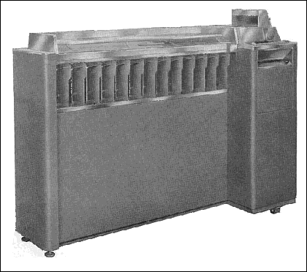
Sorting Punched Cards
From the 1880 census onward, information was often stored on punched cards like the one shown at the right, in which the number 236 has been punched in the first three columns.
1
. . .
2
3
4
5
6
7
8
9
10
11
12
13
14
15
16
17
18
19
20
21
22
23
24
25
78
79
0
1
2
3
4
5
6
7
8
9
80
0
1
2
3
4
5
6
7
8
9
0
1
2
3
4
5
6
7
8
9
0
1
2
3
4
5
6
7
8
9
0
1
2
3
4
5
6
7
8
9
0
1
2
3
4
5
6
7
8
9
0
1
2
3
4
5
6
7
8
9
0
1
2
3
4
5
6
7
8
9
0
1
2
3
4
5
6
7
8
9
0
1
2
3
4
5
6
7
8
9
0
1
2
3
4
5
6
7
8
9
0
1
2
3
4
5
6
7
8
9
0
1
2
3
4
5
6
7
8
9
0
1
2
3
4
5
6
7
8
9
0
1
2
3
4
5
6
7
8
9
0
1
2
3
4
5
6
7
8
9
0
1
2
3
4
5
6
7
8
9
0
1
2
3
4
5
6
7
8
9
0
1
2
3
4
5
6
7
8
9
0
1
2
3
4
5
6
7
8
9
0
1
2
3
4
5
6
7
8
9
0
1
2
3
4
5
6
7
8
9
0
1
2
3
4
5
6
7
8
9
0
1
2
3
4
5
6
7
8
9
0
1
2
3
4
5
6
7
8
9
0
1
2
3
4
5
6
7
8
9
0
1
2
3
4
5
6
7
8
9
0
1
2
3
4
5
6
7
8
9
Computer companies built machines to sort stacks of punched cards, such as the IBM 083 sorter on the left. The stack of cards was loaded in a large hopper at the right end of the machine, and the cards would then be distributed into the various bins on the front of the sorter according to what value was punched in a particular column.
The IBM 083 Sorter

Slide 24
The Radix Sort Algorithm
Although you will learn more efficient sorting algorithms if you go on to CS106B, the IBM 083 sorter does a much better job by using an algorithm called radix sort and consists of the following steps:
1.
Set the machine so that it sorts on the last digit of the number.
2.
Put the entire stack of cards in the hopper.
3.
Run the machine so that the cards are distributed into the bins.
4.
Put the cards from the bins back in the hopper, making sure that the cards from the 0 bin are on the bottom, the cards from the 1 bin come on top of those, and so on.
5.
Reset the machine so that it sorts on the preceding digit.
6.
Repeat steps 3 through 5 until all the digits are processed.
The next slide illustrates this process for a set of three-digit numbers.

Slide 25
Simulating Radix Sort
809
259
659
838
367
987
946
236
503
361
809
259
659
838
367
987
946
236
503
809
259
659
838
367
987
946
236
809
259
659
838
367
987
946
809
259
659
838
367
987
809
259
659
838
367
809
259
659
838
809
259
659
809
259
809
987
367
361
259
659
946
838
236
809
503
367
361
259
659
946
838
236
809
503
259
659
946
838
236
809
503
946
838
236
809
503
838
236
809
503
809
503
987
367
361
259
659
946
838
236
809
503
987
367
361
259
659
946
838
236
809
987
367
361
259
659
946
838
236
987
367
361
259
659
946
838
987
367
361
259
659
946
987
367
361
259
659
987
367
361
259
987
367
361
987
367
987
259
236
367
361
259
236
503
367
361
259
236
659
503
367
361
259
236
838
809
659
503
367
361
259
236
987
946
838
809
659
503
367
361
259
236
987
946
838
809
659
503
367
361
259
236
809
503
946
367
987
838
259
236
659
361
809
503
946
367
987
838
259
236
659
809
503
946
367
987
838
259
236
809
503
946
367
987
838
259
809
503
946
367
987
838
809
503
946
367
987
809
503
946
367
809
503
946
809
503
809
361
503
361
946
236
503
361
367
987
946
236
503
361
838
367
987
946
236
503
361
809
259
659
838
367
987
946
236
503
361
Step 1a.
Sort the cards using the last digit.
Step 1b.
Refill the hopper by emptying the bins in order.
Note that the list is now sorted by the last digit.
Step 2a.
Sort the cards using the middle digit.
Step 2b.
Again refill the hopper by emptying the bins.
The list is now sorted by the last two digits.
Step 3a.
Sort the cards using the first digit.
Step 3b.
Refill the hopper one last time.
The list is now completely sorted.
361
659
236
259
838
987
367
946
503
809
361
503
236
946
987
367
838
659
259
809
503
809
236
838
946
659
259
361
367
503
987
809
236
259
236
838
361
367
946
659
259
503
361
367
659
809
838
987
946
361
503
236
987
946
987
367
838
659
259
809
0
0
1
1
2
2
3
3
4
4
5
5
6
6
7
7
8
8
9
9
skip simulation

Slide 26
Comparing N ² and N log N
Like most of the algorithms you will encounter in CS106B, radix sort runs in time proportional to N times the log of N.
The difference between N ² and N log N can be enormous for large values of N, as shown in this table:
N
N ²
N log N
10
100
33
100
10,000
664
1,000
1,000,000
9,966
10,000
100,000,000
132,877
100,000
10,000,000,000
1,660,964
1,000,000
1,000,000,000,000
19,931,569

Slide 27
The End

