Slide 1
CS 106A, Lecture 20
HashMaps
suggested reading:
Java Ch. 13.2

Slide 2
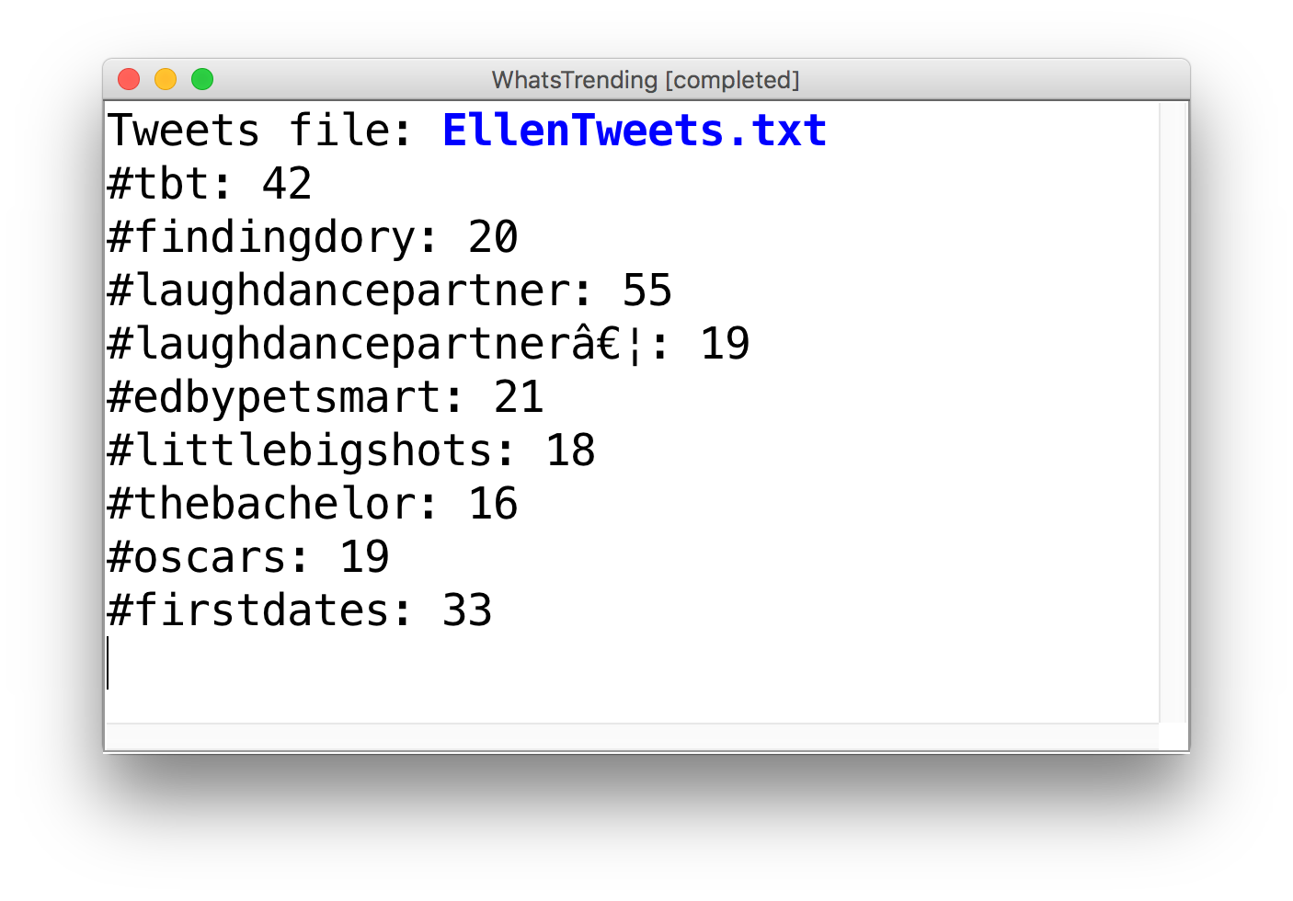
Learning Goals
Know how to store data in and retrieve data from a HashMap.

Slide 3
Plan for today
Recap: ArrayLists
HashMaps
Practice: Dictionary
HashMaps as Counters
Practice: What’s Trending
Recap

Slide 4
Plan for today
Recap: ArrayLists
HashMaps
Practice: Dictionary
HashMaps as Counters
Practice: What’s Trending
Recap

Slide 5
Our First ArrayList
// Create an (initially empty) list
ArrayList<String> list = new ArrayList<>();
// Add an element to the back
list.add("Hello"); // now size 1
list.add("there!"); // now size 2
“Hello”
“Hello” | “there!”

Slide 6
ArrayList Methods
list.add(value); | appends value at end of list
list.add(index, value); | inserts given value just before the given index, shifting subsequent values to the right
list.clear(); | removes all elements of the list
list.get(index) | returns the value at given index
list.indexOf(value) | returns first index where given value is found in list (-1 if not found)
list.isEmpty() | returns true if the list contains no elements
list.remove(index); | removes/returns value at given index, shifting subsequent values to the left
list.remove(value); | removes the first occurrence of the value, if any
list.set(index, value); | replaces value at given index with given value
list.size() | returns the number of elements in the list
list.toString() | returns a string representation of the list such as "[3, 42, -7, 15]"
Notes:
Shifts elements if you add or remove!

Slide 7
Insert/remove
If you insert/remove in the front or middle of a list, elements shift to fit.
  list.add(2, 42);
    shift elements right to make room for the new element
  list.remove(1);
    shift elements left to cover the space left by the removed element
index | 0 | 1 | 2 | 3 | 4
value | 3 | 8 | 9 | 7 | 5
index | 0 | 1 | 2 | 3 | 4 | 5
value | 3 | 8 | 42 | 9 | 7 | 5
index | 0 | 1 | 2 | 3 | 4 | 5
value | 3 | 8 | 42 | 9 | 7 | 5
index | 0 | 1 | 2 | 3 | 4
value | 3 | 42 | 9 | 7 | 5
Notes:
9 7 5 are different indexes now!

Slide 8
ArrayLists + Primitives = 💔
Primitive | “Wrapper” Class
int | Integer
double | Double
boolean | Boolean
char | Character

Slide 9
ArrayLists + Wrappers = ❤️️
// Use wrapper classes when making an ArrayList
ArrayList<Integer> list = new ArrayList<>();
// Java converts Integer <-> int automatically!
int num = 123;
list.add(num);
int first = list.get(0); // 123
Conversion happens automatically!

Slide 10
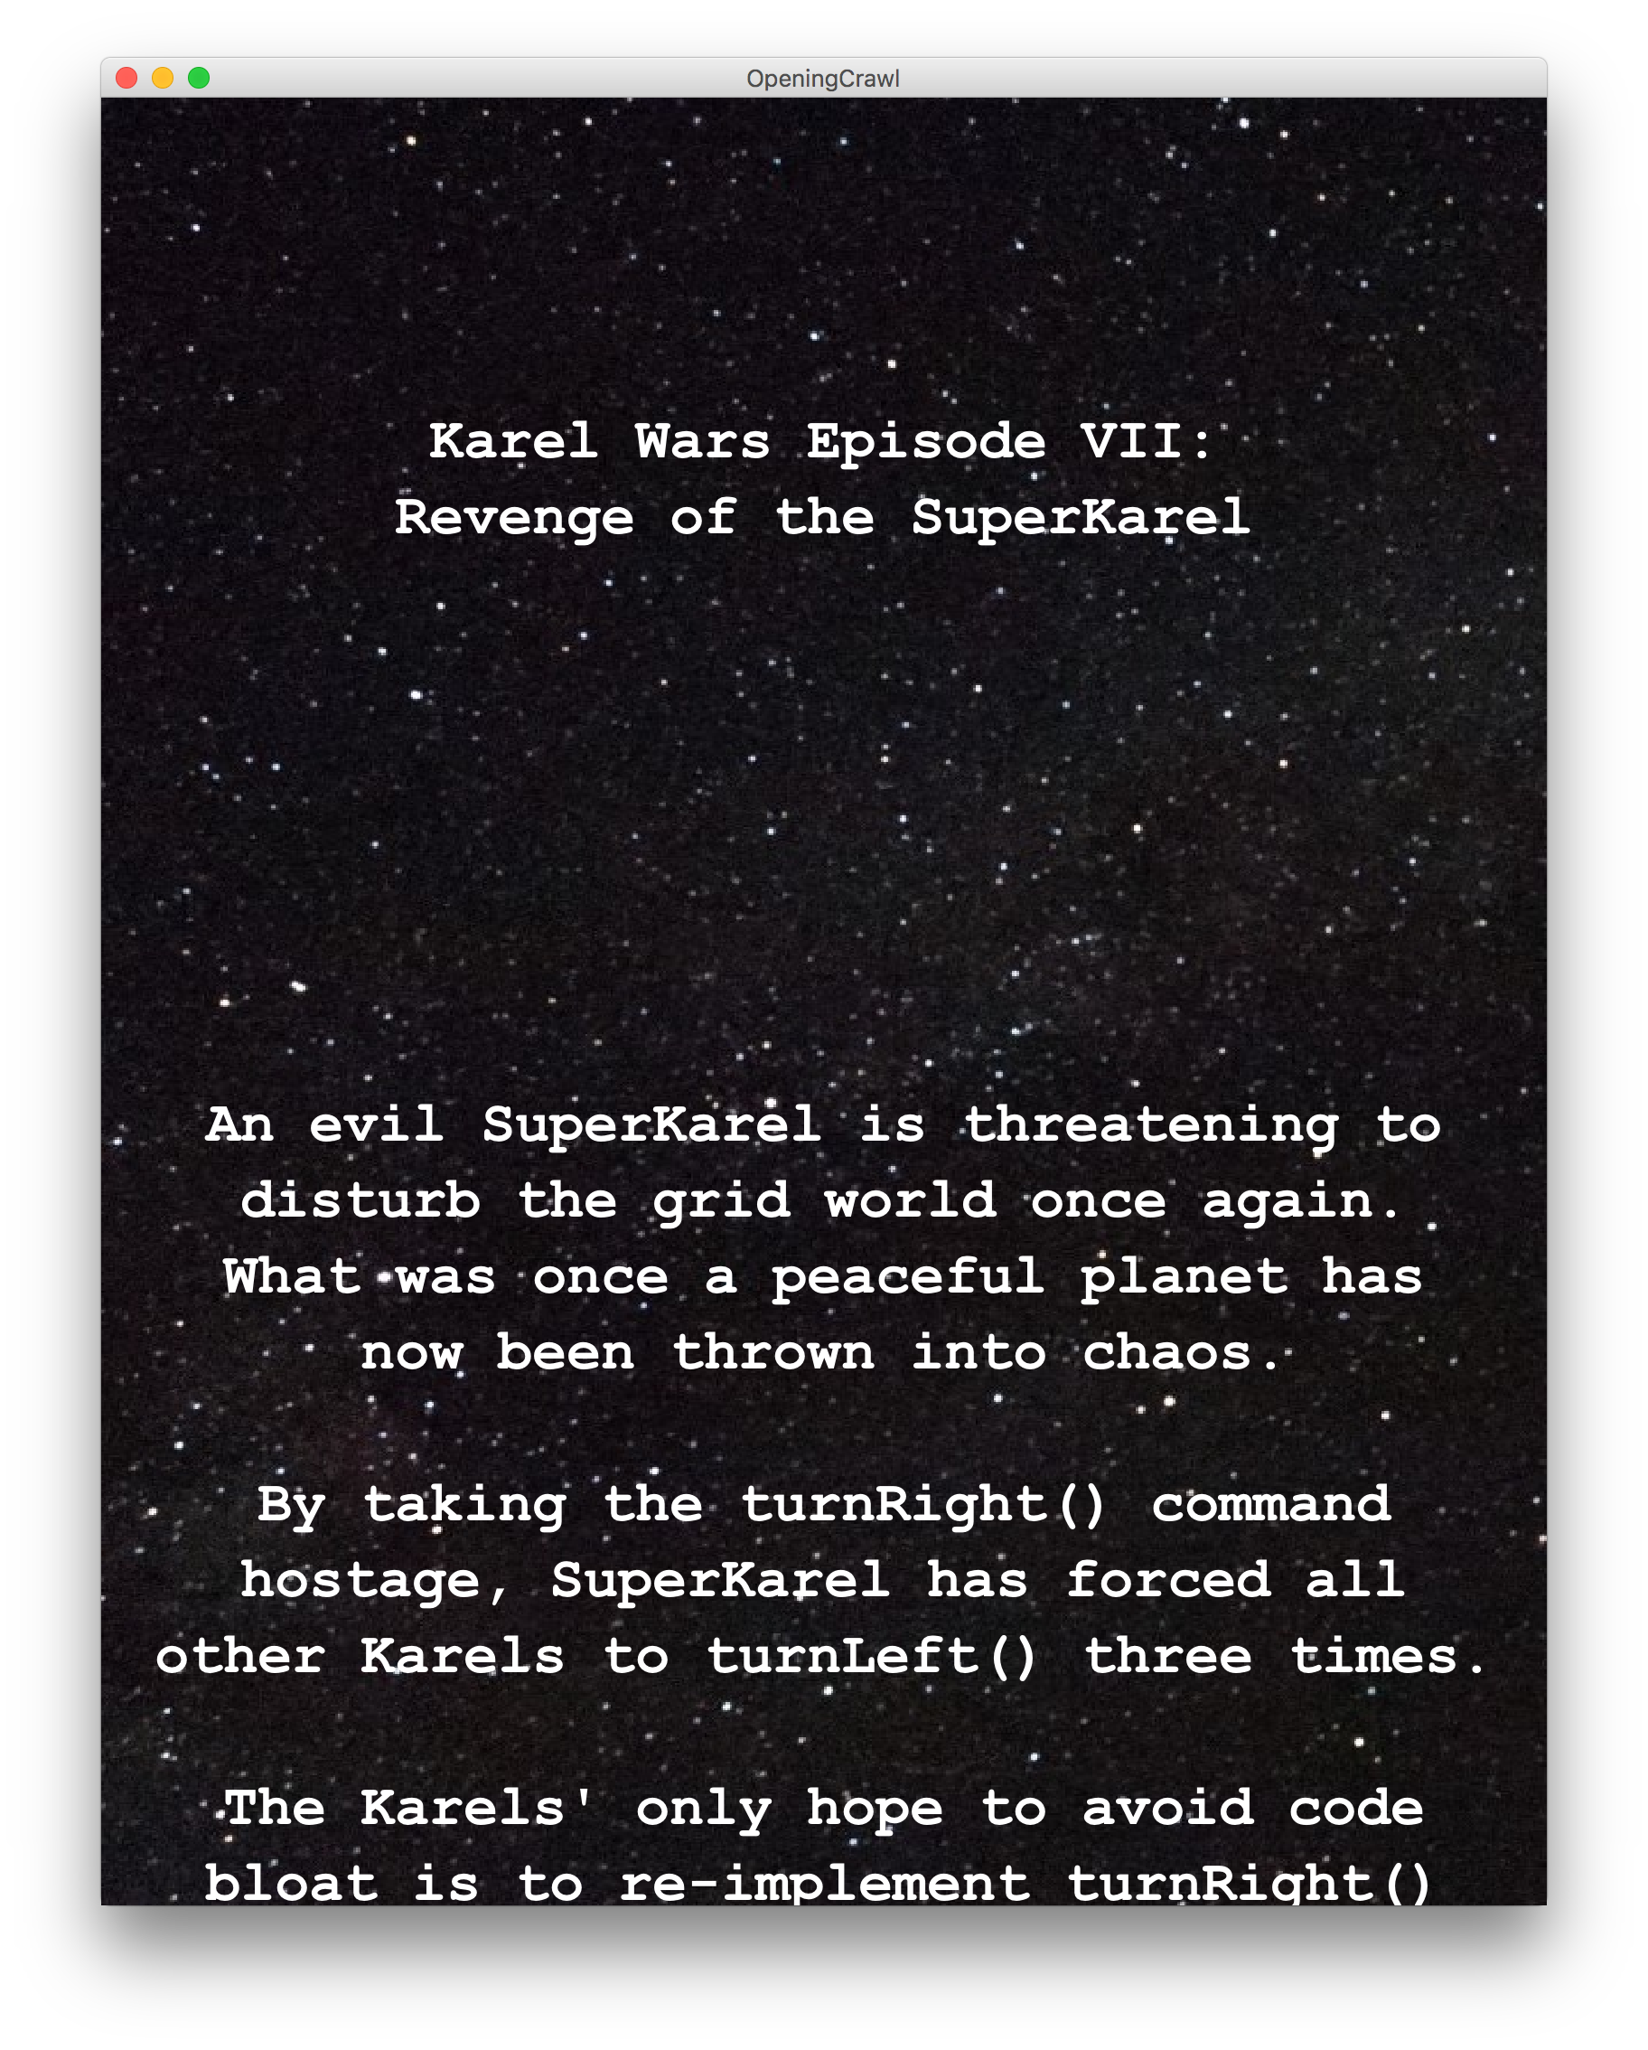
Example: Opening Crawl

Slide 11
Example: Planner
Let’s write a program that emulates the Star Wars “opening crawl”
  The program first reads in a text file
  It then animates this text flowing upwards

Slide 12
Plan for today
Recap: ArrayLists
HashMaps
Practice: Dictionary
HashMaps as Counters
Practice: What’s Trending
Recap

Slide 13
Limitations of Lists
Can only look up by index (int), not by String, etc.
Cumbersome for preventing duplicate information
Slow for lookup
index | 0 | 1 | 2 | 3 | 4 | 5 | 6 | 7 | 8 | 9
value | 12 | 49 | -2 | 26 | 5 | 17 | -6 | 84 | 72 | 3

Slide 14
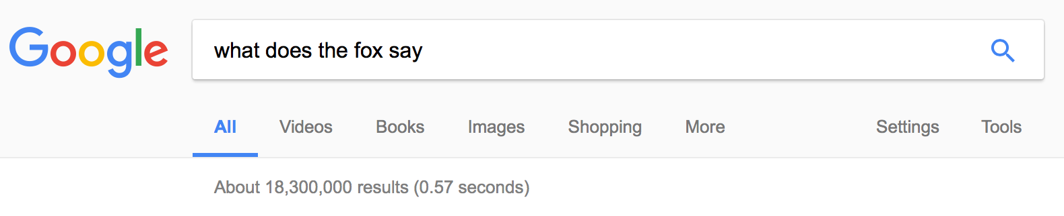
How Is Webpage Lookup So Fast?

Slide 15
Introducing… HashMaps!
A variable type that represents a collection of key-value pairs
You access values by key
Keys and values can be any type of object
Resizable – can add and remove pairs
Has helpful methods for searching for keys

Slide 16
HashMap Examples
Phone book: name -> phone number
Search engine: URL -> webpage
Dictionary: word -> definition
Bank: account # -> balance
Social Network: name -> profile
Counter: text -> # occurrences
And many more…

Slide 17
Our First HashMap
import java.util.*;
HashMap<String, String> myHashMap = new HashMap<>();

Slide 18
Our First HashMap
HashMap<String, String> myHashMap = new HashMap<>();

Slide 19
Our First HashMap
Type of keys your HashMap will store.
HashMap<String, String> myHashMap = new HashMap<>();

Slide 20
Our First HashMap
Type of values your HashMap will store.
HashMap<String, String> myHashMap = new HashMap<>();

Slide 21
Our First HashMap
HashMap<String, String> myHashMap = new HashMap<>();

Slide 22
Our First HashMap
HashMap<String, String> myHashMap = new HashMap<>();

Slide 23
Our First HashMap
HashMap<String, String> myHashMap = new HashMap<>();

Slide 24
Our First HashMap - Put
// Create an (initially empty) HashMap
HashMap<String, String> map = new HashMap<>();
map.put("dog", "bark"); // Add a key-value pair
map.put("cat", "meow"); // Add another pair
map.put("seal", "ow ow"); // Add another pair
map.put("seal", "ow ow ow"); // Overwrites!
“ow
ow
ow”
“ow
ow”
Values:
“bark”
“meow”
Keys:
“dog”
“cat”
“seal”

Slide 25
Our First HashMap - Get
...
String s = map.get("dog"); // Get a value for a key
String s = map.get("cat"); // Get a value for a key
String s = map.get("fox"); // null
“ow
ow
ow”
Values:
“bark”
“meow”
Keys:
“dog”
“cat”
“seal”

Slide 26
Our First HashMap - Remove
...
map.remove("dog"); // Remove pair from map
map.remove("seal"); // Remove pair from map
map.remove("fox"); // Does nothing if not in map
“ow
ow
ow”
“ow
ow”
Values:
“bark”
“meow”
Keys:
“dog”
“cat”
“seal”

Slide 27
Review: HashMap Operations
m.put(key, value); Adds a key/value pair to the map.
  m.put("Eric", "650-123-4567");
    Replaces any previous value for that key.
m.get(key) Returns the value paired with the given key.
  String phoneNum = m.get("Jenny"); // "867-5309"
    Returns null if the key is not found.
m.remove(key); Removes the
given key and its paired value.
  m.remove("Rishi");
    Has no effect if the key is not in the map.
key value
"Jenny” → "867-5309"
"Mehran" → "123-4567"
"Marty" → "685-2181"
"Chris” → "947-2176"

Slide 28
Using HashMaps
A HashMap allows you to get from one half of a pair to the other.
  Remembers one piece of information about every key.
  Later, we can supply only the key and get back the related value:
    Allows us to ask: What is Jenny’s phone number?
// key value
m.put("Jenny", "867-5309");
HashMap
m.get("Jenny")
HashMap
"867-5309"

Slide 29
Practice: Map Mystery
Q: What are the correct map contents after the following code?
  HashMap<String, String> map = new HashMap<>();
  map.put("K", "Schwarz");
  map.put("C", "Lee");
  map.put("M", "Sahami");
  map.put("M", "Stepp");
  map.remove("Stepp");
  map.remove("K");
  map.put("J", "Cain");
  map.remove("C, Lee");
  A. {C=Lee, J=Cain, M=Stepp, M=Sahami}
  B. {C=Lee, J=Cain, M=Stepp}
  C. {J=Cain M=Sahami, M=Stepp}
  D. {J=Cain, K=Schwarz, M=Sahami}
  E. other
Notes:
B

Slide 30
Practice: Map Mystery
Q: What are the correct map contents after the following code?
  HashMap<String, String> map = new HashMap<>();
  map.put("K", "Schwarz");
  map.put("C", "Lee");
  map.put("M", "Sahami");
  map.put("M", "Stepp");
  map.remove("Stepp");
  map.remove("K");
  map.put("J", "Cain");
  map.remove("C, Lee");
Values:
“Schwarz”
“Sahami”
“Lee”
Keys:
“K”
“M”
“C”
Notes:
B

Slide 31
Practice: Map Mystery
Q: What are the correct map contents after the following code?
  HashMap<String, String> map = new HashMap<>();
  map.put("K", "Schwarz");
  map.put("C", "Lee");
  map.put("M", "Sahami");
  map.put("M", "Stepp");
  map.remove("Stepp");
  map.remove("K");
  map.put("J", "Cain");
  map.remove("C, Lee");
Values:
“Schwarz”
“Stepp”
“Lee”
Keys:
“K”
“M”
“C”
Notes:
B

Slide 32
Practice: Map Mystery
Q: What are the correct map contents after the following code?
  HashMap<String, String> map = new HashMap<>();
  map.put("K", "Schwarz");
  map.put("C", "Lee");
  map.put("M", "Sahami");
  map.put("M", "Stepp");
  map.remove("Stepp");
  map.remove("K");
  map.put("J", "Cain");
  map.remove("C, Lee");
Values:
“Schwarz”
“Stepp”
“Lee”
Keys:
“K”
“M”
“C”
Notes:
B

Slide 33
Practice: Map Mystery
Q: What are the correct map contents after the following code?
  HashMap<String, String> map = new HashMap<>();
  map.put("K", "Schwarz");
  map.put("C", "Lee");
  map.put("M", "Sahami");
  map.put("M", "Stepp");
  map.remove("Stepp");
  map.remove("K");
  map.put("J", "Cain");
  map.remove("C, Lee");
Values:
“Stepp”
“Lee”
Keys:
“M”
“C”
Notes:
B

Slide 34
Practice: Map Mystery
Q: What are the correct map contents after the following code?
  HashMap<String, String> map = new HashMap<>();
  map.put("K", "Schwarz");
  map.put("C", "Lee");
  map.put("M", "Sahami");
  map.put("M", "Stepp");
  map.remove("Stepp");
  map.remove("K");
  map.put("J", "Cain");
  map.remove("C, Lee");
Values:
“Cain”
“Stepp”
“Lee”
Keys:
“J”
“M”
“C”
Notes:
B

Slide 35
Practice: Map Mystery
Q: What are the correct map contents after the following code?
  HashMap<String, String> map = new HashMap<>();
  map.put("K", "Schwarz");
  map.put("C", "Lee");
  map.put("M", "Sahami");
  map.put("M", "Stepp");
  map.remove("Stepp");
  map.remove("K");
  map.put("J", "Cain");
  map.remove("C, Lee");
Values:
“Cain”
“Stepp”
“Lee”
Keys:
“J”
“M”
“C”
Notes:
B

Slide 36
Plan for today
Recap: ArrayLists
HashMaps
Practice: Dictionary
HashMaps as Counters
Practice: What’s Trending
Recap

Slide 37
Exercise: Dictionary
Write a program to read a dictionary of words and definitions from a file, then prompt the user for words to look up.
  Example data from the dictionary input file:
  abate
  to lessen; to subside
  pernicious
  harmful, injurious
How can a HashMap help us solve this problem?
Notes:
Live code

Slide 38
Plan for today
Recap: ArrayLists
HashMaps
Practice: Dictionary
HashMaps as Counters
Practice: What’s Trending
Recap

Slide 39
Iterating Over HashMaps
...
for (String key : map.keySet()) {
String value = map.get(key);
// do something with key/value pair...
}
// Keys occur in an unpredictable order!
“ow
ow
ow”
Values:
“bark”
“meow”
Keys:
“dog”
“cat”
“seal”
Notes:
Loop over keys only!

Slide 40
Counting Exercise
Write a program to count the number of occurrences of each unique word in a large text file (e.g. Moby Dick ).
  Allow the user to type a word and report how many times that word appeared in the book.
  Report all words that appeared in the book at least 500 times.
How can a map help us solve this problem?
  Think about scanning over a file containing this input data:
  To be or not to be or to be a bee not two bees ...
  ^
Notes:
Think pair share

Slide 41
Maps and Tallying
a map can be thought of as generalization of a tallying array
  the "index" (key) doesn't have to be an int
  count digits: 22092310907
  // (R)epublican, (D)emocrat, (I)ndependent
  count votes: "RDDDDDDRRRRRDDDDDDRDRRIRDRRIRDRRID"
index | 0 | 1 | 2 | 3 | 4 | 5 | 6 | 7 | 8 | 9
value | 3 | 1 | 3 | 0 | 0 | 0 | 0 | 1 | 0 | 2
key | "R" | "D" | "I"
value | 16 | 14 | 3
key value
"R" → 16
"D" → 14
"I" → 3

Slide 42
Plan for today
Recap: ArrayLists
HashMaps
Practice: Dictionary
HashMaps as Counters
Practice: What’s Trending
Recap

Slide 43
Practice: What's Trending?
Social media can be used to monitor popular conversation topics.
Write a program to count the frequency of #hashtags in tweets:
  Read saved tweets from a large text file.
  Report hashtags that occur at least 15 times.
How can a map help us solve this problem?
  Given these hashtags… We want to store...
#stanford
#summer
#california
#stanford
"#stanford" → 2
"#summer" → 1
"#california" → 1

Slide 44
Recap
Recap: ArrayLists
HashMaps
Practice: Dictionary
HashMaps as Counters
Practice: What’s Trending
Next time: defining our own variable types

Slide 45
Overflow (extra) slides

Slide 46
Anagram exercise
Write a program to find all anagrams of a word the user types.
  Type a word [Enter to quit]: scared
  Anagrams of scared:
  cadres cedars sacred scared
How can a map help us solve this problem?

Slide 47
Anagram observation
Every word has a sorted form where its letters are arranged into alphabetical order.
  "fare" → "aefr"
  "fear" → "aefr"
  "swell" → "ellsw"
  "wells" → "ellsw"
Notice that anagrams have the same sorted form as each other.
  How is this helpful for solving the problem?
  Suppose we were given a sortLetters method. How to use it?

Slide 48
Anagram solution
public String sortLetters(String s) { ... } // assume this exists
...
// build map of {sorted form => all words with that sorted form}
HashMap<String, String> anagrams = new
HashMap<String, String>();
try {
Scanner input = new Scanner(new File("dictionary.txt"));
while (true) {
String word = input.next();
String sorted = sortLetters(word); // "acders"
if (anagrams.containsKey(sorted)) {
String rest = anagrams.get(sorted);
anagrams.put(sorted, rest + " " + word); // append
} else {
anagrams.put(sorted, word); // new k/v pair
}
// {"acders" => "cadres caders sacred scared", ...}
}
} catch (FileNotFoundException fnfe) {
println("Error reading file: " + fnfe);
}

Slide 49
Anagram solution cont'd.
// prompt user for words and look up anagrams in map
String word = readLine("Type a word [Enter to quit]: ");
while (word.length() > 0) {
String sorted = sortLetters(word.toLowerCase());
if (anagrams.containsKey(sorted)) {
println("Anagrams of " + word + ":");
println(anagrams.get(sorted));
} else {
println("No anagrams for " + word + ".");
}
word = readLine("Type a word [Enter to quit]: ");
}

