Slide 1

Data Structure Design I
Chris Piech
CS106A, Stanford University

Slide 2
Interactors

Slide 3
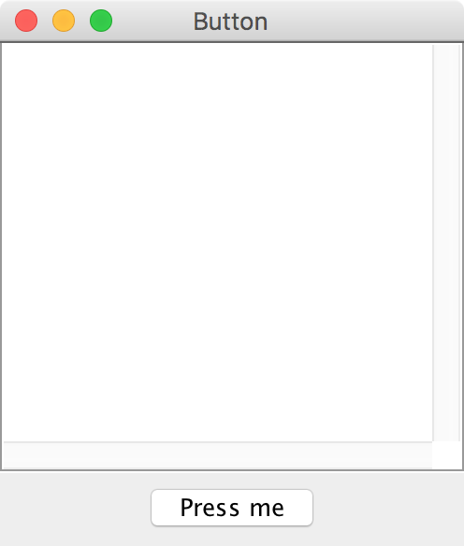
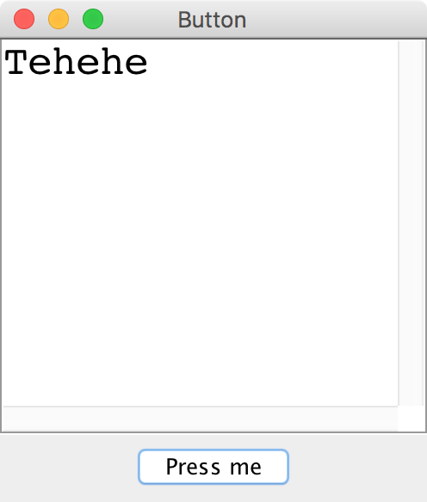
Button

Slide 4
JButton

Slide 5
JButton
JButton button = new JButton("Press me");

Slide 6
JButton
Button Text
JButton button = new JButton("Press me");

Slide 7

JButton
JButton button = new JButton("Press me");
add(button, SOUTH);

Slide 8
JButton
JButton button = new JButton("Press me");
add(button, SOUTH);
addActionListeners();

Slide 9
JButton
public void actionPerformed(ActionEvent e) {
String actionCmd = e.getActionCommand();
if(actionCmd.equals(“Press me”)) {
println(“Tehehe”);
}
}

Slide 10
JButton
public void actionPerformed(ActionEvent e) {
String actionCmd = e.getActionCommand();
if(actionCmd.equals(“Press me”)) {
println(“Tehehe”);
}
}

Slide 11
JButton
public void actionPerformed(ActionEvent e) {
String actionCmd = e.getActionCommand();
if(actionCmd.equals(“Press me”)) {
println(“Tehehe”);
}
}

Slide 12
JButton
public void actionPerformed(ActionEvent e) {
String actionCmd = e.getActionCommand();
if(actionCmd.equals(“Press me”)) {
println(“Tehehe”);
}
}

Slide 13
End review

Slide 14
Some large programs are in Java

Slide 17
How?

Slide 18

Define New Variable Types
Email Sender
Login Manager
Inbox Database
Email
Inbox
User

Slide 19
Even small programs
define new variable types

Slide 20
Can you do this?

Slide 21
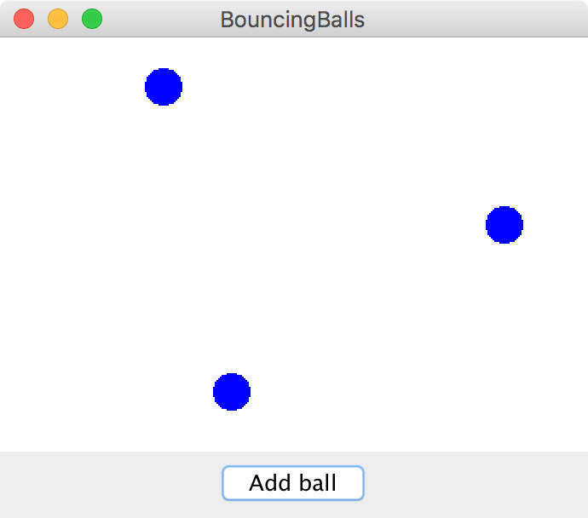
Bouncing Balls

Slide 22


Classes define new Variable Types
A student registration system needs to store info
about students, but Java has no Student type.
A music synthesizer app might want to store information about users' accounts, but Java has no Instrument type.
However, Java does provide a feature for us to add
new data types to the language: classes.
  Writing a class defines a new data type.

Slide 23


Classes are like blueprints
class: A template for a new type of variable.
A blueprint is a helpful analogy

Slide 24
Classes define new variable types

Slide 25
Classes decompose your program across files

Slide 26
Classes are like blueprints
To design a new variable type you must specify three things:
What subvariables make up this new variable type?
What methods can you call on a variable of this type?
What happens when you make a new instance of this type?

Slide 27
What is a class?

Slide 28
A class defines a new variable type

Slide 29
Kenya has used mobile banking for 10 years

Slide 30
Classes: Take 1
This goes in BankAccount.java!
public class BankAccount {
// the instance variable define what makes up the class
public String name;
public double money;
}
Instance variables have a special meaning

Slide 31
Classes: Take 1
public class BankAccount {
// the instance variable define what makes up the class
public String name;
public double money;
}
public class Benmo{
public void run() {
BankAccount chris = new BankAccount();
BankAccount nick = new BankAccount();
chris.name = “Chris”;
chris.money = 100;
nick.name = “Nick”;
nick.money = 50;
}
}

Slide 32
Classes: Take 1
public class BankAccount {
// the instance variable define what makes up the class
public String name;
public double money;
}
public class Benmo{
public void run() {
BankAccount chris = new BankAccount();
BankAccount nick = new BankAccount();
chris.name = “Chris”;
chris.money = 100;
nick.name = “Nick”;
nick.money = 50;
}
}
run
name
chris
money
nick

Slide 33
Classes: Take 1
public class BankAccount {
// the instance variable define what makes up the class
public String name;
public double money;
}
public class Benmo{
public void run() {
BankAccount chris = new BankAccount();
BankAccount nick = new BankAccount();
chris.name = “Chris”;
chris.money = 100;
nick.name = “Nick”;
nick.money = 50;
}
}
run
name
chris
money
name
nick
money

Slide 34
Classes: Take 1
public class BankAccount {
// the instance variable define what makes up the class
public String name;
public double money;
}
public class Benmo{
public void run() {
BankAccount chris = new BankAccount();
BankAccount nick = new BankAccount();
chris.name = “Chris”;
chris.money = 100;
nick.name = “Nick”;
nick.money = 50;
}
}
run
name
“Chris”
chris
money
name
nick
money

Slide 35
Classes: Take 1
public class BankAccount {
// the instance variable define what makes up the class
public String name;
public double money;
}
public class Benmo{
public void run() {
BankAccount chris = new BankAccount();
BankAccount nick = new BankAccount();
chris.name = “Chris”;
chris.money = 100;
nick.name = “Nick”;
nick.money = 50;
}
}
run
name
“Chris”
chris
money
100.0
name
nick
money

Slide 36
Classes: Take 1
public class BankAccount {
// the instance variable define what makes up the class
public String name;
public double money;
}
public class Benmo{
public void run() {
BankAccount chris = new BankAccount();
BankAccount nick = new BankAccount();
chris.name = “Chris”;
chris.money = 100;
nick.name = “Nick”;
nick.money = 50;
}
}
run
name
“Chris”
chris
money
100.0
name
“Nick”
nick
money

Slide 37
Classes: Take 1
public class BankAccount {
// the instance variable define what makes up the class
public String name;
public double money;
}
public class Benmo{
public void run() {
BankAccount chris = new BankAccount();
BankAccount nick = new BankAccount();
chris.name = “Chris”;
chris.money = 100;
nick.name = “Nick”;
nick.money = 50;
}
}
run
name
“Chris”
chris
money
100.0
name
“Nick”
nick
money
50.0

Slide 39
What is a class?

Slide 40
A class defines a new variable type

Slide 41
withdraw
Bank account data
run
deposit
Wall of abstraction

Slide 42
Adding Privacy
  private double money;
encapsulation: Hiding implementation details of an
object from its clients.
  Encapsulation provides abstraction.
    separates external view (behavior) from internal view (state)
  Encapsulation protects the integrity of an object's data.
A class's instance variables should be declared private.
  No code outside the class can access or change it.

Slide 43
Classes: Take 2
This goes in its own file!
public class BankAccount {
// the instance variable define what makes up the class
public String name;
public double money;
}
Instance variables have a special meaning

Slide 44
Classes: Take 2
public class BankAccount {
// 1. What variables make up the class
public String name;
public double money;
}

Slide 45
Classes: Take 2
public class BankAccount {
// 1. What variables make up the class
private String name;
private double money;
}

Slide 46
Classes: Take 2
public class BankAccount {
// 1. What variables make up the class
private String name;
private double money;
// 2. What methods can a user call on a bankAccount?
public void deposit(double amount) {
...
}
public boolean withdraw(double amount) {
...
}
}

Slide 47
Classes: Take 2
public class BankAccount {
// 1. What variables make up the class
private String name;
private double money;
// 2. What methods can a user call on a bankAccount?
public void deposit(double amount) {
money += amount;
}
public boolean withdraw(double amount) {
...
}
}

Slide 48
Classes: Take 2
public class BankAccount {
// 1. What variables make up the class
private String name;
private double money;
// 2. What methods can a user call on a bankAccount?
public void deposit(double amount) {
this.money += amount;
}
public boolean withdraw(double amount) {
...
}
}

Slide 49
this

Slide 50
Classes: Take 2
public class BankAccount {
// 1. What variables make up the class
private String name;
private double money;
// 2. What methods can a user call on a bankAccount?
public void deposit(double amount) {
this.money += amount;
}
public boolean withdraw(double amount) {
...
}
}

Slide 51
Classes: Take 2
public class BankAccount {
// 1. What variables make up the class
private String name;
private double money;
// 2. What methods can a user call on a bankAccount?
public void deposit(double amount) {
this.money += amount;
}
public boolean withdraw(double amount) {
if(amount <= this.money) {
this.money -= amount;
return true;
}
return false;
}
}

Slide 52
Classes: Take 2
public class BankAccount {
// 1. What variables make up the class
private String name;
private double money;
// 2. What methods can a user call on a bankAccount?
public void deposit(double amount) {
this.money += amount;
}
public boolean withdraw(double amount) {
if(amount <= this.money) {
this.money -= amount;
return true;
}
return false;
}
// 3. How do you make a new one?
public BankAccount(String name, double amount) {
this.money = amount;
this.money = name;
}
}

Slide 54
You must define three things
1. What variables does each instance store?
2. What methods can you call on an instance?
3. What happens when you make a new one?

Slide 55
Classes on one slide
1. What variables make up this new super variable type?
Instance variables
2. What methods can you call on a variable of this type?
It’s public methods
3. What happens when the user makes a new instance?
The “constructor”
* Don’t forget that all methods and constructors have access to a this reference

Slide 56
What is a class?

Slide 57
A class defines a new variable type

Slide 58
Bouncing Balls

Slide 59
A Ball Variable Type
The Ball class
1. What variables does each instance store?
Each ball has its own Goval (lets call it shape)
Each ball has its own dx
Each ball has its own dy
2. What methods can you call on an instance?
heartbeat();
getShape();
3. What happens when you make a new one?
Sets initial values for all the ”instance” vars
*details on how to define these three things coming soon

Slide 60
What classes?

Slide 61
What classes?

