Slide 1
Graph Algorithms
Eric Roberts
CS 106B
February 27, 2013

Slide 2
Outline
1.
A review the graphtypes.h and graph.h interfaces
2.
A tour of the Pathfinder assignment
3.
Examples of depth-first and breadth-first search
4.
Dijkstra’s shortest-path algorithm
5.
Kruskal’s minimum-spanning-tree algorithm

Slide 3
The Node and Arc Structures
struct Node; /* Forward references to these two types so */
struct Arc; /* that the C++ compiler can recognize them. */
/*
* Type: Node
* -----------
* This type represents an individual node and consists of the
* name of the node and the set of arcs from this node.
*/
struct Node {
string name;
Set<Arc *> arcs;
};
/*
* Type: Arc
* ----------
* This type represents an individual arc and consists of pointers
* to the endpoints, along with the cost of traversing the arc.
*/
struct Arc {
Node *start;
Node *finish;
double cost;
};

Slide 4
Entries in the graph.h Interface
template <typename NodeType,typename ArcType>
class Graph {
public:
Graph();
~Graph();
void clear();
NodeType *addNode(string name);
NodeType *addNode(NodeType *node);
ArcType *addArc(string s1, string s2);
ArcType *addArc(NodeType *n1, NodeType *n2);
ArcType *addArc(ArcType *arc);
bool isConnected(NodeType *n1, NodeType *n2);
bool isConnected(string s1, string s2);
NodeType *getNode(string name);
Set<NodeType *> & getNodeSet();
Set<ArcType *> & getArcSet();
Set<ArcType *> & getArcSet(NodeType *node);
};

Slide 5
Modules in the Pathfinder Assignment
Pathfinder.cpp
graphtypes.h
path.h
path.cpp
gtypes.h
gpathfinder.h
gpathfinder.cpp
pqueue.h

Slide 6
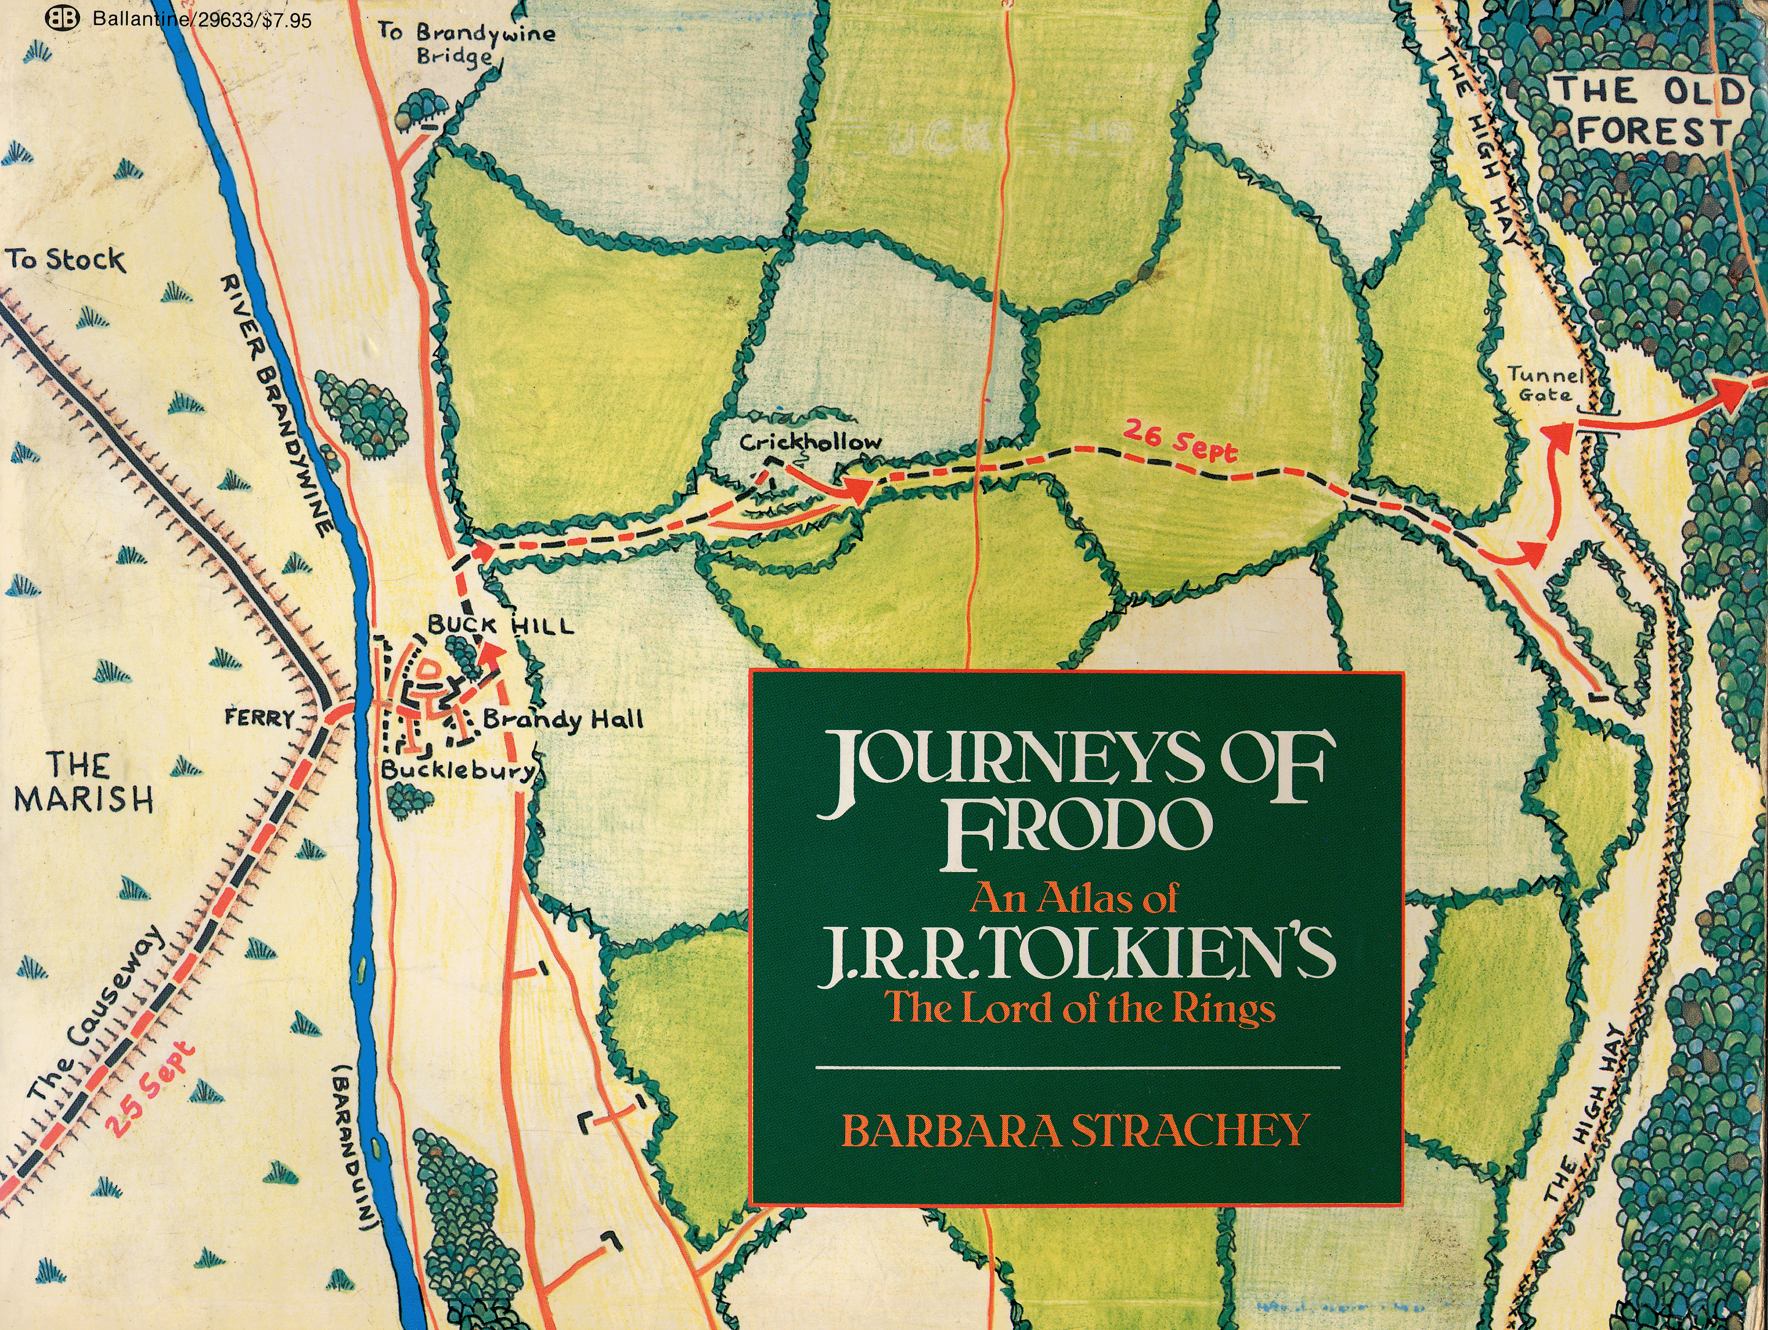
Frodo’s Journey

Slide 7
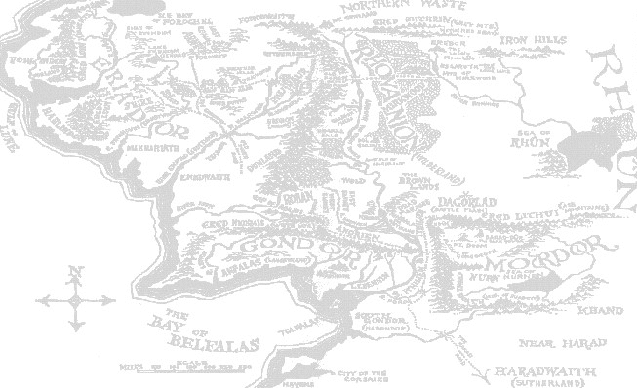
The Middle Earth Graph
Hobbiton
10
Bree
30
Rivendell
1
Southfarthing
10
30
Caradhras
Moria
30
50
40
Lorien
Isengard
10
5
50
10
Rauros
BlackGate
Edoras
20
15
70
15
20
MountDoom
MinasTirith
30
40
CirithUngol

Slide 8
Exercise: Depth-First Search
Construct a depth-first search starting from Hobbiton (HOB):
BRE
Visiting node HOB
Visiting node BRE
Visiting node RIV
Visiting node CAR
Visiting node LOR
Visiting node EDO
Visiting node ISE
Visiting node SOU
Visiting node MIN
Visiting node CIR
Visiting node BLA
Visiting node MOU
Visiting node RAU
Visiting node MOR
HOB
RIV
SOU
CAR
MOR
LOR
ISE
EDO
RAU
BLA
MOU
MIN
CIR

Slide 9
Exercise: Breadth-First Search
Construct a breadth-first search starting from Isengard (ISE):
BRE
Visiting node ISE
Visiting node EDO
Visiting node SOU
Visiting node LOR
Visiting node MIN
Visiting node RAU
Visiting node HOB
Visiting node CAR
Visiting node MOR
Visiting node CIR
Visiting node BLA
Visiting node BRE
Visiting node RIV
Visiting node MOU
HOB
RIV
SOU
CAR
MOR
LOR
ISE
EDO
RAU
BLA
MOU
MIN
CIR
Queue:
ISE
EDO
SOU
LOR
MIN
RAU
HOB
CAR
MOR
CIR
BLA
BRE
RIV
MOU

Slide 10
Dijkstra’s Algorithm
One of the most useful algorithms for computing the shortest paths in a graph was developed by Edsger W. Dijkstra in 1959.
The strategy is similar to the breadth-first search algorithm you used to implement the word-ladder program in Assignment #2. The major difference are:
  The queue used to hold the paths delivers items in increasing order of total cost rather than in the traditional first-in/first-out order. Such queues are called priority queues.
  The algorithm keeps track of all nodes to which the total distance has already been fixed. Distances are fixed whenever you dequeue a path from the priority queue.

Slide 11
Shortest Path
Hobbiton
10
Bree
30
Rivendell
1
Southfarthing
10
30
Caradhras
Moria
30
50
40
Lorien
Isengard
10
5
50
10
Rauros
BlackGate
Edoras
20
15
70
15
20
MountDoom
MinasTirith
30
40
CirithUngol

Slide 12
Exercise: Dijkstra’s Algorithm
Find the shortest path from Hobbiton (HOB) to Lorien (LOR):
HOB (0)
HOB (0)
HOB (0)
HOB (0)
HOB (0)
HOB (0)
HOB (0)
HOB (0)
HOB (0)
HOB (0)
HOB (0)
HOB (0)
HOB (0)
HOB (0)
HOB (0)
HOB (0)
HOB (0)
HOB (0)
10
BRE
30
HOB→BRE (10)
HOB→SOU (1)
HOB→SOU (1)
HOB→SOU (1)
HOB→SOU (1)
HOB→SOU (1)
HOB→SOU (1)
HOB→SOU (1)
HOB→SOU (1)
HOB→SOU (1)
HOB→SOU (1)
HOB→SOU (1)
HOB→SOU (1)
HOB→SOU (1)
HOB→SOU (1)
HOB
RIV
HOB→SOU (1)
1
30
HOB→BRE (10)
HOB→BRE (10)
HOB→BRE (10)
HOB→BRE (10)
HOB→BRE (10)
HOB→BRE (10)
HOB→BRE (10)
HOB→BRE (10)
HOB→BRE (10)
HOB→BRE (10)
HOB→BRE (10)
HOB→BRE (10)
HOB→BRE (10)
HOB→BRE (10)
SOU
10
HOB→BRE (10)
CAR
HOB→SOU→ISE (51)
HOB→SOU→ISE (51)
HOB→BRE→RIV (40)
HOB→BRE→RIV (40)
HOB→BRE→RIV (40)
HOB→BRE→RIV (40)
HOB→BRE→RIV (40)
HOB→BRE→RIV (40)
HOB→BRE→RIV (40)
HOB→BRE→RIV (40)
HOB→BRE→RIV (40)
HOB→BRE→RIV (40)
MOR
HOB→BRE→RIV (40)
30
HOB→SOU→ISE (51)
HOB→SOU→ISE (51)
HOB→SOU→ISE (51)
HOB→BRE→RIV→MOR (50)
HOB→BRE→RIV→MOR (50)
HOB→BRE→RIV→MOR (50)
HOB→BRE→RIV→MOR (50)
HOB→BRE→RIV→MOR (50)
HOB→BRE→RIV→MOR (50)
HOB→BRE→RIV→MOR (50)
50
40
HOB→BRE→RIV→MOR (50)
LOR
HOB→BRE→RIV→CAR (70)
HOB→SOU→ISE (51)
HOB→SOU→ISE (51)
HOB→SOU→ISE (51)
HOB→SOU→ISE (51)
HOB→SOU→ISE (51)
HOB→SOU→ISE (51)
HOB→SOU→ISE (51)
HOB→SOU→ISE (51)
HOB→BRE→RIV→CAR (70)
HOB→BRE→RIV→CAR (70)
HOB→BRE→RIV→CAR (70)
HOB→BRE→RIV→CAR (70)
HOB→BRE→RIV→CAR (70)
HOB→BRE→RIV→CAR (70)
HOB→BRE→RIV→CAR (70)
ISE
10
5
HOB→BRE→RIV→CAR (70)
HOB→BRE→RIV→MOR→LOR (90)
HOB→BRE→RIV→MOR→LOR (90)
HOB→BRE→RIV→MOR→LOR (90)
HOB→BRE→RIV→MOR→LOR (90)
HOB→BRE→RIV→MOR→LOR (90)
50
HOB→BRE→RIV→MOR→LOR (90)
10
RAU
20
BLA
HOB→SOU→ISE→EDO (101)
HOB→SOU→ISE→EDO (101)
HOB→BRE→RIV→CAR→LOR (100)
EDO
70
HOB→BRE→RIV→CAR→LOR (100)
15
15
HOB→SOU→ISE→EDO (101)
20
MOU
HOB→SOU→ISE→EDO (101)
MIN
30
40
CIR

Slide 13
Kruskal’s Algorithm
In many cases, finding the shortest path is not as important as as minimizing the cost of a network as a whole. A set of arcs that connects every node in a graph at the smallest possible cost is called a minimum spanning tree.
The following algorithm for finding a minimum spanning tree was developed by Joseph Kruskal in 1956:
  Start with a new empty graph with the same nodes as the original one but an empty set of arcs.
  Sort all the arcs in the graph in order of increasing cost.
  Go through the arcs in order and add each one to the new graph if the endpoints of that arc are not already connected by a path.
This process can be made more efficient by maintaining sets of nodes in the new graph, as described on the next slide.

Slide 14
Combining Sets in Kruskal’s Algorithm
Implementing the Pathfinder version of Kruskal’s algorithm requires you need to build a new graph containing the spanning tree. As you do, you will generate sets of disconnected graphs.
When you choose a new arc, there are four possibilities for the sets formed by the nodes at the endpoints:
1.
Neither node is yet in a set. In this case, create a new set and add both nodes to it.
2.
One node is in a set and the other isn’t. In this case, add the new node to the same set.
3.
The endpoints are in different existing sets. In this case, you need to merge the two sets to create a new one containing the union of the existing ones.
4.
The endpoints are in the same set. In this case, there is already a path between these two nodes, so you don’t need this arc.

Slide 15
Exercise: Minimum Spanning Tree
Apply Kruskal’s algorithm to find a minimum spanning tree:
1:
HOB
→
SOU
10
BRE
5:
LOR
HOB
30
RIV
→
RAU
10:
BRE
1
10
30
→
HOB
SOU
CAR
10:
EDO
→
LOR
MOR
10:
EDO
30
→
RAU
50
40
10:
MOR
LOR
→
RIV
15:
EDO
→
MIN
ISE
10
5
15:
MIN
→
RAU
50
20:
BLA
10
RAU
20
BLA
→
CIR
EDO
20:
BLA
15
15
70
→
RAU
20
MOU
30:
BRE
30
40
→
RIV
MIN
30:
CAR
CIR
→
LOR
30:
CAR
→
RIV
30:
CIR
→
MIN
40:
CIR
→
MOU
40:
LOR
→
MOR
50:
EDO
→
ISE
50:
ISE
→
SOU
70:
BLA
→
MOU

Slide 16
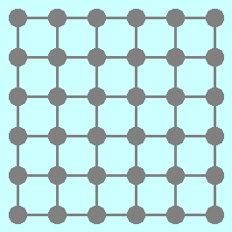
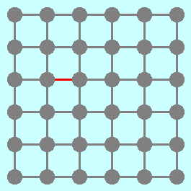
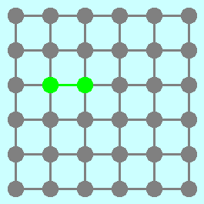
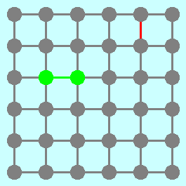
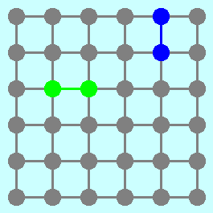
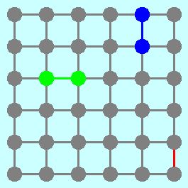
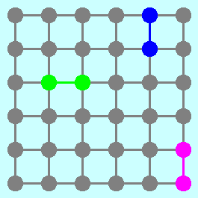
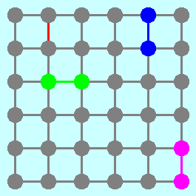
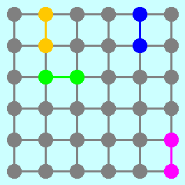
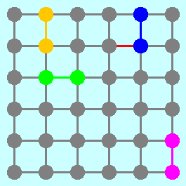
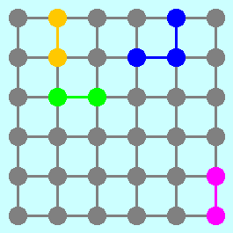
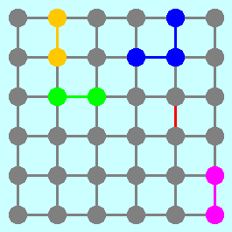
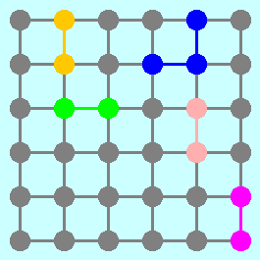
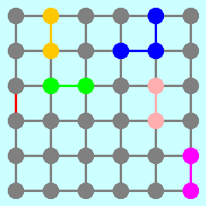
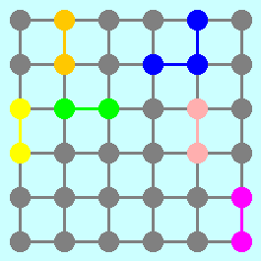
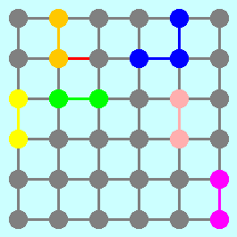
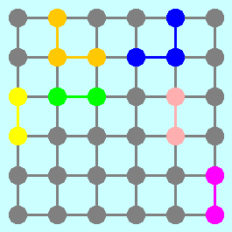
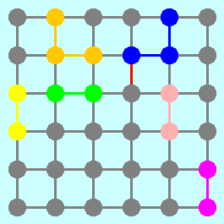
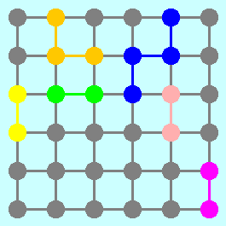
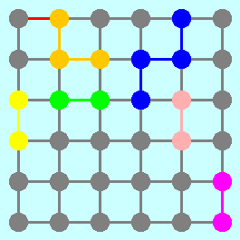
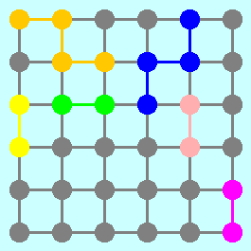

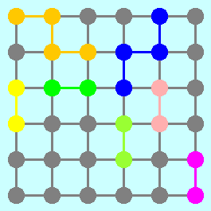
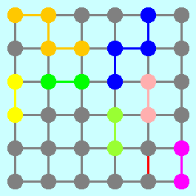
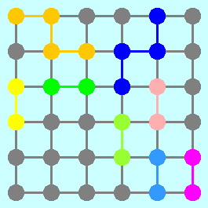
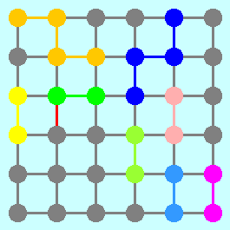
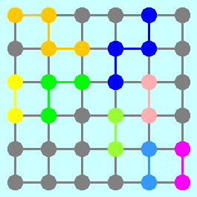
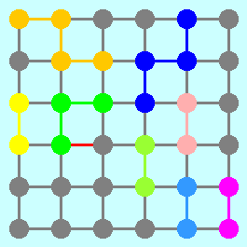
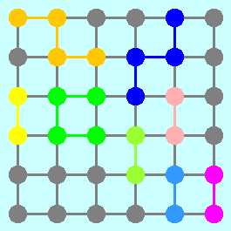
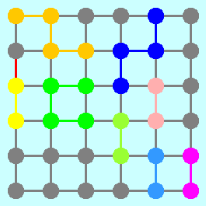
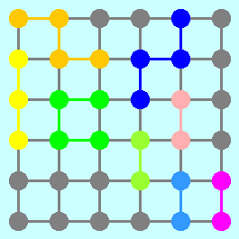
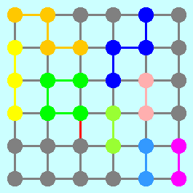
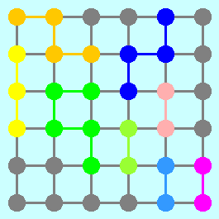
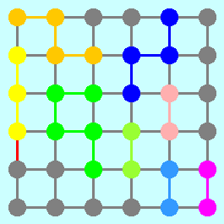
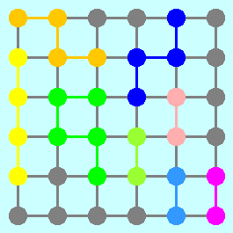

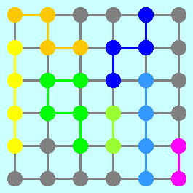

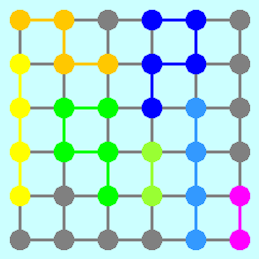
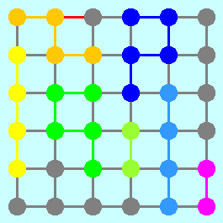
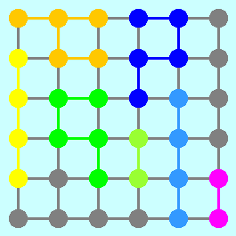
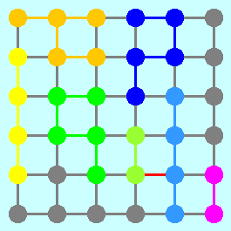
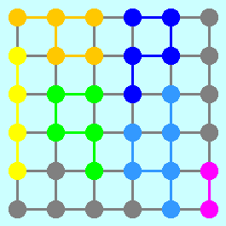
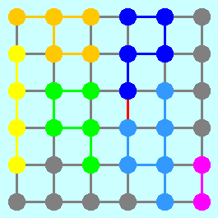
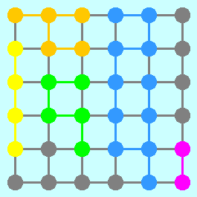
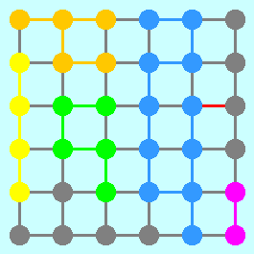
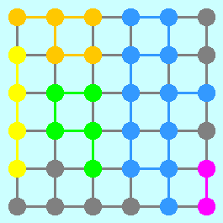
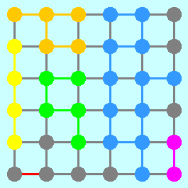
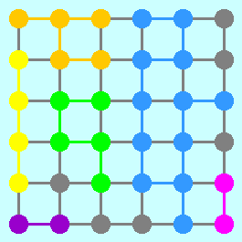
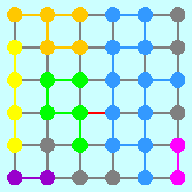
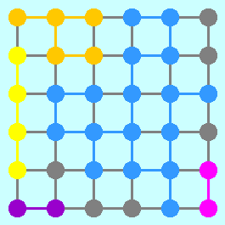






































































An Application of Kruskal’s Algorithm
Suppose that you have a graph that looks like this:
What would happen if you applied Kruskal’s algorithm for finding a minimum spanning tree, assuming that you choose the arcs in a random order?

Slide 17
The End

