Slide 1


Slide 2

Memoization
Chris Piech
CS 106B
Lecture 10
Jan 29, 2015

Slide 3
Tell me and I forget. Teach me and I rememoize.*
^{- Xun Kuang, 300 BCE}
* This is almost the correct quote

Slide 4
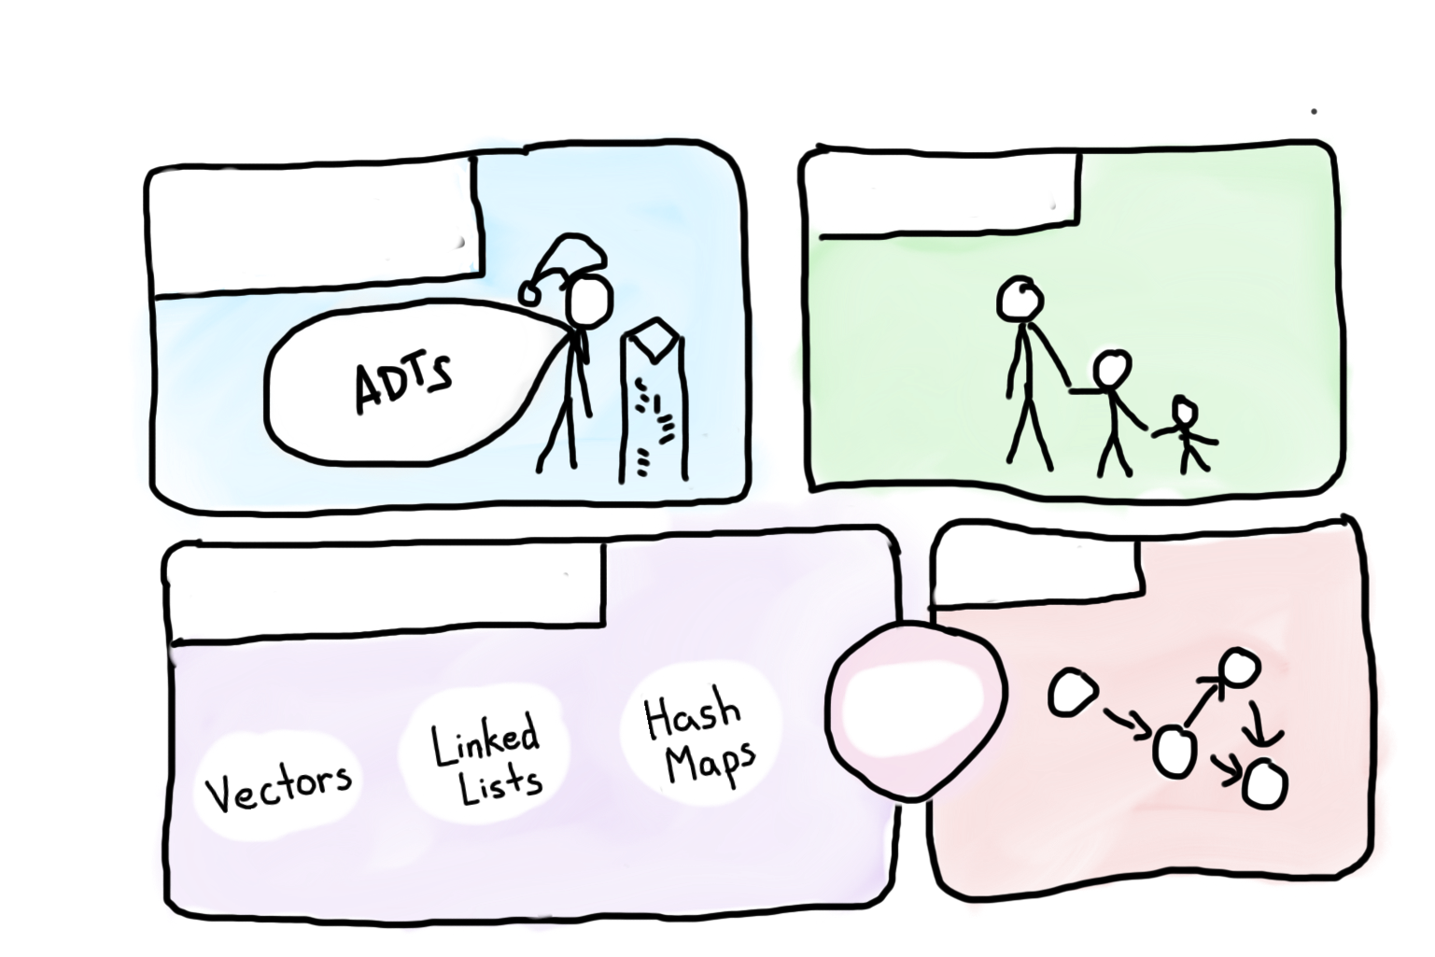


Course Syllabus
Intro to Abstractions
Recursion
Graphs
Under the Hood
Trees
You are here

Slide 5

Socrative.com
Room: 106BWIN16

Slide 6
Midterm
Date: Tuesday, Feb 9th
Time: 7-9pm
Location: Hewlett 200, Hewlett 201 + Braun Aud.
More details on Wednesday

Slide 7
Milestone 5
Write a recursive function that completes a grammar.
Sentence is an easy to understand test case.
Mystery trace is a fun test case.

Slide 8
Milestone 5
QUESTION: {{lots of text that I excluded for space}}
-----
RECURSION:CALL|CALL OP TERM
-----
CALL:mystery(level - 1, XEXP)
-----
COMBO:REXP OP XEXP
-----
XEXP:x|x OP XEXP|x OP NUM
-----
REXP:r|r OP REXP|r OP NUM
-----
NUM:1|5
-----
OP:+|-|*|%|/
-----

Slide 9
Milestone 5
QUESTION

Slide 10
Milestone 5
int mystery(int level, int x) {
if(level == 0) {
return NUM;
} else {
int r = CALL;
return COMBO;
}
}
What is the result of mystery(3, 5);

Slide 11
Milestone 5
“int mystery(int level, int x) {
if(level == 0) {
return NUM;
} else {
int r = CALL;
return COMBO;
}
}
What is the result of mystery(3, 5);”

Slide 12
Milestone 5
int mystery(int level, int x) {
if(level == 0) {
return NUM;
} else {
int r = CALL;
return COMBO;
}
}
What is the result of mystery(3, 5);

Slide 13
Milestone 5
int mystery(int level, int x) {
if(level == 0) {
return 5;
} else {
int r = CALL;
return COMBO;
}
}
What is the result of mystery(3, 5);

Slide 14
Milestone 5
int mystery(int level, int x) {
if(level == 0) {
return 5;
} else {
int r = mystery(level-1, XEXP);
return COMBO;
}
}
What is the result of mystery(3, 5);

Slide 15
Milestone 5
int mystery(int level, int x) {
if(level == 0) {
return 5;
} else {
int r = mystery(level-1, x OP XEXP);
return COMBO;
}
}
What is the result of mystery(3, 5);

Slide 16
Milestone 5
int mystery(int level, int x) {
if(level == 0) {
return 5;
} else {
int r = mystery(level-1, x + XEXP);
return COMBO;
}
}
What is the result of mystery(3, 5);

Slide 17
Milestone 5
int mystery(int level, int x) {
if(level == 0) {
return 5;
} else {
int r = mystery(level-1, x + x);
return COMBO;
}
}
What is the result of mystery(3, 5);

Slide 18
Milestone 5
int mystery(int level, int x) {
if(level == 0) {
return 5;
} else {
int r = mystery(level-1, x + x);
return REXP OP XEXP;
}
}
What is the result of mystery(3, 5);

Slide 19
Milestone 5
int mystery(int level, int x) {
if(level == 0) {
return 5;
} else {
int r = mystery(level-1, x + x);
return r OP XEXP;
}
}
What is the result of mystery(3, 5);

Slide 20
Milestone 5
int mystery(int level, int x) {
if(level == 0) {
return 5;
} else {
int r = mystery(level-1, x + x);
return r * XEXP;
}
}
What is the result of mystery(3, 5);

Slide 21
Milestone 5
int mystery(int level, int x) {
if(level == 0) {
return 5;
} else {
int r = mystery(level-1, x + x);
return r * x OP NUM;
}
}
What is the result of mystery(3, 5);

Slide 22
Milestone 5
int mystery(int level, int x) {
if(level == 0) {
return 5;
} else {
int r = mystery(level-1, x + x);
return r * x - NUM;
}
}
What is the result of mystery(3, 5);

Slide 23
Milestone 5
int mystery(int level, int x) {
if(level == 0) {
return 5;
} else {
int r = mystery(level-1, x + x);
return r * x - 1;
}
}
What is the result of mystery(3, 5);

Slide 24
Jazzy

Slide 25

Today’s Goals
Feel Comfort with Big O
Understand the benefit of memoization

Slide 26
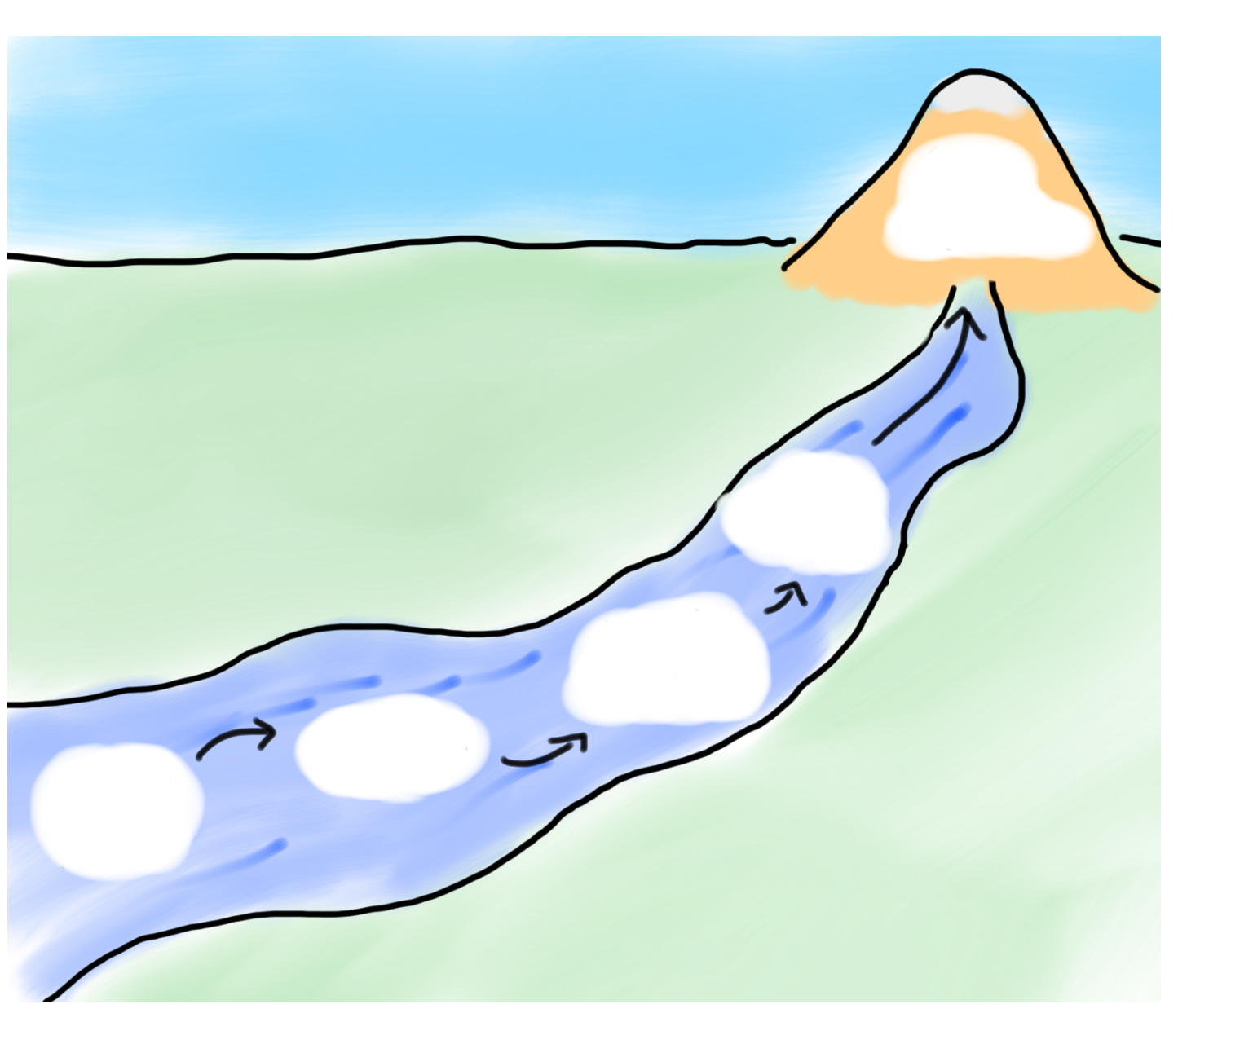
Today’s Goals
Monday
DNA
Fibb
Compare
All
Review
Big O River

Slide 27
Today’s Goals
Monday
DNA
Fibb
Compare
All
Review
Big O River

Slide 28
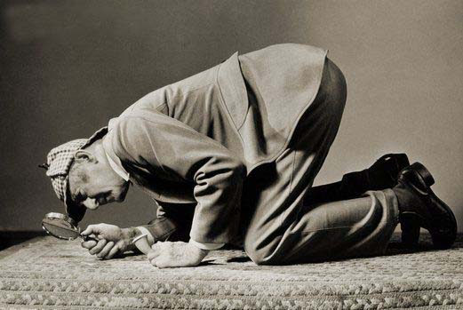
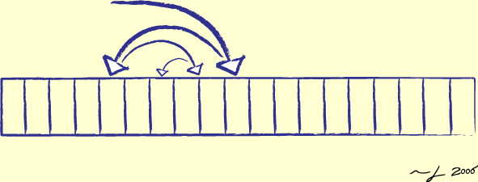
How Can We Compare Algorithms?
Linear Search
Binary Search

Slide 29
Count Number of Executions
int find(Vector<int> & vec, int goal) {
for(int i = 0; i < vec.size(); i++) {
if(vec[i] == goal) return i;
}
return -1;
}
2n + 1
2n
1
T(n) = 4n + 2
Do we really care
about the +2?
Do we really care
about the 4?

Slide 30
Big O Notation
Ignore everything except the dominant growth term, including constant factors.
Examples:
  4n + 2 = O(n)
  137n + 271 = O(n)
  n² + 3n + 4 = O(n²)
  2^{n} + n³ = O(2^{n})
  log₂n = O(logn)

Slide 31
Standard Complexity
The complexity of a particular algorithm tends to fall into one of a small number of standard complexity classes:
constant
O(1)
Finding first element in a vector
logarithmic
O(log N)
Binary search in a sorted vector
linear
O(N)
Summing a vector; linear search
N log N
O(N log N)
Merge sort
quadratic
O(N ²)
Selection sort
cubic
O(N ³)
Obvious algorithms for matrix multiplication
exponential
O(2^{N})
Tower of Hanoi solution

Slide 32

log n | n | n log n | n² | 2^{n}
2 | 4 | 8 | 16 | 16
3 | 8 | 24 | 64 | 256
4 | 16 | 64 | 256 | 65,536
5 | 32 | 160 | 1,024 | 4,294,967,296
6 | 64 | 384 | 4,096 | 1.84 x 10¹⁹
7 | 128 | 896 | 16,384 | 3.40 x 10³⁸
8 | 256 | 2,048 | 65,536 | 1.16 x 10⁷⁷
9 | 512 | 4,608 | 262,144 | 1.34 x 10¹⁵⁴
10 | 1,024 | 10,240 (.000003s) | 1,048,576 (.0003s) | 1.80 x 10³⁰⁸
30 | 1,300,000,000 | 39000000000 (13s) | 1690000000000000000 (18 years)
LOL

Slide 33
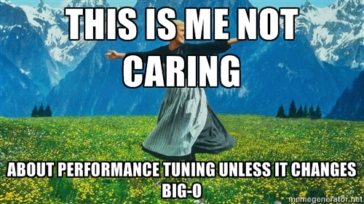

Slide 34
Types of Analysis
Worst-Case Analysis
  What's the worst possible runtime for the algorithm?
  Useful for "sleeping well at night.”
  What we use in CS106B
Best-Case Analysis
  Said nobody ever.
Average-Case Analysis
  What's the average runtime for the algorithm?
  Far beyond the scope of this class; take CS109, CS161!

Slide 35
Types of Analysis
Worst-Case Analysis
  What's the worst possible runtime for the algorithm?
  Useful for "sleeping well at night.”
  What we use in CS106B
Best-Case Analysis
  Said nobody ever.
Average-Case Analysis
  What's the average runtime for the algorithm?
  Far beyond the scope of this class; take CS109, CS161!

Slide 36
Types of Analysis
Worst-Case Analysis
  What's the worst possible runtime for the algorithm?
  Useful for "sleeping well at night.”
  What we use in CS106B
Best-Case Analysis
  Said nobody ever.
Average-Case Analysis
  What's the average runtime for the algorithm?
  Far beyond the scope of this class; take CS109, CS161!

Slide 37
Types of Analysis
Worst-Case Analysis
  What's the worst possible runtime for the algorithm?
  Useful for "sleeping well at night.”
  What we use in CS106B
Best-Case Analysis
  Said nobody ever.
Average-Case Analysis
  What's the average runtime for the algorithm?
  Far beyond the scope of this class; take CS109, CS161!

Slide 38
Example
What is the big O of this function?
void friendly(Set<string>& facebookUsers) {
int n = facebookUsers.size();
cout << “n: ” << n << endl;
for(string user : facebookUsers){
notifyIfBirthday(user);
changeName(user, “John Cena”);
addFriend(user, “Mehran Sahami”);
}
}

Slide 39
Example
What is the big O of this function?
void friendly(Set<string>& facebookUsers) {
int n = facebookUsers.size();
cout << “n: ” << n << endl;
for(string user : facebookUsers){
notifyIfBirthday(user);
changeName(user, “John Cena”);
addFriend(user, “Mehran Sahami”);
}
}

Slide 40
Example
What is the big O of this function?
void friendly(Set<string>& facebookUsers) {
int n = facebookUsers.size();
cout << “n: ” << n << endl;
for(string user : facebookUsers){
notifyIfBirthday(user);
changeName(user, “John Cena”);
addFriend(user, “Mehran Sahami”);
}
}

Slide 41
Example
What is the big O of this function?
void friendly(Set<string>& facebookUsers) {
int n = facebookUsers.size();
cout << “n: ” << n << endl;
for(string user : facebookUsers){
notifyIfBirthday(user);
changeName(user, “John Cena”);
addFriend(user, “Mehran Sahami”);
}
}

Slide 42
Example
What is the big O of this function?
void friendly(Set<string>& facebookUsers) {
int n = facebookUsers.size();
cout << “n: ” << n << endl;
for(string user : facebookUsers){
notifyIfBirthday(user);
changeName(user, “John Cena”);
addFriend(user, “Mehran Sahami”);
}
}

Slide 43
Example
What is the big O of this function?
void friendly(Set<string>& facebookUsers) {
int n = facebookUsers.size();
cout << “n: ” << n << endl;
for(string user : facebookUsers){
notifyIfBirthday(user);
changeName(user, “John Cena”);
addFriend(user, “Mehran Sahami”);
}
}

Slide 44
Example
What is the big O of this function?
void friendly(Set<string>& facebookUsers) {
int n = facebookUsers.size();
cout << “n: ” << n << endl;
for(string user : facebookUsers){
notifyIfBirthday(user);
changeName(user, “John Cena”);
addFriend(user, “Mehran Sahami”);
}
}

Slide 45
Example
What is the big O of this function?
void friendly(Set<string>& facebookUsers) {
int n = facebookUsers.size();
cout << “n: ” << n << endl;
for(string user : facebookUsers){
notifyIfBirthday(user);
changeName(user, “John Cena”);
addFriend(user, “Mehran Sahami”);
}
}

Slide 46
Strategy
Big O
Non-Recursive
Recursive
Try and count number of executions
Try and count number of function calls

Slide 47
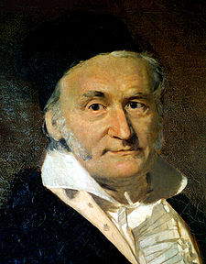
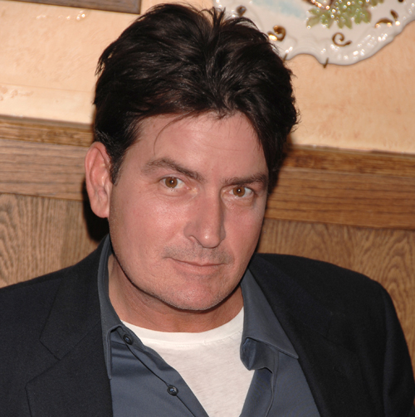
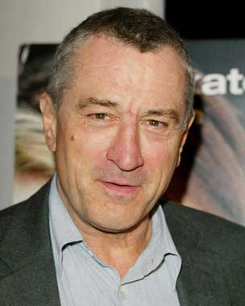
Gauss Summation

Slide 48
Arithmetic Sum
You can convince yourself that
N ^{x} (N + 1)
1 + 2 + 3 + . . . + (N - 2) + (N - 1) + N =
2

Slide 49

Arithmetic Sum
You can convince yourself that
N ^{x} (N + 1)
1 + 2 + 3 + . . . + (N - 2) + (N - 1) + N =
2

Slide 50
Arithmetic Sum
You can convince yourself that
N ^{x} (N + 1)
1 + 2 + 3 + . . . + (N - 2) + (N - 1) + N =
2

Slide 51
Arithmetic Sum
You can convince yourself that
N ^{x} (N + 1)
1 + 2 + 3 + . . . + (N - 2) + (N - 1) + N =
2

Slide 52
Arithmetic Sum
You can convince yourself that
N ^{x} (N + 1)
1 + 2 + 3 + . . . + (N - 2) + (N - 1) + N =
2

Slide 53
Arithmetic Sum
You can convince yourself that
N ^{x} (N + 1)
1 + 2 + 3 + . . . + (N - 2) + (N - 1) + N =
2

Slide 54
Arithmetic Sum
You can convince yourself that
N ^{x} (N + 1)
1 + 2 + 3 + . . . + (N - 2) + (N - 1) + N =
2

Slide 55

Arithmetic Sum
You can convince yourself that
N ^{x} (N + 1)
1 + 2 + 3 + . . . + (N - 2) + (N - 1) + N =
2

Slide 56
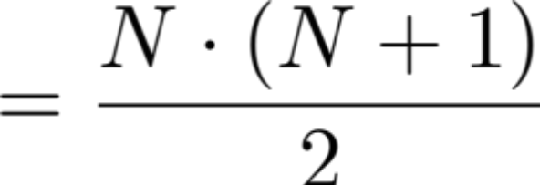
Arithmetic Sum
You can convince yourself that
N ^{x} (N + 1)
1 + 2 + 3 + . . . + (N - 2) + (N - 1) + N =
2

Slide 57

Arithmetic Sum
You can convince yourself that
N ^{x} (N + 1)
1 + 2 + 3 + . . . + (N - 2) + (N - 1) + N =
2

Slide 58
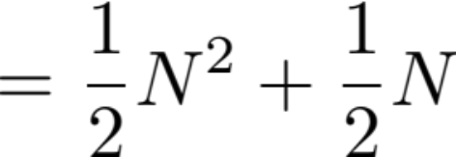
Arithmetic Sum
You can convince yourself that
N ^{x} (N + 1)
1 + 2 + 3 + . . . + (N - 2) + (N - 1) + N =
2

Slide 59
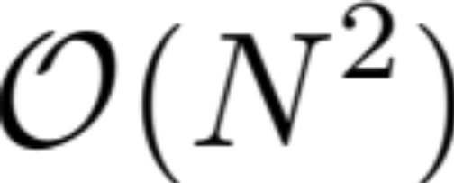
Arithmetic Sum
You can convince yourself that
N ^{x} (N + 1)
1 + 2 + 3 + . . . + (N - 2) + (N - 1) + N =
2

Slide 60
Today’s Goals
Monday
DNA
Fibb
Compare
All
Review
Big O River

Slide 61
Today’s Goals
Monday
DNA
Fibb
Compare
All
Review
Big O River

Slide 62
Complexity Compare All
What is the complexity of this function?
Let n be data.size()
Grid<double> compareAll(Vector<double>& data) {
int n = data.size();
Grid<double> similarity(n, n);
for(int i = 0; i < n; i++) {
for(int j = 0; j < n; j++) {
double diff = calculateDiff(data[i], data[j]);
similarity[i][j] = diff;
}
}
return similarity;
}

Slide 63
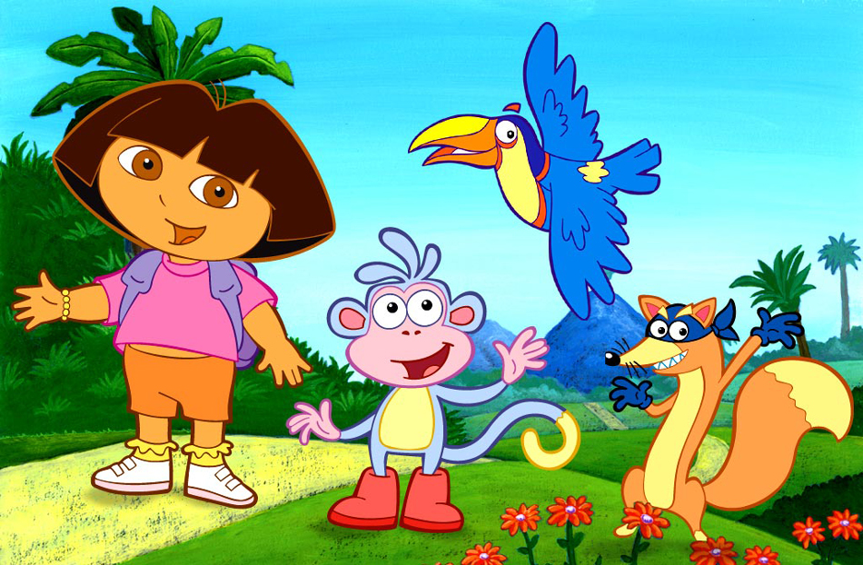


Slide 64
Today’s Goals
Monday
DNA
Fibb
Compare
All
Review
Big O River

Slide 65
Today’s Goals
Monday
DNA
Fibb
Compare
All
Review
Big O River

Slide 66
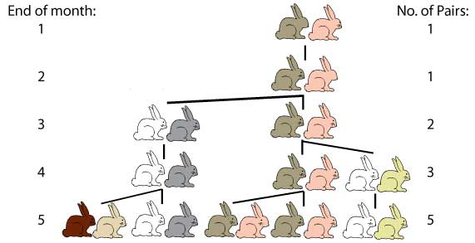

Slide 67
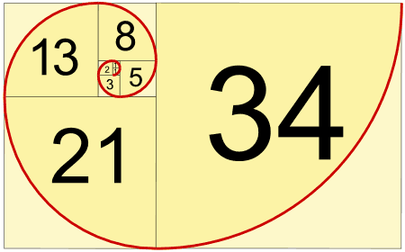

Slide 68
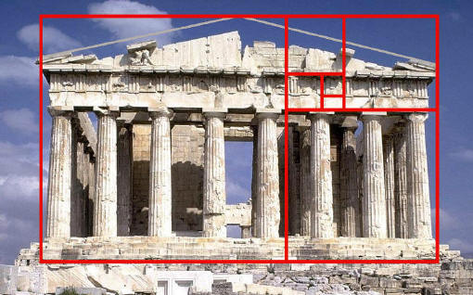

Slide 69
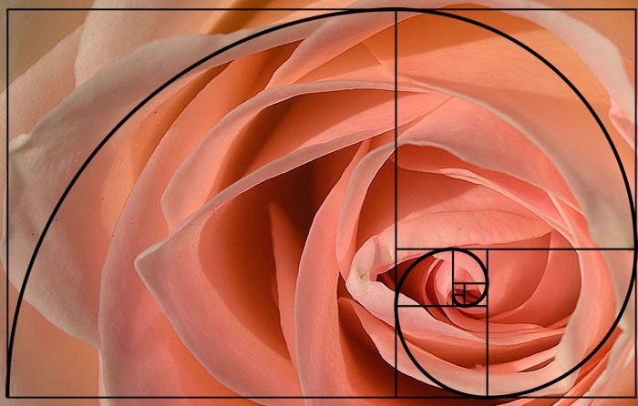

Slide 70
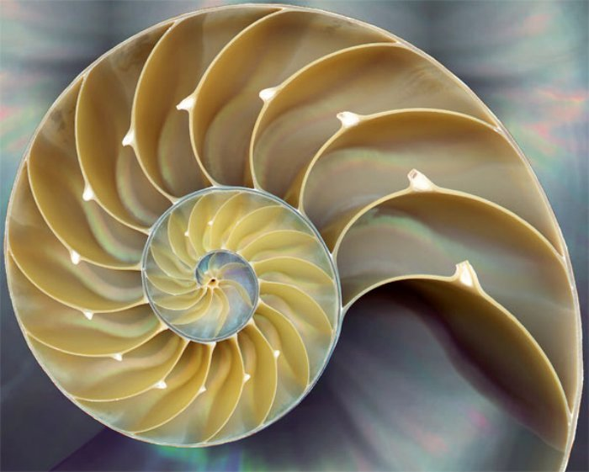

Slide 71
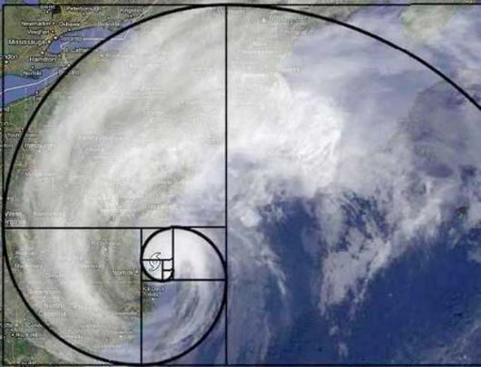

Slide 72
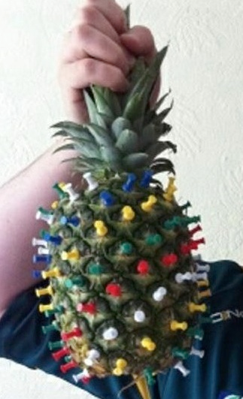
Fibonacci

Slide 73
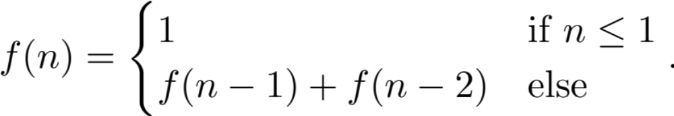
Fibonacci
n = 0, 1, 2, 3, 4, 5, 6…
f(n) = 1, 1, 2, 3, 5, 8, 13 …

Slide 74
Fibonacci
int fib(int n) {
if(n <= 1) {
// base case
return 1;
} else {
// recursive case
return fib(n – 1) + fib(n – 2);
}
}

Slide 75
Fibonacci
int fib(int n) {
if(n <= 1) {
// base case
return 1;
} else {
// recursive case
return fib(n – 1) + fib(n – 2);
}
}

Slide 76
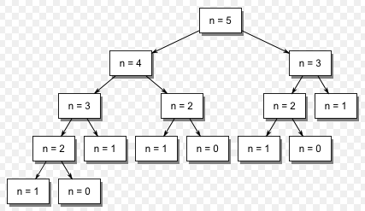
Fibonacci
int fib(int n) {
if(n <= 1) {
// base case
return 1;
} else {
// recursive case
return fib(n – 1) + fib(n – 2);
}
}
Call tree

Slide 77
Big O?

Slide 78
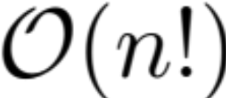
Big O and Recursion
T.S.P.
1
Count the number of recursive calls
N
2
[2,1]
[2,3]
[2,N]
# calls = (N) (N – 1) × … × 1

Slide 79
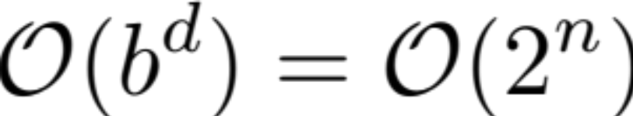
Big O and Fibonacci
Count the number of recursive calls
Branching (b) = decisions in worse recursive case.
Depth (d) = longest chain of recursive calls.

Slide 80
Aside

Slide 81
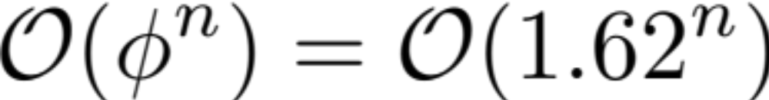
Big O and Fibonacci
Count the number of recursive calls
This is beyond CS106B:

Slide 82
Big O
technically is
since
<
We call it a “tighter” bound

Slide 83
End Aside

Slide 84
Doesn’t look good.

Slide 85
Call Ghost Busters!

Slide 86
Fibonacci
int fib(int n) {
if(n <= 1) {
// base case
return 1;
} else {
// recursive case
return fib(n – 1) + fib(n – 2);
}
}
Call tree

Slide 87
Fibonacci
int fib(int n) {
if(n <= 1) {
// base case
return 1;
} else {
// recursive case
return fib(n – 1) + fib(n – 2);
}
}
Call tree

Slide 88
Fibonacci
int fib(int n) {
if(n <= 1) {
// base case
return 1;
} else {
// recursive case
return fib(n – 1) + fib(n – 2);
}
}
Call tree
fib(2) is calculated 3 separate times when calculating fib(5)!

Slide 89
Memoization
Memoization: Store previous results so that in future executions, you don’t have to recalculate them.
aka
Remember what you have already done!

Slide 90
Memoized Fibonacci
Cache:

Slide 91
Memoized Fibonacci
Cache:

Slide 92
Memoized Fibonacci
Cache:

Slide 93
Memoized Fibonacci
Cache:

Slide 94
Memoized Fibonacci
Cache:

Slide 95
Memoized Fibonacci
Cache:
f(2) = 2

Slide 96
Memoized Fibonacci
Cache:
f(2) = 2

Slide 97
Memoized Fibonacci
Cache:
f(2) = 2

Slide 98
Memoized Fibonacci
Cache:
f(2) = 2, f(3) = 3

Slide 99
Memoized Fibonacci
Cache:
f(2) = 2, f(3) = 3

Slide 100
Memoized Fibonacci
Cache:
f(2) = 2, f(3) = 3

Slide 101
Memoized Fibonacci
Cache:
f(2) = 2, f(3) = 3

Slide 102
Memoized Fibonacci
Cache:
f(2) = 2, f(3) = 3, f(4) = 5

Slide 103
Memoized Fibonacci
Cache:
f(2) = 2, f(3) = 3, f(4) = 5

Slide 104
Memoized Fibonacci
Cache:
f(2) = 2, f(3) = 3, f(4) = 5

Slide 105
Too Fast, Too Furious

Slide 106
Fast Fibb
int fastFibb(Map<int, int>&cache, int n) {
// base case
if(cache.containsKey(n)) return cache[n];
if(n <= 1) return 1;
// recursive case
int result = fastFibb(cache, n-1) + fastFibb(cache, n-2);
cache[n] = result;
return result;
}
// This is now a wrapper that calls fastFibb
int fibb(int n) {
Map<int, int> cache;
return fastFibb(cache, n);
}

Slide 107
Fast Fibb
int fastFibb(Map<int, int>&cache, int n) {
// base case
if(cache.containsKey(n)) return cache[n];
if(n <= 1) return 1;
// recursive case
int result = fastFibb(cache, n-1) + fastFibb(cache, n-2);
cache[n] = result;
return result;
}
// This is now a wrapper that calls fastFibb
int fibb(int n) {
Map<int, int> cache;
return fastFibb(cache, n);
}

Slide 108
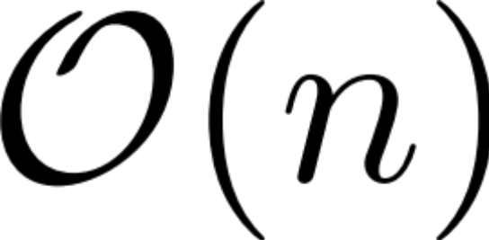
Fast Fibb

Slide 109
Today’s Goals
Monday
DNA
Fibb
Compare
All
Review
Big O River

Slide 110
Today’s Goals
Monday
DNA
Fibb
Compare
All
Review
Big O River

Slide 112
DNA Alignment
Original DNA strings:
s1 = GAATTC
s2 = GATTA
Optimal Alignment
s1 = GAATTC
s2 = GA TTA
Dissimilarity
Each gap or mismatch has a penalty of 1
2

Slide 113
DNA Decision Tree
GAATTC
GATTA

Slide 114
DNA Decision Tree
GAATTC
GATTA
Match first
Score += 0
Gap s2 first
Score += 1
Gap s1 first
Score += 1

Slide 115
DNA Decision Tree
GAATTC
GATTA
Match
Score += 0
Gap s2
Score += 1
Gap s1
Score += 1
AATTC
ATTA
AATTC
GATTA
GAATTC
ATTA

Slide 116
DNA Decision Tree
GAATTC
GATTA
Match
Score += 0
Gap s2
Score += 1
Gap s1
Score += 1
AATTC
ATTA
AATTC
GATTA
GAATTC
ATTA
Match
Score += 1
Gap s1
Score += 1
Gap s2
Score += 1

Slide 117
DNA Decision Tree
GAATTC
GATTA
Match
Score += 0
Gap s2
Score += 1
Gap s1
Score += 1
AATTC
ATTA
AATTC
GATTA
GAATTC
ATTA
Match
Score += 1
Gap s1
Score += 1
Gap s2
Score += 1
AATTC
TTA
GAATTC
TA
AATTC
ATTA

Slide 118
DNA Decision Tree
Try every combination of decisions.
Return the one with the smallest score.

Slide 119
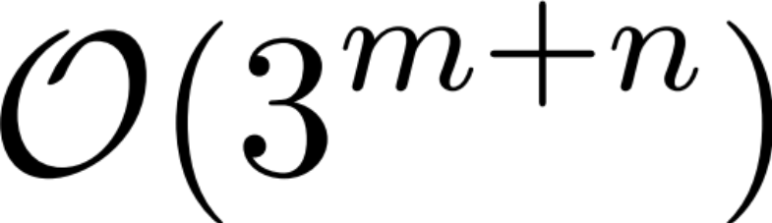
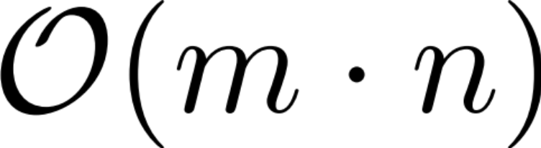
DNA Decision Tree
Without memoization:
LOL
With memoization:
Slow
Where m is the length of str1 and
n is the length of str2

Slide 120
Today’s Goals
Monday
DNA
Fibb
Compare
All
Review
Big O River

Slide 121
Today’s Goals
Monday
DNA
Fibb
Compare
All
Review
Big O River

Slide 122
Today’s Goals
Feel Comfort with Big O
Understand the benefit of memoization

