Slide 1

Linked Lists II
Chris Piech
CS 106B
Lecture 14
Feb 8, 2016

Slide 2

Contest

Slide 3
Thanks to all of those who submitted

Slide 4
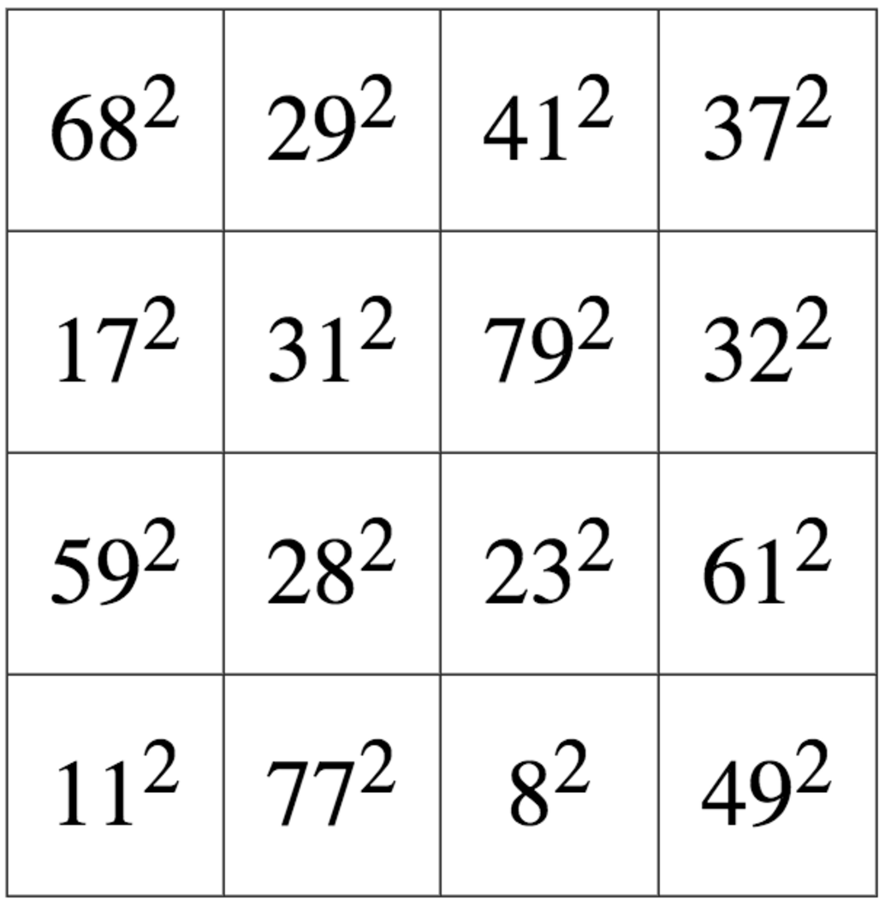
Finalists
Robert Haag

Slide 5
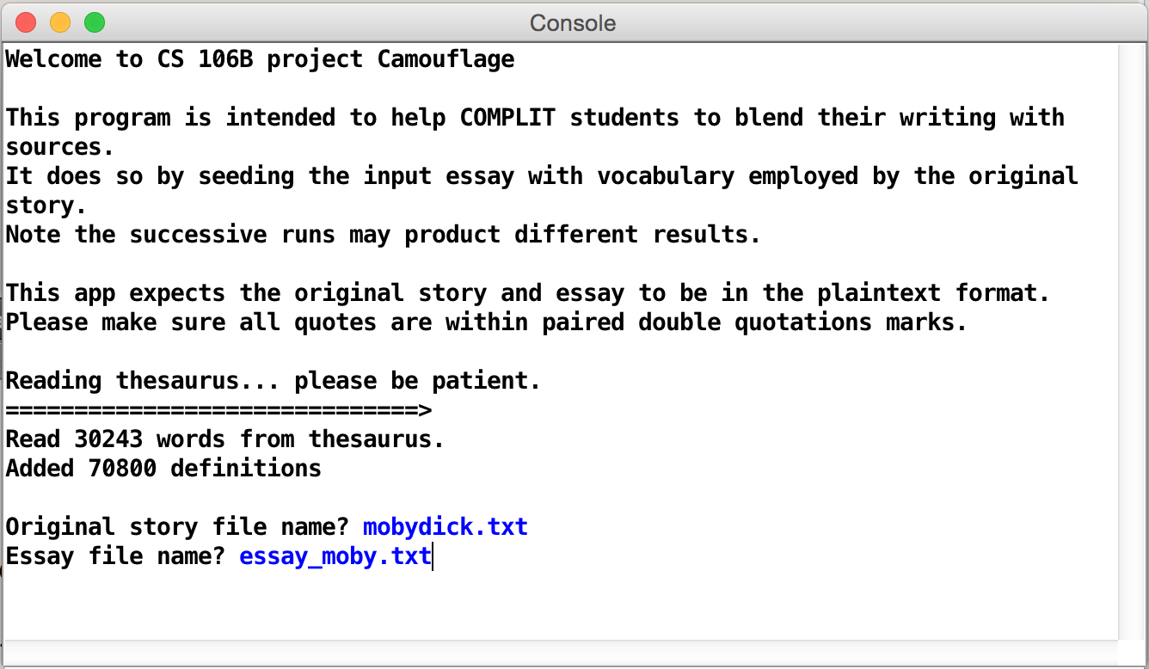
Finalist
Daniel Kharitonov

Slide 6
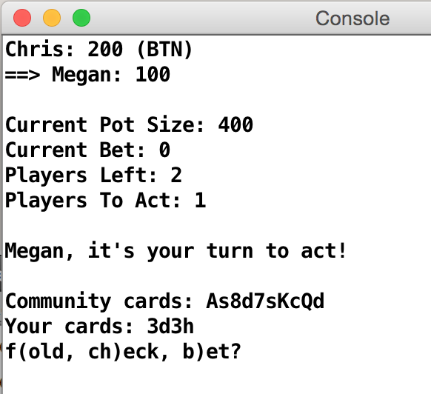
Finalist
Niko Alino

Slide 7
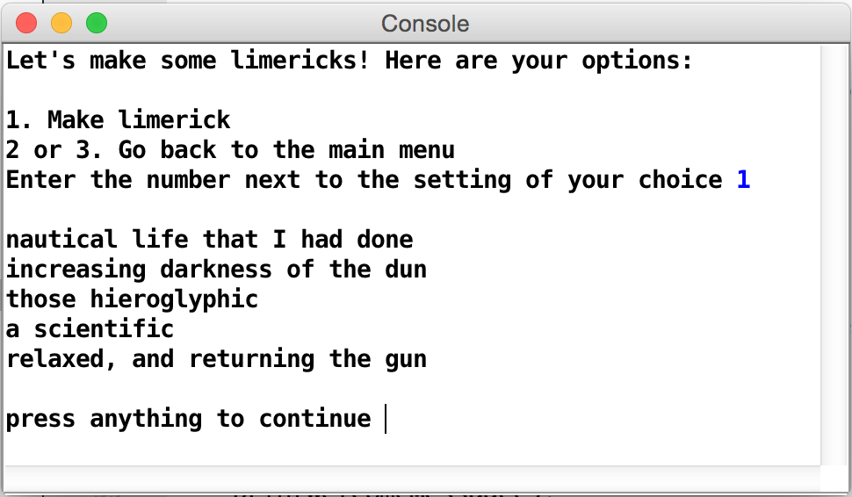
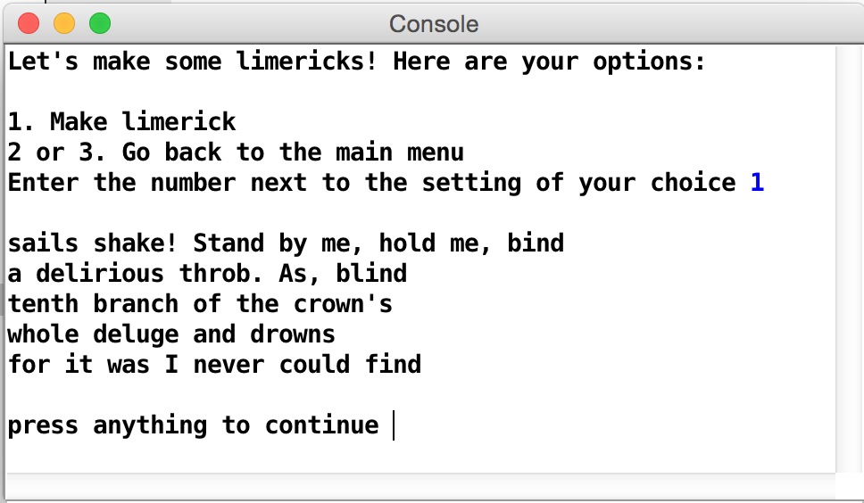
Runner Up - Creativity
Gregory Luppescu

Slide 8
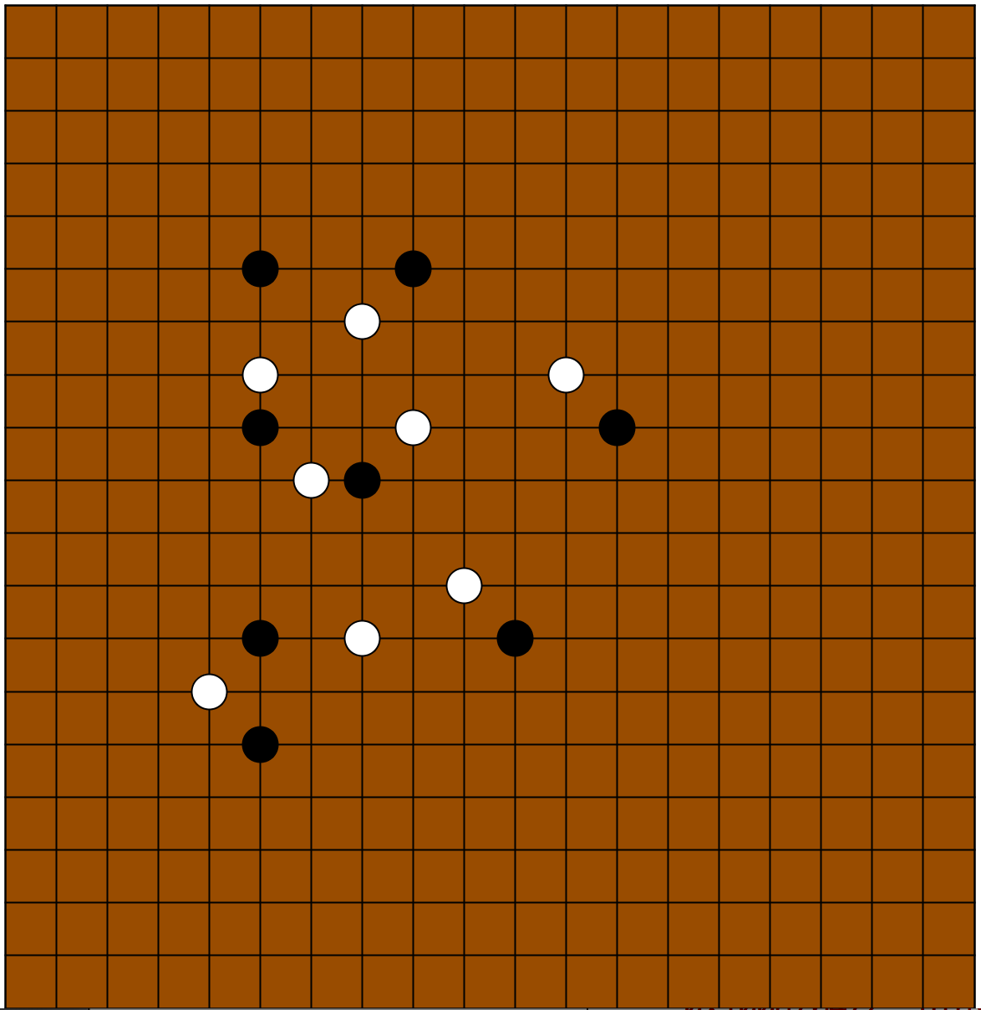
Runner Up - Algorithmic
Cindy Lu

Slide 9
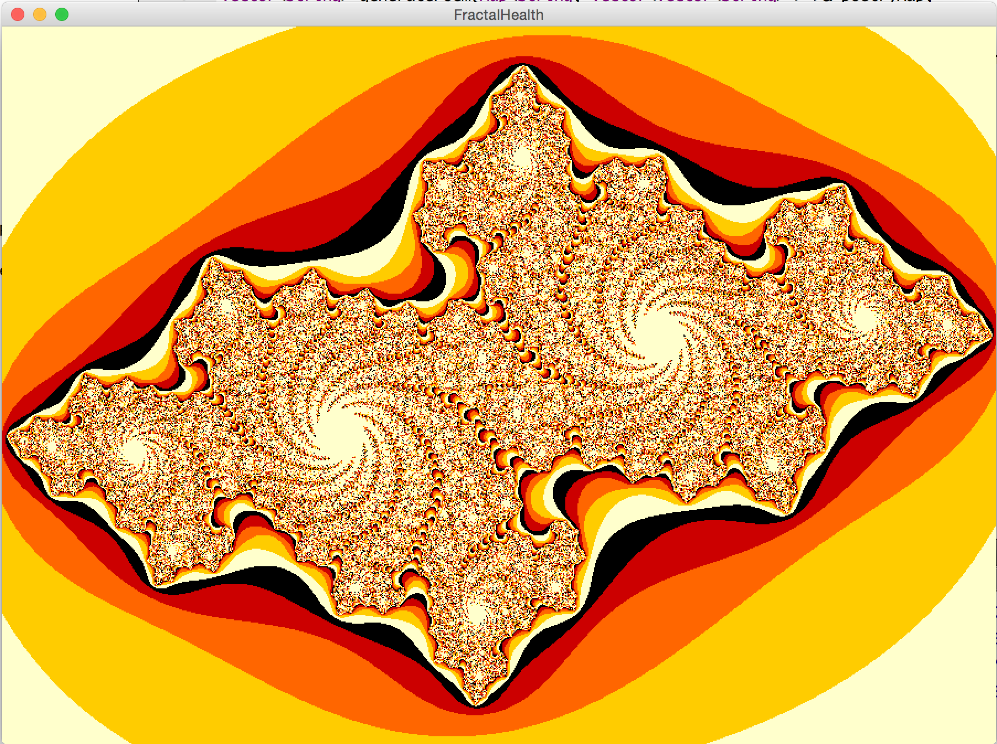
Winner - Creativity
Michelle Park

Slide 10
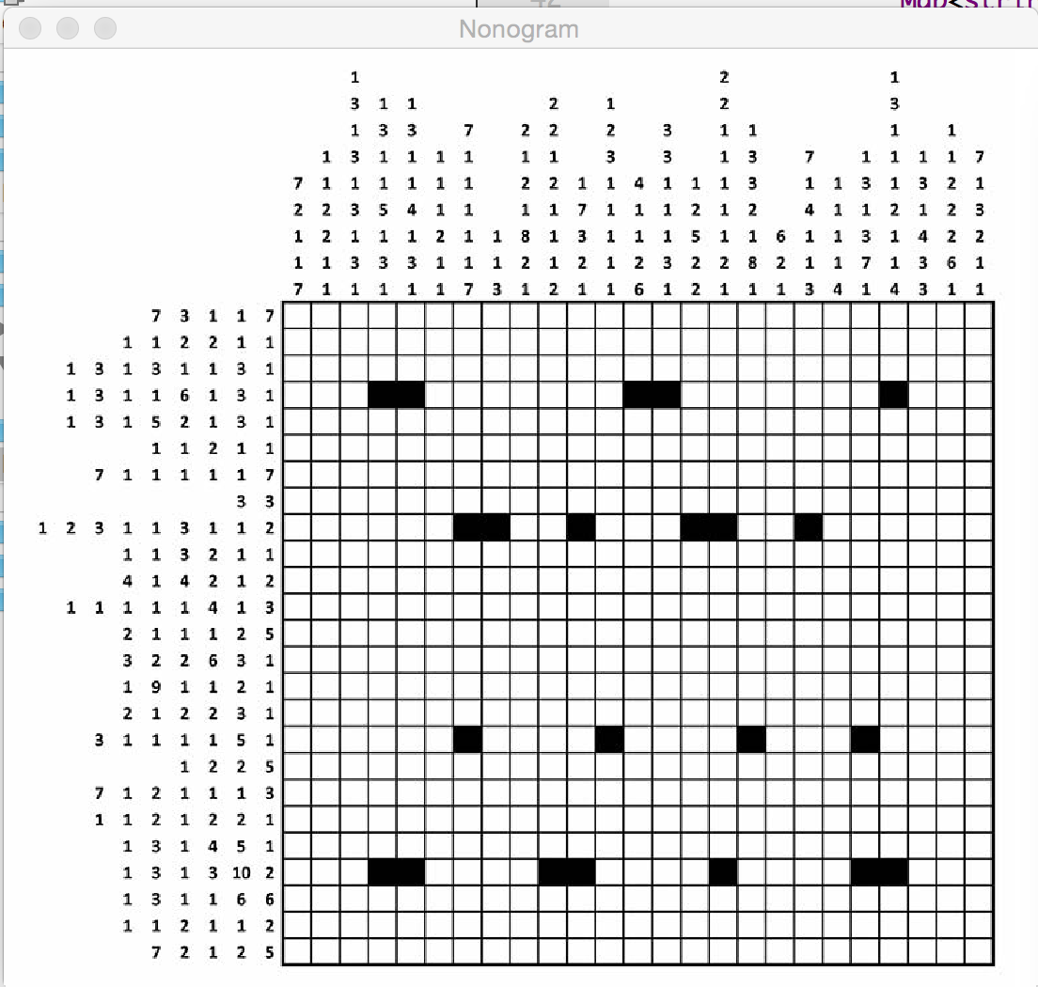
Winner - Algorithmic
Ali Malik

Slide 11
Thanks for playing

Slide 12
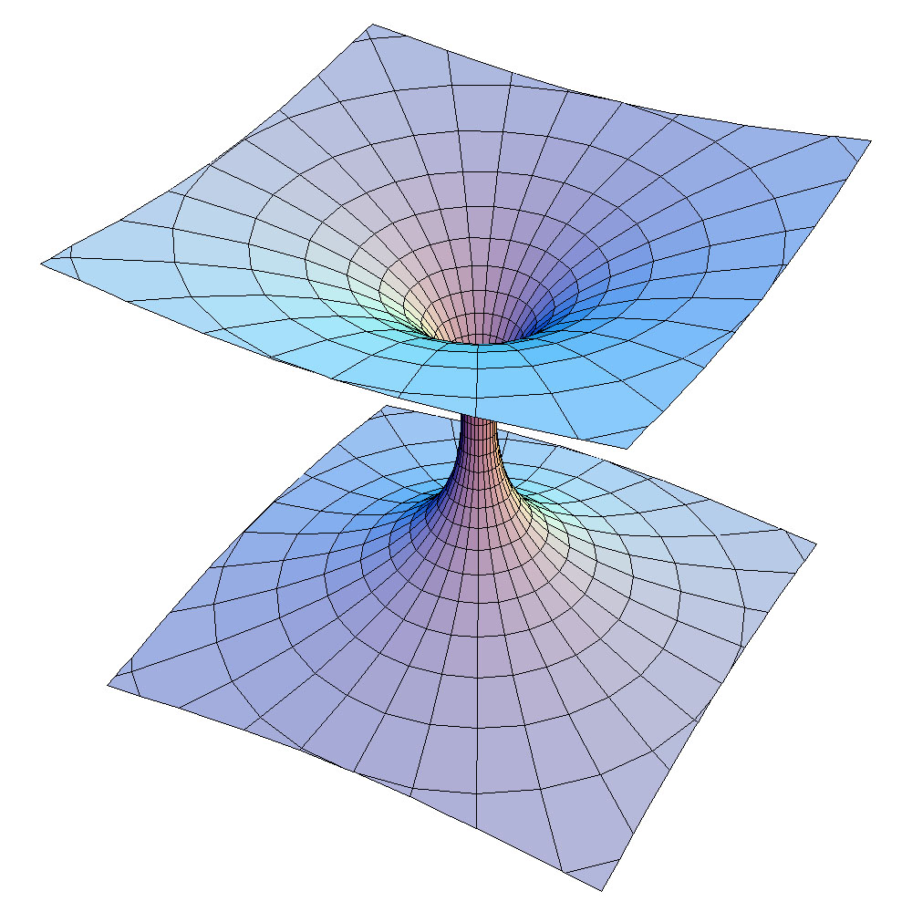

Midterm
Santa
Megan
Mehran
Rudolf
Chris
Get them back on Wednesday
Tell us your favorite song and we’ll create a station that explores that part of the music universe.
Enter Song
Create

Slide 13

Today’s Goals
Round out knowledge of linked lists
See how Stack + Queue work

Slide 14
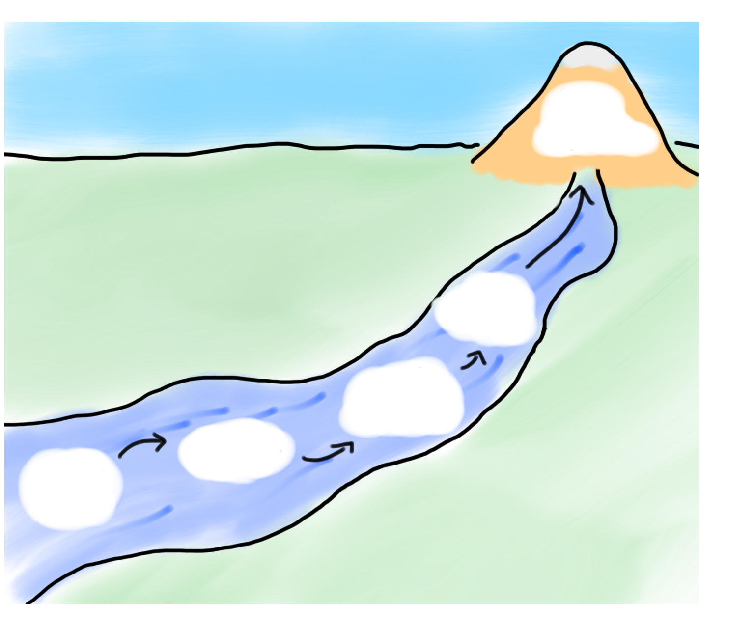
Today’s Goals
Wednesday
Stack +
Queue
Gondor
Linked
Lists
River of Linked Lists II
Review

Slide 15

Today’s Goals
Wednesday
Stack +
Queue
Gondor
Linked
Lists
River of Linked Lists II
Review

Slide 16

How is the Stack Implemented?

Slide 17
VectorInt
  class StackInt { // in VectorInt.h
  public:
  StackInt (); // constructor
  void push(int value); // append a value to the end
  int pop(); // return the value at index
  private:
  VectorInt data; // member variables
  };

Slide 18
There’s always a better way

Slide 19
What About This?
push(7);
int *
data
8
9

Slide 20
What About This?
push(7);
int *
data
8
9
7

Slide 21
What About This?
push(7);
int *
data
8
9
7

Slide 22
What About This?
push(7);
int *
data
8
9
7

Slide 23
Oh Cool

Slide 24
What About This?
push(6);
int *
data
8
9
7

Slide 25
What About This?
push(6);
int *
data
8
9
7
6

Slide 26
What About This?
push(6);
int *
data
8
9
7
6

Slide 27
What About This?
push(6);
int *
data
8
9
7
6

Slide 28

What About This?
push(6);
int *
data
8
9
7
6

Slide 29
And Pop?

Slide 30
What About This?
pop();
int *
data
8
9
7
6

Slide 31
What About This?
pop();
int *
data
8
9
int return
7
6
6

Slide 32
What About This?
pop();
int *
data
8
9
int return
7
6
6

Slide 33
What About This?
pop();
int *
data
8
9
int return
7
6

Slide 34
What About This?
pop();
int *
data
8
9
int return
7
6

Slide 35
Linked Lists!

Slide 36
Today’s Goals
Wednesday
Stack +
Queue
Gondor
Linked
Lists
River of Linked Lists II
Review

Slide 37
Today’s Goals
Wednesday
Stack +
Queue
Gondor
Linked
Lists
River of Linked Lists II
Review

Slide 38
Linked Lists
A linked list is a data structure for storing a sequence of elements.
Each element is stored separately from the rest.
The elements are then chained together into a sequence.
1
2
3

Slide 39
Linked Lists
A linked list is a data structure for storing a sequence of elements.
Each element is stored separately from the rest.
The elements are then chained together into a sequence.
1
2
3
4

Slide 40
Linked Lists
A linked list is a data structure for storing a sequence of elements.
Each element is stored separately from the rest.
The elements are then chained together into a sequence.
1
2
3
4

Slide 41
Linked Lists
A linked list is a data structure for storing a sequence of elements.
Each element is stored separately from the rest.
The elements are then chained together into a sequence.
1
2
3
4

Slide 42
Linked Lists
A linked list is a data structure for storing a sequence of elements.
Each element is stored separately from the rest.
The elements are then chained together into a sequence.
1
2
137
3
4

Slide 43
Linked Lists
A linked list is a data structure for storing a sequence of elements.
Each element is stored separately from the rest.
The elements are then chained together into a sequence.
1
137
3
4

Slide 44
Linked Lists
Can efficiently splice new elements into the list or remove existing elements anywhere in the list.
Never have to do a massive copy step; insertion is efficient in the worst-case.
Has some tradeoffs; we'll see this later.

Slide 45
Linked Lists
In order to use linked lists, we will need to introduce or revisit several new language features:
  Structures
  Dynamic allocation
  Null pointers

Slide 46
Linked Lists
In order to use linked lists, we will need to introduce or revisit several new language features:
  Structures
  Dynamic allocation
  Null pointers

Slide 47
Structs
In C++, a structure is a type consisting of several individual variables all bundled together.
To create a structure, we must
  Define what fields are in the structure, then
  Create a variable of the appropriate type.
Similar to using classes – need to define and implement the class before we can use it.

Slide 48
Structs
You can define a structure by using the struct keyword:
struct TypeName {
/* … field declarations … */
};
For those of you with a C background: in C++, “typedef struct” is not necessary.

Slide 49
Structs
struct Tribute {
string name;
int districtNumber;
};
Tribute t;
t.name = "Katniss Everdeen";
t.districtNumber = 12;

Slide 50
Structs
struct Tribute {
string name;
int districtNumber;
};
Tribute t;
t.name = "Katniss Everdeen";
t.districtNumber = 12;

Slide 51
Structs
struct Tribute {
string name;
int districtNumber;
};
Tribute t;
t.name = "Katniss Everdeen";
t.districtNumber = 12;

Slide 52
Structs
In C++, a class is a pair of an interface and an implementation.
  Interface controls how the class is to be used.
  Implementation specifies how it works.
A struct is a stripped-down version of a class:
  Purely implementation, no interface.
  Primarily used to bundle information together when no interface is needed.

Slide 53
Structs
In order to use linked lists, we will need to introduce or revisit several new language features:
  Structures
  Dynamic allocation
  Null pointers

Slide 54
Structs
In order to use linked lists, we will need to introduce or revisit several new language features:
  Structures
  Dynamic allocation
  Null pointers

Slide 55
Structs
As a reminder we can use the new keyword to allocate single objects.
The syntax:
new T(args)
creates a new object of type T passing the appropriate arguments to the constructor, then returns a pointer to it.

Slide 56
Structs
struct Tribute {
string name;
int districtNumber;
};
Tribute* t = new Tribute;
t->name = "Katniss Everdeen";
t->districtNumber = 12;

Slide 57
Structs
struct Tribute {
string name;
int districtNumber;
};
Tribute* t = new Tribute;
t->name = "Katniss Everdeen";
t->districtNumber = 12;

Slide 58
Structs
struct Tribute {
string name;
int districtNumber;
};
Tribute* t = new Tribute;
t->name = "Katniss Everdeen";
t->districtNumber = 12;
t

Slide 59
Structs
struct Tribute {
string name;
int districtNumber;
};
Tribute* t = new Tribute;
t->name = "Katniss Everdeen";
t->districtNumber = 12;
name
????
districtNumber
t

Slide 60
Structs
struct Tribute {
string name;
int districtNumber;
};
Tribute* t = new Tribute;
t->name = "Katniss Everdeen";
t->districtNumber = 12;
name
????
districtNumber
t

Slide 61
Structs
struct Tribute {
string name;
int districtNumber;
};
Tribute* t = new Tribute;
t->name = "Katniss Everdeen";
t->districtNumber = 12;
name
????
districtNumber
t

Slide 62
Structs
struct Tribute {
string name;
int districtNumber;
};
Tribute* t = new Tribute;
t->name = "Katniss Everdeen";
t->districtNumber = 12;
name
????
districtNumber
t

Slide 63
Structs
Because t is a pointer to a Tribute, not an actual Tribute, we have to use the arrow operator to access the fields pointed at by t.
struct Tribute {
string name;
int districtNumber;
};
Tribute* t = new Tribute;
t->name = "Katniss Everdeen";
t->districtNumber = 12;
name
????
districtNumber
t

Slide 64
Structs
struct Tribute {
string name;
int districtNumber;
};
Tribute* t = new Tribute;
t->name = "Katniss Everdeen";
t->districtNumber = 12;
name
????
districtNumber
t

Slide 65
Structs
struct Tribute {
string name;
int districtNumber;
};
Tribute* t = new Tribute;
t->name = "Katniss Everdeen";
t->districtNumber = 12;
Katniss Everdeen
name
????
districtNumber
t

Slide 66
Structs
struct Tribute {
string name;
int districtNumber;
};
Tribute* t = new Tribute;
t->name = "Katniss Everdeen";
t->districtNumber = 12;
Katniss Everdeen
name
????
districtNumber
t

Slide 67
Structs
struct Tribute {
string name;
int districtNumber;
};
Tribute* t = new Tribute;
t->name = "Katniss Everdeen";
t->districtNumber = 12;
Katniss Everdeen
name
12
districtNumber
t

Slide 68
Structs
As with dynamic arrays, you are responsible for cleaning up memory allocated with new.
You can deallocate memory with the delete keyword:
delete ptr;
This destroys the object pointed at by the given pointer, not the pointer itself.
137
ptr

Slide 69
Structs
As with dynamic arrays, you are responsible for cleaning up memory allocated with new.
You can deallocate memory with the delete keyword:
delete ptr;
This destroys the object pointed at by the given pointer, not the pointer itself.
137
ptr

Slide 70
Building our Vocabulary
In order to use linked lists, we will need to introduce or revisit several new language features:
  Structures
  Dynamic allocation
  Null pointers

Slide 71
Building our Vocabulary
In order to use linked lists, we will need to introduce or revisit several new language features:
  Structures
  Dynamic allocation
  Null pointers

Slide 72
The Null Pointer
When working with pointers, we sometimes wish to indicate that a pointer is not pointing to anything.
In C++, you can set a pointer to NULL to indicate that it is not pointing to an object:
ptr = NULL;
This is not the default value for pointers; by default, pointers default to a garbage value.

Slide 73
Building our Vocabulary
In order to use linked lists, we will need to introduce or revisit several new language features:
  Structures
  Dynamic allocation
  Null pointers

Slide 74
Building our Vocabulary
In order to use linked lists, we will need to introduce or revisit several new language features:
  Structures
  Dynamic allocation
  Null pointers

Slide 75
And now... linked lists!

Slide 76
Linked Lists
A linked list is a chain of nodes.
Each cell contains two pieces of information:
  Some piece of data that is stored in the sequence, and
  A link to the next node in the list.
We can traverse the list by starting at the first cell and repeatedly following its link.

Slide 77
Linked Lists
For simplicity, let's assume we're building a linked list of strings.
We can represent a node in the linked list as a structure:
struct Node {
string value;
/* ? */ next;
};
The structure is defined recursively!

Slide 78
Linked Lists
For simplicity, let's assume we're building a linked list of strings.
We can represent a node in the linked list as a structure:
struct Node {
string value;
Node* next;
};
The structure is defined recursively!

Slide 79
Linked Lists
For simplicity, let's assume we're building a linked list of strings.
We can represent a node in the linked list as a structure:
struct Node {
string value;
Node* next;
};
The structure is defined recursively!

Slide 80
First Rule of Linked List Club

Slide 81
First Rule of Linked List Club
Draw a picture

Slide 82
Today’s Goals
Wednesday
Stack +
Queue
Gondor
Linked
Lists
River of Linked Lists II
Review

Slide 83
Today’s Goals
Wednesday
Stack +
Queue
Gondor
Linked
Lists
River of Linked Lists II
Review

Slide 84

Beacons of Gondor
For answer Gandalf cried aloud to his horse. “On, Shadowfax! We must hasten. Time is short. See! The beacons of Gondor are alight, calling for aid. War is kindled. See, there is the fire on Amon Dîn, and flame on Eilenach; and there they go speeding west: Nardol, Erelas, Min-Rimmon, Calenhad, and the Halifirien on the borders of Rohan.”
—J. R. R. Tolkien, The Return of the King, 1955
In a scene that was brilliantly captured in Peter Jackson’s film adaptation of The Return of the King, Rohan is alerted to the danger to Gondor by a succession of signal fires moving from mountain top to mountain top. This scene is a perfect illustration of the idea of message passing in a linked list.
Minas Tirith
Amon Dîn
Eilenach
Nardol
Erelas
Min-Rimmon
Calenhad
Halifirien
Rohan

Slide 85

The Beacons of Gondor

Slide 86


Slide 87

Volunteer

Slide 88
Beacons of Gondor
struct Tower {
string name; /* The name of this tower */
Tower *link; /* Pointer to the next tower */
};

Slide 89
Beacons of Gondor
// add the first tower
Tower * head = new Tower;
head->name = “Rohan”;
head->link = NULL;

Slide 90
Beacons of Gondor
// add the first tower
Tower * head = new Tower;
head->name = “Rohan”;
head->link = NULL;

Slide 91
Beacons of Gondor
// add the first tower
Tower * head = new Tower;
head->name = “Rohan”;
head->link = NULL;

Slide 92
Beacons of Gondor
// add the first tower
Tower * head = new Tower;
head->name = “Rohan”;
head->link = NULL;

Slide 93
Beacons of Gondor
Min-Rimmon
Eilenach
Halifirien
Minas Tirith
Amon Dîn
Nardol
Erelas
Calenhad
Rohan
// add a new tower
Tower * temp = new Tower;
temp->name = towerName;
temp->link = head;
head = temp;

Slide 94
Beacons of Gondor
Min-Rimmon
Eilenach
Halifirien
Minas Tirith
Amon Dîn
Nardol
Erelas
Calenhad
Rohan
// add a new tower
Tower * temp = new Tower;
temp->name = towerName;
temp->link = head;
head = temp;

Slide 95
Beacons of Gondor
Min-Rimmon
Eilenach
Halifirien
Minas Tirith
Amon Dîn
Nardol
Erelas
Calenhad
Rohan
// add a new tower
Tower * temp = new Tower;
temp->name = towerName;
temp->link = head;
head = temp;

Slide 96
Beacons of Gondor
Min-Rimmon
Eilenach
Halifirien
Minas Tirith
Amon Dîn
Nardol
Erelas
Calenhad
Rohan
// add a new tower
Tower * temp = new Tower;
temp->name = towerName;
temp->link = head;
head = temp;

Slide 97
Beacons of Gondor
Min-Rimmon
Eilenach
Halifirien
Minas Tirith
Amon Dîn
Nardol
Erelas
Calenhad
Rohan
// add a new tower
Tower * temp = new Tower;
temp->name = towerName;
temp->link = head;
head = temp;

Slide 98
Light the Fire
void signal(Tower *start) {
if (start != NULL) {
cout << "Lighting " << start->name << endl;
signal(start->link);
}
}
signal(head);

Slide 99
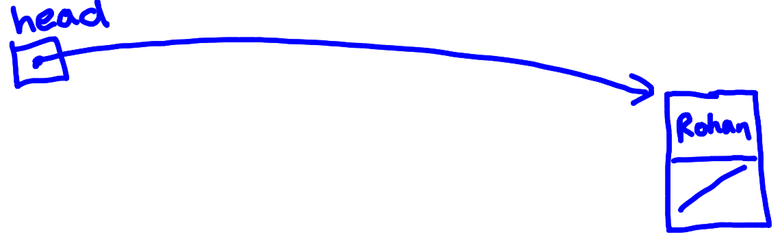
Lets Look at What Happens

Slide 100
Message Passing in Linked Lists
To represent this message-passing image, you might use a definition such as the one shown on the right.
struct Tower {
string name; /* The name of this tower */
Tower *link; /* Pointer to the next tower */
};
/*
* Function: createTower(name, link);
* ----------------------------------
* Creates a new Tower with the specified values.
*/
Tower *createTower(string name, Tower *link) {
Tower *tp = new Tower;
tp->name = name;
tp->link = link;
return tp;
}
/*
* Function: signal(start);
* ------------------------
* Generates a signal beginning at start.
*/
void signal(Tower *start) {
if (start != NULL) {
cout << "Lighting " << start->name << endl;
signal(start->link);
}
}
You can then initialize a chain of Tower structures, like this:
Minas Tirith
Min-Rimmon
Amon Dîn
Calenhad
Eilenach
Halifirien
Nardol
Rohan
Erelas
Calling signal on the first tower sends a message down the chain.

Slide 101
Today’s Goals
Wednesday
Stack +
Queue
Gondor
Linked
Lists
River of Linked Lists II
Review

Slide 102
Today’s Goals
Wednesday
Stack +
Queue
Gondor
Linked
Lists
River of Linked Lists II
Review

Slide 103
How is the Stack Implemented?

Slide 104
Beacons of Gondor
struct Node{
int value; /* The value of this elem */
Node *link; /* Pointer to the next node */
};

Slide 105
Stack is a Linked List
Node *
data
8
9

Slide 106
Stack is a Linked List
push(7);
Node *
data
8
9

Slide 107
Stack is a Linked List
push(7);
Node *
data
8
9
Node*
temp
7
Node * temp = new Node;
temp -> value = 7;

Slide 108
Stack is a Linked List
push(7);
Node *
data
8
9
Node*
temp
7
temp -> link = data;

Slide 109
Stack is a Linked List
push(7);
Node *
data
8
9
Node*
temp
7
data = temp;

Slide 110
Stack is a Linked List
push(7);
Node *
data
8
9
7
exit function

Slide 112
Stack is a Linked List
pop();
Node *
data
8
9
7

Slide 113
Stack is a Linked List
pop();
Node *
data
8
9
int return
7
7
int return = data->value;

Slide 114
Stack is a Linked List
pop();
Node *
data
8
9
int return
Node*
temp
7
7
Node * temp = data;

Slide 115
Stack is a Linked List
pop();
Node *
data
8
9
int return
Node*
temp
7
7
data = temp->link;

Slide 116
Stack is a Linked List
pop();
Node *
data
8
9
int return
Node*
temp
7
delete temp;

Slide 117
Stack is a Linked List
pop();
Node *
data
8
9
int return
7
exit function + return

Slide 118

Big O of Push?

Slide 119
Big O of Pop?

Slide 120

Stack in C++

Slide 121

How is the Queue Implemented?

Slide 122
Queue?
Node *
data
8
9

Slide 123
Queue Enqueue?
Node *
data
8
9
7

Slide 124
Queue Enqueue?
Node *
data
8
9
7

Slide 125
Queue Dequeue?
Node *
data
8
9
7

Slide 126
Queue Dequeue?
Node *
data
8
9
7

Slide 127
Queue Dequeue?
Node *
data
8
9
7

Slide 128
Queue Dequeue?
Node *
data
8
9
7

Slide 129
Queue Dequeue?
Node *
data
8
7

Slide 130

Queue Dequeue?
Node *
data
8
7

Slide 131
Always a Better Way

Slide 132
Queue Enqueue?
Node *
tail
Node *
head
3
2
1

Slide 133
Queue Enqueue?
Node *
tail
Node *
head
4
3
2
1
Node *
cp
Node * cp = new Node;
cp->value = 4;

Slide 134
Queue Enqueue?
Node *
tail
Node *
head
4
3
2
1
Node *
cp
tail->link = cp;

Slide 135
Queue Enqueue?
Node *
tail
Node *
head
4
3
2
1
Node *
cp
tail = cp;

Slide 136
Queue Enqueue?
Node *
tail
Node *
head
4
3
2
1
return

Slide 137
Queue Enqueue?
Node *
tail
Node *
head
4
3
2
1

Slide 138
Dequeue

Slide 139
Queue Enqueue?
Node *
tail
Node *
head
4
3
2
1

Slide 140
Node *
tail
Node *
head
4
3
2
1
Node *
cp
Node * cp = head;

Slide 141
Node *
tail
Node *
head
4
3
2
1
Node *
cp
head = cp->link;

Slide 142
Node *
tail
Node *
head
4
3
2
Node *
cp
delete cp;

Slide 143
Node *
tail
Node *
head
4
3
2
return 1

Slide 144
Node *
tail
Node *
head
4
3
2

Slide 145
Summary
Stack Push
Stack Pop
Queue Enqueue
Queue Dequeue

Slide 146
Today’s Goals
Wednesday
Stack +
Queue
Gondor
Linked
Lists
River of Linked Lists II
Review

Slide 147
Today’s Goals
Wednesday
Stack +
Queue
Gondor
Linked
Lists
River of Linked Lists II
Review

Slide 148
Today’s Goals
Round out knowledge of linked lists
See how Stack + Queue work

