Slide 1
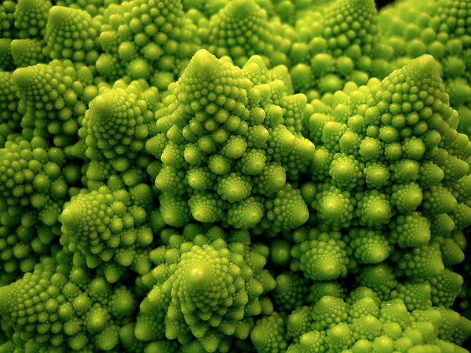
Thinking Recursively
Chris Piech
CS 106B
Lecture 6
Jan 20, 2016

Slide 2

Women in CS Dinner
Today
5:30 – 7:30pm
Women’s
Community
Center

Slide 3

Socrative.com
Room: 106BWIN16

Slide 4
Today is an exciting day

Slide 5
Learn a new way to think

Slide 6
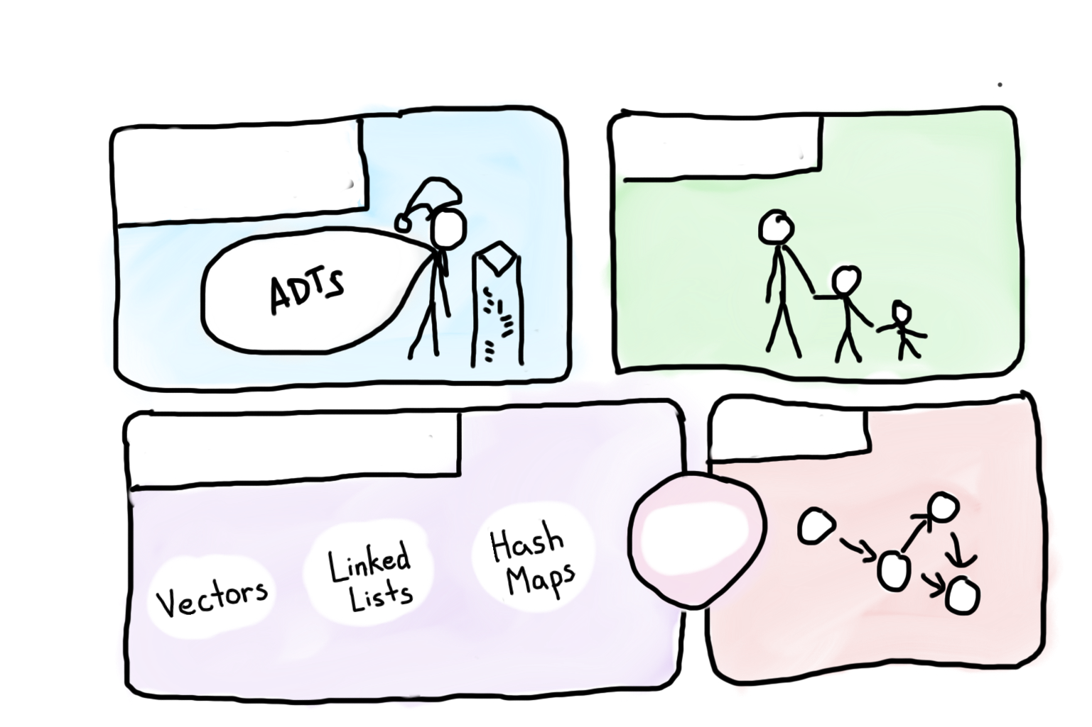


Course Syllabus
Intro to Abstractions
Recursion
Graphs
Under the Hood
Trees
You are here

Slide 7
Towers of Hanoi
A
B
C

Slide 8
Towers of Hanoi
Move this tower...
A
B
C

Slide 9
Towers of Hanoi
Move this tower...
...to this spindle.
A
B
C

Slide 10
Towers of Hanoi
Move this tower...
...to this spindle.
A
B
C

Slide 11
Towers of Hanoi
A
B
C

Slide 12
Towers of Hanoi
A
B
C

Slide 13
Towers of Hanoi
A
B
C

Slide 14
Towers of Hanoi
A
B
C

Slide 15


Slide 16
By the end of today we will write code
that solves this problem

Slide 17

We’ve Gotten Ahead of Ourselves
Source: The Hobbit

Slide 18

Start at the Beginning
Source: The Hobbit

Slide 19

Today’s Goal
Be able to think about problems recursively

Slide 20
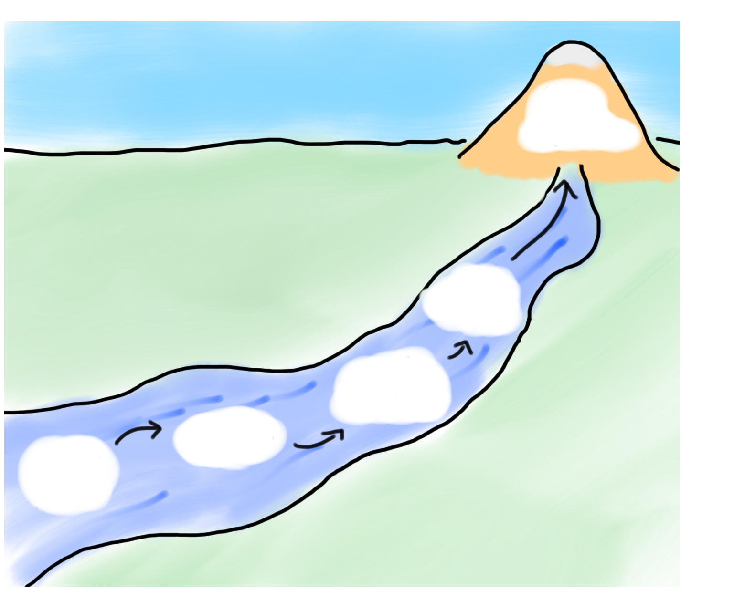
Today’s Route
Wednesday
Hanoi
Many
Examples
Powers
Intuition
Recursion River

Slide 21
Today’s Route
Wednesday
Hanoi
Many
Examples
Powers
Intuition
Recursion River

Slide 22

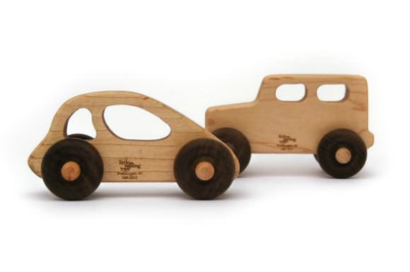
Pedagogy
Start Simple
Build Complexity

Slide 23
Recursion
Define an operation in terms of itself.

Slide 24
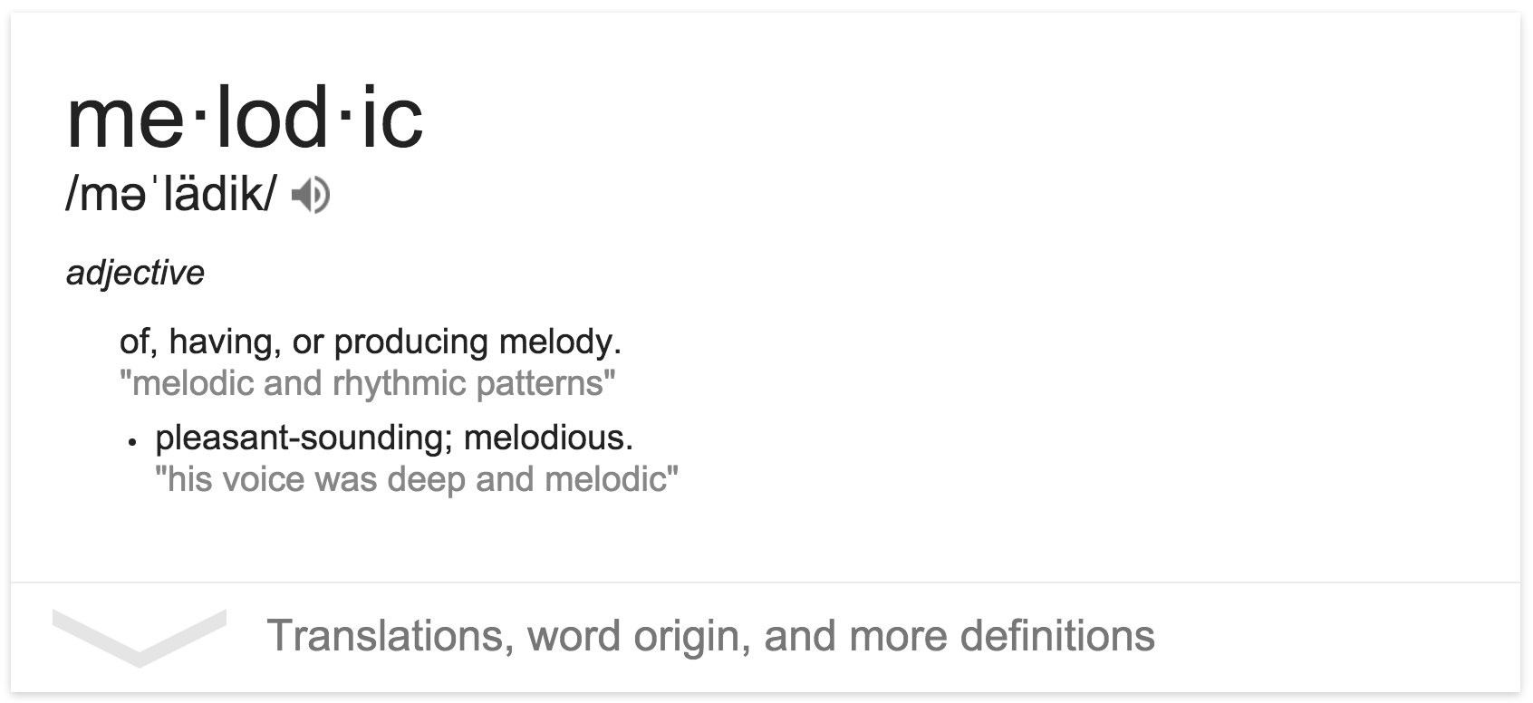
Understanding a Word
Operation: Understand Word

Slide 26
How Many Students in Col?
How many students total are directly behind you in your "column" of the classroom?

Slide 27
How Many Students in Col?
How many students total are behind you in your "column" of the classroom?
  You can see only the people right next to you. So you can't just look back and count.
  But you are allowed to ask
  questions of the person next to you.
  How can we solve this problem (recursively )

Slide 29
How Many Students in Col?
int numStudentsBehind(Student curr) {
if(lastInRow(curr)) {
return 0;
} else {
Student next = curr.getBehind();
return numStudentsBehind(next) + 1;
}
}

Slide 30
Anatomy of Recursion
int numStudentsBehind(Student curr) {
if(lastInRow(curr)) {
return 0;
} else {
Student next = curr.getBehind();
return numStudentsBehind(next) + 1;
}
}

Slide 31
Base Case
int numStudentsBehind(Student curr) {
if(lastInRow(curr)) {
return 0;
} else {
Student next = curr.getBehind();
return numStudentsBehind(next) + 1;
}
}

Slide 32
Recursive Case
int numStudentsBehind(Student curr) {
if(lastInRow(curr)) {
return 0;
} else {
Student next = curr.getBehind();
return numStudentsBehind(next) + 1;
}
}

Slide 33
Recursive Call
int numStudentsBehind(Student curr) {
if(lastInRow(curr)) {
return 0;
} else {
Student next = curr.getBehind();
return numStudentsBehind(next) + 1;
}
}

Slide 34
Recursive Call
int numStudentsBehind(Student curr) {
if(lastInRow(curr)) {
return 0;
} else {
Student next = curr.getBehind();
return numStudentsBehind(next) + 1;
}
}
Progress towards the base case

Slide 35
Three Musts of Recursion
Your code must have a case for all valid inputs.
You must have a base case (makes no recursive calls).
When you make a recursive call it should be to a simpler instance (forward progress towards base case)

Slide 36
Today’s Route
Wednesday
Hanoi
Many
Examples
Powers
Intuition
Recursion River

Slide 37
Today’s Route
Wednesday
Hanoi
Many
Examples
Powers
Intuition
Recursion River

Slide 38
Powers
Write a recursive function that takes in a base and an
exponent and returns the result of base^{exp}

Slide 39
Powers
Write a recursive function that takes in a base and an
exponent and returns the result of base^{exp}
The term “base” here is the term for
the bottom of a power.
Not to be confused with “base case”

Slide 40
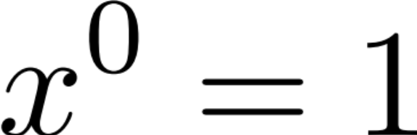
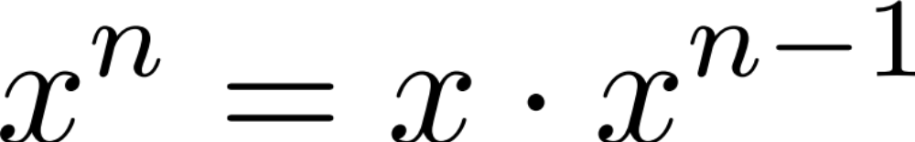
Recursive Insight

Slide 41
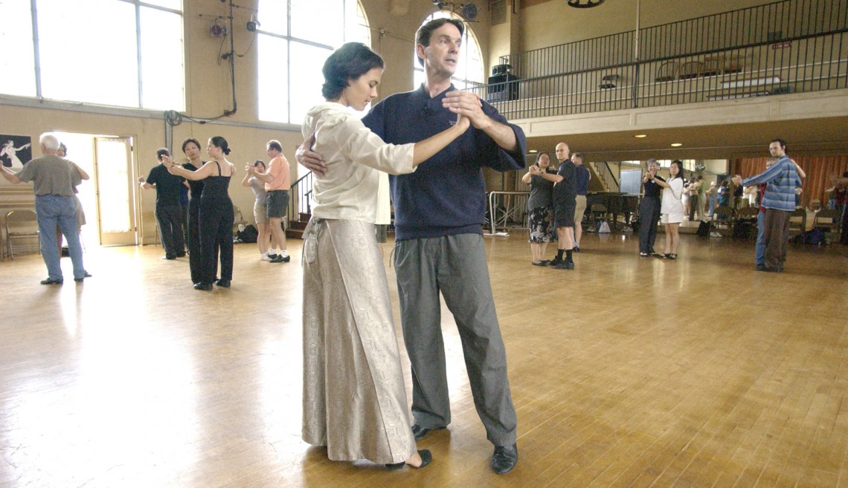

Slide 42
The Call Stack
Each previous call waits for the next call to finish.
  cout << power(5, 3) << endl;
// first call: 5 3
int power(int base, int exp) {
if (exp == 1) {
return base;
} else {
return base * power(base, exp - 1);
}
}
// second call: 5 2
int power(int base, int exp) {
if (exp == 1) {
return base;
} else {
return base * power(base, exp - 1);
}
}
// third call: 5 1
int power(int base, int exp) {
if (exp == 1) {
return base; // 5
} else {
return base * power(base, exp - 1);
}
}

Slide 43
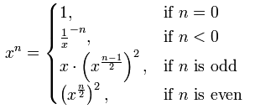
Even Cooler Recursive Insight
Exponentiation by squaring
Not important right now

Slide 44
Today’s Route
Wednesday
Hanoi
Many
Examples
Powers
Intuition
Recursion River

Slide 45
Today’s Route
Wednesday
Hanoi
Many
Examples
Powers
Intuition
Recursion River

Slide 46
What Does This Code Do?
A: 5
int mystery(int n) {
if(n < 10) {
return n;
} else {
int toAdd = n % 10;
int theRest = mystery(n / 10);
return theRest + toAdd;
}
}
B: 6
C: 7
D: 8
What is the result of mystery(123)?
// second call: 5 2
int power(int base, int exp) {
if (exp == 1) {
return base;
} else {
return base * power(base, exp - 1);
}
}
// third call: 5 1
int power(int base, int exp) {
if (exp == 1) {
return base; // 5
} else {
return base * power(base, exp - 1);
}

Slide 47
What Does This Code Do?
A: 5
int mystery(int n) {
if(n < 10) {
return n;
} else {
int toAdd = n % 10;
int theRest = mystery(n / 10);
return theRest + toAdd;
}
}
// first call: 123
int mystery(int n) {
if (n < 10) {
return n;
} else {
return (n % 10) + mystery(n / 10);
}
}
B: 6
C: 7
3
D: 8
What is the result of mystery(123)?
// second call: 5 2
int power(int base, int exp) {
if (exp == 1) {
return base;
} else {
return base * power(base, exp - 1);
}
}
// third call: 5 1
int power(int base, int exp) {
if (exp == 1) {
return base; // 5
} else {
return base * power(base, exp - 1);
}

Slide 48
What Does This Code Do?
A: 5
int mystery(int n) {
if(n < 10) {
return n;
} else {
int toAdd = n % 10;
int theRest = mystery(n / 10);
return theRest + toAdd;
}
}
// first call: 123
int mystery(int n) {
if (n < 10) {
return n;
} else {
return (n % 10) + mystery(n / 10);
}
}
B: 6
// second call: 12
int mystery(int n) {
if (n < 10) {
return n;
} else {
return (n % 10) + mystery(n / 10);
}
}
C: 7
3
2
D: 8
What is the result of mystery(123)?
// second call: 5 2
int power(int base, int exp) {
if (exp == 1) {
return base;
} else {
return base * power(base, exp - 1);
}
}
// third call: 5 1
int power(int base, int exp) {
if (exp == 1) {
return base; // 5
} else {
return base * power(base, exp - 1);
}

Slide 49
What Does This Code Do?
A: 5
int mystery(int n) {
if(n < 10) {
return n;
} else {
int toAdd = n % 10;
int theRest = mystery(n / 10);
return theRest + toAdd;
}
}
// first call: 123
int mystery(int n) {
if (n < 10) {
return n;
} else {
return (n % 10) + mystery(n / 10);
}
}
B: 6
// second call: 12
int mystery(int n) {
if (n < 10) {
return n;
} else {
return (n % 10) + mystery(n / 10);
}
}
C: 7
3
// third call: 1
int mystery(int n) {
if (n < 10) {
return n;
} else {
return (n % 10) + mystery(n / 10);
}
}
D: 8
2
1
What is the result of mystery(123)?
// second call: 5 2
int power(int base, int exp) {
if (exp == 1) {
return base;
} else {
return base * power(base, exp - 1);
}
}
// third call: 5 1
int power(int base, int exp) {
if (exp == 1) {
return base; // 5
} else {
return base * power(base, exp - 1);
}

Slide 50
What Does This Code Do?
A: 5
int mystery(int n) {
if(n < 10) {
return n;
} else {
int toAdd = n % 10;
int theRest = mystery(n / 10);
return theRest + toAdd;
}
}
// first call: 123
int mystery(int n) {
if (n < 10) {
return n;
} else {
return (n % 10) + mystery(n / 10);
}
}
B: 6
// second call: 12
int mystery(int n) {
if (n < 10) {
return n;
} else {
return (n % 10) + mystery(n / 10);
}
}
C: 7
3
2
D: 8
1
What is the result of mystery(123)?
// second call: 5 2
int power(int base, int exp) {
if (exp == 1) {
return base;
} else {
return base * power(base, exp - 1);
}
}
// third call: 5 1
int power(int base, int exp) {
if (exp == 1) {
return base; // 5
} else {
return base * power(base, exp - 1);
}

Slide 51
What Does This Code Do?
A: 5
int mystery(int n) {
if(n < 10) {
return n;
} else {
int toAdd = n % 10;
int theRest = mystery(n / 10);
return theRest + toAdd;
}
}
// first call: 123
int mystery(int n) {
if (n < 10) {
return n;
} else {
return (n % 10) + mystery(n / 10);
}
}
B: 6
C: 7
3
3
D: 8
What is the result of mystery(123)?
// second call: 5 2
int power(int base, int exp) {
if (exp == 1) {
return base;
} else {
return base * power(base, exp - 1);
}
}
// third call: 5 1
int power(int base, int exp) {
if (exp == 1) {
return base; // 5
} else {
return base * power(base, exp - 1);
}

Slide 53
Is Palindrome
Write a recursive function isPalindrome(string s) accepts a string and returns true if it reads the same forwards as backwards.
  isPalindrome("madam") → true
  isPalindrome("racecar") → true
  isPalindrome("step on no pets") → true
  isPalindrome("able was I ere I saw elba") → true
  isPalindrome("Q") → true
  isPalindrome("Java") → false
  isPalindrome("rotater") → false
  isPalindrome("byebye") → false
  isPalindrome("notion") → false
  What is a good base case?What
What is a good base case?

Slide 54
Is Palendrome
  // Returns true if the given string reads the same
  // forwards as backwards.
  // Trivially true for empty or 1-letter strings.
  bool isPalindrome(string s) {
  if (s.length() < 2) { // base case
  return true;
  } else { // recursive case
  if (s[0] != s[s.length() - 1]) {
  return false;
  }
  string middle = s.substr(1, s.length() - 2);
  return isPalindrome(middle);
  }
  }

Slide 56
Hailstone
Print the sequences of numbers that you take to get from N until 1, using the Hailstone (Collatz) production rules:
If n == 1, you are done.
If n is odd your next number is 3*n + 1.
If n is even your next number is n / 2.

Slide 57
Hailstone
// Couts the sequence of numbers from n to one
// produced by the Hailstone (aka Collatz)
// procedure
void hailstone(int n) {
cout << n << endl;
if(n == 1) {
return;
} else {
if(n % 2 == 0) {
// n is even so we repeat with n/2 hailstone(n / 2);
} else {
// n is odd so we repeat with 3 * n + 1 hailstone(3 * n + 1);
}
}
}

Slide 58
Are The Recursive Calls Simpler?
// Couts the sequence of numbers from n to one
// produced by the Hailstone (aka Collatz)
// procedure
void hailstone(int n) {
cout << n << endl;
if(n == 1) {
return;
} else {
if(n % 2 == 0) {
// n is even so we repeat with n/2 hailstone(n / 2);
} else {
// n is odd so we repeat with 3 * n + 1 hailstone(3 * n + 1);
}
}
}
When you make a recursive call it should be to a simpler instance (forward progress towards base case)
Well that seems to be true…

Slide 59
Works for numbers up to 5×10¹⁸

Slide 60
Reward for proof

Slide 62
$1,400

Slide 63
Today’s Route
Wednesday
Hanoi
Many
Examples
Powers
Intuition
Recursion River

Slide 64
Today’s Route
Wednesday
Hanoi
Many
Examples
Powers
Intuition
Recursion River

Slide 65
And Here We Are

Slide 66
Tower of Hanoi
A
B
C
This disk...
...needs to get over here.

Slide 68
Tower of Hanoi Insight
A
B
C
This disk...
...needs to get over here.

Slide 69
Tower of Hanoi Insight
A
B
C
This disk...
...needs to get over here.

Slide 70
Tower of Hanoi Insight
A
B
C
This disk...
...needs to get over here.

Slide 71
Tower of Hanoi Insight
A
B
C

Slide 73
Tower of Hanoi Insight
A
B
C
This disk...
...needs to get over here.

Slide 74
Tower of Hanoi Insight
A
B
C
This disk...
...needs to get over here.

Slide 75
Tower of Hanoi Insight
A
B
C
This disk...
...needs to get over here.

Slide 76
Tower of Hanoi Insight
A
B
C
This disk...
...needs to get over here.

Slide 77
Base Case
We need to find a very simple case that we can solve directly in order for the recursion to work.
If the tower has size one, we can just move that single disk from the source to the destination.

Slide 78
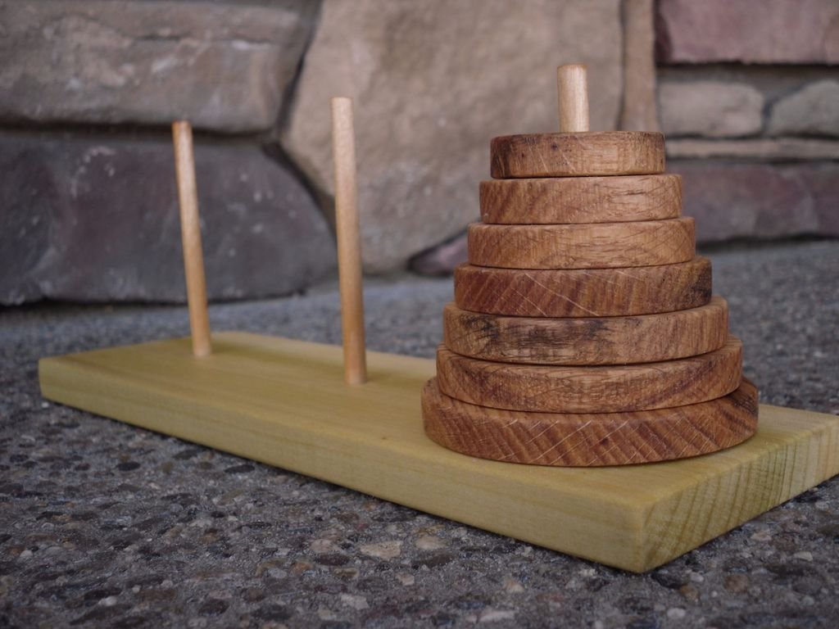

Slide 79
int main() {
moveTower(3, 'a', 'c', 'b');
}
A
A
B
C

Slide 80
int main() {
moveTower(3, 'a', 'c', 'b');
}
A
A
B
C

Slide 81
int main() {
moveTower(3, 'a', 'b', 'c');
}
void moveTower(int n, char from, char to, char temp) {
if (n == 1) {
moveSingleDisk(from, to);
} else {
moveTower(n – 1, from, temp, to);
moveSingleDisk(from, to);
moveTower(n – 1, temp, to, from);
}
}
n
3
from
a
to
c
temp
b
A
A
B
C

Slide 82
int main() {
moveTower(3, 'a', 'b', 'c');
}
void moveTower(int n, char from, char to, char temp) {
if (n == 1) {
moveSingleDisk(from, to);
} else {
moveTower(n – 1, from, temp, to);
moveSingleDisk(from, to);
moveTower(n – 1, temp, to, from);
}
}
n
3
from
a
to
c
temp
b
A
A
B
C

Slide 83
int main() {
moveTower(3, 'a', 'b', 'c');
}
void moveTower(int n, char from, char to, char temp) {
if (n == 1) {
moveSingleDisk(from, to);
} else {
moveTower(n – 1, from, temp, to);
moveSingleDisk(from, to);
moveTower(n – 1, temp, to, from);
}
}
n
3
from
a
to
c
temp
b
A
A
B
C

Slide 84
int main() {
moveTower(3, 'a', 'b', 'c');
}
void moveTower(int n, char from, char to, char temp) {
if (n == 1) {
moveSingleDisk(from, to);
} else {
moveTower(n – 1, from, temp, to);
moveSingleDisk(from, to);
moveTower(n – 1, temp, to, from);
}
}
n
3
from
a
to
c
temp
b
A
A
B
C

Slide 85
int main() {
moveTower(3, 'a', 'b', 'c');
}
void moveTower(int n, char from, char to, char temp) {
if (n == 1) {
moveSingleDisk(from, to);
} else {
moveTower(n – 1, from, temp, to);
moveSingleDisk(from, to);
moveTower(n – 1, temp, to, from);
}
}
void moveTower(int n, char from, char to, char temp) {
if (n == 1) {
moveSingleDisk(from, to);
} else {
moveTower(n – 1, from, temp, to);
moveSingleDisk(from, to);
moveTower(n – 1, temp, to, from);
}
}
n
3
from
a
to
b
temp
c
n
2
from
a
to
b
temp
c
A
A
B
C

Slide 86
int main() {
moveTower(3, 'a', 'b', 'c');
}
void moveTower(int n, char from, char to, char temp) {
if (n == 1) {
moveSingleDisk(from, to);
} else {
moveTower(n – 1, from, temp, to);
moveSingleDisk(from, to);
moveTower(n – 1, temp, to, from);
}
}
void moveTower(int n, char from, char to, char temp) {
if (n == 1) {
moveSingleDisk(from, to);
} else {
moveTower(n – 1, from, temp, to);
moveSingleDisk(from, to);
moveTower(n – 1, temp, to, from);
}
}
n
3
from
a
to
b
temp
c
n
2
from
a
to
b
temp
c
A
A
B
C

Slide 87
int main() {
moveTower(3, 'a', 'b', 'c');
}
void moveTower(int n, char from, char to, char temp) {
if (n == 1) {
moveSingleDisk(from, to);
} else {
moveTower(n – 1, from, temp, to);
moveSingleDisk(from, to);
moveTower(n – 1, temp, to, from);
}
}
void moveTower(int n, char from, char to, char temp) {
if (n == 1) {
moveSingleDisk(from, to);
} else {
moveTower(n – 1, from, temp, to);
moveSingleDisk(from, to);
moveTower(n – 1, temp, to, from);
}
}
n
3
from
a
to
b
temp
c
n
2
from
a
to
b
temp
c
A
A
B
C

Slide 88
int main() {
moveTower(3, 'a', 'b', 'c');
}
void moveTower(int n, char from, char to, char temp) {
if (n == 1) {
moveSingleDisk(from, to);
} else {
moveTower(n – 1, from, temp, to);
moveSingleDisk(from, to);
moveTower(n – 1, temp, to, from);
}
}
void moveTower(int n, char from, char to, char temp) {
if (n == 1) {
moveSingleDisk(from, to);
} else {
moveTower(n – 1, from, temp, to);
moveSingleDisk(from, to);
moveTower(n – 1, temp, to, from);
}
}
n
3
from
a
to
b
temp
c
n
2
from
a
to
b
temp
c
A
A
B
C

Slide 89
int main() {
moveTower(3, 'a', 'b', 'c');
}
void moveTower(int n, char from, char to, char temp) {
if (n == 1) {
moveSingleDisk(from, to);
} else {
moveTower(n – 1, from, temp, to);
moveSingleDisk(from, to);
moveTower(n – 1, temp, to, from);
}
}
void moveTower(int n, char from, char to, char temp) {
if (n == 1) {
moveSingleDisk(from, to);
} else {
moveTower(n – 1, from, temp, to);
moveSingleDisk(from, to);
moveTower(n – 1, temp, to, from);
}
}
void moveTower(int n, char from, char to, char temp) {
if (n == 1) {
moveSingleDisk(from, to);
} else {
moveTower(n – 1, from, temp, to);
moveSingleDisk(from, to);
moveTower(n – 1, temp, to, from);
}
}
n
3
from
a
to
b
temp
c
n
2
from
a
to
c
temp
b
n
1
from
a
to
c
temp
b
A
A
B
C

Slide 90
int main() {
moveTower(3, 'a', 'b', 'c');
}
void moveTower(int n, char from, char to, char temp) {
if (n == 1) {
moveSingleDisk(from, to);
} else {
moveTower(n – 1, from, temp, to);
moveSingleDisk(from, to);
moveTower(n – 1, temp, to, from);
}
}
void moveTower(int n, char from, char to, char temp) {
if (n == 1) {
moveSingleDisk(from, to);
} else {
moveTower(n – 1, from, temp, to);
moveSingleDisk(from, to);
moveTower(n – 1, temp, to, from);
}
}
void moveTower(int n, char from, char to, char temp) {
if (n == 1) {
moveSingleDisk(from, to);
} else {
moveTower(n – 1, from, temp, to);
moveSingleDisk(from, to);
moveTower(n – 1, temp, to, from);
}
}
n
3
from
a
to
b
temp
c
n
2
from
a
to
c
temp
b
n
1
from
a
to
c
temp
b
A
A
B
C

Slide 91
int main() {
moveTower(3, 'a', 'b', 'c');
}
void moveTower(int n, char from, char to, char temp) {
if (n == 1) {
moveSingleDisk(from, to);
} else {
moveTower(n – 1, from, temp, to);
moveSingleDisk(from, to);
moveTower(n – 1, temp, to, from);
}
}
void moveTower(int n, char from, char to, char temp) {
if (n == 1) {
moveSingleDisk(from, to);
} else {
moveTower(n – 1, from, temp, to);
moveSingleDisk(from, to);
moveTower(n – 1, temp, to, from);
}
}
void moveTower(int n, char from, char to, char temp) {
if (n == 1) {
moveSingleDisk(from, to);
} else {
moveTower(n – 1, from, temp, to);
moveSingleDisk(from, to);
moveTower(n – 1, temp, to, from);
}
}
n
3
from
a
to
b
temp
c
n
2
from
a
to
c
temp
b
n
1
from
a
to
c
temp
b
A
A
B
C

Slide 92
int main() {
moveTower(3, 'a', 'b', 'c');
}
void moveTower(int n, char from, char to, char temp) {
if (n == 1) {
moveSingleDisk(from, to);
} else {
moveTower(n – 1, from, temp, to);
moveSingleDisk(from, to);
moveTower(n – 1, temp, to, from);
}
}
void moveTower(int n, char from, char to, char temp) {
if (n == 1) {
moveSingleDisk(from, to);
} else {
moveTower(n – 1, from, temp, to);
moveSingleDisk(from, to);
moveTower(n – 1, temp, to, from);
}
}
void moveTower(int n, char from, char to, char temp) {
if (n == 1) {
moveSingleDisk(from, to);
} else {
moveTower(n – 1, from, temp, to);
moveSingleDisk(from, to);
moveTower(n – 1, temp, to, from);
}
}
n
3
from
a
to
b
temp
c
n
2
from
a
to
c
temp
b
n
1
from
a
to
c
temp
b
A
A
B
C

Slide 93
int main() {
moveTower(3, 'a', 'b', 'c');
}
void moveTower(int n, char from, char to, char temp) {
if (n == 1) {
moveSingleDisk(from, to);
} else {
moveTower(n – 1, from, temp, to);
moveSingleDisk(from, to);
moveTower(n – 1, temp, to, from);
}
}
void moveTower(int n, char from, char to, char temp) {
if (n == 1) {
moveSingleDisk(from, to);
} else {
moveTower(n – 1, from, temp, to);
moveSingleDisk(from, to);
moveTower(n – 1, temp, to, from);
}
}
n
3
from
a
to
b
temp
c
n
2
from
a
to
b
temp
c
A
A
B
C

Slide 94
int main() {
moveTower(3, 'a', 'b', 'c');
}
void moveTower(int n, char from, char to, char temp) {
if (n == 1) {
moveSingleDisk(from, to);
} else {
moveTower(n – 1, from, temp, to);
moveSingleDisk(from, to);
moveTower(n – 1, temp, to, from);
}
}
void moveTower(int n, char from, char to, char temp) {
if (n == 1) {
moveSingleDisk(from, to);
} else {
moveTower(n – 1, from, temp, to);
moveSingleDisk(from, to);
moveTower(n – 1, temp, to, from);
}
}
n
3
from
a
to
b
temp
c
n
2
from
a
to
b
temp
c
A
A
B
C

Slide 95
int main() {
moveTower(3, 'a', 'b', 'c');
}
void moveTower(int n, char from, char to, char temp) {
if (n == 1) {
moveSingleDisk(from, to);
} else {
moveTower(n – 1, from, temp, to);
moveSingleDisk(from, to);
moveTower(n – 1, temp, to, from);
}
}
void moveTower(int n, char from, char to, char temp) {
if (n == 1) {
moveSingleDisk(from, to);
} else {
moveTower(n – 1, from, temp, to);
moveSingleDisk(from, to);
moveTower(n – 1, temp, to, from);
}
}
n
3
from
a
to
b
temp
c
n
2
from
a
to
b
temp
c
A
A
B
C

Slide 96
int main() {
moveTower(3, 'a', 'b', 'c');
}
void moveTower(int n, char from, char to, char temp) {
if (n == 1) {
moveSingleDisk(from, to);
} else {
moveTower(n – 1, from, temp, to);
moveSingleDisk(from, to);
moveTower(n – 1, temp, to, from);
}
}
void moveTower(int n, char from, char to, char temp) {
if (n == 1) {
moveSingleDisk(from, to);
} else {
moveTower(n – 1, from, temp, to);
moveSingleDisk(from, to);
moveTower(n – 1, temp, to, from);
}
}
n
3
from
a
to
b
temp
c
n
2
from
a
to
b
temp
c
A
A
B
C

Slide 97
int main() {
moveTower(3, 'a', 'b', 'c');
}
void moveTower(int n, char from, char to, char temp) {
if (n == 1) {
moveSingleDisk(from, to);
} else {
moveTower(n – 1, from, temp, to);
moveSingleDisk(from, to);
moveTower(n – 1, temp, to, from);
}
}
void moveTower(int n, char from, char to, char temp) {
if (n == 1) {
moveSingleDisk(from, to);
} else {
moveTower(n – 1, from, temp, to);
moveSingleDisk(from, to);
moveTower(n – 1, temp, to, from);
}
}
void moveTower(int n, char from, char to, char temp) {
if (n == 1) {
moveSingleDisk(from, to);
} else {
moveTower(n – 1, from, temp, to);
moveSingleDisk(from, to);
moveTower(n – 1, temp, to, from);
}
}
n
3
from
a
to
b
temp
c
n
2
from
a
to
c
temp
b
n
1
from
c
to
b
temp
a
A
A
B
C

Slide 98
int main() {
moveTower(3, 'a', 'b', 'c');
}
void moveTower(int n, char from, char to, char temp) {
if (n == 1) {
moveSingleDisk(from, to);
} else {
moveTower(n – 1, from, temp, to);
moveSingleDisk(from, to);
moveTower(n – 1, temp, to, from);
}
}
void moveTower(int n, char from, char to, char temp) {
if (n == 1) {
moveSingleDisk(from, to);
} else {
moveTower(n – 1, from, temp, to);
moveSingleDisk(from, to);
moveTower(n – 1, temp, to, from);
}
}
void moveTower(int n, char from, char to, char temp) {
if (n == 1) {
moveSingleDisk(from, to);
} else {
moveTower(n – 1, from, temp, to);
moveSingleDisk(from, to);
moveTower(n – 1, temp, to, from);
}
}
n
3
from
a
to
b
temp
c
n
2
from
a
to
c
temp
b
n
1
from
c
to
b
temp
a
A
A
B
C

Slide 99
int main() {
moveTower(3, 'a', 'b', 'c');
}
void moveTower(int n, char from, char to, char temp) {
if (n == 1) {
moveSingleDisk(from, to);
} else {
moveTower(n – 1, from, temp, to);
moveSingleDisk(from, to);
moveTower(n – 1, temp, to, from);
}
}
void moveTower(int n, char from, char to, char temp) {
if (n == 1) {
moveSingleDisk(from, to);
} else {
moveTower(n – 1, from, temp, to);
moveSingleDisk(from, to);
moveTower(n – 1, temp, to, from);
}
}
void moveTower(int n, char from, char to, char temp) {
if (n == 1) {
moveSingleDisk(from, to);
} else {
moveTower(n – 1, from, temp, to);
moveSingleDisk(from, to);
moveTower(n – 1, temp, to, from);
}
}
n
3
from
a
to
b
temp
c
n
2
from
a
to
c
temp
b
n
1
from
c
to
b
temp
a
A
A
B
C

Slide 100
int main() {
moveTower(3, 'a', 'b', 'c');
}
void moveTower(int n, char from, char to, char temp) {
if (n == 1) {
moveSingleDisk(from, to);
} else {
moveTower(n – 1, from, temp, to);
moveSingleDisk(from, to);
moveTower(n – 1, temp, to, from);
}
}
void moveTower(int n, char from, char to, char temp) {
if (n == 1) {
moveSingleDisk(from, to);
} else {
moveTower(n – 1, from, temp, to);
moveSingleDisk(from, to);
moveTower(n – 1, temp, to, from);
}
}
void moveTower(int n, char from, char to, char temp) {
if (n == 1) {
moveSingleDisk(from, to);
} else {
moveTower(n – 1, from, temp, to);
moveSingleDisk(from, to);
moveTower(n – 1, temp, to, from);
}
}
n
3
from
a
to
b
temp
c
n
2
from
a
to
c
temp
b
n
1
from
c
to
b
temp
a
A
A
B
C

Slide 101
int main() {
moveTower(3, 'a', 'b', 'c');
}
void moveTower(int n, char from, char to, char temp) {
if (n == 1) {
moveSingleDisk(from, to);
} else {
moveTower(n – 1, from, temp, to);
moveSingleDisk(from, to);
moveTower(n – 1, temp, to, from);
}
}
void moveTower(int n, char from, char to, char temp) {
if (n == 1) {
moveSingleDisk(from, to);
} else {
moveTower(n – 1, from, temp, to);
moveSingleDisk(from, to);
moveTower(n – 1, temp, to, from);
}
}
n
3
from
a
to
b
temp
c
n
2
from
a
to
b
temp
c
A
A
B
C

Slide 102
int main() {
moveTower(3, 'a', 'b', 'c');
}
void moveTower(int n, char from, char to, char temp) {
if (n == 1) {
moveSingleDisk(from, to);
} else {
moveTower(n – 1, from, temp, to);
moveSingleDisk(from, to);
moveTower(n – 1, temp, to, from);
}
}
n
3
from
a
to
c
temp
b
A
A
B
C

Slide 103
int main() {
moveTower(3, 'a', 'b', 'c');
}
void moveTower(int n, char from, char to, char temp) {
if (n == 1) {
moveSingleDisk(from, to);
} else {
moveTower(n – 1, from, temp, to);
moveSingleDisk(from, to);
moveTower(n – 1, temp, to, from);
}
}
n
3
from
a
to
c
temp
b
A
A
B
C

Slide 104
int main() {
moveTower(3, 'a', 'b', 'c');
}
void moveTower(int n, char from, char to, char temp) {
if (n == 1) {
moveSingleDisk(from, to);
} else {
moveTower(n – 1, from, temp, to);
moveSingleDisk(from, to);
moveTower(n – 1, temp, to, from);
}
}
n
3
from
a
to
c
temp
b
A
A
B
C

Slide 105
int main() {
moveTower(3, 'a', 'b', 'c');
}
void moveTower(int n, char from, char to, char temp) {
if (n == 1) {
moveSingleDisk(from, to);
} else {
moveTower(n – 1, from, temp, to);
moveSingleDisk(from, to);
moveTower(n – 1, temp, to, from);
}
}
n
3
from
a
to
c
temp
b
A
A
B
C

Slide 106
int main() {
moveTower(3, 'a', 'b', 'c');
}
void moveTower(int n, char from, char to, char temp) {
if (n == 1) {
moveSingleDisk(from, to);
} else {
moveTower(n – 1, from, temp, to);
moveSingleDisk(from, to);
moveTower(n – 1, temp, to, from);
}
}
void moveTower(int n, char from, char to, char temp) {
if (n == 1) {
moveSingleDisk(from, to);
} else {
moveTower(n – 1, from, temp, to);
moveSingleDisk(from, to);
moveTower(n – 1, temp, to, from);
}
}
n
3
from
a
to
b
temp
c
n
2
from
b
to
c
temp
a
A
A
B
C

Slide 107
int main() {
moveTower(3, 'a', 'b', 'c');
}
void moveTower(int n, char from, char to, char temp) {
if (n == 1) {
moveSingleDisk(from, to);
} else {
moveTower(n – 1, from, temp, to);
moveSingleDisk(from, to);
moveTower(n – 1, temp, to, from);
}
}
void moveTower(int n, char from, char to, char temp) {
if (n == 1) {
moveSingleDisk(from, to);
} else {
moveTower(n – 1, from, temp, to);
moveSingleDisk(from, to);
moveTower(n – 1, temp, to, from);
}
}
n
3
from
a
to
b
temp
c
n
2
from
b
to
c
temp
a
A
A
B
C

Slide 108
int main() {
moveTower(3, 'a', 'b', 'c');
}
void moveTower(int n, char from, char to, char temp) {
if (n == 1) {
moveSingleDisk(from, to);
} else {
moveTower(n – 1, from, temp, to);
moveSingleDisk(from, to);
moveTower(n – 1, temp, to, from);
}
}
void moveTower(int n, char from, char to, char temp) {
if (n == 1) {
moveSingleDisk(from, to);
} else {
moveTower(n – 1, from, temp, to);
moveSingleDisk(from, to);
moveTower(n – 1, temp, to, from);
}
}
n
3
from
a
to
b
temp
c
n
2
from
b
to
c
temp
a
A
A
B
C

Slide 109
int main() {
moveTower(3, 'a', 'b', 'c');
}
void moveTower(int n, char from, char to, char temp) {
if (n == 1) {
moveSingleDisk(from, to);
} else {
moveTower(n – 1, from, temp, to);
moveSingleDisk(from, to);
moveTower(n – 1, temp, to, from);
}
}
void moveTower(int n, char from, char to, char temp) {
if (n == 1) {
moveSingleDisk(from, to);
} else {
moveTower(n – 1, from, temp, to);
moveSingleDisk(from, to);
moveTower(n – 1, temp, to, from);
}
}
n
3
from
a
to
b
temp
c
n
2
from
b
to
c
temp
a
A
A
B
C

Slide 110
int main() {
moveTower(3, 'a', 'b', 'c');
}
void moveTower(int n, char from, char to, char temp) {
if (n == 1) {
moveSingleDisk(from, to);
} else {
moveTower(n – 1, from, temp, to);
moveSingleDisk(from, to);
moveTower(n – 1, temp, to, from);
}
}
void moveTower(int n, char from, char to, char temp) {
if (n == 1) {
moveSingleDisk(from, to);
} else {
moveTower(n – 1, from, temp, to);
moveSingleDisk(from, to);
moveTower(n – 1, temp, to, from);
}
}
void moveTower(int n, char from, char to, char temp) {
if (n == 1) {
moveSingleDisk(from, to);
} else {
moveTower(n – 1, from, temp, to);
moveSingleDisk(from, to);
moveTower(n – 1, temp, to, from);
}
}
n
3
from
a
to
b
temp
c
n
2
from
b
to
c
temp
a
n
1
from
b
to
a
temp
c
A
A
B
C

Slide 111
int main() {
moveTower(3, 'a', 'b', 'c');
}
void moveTower(int n, char from, char to, char temp) {
if (n == 1) {
moveSingleDisk(from, to);
} else {
moveTower(n – 1, from, temp, to);
moveSingleDisk(from, to);
moveTower(n – 1, temp, to, from);
}
}
void moveTower(int n, char from, char to, char temp) {
if (n == 1) {
moveSingleDisk(from, to);
} else {
moveTower(n – 1, from, temp, to);
moveSingleDisk(from, to);
moveTower(n – 1, temp, to, from);
}
}
void moveTower(int n, char from, char to, char temp) {
if (n == 1) {
moveSingleDisk(from, to);
} else {
moveTower(n – 1, from, temp, to);
moveSingleDisk(from, to);
moveTower(n – 1, temp, to, from);
}
}
n
3
from
a
to
b
temp
c
n
2
from
b
to
c
temp
a
n
1
from
b
to
a
temp
c
A
A
B
C

Slide 112
int main() {
moveTower(3, 'a', 'b', 'c');
}
void moveTower(int n, char from, char to, char temp) {
if (n == 1) {
moveSingleDisk(from, to);
} else {
moveTower(n – 1, from, temp, to);
moveSingleDisk(from, to);
moveTower(n – 1, temp, to, from);
}
}
void moveTower(int n, char from, char to, char temp) {
if (n == 1) {
moveSingleDisk(from, to);
} else {
moveTower(n – 1, from, temp, to);
moveSingleDisk(from, to);
moveTower(n – 1, temp, to, from);
}
}
void moveTower(int n, char from, char to, char temp) {
if (n == 1) {
moveSingleDisk(from, to);
} else {
moveTower(n – 1, from, temp, to);
moveSingleDisk(from, to);
moveTower(n – 1, temp, to, from);
}
}
n
3
from
a
to
b
temp
c
n
2
from
b
to
c
temp
a
n
1
from
b
to
a
temp
c
A
A
B
C

Slide 113
int main() {
moveTower(3, 'a', 'b', 'c');
}
void moveTower(int n, char from, char to, char temp) {
if (n == 1) {
moveSingleDisk(from, to);
} else {
moveTower(n – 1, from, temp, to);
moveSingleDisk(from, to);
moveTower(n – 1, temp, to, from);
}
}
void moveTower(int n, char from, char to, char temp) {
if (n == 1) {
moveSingleDisk(from, to);
} else {
moveTower(n – 1, from, temp, to);
moveSingleDisk(from, to);
moveTower(n – 1, temp, to, from);
}
}
void moveTower(int n, char from, char to, char temp) {
if (n == 1) {
moveSingleDisk(from, to);
} else {
moveTower(n – 1, from, temp, to);
moveSingleDisk(from, to);
moveTower(n – 1, temp, to, from);
}
}
n
3
from
a
to
b
temp
c
n
2
from
b
to
c
temp
a
n
1
from
b
to
a
temp
c
A
A
B
C

Slide 114
int main() {
moveTower(3, 'a', 'b', 'c');
}
void moveTower(int n, char from, char to, char temp) {
if (n == 1) {
moveSingleDisk(from, to);
} else {
moveTower(n – 1, from, temp, to);
moveSingleDisk(from, to);
moveTower(n – 1, temp, to, from);
}
}
void moveTower(int n, char from, char to, char temp) {
if (n == 1) {
moveSingleDisk(from, to);
} else {
moveTower(n – 1, from, temp, to);
moveSingleDisk(from, to);
moveTower(n – 1, temp, to, from);
}
}
n
3
from
a
to
b
temp
c
n
2
from
b
to
c
temp
a
A
A
B
C

Slide 115
int main() {
moveTower(3, 'a', 'b', 'c');
}
void moveTower(int n, char from, char to, char temp) {
if (n == 1) {
moveSingleDisk(from, to);
} else {
moveTower(n – 1, from, temp, to);
moveSingleDisk(from, to);
moveTower(n – 1, temp, to, from);
}
}
void moveTower(int n, char from, char to, char temp) {
if (n == 1) {
moveSingleDisk(from, to);
} else {
moveTower(n – 1, from, temp, to);
moveSingleDisk(from, to);
moveTower(n – 1, temp, to, from);
}
}
n
3
from
a
to
b
temp
c
n
2
from
b
to
c
temp
a
A
A
B
C

Slide 116
int main() {
moveTower(3, 'a', 'b', 'c');
}
void moveTower(int n, char from, char to, char temp) {
if (n == 1) {
moveSingleDisk(from, to);
} else {
moveTower(n – 1, from, temp, to);
moveSingleDisk(from, to);
moveTower(n – 1, temp, to, from);
}
}
void moveTower(int n, char from, char to, char temp) {
if (n == 1) {
moveSingleDisk(from, to);
} else {
moveTower(n – 1, from, temp, to);
moveSingleDisk(from, to);
moveTower(n – 1, temp, to, from);
}
}
n
3
from
a
to
b
temp
c
n
2
from
b
to
c
temp
a
A
A
B
C

Slide 117
int main() {
moveTower(3, 'a', 'b', 'c');
}
void moveTower(int n, char from, char to, char temp) {
if (n == 1) {
moveSingleDisk(from, to);
} else {
moveTower(n – 1, from, temp, to);
moveSingleDisk(from, to);
moveTower(n – 1, temp, to, from);
}
}
void moveTower(int n, char from, char to, char temp) {
if (n == 1) {
moveSingleDisk(from, to);
} else {
moveTower(n – 1, from, temp, to);
moveSingleDisk(from, to);
moveTower(n – 1, temp, to, from);
}
}
n
3
from
a
to
b
temp
c
n
2
from
b
to
c
temp
a
A
A
B
C

Slide 118
int main() {
moveTower(3, 'a', 'b', 'c');
}
void moveTower(int n, char from, char to, char temp) {
if (n == 1) {
moveSingleDisk(from, to);
} else {
moveTower(n – 1, from, temp, to);
moveSingleDisk(from, to);
moveTower(n – 1, temp, to, from);
}
}
void moveTower(int n, char from, char to, char temp) {
if (n == 1) {
moveSingleDisk(from, to);
} else {
moveTower(n – 1, from, temp, to);
moveSingleDisk(from, to);
moveTower(n – 1, temp, to, from);
}
}
void moveTower(int n, char from, char to, char temp) {
if (n == 1) {
moveSingleDisk(from, to);
} else {
moveTower(n – 1, from, temp, to);
moveSingleDisk(from, to);
moveTower(n – 1, temp, to, from);
}
}
n
3
from
a
to
b
temp
c
n
2
from
b
to
c
temp
a
n
1
from
a
to
c
temp
b
A
A
B
C

Slide 119
int main() {
moveTower(3, 'a', 'b', 'c');
}
void moveTower(int n, char from, char to, char temp) {
if (n == 1) {
moveSingleDisk(from, to);
} else {
moveTower(n – 1, from, temp, to);
moveSingleDisk(from, to);
moveTower(n – 1, temp, to, from);
}
}
void moveTower(int n, char from, char to, char temp) {
if (n == 1) {
moveSingleDisk(from, to);
} else {
moveTower(n – 1, from, temp, to);
moveSingleDisk(from, to);
moveTower(n – 1, temp, to, from);
}
}
void moveTower(int n, char from, char to, char temp) {
if (n == 1) {
moveSingleDisk(from, to);
} else {
moveTower(n – 1, from, temp, to);
moveSingleDisk(from, to);
moveTower(n – 1, temp, to, from);
}
}
n
3
from
a
to
b
temp
c
n
2
from
b
to
c
temp
a
n
1
from
a
to
c
temp
b
A
A
B
C

Slide 120
int main() {
moveTower(3, 'a', 'b', 'c');
}
void moveTower(int n, char from, char to, char temp) {
if (n == 1) {
moveSingleDisk(from, to);
} else {
moveTower(n – 1, from, temp, to);
moveSingleDisk(from, to);
moveTower(n – 1, temp, to, from);
}
}
void moveTower(int n, char from, char to, char temp) {
if (n == 1) {
moveSingleDisk(from, to);
} else {
moveTower(n – 1, from, temp, to);
moveSingleDisk(from, to);
moveTower(n – 1, temp, to, from);
}
}
void moveTower(int n, char from, char to, char temp) {
if (n == 1) {
moveSingleDisk(from, to);
} else {
moveTower(n – 1, from, temp, to);
moveSingleDisk(from, to);
moveTower(n – 1, temp, to, from);
}
}
n
3
from
a
to
b
temp
c
n
2
from
b
to
c
temp
a
n
1
from
a
to
c
temp
b
A
A
B
C

Slide 121
int main() {
moveTower(3, 'a', 'b', 'c');
}
void moveTower(int n, char from, char to, char temp) {
if (n == 1) {
moveSingleDisk(from, to);
} else {
moveTower(n – 1, from, temp, to);
moveSingleDisk(from, to);
moveTower(n – 1, temp, to, from);
}
}
void moveTower(int n, char from, char to, char temp) {
if (n == 1) {
moveSingleDisk(from, to);
} else {
moveTower(n – 1, from, temp, to);
moveSingleDisk(from, to);
moveTower(n – 1, temp, to, from);
}
}
void moveTower(int n, char from, char to, char temp) {
if (n == 1) {
moveSingleDisk(from, to);
} else {
moveTower(n – 1, from, temp, to);
moveSingleDisk(from, to);
moveTower(n – 1, temp, to, from);
}
}
n
3
from
a
to
b
temp
c
n
2
from
b
to
c
temp
a
n
1
from
a
to
c
temp
b
A
A
B
C

Slide 122
int main() {
moveTower(3, 'a', 'b', 'c');
}
void moveTower(int n, char from, char to, char temp) {
if (n == 1) {
moveSingleDisk(from, to);
} else {
moveTower(n – 1, from, temp, to);
moveSingleDisk(from, to);
moveTower(n – 1, temp, to, from);
}
}
void moveTower(int n, char from, char to, char temp) {
if (n == 1) {
moveSingleDisk(from, to);
} else {
moveTower(n – 1, from, temp, to);
moveSingleDisk(from, to);
moveTower(n – 1, temp, to, from);
}
}
n
3
from
a
to
b
temp
c
n
2
from
b
to
c
temp
a
A
A
B
C

Slide 123
int main() {
moveTower(3, 'a', 'b', 'c');
}
void moveTower(int n, char from, char to, char temp) {
if (n == 1) {
moveSingleDisk(from, to);
} else {
moveTower(n – 1, from, temp, to);
moveSingleDisk(from, to);
moveTower(n – 1, temp, to, from);
}
}
n
3
from
a
to
b
temp
c
A
A
B
C

Slide 124
int main() {
moveTower(3, 'a', 'b', 'c');
}
A
A
B
C

Slide 125
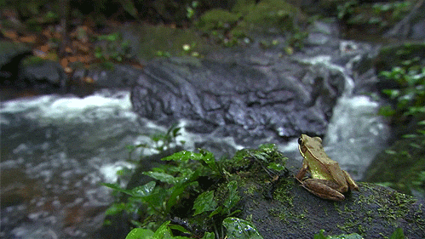
Recursive Leap of Faith

Slide 126
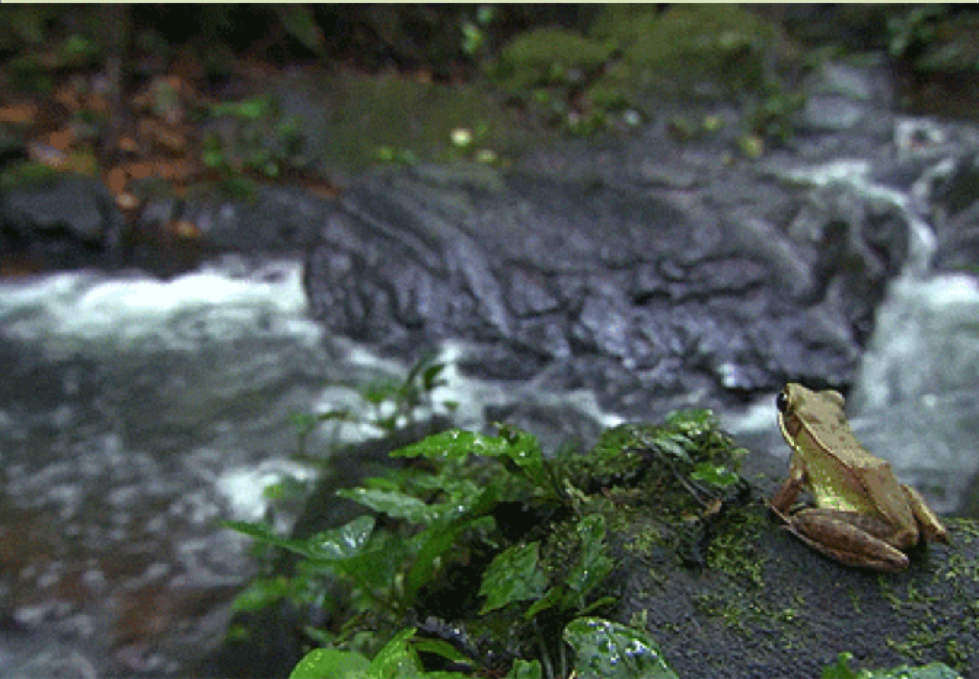
Recursive Leap of Faith

Slide 127
The Solution
void moveTower(int n, char from, char to, char temp) {
if (n == 1) {
moveSingleDisk(from, to);
} else {
moveTower(n – 1, from, temp, to);
moveSingleDisk(from, to);
moveTower(n – 1, temp, to, from);
}
}

Slide 128
Three Musts of Recursion
Your code must have a case for all valid inputs.
You must have a base case.
When you make a recursive call it should be to a simpler instance (forward progress towards base case)

Slide 129
The Solution
void moveTower(int n, char from, char to, char temp) {
if (n == 1) {
moveSingleDisk(from, to);
} else {
moveTower(n – 1, from, temp, to);
moveSingleDisk(from, to);
moveTower(n – 1, temp, to, from);
}
}

Slide 130
Another Solution
void moveTower(int n, char from, char to, char temp) {
if (n == 0) {
return;
} else {
moveTower(n – 1, from, temp, to);
moveSingleDisk(from, to);
moveTower(n – 1, temp, to, from);
}
}

Slide 131
Even Simpler Solution
void moveTower(int n, char from, char to, char temp) {
if (n > 0) {
moveTower(n – 1, from, temp, to);
moveSingleDisk(from, to);
moveTower(n – 1, temp, to, from);
}
}

Slide 132
Even Simpler Solution
void moveTower(int n, char from, char to, char temp) {
if (n > 0) {
moveTower(n – 1, from, temp, to);
moveSingleDisk(from, to);
moveTower(n – 1, temp, to, from);
}
}

Slide 133


Slide 134
You can do recursion.

Slide 135

Your Brain is Recursive

Slide 136
There is a pathway in your brain for imagination

Slide 137
Step 1: Imagine your life at the end of CS106B

Slide 138
Step 1: Imagine your life at the end of CS106B

Slide 139
Step 2: Imagine your life after Stanford

Slide 140
Step 2: Imagine your life after Stanford
Executes the same “function” with different inputs

Slide 141
Step 2: Imagine your life after Stanford
Executes the same “function” with different inputs
Corballis, M.C. The Recursive Mind. Princeton University Press, 2011.

Slide 142
Today’s Goal
Be able to think about problems recursively

Slide 143
Three Musts of Recursion
Your code must have a case for all valid inputs.
You must have a base case.
When you make a recursive call it should be to a simpler instance (forward progress towards base case)

